Slide 1
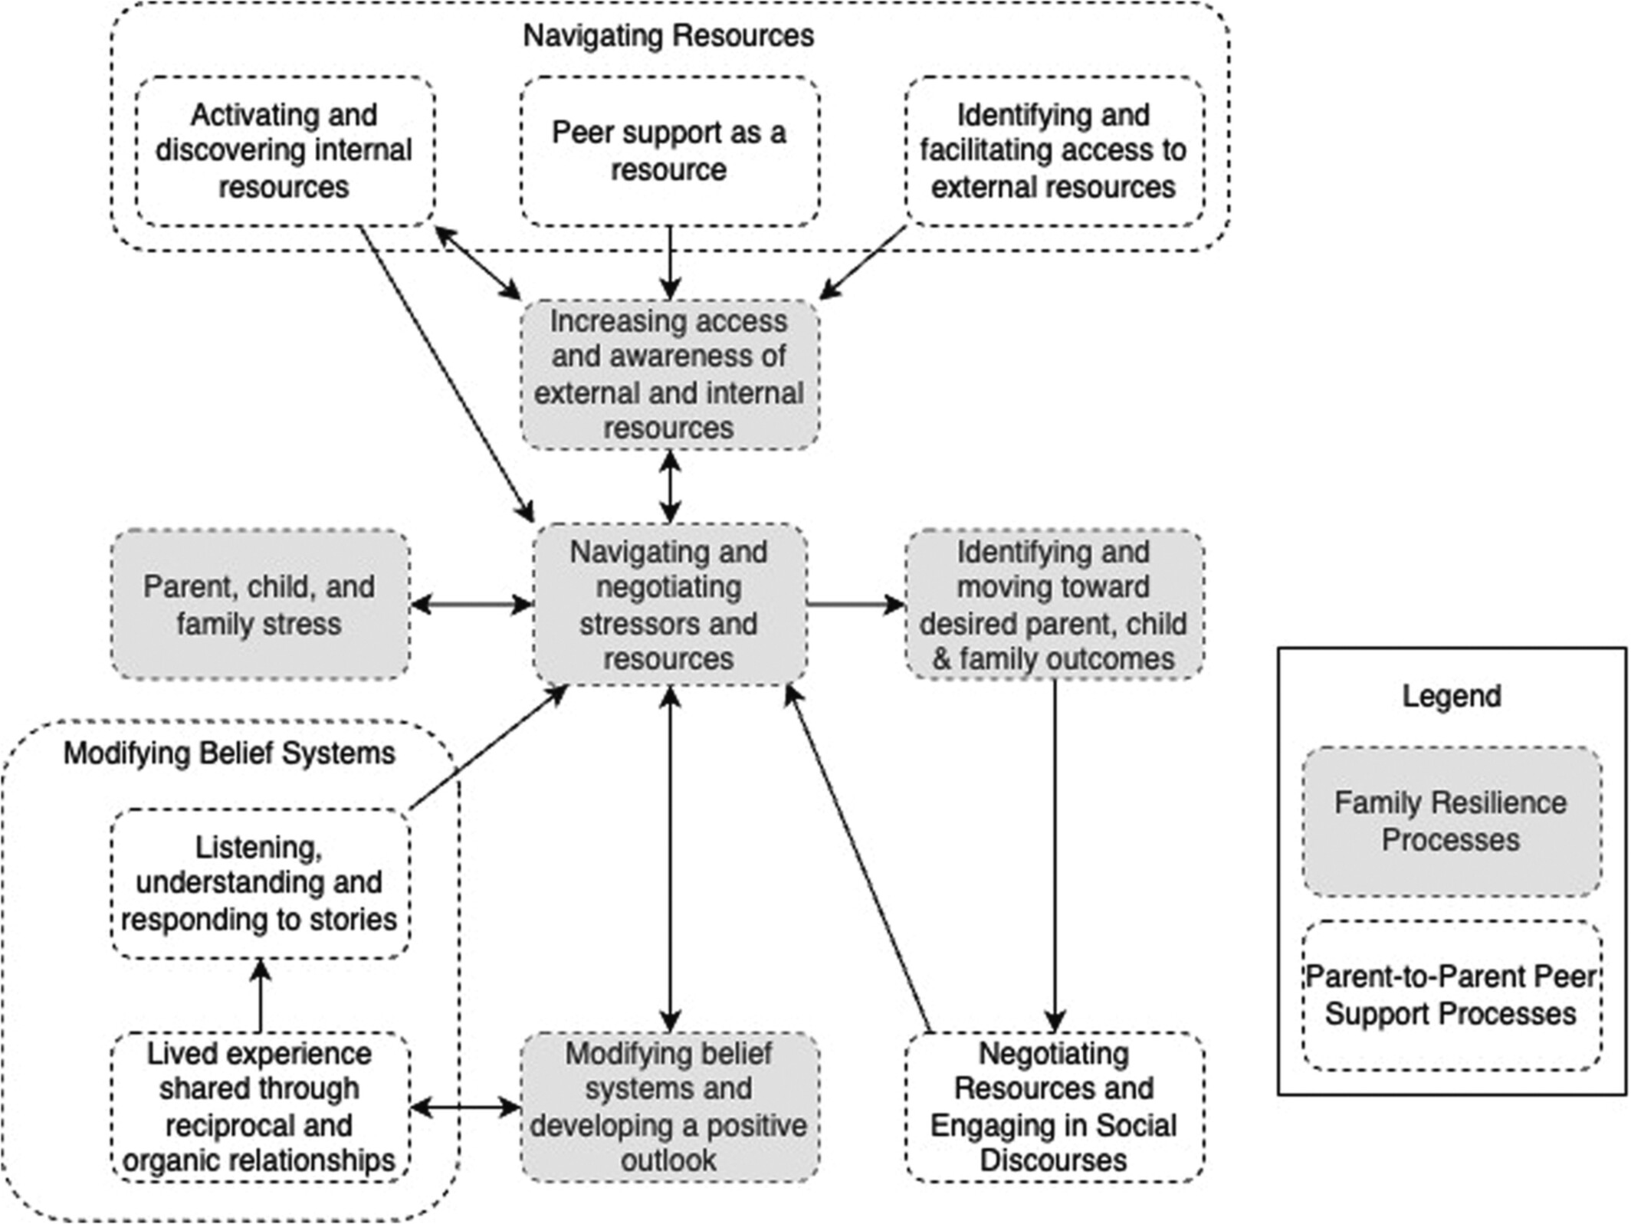
Parent‐to‐parent support for childhood neurodisability: A qualitative analysis and proposed model of peer support and family resilience
Child, Volume: 49, Issue: 3, Pages: 544-554, First published: 12 October 2022, DOI: (10.1111/cch.13069)
Notes:
A model of parent‐to‐parent peer support processes intersecting with family resilience theoretical concepts (Masten & Palmer, 2019; McCubbin & Patterson, 1983; Ungar, 2010; Walsh, 2016)
IF THIS IMAGE HAS BEEN PROVIDED BY OR IS OWNED BY A THIRD PARTY, AS INDICATED IN THE CAPTION LINE, THEN FURTHER PERMISSION MAY BE NEEDED BEFORE ANY FURTHER USE. PLEASE CONTACT WILEY'S PERMISSIONS DEPARTMENT ON PERMISSIONS@WILEY.COM OR USE THE RIGHTSLINK SERVICE BY CLICKING ON THE 'REQUEST PERMISSIONS' LINK ACCOMPANYING THIS ARTICLE. WILEY OR AUTHOR OWNED IMAGES MAY BE USED FOR NON-COMMERCIAL PURPOSES, SUBJECT TO PROPER CITATION OF THE ARTICLE, AUTHOR, AND PUBLISHER.

