Slide 1
Rail Schedule Analysis
By Jeff Page

Slide 2
Problem State
SEPTA Regional Rail provides commuter rail service
SEPTA wishes to maintain a high degree of reliable service.
Service reliability is measured with On-Time Performance.
The goal is 91% of trains arrive at their destination less than 6 minutes late.

Slide 3
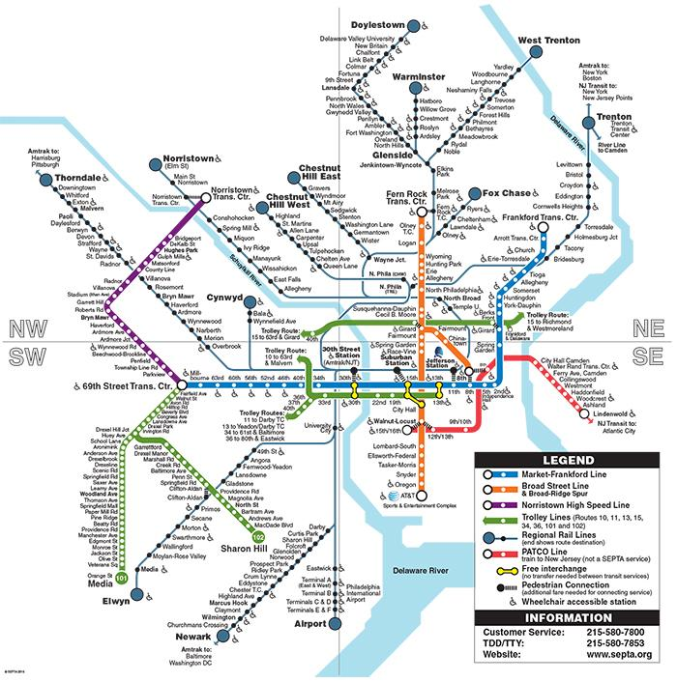
Big Picture

Slide 4
Data Preparation
Obtain train-station arrival measurement data (https://www.kaggle.com/septa/on-time-performance)
Manually list stations by line (from map/schedule)
Import data into SQL Server
Derive numeric late time from descriptive text

Slide 5
Outlier Data
Late Time (In minutes) | Frequency of occurance
119 | 1
124 | 2
999 | 390
1440 | 1

Slide 6
Descriptive Statistics (No Outlier)
Total measurements: 1322066
Mean late time: 3.5 minutes
Standard Deviation: 5.6

Slide 7
Distribution of Late Time
Late Time (In minutes) | Frequency of occurrence
0 | 460275
1 | 179854
2 | 149978
3 | 112485
4 | 86905
5 | 28820
6 | 23183

Slide 8
Probability of occurrence
83% 5 minutes late or less
90% 6 minutes or less

Slide 9
Opportunity for improvement
Delays at multi line stations may impact overall system performance
30th Street Station serves 15 lines
Has 10627 late arrivals

