Slide 1
Time Series: Fitting and Forecasting
Jeffrey R. Norton, Ph.D.
Meetup: Applied Artificial Intelligence and Analytics
December 14, 2017

Slide 2

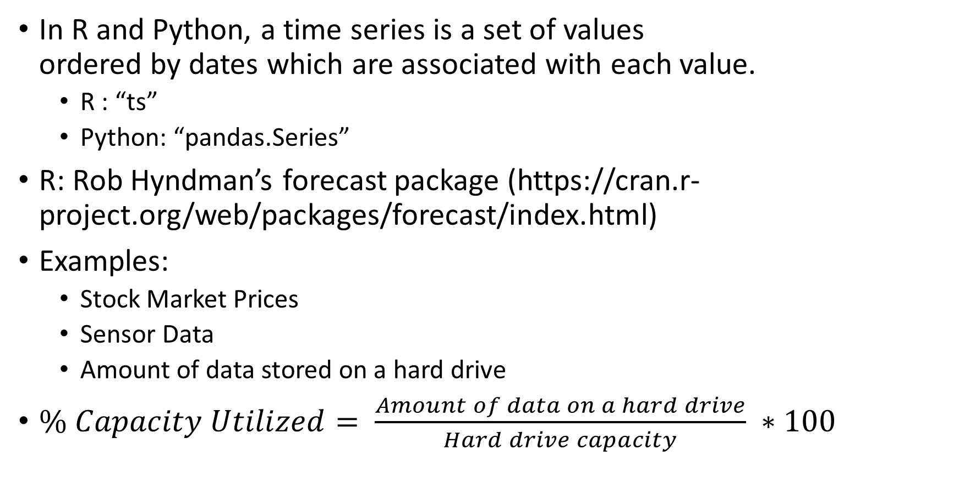
Time Series
In R and Python, a time series is a set of values ordered by dates which are associated with each value.
R : “ts”
Python: “pandas.Series”
R: Rob Hyndman’s forecast package (https://cran.r-project.org/web/packages/forecast/index.html)
Examples:
Stock Market Prices
Sensor Data
Amount of data stored on a hard drive
$\% Capacity Utilized= \frac{Amount of data on a hard drive}{Hard drive capacity} ∗100$

Slide 3
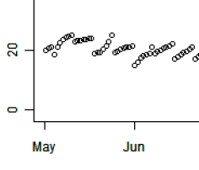
Deduplication and Compression
Deduplication
identify common blocks of data between backups via a hash on the data.
Do not copy that data, just note the backup and hash in following 6 daily backups (incremental)
On day 7, replace the hash with the data – (full)
Then, compress the data.
These methods greatly reduce space used in storing data (can be more than 99%!), but lead to interesting capacity levels:
Feature Modeling Question:
When modeling over long periods (say 6 months), do we care about every data point?
If not, what should we do?

Slide 4
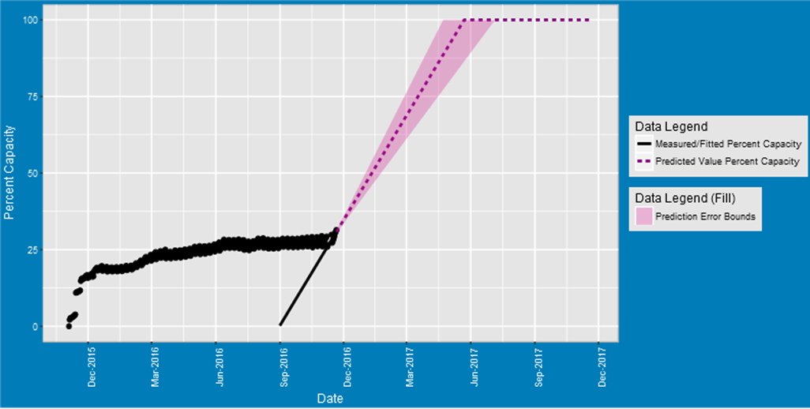
Naïve Approach – Selective Linear Regression
Previous approach was to find a period over 14-28 days of last data and do fit and forecast.
Ask yourself – what happens if data is nonlinear?
Or even a better question – what if the long-term trend is nonlinear?
Can we always assume that growth will continue at these accelerated rates?
In reality – no. Capacity growth is nonlinear

Slide 5
Naïve Approach – Resolution of Problems
It was determined fairly early that the linear approach was problematic.
A series of tests were set up to filter out bad fits/forecasts as possible.
This resulted in large numbers (up to half or even more) of the assets not being processed.

Slide 6
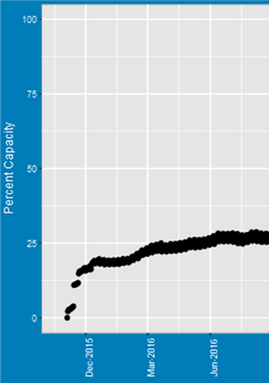
New approach
We took advantage of several observations for long-term capacity forecasting
Short term periodic trends (weekly incrementals and fulls) are not important in the long run – only the maximum value per week.
When the box first starts filling up, deduplication is not very efficient. There is always an elbow where we go from rapid growth to “steady-state”, but still non-linear growth.
How IT chooses to use the backup device can vary greatly – we needed to be able to handle periodic long-term trends and other interesting uses.
Growth is non-linear, we need to use nonlinear models (regressions)
Ensemble methods (using weighted multiple models) have been shown to give better answers than individual models.

Slide 7
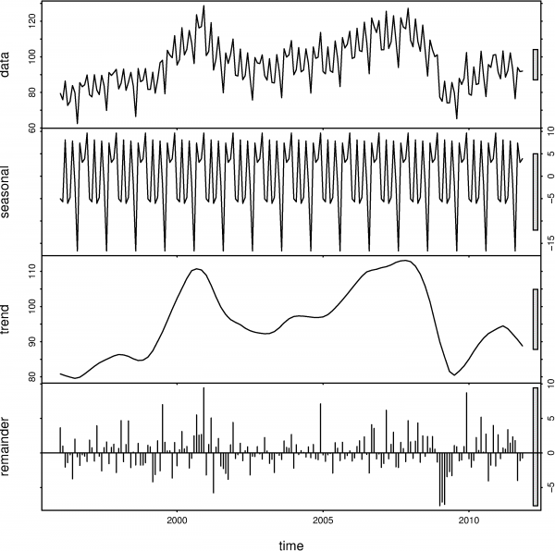
Data Preparation on Time Series Data
Considerations -- Periodic Data
How could we identify the 7-day periods?
My approach was to do a 7-day linear fits at days 1-6.
More generally, consider STL - “Seasonal and Trend decomposition using Loess”

Slide 8
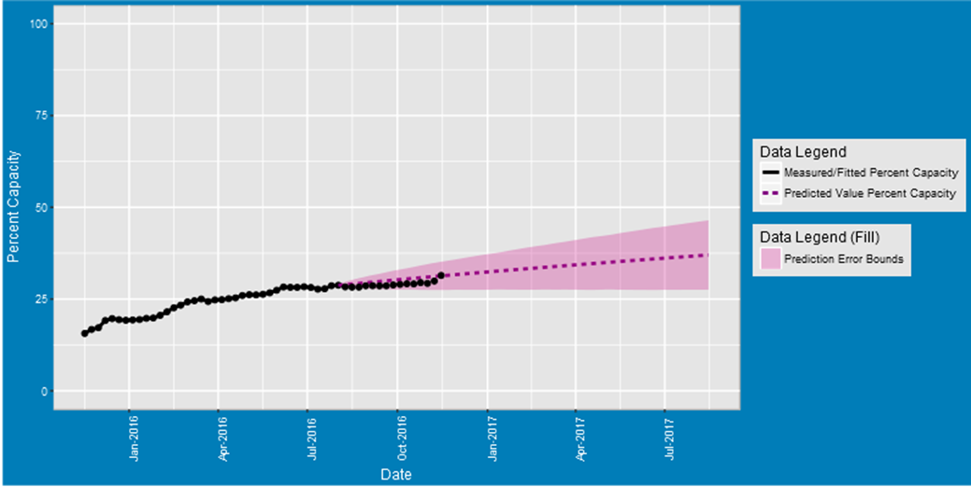
Data Preparation on Time Series Data
Considerations -- Steady State Data
Remove initial states which are not steady or trending…
Filter out “growth period” before elbow – because we care about the steady-state growth after initial fill.
Note the reduced sample density – we have already taken the maximum values on the week.

Slide 9
AR, ARMA, and ARIMA
Extremely powerful nonlinear model – one that you can fall-back on for quick fitting (auto.arima in R)!
AR : Autoregressive
Stochastic (random) process where future values are estimated based on a weighted sum of past values
An autoregressive process operates under the premise that past values have an effect on current values
A process considered AR(1) is the first order process, meaning that the current value is based on the immediately preceding value
An AR(2) process has the current value based on the previous two values.
MA : Moving average
Specifies that the output variable depends linearly (average) on the current and various past errors.
I : Integrated
Indicates that data values have been replaced with the difference between their values and the previous values (and this differencing process may have been performed more than once).

Slide 10


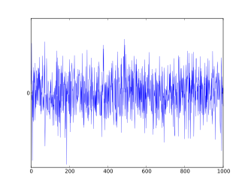
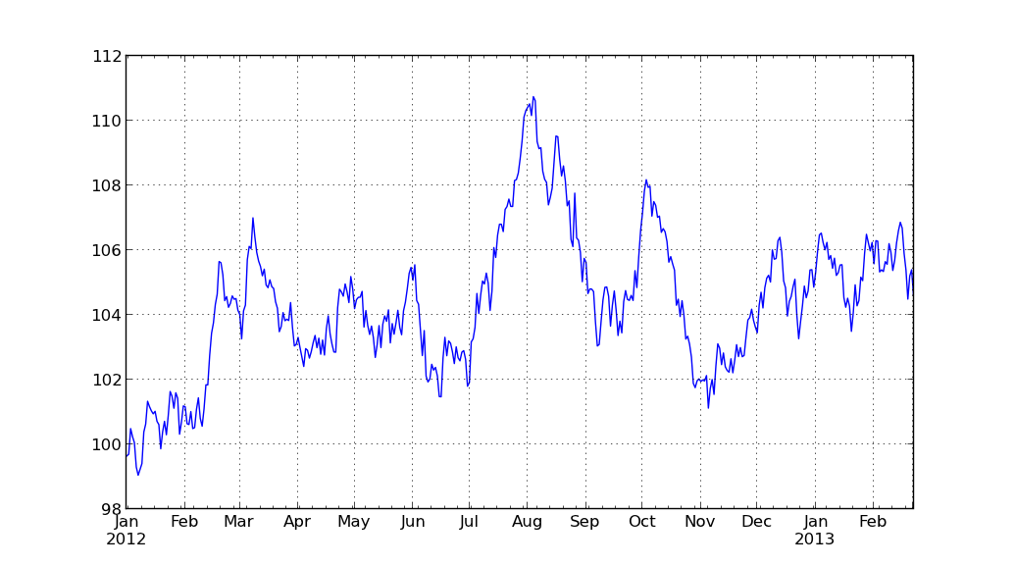
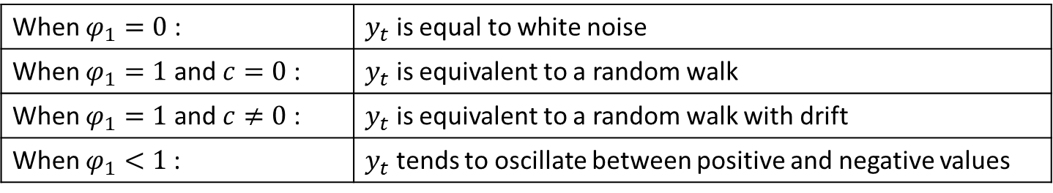

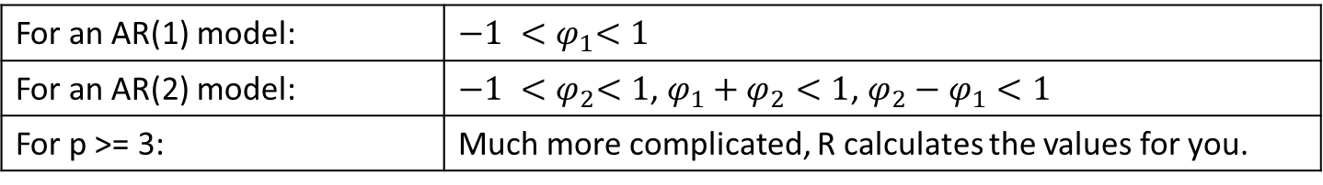
Autoregression in Detail See https://www.otexts.org/fpp/8/3
random signal having equal intensity at different frequencies, giving it a constant power spectral density
a random (stochastic) process, that describes a path that consists of a succession of random steps on some mathematical space
Overview
Forecast the variable using a linear combination of past values of the variable.
The term autoregression indicates that it is a regression of the variable against itself.
Let $y_{t−1},y_{t−2},⋯,y_{t−p}$ be past series values (lags), then AR(p): $y_{t}=c+φ_{1}y_{t−1}+$ $φ_{2}y_{t−2}+⋯+φ_{p}y_{t−p}$
For AR(1):
Normally restrict AR models to stationary data, constrain parameters as follows:
stochastic drift is the change of the average value of a stochastic (random) process
A stationary time series is one whose statistical properties such as mean, variance, autocorrelation, etc. are all constant over time
When $φ_{1}=0$ : | $y_{t}$ is equal to white noise
When $φ_{1}=1$ and $c=0$: | $y_{t}$ is equivalent to a random walk
When $φ_{1}=1$ and $c≠0$ : | $y_{t}$ is equivalent to a random walk with drift
When $φ_{1}<1$: | $y_{t}$ tends to oscillate between positive and negative values
For an AR(1) model: | $${−1 <φ}_{1}<1$$
For an AR(2) model: | ${−1 <φ}_{2}<1$, $φ_{1}+φ_{2}<1$, $φ_{2}−φ_{1}<1$
For p >= 3: | Much more complicated, R calculates the values for you.

Slide 11

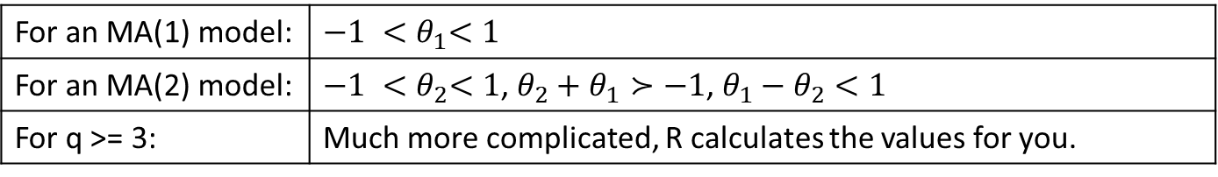
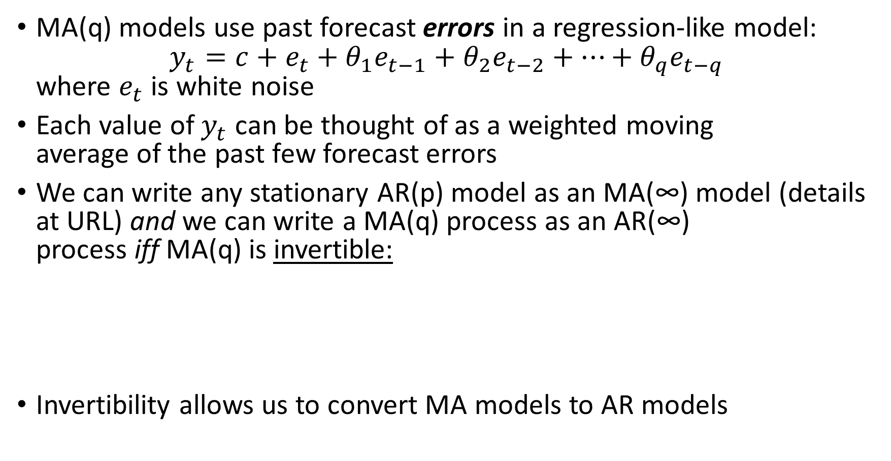
Moving Average in Detail https://www.otexts.org/fpp/8/4
MA(q) models use past forecast errors in a regression-like model: $y_{t}=c+e_{t}+θ_{1}e_{t−1}+θ_{2}e_{t−2}+⋯+θ_{q}e_{t−q}$ where $e_{t}$ is white noise
Each value of $y_{t}$ can be thought of as a weighted moving average of the past few forecast errors
We can write any stationary AR(p) model as an MA(∞) model (details at URL) and we can write a MA(q) process as an AR(∞) process iff MA(q) is invertible:
Invertibility allows us to convert MA models to AR models
Wow – didn’t I give this up when I left college? #!#!#$
For an MA(1) model: | $${−1 <θ}_{1}<1$$
For an MA(2) model: | ${−1 <θ}_{2}<1$, $θ_{2}+θ_{1}≻−1$, $θ_{1}−θ_{2}<1$
For q >= 3: | Much more complicated, R calculates the values for you.

Slide 12
Hybrid Forecast – Bag of Models
Forecast Combinations
Bates and Granger (1969) wrote their famous paper on “The Combination of Forecasts” -- combining forecasts often leads to better forecast accuracy.
Two Ensemble Models available in R
https://robjhyndman.com/hyndsight/forecast-combinations/
forecastHybrid – David Schaub, https://cran.r-project.org/web/packages/forecastHybrid/index.html
Opera - “Online Prediction by ExpeRt Aggregation”. Gaillard and Goude https://cran.r-project.org/web/packages/opera/
Our modeling uses forecastHybrid.
We also refer to forecast combinations as an “ensemble model”.

Slide 13
Forecast Hybrid
Models
ARIMA
ETS – Exponential Smoothing model - The most general and flexible version. Models (additive) error, trend and seasonal elements together.
THETAM – Exponential Smoothing Model (ets with just the additive model)
NNETAR - Feed-forward neural networks with a single hidden layer and lagged inputs
STLM - Forecasts STL objects obtained by applying a non-seasonal forecasting method to the seasonally adjusted data and re-seasonalizing using the last year of the seasonal component.
TBATS - Exponential Smoothing State Space Model With Box-Cox Transformation, ARMA Errors, Trend And Seasonal Components
Comments and Observations
All models are nonlinear
Models do not tend to overfit – they are smooth
Well known that some models work better than others in certain conditions.
We showed that the NNETAR model can often be dropped as it is very expensive
There are other very effective models which could be added like Holt-Winters

Slide 14
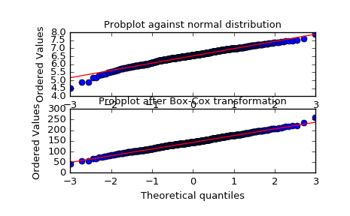

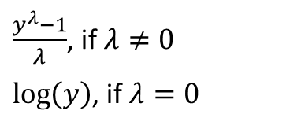
Statistics Terms 102…
Exponential Smoothing: with a simple moving average past observations are weighted equally. With exponential smoothing, exponential functions are used to assign exponentially decreasing weights over time.
Box Cox Transformation: Return a positive dataset transformed by a Box-Cox power transformation.
$\frac{y^{λ}−1}{λ}$, if $λ≠0$
$\log\left(y\right)$, if $λ=0$
$$y\left(λ\right)=$$

Slide 15
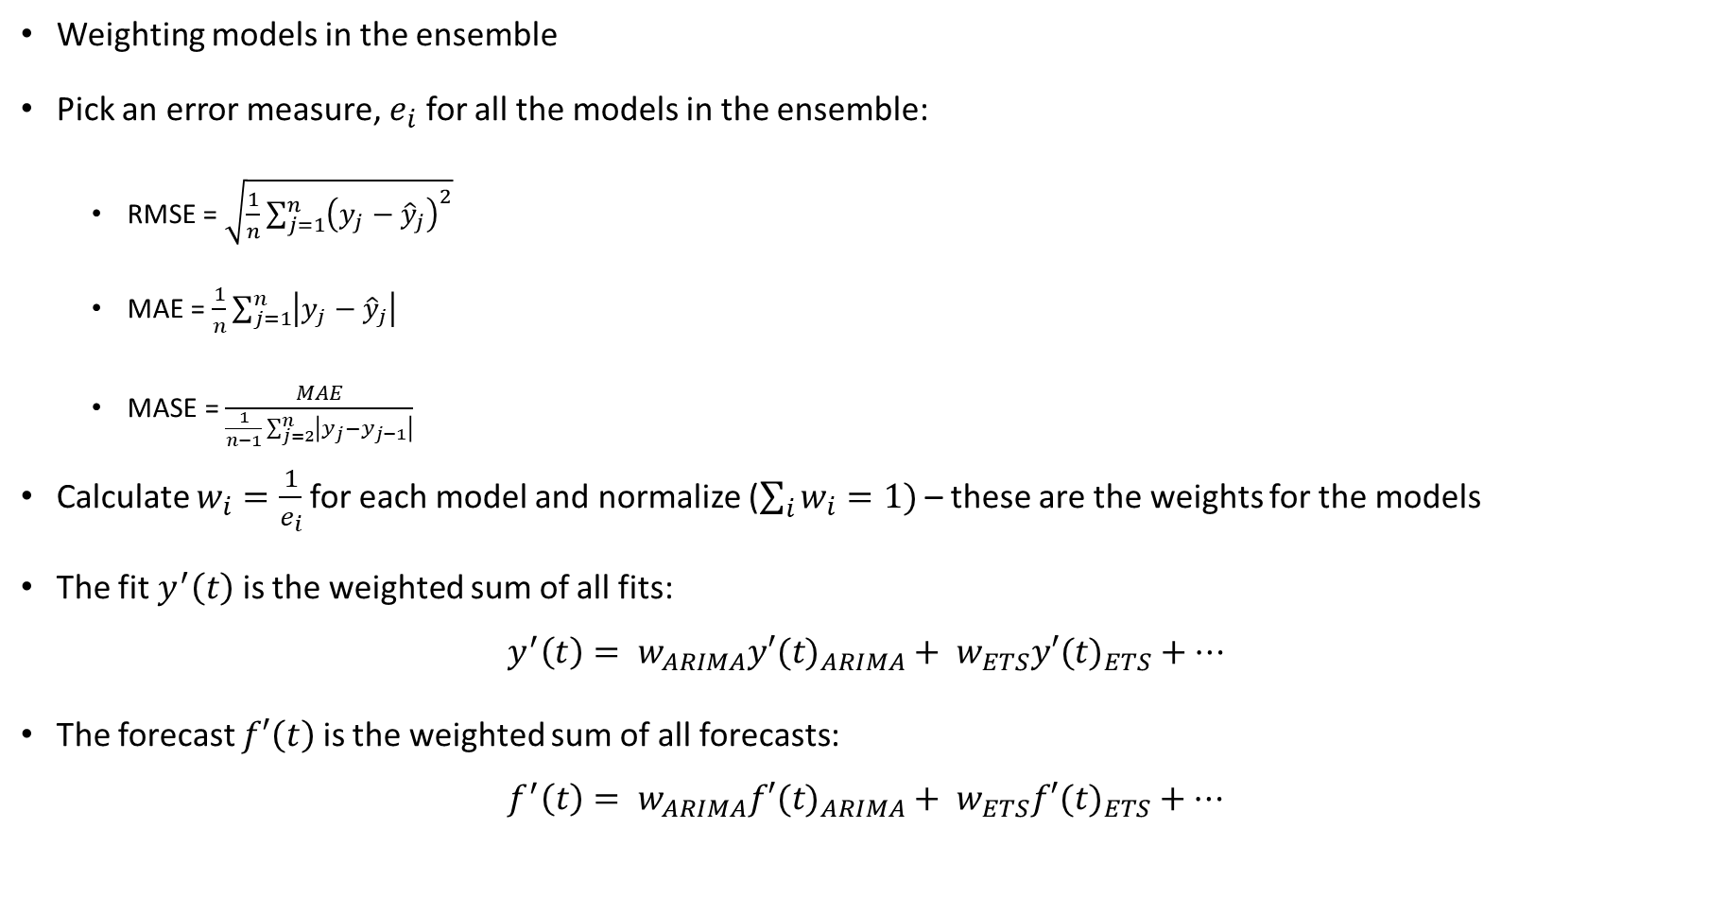
Weighting Methods
Weighting models in the ensemble
Pick an error measure, $e_{i}$ for all the models in the ensemble:
RMSE = $\sqrt{\frac{1}{n}\sum_{j=1}^{n}{{\left(y_{j}−{\hat{y}}_{j}\right)}^{2}}}$
MAE = $\frac{1}{n}\sum_{j=1}^{n}{\left|y_{j}−{\hat{y}}_{j}\right|}$
MASE = $\frac{MAE}{\frac{1}{n−1}\sum_{j=2}^{n}{\left|y_{j}−y_{j−1}\right|}}$
Calculate $w_{i}=\frac{1}{e_{i}}$for each model and normalize ($\sum_{i}{w_{i}=1)}$ – these are the weights for the models
The fit $y^{′}\left(t\right)$ is the weighted sum of all fits: $y^{′}\left(t\right)= w_{ARIMA}{y′(t)}_{ARIMA}+ w_{ETS}{y′(t)}_{ETS}+⋯$
The forecast $f′\left(t\right)$ is the weighted sum of all forecasts: $f^{′}\left(t\right)= w_{ARIMA}{f′(t)}_{ARIMA}+ w_{ETS}{f′(t)}_{ETS}+⋯$

Slide 16
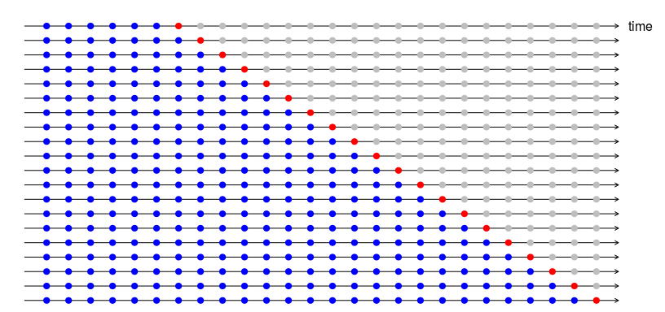
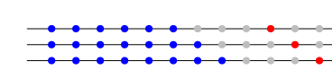

Cross-Validation
CV leads to much better fits and forecasts!
Recall from ML: training and testing
Cross-validation is how we do training and testing on time series.
For each test, fit (train) on n+i, i=1.. data points.
Test one point. This is one step forward, but we could do other steps forward (inset is 4).
The forecast accuracy is computed by averaging over the test sets. This procedure is sometimes known as “evaluation on a rolling forecasting origin” because the “origin” at which the forecast is based rolls forward in time.
Cool thing to try: CV as currently implemented does not change model parameters, it just gets the best model.
But ARIMA and ETS (perhaps other models as well) will allow an old model to be input.
That means that you could use CV and replace old models in a true train/test method – how well would that work I wonder?

Slide 17

Backfitting
How do you really know if the model is any good?
Do I really trust confidence bands, calculated errors, and all this math stuff?
Answer: Use Backfitting
With backfitting, withhold some data to test against a forecast.
Quiz Time
Desired …
Fit on 2 years worth of data, forecast 1 year out.
Backfit the last 6 months (June-December 2017).
Read Period: Start, End?
June 2015
December 2017
Forecast Period: Start, End?
June 2017
June 2018
Backfit Period: Start, End?
June 2017
December 2017

Slide 18
Observations on Performance
Comparison of Methods
The new model applied to asset with typical capacity growth pattern
Three months of back testing fall within the 80% confidence bounds.
Data transformations lead to reduced error – ~ 20% spread on confidence bounds one year out!
Overall
Far more models can be accepted as viable!
Cumulative error (numbers forthcoming) is greatly reduced!
 | Total Models Fit | Total Models Accepted | Percentage Models Fit
Piecewise Model | 43072 | 12756 | 29.6%
Hybrid Model | 40954 | 40368 | 98.6%
Backfit Period

Slide 19
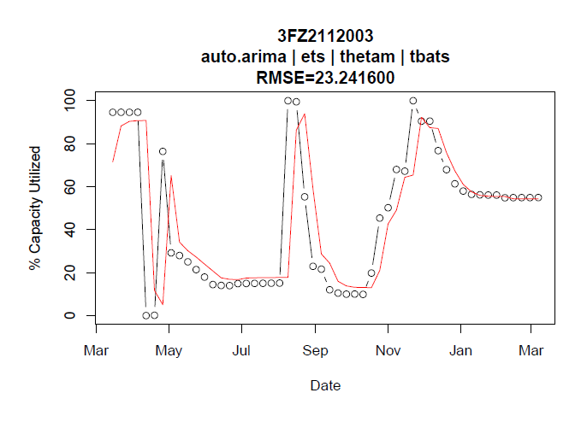
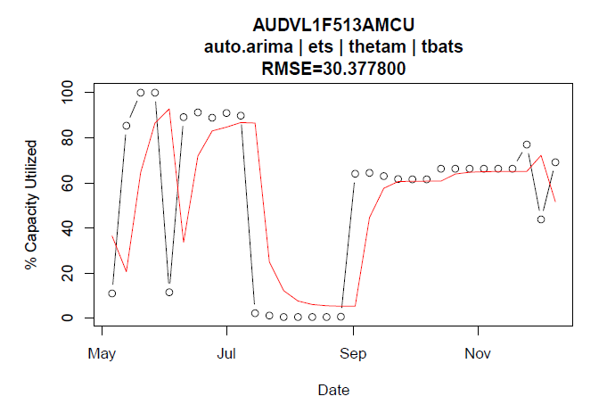
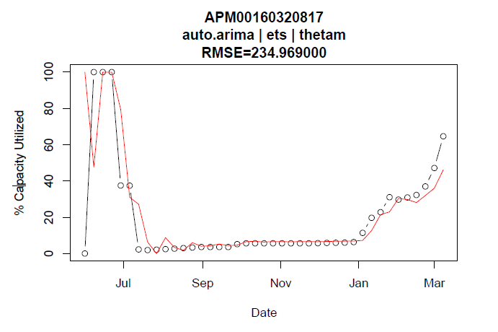
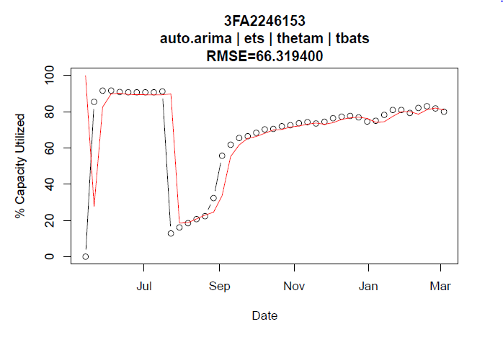
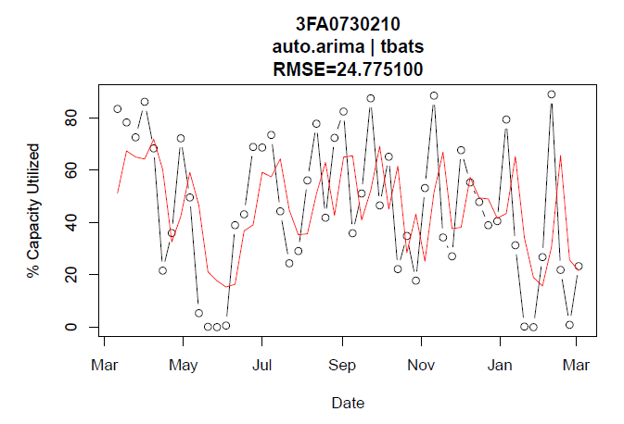
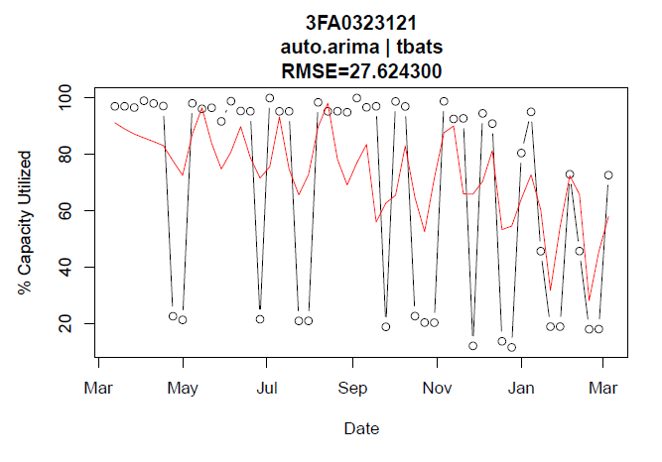
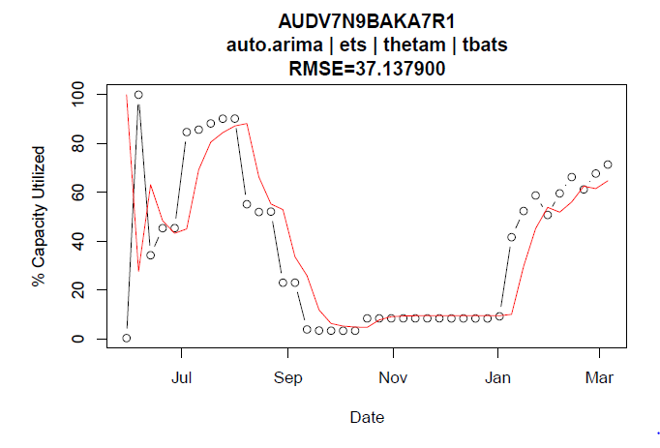
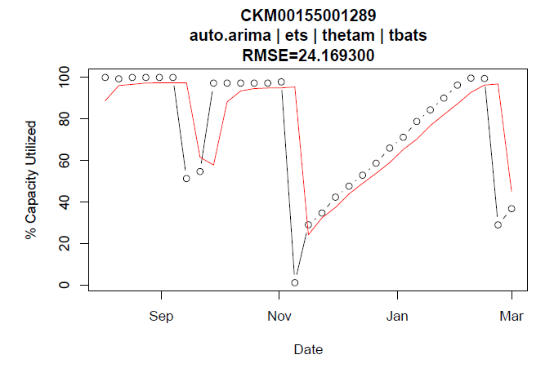
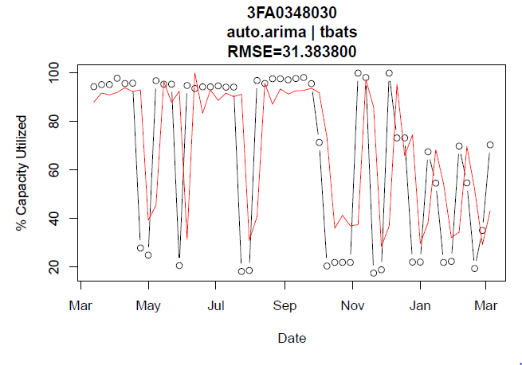
Some Hard Cases

Slide 20
Next Steps
Address problems with R
R lacks strong support for parallel programming.
R’s object oriented models are messy at best.
Python
Offers solutions to the problems with R
But lacks the rich time-series model of R’s forecast package (from Hyndman)
Solution: Python library driving R scripts
Python driver with classes/threading.
Use rpy2 to interface with R
Call the R forecast scripts (on different threads)
For R aficionados, Python can be called from r with rPython

Slide 21
Outline
What is a time series? (From the standpoint of R)
Naïve Fitting methods (linear on nonlinear)
Data Prep methods
What are you really trying to look at – and what can you do to the data to get it there?
Filtering
STL
AR, ARMA, and ARIMA
Other methods – include other methods not in the ensemble.
Ensemble methods – point at the forecast hybrid library
Cross-fitting
Backfitting
Results
Potential Future work - R and parallelization vs Python – how to call R from Python

