Slide 1
DevFest Hackathon Yahoo YQL API Demo
Friday February 5, 2016

Slide 2
About Me
Jeffrey Scholz
Masters Degree in Computer Science, Columbia May 2015
I was a TA for:
COMS 4187, Fall 2014 Security Architecture and Engineering
COMS 4995, Spring 2015 GPU Computing
COMS 3995, Spring 2015 Computers and Society
Backend Engineer (Node JS) at Yahoo since then, one of the engineers behind the Yahoo Video Guide (https://mobile.yahoo.com/videoguide)

Slide 3
Yahoo YQL
Full list of public Yahoo APIs / Libraries here: developer.yahoo.com/everything.html
We will focus on YQL: developer.yahoo.com/yql
What is YQL?
A database query language very similar to SQL
select * from weather.forecast where woeid=2502265 (weather forecast for sunnyvale)
Demo Dashboard https://developer.yahoo.com/yql/console/

Slide 4
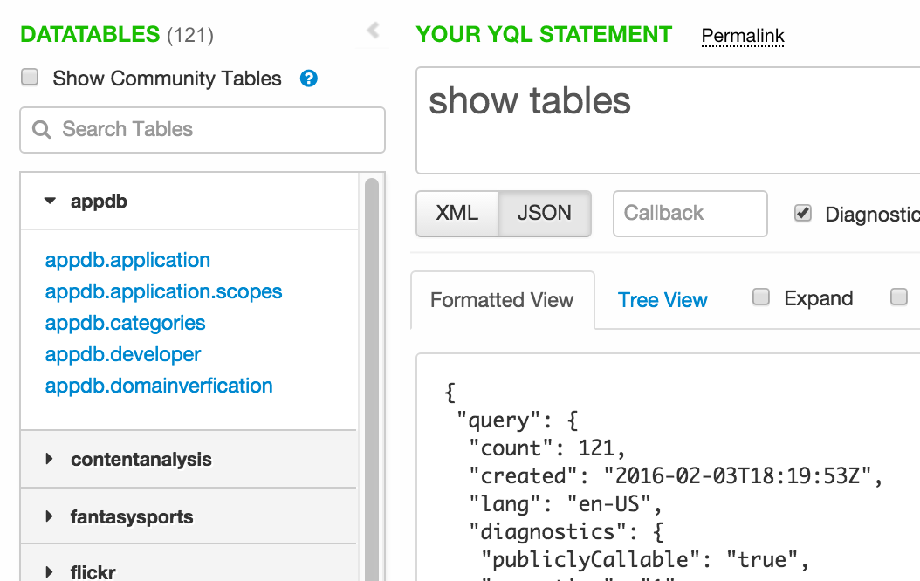
Yahoo YQL
All kinds of data here!
See community tables (craigslist, currency exchange rates, etc)
You can even write custom queries to scrape websites we don’t have data for.

Slide 5
Ultra-fast Tutorial in Website Scraping with YQL (1/2)
Warning! Don’t spam the endpoint. Fine for a hack.
Demo App: https://github.com/jeffreyscholz/yql-tech-talk-demo
git clone https://github.com/jeffreyscholz/yql-tech-talk-demo.git
Hack/Jack my code

Slide 6
Ultra-fast Tutorial in Website Scraping with YQL (2/2)
YQL query: SELECT <key> FROM HTML(0,10) WHERE url=<website-to-scrape> and compat='html5' and xpath='//path/to/target'
<key> is the JSON key that is returned from the query
HTML(0,10) means that we are doing HTML scraping and say we want the first 10 items.
<website-to-scrape> the path. E.g. http://www.amazon.com/s?field-keywords=red+bull
Add compat='html5' for HTML5 websites.
Xpath, short for XML Path specifies where in the HTML page you want to look for the item of interest.

Slide 7
YQL Demo

Slide 8
Questions?
????

Slide 9
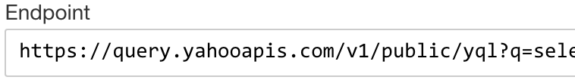
Appendix
select * from html where url='http://www.amazon.com/s?field-keywords=gunnar+glasses' and compat='html5’
select * from html where url='http://www.amazon.com/s?field-keywords=gunnar+glasses' and compat='html5' and xpath='/html/body/div[1]/div[1]/div[3]/div[2]/div/div[4]/div[1]/div/ul/li[1]/div/div/div/div[2]/div[2]/div[1]/div[2]/a/span’
select * from html where url='http://www.amazon.com/s?field-keywords=gunnar+glasses' and compat='html5' and xpath='/html/body/div[1]/div[1]/div[3]/div[2]/div/div[4]/div[1]/div/ul/li/div/div/div/div[2]/div[2]/div[1]/div[2]/a/span’
select content from html where url='http://www.amazon.com/s?field-keywords=gunnar+glasses' and compat='html5' and xpath='/html/body/div[1]/div[1]/div[3]/div[2]/div/div[4]/div[1]/div/ul/li/div/div/div/div[2]/div[2]/div[1]/div[2]/a/span'Copy endpoint result and use it in your code
It will not always work out this cleanly. Sometimes, you will have to cut down the xpath and manually drill down on the item.

