Slide 1
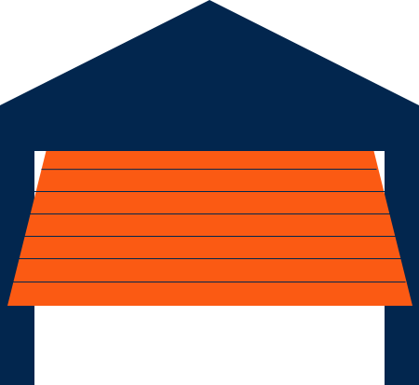
OpenSesame
Jeff Dempsey
Project Milestone 3
IASC8080
Secure Mobile Development

Slide 2
Review
A fancy IOT garage door opener
More people/cars than garage door remotes.
Proposed Features:
Open and close garage doors via Bluetooth from app
Tell the state of the door
Sensor vs. Camera
Web server vs. None

Slide 3
Review
How it works:
Python script on the Pi
Sets up rfcomm Bluetooth server which listens for connection from phone
Python script controls GPIO
GPIO fires a relay to open a garage door
Native Android app which will send data via Bluetooth to toggle the door circuit

Slide 4

Story Time

Slide 5
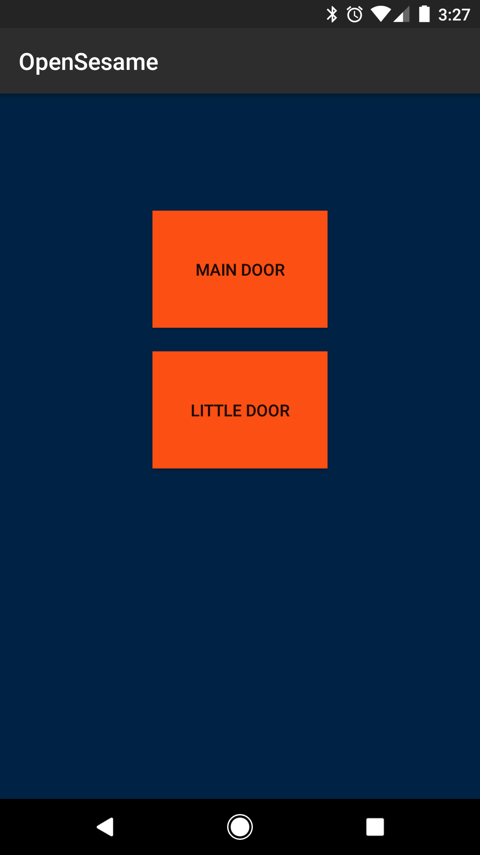
Demo
Notes:
Talk about RANGE

Slide 6

Last Three Days

Slide 7
User Stories
As someone who has a garage, I want to open and close my garage door using my phone, which I always have on me, instead of a dedicated remote.
As a worrier, I want to visually verify the status of my garage doors remotely.
As a forgetful person, I want to close my open garage door away from home without going to my garage or car.

Slide 8
User Stories
As someone who has a garage, I want to open and close my garage door using my phone, which I always have on me, instead of a dedicated remote.
As a worrier, I want to visually verify the status of my garage doors remotely.
As a forgetful person, I want to close my open garage door away from home without going to my garage or car.

Slide 9
User Stories
As someone who has a garage, I want to open and close my garage door using my phone, which I always have on me, instead of a dedicated remote.
As a worrier, I want to visually verify the status of my garage doors remotely.
As a forgetful person, I want to close my open garage door away from home without going to my garage or car.

Slide 10
User Stories
As someone who has a garage, I want to open and close my garage door using my phone, which I always have on me, instead of a dedicated remote.
As a worrier, I want to visually verify the status of my garage doors remotely.
As a forgetful person, I want to close my open garage door away from home without going to my garage or car.

Slide 11
User Stories
As someone who has a garage, I want to open and close my garage door using my phone, which I always have on me, instead of a dedicated remote.
As a worrier, I want to visually verify the status of my garage doors remotely.
As a forgetful person, I want to close my open garage door away from home without going to my garage or car.

Slide 12
Misuser Stories
As an aspiring home invader, I want to connect to the opener to gain unauthorized access to the garage/home.
As an incompetent neighbor, I do not want, but still manage to connect to the wrong device.
As a power interruption or outage, I want to shut off the server and garage door motor.

Slide 13
Misuser Stories
As an aspiring home invader, I want to connect to the opener to gain unauthorized access to the garage/home.
As an incompetent neighbor, I do not want, but still manage to connect to the wrong device.
As a power interruption or outage, I want to shut off the server and garage door motor.

Slide 14
Misuser Stories
As an aspiring home invader, I want to connect to the opener to gain unauthorized access to the garage/home.
As an incompetent neighbor, I do not want, but still manage to connect to the wrong device.
As a power interruption or outage, I want to shut off the server and garage door motor.

Slide 15
Misuser Stories
As an aspiring home invader, I want to connect to the opener to gain unauthorized access to the garage/home.
Pi must authorize pairing before app can be used
As an incompetent neighbor, I do not want, but still manage to connect to the wrong device.
Pi must authorize pairing before app can be used
As a power interruption or outage, I want to shut off the server and garage door motor.
Auto-starting script is buggy
Script error handling is still buggy

Slide 16
Current State
Pi-side Python working
But still buggy
Android app is functional!
But far from polished
Physical setup
Action plan:
3D print mounts for Pi, relay module
Get more 22-guage wire

Slide 17
For a Summer Project
Get comfortable with Java
Continue to debug server script and get persistence working
Explore threading
Connect multiple devices simultaneously OR
Smooth connect/disconnect for device switching
Door state sensor
Log Door activity?

