Slide 1
US companies’ stocks and ADR are traded.
Indexes for specific stocks are also published.
Ex. NASD (NASDAQ)
DJIA(Dow Jones Industrial Average)
USA
9:30
16:00
23:45
6:00
9:30
a
b
c
9h30m ahead
The previous day’s USA stock market (NYSE)
seems to affect
the next day’s IND stock market (NSE)
A
B
C
15:30
19:00
1:30
9:15
15:30
Indian companies’ stocks are traded.
Ex. INFY (Infosys)
TATA MOTORS
ICICI BANK
IND

Slide 2
Data Frame Structure
Close price – Open price in NSE (C-B)
1 (Close – Open > 0) or 0(Close – Open < 0)
Previous business day’s data
Open price in NSE (B)
Close price in NSE (A)
nse_Close_Open | nse_Open | nse_preClose | nyse_Open | nyse_High | nyse_Low | nyse_Close | idx_Open | idx_High | idx_Low | idx_Close
1 | 327.500000 | 326.575012 | 7.002500 | 7.112500 | 7.001250 | 7.095000 | 2294.40991 | 2311.14990 | 2294.40991 | 2308.41992
0 | 335.375000 | 327.668762 | 7.087500 | 7.125000 | 7.048750 | 7.122500 | 2307.27002 | 2313.72998 | 2295.62011 | 2308.70996
… | … | … | … | … | … | … | … | … | … | …
NYSE data:
Open price (a)
High price (between a and b)
Low price (between a and b)
Close price (b)
NASDAQ data:
Open price (a)
High price (between a and b)
Low price (between a and b)
Close price (b)

Slide 3
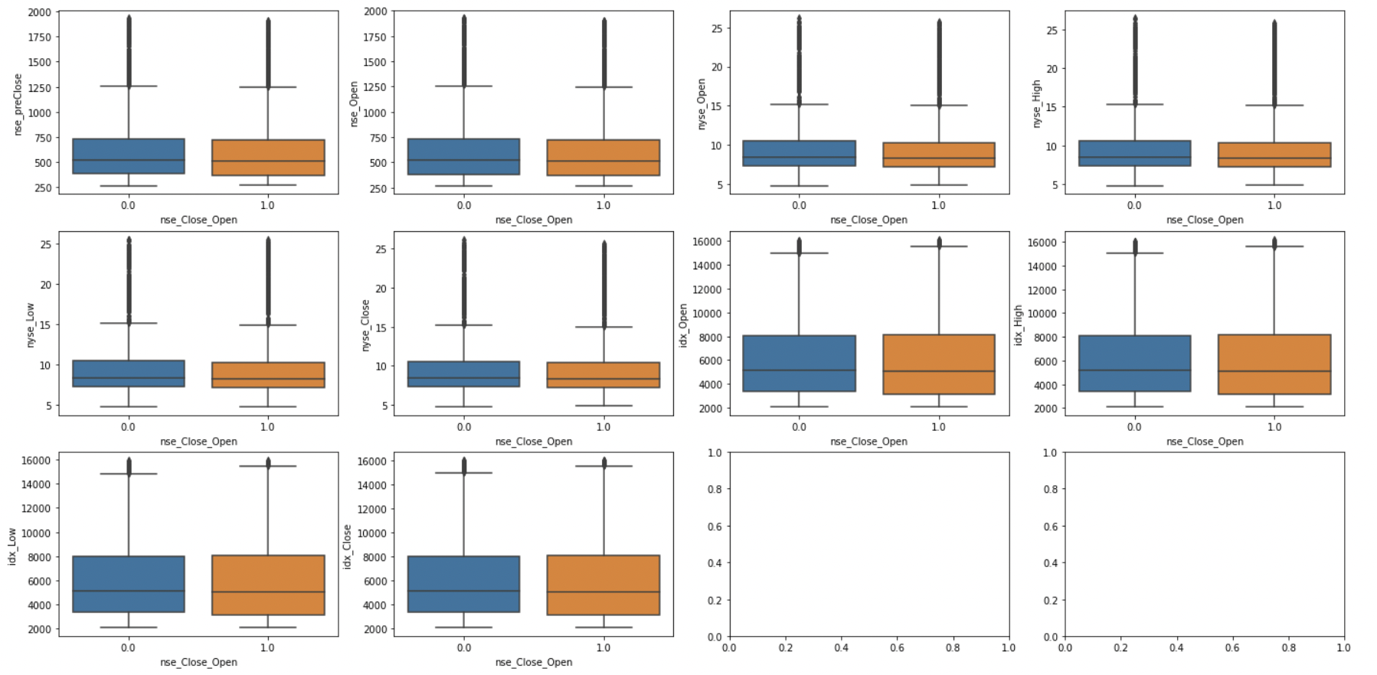
EDA – Box Plots
X: nse_Close_Open, Y: other columns
There is no obvious difference between nse_Close_Open = 1 and 0

Slide 4
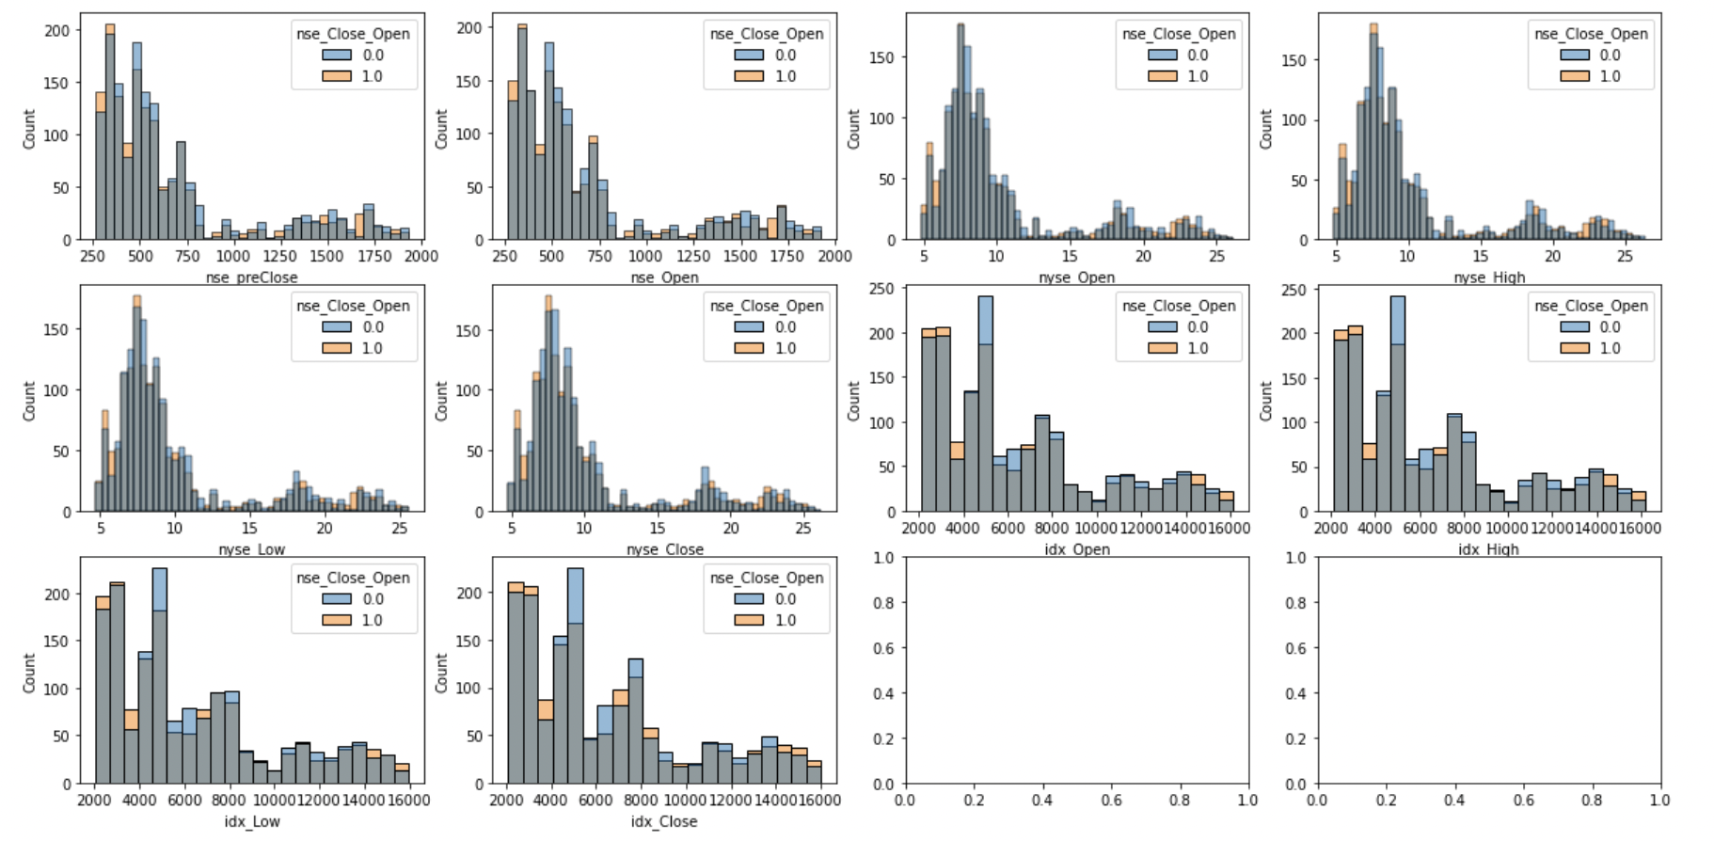
EDA – Histogram
X: each price, colored by nse_Close_Open
There is no obvious difference between nse_Close_Open = 1 and 0

Slide 5
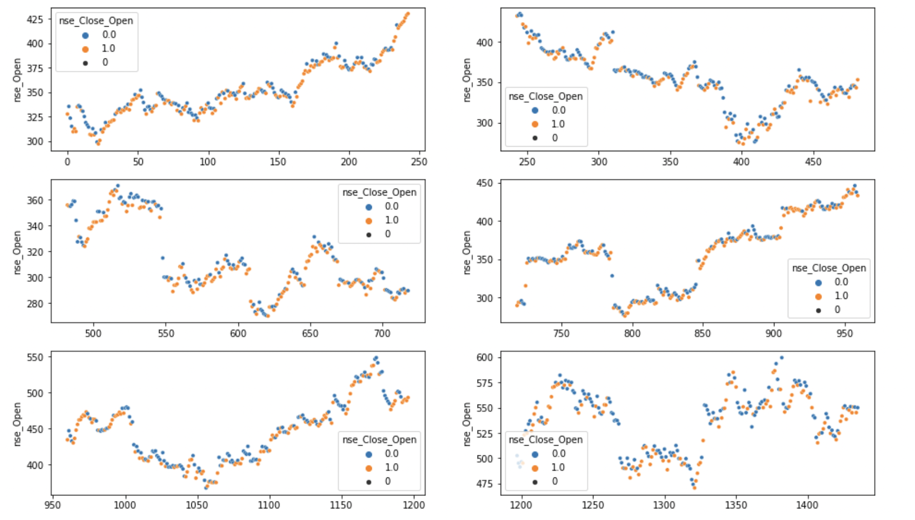
EDA – Time Series Change of nse_Open (1)
Is there any difference in the distribution of nse_Close_Open = 1 and 0
during the up and down phases of the stock price?
→ nse_Close_Open = 1 and 0 seem to be generally similarly distributed.
2010
2011
2013
2012
2014
2015

Slide 6
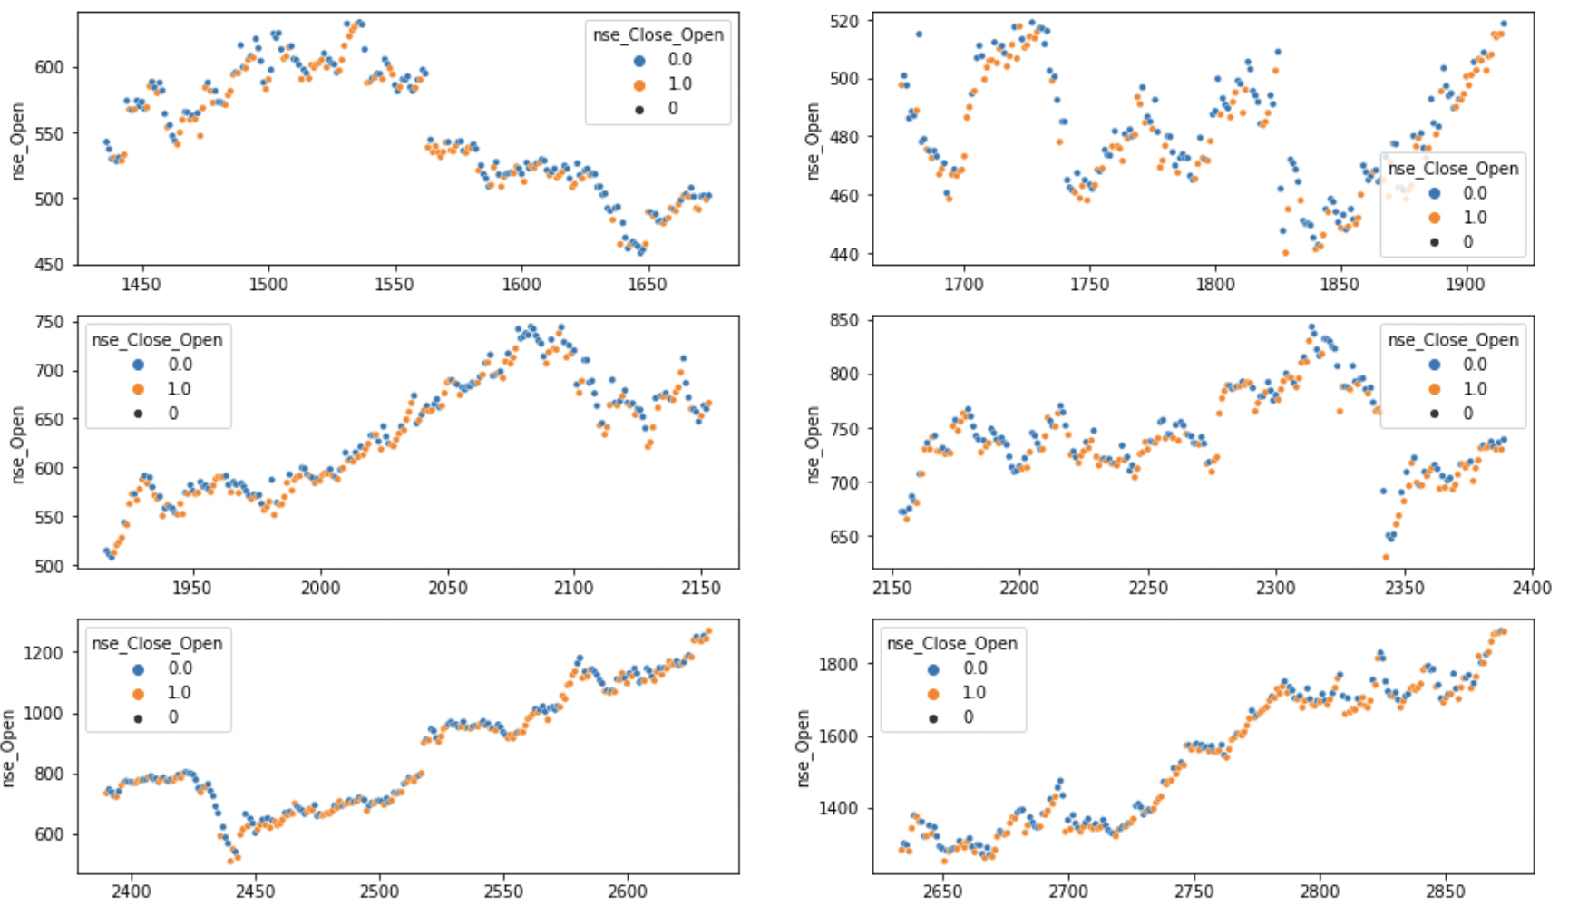
EDA – Time Series Change of nse_Open (2)
Is there any difference in the distribution of nse_Close_Open = 1 and 0
during the up and down phases of the stock price?
→ nse_Close_Open = 1 and 0 seem to be generally similarly distributed.
2016
2017
2019
2018
2020
2021

Slide 7
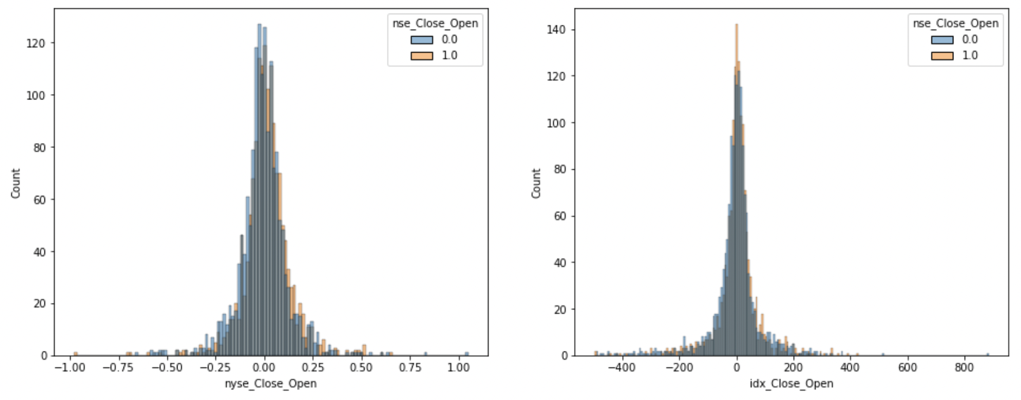
EDA – Histogram of nyse(idx) Close - Open
The distributions of nse_Close_Open = 1 and 0 are almost identical, but appear to be very slightly off.
→ add new columns “nyse_Close – nyse_Open” and “idx_Close – idx_Open”

Slide 8
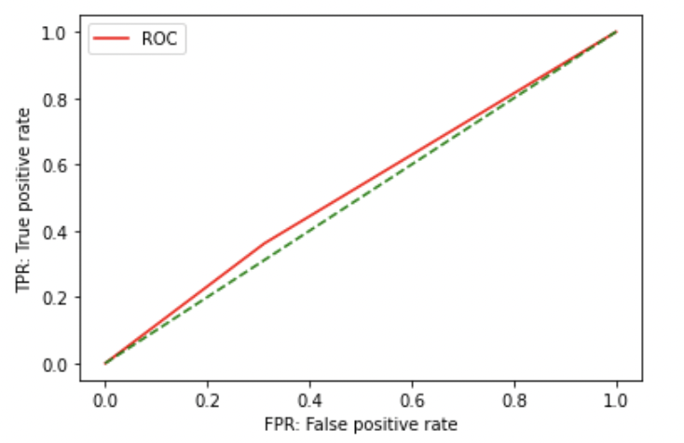
Model 1 – logistic regression
Split the data into training (70%) and testing(30%)
Accuracy is ~ 52%

Slide 9
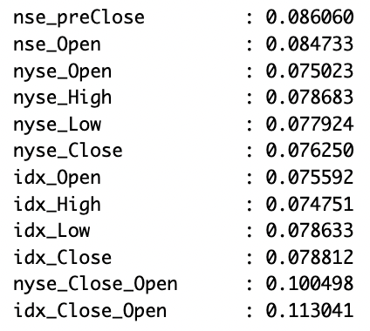
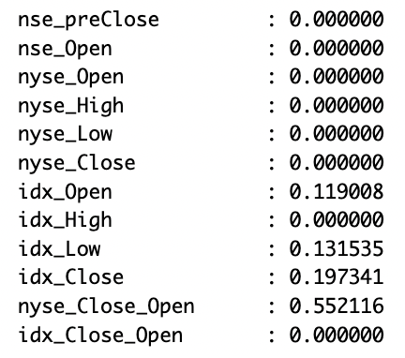
Model 2 – Random Forest
Split the data into training (70%) and testing(30%)
Default model:
n_estimators=100, max_depth=None,
max_features=‘sqrt’, bootstrap=True
Accuracy = ~ 53.6%
Feature importance:
After RandomazidSearchCV:
n_estimators=600, max_depth=2,
max_features=None, bootstrap=False
Accuracy = ~ 52.6%
Feature importance:

Slide 10
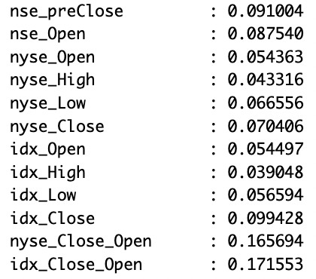
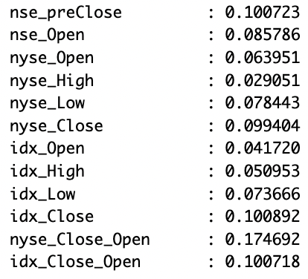
Model 3 – Boosting
Split the data into training (70%) and testing(30%)
Default model:
n_estimators=100, max_depth=3,
max_features=None, learning_rate=0.1
Accuracy = ~ 54.6%
Feature importance:
After RandomazidSearchCV:
n_estimators=200, max_depth=2,
max_features=None, learning_rate=0.1
Accuracy = ~ 55.1%
Feature importance:

