Slide 1
Enabling Tourism Marketing & SME Competitiveness
Institutional Capacity Workshop · ITC EU Youth Empowerment Project
Banjul, The Gambia · May 2026 · 13 institutions · 2 days

Slide 2
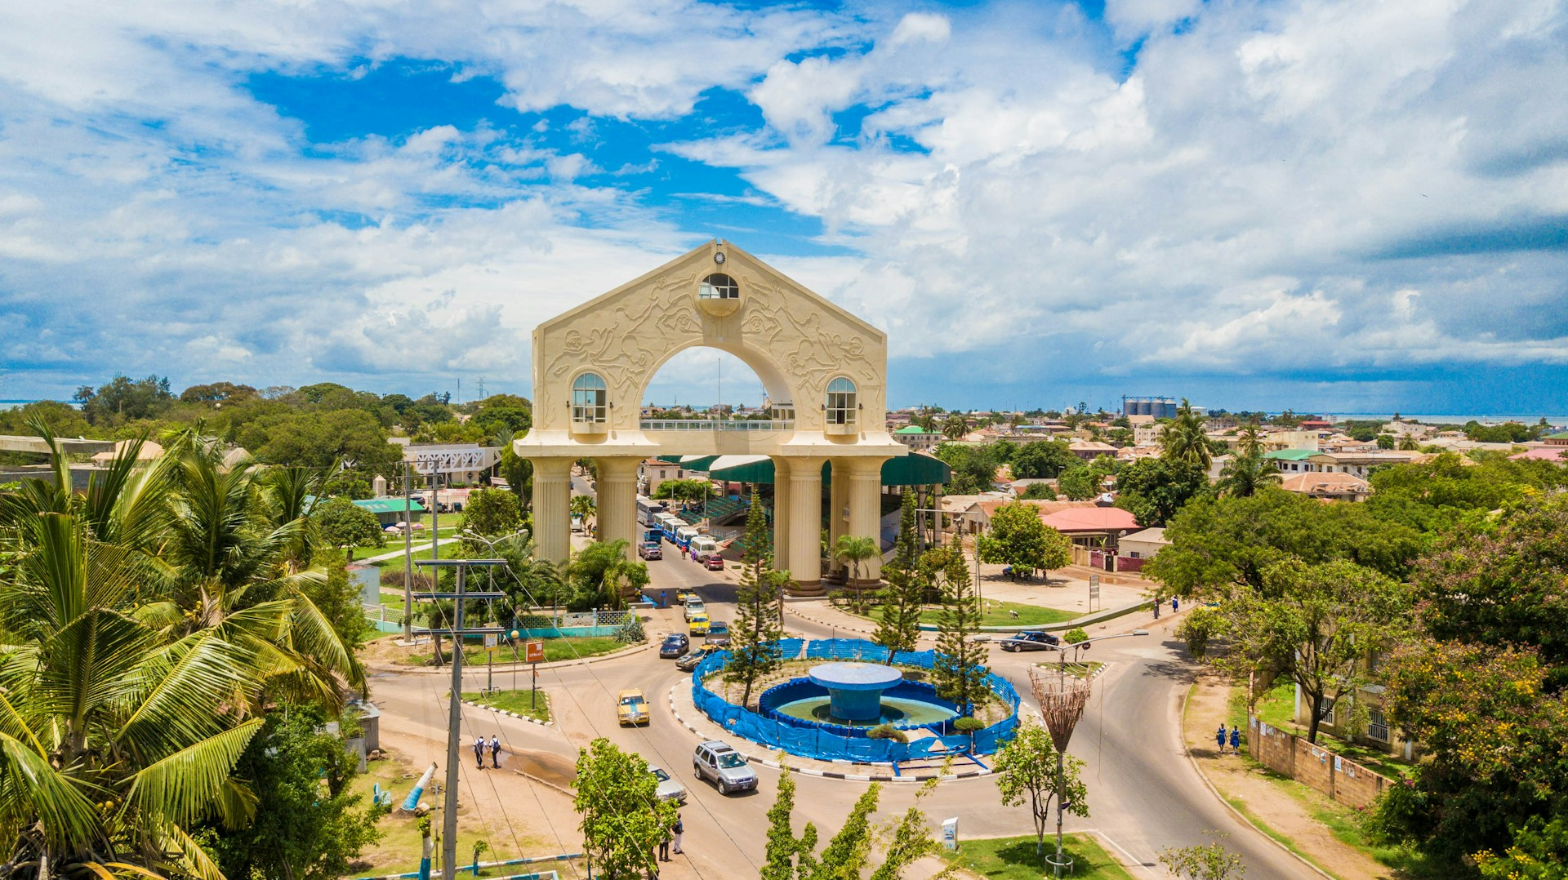
OPENING · 8:30–9:00
Why we're here together
– This week, SMEs worked on their own digital presence. Today you're here to work on something only institutions can do : read the landscape and create conditions for members to succeed.
– The question is not "how do we promote The Gambia?" It is: "how do we make it easier for others to promote it well?"
2
Day 1 · Gambia Institutional Workshop

Slide 3
Before the data — a question for each of you
Name, institution, one sentence: how do you see your connection to promoting The Gambia?
No right answer. Some of you will see it immediately. Some may wonder. That's exactly why all three tiers are in this room together.
3
Day 1 · Gambia Institutional Workshop

