Slide 1
Enabling Tourism Marketing & SME Competitiveness
Institutional Capacity Workshop · ITC EU Youth Empowerment Project
Banjul, The Gambia · May 2026 · 13 institutions · 2 days

Slide 2
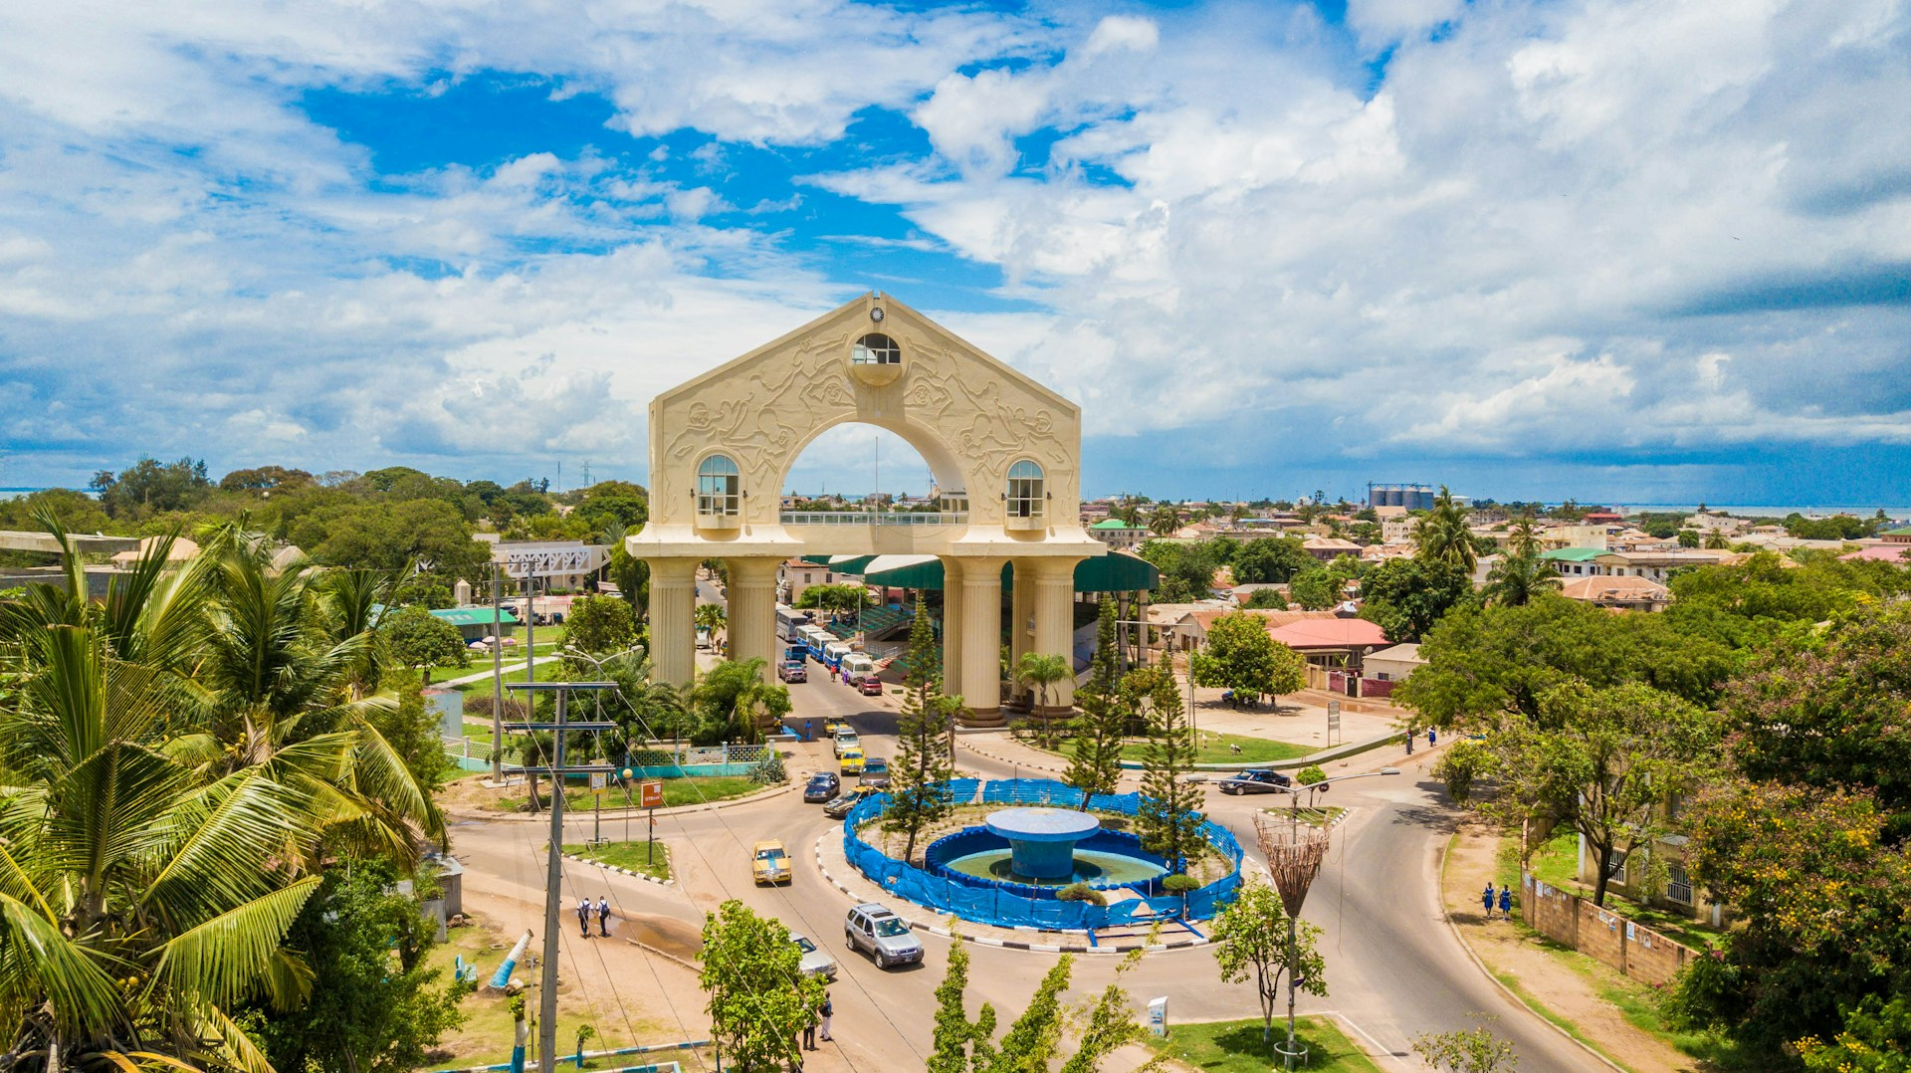
OPENING · 8:30–9:00
Why we're here together
– This week, SMEs worked on their own digital presence. Today you're here to work on something only institutions can do : read the landscape and create conditions for members to succeed.
– The question is not "how do we promote The Gambia?" It is: "how do we make it easier for others to promote it well?"
2
Day 1 · Gambia Institutional Workshop

Slide 3
Before the data — a question for each of you
Name, institution, one sentence: how do you see your connection to promoting The Gambia?
No right answer. Some of you will see it immediately. Some may wonder. That's exactly why all three tiers are in this room together.
3
Day 1 · Gambia Institutional Workshop

Slide 4
THE ARC
Two days. One clear direction.
1
2
3
Thursday morning
Thursday afternoon
Friday
What the data shows — inside and outside The Gambia. Every sector sees its numbers.
Four things you can do — for free, this month, without a new project or new budget.
How you know it's working — and what you commit to together before you leave the room.
Thursday 8:30–16:00 · Friday 8:30–13:00 · 13 institutions · 3 tiers of the ecosystem
4
Day 1 · Gambia Institutional Workshop

Slide 5
EXERCISE
WHAT YOU'LL DO
01
Write on a card: your institution name + one word for your mandate. Hand it to the facilitator. The map goes on the wall and stays there for both days.
1
Write your institution + one word for your mandate (3 min).
1
2
Hand your card to the facilitator to place on the board.
2
Opening activity — Map the room
3
The map stays visible. Refer back to it whenever coordination comes up.
3
15 min
5
Day 1 · Gambia Institutional Workshop

Slide 6
BLOCK 1 · 9:00–10:30 · 90 MIN
The Evidence
B1
What did we find — and how did we find it? Every sector sees its data before we talk about what to do.
6
Day 1 · Gambia Institutional Workshop

Slide 7
“
D2 EXECUTIVE SUMMARY
"The Gambia possesses authentic creative assets and generates positive visitor sentiment relative to the region, yet remains digitally invisible in the global cultural-tourism marketplace."
Liked but not looked for.
D2 · Regional Benchmarking & Market Positioning Analysis · Oct 2025
7
Day 1 · Gambia Institutional Workshop

