Slide 1
Enabling Tourism Marketing & SME Competitiveness
Institutional Capacity Workshop · ITC EU Youth Empowerment Project
Banjul, The Gambia · May 2026 · 13 institutions · 2 days

Slide 2
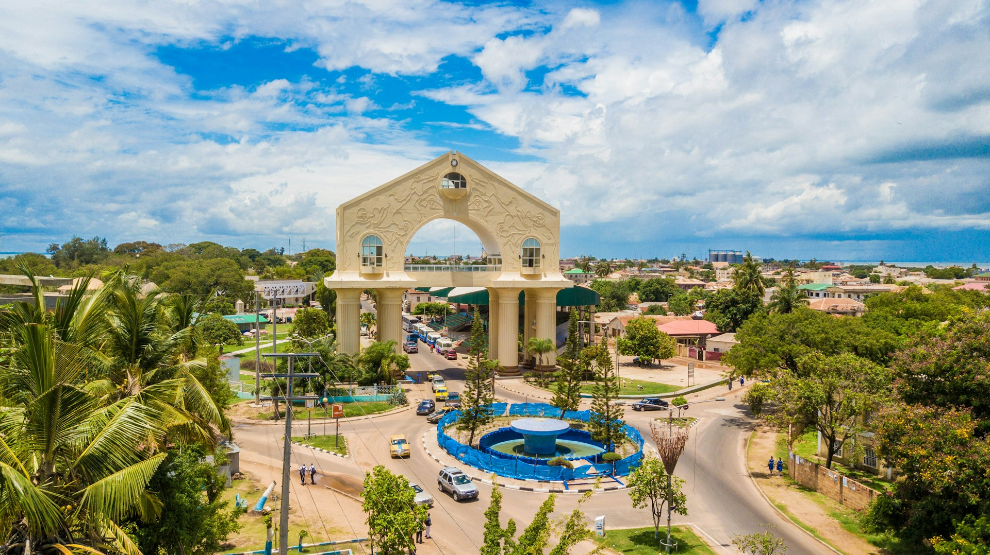
OPENING · 8:30–9:00
Why we're here together
– This week, SMEs worked on their own digital presence. Today you're here to work on somethingonly institutions can do: read the landscape and create conditions for members to succeed.
– The question is not "how do we promote The Gambia?" It is:"how do we make it easier for others to promote it well?"
2
Day 1 · Gambia Institutional Workshop

Slide 3
Before the data — a question for each of you
Name, institution, one sentence: how do you see your connection to promoting The Gambia?
No right answer. Some of you will see it immediately. Some may wonder. That's exactly why all three tiers are in this room together.
3
Day 1 · Gambia Institutional Workshop

Slide 4
THE ARC
Two days. One clear direction.
1
2
3
Thursday morning
Thursday afternoon
Friday
What the data shows — inside and outside The Gambia. Every sector sees its numbers.
Four things you can do — for free, this month, without a new project or new budget.
How you know it's working — and what you commit to together before you leave the room.
Thursday 8:30–16:00 · Friday 8:30–13:00 · 13 institutions · 3 tiers of the ecosystem
4
Day 1 · Gambia Institutional Workshop

Slide 5
EXERCISE
WHAT YOU'LL DO
01
Write on a card: your institution name + one word for your mandate. Hand it to the facilitator. The map goes on the wall and stays there for both days.
1
Write your institution + one word for your mandate (3 min).
2
Hand your card to the facilitator to place on the board.
Opening activity — Map the room
3
The map stays visible. Refer back to it whenever coordination comes up.
15 min
5
Day 1 · Gambia Institutional Workshop

Slide 6
BLOCK 1 · 9:00–10:30 · 90 MIN
The Evidence
B1
What did we find — and how did we find it? Every sector sees its data before we talk about what to do.
6
Day 1 · Gambia Institutional Workshop

Slide 7
EXERCISE
WHAT YOU'LL DO
02
Write three words you believe international visitors currently use to describe The Gambia as a destination.
Activity — Three words · Part 1
3 min · individual · before the data
7
Day 1 · Gambia Institutional Workshop

Slide 8
EXERCISE
WHAT YOU'LL DO
03
Now a second question: write three words you wish international visitors used.
Activity — Three words · Part 2
2 min · individual
8
Day 1 · Gambia Institutional Workshop

Slide 9
THE METHODOLOGY
We looked in two directions
Two reports. One story. The gap = the institutional opportunity.
– D1 (Supply side): 61 stakeholders assessed across 7 creative sectors — what exists inside The Gambia.
– D2 (Demand side): 239 international operator pages + 5,682 visitor reviews — what the world sees.
– Both reports used publicly available sources. No proprietary data. A systematic approach. You can do this yourselves.
9
Day 1 · Gambia Institutional Workshop

Slide 10
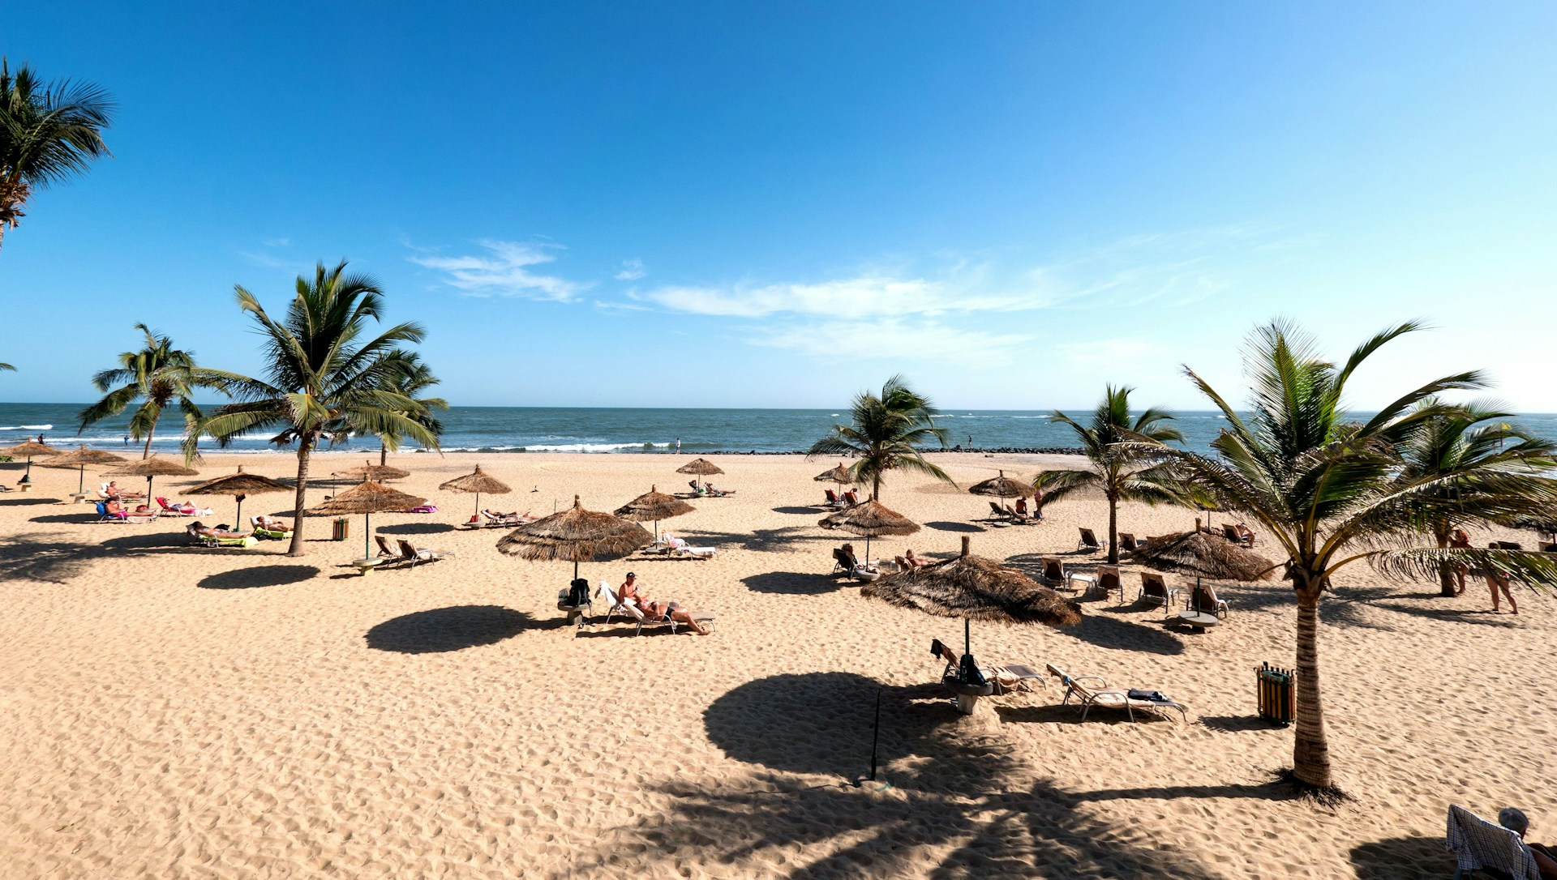
D2 — WHAT THE WORLD SEES · §3.2
What operators show the world
Share of 239 international operator pages analysed
95%
91%
9%
Beach & resort content
Wildlife & nature content
Creative & cultural content
10
Day 1 · Gambia Institutional Workshop

Slide 11
D2 — REGIONAL COMPARISON · §3.2
The Gambia is not alone — but it is behind
Share of operator pages that include creative & cultural content, by destination
Senegal
26%
Ghana
21%
Cape Verde
18%
Benin
14%
The Gambia
9%
Share of operator pages that include creative & cultural content, by destination
11
Day 1 · Gambia Institutional Workshop

Slide 12
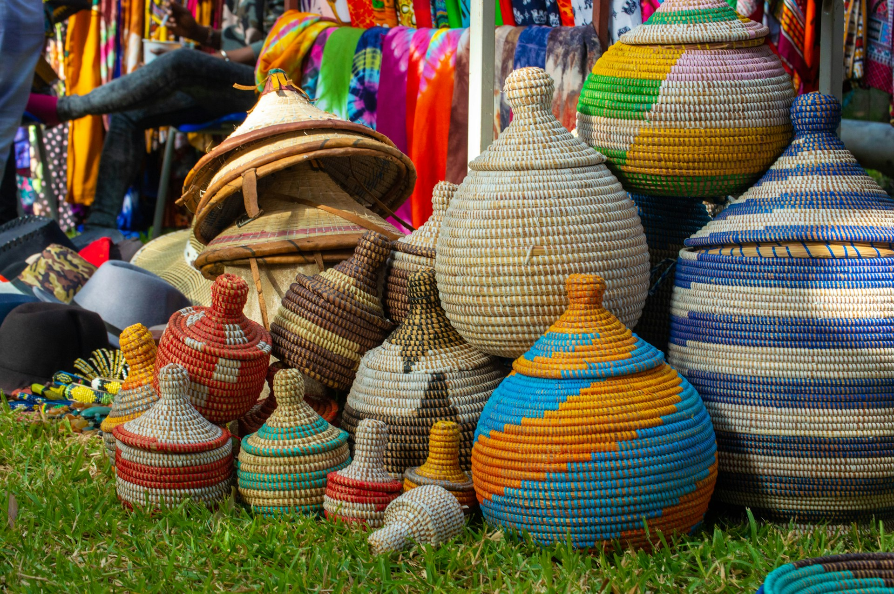
D2 — CREATIVE TOURISM SCORE · TABLE 10
The Gambia scores 16.9 out of 100
16.9
30.9
33.9
The Gambia creative tourism score
Regional mean
Senegal+Gambia packages
– Creative content mentioned on operator pages.
– Whether it is prominently featured or a passing mention.
– Whether specific products are named and bookable.
– Benchmarked against 5 regional peers.
12
Day 1 · Gambia Institutional Workshop

Slide 13
D2 — CREATIVE TOURISM SCORE COMPARISON
The regional gap — and a quick win
16.9
vs
33.9
The Gambia — pure Gambia tours
Senegal+Gambia packages
– Regional framing already doubles the creative tourism score — without changing the product.
– The Gambia's creative offer is valued when visitors can see it.
13
Day 1 · Gambia Institutional Workshop

Slide 14
D2 — VISITOR ORIGINS AND SATISFACTION · §4.4
Who is coming — and what they think
UK & Anglophone
45%
Dutch & Belgian
34%
Francophone
15%
German / Swiss
3%
Southern European
3%
Dutch/Belgian visitors are the most satisfied (avg 4.56 / 5). UK visitors dominate volume.
14
Day 1 · Gambia Institutional Workshop

Slide 15
“
D2 EXECUTIVE SUMMARY
"The Gambia possesses authentic creative assets and generates positive visitor sentiment relative to the region, yet remains digitally invisible in the global cultural-tourism marketplace."
Liked but not looked for.
D2 · Regional Benchmarking & Market Positioning Analysis · Oct 2025
15
Day 1 · Gambia Institutional Workshop

Slide 16
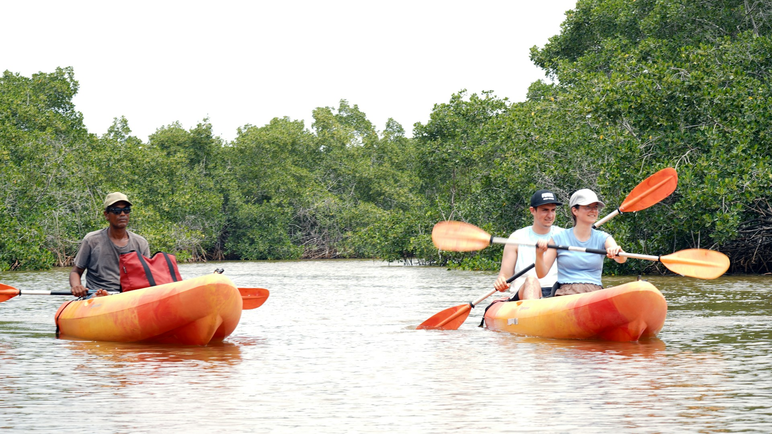
D2 · §4.2 · VISITOR SENTIMENT
The Gambia ranks #1 regionally on safety
– Safety & Security is The Gambia's strongest sentiment theme relative to all regional peers. A genuine competitive advantage that is almost never foregrounded in marketing.
– Tour operators score +0.32 sentiment — The Gambia's best digital ambassadors.
16
Day 1 · Gambia Institutional Workshop

Slide 17
D1 — CREATIVE INDUSTRIES DIGITAL BASELINE · EXECUTIVE SUMMARY
Inside The Gambia: the supply-side picture
Minimal or no digital footprint · 7 sectors · 61 stakeholders assessed
61%
64%
16%
of stakeholders are Absent or Basic digital maturity
post less than once a month
have digital booking or payment
17
Day 1 · Gambia Institutional Workshop

Slide 18
D1 — SECTOR DIGITAL MATURITY SCORES
Your sector in the data
Not an evaluation of what you have done — the starting point we have to work from. Pink = most ground to cover.
– Audiovisual / Photography (Photographers Assn) — 41% Intermediate or above
– Performing & Visual Arts (Music Union, Visual Arts Assn) — ~20% Intermediate
– Festivals & Cultural Events — Polarised: some strong, most weak
– Cultural Heritage Sites — Below average across the board
– Crafts & Artisan Products — Largely absent or basic
– Fashion & Design — Least digitally visible sector overall
18
Day 1 · Gambia Institutional Workshop

Slide 19
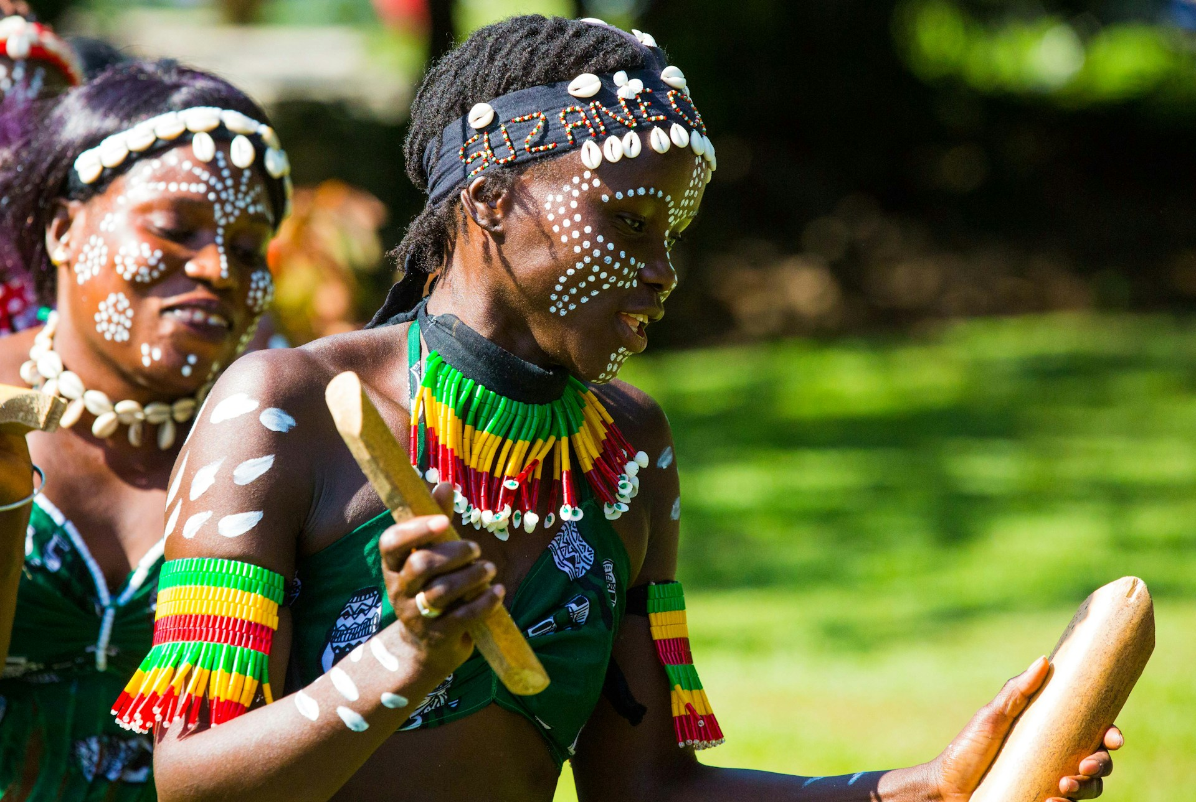
D1 — SECTOR LEADERS
Local leaders already exist
– D1 identified a cohort demonstrating local models of success — but isolated from others in their sector.
– The task is not to create something from scratch. It is to connect what already works to those who haven't found it yet.
19
Day 1 · Gambia Institutional Workshop

Slide 20
HOW D1 AND D2 WERE PRODUCED
The tools that produced this are free
No proprietary data required — publicly accessible sources, a systematic approach, and clear questions.
– TripAdvisor destination page — Most recent reviews, ratings, themes
– Google Trends — Search interest over time by region
– International operator websites — How The Gambia is described and positioned
– Google Alerts — New online content mentioning The Gambia tourism
20
Day 1 · Gambia Institutional Workshop

Slide 21
EXERCISE
WHAT YOU'LL DO
04
Open your phone or laptop. Search as a tourist would. Does your sector — or your organisation — come up?
1
Search"[your sector] + Gambia"— for example: "craft market Gambia," "live music Banjul," "tour guide Gambia," "birdwatching Gambia."
2
Does your organisation appear? Do your members appear? Note what you find — and what's missing.
Activity — Find your sector · Part 1
5 min · individual · closes Block 1
21
Day 1 · Gambia Institutional Workshop

Slide 22
ACTIVITY — FIND YOUR SECTOR · PART 2
What did you find?
Pairs (8 min) → Share-back (7 min): Where on the spectrum did you land?
Present & findable
Visible but not bookable
Effectively invisible
Your organisation or members appear clearly in search results — name, contact, what they offer.
Something comes up — a mention, a review — but no way to contact or book directly.
Nothing appears, or what appears isn't your sector at all.
22
Day 1 · Gambia Institutional Workshop

Slide 23
BLOCK 2 · 10:45–12:15 · 90 MIN
Four things you can do
B2
The evidence shows the gap. These four things help close it — for free, this month, without a new project or new budget.
23
Day 1 · Gambia Institutional Workshop

Slide 24
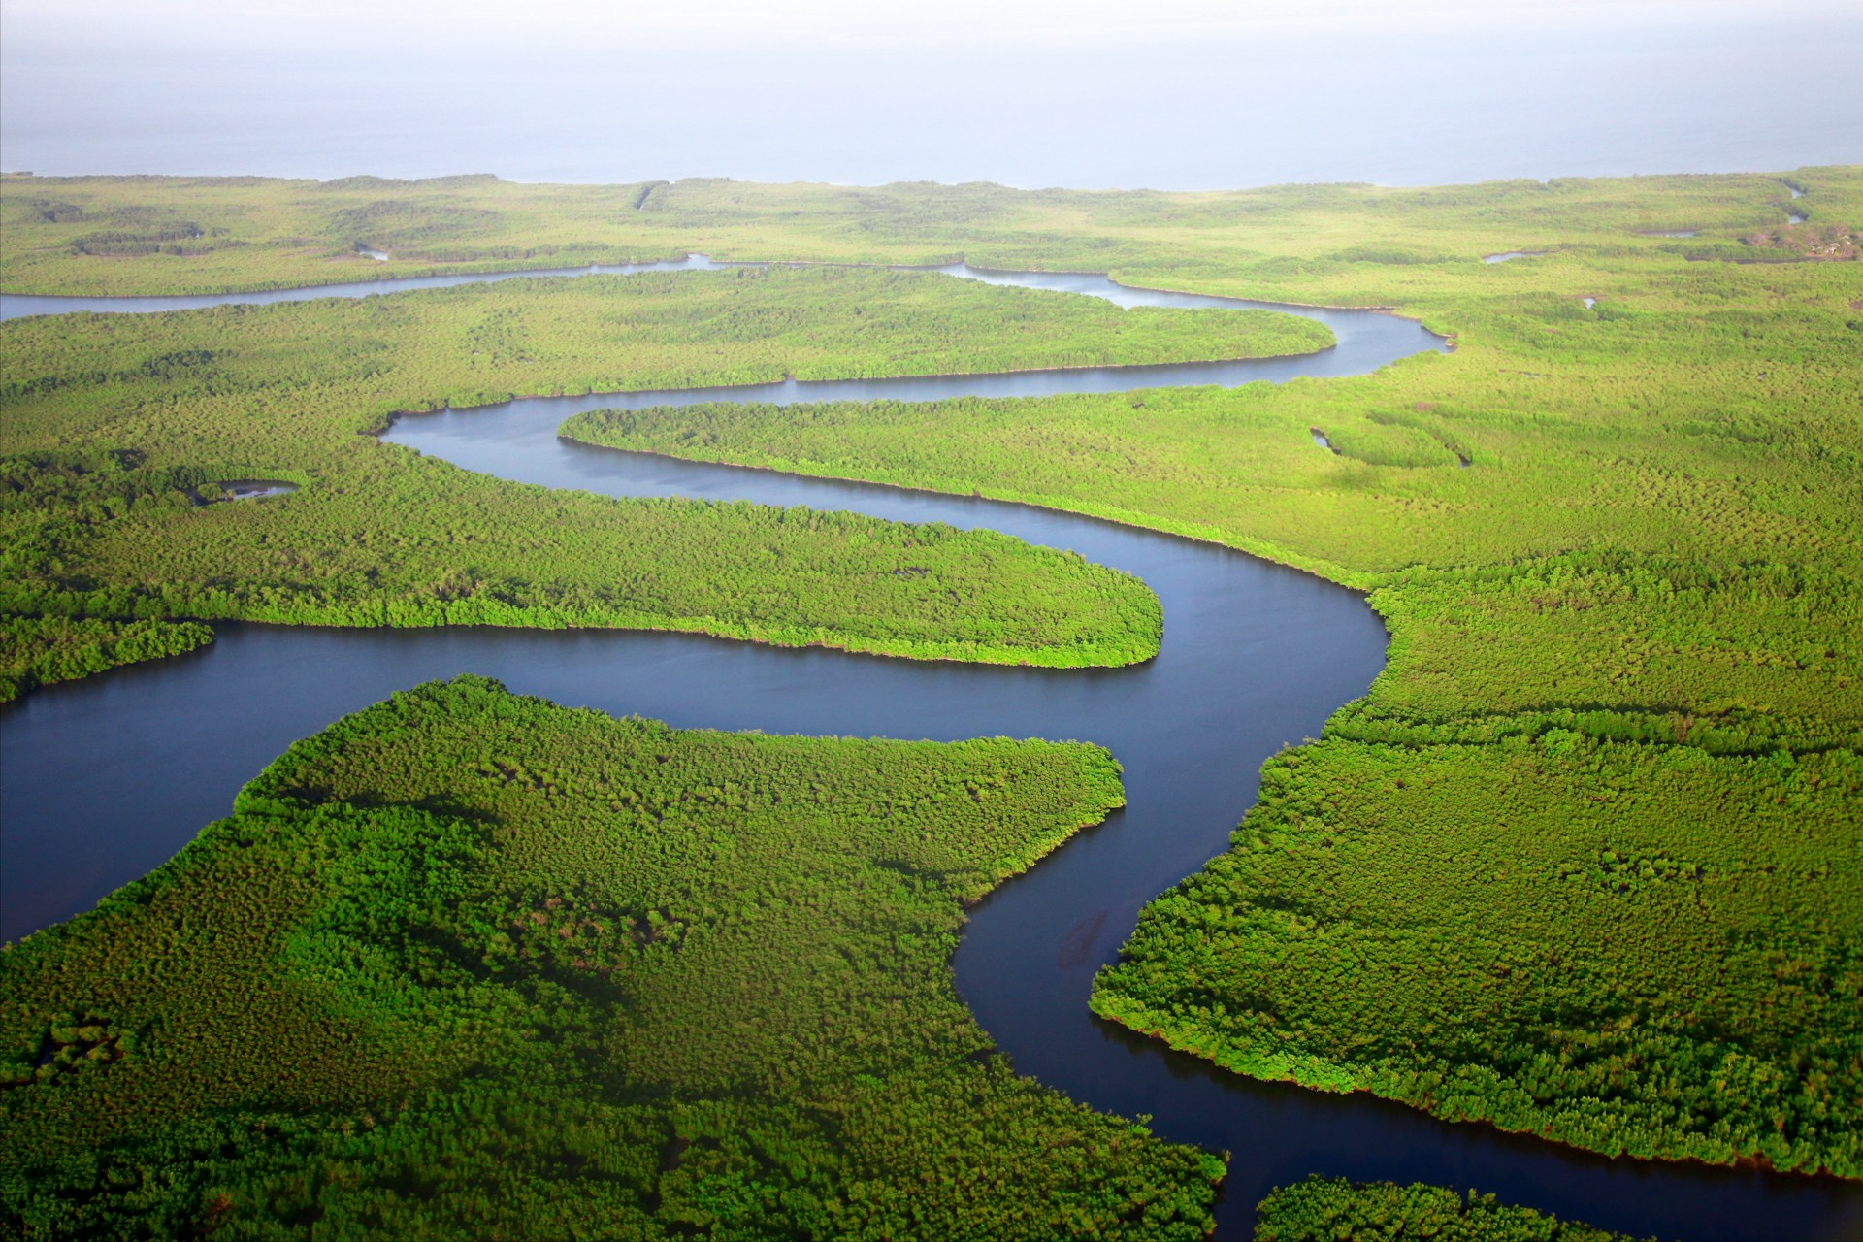
BLOCK 2 — FRAMING
Not the marketer. The enabler.
24
Day 1 · Gambia Institutional Workshop

Slide 25
BLOCK 2 — OVERVIEW
Four things institutions can do
That individual SMEs cannot
Monitor
Make findable
Open a door
Brief
Read the landscape systematically. Know what visitors are saying and operators are showing — before your members ask.
Aggregate your sector so operators and tourists can find your members — one authoritative, maintained place.
Broker access SMEs can't reach alone — operators, journalists, trade fairs, national portals.
Produce one quarterly intelligence note. Nine associations. Hundreds of businesses. Two hours of work.
25
Day 1 · Gambia Institutional Workshop

Slide 26
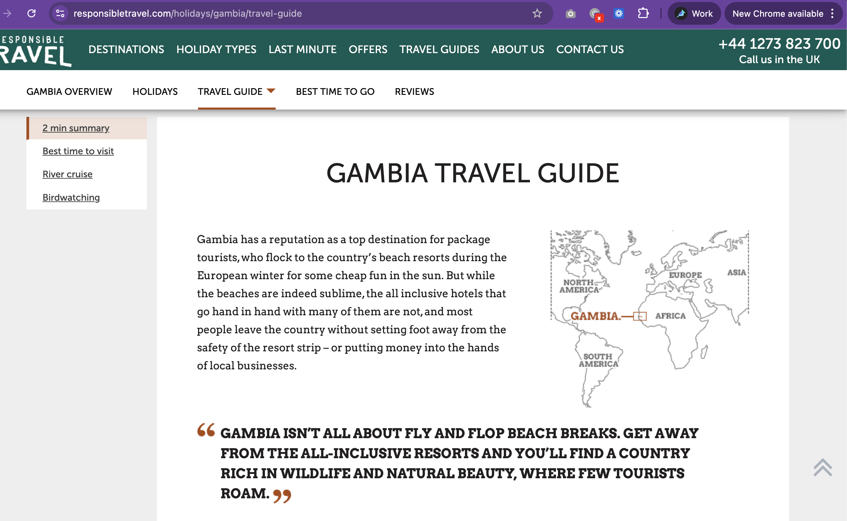
THING 1 — MONITOR
Read the landscape before your members ask
– ← One of the largest ethical UK operators. Creative industries: invisible.
26
Day 1 · Gambia Institutional Workshop

Slide 27
THING 1 — MONITOR · TOOLS
Four free tools. Starting Monday.
Google Alerts
TripAdvisor
Operator spot-check
Google Trends
Set for "Gambia tourism" + your sector. New content delivered to your inbox. Free, no expertise required.
Monthly scan: 20 most recent destination reviews. What themes recur? What's missing? What needs a response?
Quarterly: 5–10 operator websites. How is The Gambia described? Is your sector present or absent?
Track search interest in "The Gambia tourism" vs regional peers. Free, no account required.
27
Day 1 · Gambia Institutional Workshop

Slide 28
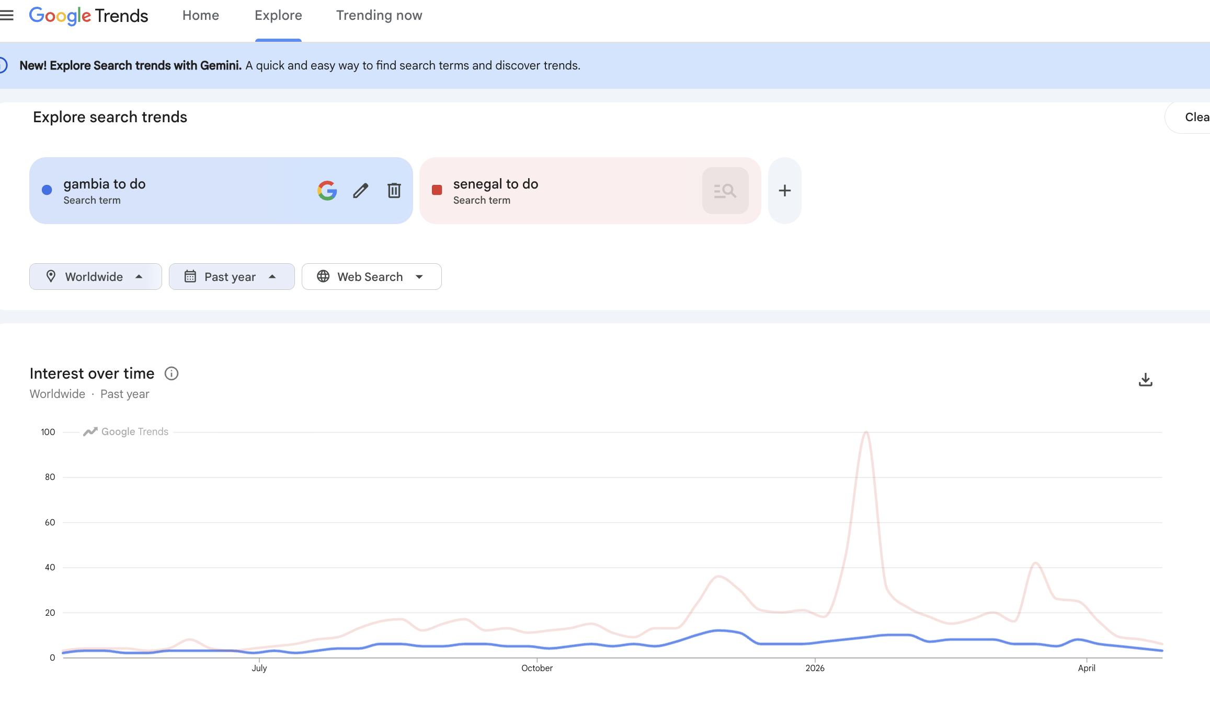
THING 1 — MONITOR · GOOGLE TRENDS
Five years of search interest. Gambia vs Senegal.
– Publicly available, updated daily. The seasonal peaks reveal when source markets are planning — useful for timing campaigns and member briefings.
28
Day 1 · Gambia Institutional Workshop

Slide 29
THING 1 — MONITOR · FOR INSTITUTIONS WITH WEBSITES
Google Search Console: visitor intent made visible
For institutions with websites — free once verified. Data flows automatically.
– Search queries — what visitors typed before finding you. Intent, not traffic.
– Pages — which pages attract visitors from search, and which don't.
– Countries — where searchers are located. Useful for prioritising languages and messaging.
– Impressions vs clicks — are you appearing in search but not being chosen?
29
Day 1 · Gambia Institutional Workshop

Slide 30
EXERCISE
WHAT YOU'LL DO
05
1
Opengoogle.com/alertson your phone or laptop.
2
Type:"Gambia tourism"→ click Create Alert.
Live activity — Set up your Google Alert now
3
Type:"[your sector] Gambia"— e.g. "craft market Gambia," "Gambia birdwatching," "Gambia music" → Create Alert.
4
Set frequency toOnce a week.Confirm your email.
10 min
30
Day 1 · Gambia Institutional Workshop

Slide 31
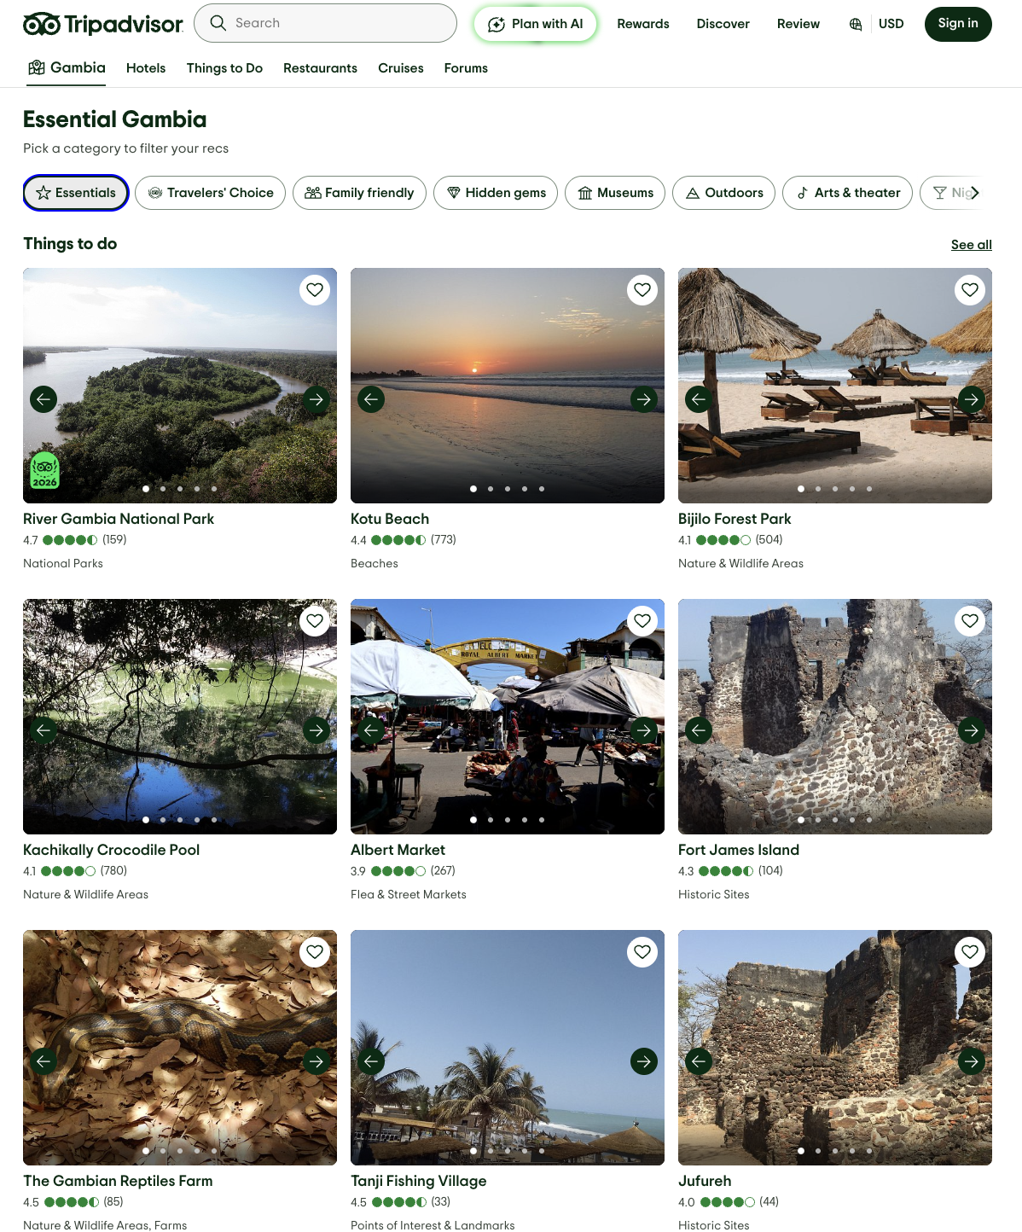
THING 1 — MONITOR · TRIPADVISOR SCAN
What TripAdvisor surfaces for The Gambia
– The top 9 things to do in The Gambia, according to TripAdvisor:
– A 20-minute monthly scan tells you what's visible — and what your sector needs to do to appear here.
31
Day 1 · Gambia Institutional Workshop

Slide 32
THING 1 — MONITOR · TRACKING
Track four numbers. That's your dashboard.
These indicators come directly from D2 Table 20. Ready-made — you don't need to design your own framework.
Indicator | Baseline 2025 | Target 2026
ITO creative tourism visibility | 52% | 60%
Average visitor sentiment score | +0.24 | +0.30
Verified TripAdvisor reviews | Baseline | +25%
Average review rating | Baseline | +0.2
32
Day 1 · Gambia Institutional Workshop

Slide 33
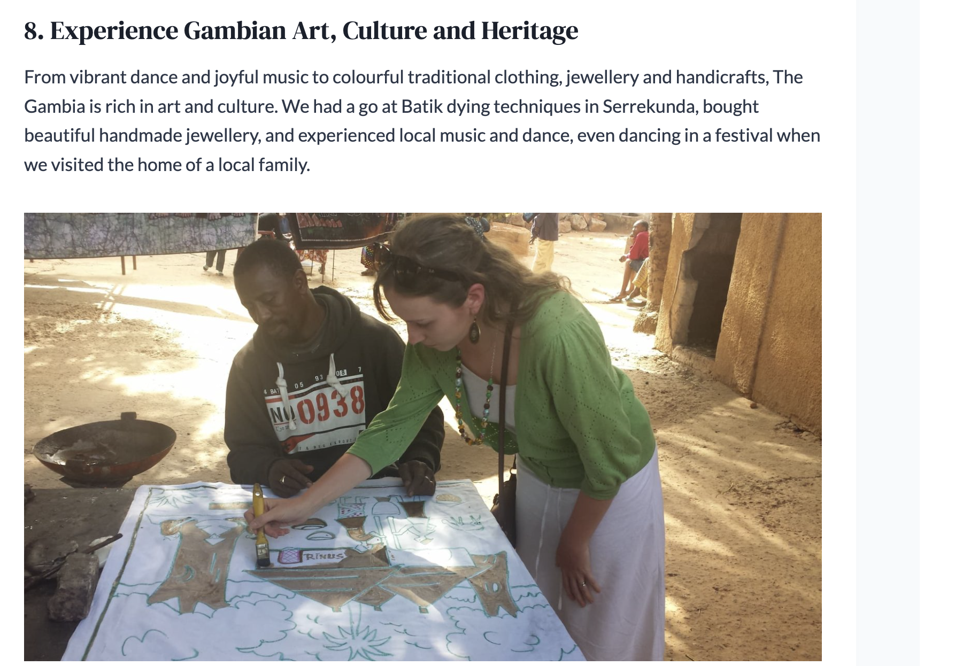
THING 2 — MAKE YOUR SECTOR FINDABLE
Creative tourism is item 8. With no way to book it.
– A travel blogger loved The Gambia. She lists creative tourism as reason #8 of 12 to visit. She describes vibrant dance, music, handicrafts.
– ← Reason #8 of 12. Loved. Memorable. Not findable. Not bookable.
33
Day 1 · Gambia Institutional Workshop

Slide 34
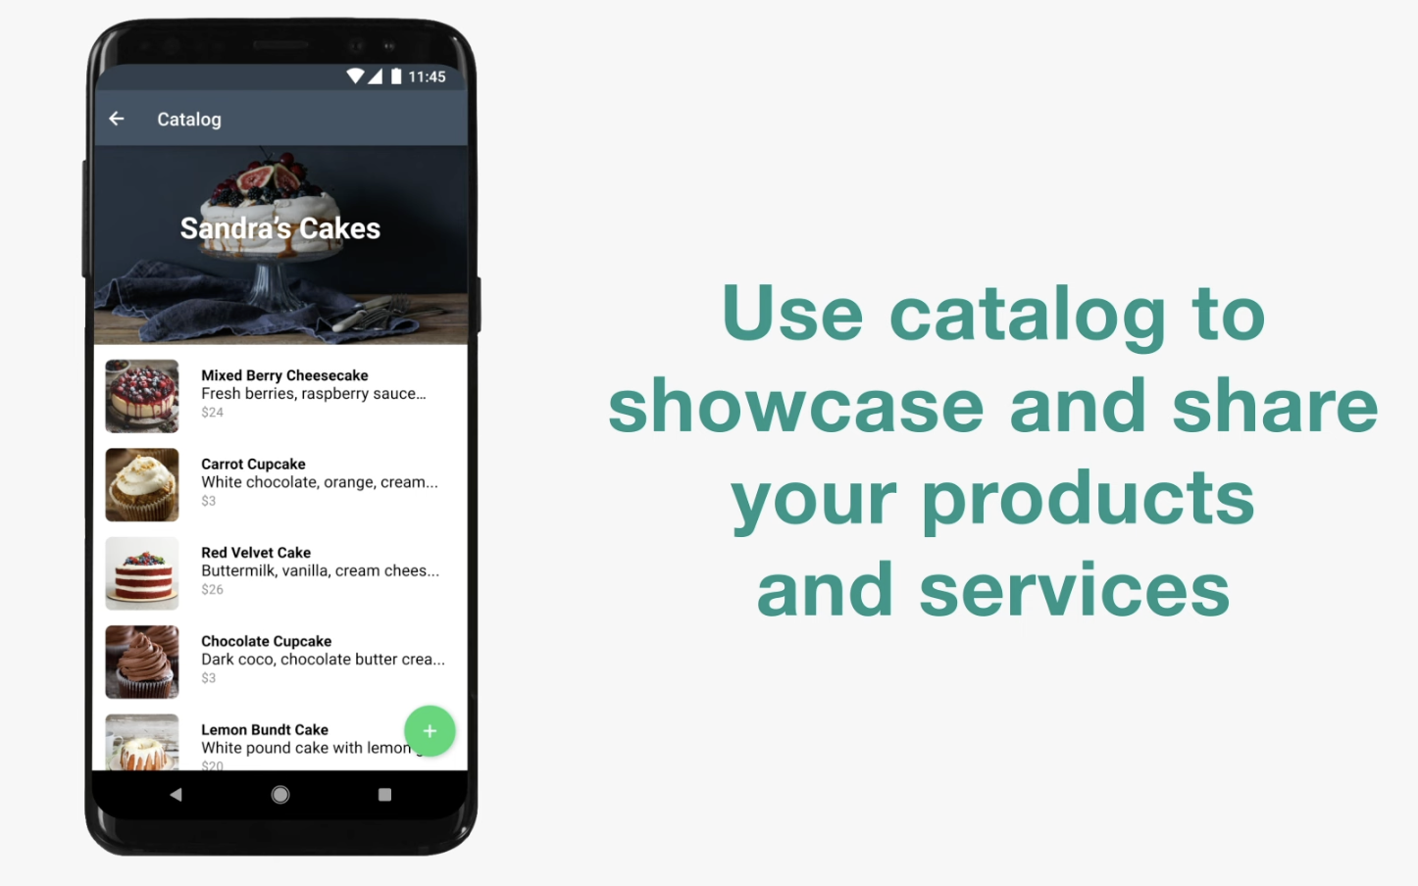
THING 2 — FROM SCATTERED TO SEARCHABLE
One place. One responsible person.
– A WhatsApp Business catalogue is free, takes an hour to set up, and reaches buyers directly on the platform your members already use every day.
34
Day 1 · Gambia Institutional Workshop

Slide 35
THING 2 — MAKE FINDABLE · BY INSTITUTION
Every institution can own one place
GT Board — VisitTheGambia.com
Craft Market Federation — Member directory
Tour Guide Association — Verified guide list
A functional creative industries section: bookable experiences, sector contacts, events calendar.
Names, photos, specialisms, WhatsApp. A tourist reads about vibrant craft markets — this is where they find who to contact.
Name, languages, specialisms, contact. One page. Operators reference it. Tourists find it.
35
Day 1 · Gambia Institutional Workshop

Slide 36
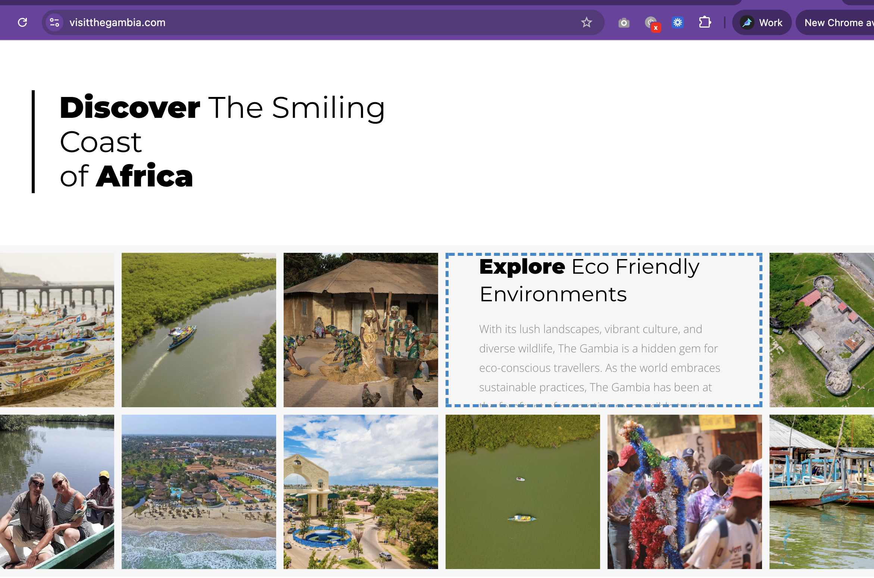
THING 2 — PLATFORM GOVERNANCE
The national portal: what's there, what's not
– "Explore Eco Friendly Environments." The national portal. Creative industries: not on this page.
36
Day 1 · Gambia Institutional Workshop

Slide 37
EXERCISE
WHAT YOU'LL DO
06
Activity — Gap identification
10 min
37
Day 1 · Gambia Institutional Workshop

Slide 38
BLOCK 3 · 13:15–14:45 · 90 MIN
Things 3 + 4
B3
Things 1 and 2 are about reading and organising. Things 3 and 4 are about using what you know.
38
Day 1 · Gambia Institutional Workshop

Slide 39
BLOCK 3 · THINGS 3 + 4
Three things SMEs need that training alone cannot deliver
The gap between 'can do' and 'does' is where institutions matter most. Three things SMEs consistently need that skill-building cannot deliver on its own:
Visibility
Credibility
Access
Being findable by the right audiences — international operators, travel journalists, and platforms SMEs can't reach alone.
Being trusted by buyers and booking platforms. A trained SME still needs institutional endorsement to be taken seriously.
Being connected to markets, events, and decision-makers. Institutions open doors individuals cannot.
39
Day 1 · Gambia Institutional Workshop

Slide 40
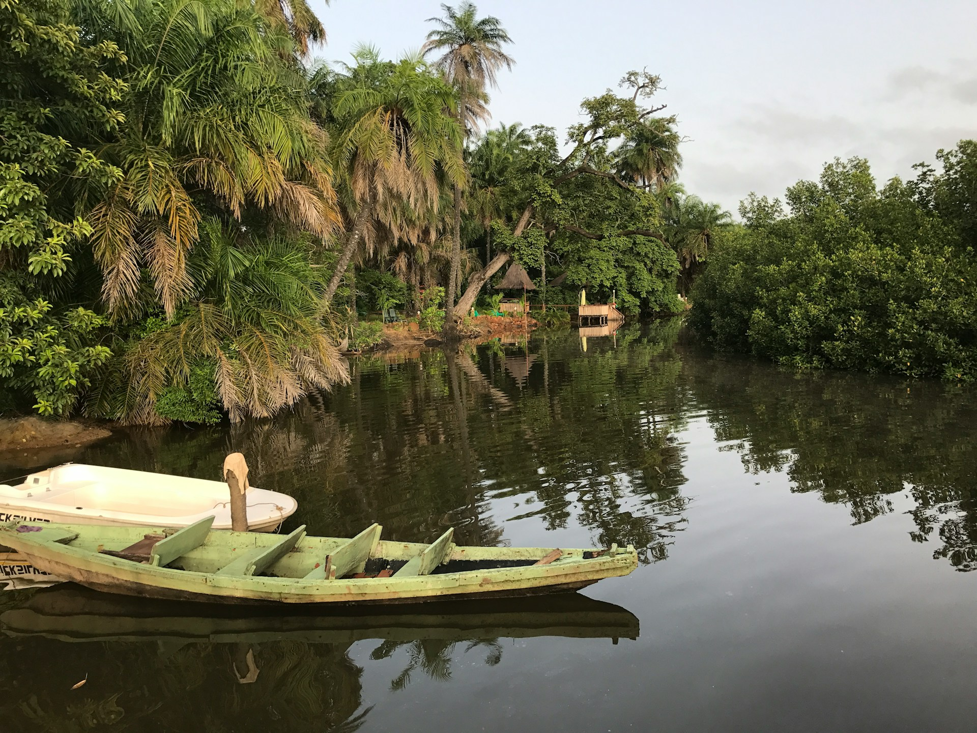
THING 3 — OPEN A DOOR
The door only you can open
– Individual SMEs — even successful ones — cannot introduce themselves to international operators, invite travel journalists, or join a trade fair delegation alone.
40
Day 1 · Gambia Institutional Workshop

Slide 41
THING 3 — THE EVIDENCE
What closing the gap actually requires
– None of this can be done by individual SMEs. All of it is within institutional mandate.
– Invite one international operator for a creative industries familiarisation visit. One trip can directly influence dozens of itineraries.
– Two pages, written for operators. Ready-to-use content for their own marketing — removes the friction that keeps creative sectors absent from itineraries.
– Broker two specific operator–SME introductions from participants in this training week. Low effort, immediate signal value.
41
Day 1 · Gambia Institutional Workshop

Slide 42
THING 3 — WHAT EACH TIER CAN DO
You don't need to open every door. Identify one. Make it a habit.
– The most durable support structures are those simple enough to maintain with existing staff and resources — not those requiring specialist skills or dedicated budget.
42
Day 1 · Gambia Institutional Workshop

Slide 43
EXERCISE
WHAT YOU'LL DO
07
One thing your institution could realistically do in the next six months to better support SME visibility or market access — without additional budget.
1
Individual (5 min):Write it down. Be specific — not "connect with operators" but "invite [type of operator] for a one-day creative industries fam visit in [month]" or "distribute GT Board quarterly brief to our members via WhatsApp."
2
Pairs (5 min):Share with someone from a different tier or sector. Is it realistic? What would it actually take?
Activity — What door can your institution open?
3
Facilitator reads back 4–5 responsesand groups on the board by type.
15 min
43
Day 1 · Gambia Institutional Workshop

Slide 44
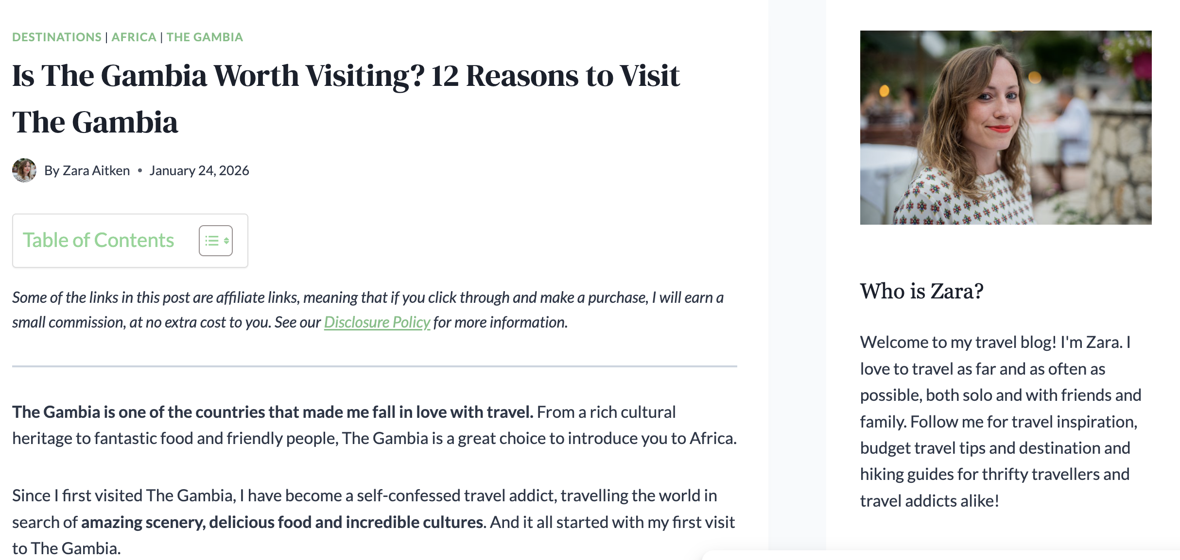
THING 4 — SHARE A BRIEFING
Intelligence your members don't know to ask for
– SMEs know their own businesses. They don't know how The Gambia is being sold internationally, what operators are saying, or what trends are emerging in source markets.
– You do — because you've been monitoring (Thing 1).
– ← This blogger wrote about The Gambia in Jan 2026. Did your members know? Could they have been featured?
44
Day 1 · Gambia Institutional Workshop

Slide 45
THING 4 — THE BRIEFING FORMAT
One page. Three sections. Quarterly.
1
2
3
Section 1 — What we saw
Section 2 — What it means for you
Section 3 — One thing to do
Key findings from monitoring — 2–3 bullet points. What's new, what's changed, what's still missing.
Practical implications for members. Not analysis — direct guidance relevant to their businesses.
A concrete action members can take this month. Specific and checkable.
Tone: peers sharing intelligence, not management reporting down.
45
Day 1 · Gambia Institutional Workshop

Slide 46
THING 4 — THE ROUTINE
From monitoring to briefing in three steps
1
2
3
Check 3–4 sources
Note 2–3 findings
Write one paragraph. Share.
Google Alert digest, 20 TripAdvisor reviews, 5 operator pages. What's new, changing, or worth acting on?
What did you see that your members don't know? What trend is emerging? What gap is still there?
Send by WhatsApp, email, or raise at your next sector meeting. Done. 2 hours per quarter.
46
Day 1 · Gambia Institutional Workshop

Slide 47
EXERCISE
WHAT YOU'LL DO
08
Every association in this room is a distribution channel. This maps who can reach how many people — and what content would actually travel through those channels.
1
How many members does your institution or association represent? ___
2
One channel you currently use to reach them:WhatsApp / meetings / email / newsletter / none
Activity — Your multiplier
3
One thing GT Board or NCAC could give you that you wouldimmediately distributeto your members: ___
20 min
47
Day 1 · Gambia Institutional Workshop

Slide 48
THING 4 — THE MULTIPLIER LOGIC
One briefing. Nine channels. Hundreds of businesses.
GT Board produces one quarterly brief. Nine associations each distribute to their members.
– One document reaches the whole ecosystem — with 2 hours of work.
– Associations: Music Union · Photographers Association · Visual Arts · Craft Market · Collecting Society · Bird Watchers · Tour Guides · Chef Association · Tourist Security Guard Association
– Each association multiplies the reach: one brief → hundreds of individual businesses.
48
Day 1 · Gambia Institutional Workshop

Slide 49
Day 1 Close · 15:00–16:00 · 60 min
Not three months. Not six months. One thing you will do in the next 30 days.
49
Day 1 · Gambia Institutional Workshop

Slide 50
EXERCISE
WHAT YOU'LL DO
09
"A journalist from a Dutch travel magazine is writing a piece on cultural tourism in The Gambia. They search online for contacts, experiences, and bookable products. Would they find your organisation? Would they find your members? "
1
Individual (8 min):Write — what the journalist would find about your sector; what they would miss; one thing that, if it existed, would change the result.
2
Pairs (8 min):Compare. Does your partner agree with your assessment?
Activity — The journalist test
3
Group (8 min):4–5 share. Facilitator captures on board: Currently findable · Visible but not bookable · Effectively invisible.
25 min · Day 1 close
50
Day 1 · Gambia Institutional Workshop

Slide 51
EXERCISE
WHAT YOU'LL DO
10
Not three months. Not six months. One thing you will do in the next 30 days.
Activity — One thing in 30 days
20 min
51
Day 1 · Gambia Institutional Workshop

Slide 52
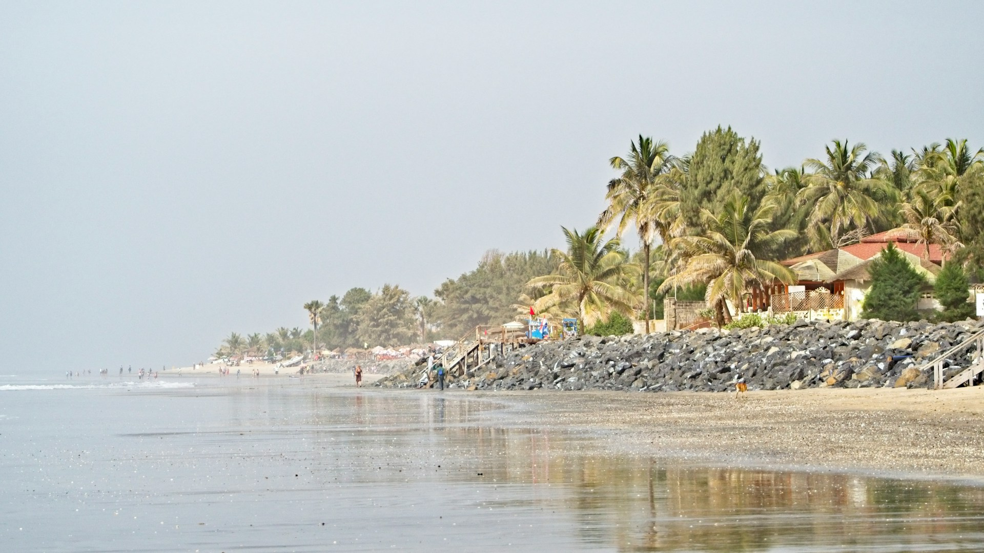
END OF DAY 1
See you tomorrow
– Today was about what each of you can do individually. Friday shifts focus.
52
Day 1 · Gambia Institutional Workshop

