Slide 1
Tracking Progress & Institutional Coordination
Institutional Capacity Workshop · ITC EU Youth Empowerment Project
Banjul, The Gambia · May 2026 · 8:30 – 13:00

Slide 2
YESTERDAY'S COMMITMENTS
What we agreed on Day 1
Today we return to these — to confirm, refine, and coordinate.
Monitor
Make findable
Open a door
Share + coordinate
Track what the world sees about The Gambia — consistently, not occasionally.
Ensure your sector and members appear where operators and tourists search.
Connect at least one SME to an operator, platform, or journalist they couldn't reach alone.
Act on intelligence together — at least one joint action per quarter.
2
Day 1 · Gambia Institutional Workshop

Slide 3
TODAY'S ARC
From individual action to shared momentum
– Yesterday was about what exists and what each of you can do — individually, within your mandate, with free tools.
– Today is about two things: how you know it's working, and where doing this together produces more than doing it separately.
3
Day 1 · Gambia Institutional Workshop

Slide 4
FRIDAY · 8:30 – 13:00
Today's programme
– 8:30 – 9:00 Opening — recap of Day 1 commitments, arc of today
– 9:00 – 10:00 Session 5 · Digital Ecosystem and Institutional Visibility — governance, SEO, partnerships, seasonal presence, crisis
– 10:00 – 11:00 Session 6 · Monitoring Progress — framework, KPIs, coordination, exercises
– 11:00 – 11:15 Break
– 11:15 – 13:00 Wrap-Up · Priorities, Commitments, and Coordination — synthesis, 30-day commitments, coordination mechanism, close
4
Day 1 · Gambia Institutional Workshop

Slide 5
SESSION 5
Digital Ecosystem and
Institutional Visibility
5
Who maintains what, who owns what, and what falls through the gaps.
5
Day 1 · Gambia Institutional Workshop

Slide 6
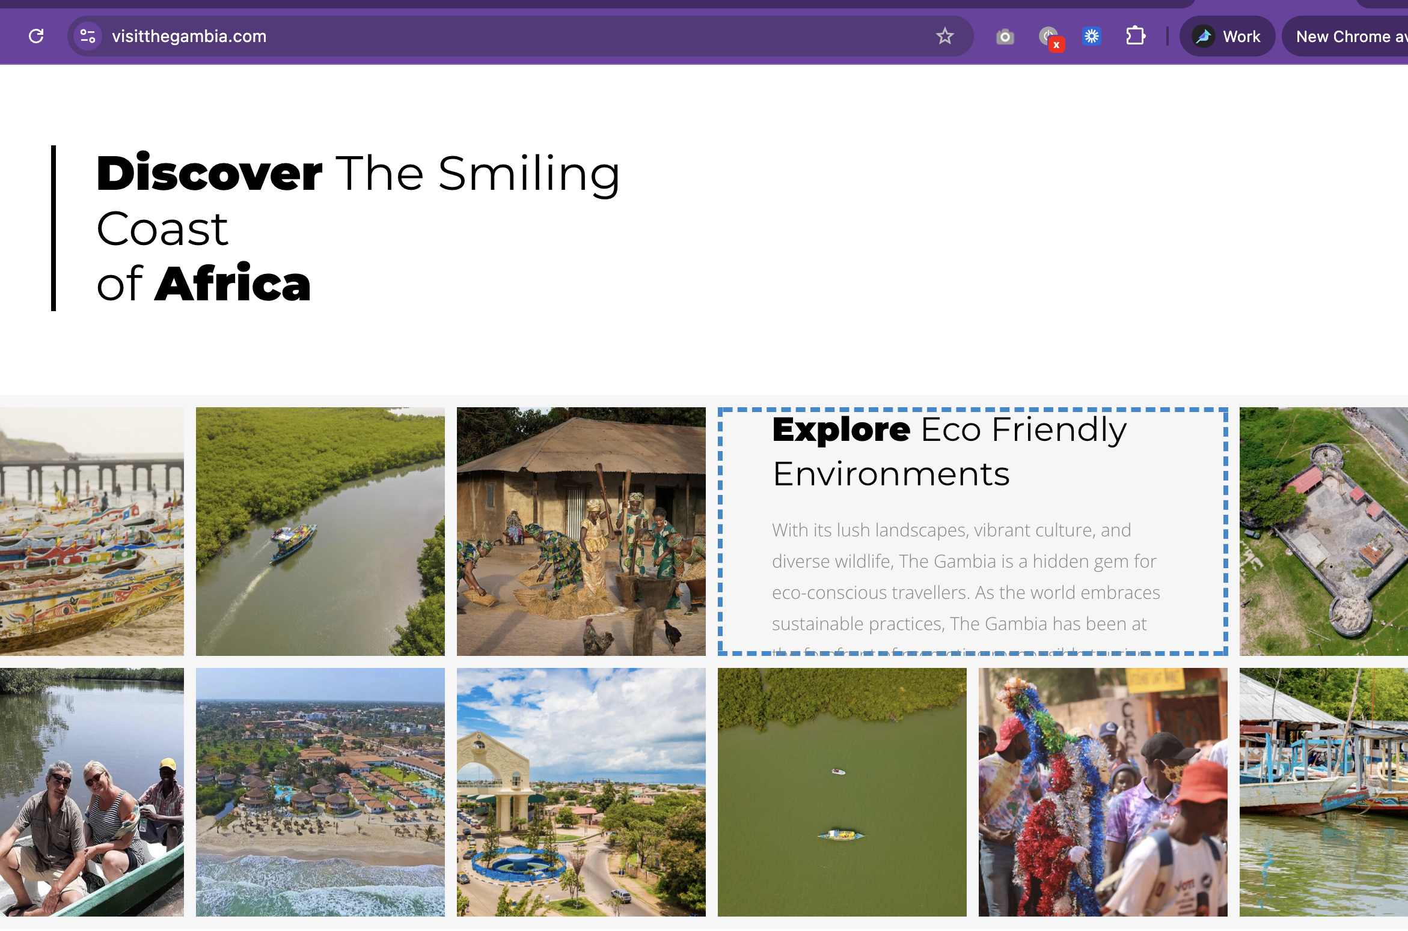
PLATFORM GOVERNANCE
Who owns what?
Platform governance is an organisational question, not a technical one.
– For each official platform — website, social media, Google Business profile — who has admin access?
– Who is responsible for updates? What happens when that person leaves?
– Digital orphans: platforms created for projects that ended without a handover plan. Still live, still appearing credible to visitors, but containing outdated information.
– Starting action: one spreadsheet, one hour — list every official digital touchpoint, note when it was last updated, identify who has access.
6
Day 1 · Gambia Institutional Workshop

Slide 7
DESTINATION-LEVEL SEO
The institutional role in how The Gambia appears in search
– Individual operators appear in search results for their own names — but who ensures The Gambia appears as a destination for visitors who don't yet know which operator to book with?
– This is the destination-level search problem. It is not solved by any individual SME — it requires coordinated institutional action.
– Content aggregation: a single authoritative source of what The Gambia offers — maintained consistently, shared across partner platforms and media.
– Search engines reward consistency: the same correct, updated information appearing across GT Board, NCAC listings, and verified operator profiles.
7
Day 1 · Gambia Institutional Workshop

Slide 8
WHAT INSTITUTIONS CAN BROKER
Partnerships SMEs cannot open alone
– OTAs — negotiating creative tourism categories on GetYourGuide, Viator, or Booking Experiences requires institutional credibility, not just individual applications.
– Travel media — pitching The Gambia to Lonely Planet, BBC Travel, or specialist press is more effective from a national institution than from an individual artisan.
– Influencer programmes — a curated programme managed by GT Board, where institutions vet, brief, and facilitate, gives far greater control over messaging than ad hoc SME arrangements.
– Trade fairs — World Travel Market, ITB Berlin: institutions attend and can carry SME profiles into rooms those SMEs will never enter alone.
8
Day 1 · Gambia Institutional Workshop

Slide 9
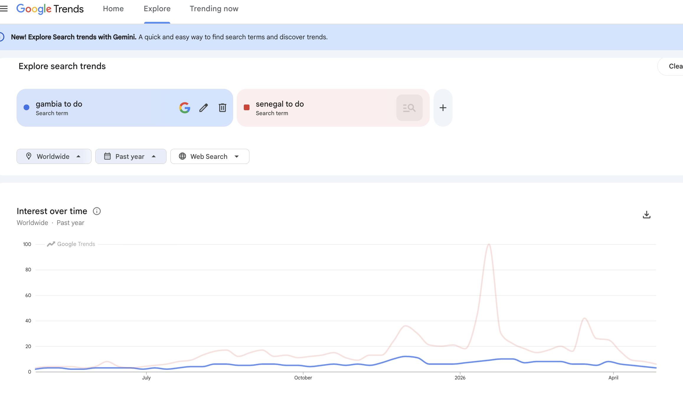
THE OFF-SEASON PROBLEM
Keeping The Gambia visible year-round
– The Gambia's main tourist season runs October–April. Between May and September, search interest drops sharply — while competitor destinations maintain their content and campaigns.
– The visibility gap: a potential visitor searching in July finds stale content from the previous peak season. The destination loses consideration at the planning stage.
– Institutional role: schedule consistent content updates, press releases, and social media activity regardless of season. The same effort in August has greater impact because so few competitors are active.
– Practical anchor: a quarterly content calendar, maintained by GT Board and shared with associations — agreed topics, agreed timing, consistent presence.
9
Day 1 · Gambia Institutional Workshop

Slide 10
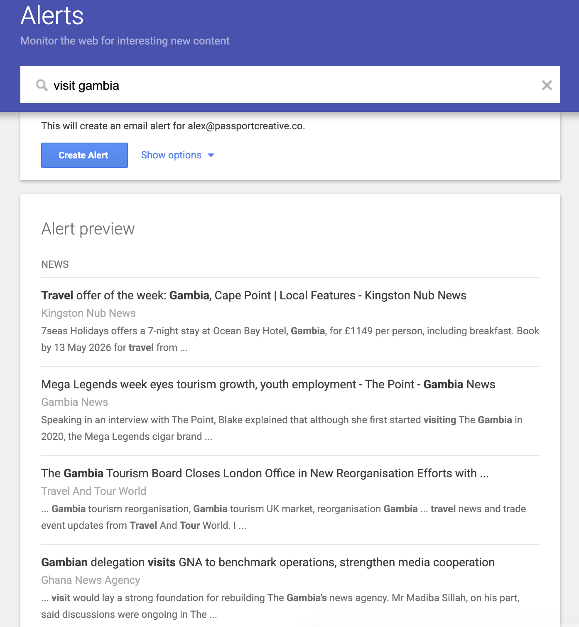
WHEN THINGS GO WRONG
Crisis and reputation management
– Your monitoring routine will surface problems. Institutions need an agreed protocol before a crisis, not during one.
– Designate one person per institution responsible for weekly monitoring. Set a Google Alert for "The Gambia" + your sector name.
– Agree a response threshold — any review below 3 stars on an official platform, or any factual error, triggers a response within 24 hours.
– Share patterns of negative reviews at the quarterly call — don't manage reputation in isolation.
10
Day 1 · Gambia Institutional Workshop

Slide 11
SESSION 6
Monitoring Progress:
Building a Simple Intelligence Routine
6
A simple check done consistently is more valuable than a comprehensive study done once every two years.
11
Day 1 · Gambia Institutional Workshop

Slide 12
“
"Routine beats sophistication. "
"Routine beats sophistication. "
12
Day 1 · Gambia Institutional Workshop

Slide 13
THE MONITORING ROUTINE
Three questions a monitoring routine answers
1
2
3
Are we being found?
Right experience?
Improving over time?
By the right audiences, on the platforms they use to plan and book.
Are visitors having the experience we want them to have and report?
Consistency matters more than any single data point. Is the trend moving?
13
Day 1 · Gambia Institutional Workshop

Slide 14
A SIMPLE MONITORING FRAMEWORK
Three tools. Three habits. All free.
Q
M
A
Operator catalogue check
Review sentiment scan
Annual benchmarking snapshot
Visit 10 key operators each quarter — same ones each time. Note what they feature. 2 hours / quarter.
Read 20 most recent TripAdvisor reviews monthly. Note themes, flag issues. 1 hour / month.
Same D1 dimensions — social media, website currency, discoverability, booking. Half a day / year.
14
Day 1 · Gambia Institutional Workshop

Slide 15
TOOL 1 · QUARTERLY
Operator catalogue check
– Visit the websites of 10 key operators selling The Gambia — same 10 each quarter.
– Note: How is The Gambia described? Which experiences are featured? What images are used? Is your sector present?
– Record in a simple shared spreadsheet. Compare quarter-on-quarter — the trend matters more than any single snapshot.
– 2 hours per quarter. No login, no account, no cost.
15
Day 1 · Gambia Institutional Workshop

Slide 16
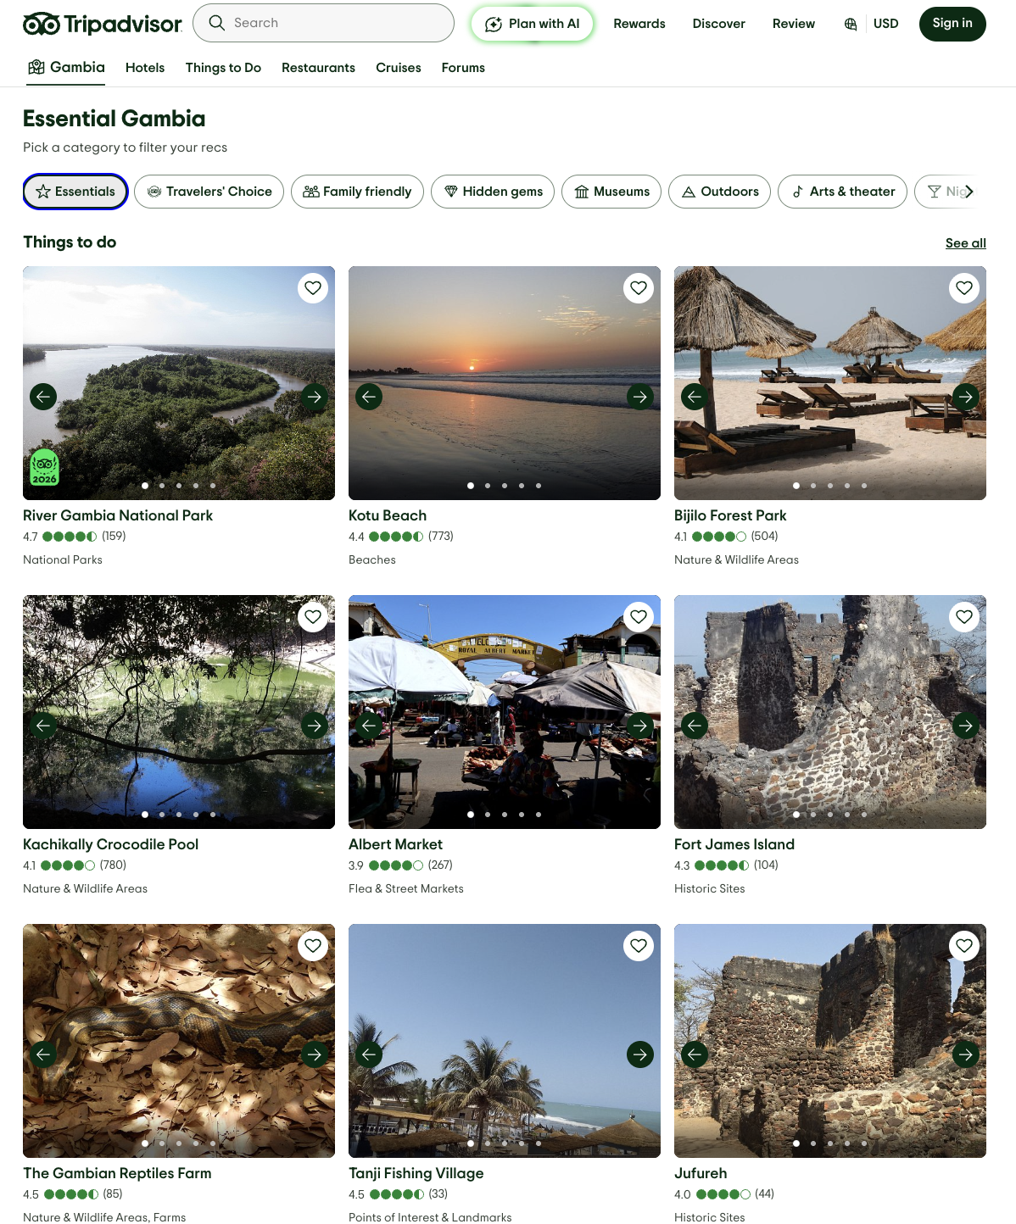
TOOL 2 · MONTHLY
Review sentiment scan
– Read the 20 most recent TripAdvisor reviews for The Gambia destination page and 2–3 key attractions.
– Note recurring themes — both positive and negative.
– Flag anything requiring a response: below 3 stars, specific complaint, or factual error.
– Track direction of travel: improving / stable / declining. The Gambia's current baseline is +0.24.
16
Day 1 · Gambia Institutional Workshop

Slide 17
TOOL 3 · ANNUAL
Annual benchmarking snapshot
– Once a year: assess The Gambia's digital presence using the same D1 dimensions.
– Social media activity, website currency, discoverability, booking capability.
– Compare year-on-year to track overall progress across sectors.
– D1 and D2 baselines provide the Year 1 starting point — already done.
[the-gambia-pfivvKSHE18.jpg]
17
Day 1 · Gambia Institutional Workshop

Slide 18
THE SHARED TRACKING TEMPLATE
One spreadsheet. Three tools. All institutions.
– The template has three tabs: Operator Catalogue (quarterly), Sentiment Scan (monthly), Annual Benchmarking.
– Each institution records its own findings. GT Board maintains the master copy and adds a summary column.
– Format: institution name · date · finding · direction (↑ ↓ →) · flag for joint action (Y/N).
– Review the shared template at each quarterly coordination call — this is what turns individual monitoring into shared intelligence.
18
Day 1 · Gambia Institutional Workshop

Slide 19
D2 · TABLE 20
The starting KPI set
Ready-made from D2 Table 20. You don't need to design your own starting framework.
Indicator | 2025 Baseline | 2026 Target | How to track
ITO creative tourism visibility | 52% | 60% | Quarterly operator catalogue check
Average visitor sentiment score | +0.24 | +0.30 | Monthly TripAdvisor scan
Verified TripAdvisor reviews | Baseline | +25% | Monthly TripAdvisor scan
Average review rating | Baseline | +0.2 | Monthly TripAdvisor scan
19
Day 1 · Gambia Institutional Workshop

Slide 20
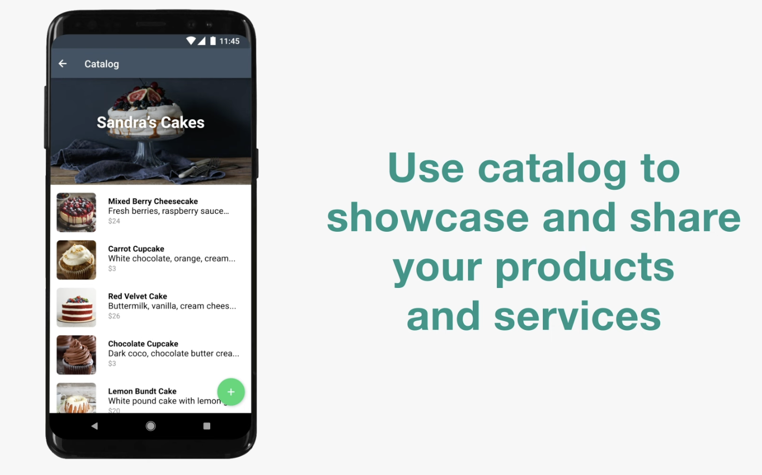
CLOSING THE LOOP
From monitoring to SME guidance
– Monitoring shared only within institutions has limited value. The goal is to translate intelligence into guidance SMEs can act on.
– Quarterly briefing note: one page, what the data shows, what it means for operators. 2 hours to produce. Distribute via WhatsApp or email.
– Short alert: when something significant changes — a new operator selling The Gambia, a cluster of negative reviews. Triggered, not scheduled.
– Tone: "here is what we are seeing and what it might mean for you" — not evaluation or judgement.
20
Day 1 · Gambia Institutional Workshop

Slide 21
Monitoring as coordination
Monitoring done by one institution produces one view.
Monitoring shared by three produces a picture no single institution could create alone.
The quarterly call is the mechanism. GT Board convenes. NCAC, associations, and sector bodies share what they've seen.
21
Day 1 · Gambia Institutional Workshop

Slide 22
THE COORDINATION MECHANISM
The quarterly coordination call
1
2
3
Share
Identify
Agree
What has each institution observed in the past quarter? One thing each — a trend, a finding, a flag.
What's new, changing, or worth acting on together? Where do findings from different institutions point in the same direction?
Is there one joint response this quarter? Assign it to a named person before the call ends.
22
Day 1 · Gambia Institutional Workshop

Slide 23
GOVERNANCE
Who convenes?
– GT Board — Lead coordinator and custodian of shared KPI data. Convenes the quarterly call. Maintains the monitoring spreadsheet. Distributes the annual benchmarking summary.
– NCAC + associations — Core participants. Each brings their sector's observation from the past quarter. Contribute to operator catalogue check where mandates align.
– Ministry of Tourism — Observer and escalation point. Summary note shared after each quarterly meeting. Not required to convene.
– Key criterion: not who should be there — who will reliably show up.
23
Day 1 · Gambia Institutional Workshop

Slide 24
EXERCISE
WHAT YOU'LL DO
01
Open TripAdvisor on your phone or laptop. Search: "The Gambia". Go to the destination page. Read 10–15 of the most recent reviews.
1
Go totripadvisor.com→ search "The Gambia" → open the destination page → sort by Most Recent
2
Read 10–15 reviews. On paper, note:(a)the main positive theme you see repeated,(b)any complaint or criticism,(c)whether your sector, institution, or members are mentioned anywhere
Activity — Read TripAdvisor right now
3
Also note: what is the overall rating? Are there responses from management to any reviews? What do the most recent reviews say?
15 min
24
Day 1 · Gambia Institutional Workshop

Slide 25
ACTIVITY SHARE-BACK
What did you find?
Groups of 3 — compare notes. Then share back to the room.
– What was the main positive theme repeated across reviews?
– Was there a recurring complaint or criticism?
– Was your sector or institution mentioned anywhere?
– What would change if an institution read this monthly instead of never?
25
Day 1 · Gambia Institutional Workshop

Slide 26
EXERCISE
WHAT YOU'LL DO
02
Each participant drafts on a printed sheet. Be specific — a monitoring plan that can't be assigned to a real person won't happen.
1
1Three things you will track — drawn from the framework above, or adapted for your sector and mandate
2
2How often — monthly, quarterly, or annual
Activity — Draft your three indicators
3
3Who is responsible — a specific role or name, not "the institution"
4
4How you will share findings — WhatsApp group, email, sector meeting, or quarterly call
20 minutes · Individual then pairs
26
Day 1 · Gambia Institutional Workshop

Slide 27
EXERCISE
WHAT YOU'LL DO
03
Exchange your draft with a partner from a different institution. Offer one piece of feedback on theirs.
1
1Is the responsible personspecific enough? A role or a name — not "GT Board" or "the association"
2
2Are the indicatorscheckable? You'll know unambiguously whether they happened
Pairs exchange + brief share-back
3
3Is the sharing channelrealistic? Something that will actually happen, not something aspirational
10 minutes exchange · 5 minutes share-back
27
Day 1 · Gambia Institutional Workshop

Slide 28
WRAP-UP
Priorities, Commitments,
and Coordination
↗
Specific. Checkable. Realistic. — and agreed before you leave the room.
28
Day 1 · Gambia Institutional Workshop

Slide 29
PART 1 — WHAT WE LEARNED · 30 MIN
Facilitator synthesis
3–4 themes from across the two days — populated live by the facilitator.
– [ Theme 1 — facilitator completes live ]
– [ Theme 2 — facilitator completes live ]
– [ Theme 3 — facilitator completes live ]
– "What confirmed existing assumptions, and what challenged them? Both are useful — but they call for different responses."
29
Day 1 · Gambia Institutional Workshop

Slide 30
“
In one sentence: the finding or idea that was most useful or most surprising.
Round the table. One sentence each. No extended discussion yet.
Facilitator: note any themes that haven't been captured — they may surface here.
30
Day 1 · Gambia Institutional Workshop

Slide 31
EXERCISE
WHAT YOU'LL DO
04
Revisit your commitment from yesterday's board. Confirm or refine it. The question is: "What is one specific thing I will do in the next 30 days?"
1
SSpecific— not "improve our digital presence" but "conduct a platform audit and identify three outdated pages to update by June"
2
CCheckable— you'll know unambiguously whether it happened or not
One concrete action in 30 days
3
RRealistic— within current budget, team size, and institutional mandate
15 minutes · Individual
31
Day 1 · Gambia Institutional Workshop

Slide 32
PART 2 — PRIORITY ACTIONS · 45 MIN
Commitments board — capture by theme
Facilitator collects commitments and groups them on the board by category.
Monitor
Make findable
Open a door
Share + coordinate
Track what the world sees — consistently, not occasionally.
Ensure your sector and members are discoverable where operators and tourists search.
Connect one operator, platform, or journalist to one SME they couldn't reach alone.
Act on intelligence together — at least one joint action per quarter.
32
Day 1 · Gambia Institutional Workshop

Slide 33
EXERCISE
WHAT YOU'LL DO
05
Using what you found in this morning's TripAdvisor exercise: write three sentences for your members. This is what a quarterly briefing looks like before it's polished.
1
What we saw:One finding from this morning's TripAdvisor exercise — a recurring theme, a complaint, or a gap you noticed.
2
What it means for you:One direct implication for your members' businesses — specific, not abstract.
Activity — Draft one briefing paragraph
3
One thing to do:A concrete action your members could take this month in response.
10 min
33
Day 1 · Gambia Institutional Workshop

Slide 34
DISCUSSION · PART 2
Where does coordination amplify?
Look at the board: where would two institutions working together produce more than two working separately?
– "One quarterly operator spot-check, shared between GT Board and NCAC, covers more ground than two separate ones."
– "A joint press release from GT Board + NCAC carries more authority than one from either alone."
– "If Tour Guide Association and Craft Market Federation both briefed visitors about each other, both sectors would benefit."
34
Day 1 · Gambia Institutional Workshop

Slide 35
PART 3 — COORDINATION MECHANISM · 30 MIN
A minimum viable mechanism
1
2
3
Quarterly check-in
Share observations
Agree joint response
GT Board + NCAC + willing associations. Start here. Nothing more required.
Each institution shares what they've observed and one thing they've done in the past quarter.
Is there one thing worth doing together this quarter? Assign it to a named person. Done.
"Format: a call, a brief meeting, or a shared document — whatever is most likely to actually happen."
35
Day 1 · Gambia Institutional Workshop

Slide 36
WHEN THE ROUTINE IS ESTABLISHED
If there's appetite for more
– A lightweight quarterly briefing note — shared across institutions and select SMEs — summarising what the monitoring data shows.
– Designed to be produced in 2 hours. Distributed via WhatsApp or email.
– Not a new project. It is what consistent monitoring produces.
– Before leaving: agree the date of the first quarterly check-in, who convenes, and what format.
36
Day 1 · Gambia Institutional Workshop

Slide 37
BEFORE YOU LEAVE
Three things to agree before the room empties
1
2
3
Date of the first quarterly check-in
Who convenes
One action, agreed in the room
A specific date — not "sometime in Q3." Write it down. Put it in a calendar before you leave.
A specific person, not an institution. The convener sends the invite, sets the agenda, keeps the notes.
One thing — specific, with a name against it — that at least two institutions commit to doing before the next meeting.
37
Day 1 · Gambia Institutional Workshop

Slide 38
“
"Maintain momentum. Don't start something new."
The SMEs you met this week are building their digital presence.
The infrastructure they need to connect to the world is what you build next.
38
Day 1 · Gambia Institutional Workshop

Slide 39
EXERCISE
WHAT YOU'LL DO
06
One word, round the room
Close · 5 minutes
39
Day 1 · Gambia Institutional Workshop

Slide 40
Thank you.
Institutional Capacity Workshop · Banjul, The Gambia · May 2026
ITC EU Youth Empowerment Project · Banjul, The Gambia · May 2026

