Slide 1
Setter
CPSC 481 – Group 3.3
Stage 5- Final Stage

Slide 2
Executive Summary
Setter is a new mobile application to set, discover and attempt new bouldering problems in rock-climbing gyms. Featuring an easy to use creation tool and community grading, Setter’s goal is to provide users with a variety of accurately graded bouldering problems.

Slide 3
Design Problems
Problems are set by the gym and not the community
Results in a lack of variety of the problems and a non-standard grading scheme
Our goal is to standardize grading schemes and produce a creative community driven way to set problems

Slide 4
End-Users and Stakeholders
Boulderers/Climbers
Gym owners/Staff
New Climbers
Developers

Slide 5
User Research and Findings
Research Type: Survey and Interviews
Age: 18-24
Experience: Varies from <1 year to 5+ years
Average Skill level: Intermediate
Haven’t used any similar applications
Commonly requested features:
Filtering problems
Offline features
Community grading
Statistical tracking

Slide 6

Design and Justification
Design influenced mainly from our user research.
Key features:
Creating and Viewing Problems
Offline Mode
Filtering problems
Community grading/ranking
Profiles and personal stats

Slide 7
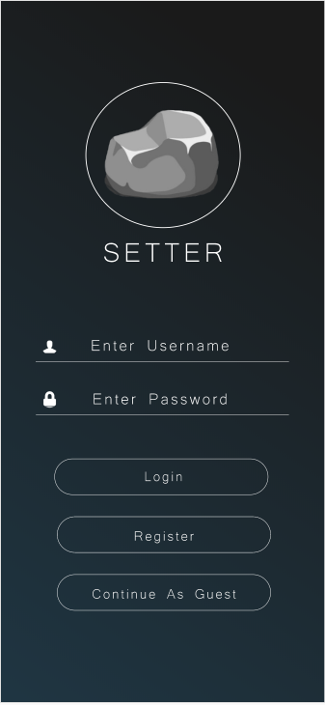
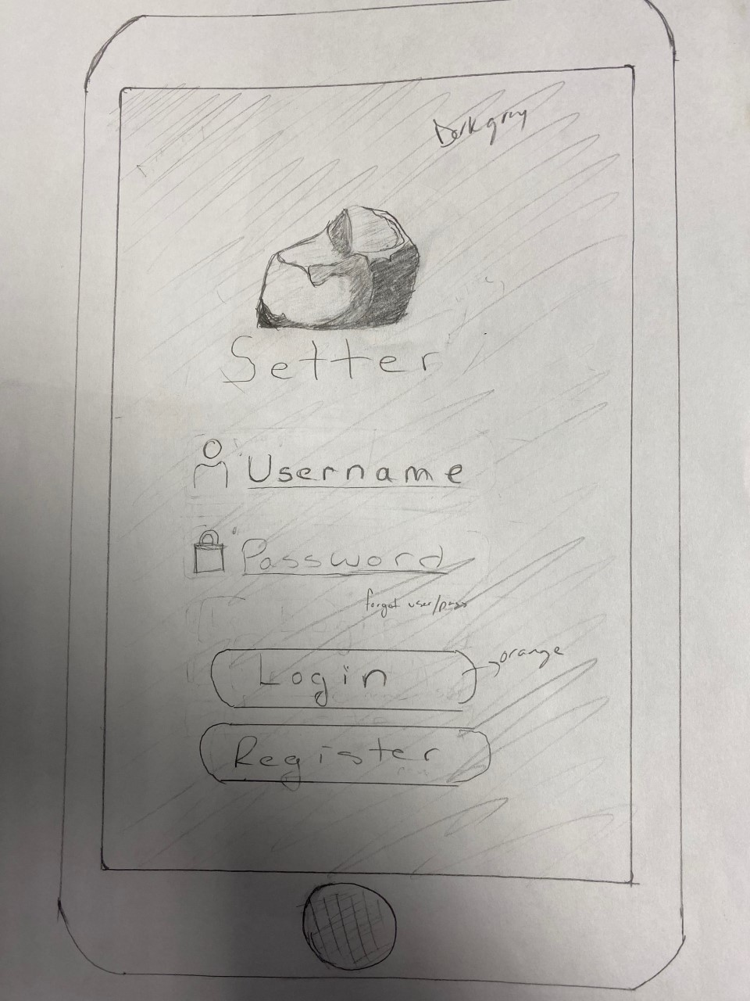
Design Choices

Slide 8
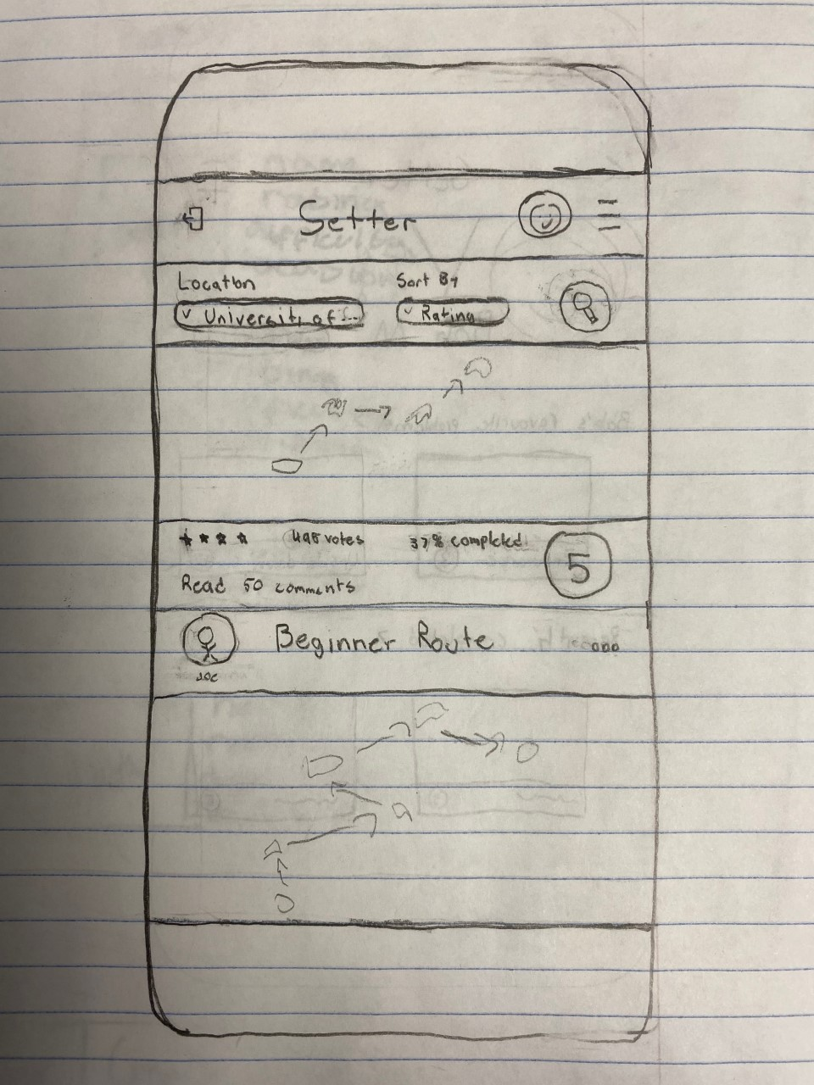
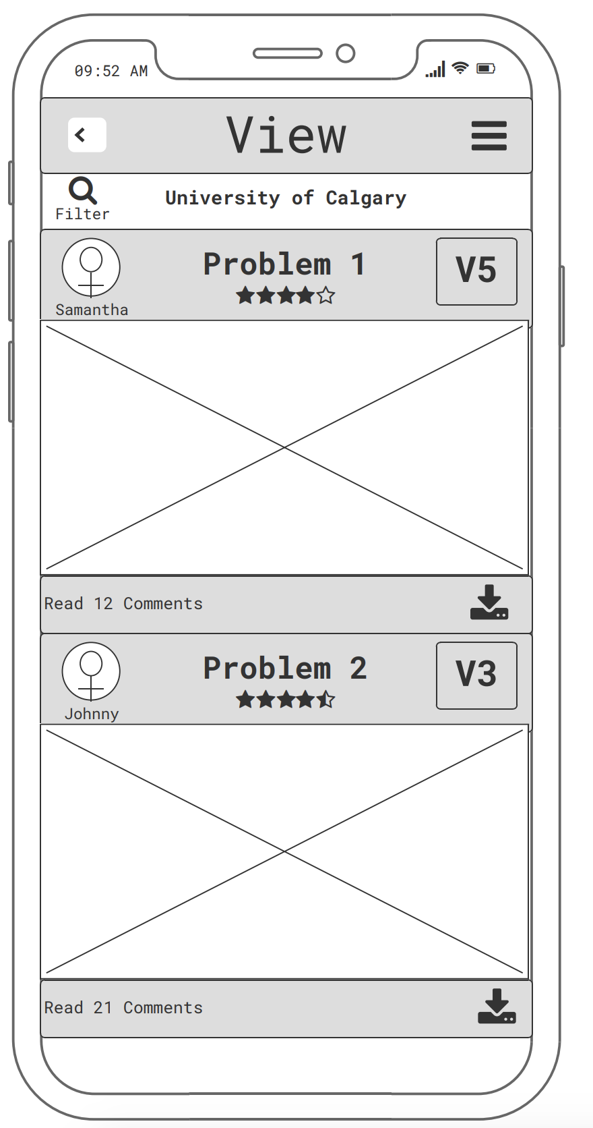
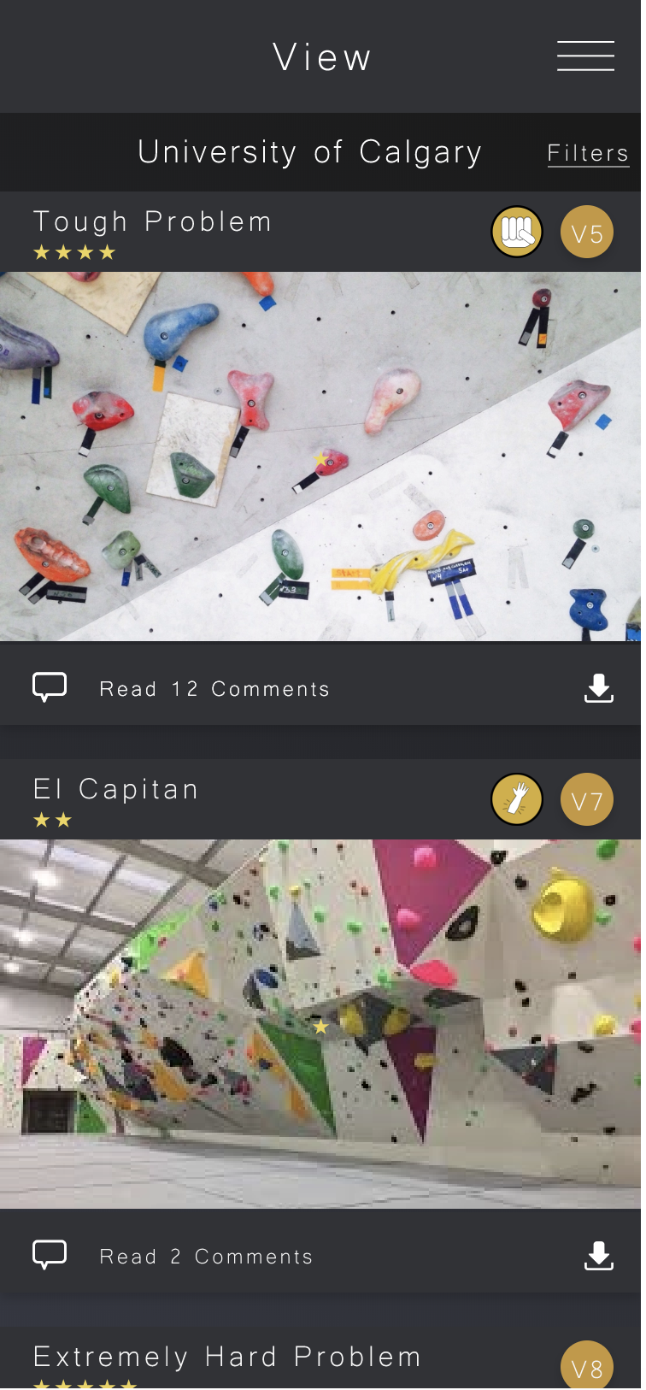
Design Choices

Slide 9
Heuristic Evaluations Summary

Slide 10
Findings
Help and Documentation
• Inexperienced users could find the climbing specific terminology confusing
Help Users Recognize, Diagnose, and Recover from Errors:
• Lack of a way to delete comments after posting them
Flexibility and Ease of Use
• The submenu to access rating, commenting and grading felt unnecessary

Slide 11
Findings
Visibility of System Status:
• The buttons on the filter screen did not have enough feedback to indicate when selected
• Some header titles were insufficiently descriptive
User Control and Freedom:
• Hard to determine the border of the buttons on the filter screen]
• Some buttons were not large enough
Could not return to the main page with a click of one button on some screens

Slide 12
Design Changes
Help and Documentation:
A terminology page was added which appears on registration and can also be found in the settings page
Help Users Recognize, Diagnose, and Recover from Errors:
Delete functionality was added
Visibility of System Status:
Some header titles were rewritten

Slide 13
Recommendations for Next Iteration
Visibility of System Status
Better feedback when selecting a filter option
Visual cues to show the borders of a button
Flexibility and Ease of Use
Easier/more efficient way to indicate attempt or completion of a problem

Slide 14

Conclusion
Utilize tools and Process taught in class
Used research methods described in IDEO cards
Prototyping
Heuristic Evaluations

