Slide 1
Creating New Tools
Summary
Figuring out how to use the various tools available for sequence analysis can be challenging enough. It may seem fanciful that biologists unschooled in the art of computer programming might be able to make their own.
In this tour, I show how the tool described in theory in the tour How to cope with overwhelming information? is readily constructed. Another problem is taken from party chatter to a solution that anyone can make use of.
This is best viewed as a slide show.
To view it, click Slide Show on the top tool bar, then View show.
Click to start

Slide 2
Creating New Tools
Slide #
Problem 1: Backwards translation and alignment of genes
Problem 2: Make new function to plot genome sizes
Make plot of phage genome sizes
Package procedure as a general function
Make function available to other users
Reflections and coming attractions
3 – 7
8 – 46
12 – 31
32 – 40
41 – 46
47
To navigate to a specific slide, type the slide number and press Enter (works only within a Slide Show)

Slide 3
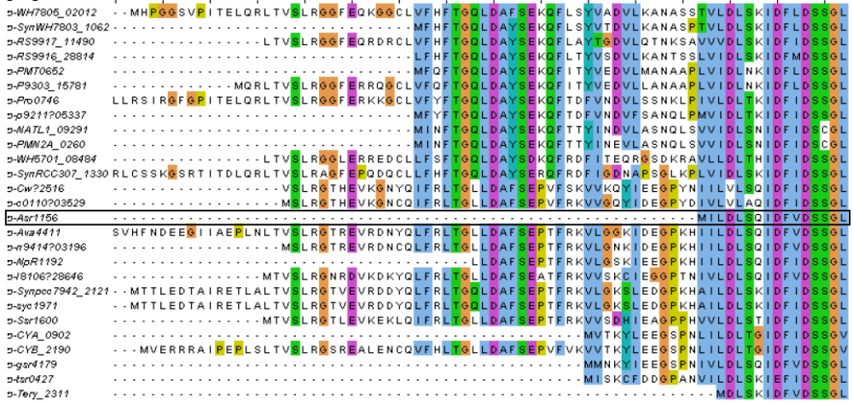

Creating New Tools
? ? ? Paradox
In a previous tour:
What problems do phage biologists face?
I described a case where we came
to doubt a supposed start codon
and suspected that the true start
codon lay earlier in the sequence.

Slide 4
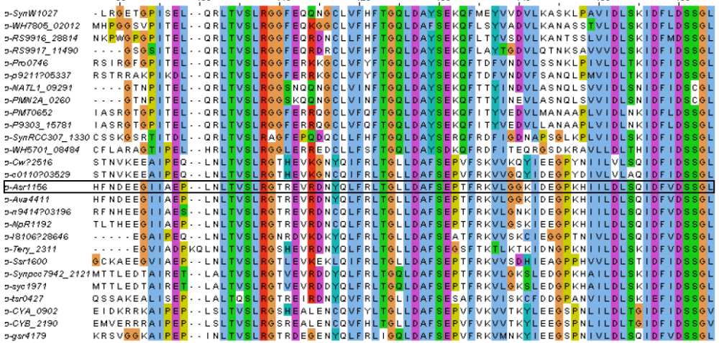
Creating New Tools
? ? ? Paradox
Resolution
I proposed a solution: Scan
backwards, translating as you go,
then align the new predicted sequences.
But I don't know of any
available tool that will do this.

Slide 5

Creating New Tools
To make the first, simple alignment is straightforward (essentially as described in the tour Integration of tools).
To make the second is more complicated, roughly matching the complexity of the problem.

Slide 6
Creating New Tools
This example shows a new
tool composed of functions
that are built into BioBIKE.
But it is possible to extend BioBIKE in any direction you want by building new functions.

Slide 7
Creating New Tools
Extending BioBIKE
How can new functions be devised,
to meet needs as they arise in your mind?
I'll go through an example that actually
arose in a conversation at a recent
Evergreen Phage meeting.
Ordinarily such conversations end
with a whistful "It would be nice
to know if…", but the ability to make
new computational tools permits
questions to be answered on the spot.

Slide 8
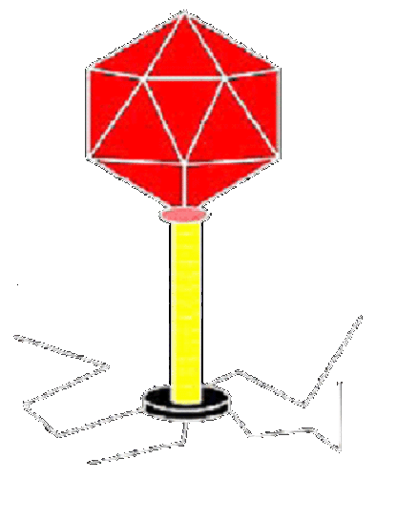
Creating New Tools
Extending BioBIKE
Summary of conversation
Sequencing lots of phage genomes
… They come in various sizes

Slide 9
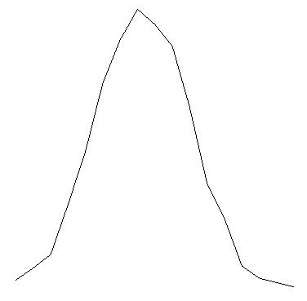
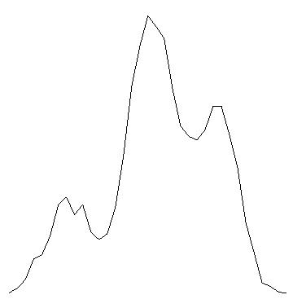
Creating New Tools
Extending BioBIKE
Summary of conversation
Sequencing lots of phage genomes
… They come in various sizes
Are there genome lengths Nature favors?
Hypothetical curves
Frequency
No
Yes
Genome length
Genome length

Slide 10
Creating New Tools
Extending BioBIKE
Summary of conversation
Sequencing lots of phage genomes
… They come in various sizes
Are there genome lengths Nature favors?
Are we biased in those phages we study?
Hypothetical curves
Nature?
Observer bias?
Frequency
No
Yes
Genome length
Genome length

Slide 11
Creating New Tools
Extending BioBIKE
Summary of conversation
Sequencing lots of phage genomes
… They come in various sizes
Are there genome lengths Nature favors?
Are we biased in those phages we study?
One thing at a time… It would be nice
to have a function that could plot the
lengths of a given set of genomes.
Hypothetical curves
Nature?
Observer bias?
How do we make this function?
Frequency
No
Yes
Genome length
Genome length

Slide 12
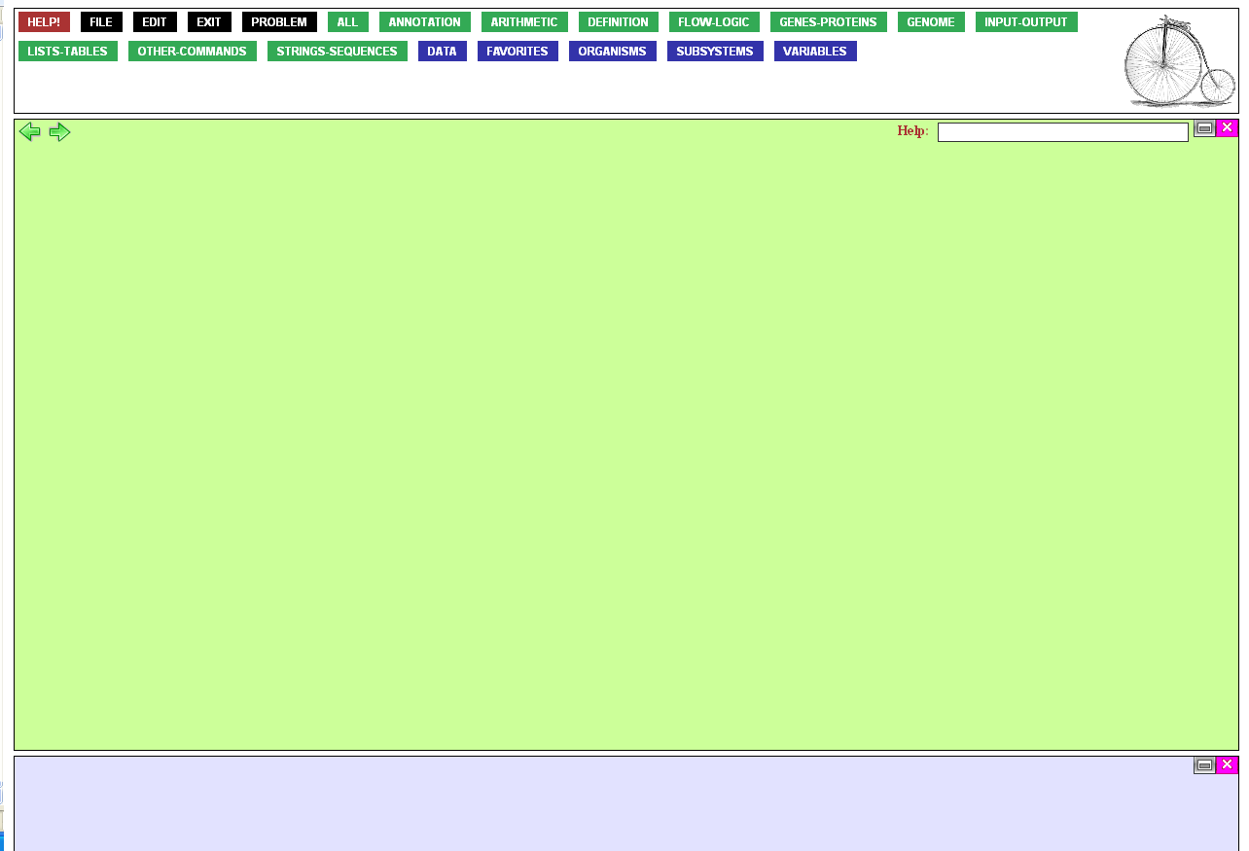
Step 1 is to get the
lengths of all phages.
To do this, mouse over the
Lists-Tables button,…

Slide 13
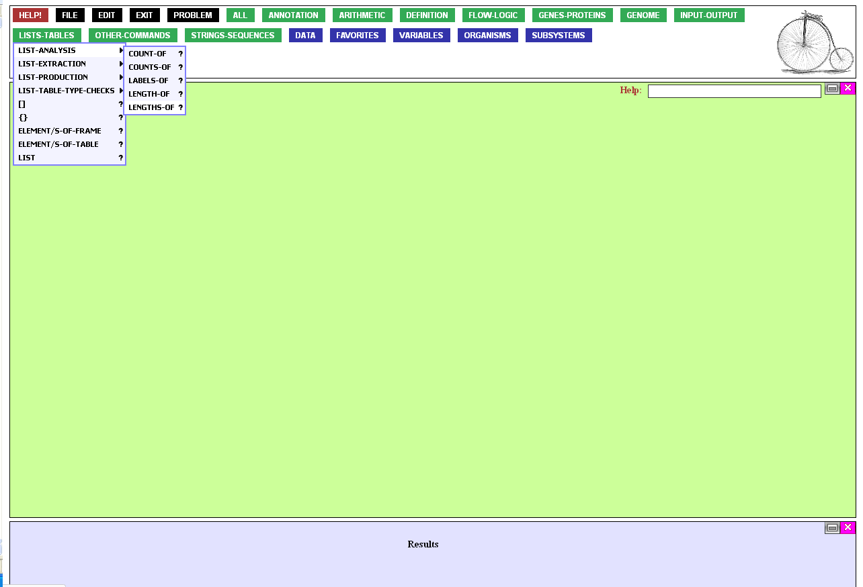
…then over List-Analysis,
and finally click LENGTHS-OF

Slide 14
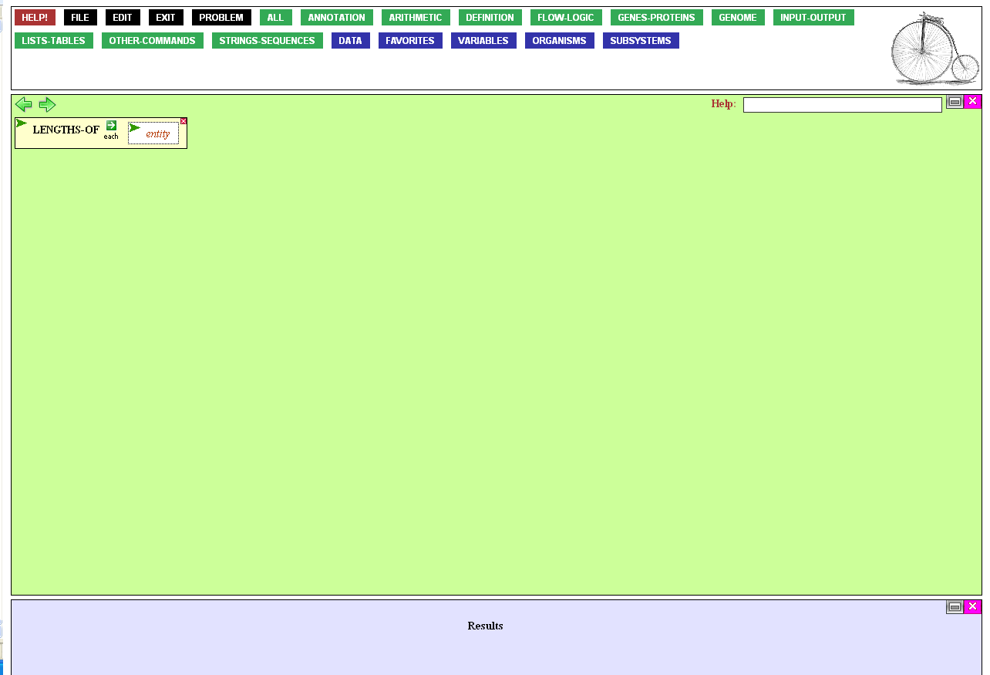
The LENGTHS-OF function naturally asks for the entity
(e.g. genome) or entities we
want to know the length of.
That would be all phage.
Click the entity box,…

Slide 15
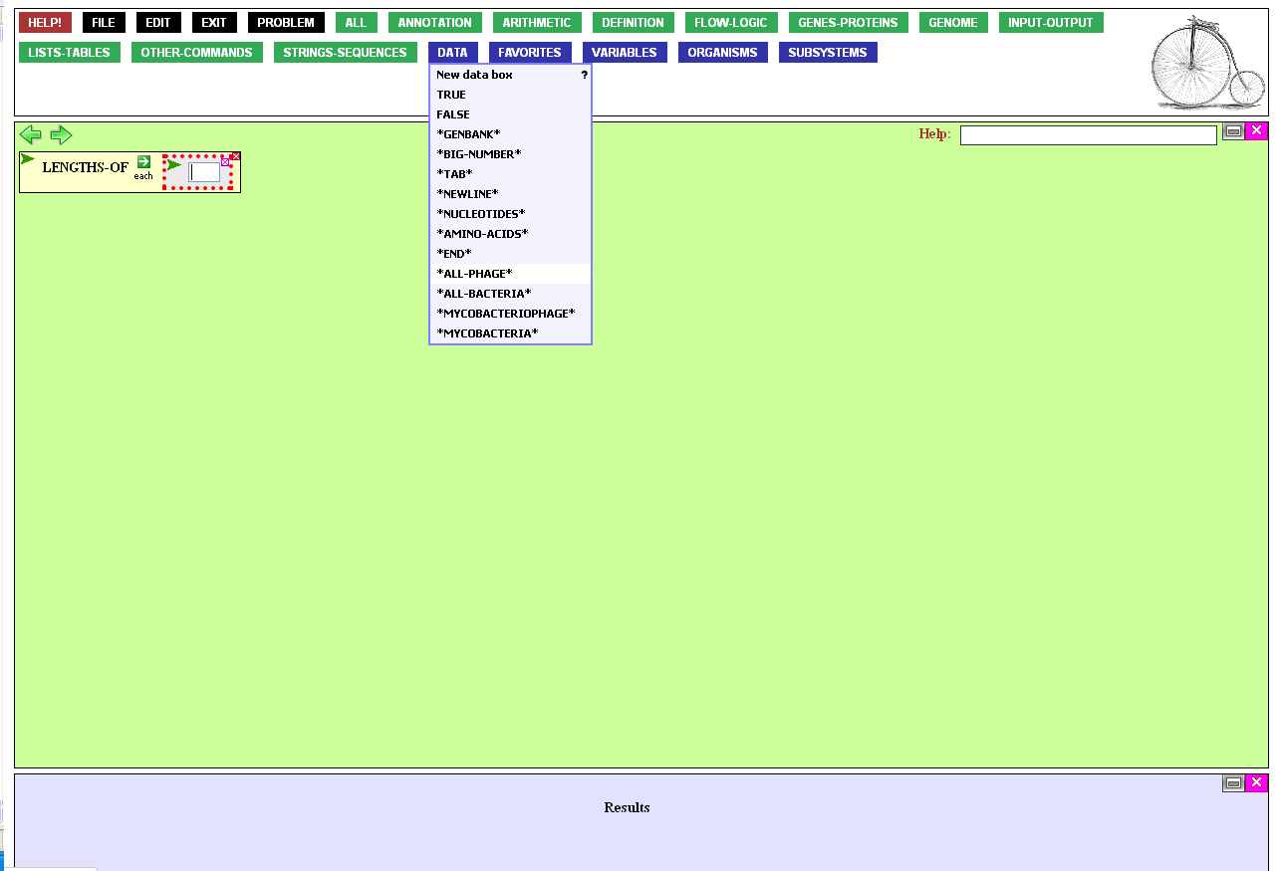
Then mouse over the Data
button and click *all-phage*.
(The asterisks serve as a
reminder that the entity is
built provided by the system.
It isn't a variable that you invented)

Slide 16
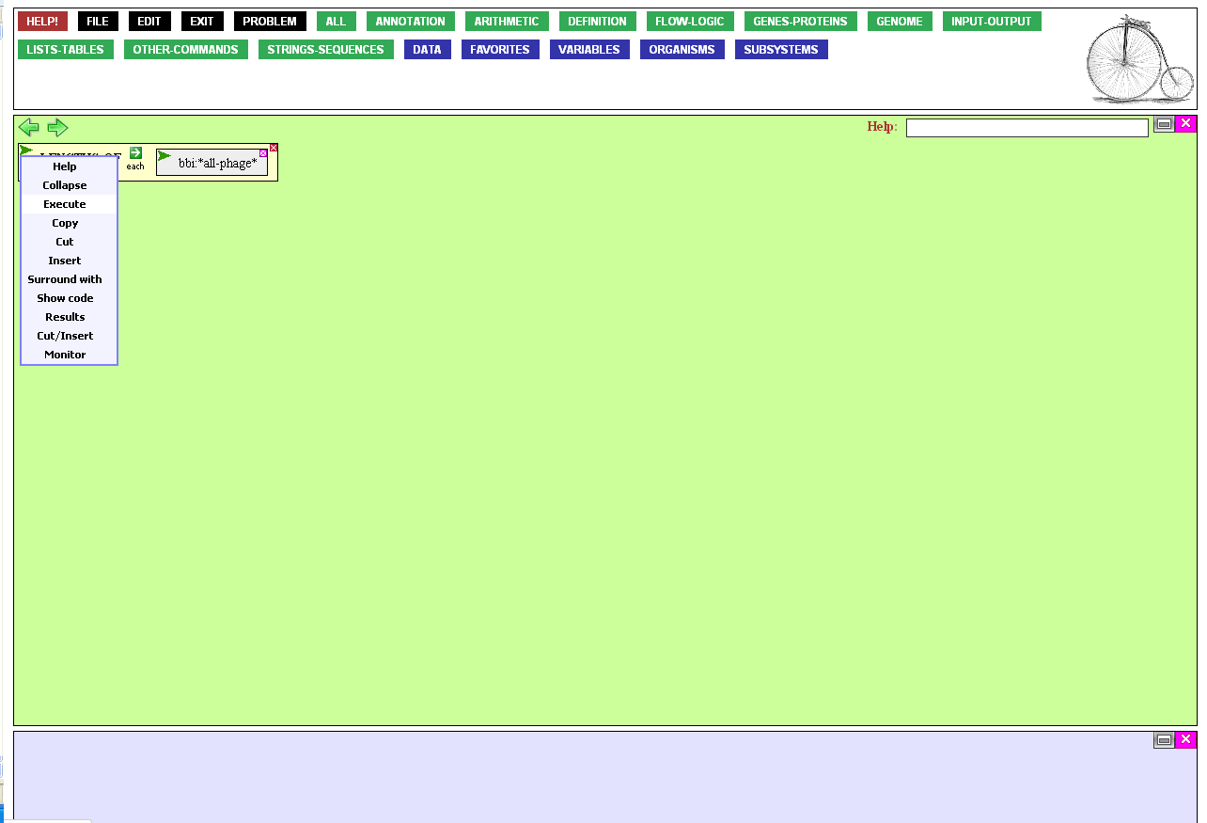
Now execute the function by mousing over the action icon of LENGTHS-OF (i.e. its green wedge) and clicking Execute.
Alternatively, you could double-click the name of the function.

Slide 17
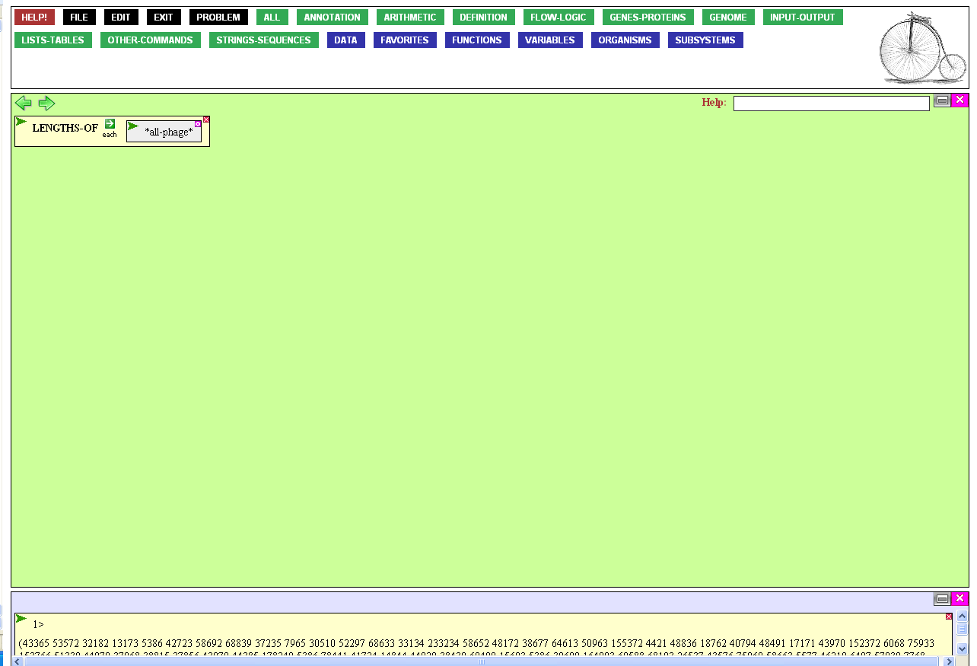
There are hundreds of phages
in PhAnToMe, and so you get
back a list consisting of
hundreds of lengths.
Now to plot those lengths.
Mouse over the
Input-Output button…

Slide 18
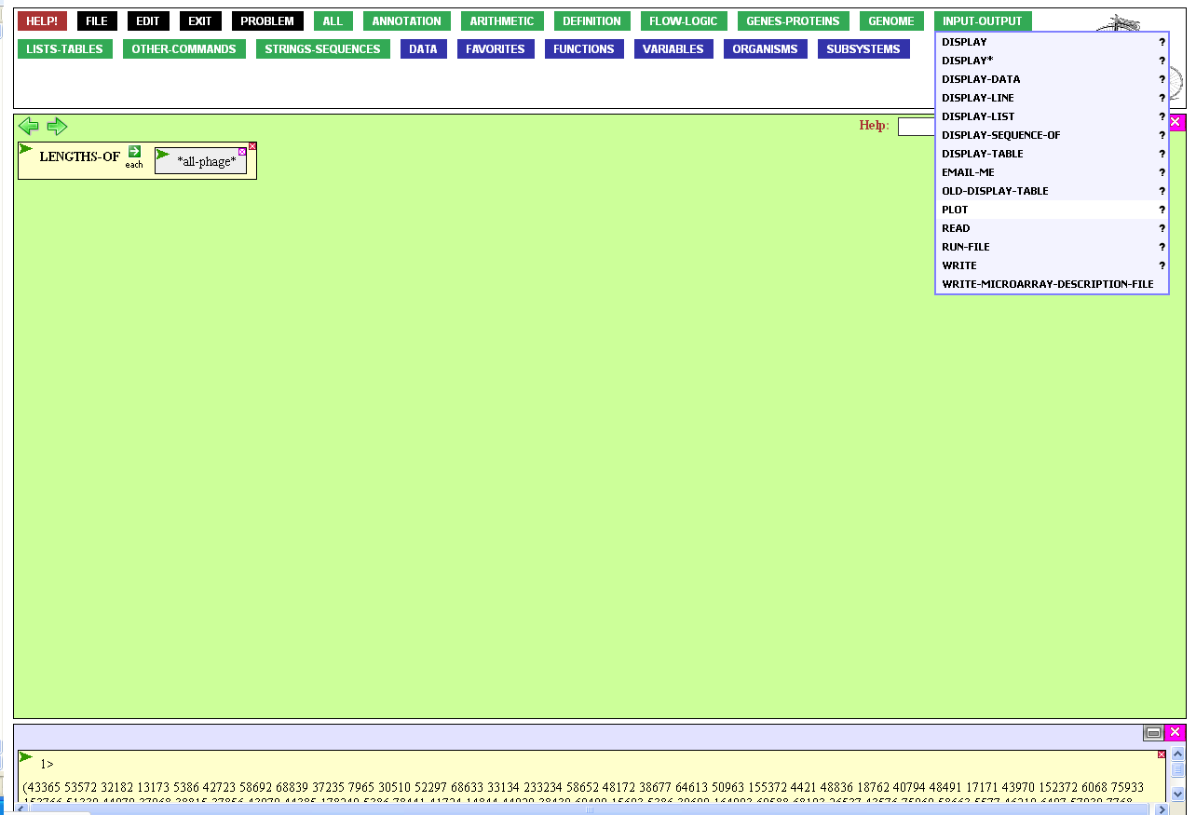
…and click PLOT.

Slide 19
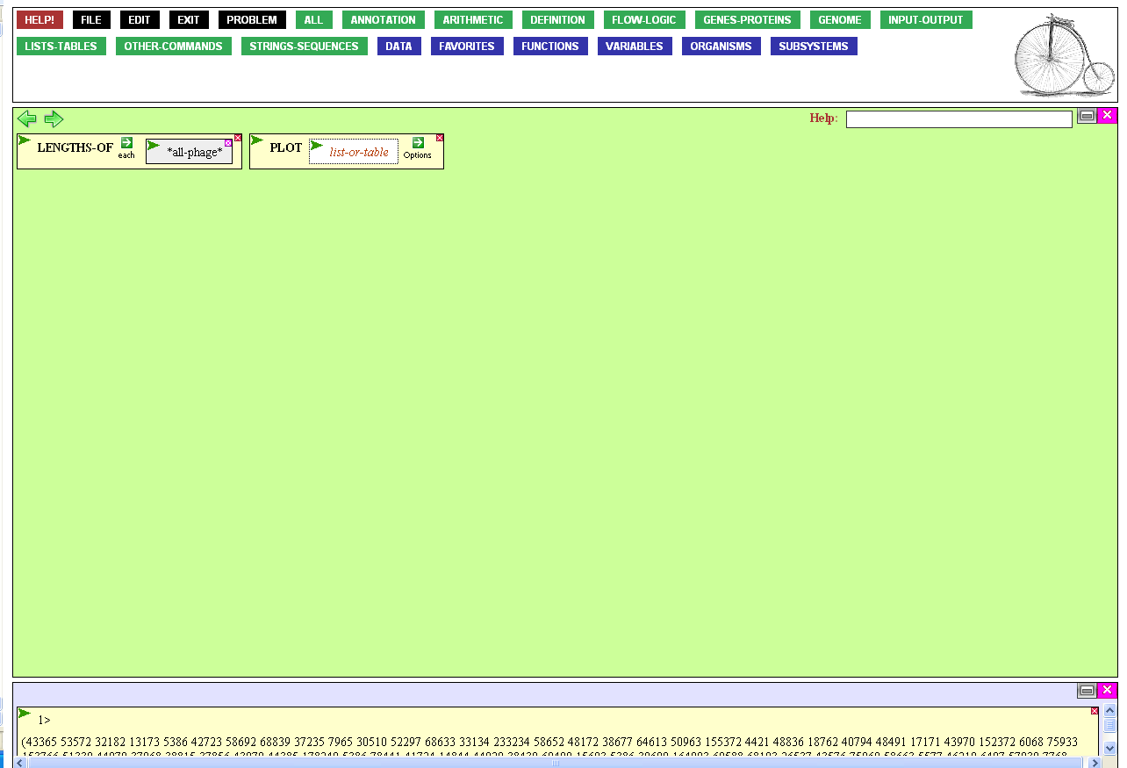
The PLOT function asks
for a list or a table.
We have a list, the
one you just made.
Drag the LENGTHS-OF function into the list-or-table box of PLOT.

Slide 20
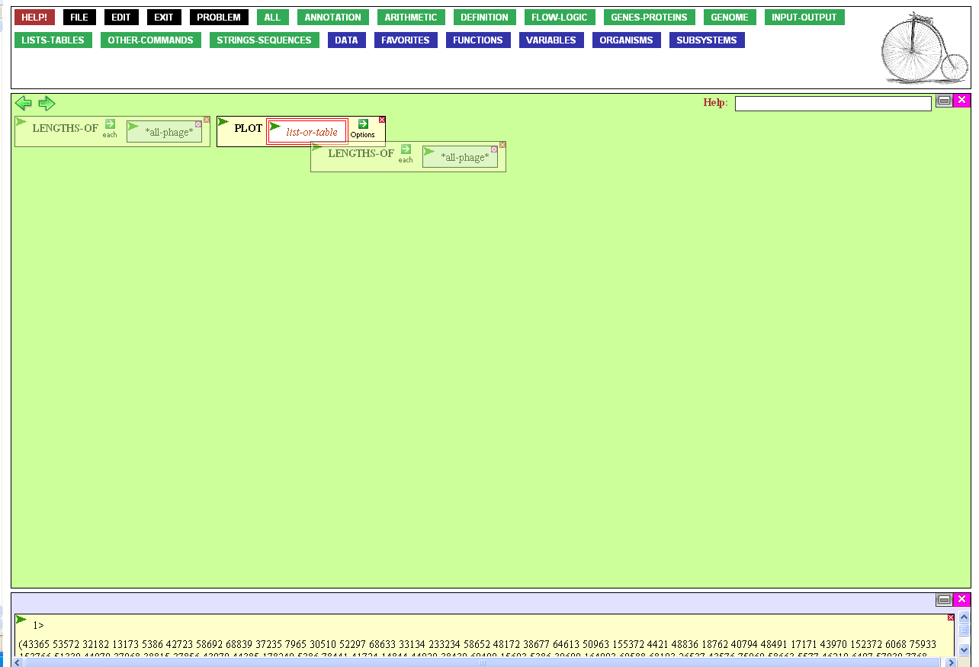
Release the box when you’ve reached the list-or-table box, highlighting it.

Slide 21
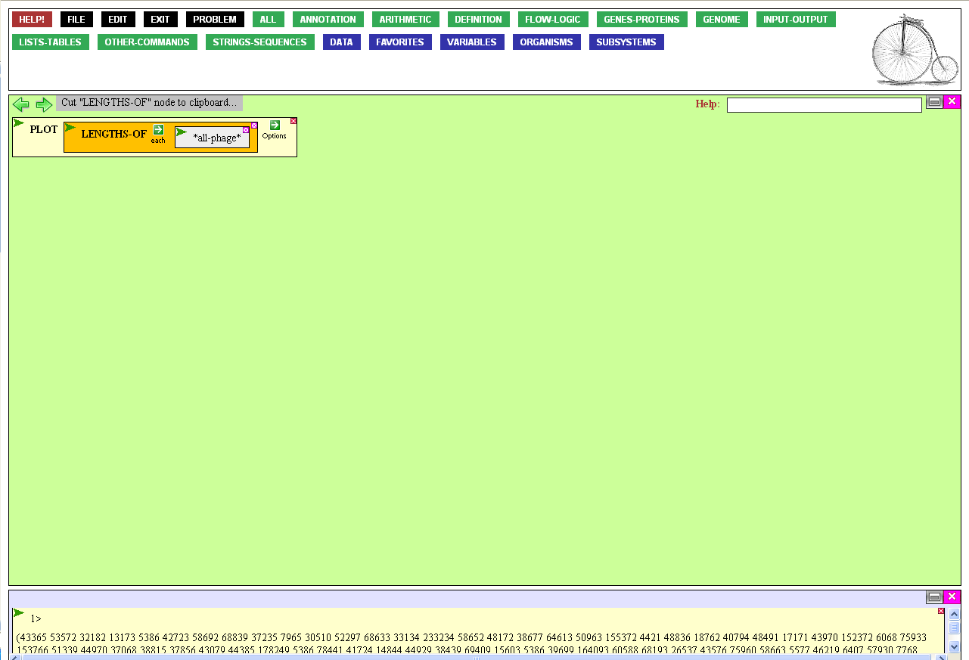
The function is complete,
so execute it, as before…

Slide 22
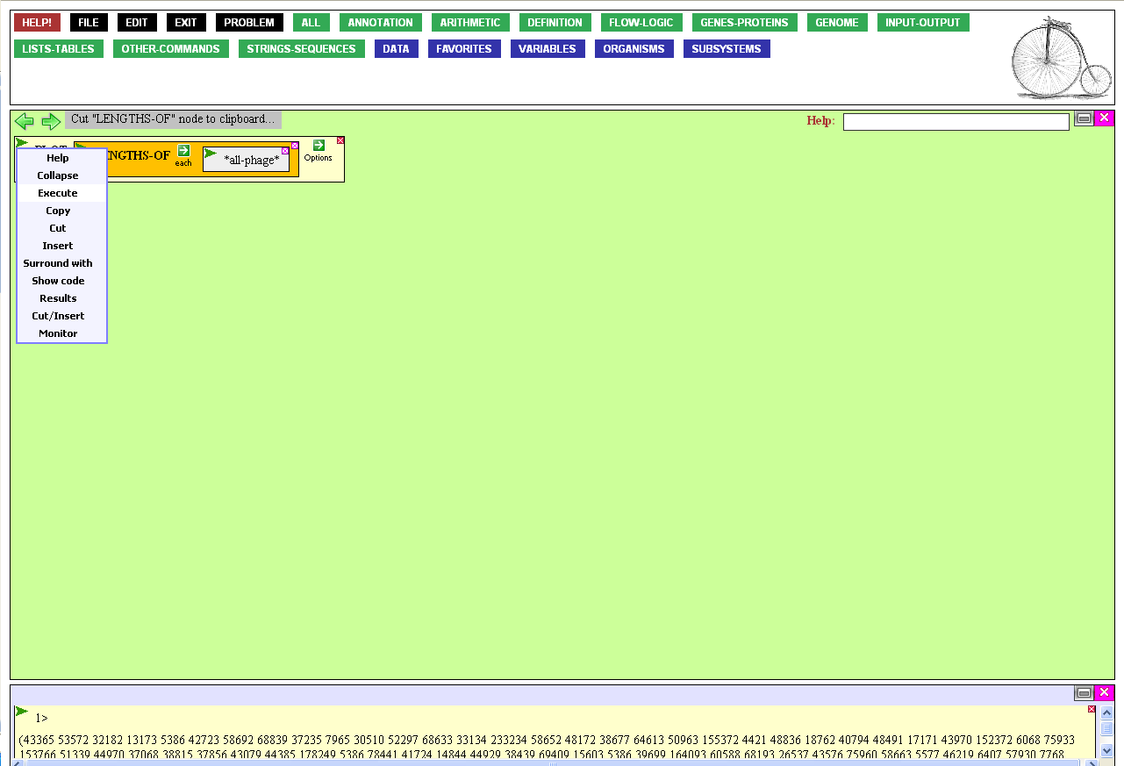
…through the action menu.

Slide 23
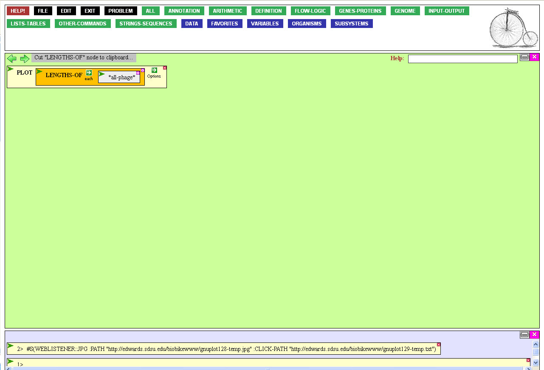
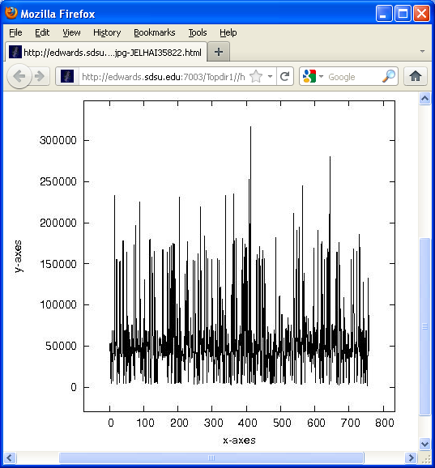
This isn't at all
what I had in mind!
But recalling the lengths
of the first few phages…

Slide 24

…I see that the function really did do what I asked of it, displaying the length of
each phage, one at a time.
X out of the plot
and we'll try again.

Slide 25
It would be more useful to plot
the frequency of defined length-classes.
To modify the default behavior
of PLOT, mouse over the
Option icon of the function…

Slide 26
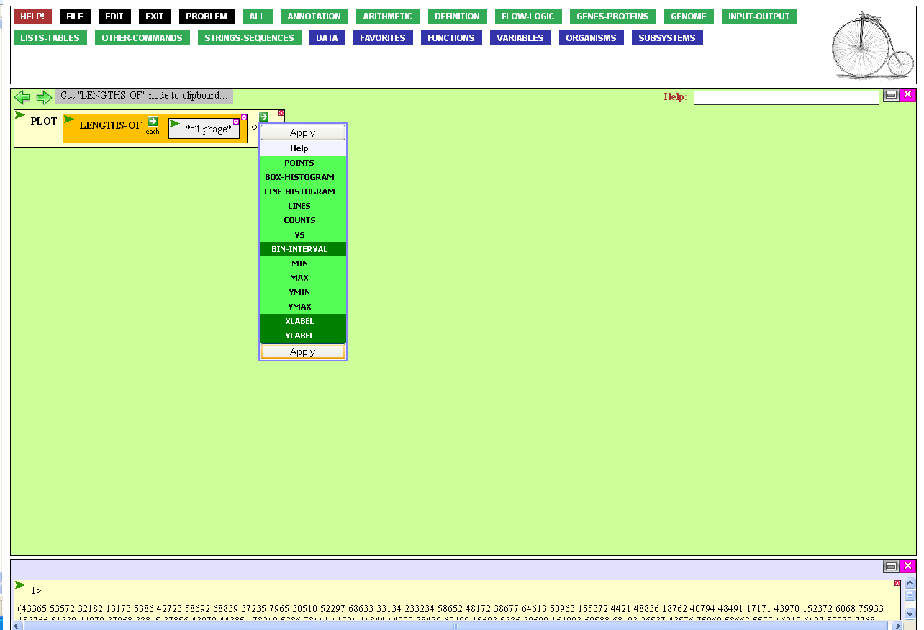
… and click Bin-Interval.
To make the plot more beautiful,
we’ll provide labels for the X- and
Y-axes. Click those options.
Finally, click Apply.

Slide 27
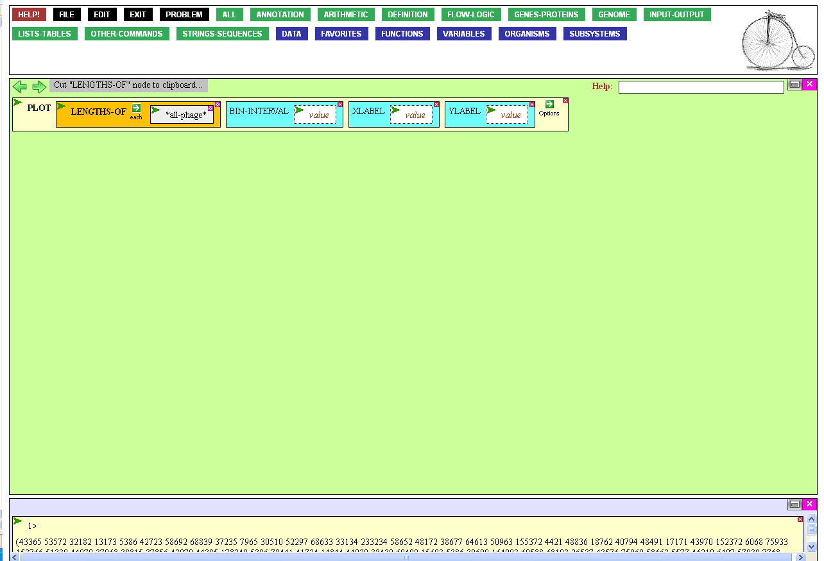
We’ve given ourselves
three boxes to fill in.
First, click the value box
for the Bin-Interval option.

Slide 28
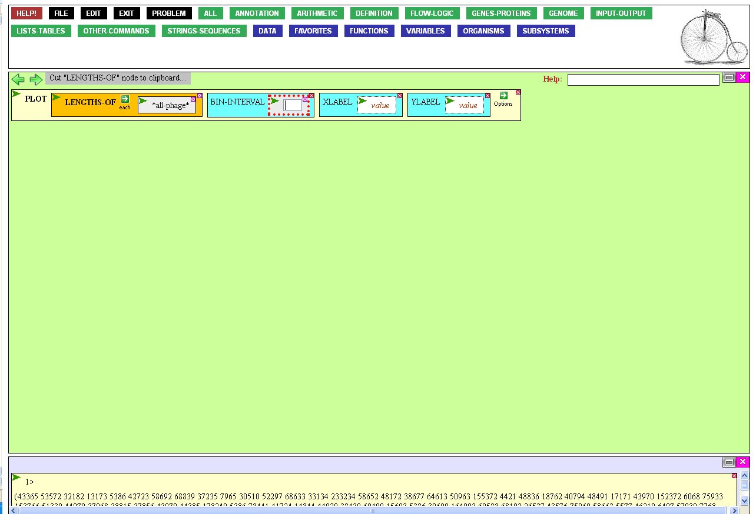
Enter a reasonable width.
I chose 10000 kbases,
which will accumulate
values for 1-10000 kb,
10001-20000 kb, etc.
After you type the
number, press Tab.

Slide 29
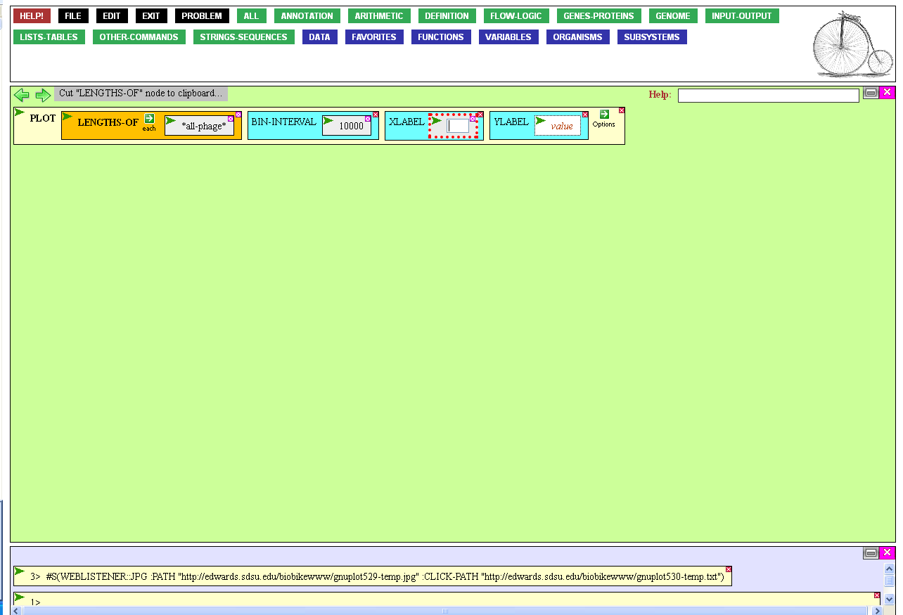
Now enter (in quotes), the label for
the X-axis. I chose “Genome Size”.
Press Tab, and enter a label for the
Y-axis. I chose “Number of Genomes”.
Press Tab or Enter to close the box.

Slide 30
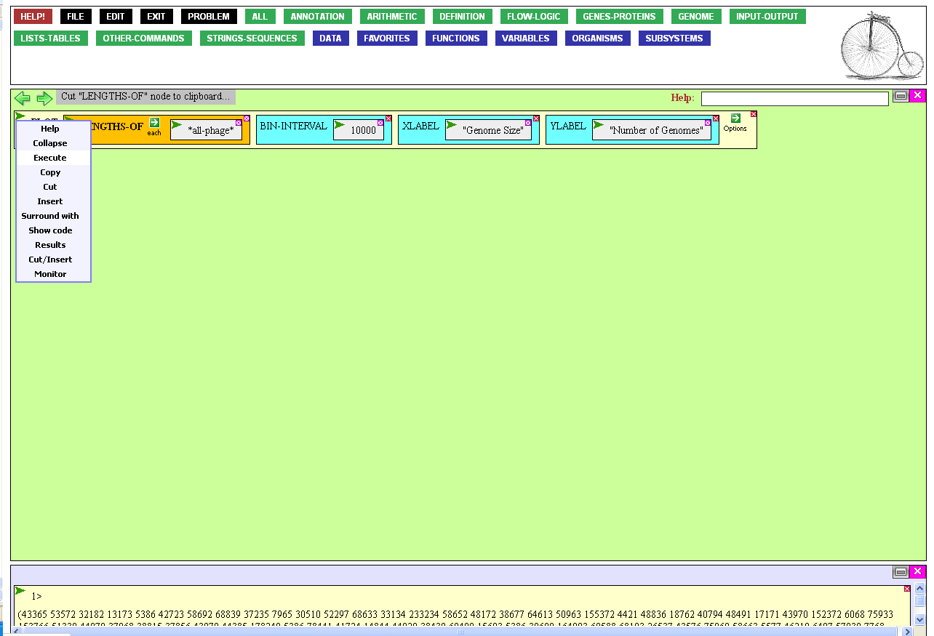
Hypothetical curves
Frequency
No
Yes
Genome length
Genome length
Now execute the completed function, recalling the types of plots I might expect: Smooth? Lumpy?

Slide 31
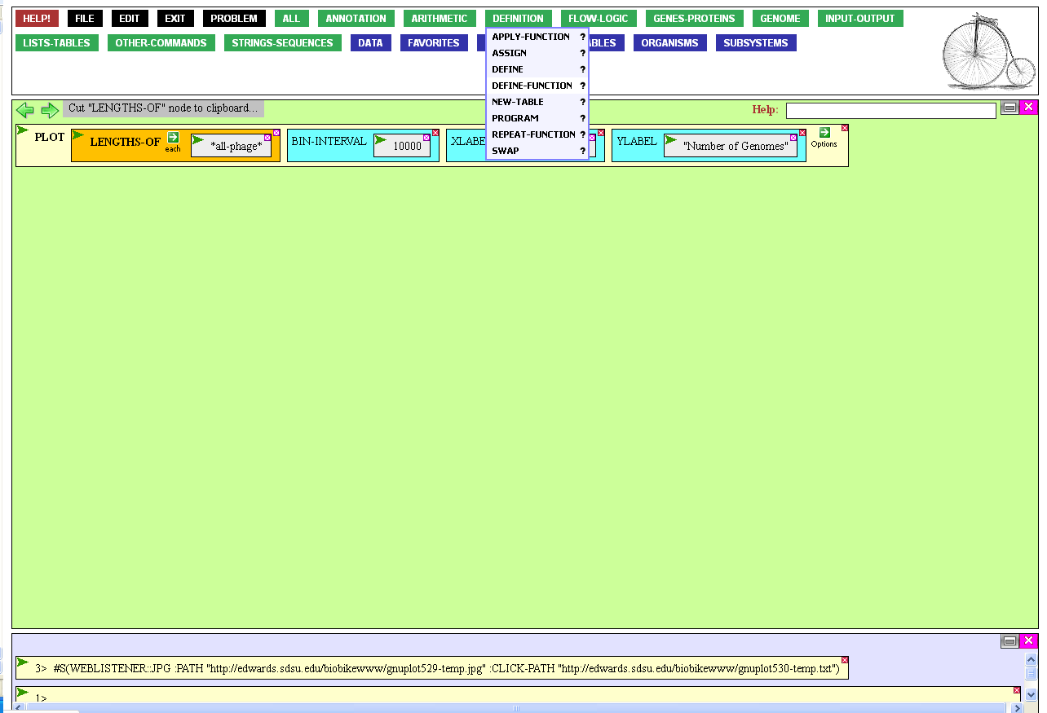
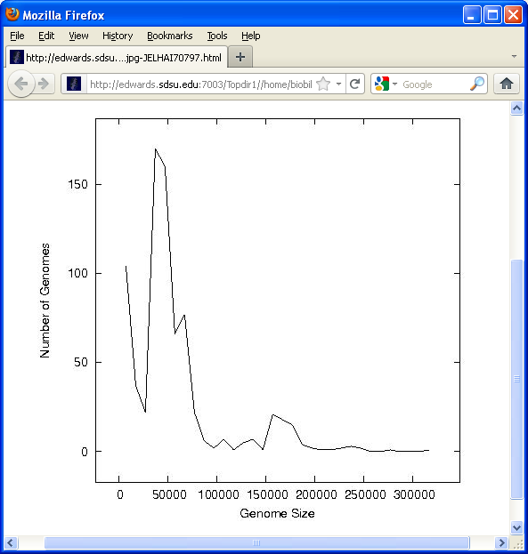
Definitely lumpy.
But I can imagine doing the same thing with bacterial genomes or specific subsets of genomes…
This could be a generally useful function!
To incorporate this function into BioBIKE’s language, mouse over the Define button…

Slide 32
…and click DEFINE-FUNCTION.

Slide 33
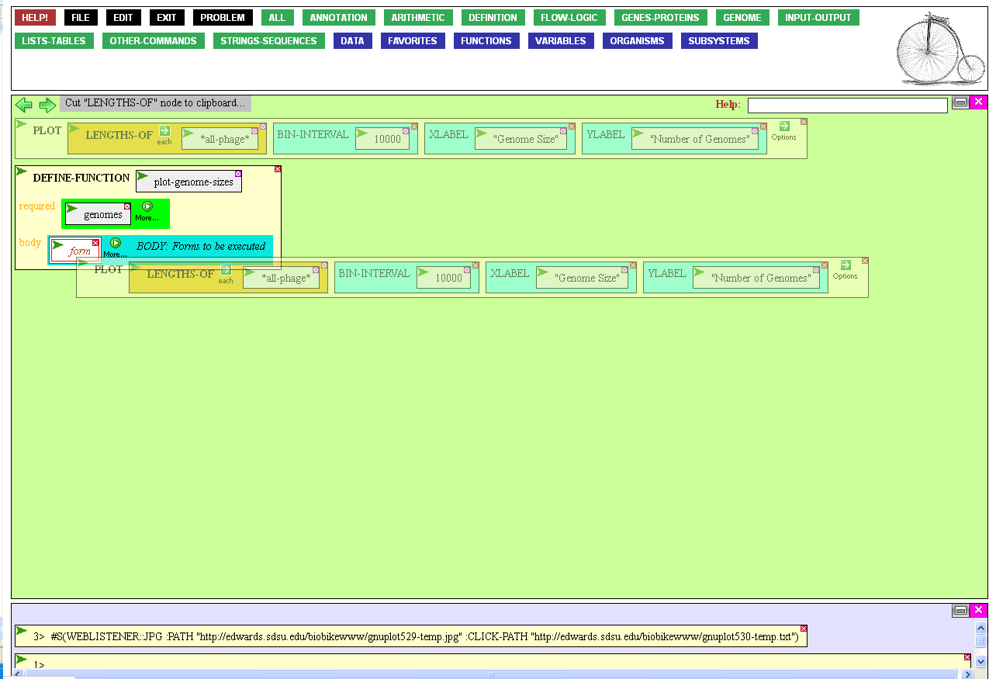
I’ve already done the preliminaries, giving the new function a name
(PLOT-GENOME-SIZES) and naming what the function needs (genomes).
All that’s left to do is to define what
the function does by dragging the
PLOT function we already created
into the body of the new function.

Slide 34
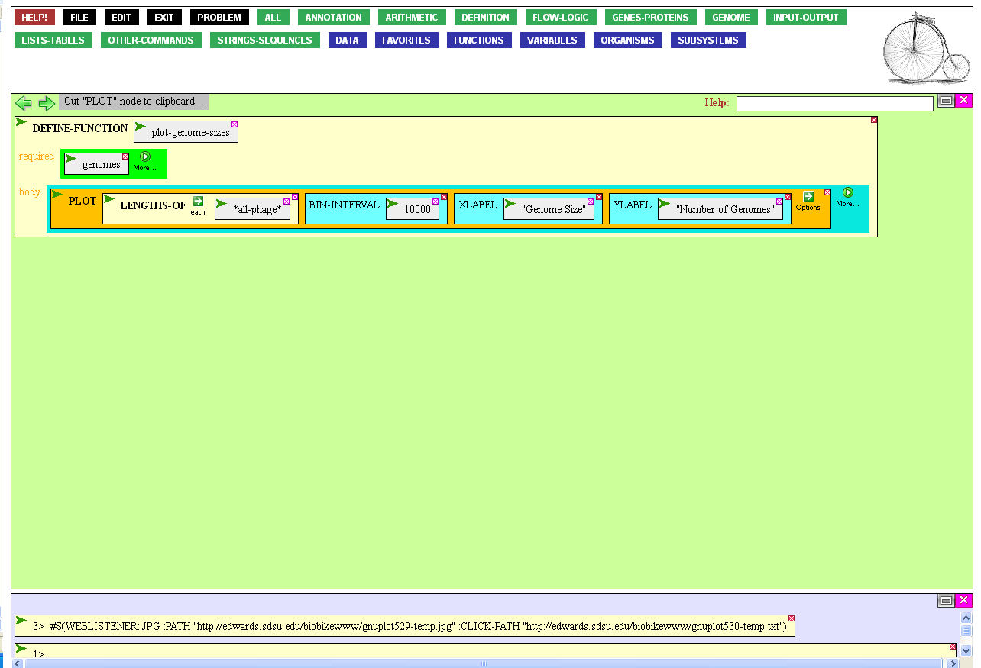
Wait, I see a problem. The PLOT function works specifically on all phages, but the new function is designed to work generally on
any set of genomes.
To make PLOT work generally
on whatever genomes the function receives, clear the entity box of LENGTHS-OF by clicking
the Clear icon.

Slide 35
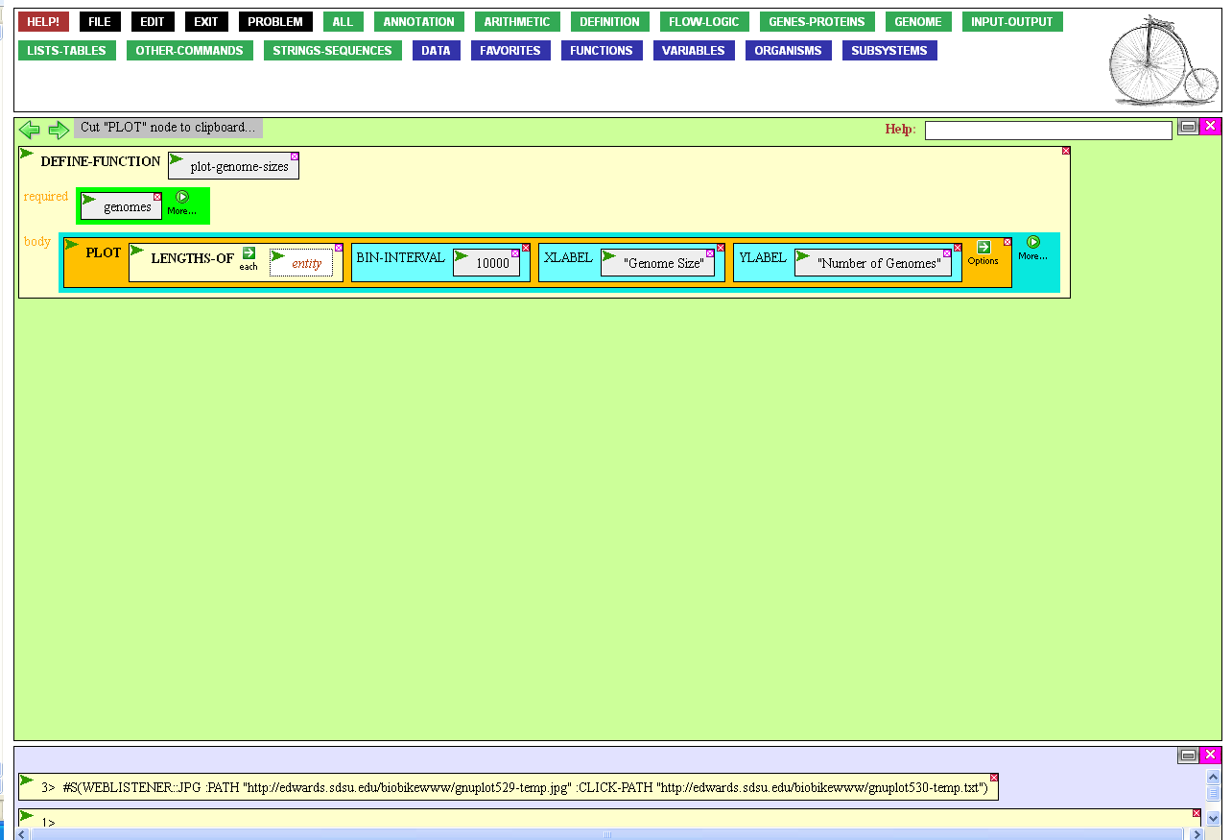
You could now click the entity box and type genomes, but here’s another way…
Mouse over the action
icon of genomes…

Slide 36
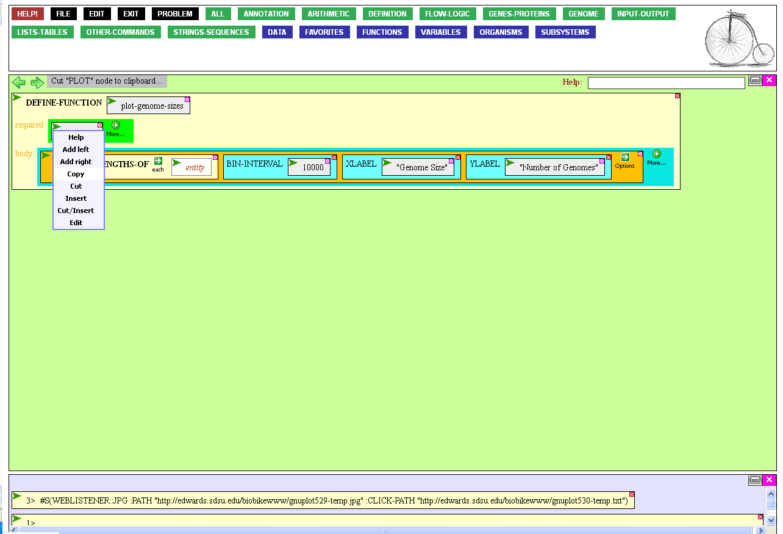
…click Copy,…

Slide 37
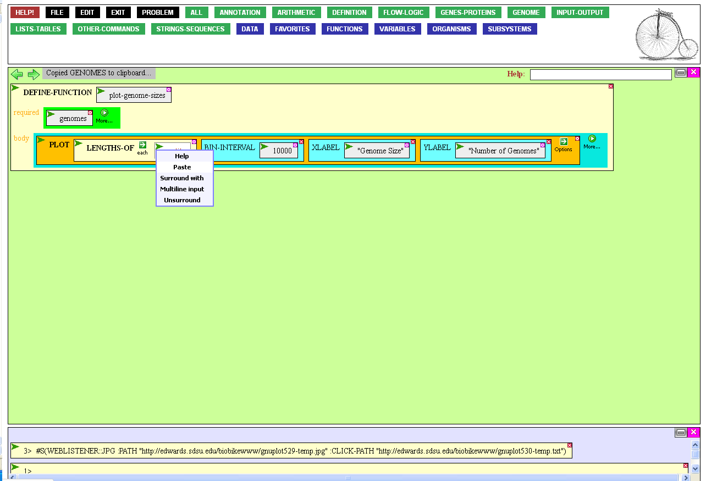
…then mouse over the action
icon of the entity box of
LENGTHS-OF, and click Paste.

Slide 38
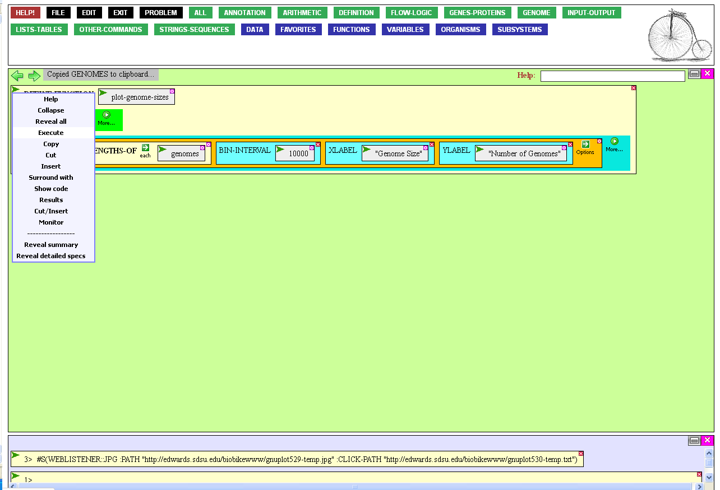
Now, after you execute
DEFINE-FUNCTION…

Slide 39
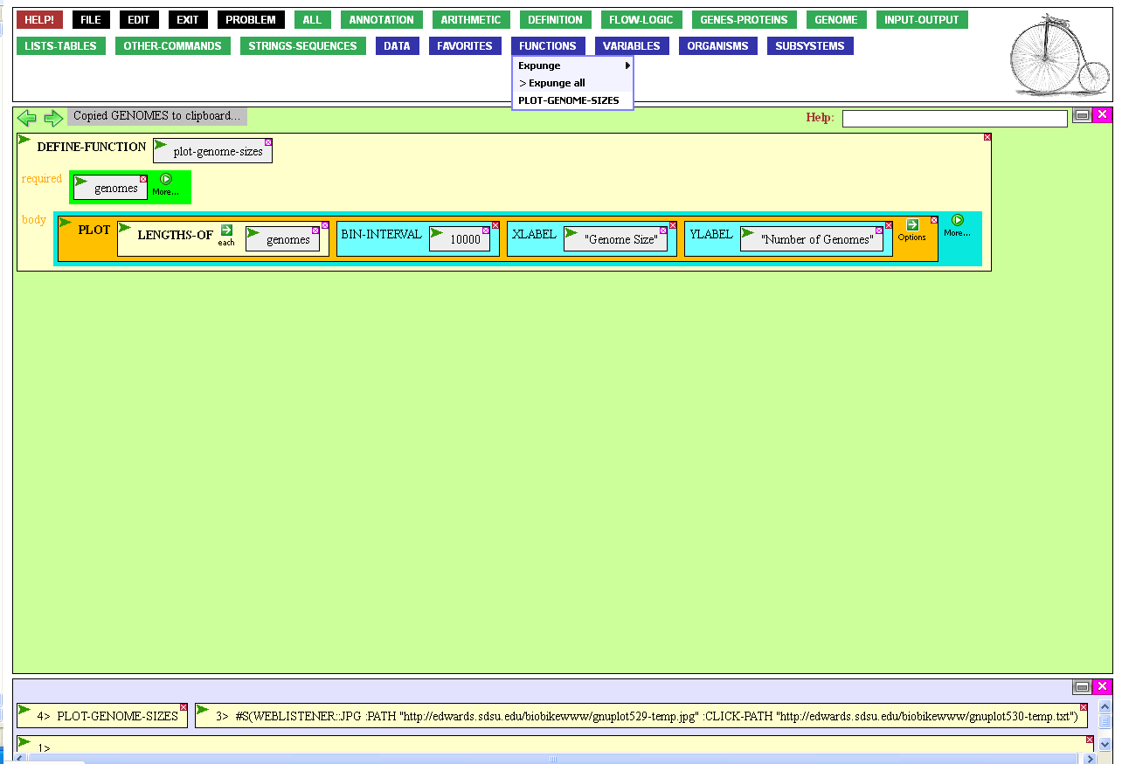
…the function has become
part of your language.
Mouse over the Function button,..

Slide 40
…and you’ll see that PLOT-GENOME-SIZES is now available from a menu, just like any other BioBIKE function.

Slide 41
Suppose that you think this is a
function that others may enjoy as well.
In that case, mouse over the
Other Commands button…

Slide 42
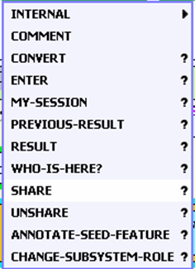
…and click share.

Slide 43

The SHARE function allows you to
make available to the world functions
and variables that you create.
You need to give what you’re sharing a name and describe what you’re sharing. I’ve done this on the next slide.

Slide 44
Executing this function makes
PLOT-GENOME-SIZE public.

Slide 45
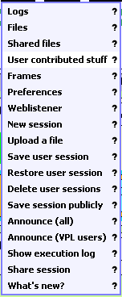

You (and other users) can find the function by mousing over the File button and clicking User contributed stuff.

Slide 46
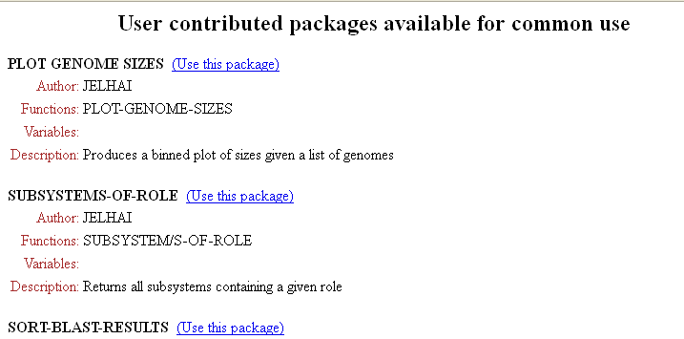
This brings you to a list of
public functions, of which
PLOT-GENOME-SIZES
is a new member.

Slide 47
Creating New Tools
Reflections and Coming Attractions
Ideally, computational tools that are easy to describe in logical terms should be easy to build, so easy that the task should be within reach of researchers who don’t care to learn a conventional programming language. This tour attempted to describe how, to some extent, this is possible within BioBIKE.
But building useful tools will never be a trivial task, and so it is important that common libraries develop that enable researchers to share tools they have built and that others may gain from.
The tour focused on a particular task, perhaps outside the mainstream of what researchers do on a routine basis. Certainly one mainstream task is identifying proteins within certain classes, the subject of a few tours, including Finding genes / Use of Subsystems.

