Slide 1
Finding proteins / Use of subystems
Summary
Amongst the most common bioinformatic questions posed by biological researchers are: “What is the function of protein X?” and “Which protein in my favorite organism performs function Y?” There are many ways of approaching these questions. This tour touches on three: (a) searching annotation,
(b) sequence similarity, and (c) human-curated protein categories (e.g. PhAnToMe subsystems).
This is best viewed as a slide show.
To view it, click Slide Show on the top tool bar, then View show.
Click to start

Slide 2
Finding proteins / Use of subystems
Slide #
Problem: Does phage Ardmore have a holin?
Attempt to find protein by annotation
Subsystems/Roles…What are they?
Find appropriate role/subsystem
Define set of all acknowledged holins
Use set to find holin in phage genome
Find motifs in protein set
Reflections and coming attractions
3 – 69
5 – 17
18 – 19
20 – 27
28 – 35
36 – 42
43 – 69
70
To navigate to a specific slide, type the slide number and press Enter (works only within a Slide Show)

Slide 3
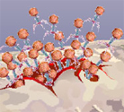

Comparative genomics / Use of subystems
All bacteriophages have to leave their host cells at some point.
Most if not all double-stranded phages do so through the action
of an enzyme, an endolysin, that degrades the host’s cell wall,
aided by another protein,
called holin, that helps the
endolysin gainaccess to the wall.
I’m telling you all this because
I ran across an article…
http://www.microphage.com/technology/phageBiology.cfm

Slide 4
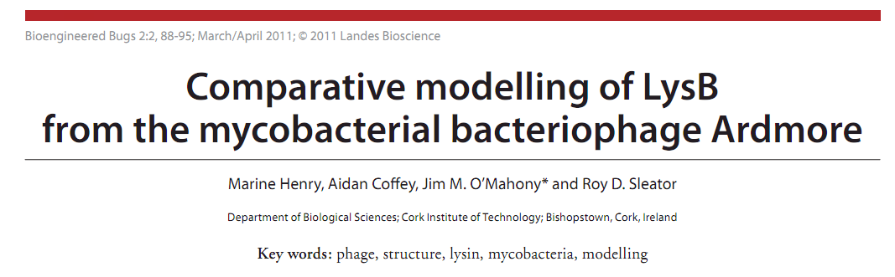
Comparative genomics / Use of subystems
This article talks about a lysis protein from the double-stranded DNA phage, Ardmore, but
nowhere in the article could
I find mention of any holin.
No doubt the protein exists, I was just surprised that they didn’t… wait, does it exist in Ardmore???

Slide 5
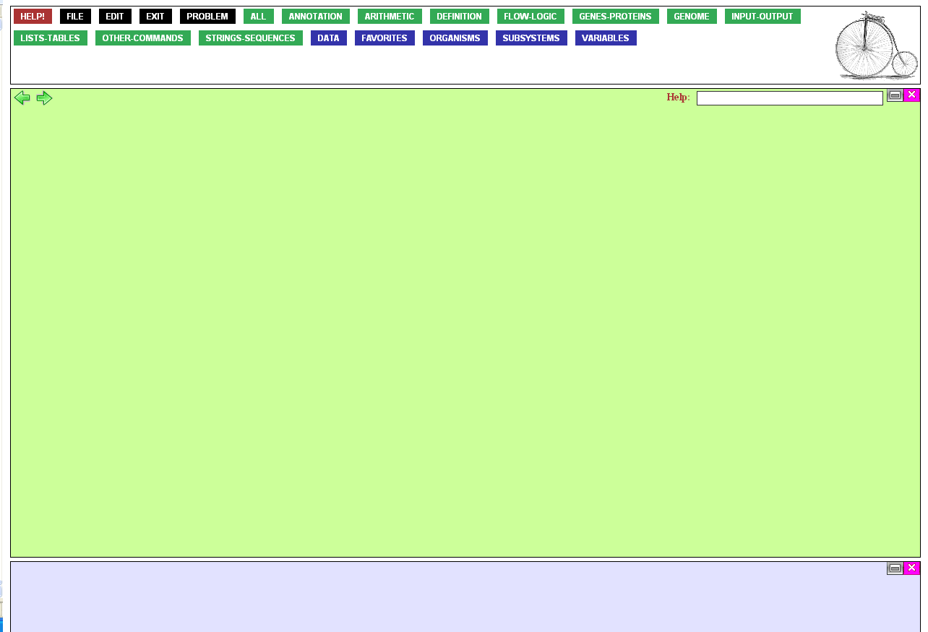
That should be easy to find
out. Just mouse over the
Genes-Proteins button…

Slide 6
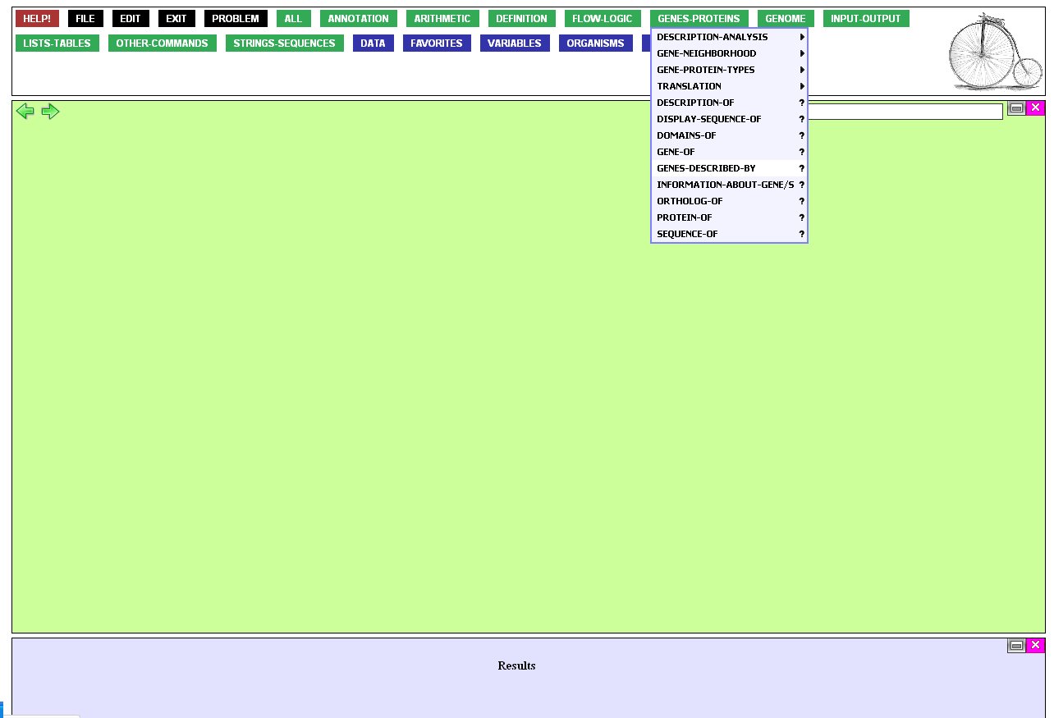
…and click GENES-DESCRIBE-BY.

Slide 7
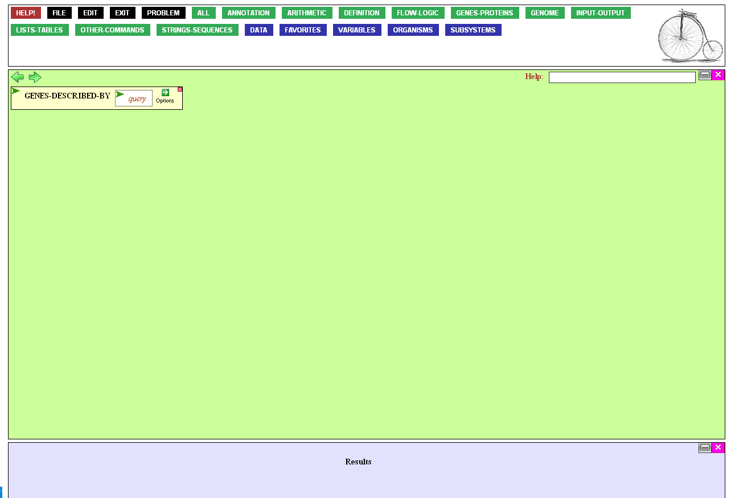
This brings the function into the workspace. The function asks for
a query, i.e. some term I’m trying
to find in gene descriptions.
Of course I’m looking for “holin”,
so I click query…

Slide 8

…opening the box for entry.
I type in “holin” and press either Enter or Tab. This is important,
for until this is done, the box is considered to be open for input, and the function can not be executed.

Slide 9

The function is now complete,
ready to be executed. But if I execute it, BioBIKE will search all genes
of all organisms it knows about.
I’m just interested in Ardmore.
To avoid slogging through all the extra results (and wasting time
in the bargain), I mouse over the Options icon…

Slide 10
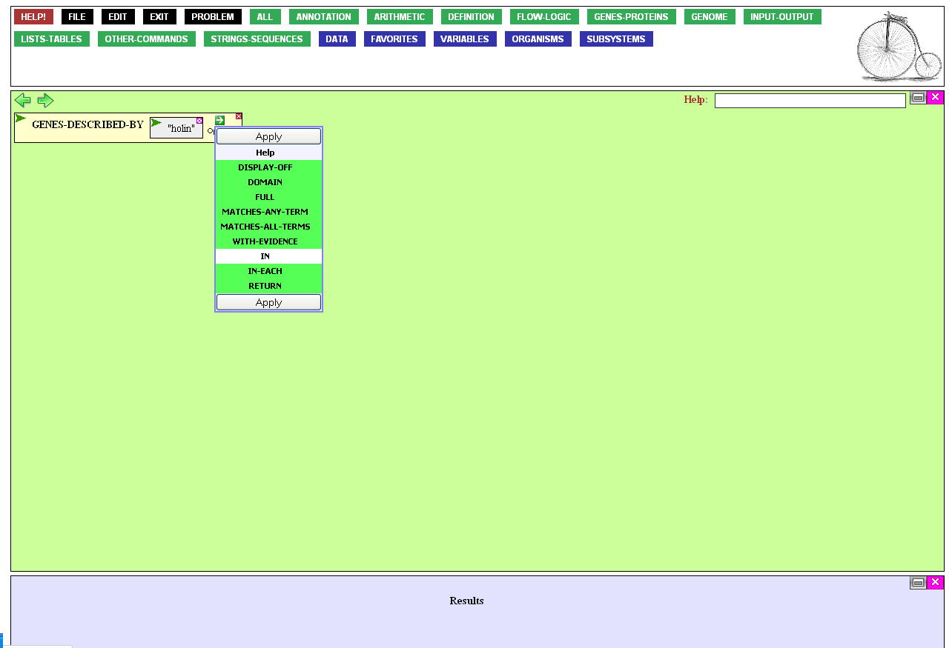
…and click the in option,
to limit the search,…

Slide 11
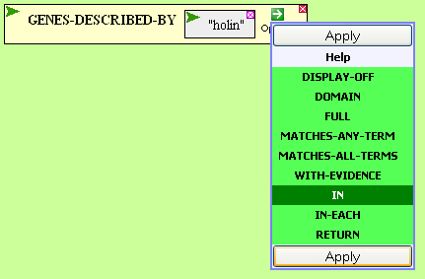
…and finally Apply
the selected option.

Slide 12
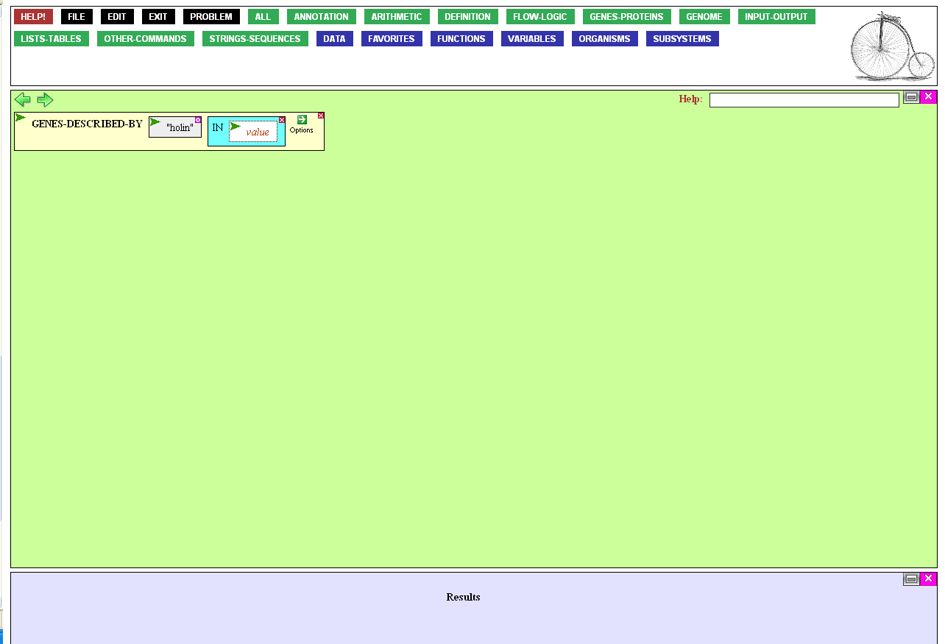
Now I open the value box for entry,…

Slide 13
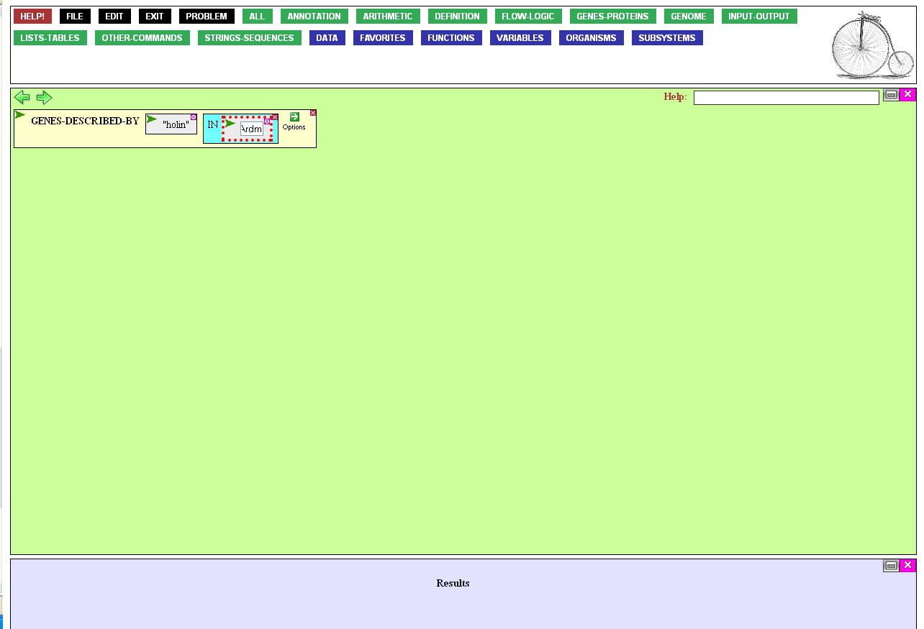
…to type in Ardmore.
(Ordinarily I’d look up the name
of the phage in the Organisms menu, but Ardmore is an unusual name, and BioBIKE generally uses unusual names as nicknames for phages and bacteria)

Slide 14

The function is ready to be executed. This can be done either by double-clicking the name of the function or mousing over the green action icon…

Slide 15
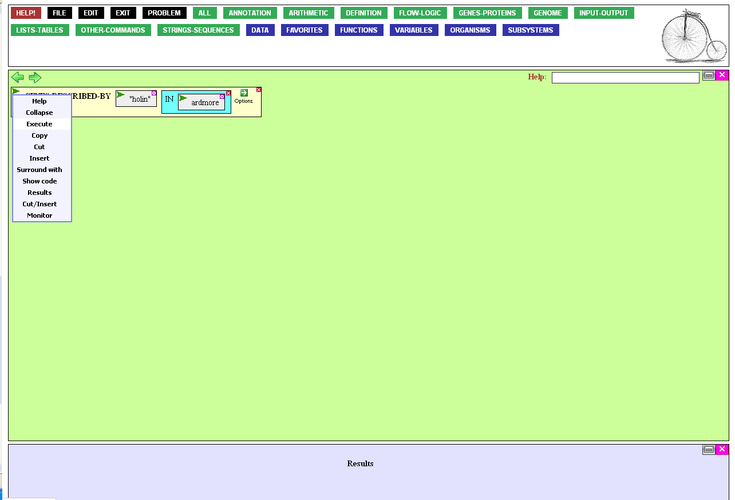
…and clicking Execute.

Slide 16
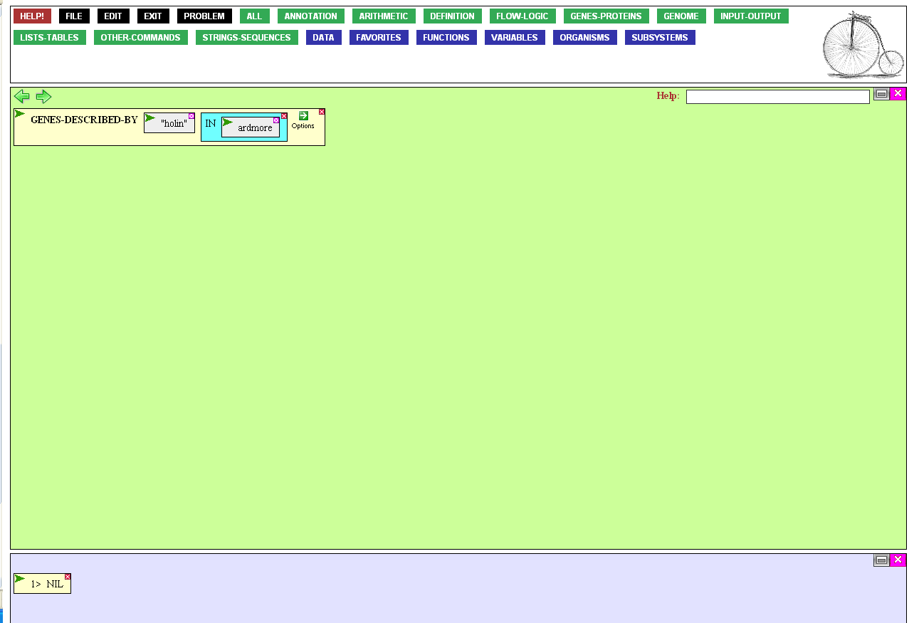
If a gene were found, a window
would pop up with possibly interesting information.
Unfortunately, all we get is a
negative answer. There is no gene
in Ardmore annotated “holin”

Slide 17
No holin? Remarkable! Fascinating!
…or more likely, just stupid.
Holins are notoriously variable, and maybe the automated annotation program missed it. Or maybe the annotator called it “hole-forming protein” or some such.
In any case, I need to find a better search strategy than annotation.

Slide 18
Subystems provide a better way.
Subsystems* are functionally connected categories, of
proteins curated by humans
expert in the specific field.
A subsystem might be a metabolic pathway or a protein assemblage
*Overbeek R et al (2005). Nucl Acids Res 33:5691-5702.

Slide 19
A subystems consists of roles.
A role might be a specific
enzymatic function in a metabolic pathway or a specific type of
protein in an assemblage.
All proteins within a role have
the same role name, given by
the expert human curator.
Diverse annotations of proteins in the same role
Methyltransferase, phage associated
DNA adenine methyltransferase, phage associated
Phage-associated DNA N-6-adenine methyltransferase
Adenine methylase
Adenine-specific methyltransferase
Adenine-methyltransferase, phage-associated
Single role for proteins withcommon function
Type II, N6M-methyladenine DNA methyltransferase (group beta)

Slide 20
Well, I'm convinced!
In an ideal world, the proteins of newly sequenced genomes like Ardmore's would automatically join established roles and subsystems
(and we're approaching that world).
But in the meantime, I can
look for proteins in Ardmore
that are similar to holins in an
expert-curated role of a subsystem.
To find such a role, mouse
over the Annotation button…

Slide 21
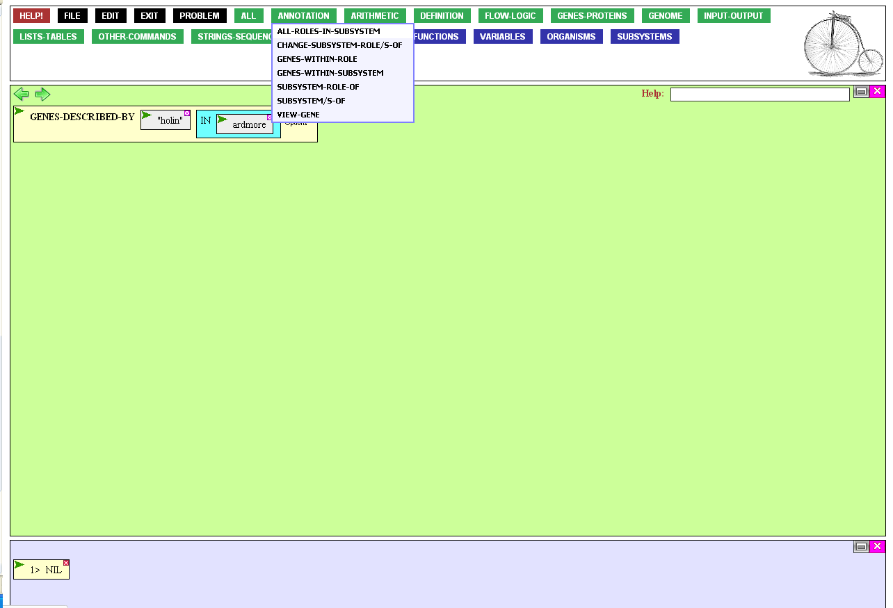
…and click
ALL-ROLES-IN-SUBSYSTEM.

Slide 22
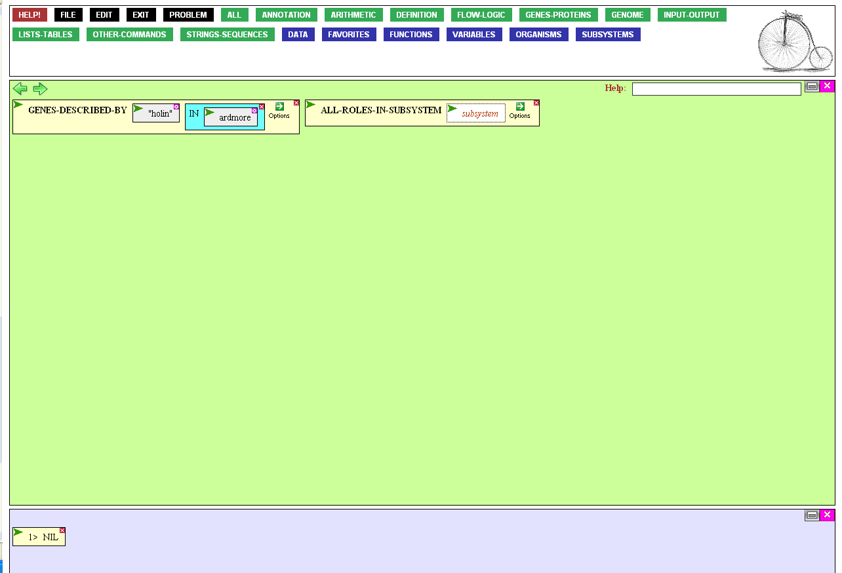
The function wants the name
of the subsystem, in this case,
one that would contain the
role related to holins.
We can find that subsystem
through the Subsystems menu

Slide 23
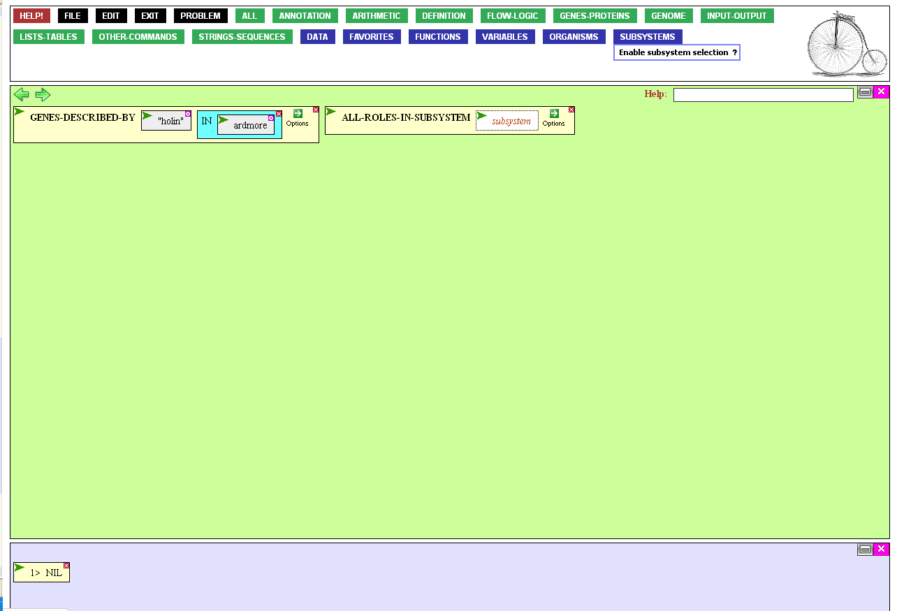
First it has to be enabled (so that
you have to live through the few seconds required to load the
menu only when you need it)

Slide 24
Click the subsystem entry box,
and then return to the
Subsystems menu

Slide 25
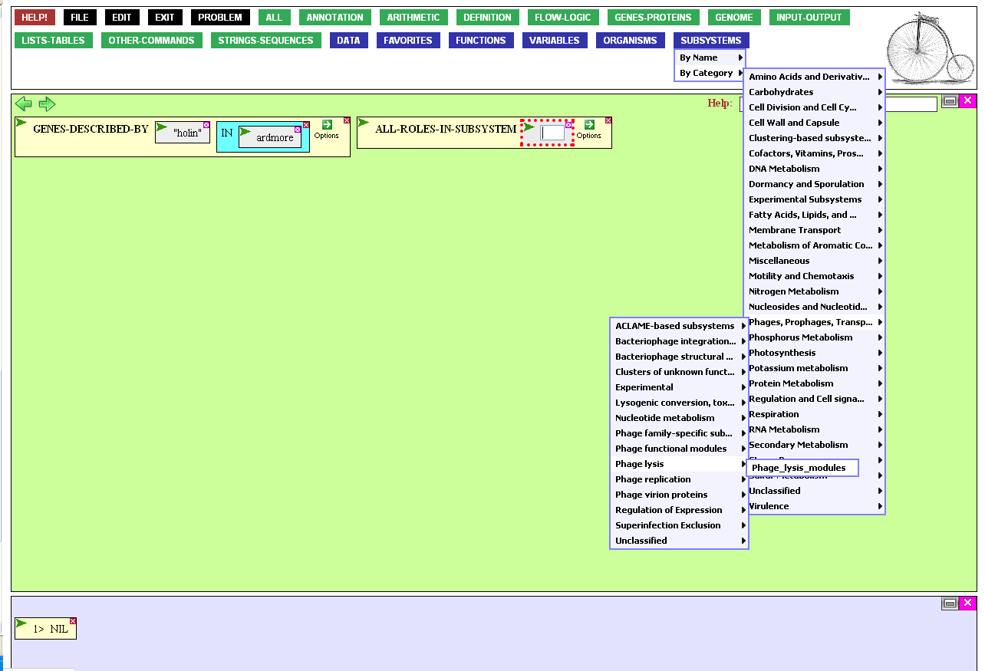
Navigating through the Subsystems menu, from Phages, Prophages, and Transposons, through Phage lysis, finally gets us to the subsystem Phage_lysis_modules. Click that.

Slide 26
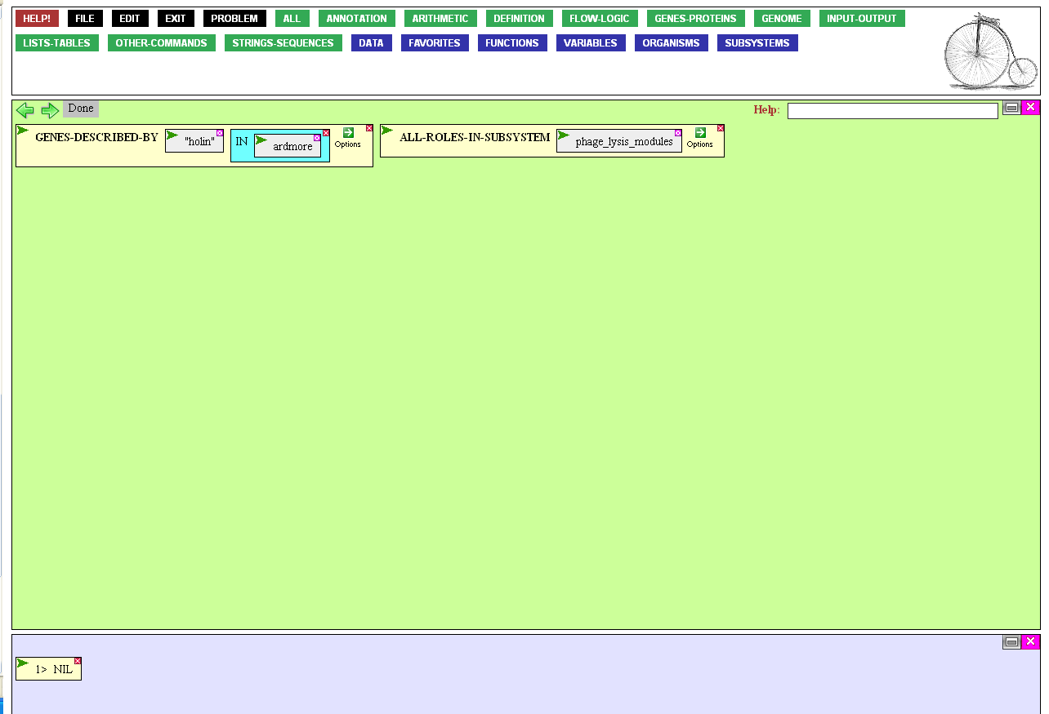
You can execute the now completed function by double clicking its name.

Slide 27
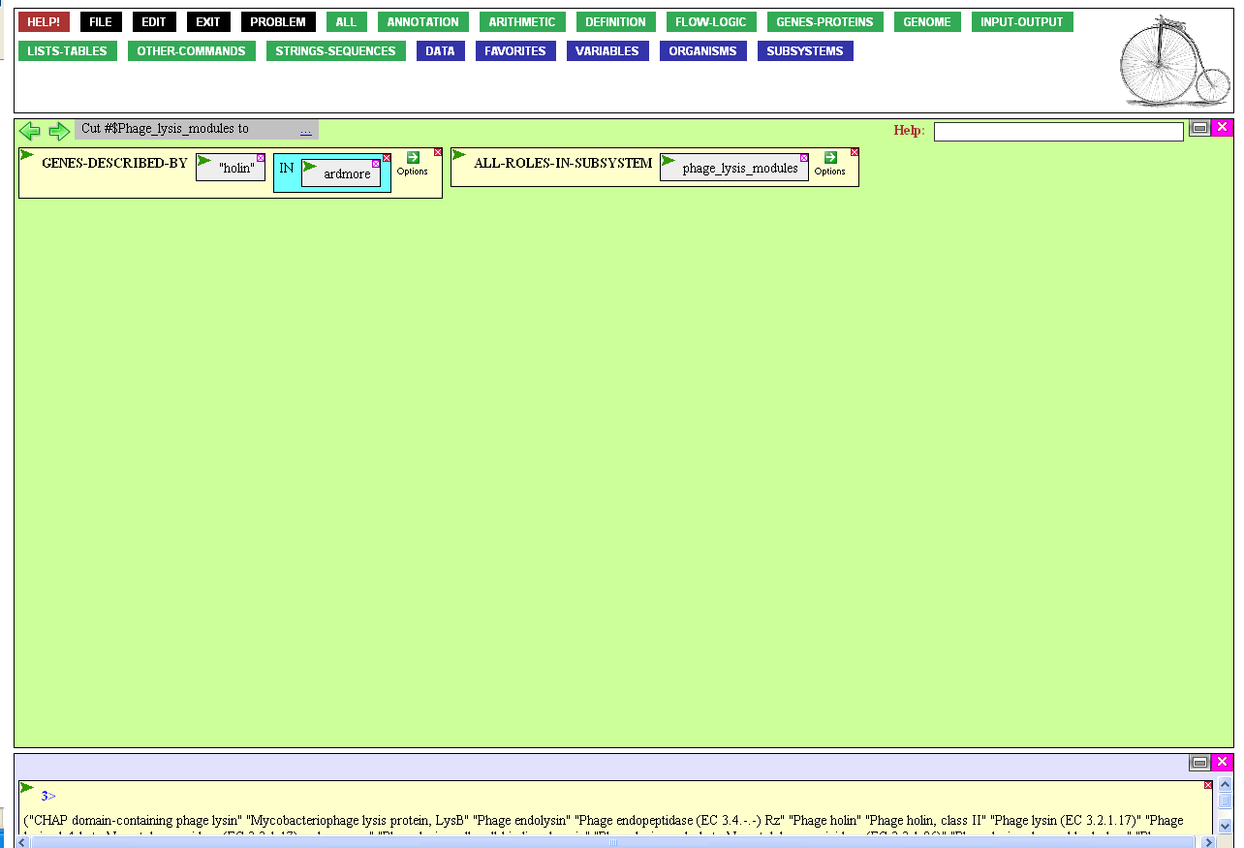
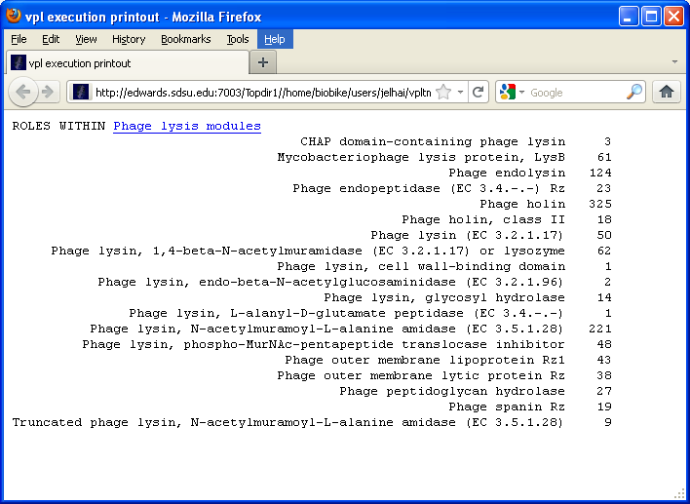
We get from this effort
the list of all roles within the Phage_lysis_modules subsystem, plus how many proteins each role contains.
There are two classes of holins. We'll focus for now
on the most numerous, the category with 325 proteins.
We've gotten what we wanted, so X out of the window.

Slide 28
We’ll now grab those 325 expert-confirmed holins, defining them as a set.
To do this, mouse over the Definition button…

Slide 29
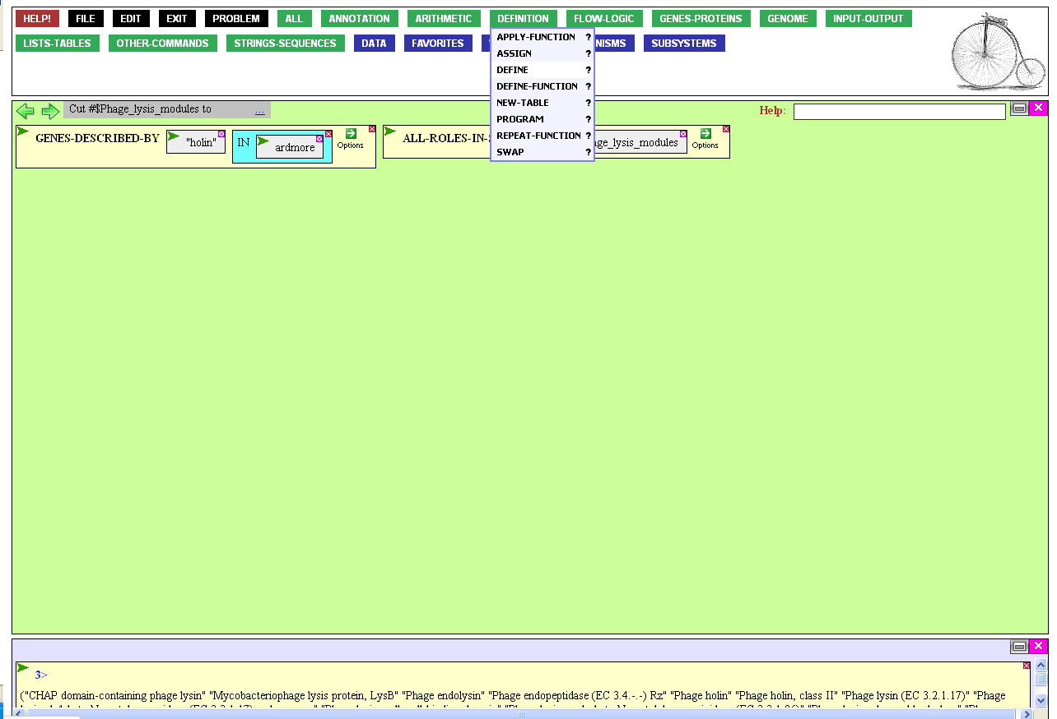
…and click DEFINE.

Slide 30
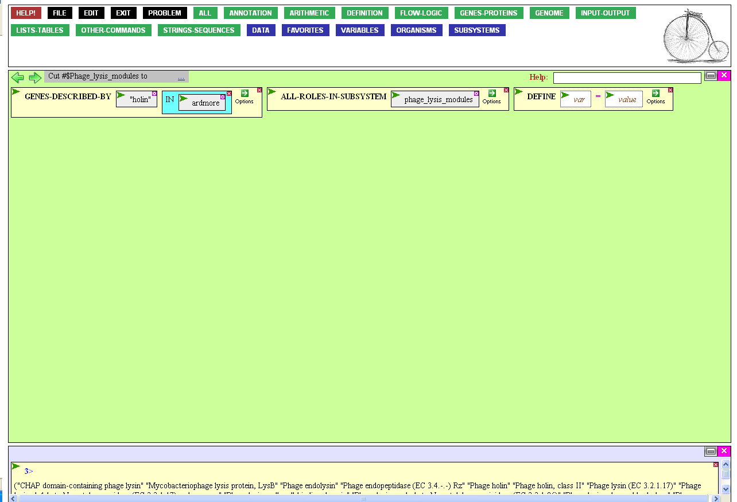
The DEFINE function allows you to refer to something, in this case a long list of proteins, by a name of your choosing.
You provide the chosen
name in the variable box
and provide the list in
the value box.
Click the variable (var)
box to get started.

Slide 31
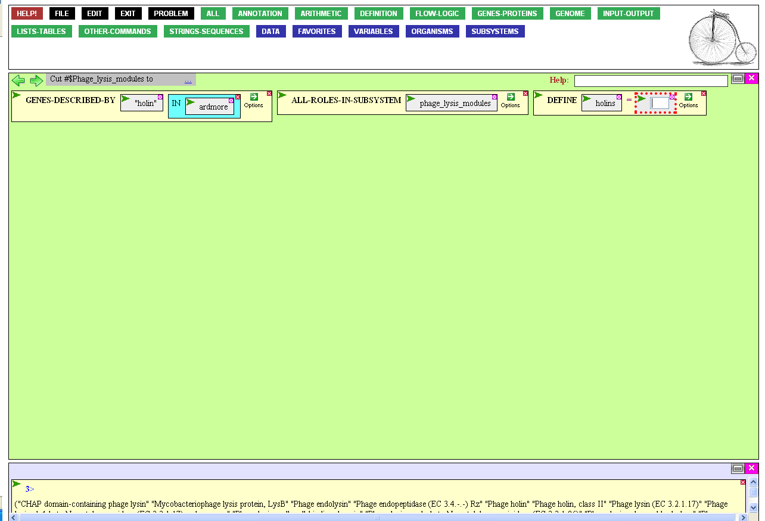
After typing whatever
you choose to be the name
of the set (I chose holins), press the Tab key to move
to the next entry box.
The list will be all the genes with the role “Phage holin”. There’s a function for that.
To get it, mouse over the Annotation button…

Slide 32
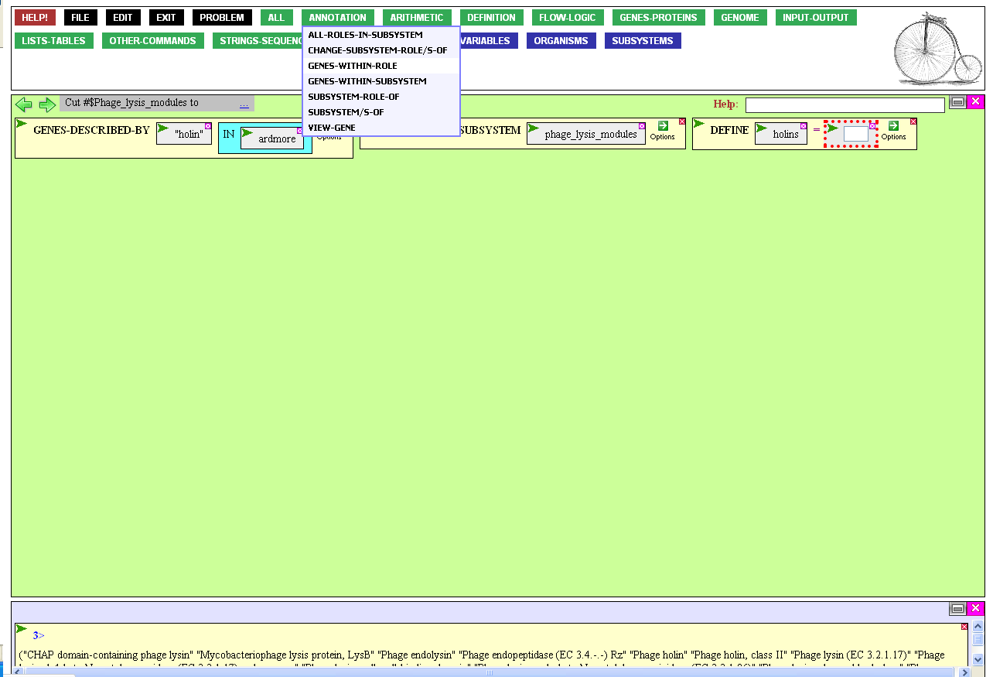
…and click
GENES-WITHIN-ROLE.

Slide 33
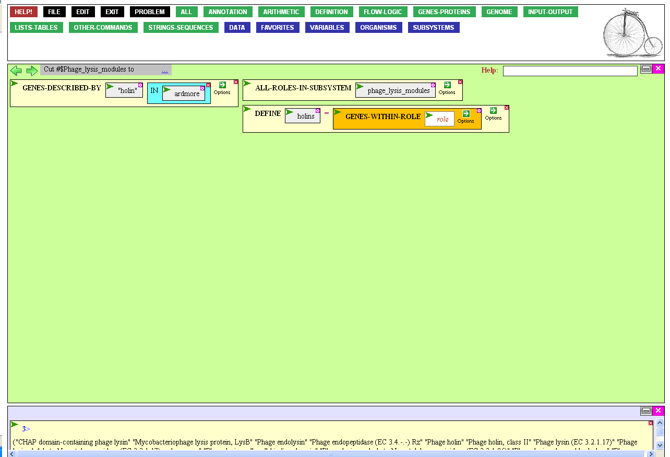
That brings the function into the value box of the definition.
Clicking the role entry box allows you to specify the role.
When the box is open,
type “Phage holin” and
press the Enter key.

Slide 34
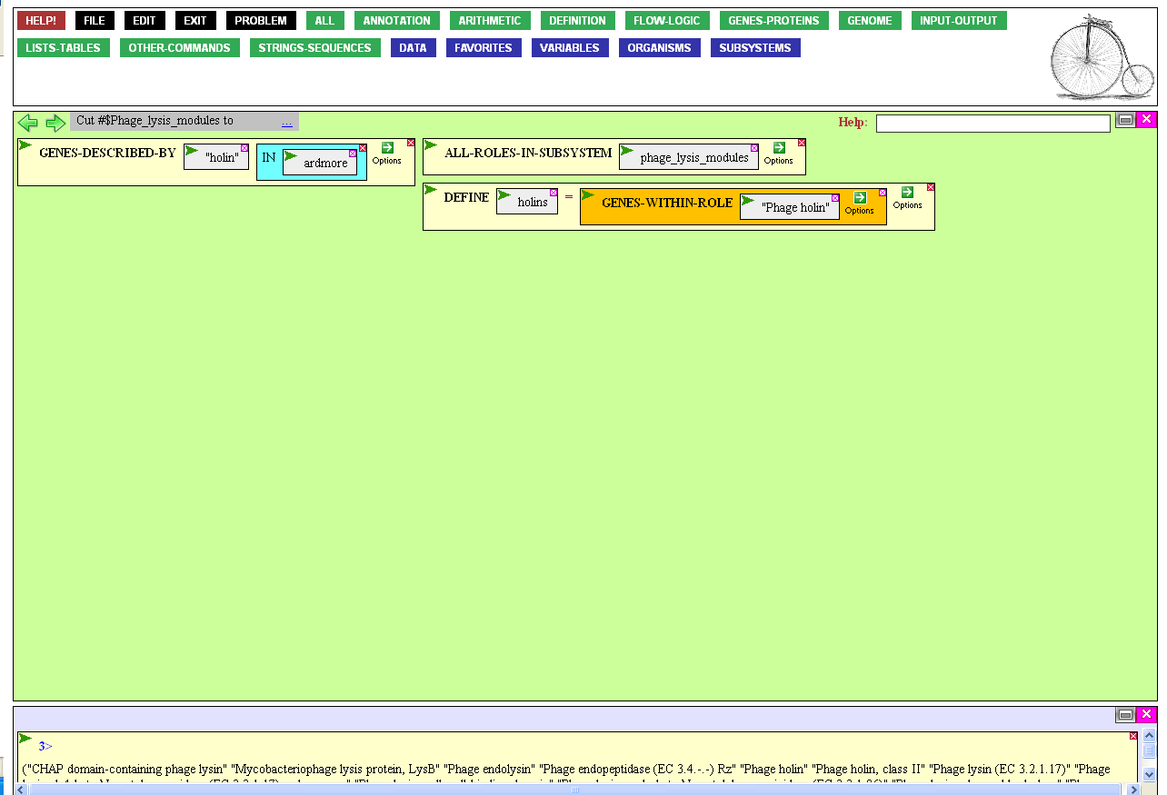
Nothing happens until
you execute the
DEFINE function.
Do so as before or by
double-clicking DEFINE.

Slide 35

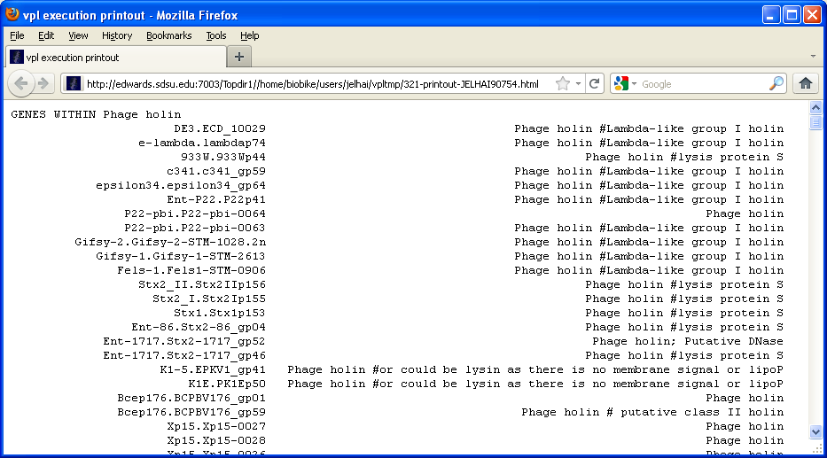
Executing the DEFINE function makes holins
part of your language, accessible through the Variables button.
You also get a list of the
genes as a side product.
X out of the popup window.

Slide 36
Our strategy is to see if
any of the acknowledged
holins are similar to proteins in phage Ardmore.
You can check for sequence similarity by mousing over the Strings-Sequence button…

Slide 37
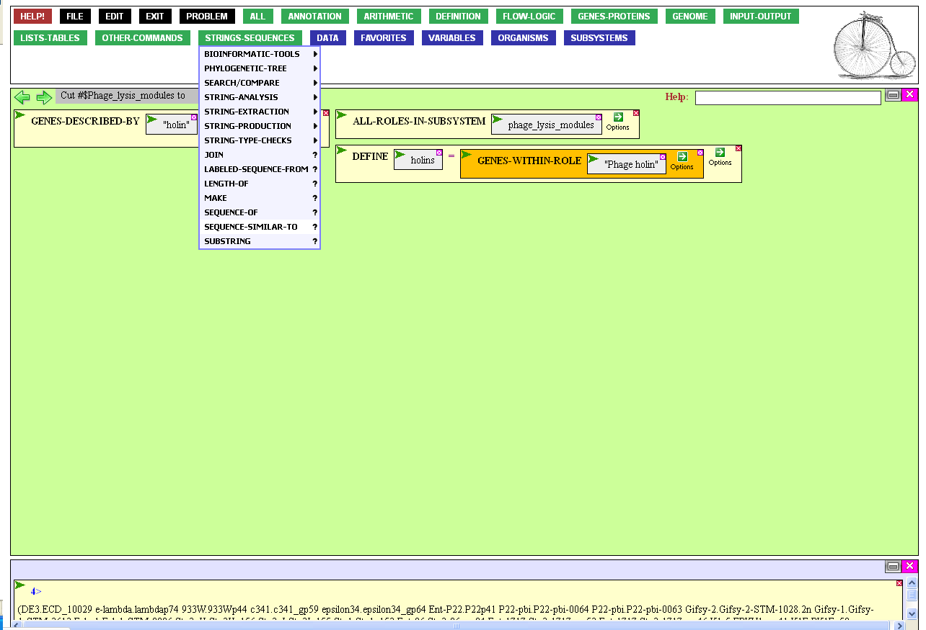
…and clicking
SEQUENCE-SIMILAR-TO.

Slide 38
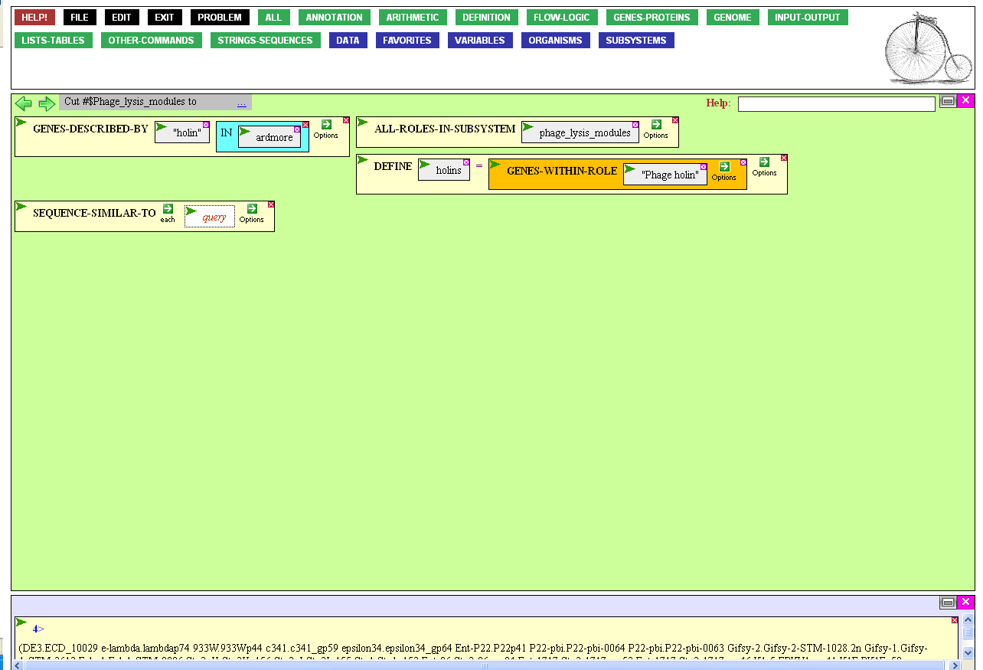
Similar to what? To the set
of holins we just defined.
Open the query entry box…

Slide 39
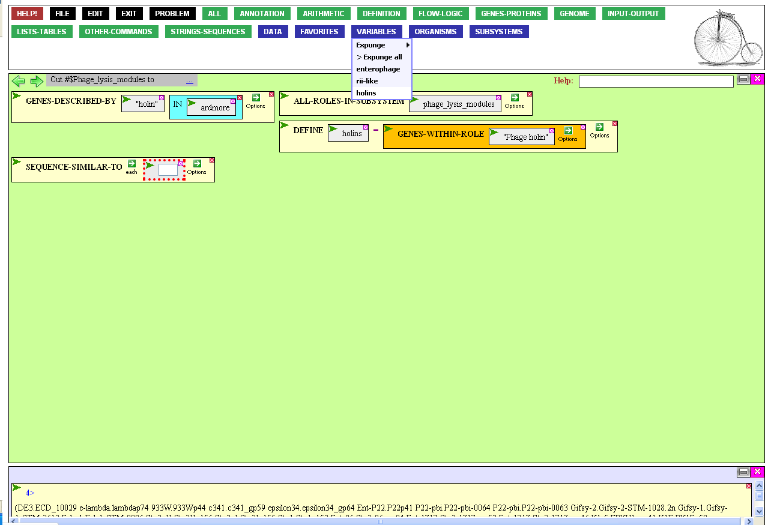
…mouse over the Variables button and retrieve the
freshly minted set, holins,
that you just defined.

Slide 40
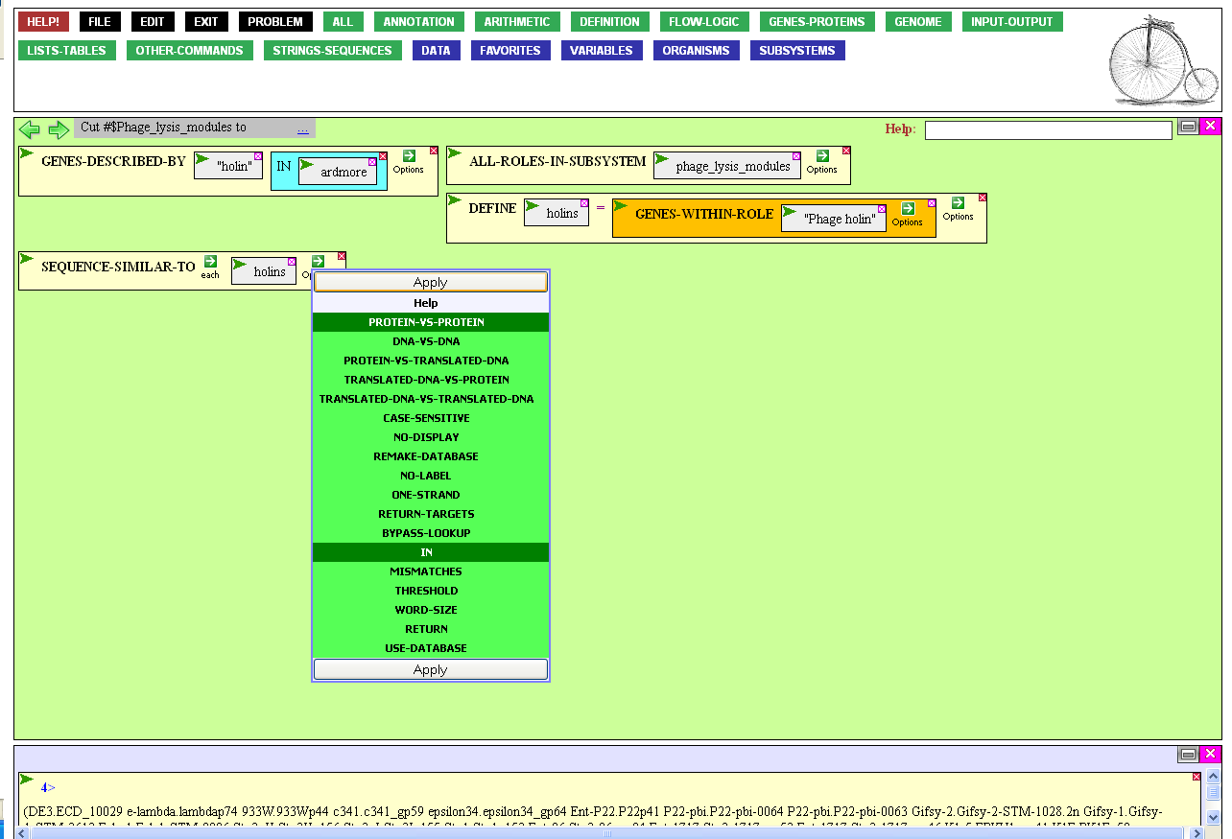
You could execute the function as is, but then, you’d (by default) compare the holin sequences to all proteins known to the system. This isn’t what you want!
To modify how the function works, mouse over the Options icon and click in (so you can specify Ardmore) and Protein-vs-protein (you might as well, for clarity).
Finally, click Apply.

Slide 41
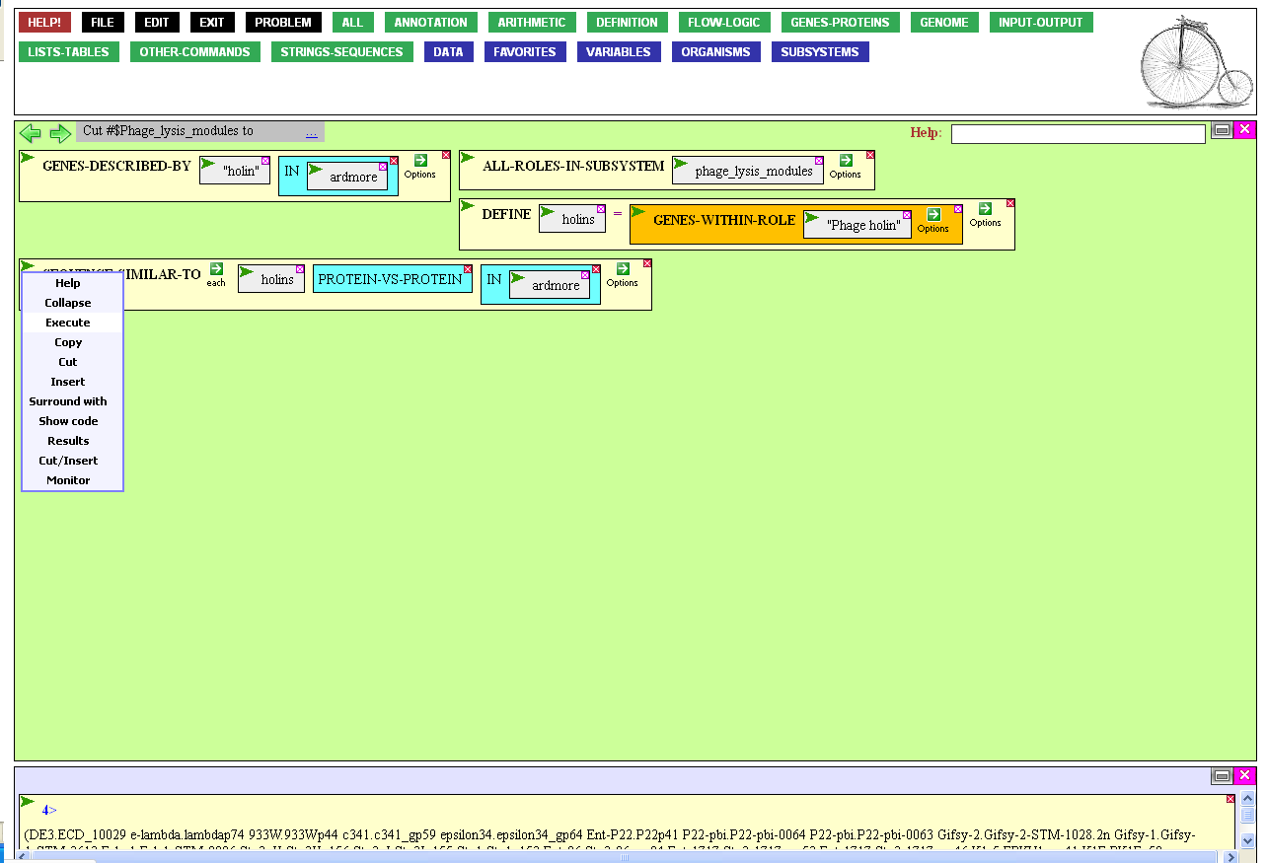
After selecting the In entry box, typing ardmore, and pressing Enter, the function is ready for execution.

Slide 42
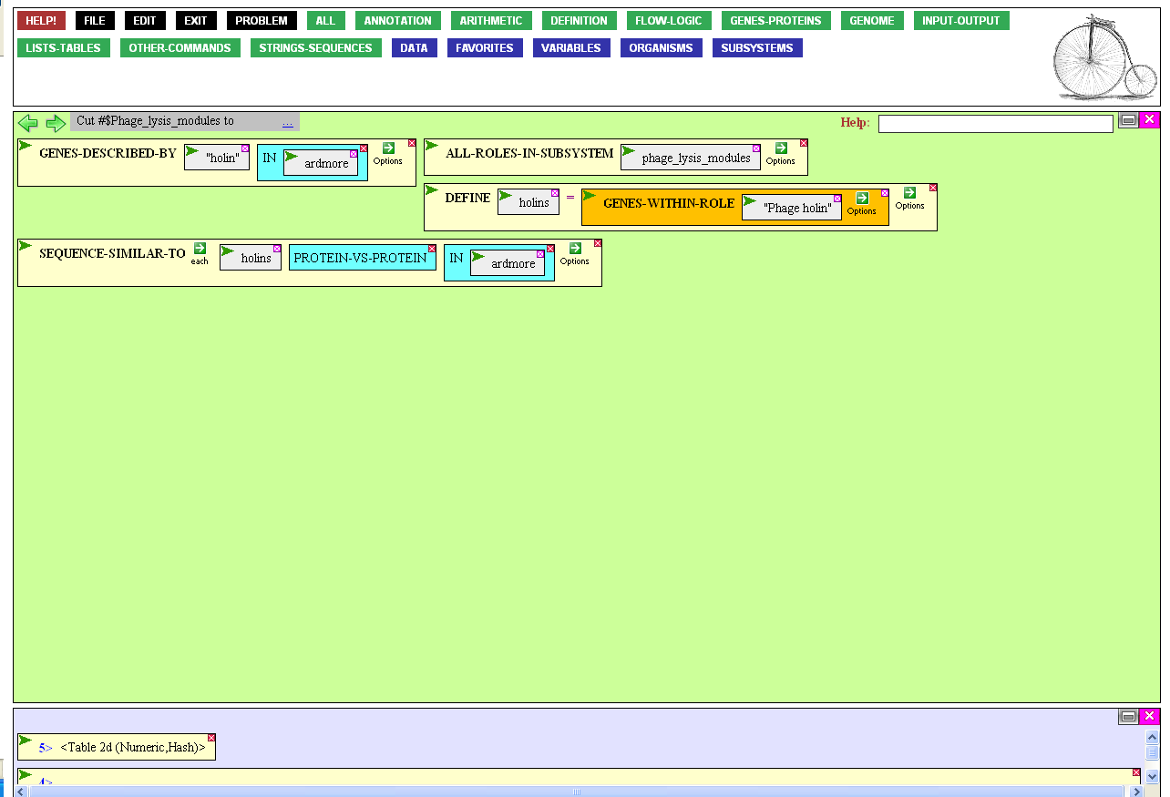
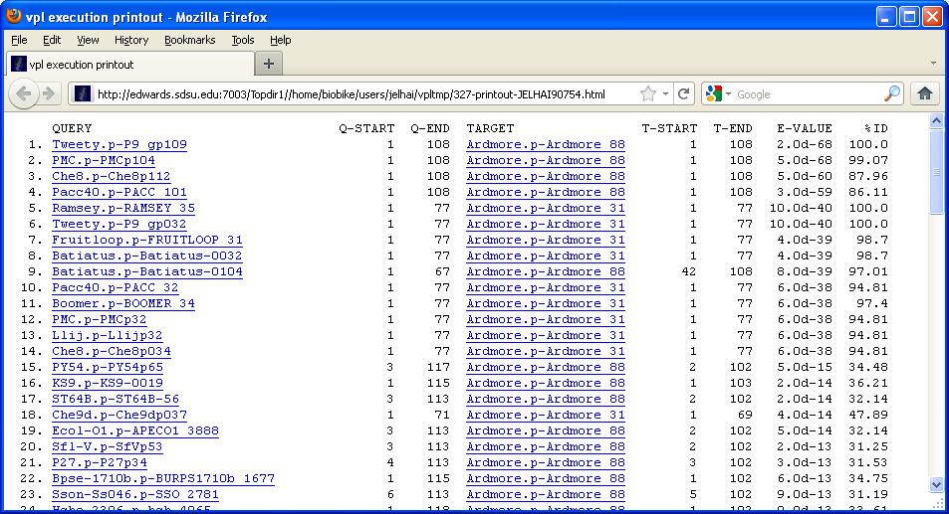
Here are all the proteins from Ardmore similar to holins. It looks like a lot, but on closer inspection, it becomes clear that there are only two such proteins, each one similar to many different holins.

Slide 43
Those two proteins seemed very similar
(e.g. low E-value) to acknowledged holins,
but two holins seems one too many. Are they
both really holins? Do both have everything
a holin must have in order to be a holin?
This is clearly a difficult question to
answer, but one strategy is to ask
whether they have conserved amino acid motifs found in acknowledged holins.
A motif-searching function would help.
Mouse over the Strings-Sequences button…

Slide 44
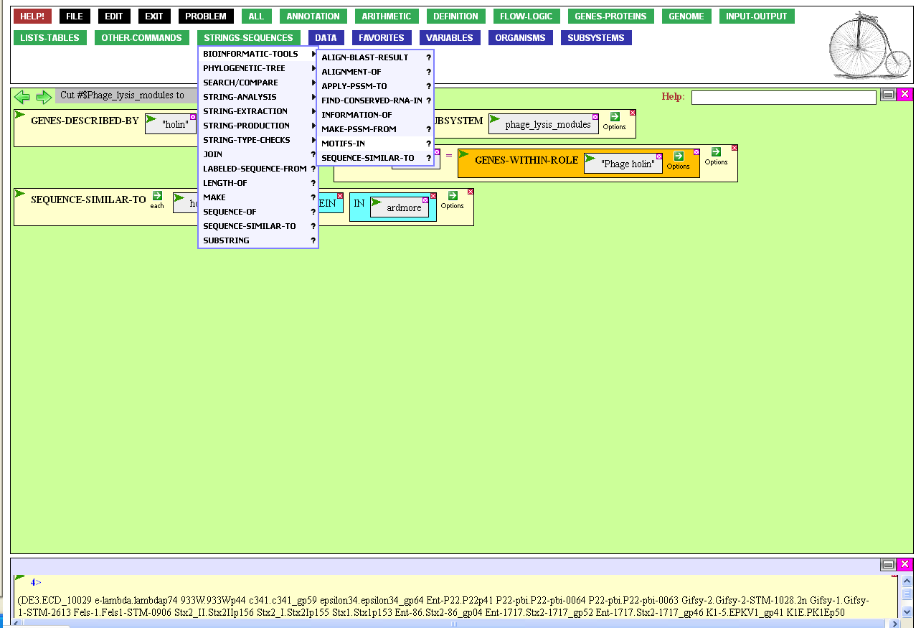
…mouse through the Bioinformatics-tools submenu, and click MOTIFS-IN.

Slide 45
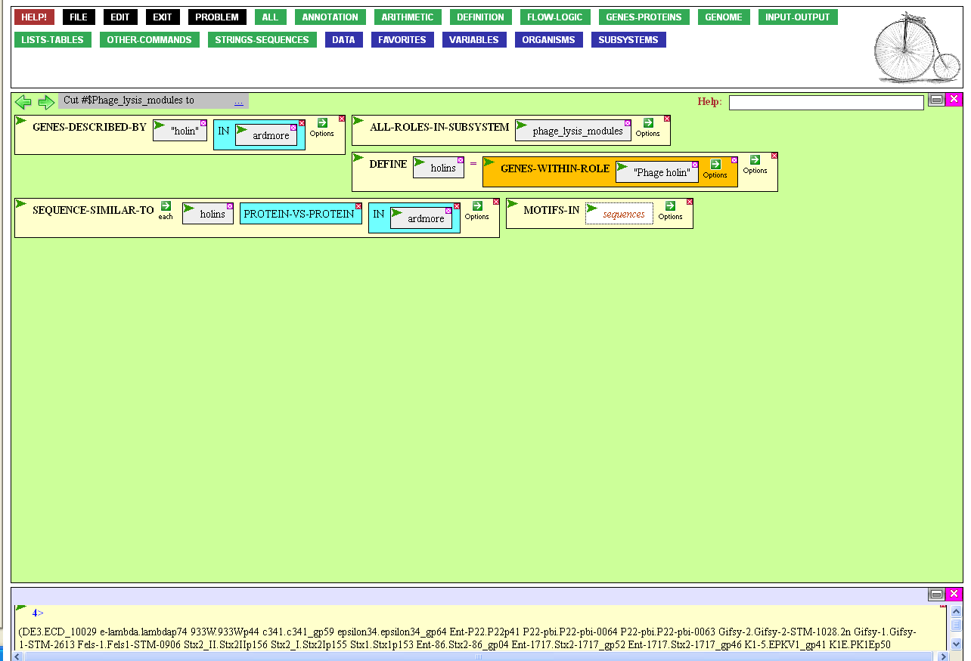
The MOTIFS-IN function accepts sequences and examines them for sub-sequences that
are statistically overrepresented.
To give it the sequences it wants,
click the sequences entry box,…

Slide 46
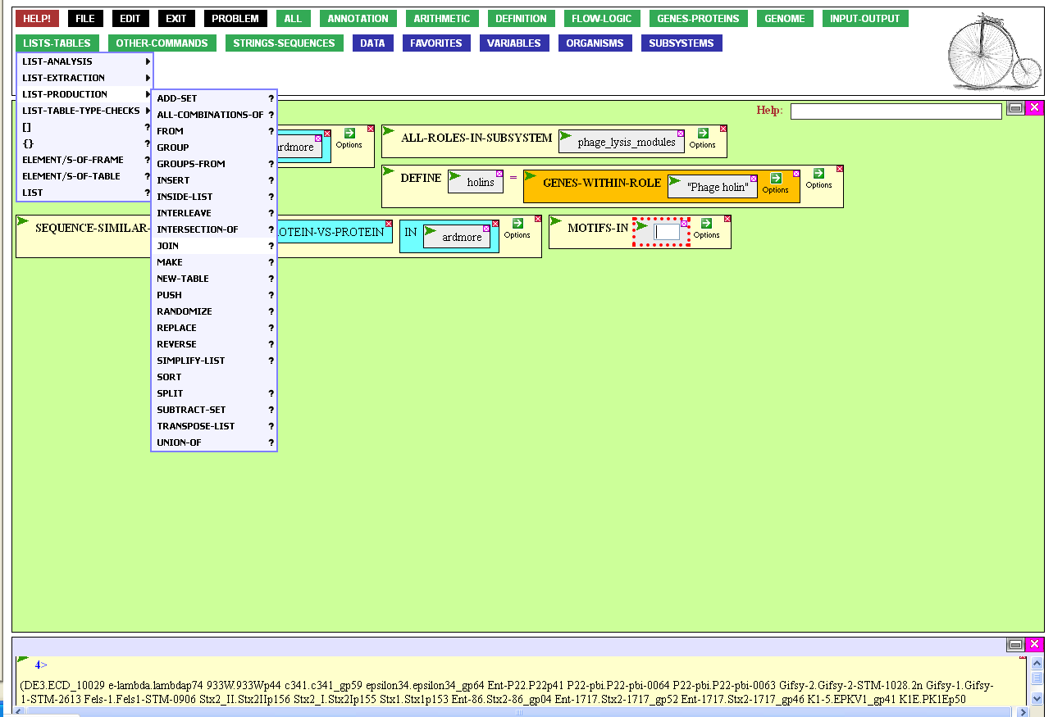
…and give it a set consisting of
the two Ardmore proteins
joined with the set of
acknowledged holins.
To produce the joined list, mouse
over the List-Tables button,
through the List-Production
submenu, and click JOIN.

Slide 47
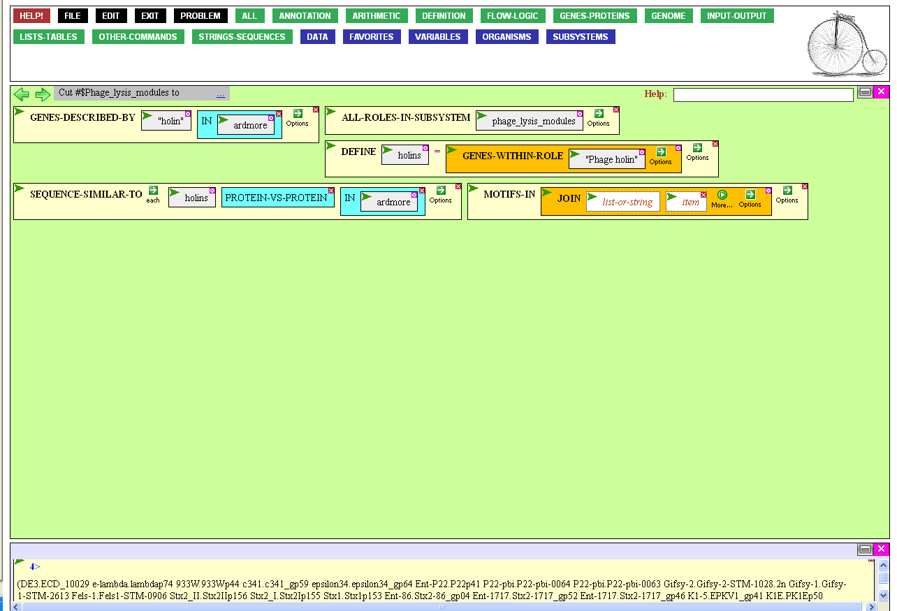
We’ll give it the set of holins first.
Click the first entry box...

Slide 48
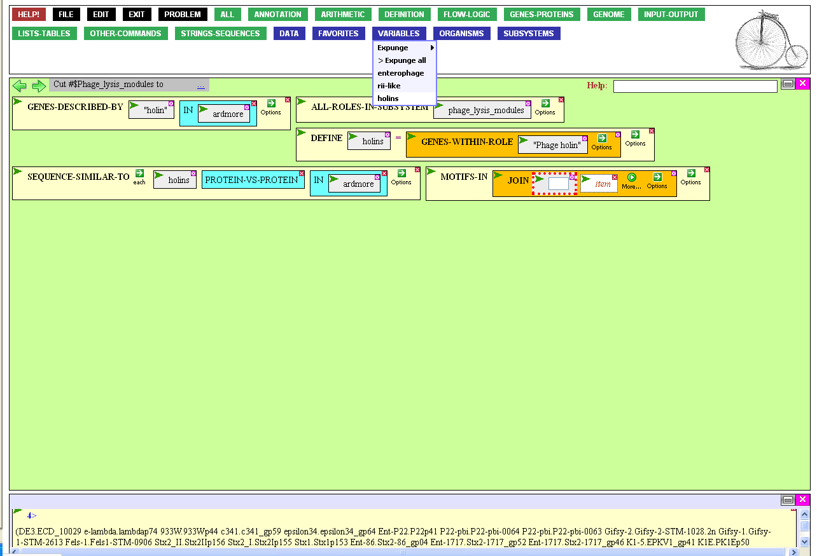
...and click the set you just created, holins, from the Variables menu.

Slide 49

That brings holin into the
first position, the first thing
to be joined into a larger list.
The second entry box (click it) is to be occupied by one of the Ardmore proteins found a moment ago.
What were they?

Slide 50
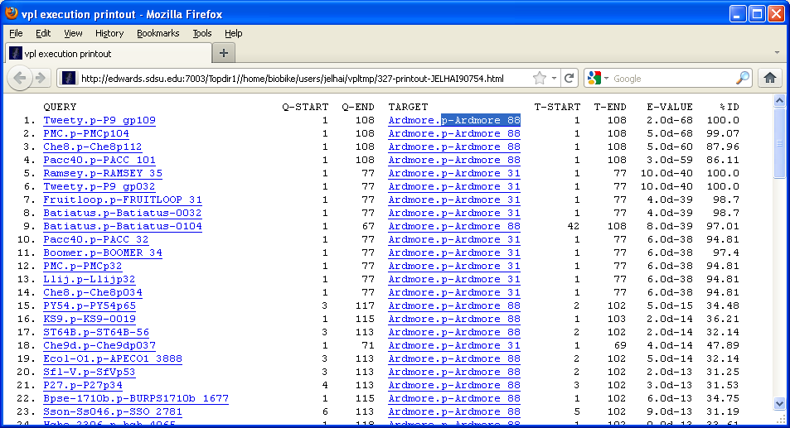
Highlight and copy the first one, and paste it into the open entry box, then press the Tab key
to close the entry box.

Slide 51
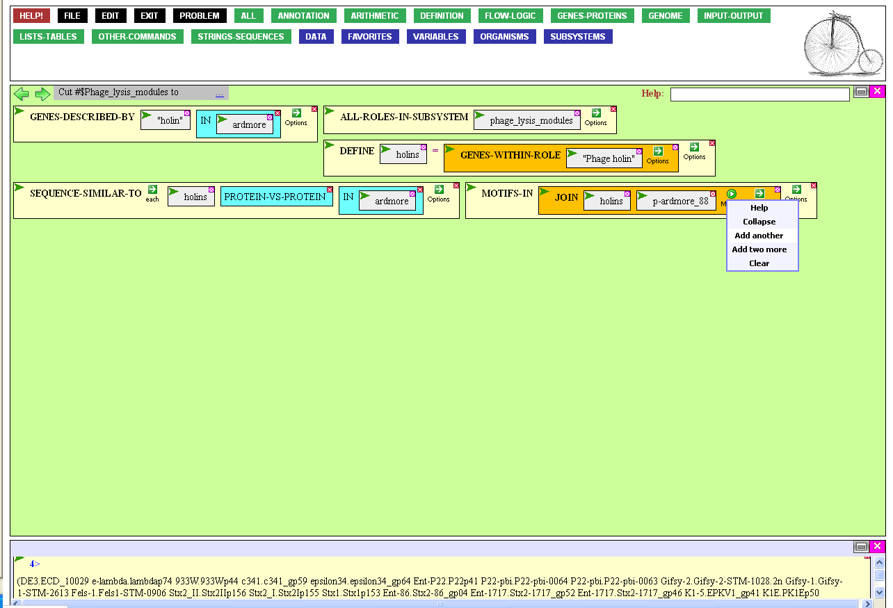
What about the third item, the other Ardmore protein?
We need to make another
entry box for it, so mouse
over the Options icon
and click Add another

Slide 52

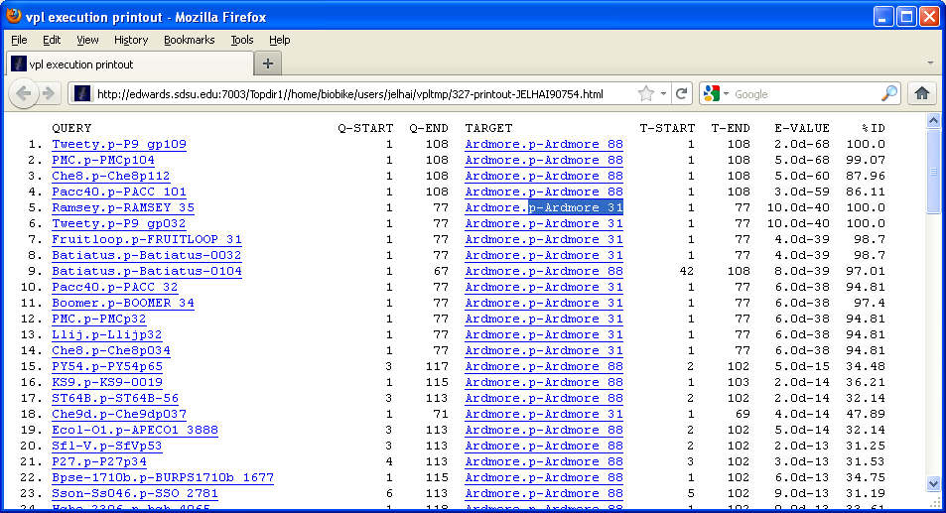
Highlight the second protein,
copy it, and paste it into the last open entry box, then press the
Tab key to close the entry box.

Slide 53
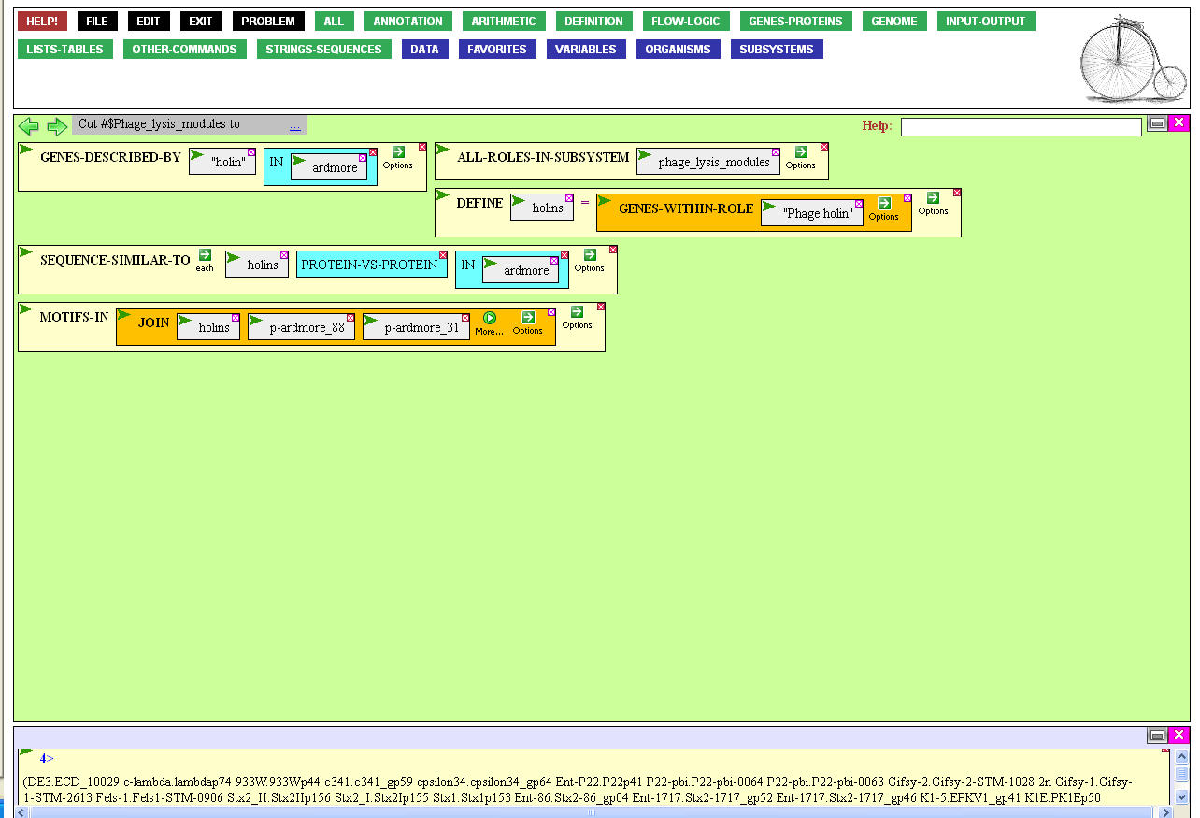
If you executed this function you’d
get a very strange result, which
(upon close inspection) you’d realize
is because most of the sequences
are DNA and two are protein!
Note that you defined holins as genes We need to convert them to proteins.
To do this, mouse over the
green action icon of holins…

Slide 54
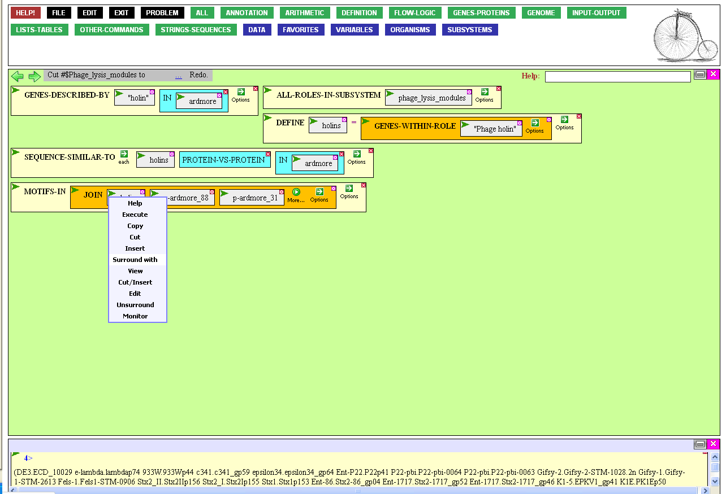
…and click Surround with.
This enables you to impose an action on the set before JOIN gets a hold of it.

Slide 55
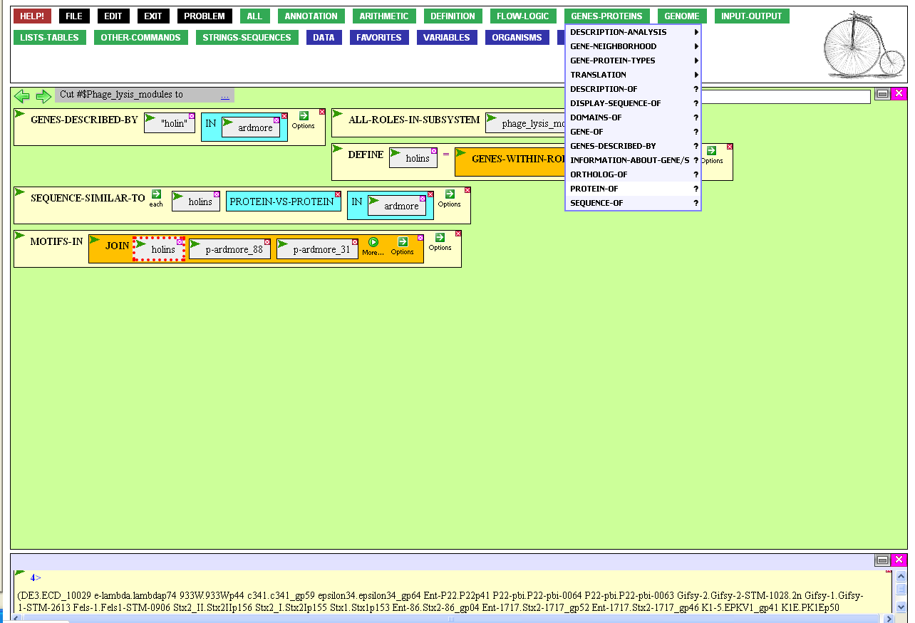
Note that holins is now highlighted, ready to be surrounded with something that will convert its genes to proteins.
Mouse over the Genes-Proteins
menu and click PROTEIN-OF.

Slide 56
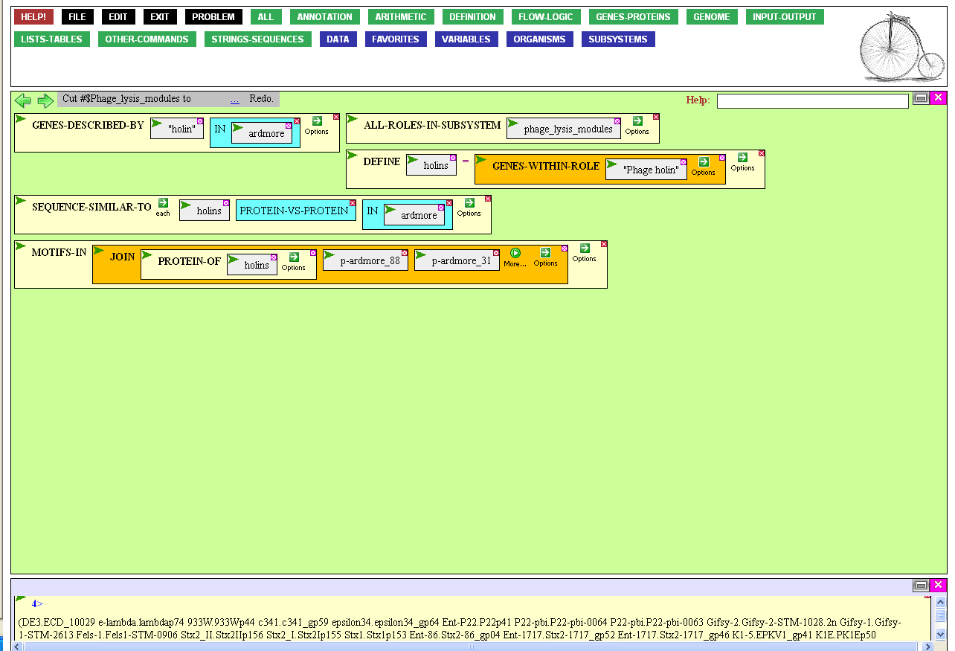
Almost ready to go. There remains
the issue of how many motifs we
want MOTIFS-IN to find. By default
it will return the three best motifs
(tradeoff: more motifs, longer wait)
We probably want more, because there are so many different kinds of holins.
To change the default, mouse
over the Options icon…

Slide 57
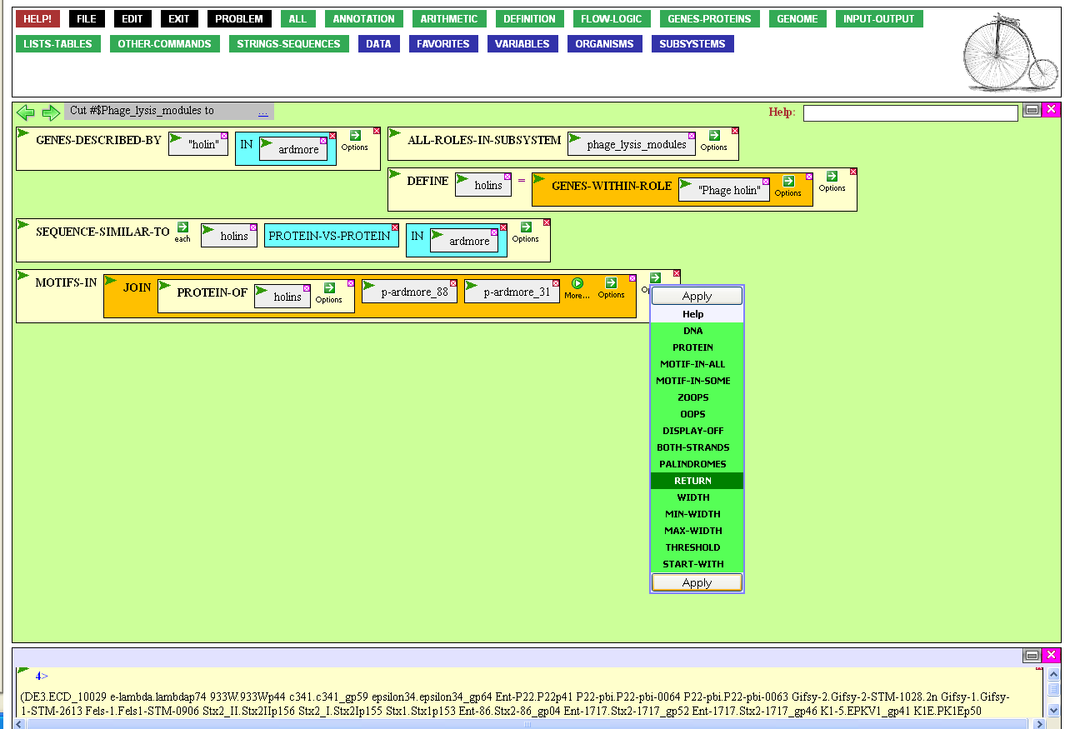
…and click Return and then Apply.

Slide 58
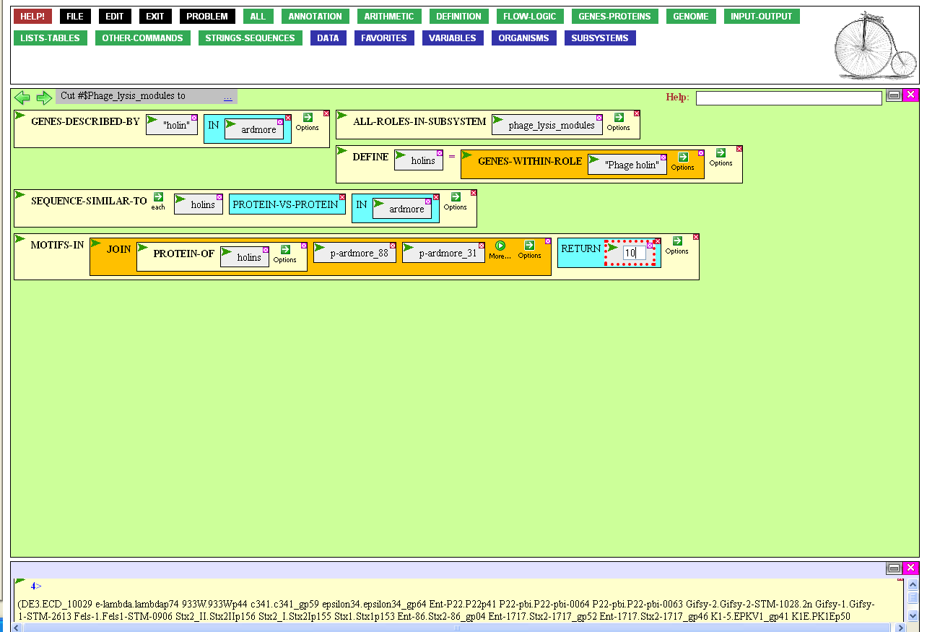
Open the Return entry box, type 10
(or whatever number you want),
and press the Enter key.

Slide 59
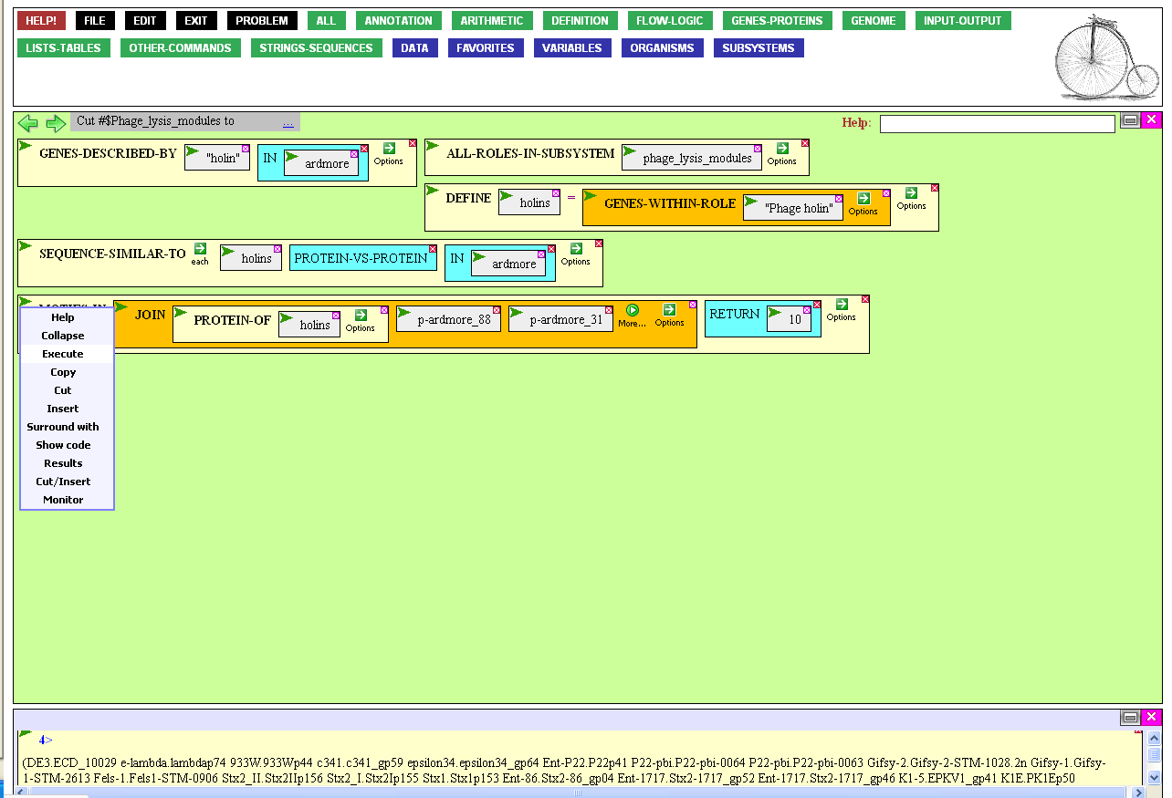
Now, finally, the function
is ready for execution…
…but I advise against it. If you
execute this function, you’ll wait for several 10’s of seconds before BioBIKE reports that you’ve run out of time.
The problem is that finding motifs in 325+2 proteins is very time consuming.

Slide 60
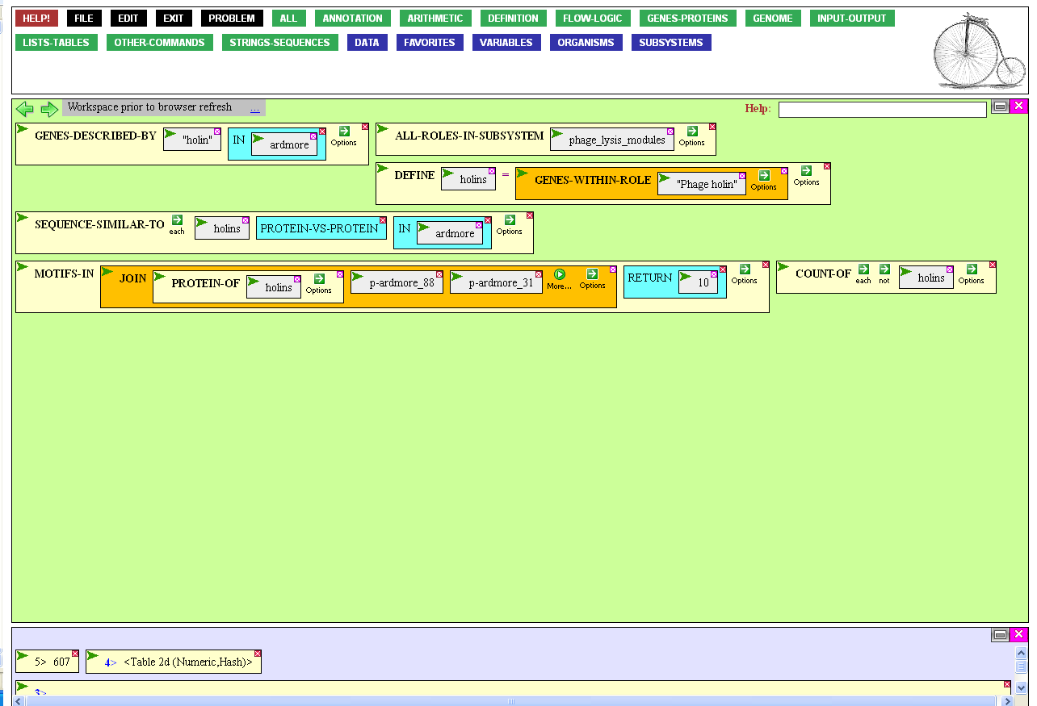
The practical solution is to make do
with less -- 325 proteins is gross
overkill. You’ll get substantially
the same results by choosing a subset
at random from holins, and you’ll
get the results within your lifetime.
Again, we want to surround the
set (or the proteins of the set),
so click the Action icon…

Slide 61
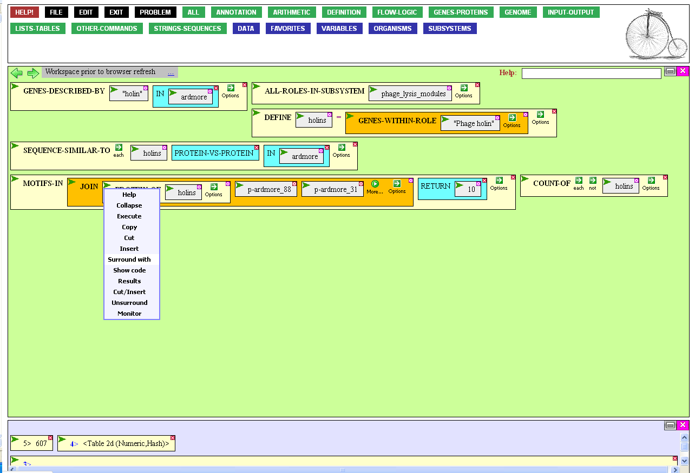
…click Surround with…

Slide 62
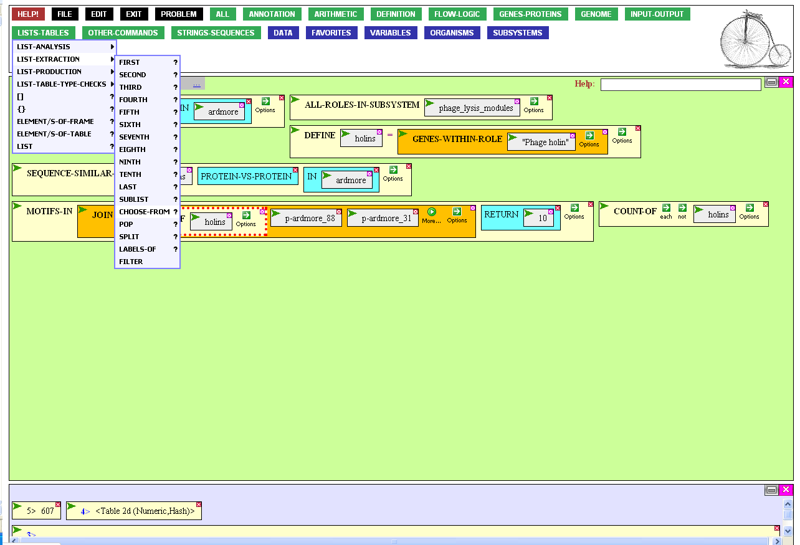
…and from the List-Tables menu, List-Extraction submenu, click
the CHOOSE-FROM function.

Slide 63

By default, CHOOSE-FROM will choose just one element from a list, but you want many, say 40, holins.
Modify the workings of the function by mousing
over the Options icon and clicking the Times
option. You don’t want the same protein twice,
so also click the Without replacement option.
Finally, Apply the options.

Slide 64

Click the value entry box of Times to specify how many random selections you want, type 40, then press Enter.

Slide 65

Now execute the function…

Slide 66


This is the output that pops up,
courtesy of MEME, the publicly available tool used by BioBIKE.
There’s much here, but for the moment, scroll down to the summary at the end.

Slide 67

The summary presents each protein and the conserved amino acid motifs that were found in each protein sequence.
The two Ardmore proteins have
motifs too… what do they mean?
Each motif is defined earlier in the output. For example, consider
Motif #3, found in p-Ardmore_88
and some acknowledged holins…

Slide 68

The motif is defined by an alignment of segments of some of the proteins. The degree of similarity is much higher than one would expect by chance.
Motif #3

Slide 69
Different holins exhibit common patterns of conserved motifs.
The pattern seen in p-Ardmore_88 coincides with the pattern observed in several proteins annotated
as holins (not all shown here)
and partially coincides with
several others.

Slide 70
Less convincingly, p-Ardmore_31 shows a single motif found
in some proteins annotated
as holins.
Of course, one would want to look for experimental evidence concerning the functionality
of these motifs before declaring
on this basis that the proteins
are or are not holins.
But this is a good start.

Slide 71
Finding proteins / Use of subystems
Reflections and Coming Attractions
This tour ended with a ray of hope that an answer may be at hand concerning the question of whether a certain phage has a protein of a certain function. Like any important question, however, this one is not answered so easily. The motifs found may not be unique to the desired function or may not be sufficient. Indeed, the human-curated protein category that led to the candidate proteins may be faulty. After all, humans are only human.
Ultimately, a satisfying answer must rest on experiment, if not with the specific protein of the specific phage, at least with other similar proteins. It is essential that those poring through vast bioinformatic databases be able to discern which conclusions are based directly on experimental evidence and which are merely inferred from perceived similarity.
This is the subject of the tour Integration of Experimental Evidence.

