Slide 1
Integration of experimental evidence
Summary
Confronted by an overwhelming amount of information, it is tempting to accept the word of the computer as truth. This is a grave mistake, but there is often little practical recourse. This tour shows one way how BioBIKE allows you to confine your attention to assertions that are based on experimental evidence and how this information enters the system.
This is best viewed as a slide show.
To view it, click Slide Show on the top tool bar, then View show.
Click to start

Slide 2
Integration of bioinformatic and experimental evidence
Slide #
Problem: Are there endonuclease genes in phage genomes?
Find phage genes annotated as “endonucleases”
Are these assertions are based on experimental evidence?
How to view / edit assertions about a gene
Reflections and coming attractions
3 – 29
4 – 15
16 – 19
20 – 29
30
To navigate to a specific slide, type the slide number and press Enter (works only within a Slide Show)

Slide 3
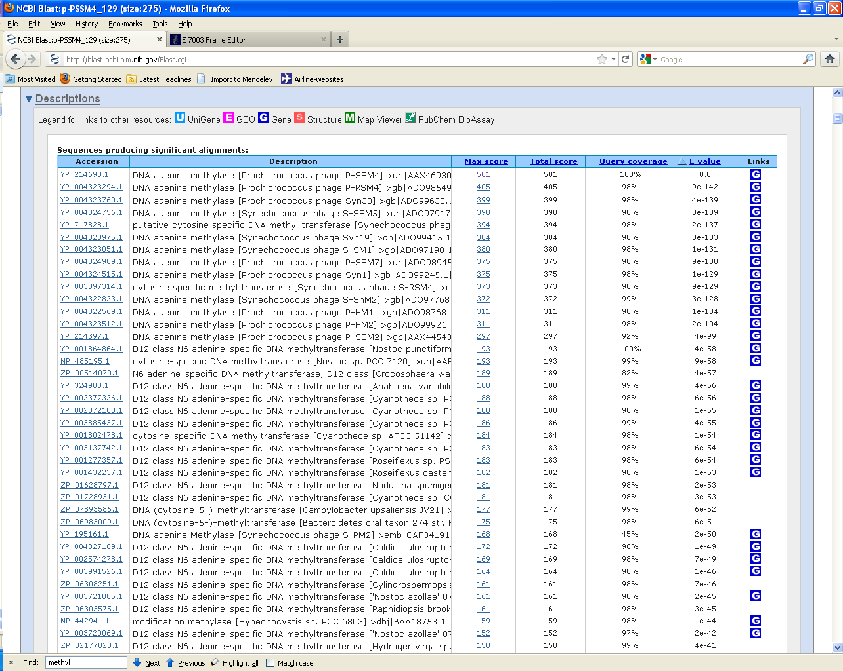

Integration of experimental evidence
The tour How to cope with overwhelming information posed the problem of identifying the proper function of a DNA methyltransferase encoded by the genome of a cyanobacterial phage.
DNA methyltransferases are often associated with restriction endonucleases. Do phage also have endonucleases as well as methyltransferases?
It’s just a passing thought, but we should
be able to answer the question fairly easily.

Slide 4
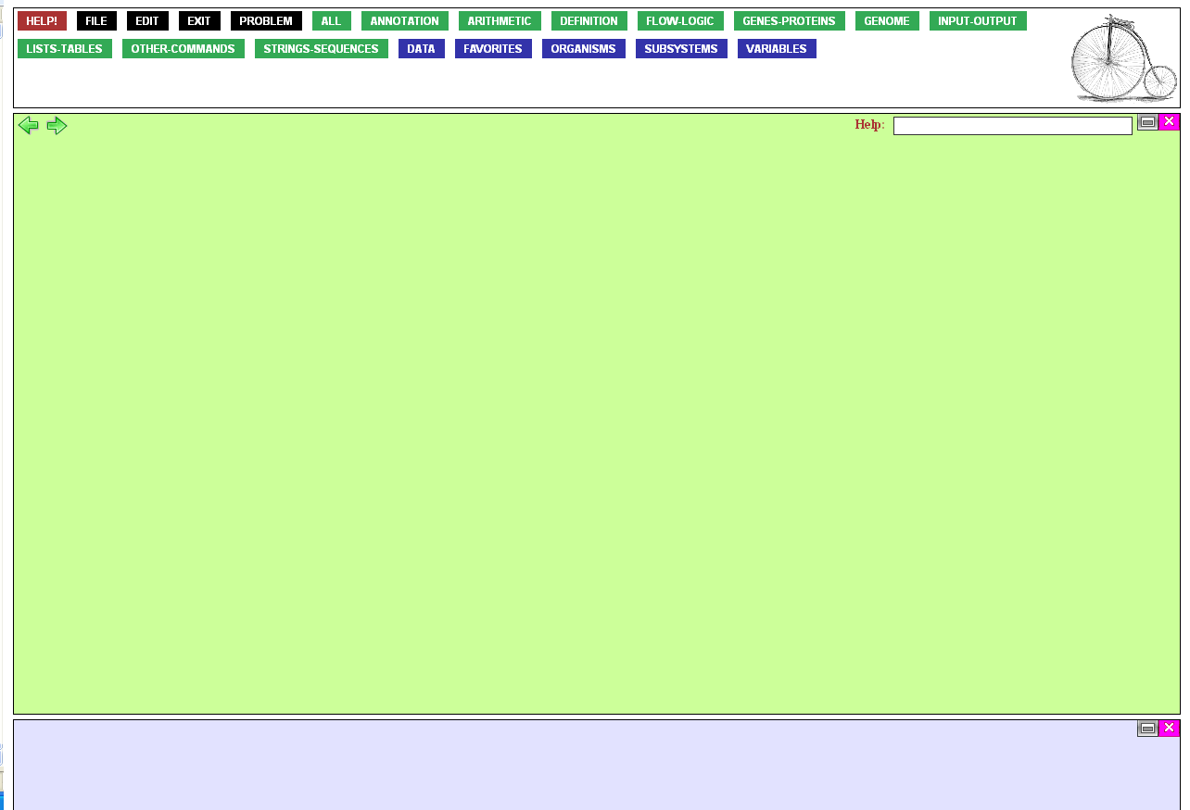
Are there any phage genes annotated as “endonucleases”?
To find out, mouse over the
Genes-Proteins button…

Slide 5
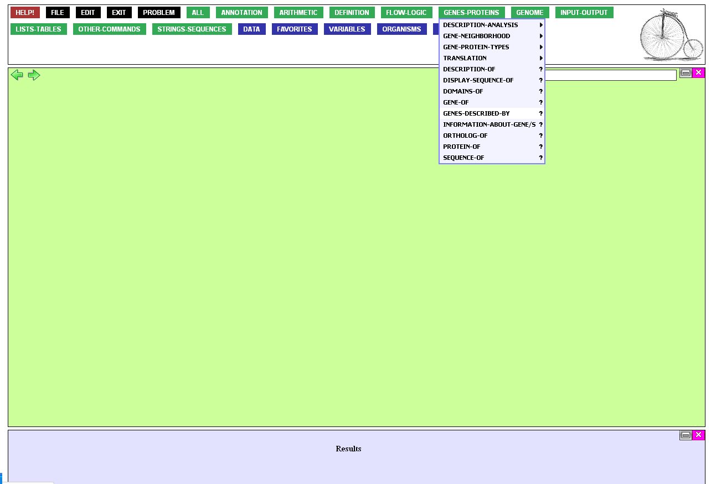
…and click
GENES-DESCRIBED-BY.

Slide 6
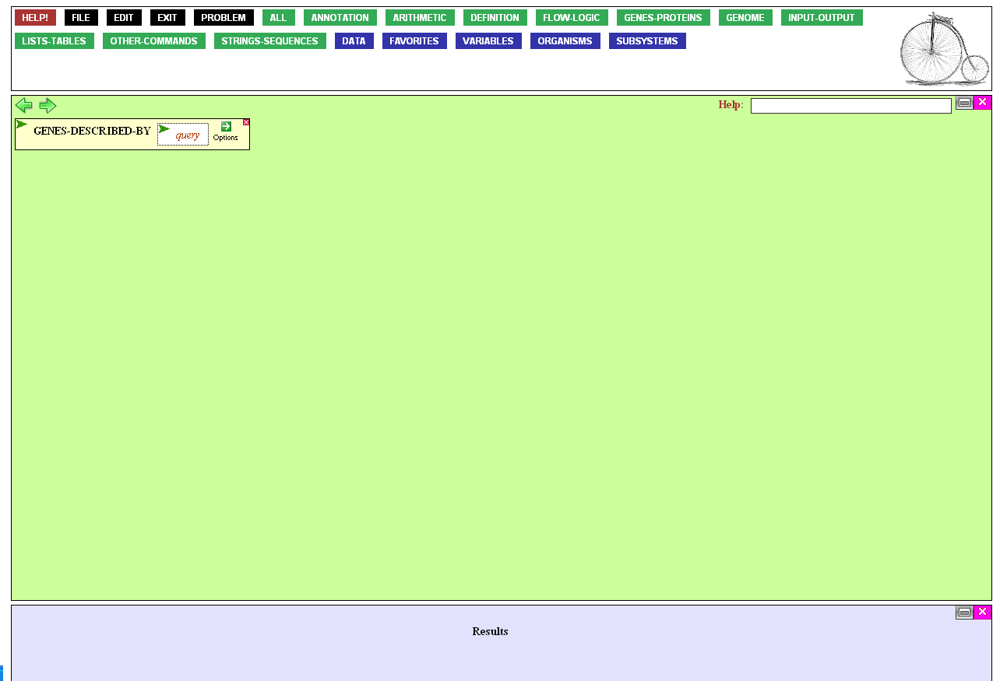
This brings the function
into the workspace.
GENES-DESCRIBED-BY requires a query, some
word or set of words you’re
looking for in the annotation.
To supply it, click
the query entry box

Slide 7

Type in the open entry box “endonuclease”, then close it by pressing the Enter or Tab key.
This is important, because
if the box is left open, the
function cannot be executed.

Slide 8
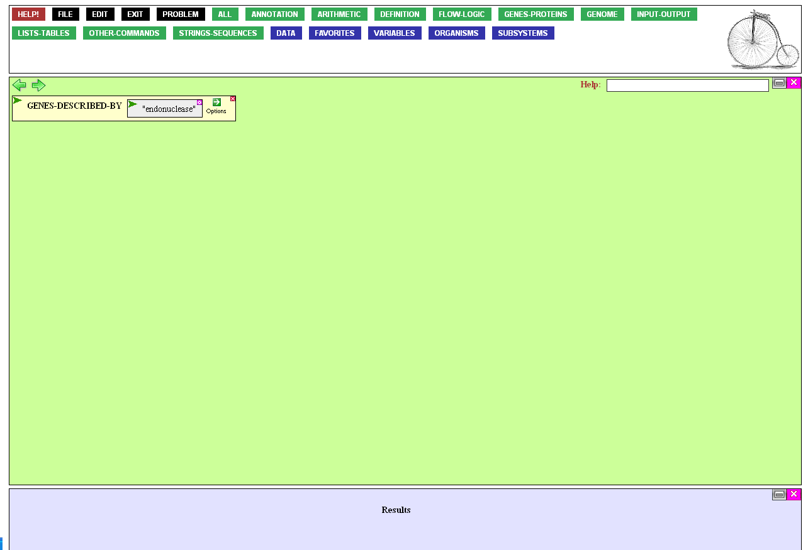
The function is now ready to be executed, but by default, BioBIKE
will look through the annotations
of all genes, including the huge
number of bacterial genes.
You can save time by specifying that you’re interested only in phage genes.
To modify the working of the function, mouse over the Options icon…

Slide 9
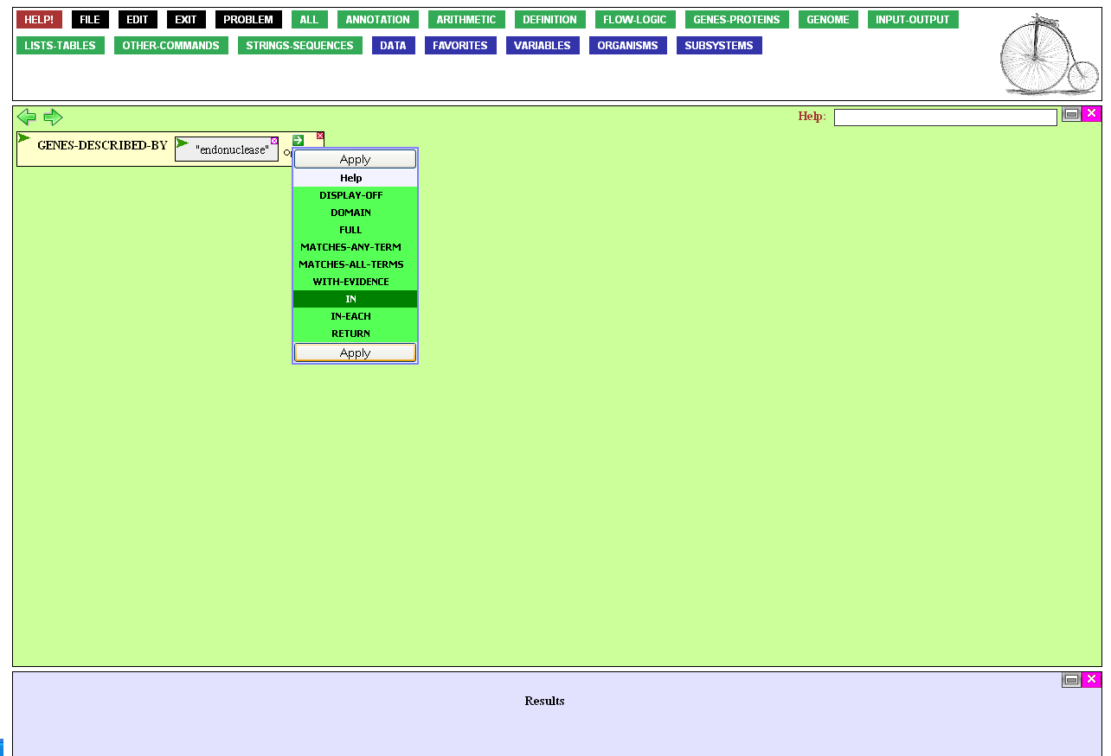
…click the In option, and then Apply.

Slide 10
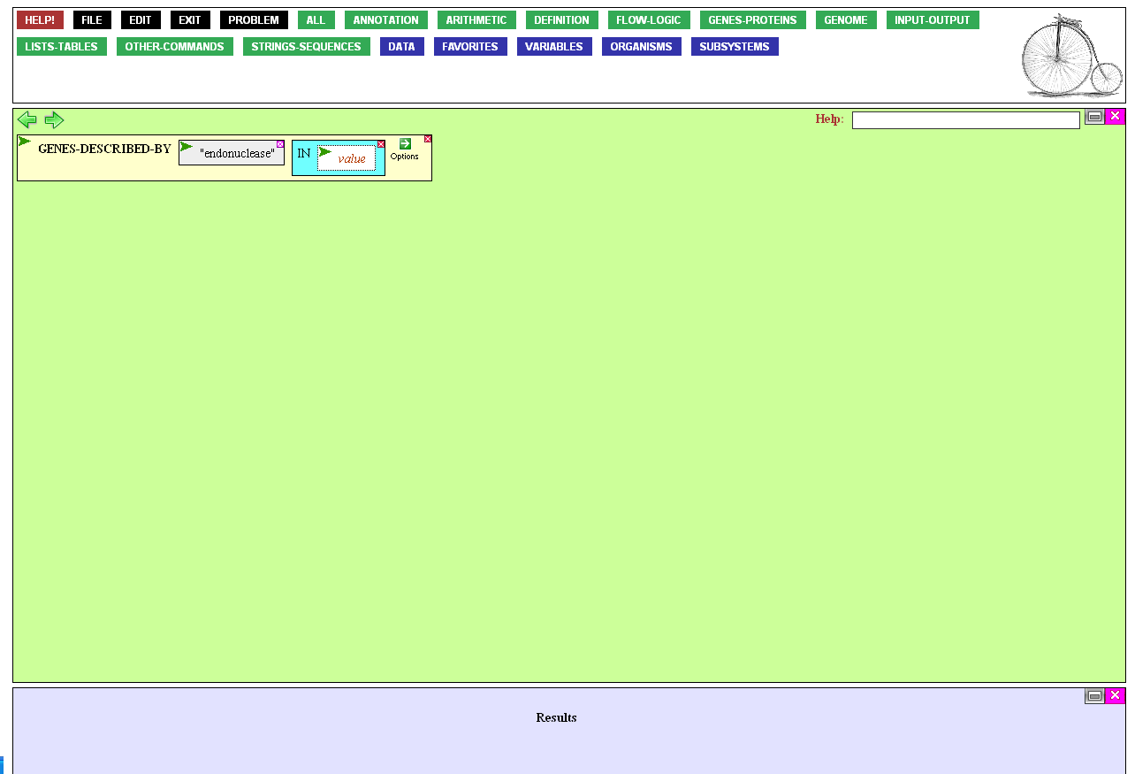
The In option allows you to specify
the range of organisms/phage
whose genes will be searched.
Open the value box for
entry by clicking it.

Slide 11

Fill the entry box by getting the
set of all phage, available
from the Organisms menu.
Mouse over that button…

Slide 12
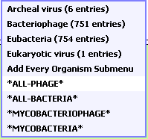
…and click *all-phage*.
(The asterisks are a reminder that
this is the name of a system-wide
set that everyone can use)

Slide 13

Now the function is ready to be executed, by mousing over the
green Action Icon of the function…

Slide 14

…and clicking Execute.

Slide 15
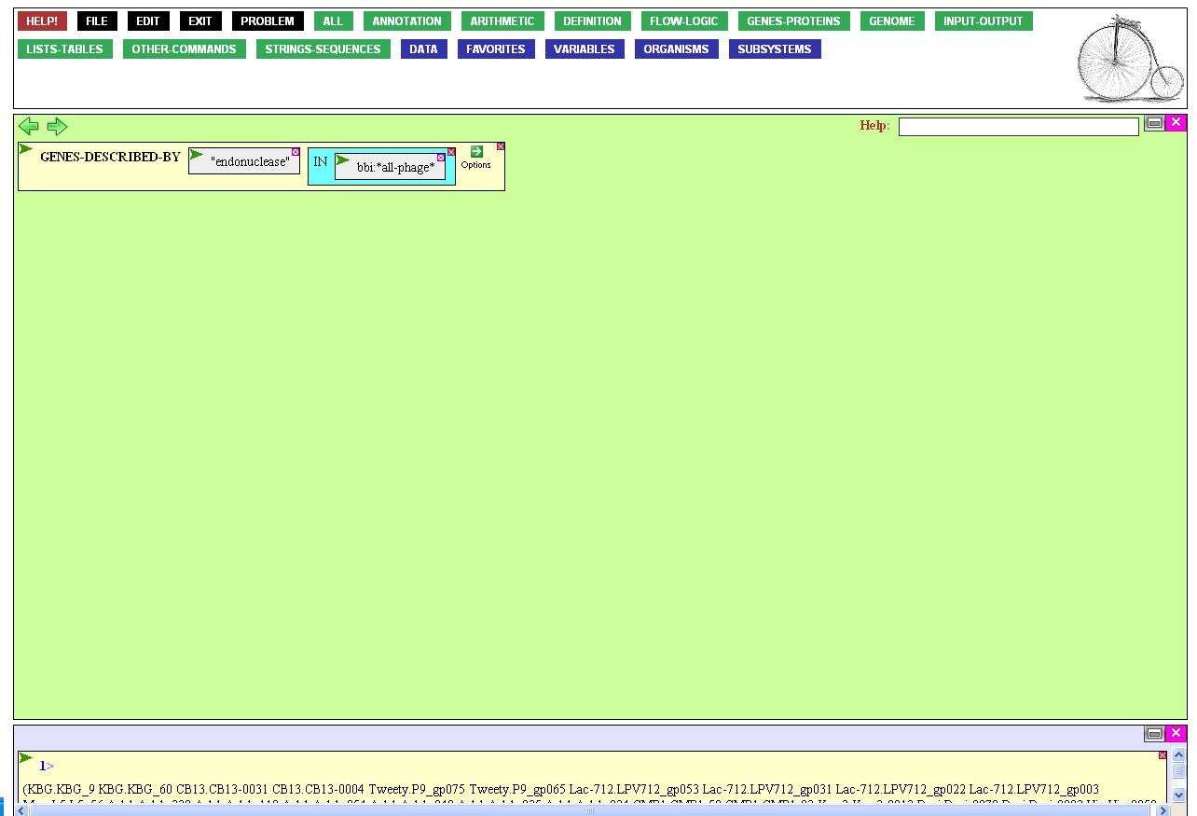
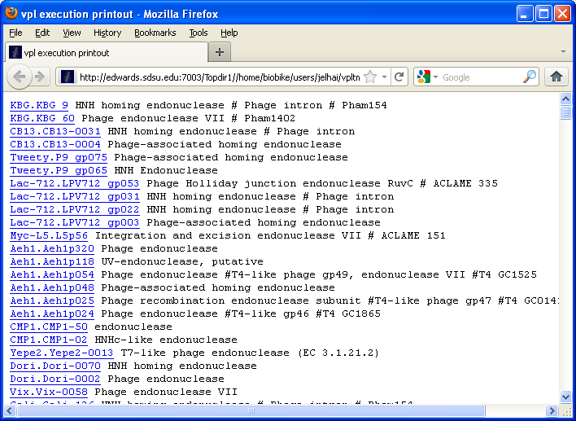
There are clearly lots of phage
genes annotated as endonucleases,
and perhaps some of them are restriction endonucleases
(though some evidently are not)

Slide 16

(From the tour How to cope with overwhelming information)
But I’ve been fooled too many
times by annotation, and I want
to know which of these assertions
of endonucleasehood are supported
by direct experimental evidence!
So X out of the popup window…

Slide 17
…and go for one more option…

Slide 18
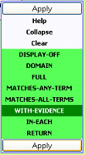
…specifying With evidence,
and click Apply.

Slide 19
Now you can execute the function
as before, through the Action Icon,
or simply by double-clicking the
name of the function.

Slide 20
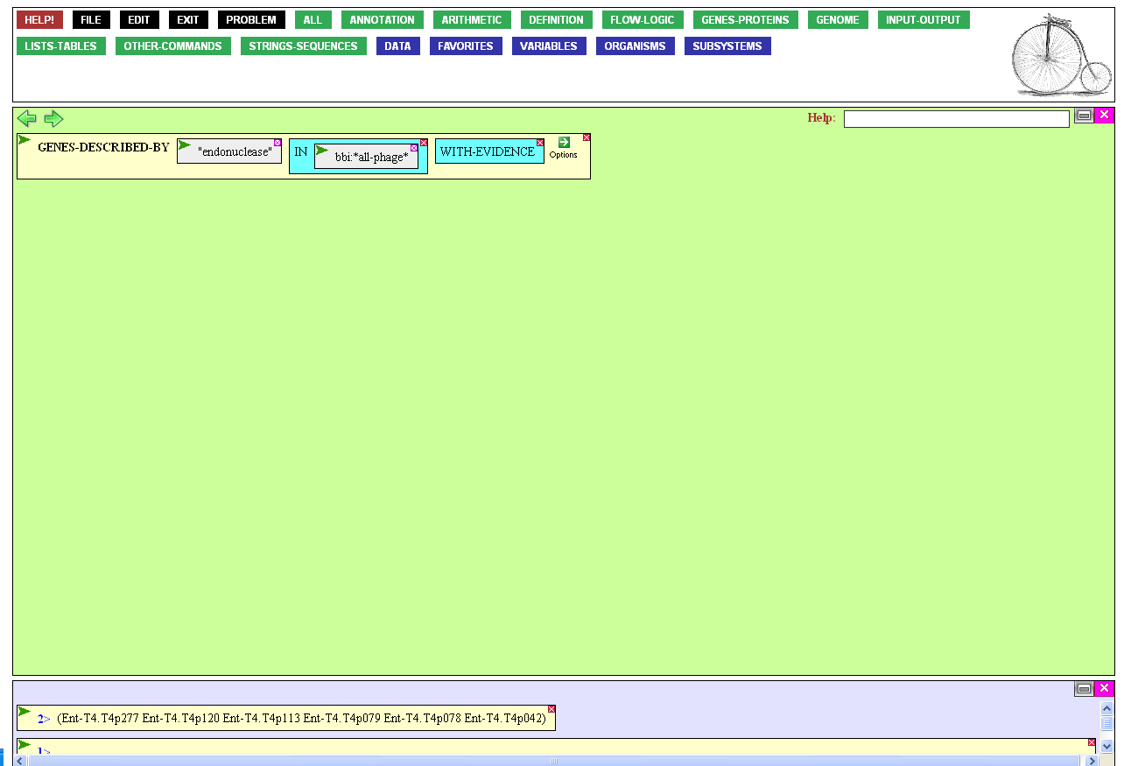
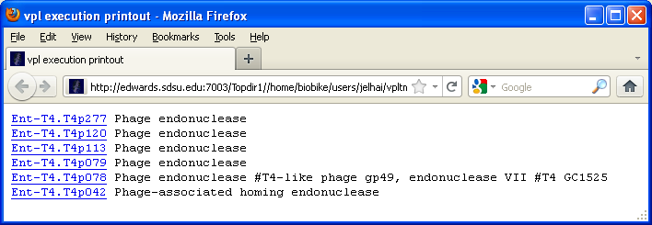
? ? ?
What? Only six are experimentally verified? And all of them in Phage T4???
That doesn’t sound likely.
Perhaps there’s a mistake in the system?

Slide 21
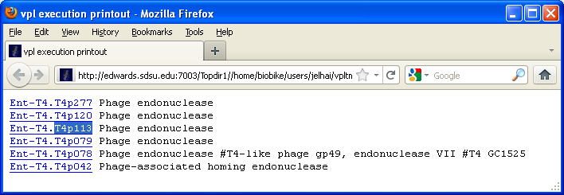
? ? ?
Let’s investigate one of the genes.
Copy its name and X out of the window.

Slide 22

Now click the gene-or-protein entry
box and paste in the name of the gene...

Slide 23
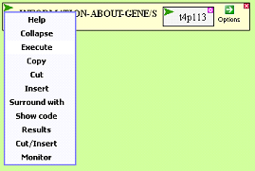
...and execute the function

Slide 24
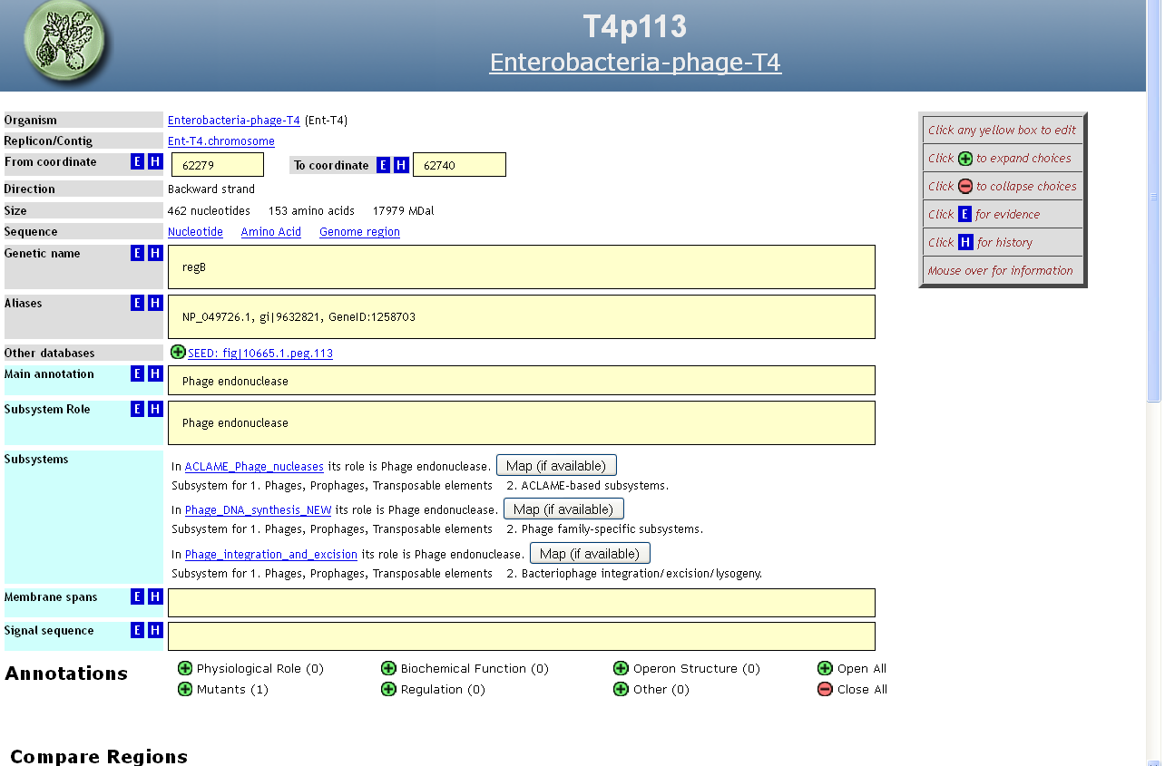
This brings us to the
gene’s annotation page.
Mousing over the Information icon for
the main annotation…

Slide 25
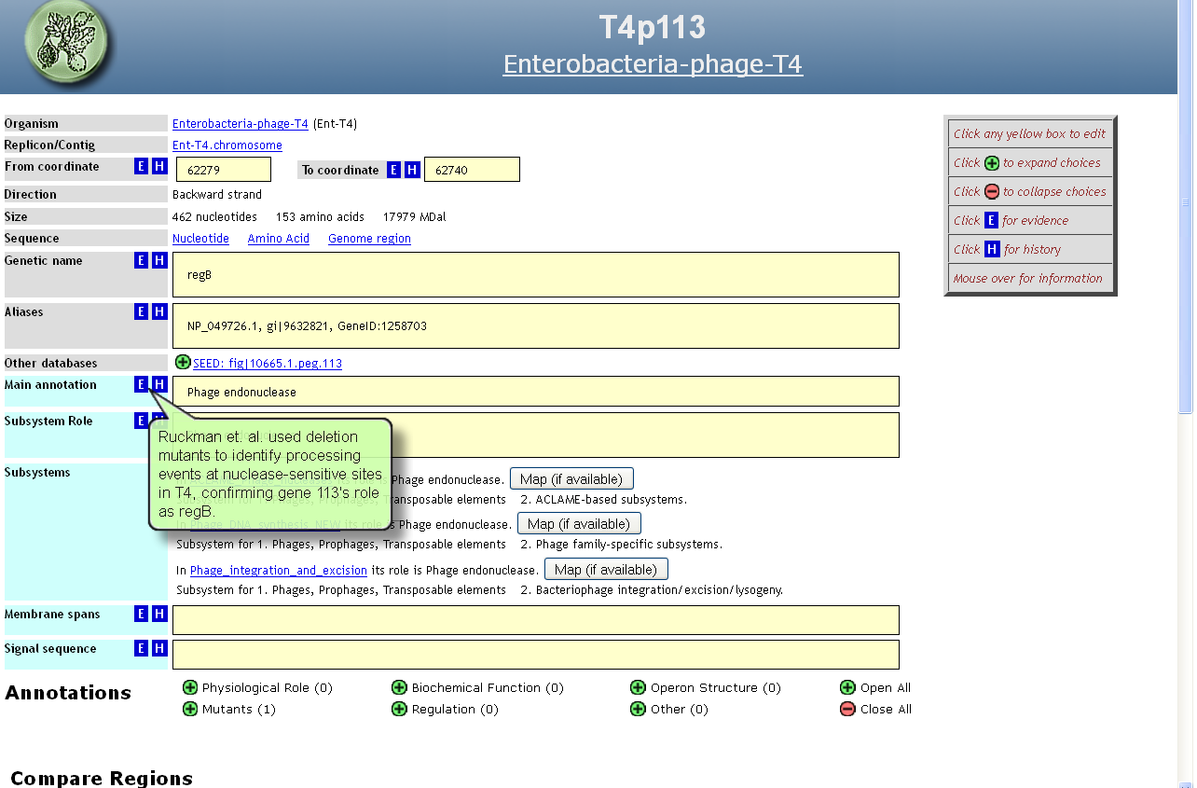
…we learn that there’s experimental evidence
for the assertion.
Clicking the same icon…

Slide 26
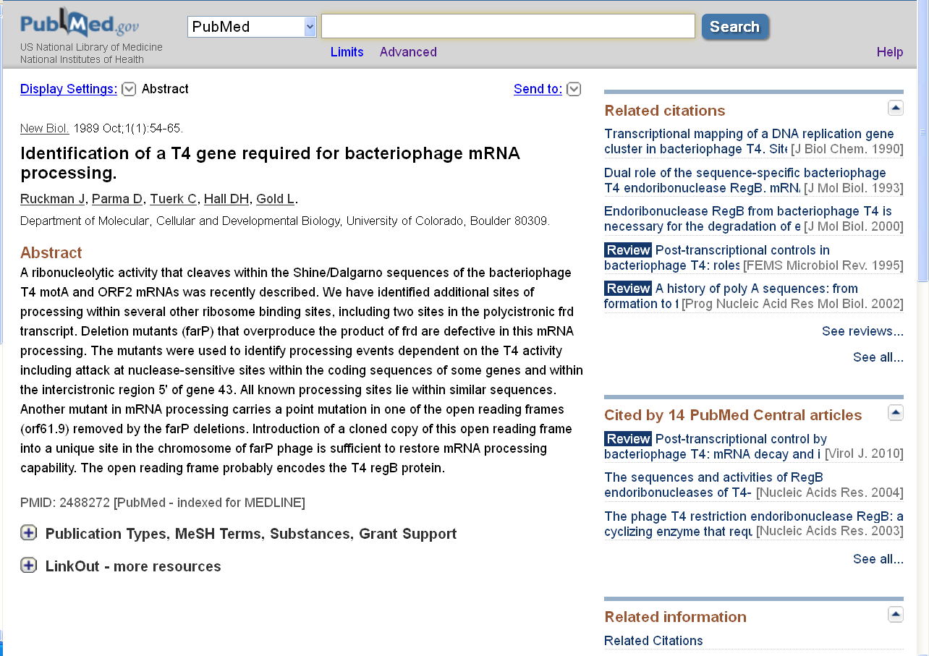
…brings us to a page from which we might learn more.

Slide 27
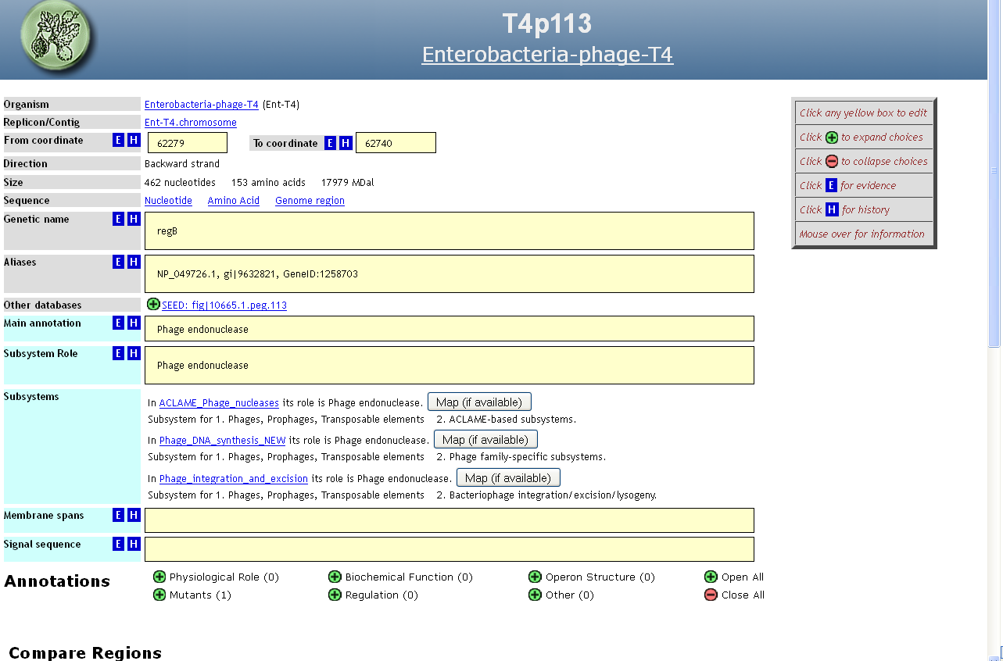
Where did this
information come from?
Mousing over the History icon, we learn that the assertion was annotated by …
Where did this
information come from?
Mousing over the History icon,
we learn that the assertion was annotated by Danielle Renner.
In fact, clicking on the yellow entry box for Main annotation,…
Changed by Danielle Renner
(2011-07-20). Click for full history.
Changed by Danielle Renner
(2011-07-20). Click for full history.

Slide 28
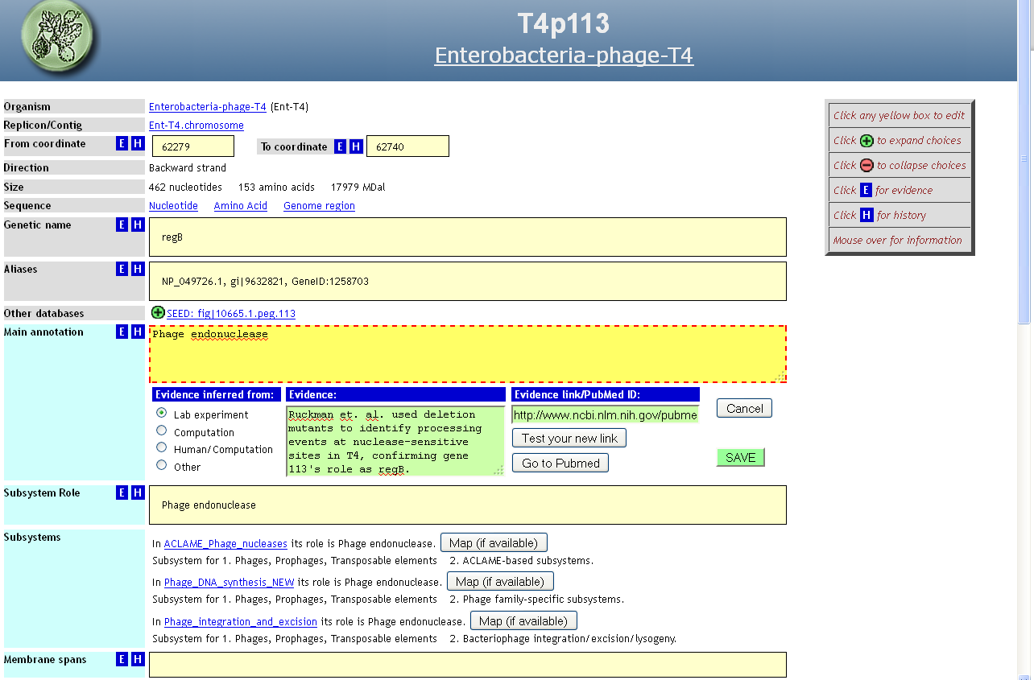
…you can see that it, like all the other yellow boxes, can be edited
by any user, including you.

Slide 29
? ? ?
The problem is not a mistake
in the system but rather the lack of people like Danielle to contribute experimental evidence concerning
their favorite genes and phages.

Slide 30
Integration of experimental evidence
Reflections and Coming Attractions
Genome databases are riddled with misinformation. Sequences are produced far faster than humans can assimilate their significance, and a natural inclination has emerged to fight automated sequence production with automated annotation. The result has been rapid annotation, but not very good annotation.
At this stage in our evolution, humans are much better than machines at figuring out what is true, and the combination of humans and machines is virtually unbeatable. Our challenge is to figure out ways to combine those two forces to propagate evidence-based annotation and to make it easy for researchers to distinguish assertions that have experimental evidence from those that don’t.
Behind every helpful computer are helpful humans.
But equally so, behind every human productive in genome analysis is a productive computer – humans need powerful computational tools. The tour Searching through patterns provides another tool in the arsenal.

