Slide 1
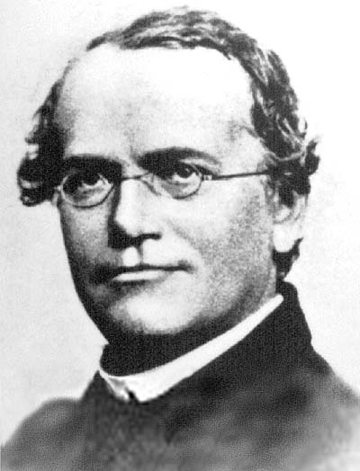
How close is close enough?
Part I
The Experiment
This demonstration is best viewed as a slide show,
enabling you to simulate a session and make
changes in cursor position more obvious.
To do this, click Slide Show on the top tool bar, then View show.

Slide 2
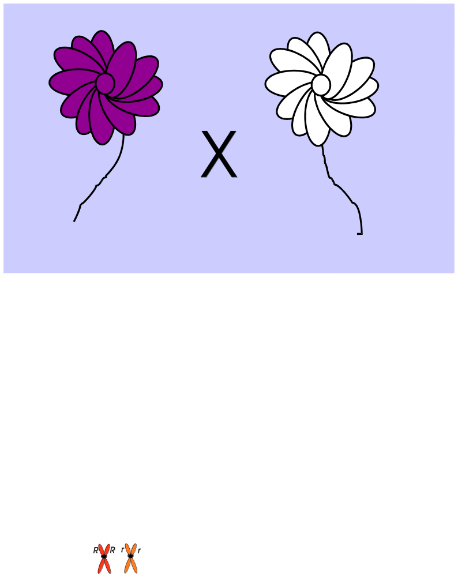
How close is close enough?
In the 1860's, long before our current understanding of genes and chromosomes, Gregor Mendal performed experiments in which he crossed pea plants with different traits and observed the traits of their offspring. From the results, he deduced rules that he claimed could predict how traits are transmitted.

Slide 3
How close is close enough?
?
In many cases, those rules do a pretty good job in predicting how often a trait appears in the next generation. But looking back on his experiments, we can see that the results don't exactly agree with what we'd predict. Perhaps we shouldn't insist on exact agreement between prediction and his results.
Are they close enough?

Slide 4
How does flower color arise?
How?
Let's take advantage of what we know and Mendel did not.

Slide 5

How does flower color arise?
How?
Let's take advantage of what we know and Mendel did not.
We know that traits, like purple color, are determined by genes.
We know that genes reside on chromosomes.

Slide 6
How does flower color arise?
...GGATCGAT…
…CCTAGCTA...
How?
Let's take advantage of what we know and Mendel did not.
We know that traits, like purple color, are determined by genes.
We know that genes reside on chromosomes.
We know that the information within genes is determined by the DNA sequence of the chromosome.

Slide 7
How does flower color arise?
P
P
...GGATCGAT…
…CCTAGCTA...
How?
Let's take advantage of what we know and Mendel did not.
We know that traits, like purple color, are determined by genes.
We know that genes reside on chromosomes.
We know that the information within genes is determined by the DNA sequence of the chromosome.
Suppose that purple color in the pea plant is determined by a gene we'll call P (capital P).

Slide 8
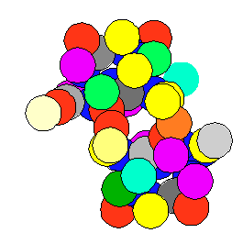
How does flower color arise?
P
P
...GGATCGAT…
…CCTAGCTA...
How?
We know that a gene determines a protein

Slide 9
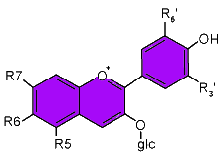
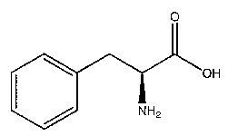
How does flower color arise?
P
P
...GGATCGAT…
…CCTAGCTA...
How?
Purple pigment
We know that proteins serve as enzymes, which catalyze chemical reaction. In this case, the enzyme catalyzes one step in the transformation of a colorless chemical to one that is purple.

Slide 10
How does flower color arise?
P
P
...GGATCGAT…
…CCTAGCTA...
How?
When that purple pigment
is made, the flower looks purple.
Purple pigment

Slide 11
How does flower color arise?
p
Mutation
P
p
P
...GGATCGAT…
…CCTAGCTA...
...GGACCGAT…
…CCTGGCTA...
Suppose one letter in the DNA on the gene in the chromosome suffers a change, a mutation. We'll call the changed version p (small p).
Purple pigment

Slide 12
How does flower color arise?
p
Mutation
P
p
P
...GGATCGAT…
…CCTAGCTA...
...GGACCGAT…
…CCTGGCTA...
That could lead to a mutation, a changed amino acid, in the protein determined by the gene
Purple pigment

Slide 13
How does flower color arise?
p
Mutation
P
p
P
...GGATCGAT…
…CCTAGCTA...
...GGACCGAT…
…CCTGGCTA...
The mutated protein may no longer work properly as an enzyme and may no longer catalyze the reaction leading to the purple pigment.
Purple pigment

Slide 14
How does flower color arise?
p
Mutation
P
p
P
...GGATCGAT…
…CCTAGCTA...
...GGACCGAT…
…CCTGGCTA...
In the absence of the enzyme-catalyzed reaction, the purple pigment is not produced.
Purple pigment

Slide 15
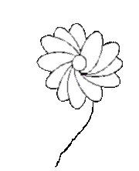
How does flower color arise?
p
Mutation
P
p
P
...GGATCGAT…
…CCTAGCTA...
...GGACCGAT…
…CCTGGCTA...
And so the mutant pea plant doesn't make the purple pigment, and its flowers are white.
Purple pigment

Slide 16
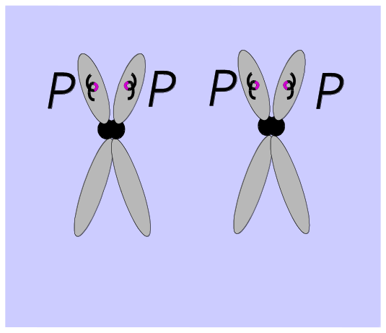
How does flower color arise?
...GGATCGAT…
…CCTAGCTA...
In brief…
You get a purple flower, if the plant carries the normal version of the gene.
(note that plants, like humans, have two copies of every chromosome)

Slide 17
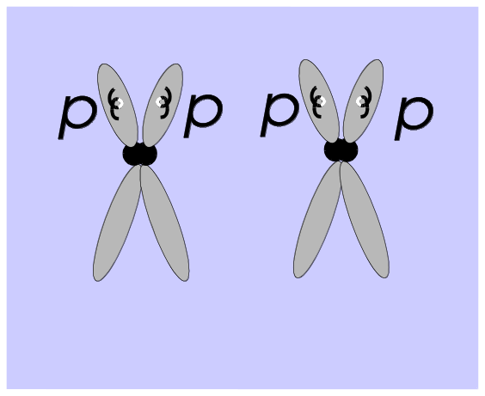
How does flower color arise?
p
p
...GGATCGAT…
…CCTAGCTA...
...GGACCGAT…
…CCTGGCTA...
In brief…
You get a purple flower, if the plant carries the normal version of the gene.
You get a white flower, if the plant carries the mutant version of the gene.
OR

Slide 18
How does flower color arise?
p
p
...GGATCGAT…
…CCTAGCTA...
...GGACCGAT…
…CCTGGCTA...
In brief…
You get a purple flower, if the plant carries the normal version of the gene.
You get a white flower, if the plant carries the mutant version of the gene.
OR
What color flower do you
get if you cross a purple flower with a white flower?
(Good question)

Slide 19
Mendel's Monohybrid Cross
p
p
...GGATCGAT…
…CCTAGCTA...
...GGACCGAT…
…CCTGGCTA...
To find out, Mendel performed a cross between a purple-flowered pea plant and a white-flowered pea plant.
In the purple pea, each chromosome carried the P version of the gene.
In the white pea, each chromosome carried the p version of the gene

Slide 20
Mendel's Monohybrid Cross
p
p
...GGATCGAT…
…CCTAGCTA...
...GGACCGAT…
…CCTGGCTA...
P
p
The progeny of this cross contained one chromosome from the purple parent and one chromosome from the white parent.
Every progeny therefore carried both versions of the gene: P and p.

Slide 21
Mendel's Monohybrid Cross
p
p
...GGATCGAT…
…CCTAGCTA...
...GGACCGAT…
…CCTGGCTA...
P
p
The protein deter-
mined by p was unable to catalyze the production of purple pigment.

Slide 22
Mendel's Monohybrid Cross
p
p
...GGATCGAT…
…CCTAGCTA...
...GGACCGAT…
…CCTGGCTA...
P
p
But the protein determined by P was an effective catalyst.

Slide 23
Mendel's Monohybrid Cross
p
p
...GGATCGAT…
…CCTAGCTA...
...GGACCGAT…
…CCTGGCTA...
All the progeny therefore had purple flowers.
This was surprising.
Most at the time expected a blending of colors.
F₁ progeny
P
p

Slide 24
Mendel's Monohybrid Cross
F₁
F₁
p
p
Even more surprising is what came next. What happens if you cross two of the progeny? (Good question)
According to the wisdom of the time, if both parents had purple flowers, so should their progeny, but…

Slide 25
Mendel's Monohybrid Cross
F₁
F₁
p
p
Most are indeed purple, but some are white.
WHY?
(GQ)

Slide 26
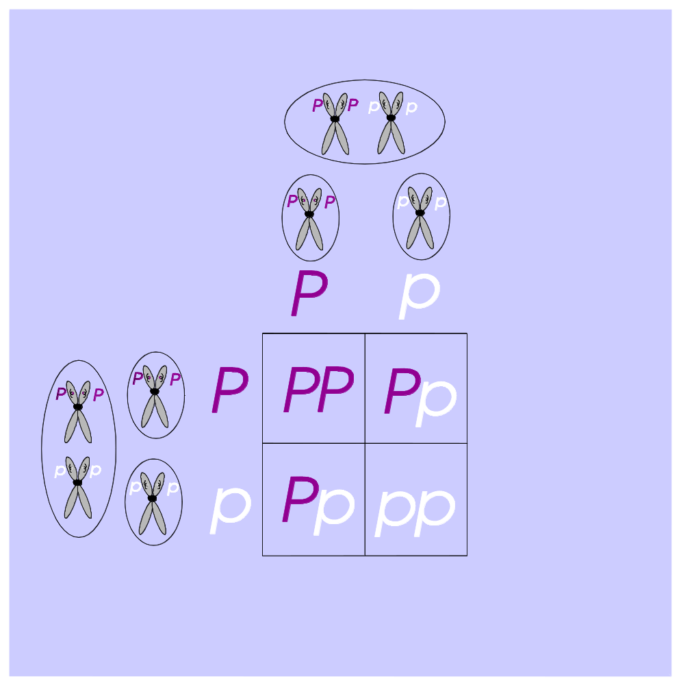

Mendel's Monohybrid Cross
F₁ Cross
Possible gametes
Both F₁ plants have the same genotype of Pp, and both produce the same two possible gametes. Gametes are sperm or eggs. For our purposes, it doesn't matter which is which.

Slide 27
Mendel's Monohybrid Cross
F₁ Cross
The two types of gametes from each parent can be combined in four possible ways.

Slide 28
Mendel's Monohybrid Cross
F₁ Cross
Only one of the ways has no effective enzyme and so produces white flowers.
Prediction
3
1

Slide 29
Mendel's Monohybrid Cross
F₁ Cross
…while three of the ways do have effective enzymes, producing purple flowers.
Prediction
3
1

Slide 30
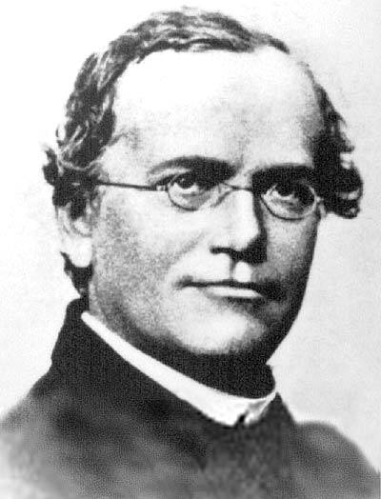
Mendel's Monohybrid Cross
F₁ Cross
So, from our current knowledge of genetics and biochemistry, we know what the result should be.
Mendel didn't know any of this. But from his results he declared that purple and white flowers appear in a 3:1 ratio, and he built his theory around these results.
Prediction
3
1
What were his results?

Slide 31
Mendel's Monohybrid Cross
Mendel's actual results
705
224
…Lots more purple flowers than white flowers!
…but is this a 3:1 ratio?

Slide 32
Mendel's Monohybrid Cross
Mendel's actual results
705
224
…Lots more purple flowers than white flowers!
705
…but is this a 3:1 ratio?
= 3.147
224
No! Too many purple flowers

Slide 33
Mendel's Monohybrid Cross
Mendel's actual results
705
224
…Lots more purple flowers than white flowers!
705
= 3.147
What should have
been the results?
224

Slide 34
Mendel's Monohybrid Cross
Mendel's actual results
705
+
224
=
929
…Lots more purple flowers than white flowers!
705
= 3.147
What should have
been the results?
224

Slide 35
Mendel's Monohybrid Cross
Mendel's actual results
705
+
224
=
929
P
p
How many plants should there have been of each genotype?
P
PP
Pp
???
???
How many purple?
How many white?
p
Pp
pp
???
???
705
= 3.147
What should have
been the results?
224

Slide 36
Mendel's Monohybrid Cross
Mendel's actual results
705
+
224
=
929
P
p
How many plants should there have been of each genotype?
P
PP
Pp
232¼
232¼
3
p
Pp
pp
232¼
232¼
1
705
= 3.147
What should have
been the results?
224

Slide 37
Mendel's Monohybrid Cross
Mendel's actual results
705
+
224
=
929
Observed:
Expected:
696¾
+
232¼
=
929
705
696¾
= 3.147
What should have
been the results?
= 3.0
224
232¼

Slide 38
Mendel's Monohybrid Cross
Mendel's actual results
705
+
224
=
929
Observed:
Expected:
696¾
+
232¼
=
929
Was Mendel
close enough?
705
696¾
= 3.147
= 3.0
224
232¼

Slide 39
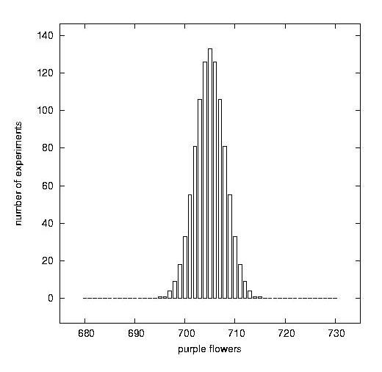
Was Mendel Close Enough?
How to tell?
705
+
224
=
929
Observed:
Expected:
696¾
+
232¼
=
929
The time-honored method of assessing the accuracy of an experimental result is to repeat the experiment multiple times.
Suppose Mendel had repeated his experiment a thousand times and each time he counted how many purple flowers there were, giving the compilation of the results shown to the right.
What would you conclude?
1000 imagined replications of experiment
Number of experiments
Expected
Purple flowers

Slide 40
Was Mendel Close Enough?
How to tell?
705
+
224
=
929
Observed:
Expected:
696¾
+
232¼
=
929
If he had done this, the answer would be clear: Under his experimental conditions, there are more purple flowers in the progeny than you would expect from a 3:1 ratio.
But Mendel didn't do the experiment a thousand times.
We'll have to think of another way to judge the matter.
1000 imagined replications of experiment
Number of experiments
Expected
Purple flowers

Slide 41
Was Mendel Close Enough?
How to tell?
705
+
224
=
929
Observed:
Expected:
696¾
+
232¼
=
929
We can't compare (nonexistent) multiple replications of Mendel's experiment against the expected 3:1 ratio, but we can do something almost as good. We can imagine 1000 replications of the experiment in an imaginary world where all the mechanisms underlying the 3:1 ratio are true.
How often would the experiment give results similar to Mendel's?
1000 imagined replications of experiment
Number of experiments
Expected
Purple flowers

Slide 42
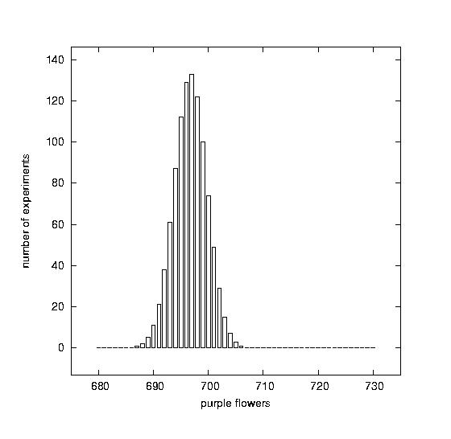
Was Mendel Close Enough?
How to tell?
1000 imagined replications in 3:1 world
Conceivably, the distribution of results in this ideal world would be narrow (as shown at the left), and Mendel's observed result would be unlikely. We'd then conclude that Mendel was not warranted to call his result close to 3:1.
Number of experiments
Expected
Observed
Purple flowers

Slide 43
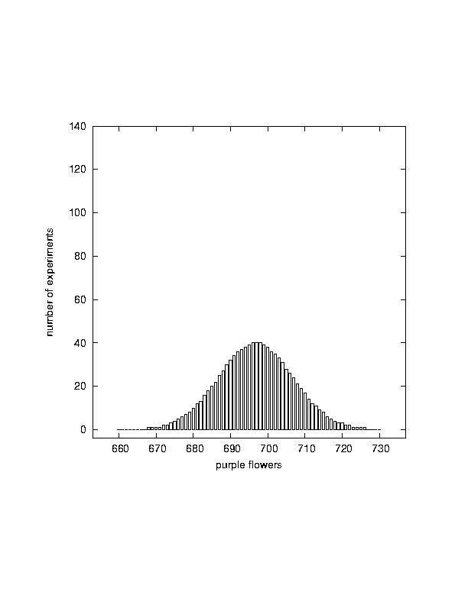
Was Mendel Close Enough?
How to tell?
1000 imagined replications in 3:1 world
Conceivably, the distribution of results in this ideal world would be narrow (as shown at the left), and Mendel's observed result would be unlikely. We'd then conclude that Mendel was not warranted to call his result close to 3:1.
Number of experiments
Expected
Observed
1000 imagined replications in 3:1 world
Number of experiments
Purple flowers
Alternatively, the distribution of results in this ideal world might be broad, easily accommodating Mendel's observed result. We'd then conclude that Mendel was warranted to call his result close to 3:1.
Expected
Observed
Purple flowers

Slide 44
Was Mendel Close Enough?
How to tell?
1000 imagined replications in 3:1 world
Number of experiments
Expected
Which (if either) is true?
Observed
1000 imagined replications in 3:1 world
Number of experiments
Purple flowers
Expected
Observed
How to find out?
Purple flowers

Slide 45

Was Mendel Close Enough?
How to tell?
Make up the world and find out!
(Click here )
Learn on the next episode of Was Mendel Close Enough how you can make a virtual world and do experiments within it!

