Slide 1
How to cope with overwhelming information?
Summary
This tour provides a rationale for the existence of PhAnToMe/BioBIKE, introducing the need for tool interoperability and the ability to make new tools.
This is best viewed as a slide show.
To view it, click Slide Show on the top tool bar, then View show.
Click to start

Slide 2
How to cope with overwhelming information?
Slide #
Sample problem: sequence → gene → function
Problem of interoperability (e.g. search, alignment, phylogeny)
Serial annotation catastrophe
Need for new tools to address ad hoc problems
Summary
False solution: The computer specialist
Proposed solution: Environment for biological researcher
(Overview of PhAnToMe and BioBIKE)
Reflections and coming attractions
3 – 36
10 – 36
13 – 21
37 – 42
43 – 56
46 – 49
50 – 56
57
To navigate to a specific slide, type the slide number and press Enter
(works only within a Slide Show)

Slide 3

>Batiatus (size:57656)
TGCAGATTTTGGTCTGTACGGAACCGGGGGGTTTCGCGGCATCCCCGAAA TGGGGTTGACCTGCGGTTTTGCTGATACCCTGTTGATTCCCGAAATGGGA GGAATGTCATGCCACCCCTACCTAAAGATCCTTCTGTGCGCGCTCGGCGC AATAAGTCGTCGACGCGGGCTACGTTGTCTGCGGATCATGATGTGGTCGC TCCTGAGTTGCCGGATGGTGTGGTGTGGCATCCGTTGACGGTGCGTTGGT GGAATGACATTTGGGCGTCGCCGATGGCCCCGGAGTACACCGATTCGGAT ATCAACGGGCTGTTTCGTGTGGCGATGTTGTACAACGATTTTTGGACCGC GGATACCGCGAAGGCGCGGGCGGAGGCTCAGGTTCGGCTAGAGAAAGCCG ATACCGATTATGGGACGAATCCGTTGGCTCGCCGCCGTCTGGAGTGGCAG ATTGAGGCGACGGAGGATTCCAAGGCGAAGGGGTCGAAGCGGCGGAAGTC GGATGCCGCGCCCGTGAGTCATCCTGTTCCCGGTGACGATCCGCGCCTGA AGCTTGTGACGTAGCGGTTCGACCGAGGCAGCTTGGATGGCTGTACTTCA GGTGCCGGCCGTGGATTTGGCGTTCCCGACGCTGGGTCCGCAGGTGTGCG ACTTCATTGAGGATCGGATGGTGTTCGGTCCGGGGTCGCTGTCGGGTCAG CCTGCACGTCTCGATGACGAGAAGCGCGCGCTGGTGTATCGGCTGTATGA GTTGTATCCGCGTGGGCACCGTTTGGCTGGCCGTCGGCGGTTCGAGCGGG CCGGTGTCGAACTCAGGAAGGGTGTAGCCAAGACCGAGTTCGCGGCGTGG ATTTGCGGTGTGGAGTTGCATCCAGAGGCGCCGGTTCGGTGTGACGGTTT TGACGCCGCGGGGAATCCTGTGGGTCGGCCGGTGCGGTCGCCGGTGATTC CGATGATGGCGGTCACCGAGGAGCAGGTGTCGGAGCTGGCGTTCGGTGTG CTGAAGTACATCTTGGAGAACGGCCCCGATGTTGATCTGTTTGATATCAG CAAGGAGCGGATCGTCCGGTTGTCGCCTTCGGGTGGCGAGGATGGGTTCG CTGTTGCTGTGTCGAATGCTCCGGGGTCTCGCGATGGCGCGCGGACGACG TTTCAGCATTTCGATGAGCCGCACCGGTTGTTTATGCCGAGGCATCGTGA CGCGCACGAGACGATGTTGCAGAACATGCCGAAGCGGCCGATGGAGGACC CGTGGACGTTGTACACGTCGACTGCTGGGCAGCCTGGTCAGGGCAGCATC GAAGAGGACGTGTTAGCTGAGGCGGAGTCGATCGCCAGGGGTGAGCGGCA GGACCCGTCGCTGTTCTTCTTTCGGCGCTGGGCCGGTGATGAGCATGATG ATCTGTCCACCGTGGAGAAGCGTGTCGCCGCTGTCGCGGATGCCACTGGC CCTATTGGGGAGTGGGGGCCGGGGCAGTTTGAGCGGATCGCGAAGGACTA CGACCGCACGGGTATTGACCGCGCTTACTGGGAGCGGGTCTATCTGAATC GGTGGCGTAAGTCTGGCTCTCAGGCGTTCGATATGACGCGCCTAGTGCAG TGCGATGAGACGGTGCCGGATGGAGCGTTCGTCACTGCAGGGTTTGACGG GTCGCGGTGGAGAGATGCGACGGCTGTCGTGGTCACTGAGATTGCGACGG GACGCCAGATGTTGTTGGGCTGTTGGGAGCGGCCCGAGAACGTCGAAGAG TGGGAAGTCCCTGAGCATGAGGTGACAGCGCTCGTTGTGGACATGATGGC CCGGTTTGAGGTGTGGCGCATGTACTGCGACCCGTGGGGCTGGGATTCGA CGATCGCCGCGTGGGCGGGTCGTTTCCCGGATCGGGTTGTGGAGTGGGCG GTTGGCGGCGGCGGCAGTTTGAGGCGTGTGGCTGCTGCGACGCAGGGTTA TGCCGATGCATTGGCGACTGGCGACGCGGCGCTGGCTGCCAATGTGTGGC GACCGAAGTTTGTTGAGCATATGGGTCATGCGGGGCGGCGTGAGCTGAAG CTGGTGGACGATACAGGCCAGCCGCTGTGGGTGATGCAGAAGCAGGATGG CCGTTTGGCCGACAAGTTTGATGCTGCGATGGCGGGGATGTTGTCGTGGG AGGCGTGTGTTGATGCGCGTCGTGATGGTGCACGTCCGCGCCCGAAAGTG TTTGCGCCTAGACGGATCTACTAGTCGCCATAGAGACAGAGAGGGGGTCA GCTGTTGACTGCTTCAACGCCAGCGGAATGGCTCCCGGTATTGACGAAGC GTATCGACGACGGAATGTCGCGGGTGCGTTTGTTGGCGCGTTACTCCAAT GGGGATGCTCCGCTGCCCGAGTTGACGAGGAACACGTCTGCGGCGTGGCG TTCGTTTCAGCGTGAGGCGCGCACCAACTGGGGTCTGATGGTGCGTGACT CTGTTGCTGACCGGATCATCCCGAATGGCATCACGGTTGGTGGTTCTGCC GATAGTGATTTGGCGTTACGTGCACGGCGCATCTGGCGGGATAACCGCAT GGATTCCGTGTGTAAGCAGTGGGTCAAGTATGGGCTGGACTTCGGCGAGT CGTATTTGACGTGCTGGCGTCGTGATGACGGTACGGCGACGATCACAGCT GACTCTCCTGAAACGATGGTTGTCAGCGTTGACCCGCTGCAGCCGTGGCG GATCAGGTCCGCTATGCGGTGGTGGCGGGACCTCGATGCCGAGTCGGATT TTGCGATTGTGTGGTCGGGTGACGGGTGGCAAAAGTTCGCCCGTCCGTGC TTTGTGCAGTCGTCGTCCCGGCGCAGGCTGGTGACGCGAATCTCAGACTC GTGGGTTCCGGTTGGTGATGCTGTAGTGACCGGTTCGCCGCCGCCGGTGG TGGTGTACCAGAACCCTGATGGCATGGGCGAGGTGGAGCCTCACATTGAC ATCATCAACCGGATCAACCGGGCTGAGCTTCAGTTGTTGTCCACGATGGC GATCCAGGCTTTCCGTCAGCGGGCGTTGAAGTCGACGGAAAATGGGTTGC CGAAGGTCGATGAGAACGGCAACGCGATCGACTACGCCTCGATCTTTGAG GCCGCGCCGGGAGCGTTGTGGGAGTTGCCCCCTGGGGTTGATATCTGGGA ATCGCAGCCGAACGACTTCACTCCGATGTTGTCGGCGATAAAGGAGCATA TTCGACAGCTGTCGTCGGCGACCAAGACTCCGTTGCCGATGTTGATGCCG GACAGCGCGAACCAGTCAGCTGAGGGTGCGCACAACATTGAGAAGGGC
What to do with vast amounts of data?
A defining feature of biological research today is the availability of an overwhelming amount of information.
In the case of phage biology research, that information often takes the form of tens of thousands of nucleotides.
What can we do with this information?

Slide 4
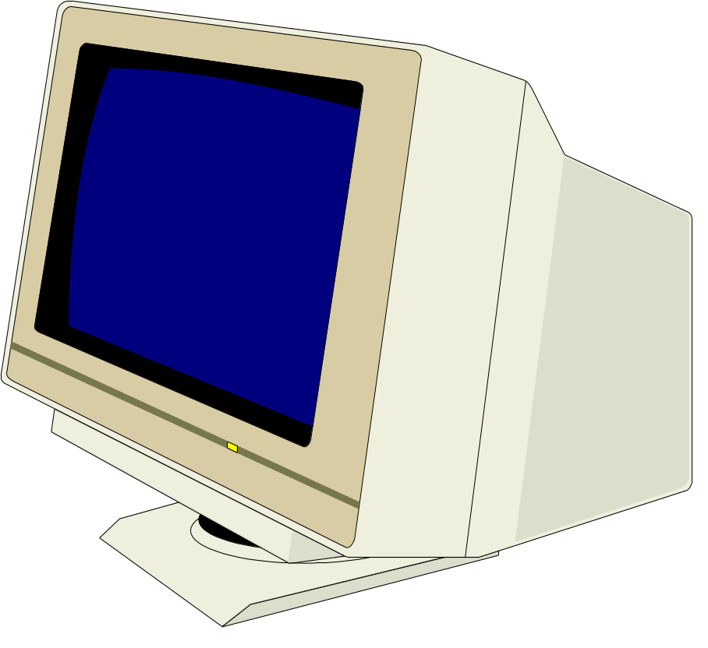
>Batiatus (size:57656)
TGCAGATTTTGGTCTGTACGGAACCGGGGGGTTTCGCGGCATCCCCGAAA TGGGGTTGACCTGCGGTTTTGCTGATACCCTGTTGATTCCCGAAATGGGA GGAATGTCATGCCACCCCTACCTAAAGATCCTTCTGTGCGCGCTCGGCGC AATAAGTCGTCGACGCGGGCTACGTTGTCTGCGGATCATGATGTGGTCGC TCCTGAGTTGCCGGATGGTGTGGTGTGGCATCCGTTGACGGTGCGTTGGT GGAATGACATTTGGGCGTCGCCGATGGCCCCGGAGTACACCGATTCGGAT ATCAACGGGCTGTTTCGTGTGGCGATGTTGTACAACGATTTTTGGACCGC GGATACCGCGAAGGCGCGGGCGGAGGCTCAGGTTCGGCTAGAGAAAGCCG ATACCGATTATGGGACGAATCCGTTGGCTCGCCGCCGTCTGGAGTGGCAG ATTGAGGCGACGGAGGATTCCAAGGCGAAGGGGTCGAAGCGGCGGAAGTC GGATGCCGCGCCCGTGAGTCATCCTGTTCCCGGTGACGATCCGCGCCTGA AGCTTGTGACGTAGCGGTTCGACCGAGGCAGCTTGGATGGCTGTACTTCA GGTGCCGGCCGTGGATTTGGCGTTCCCGACGCTGGGTCCGCAGGTGTGCG ACTTCATTGAGGATCGGATGGTGTTCGGTCCGGGGTCGCTGTCGGGTCAG CCTGCACGTCTCGATGACGAGAAGCGCGCGCTGGTGTATCGGCTGTATGA GTTGTATCCGCGTGGGCACCGTTTGGCTGGCCGTCGGCGGTTCGAGCGGG CCGGTGTCGAACTCAGGAAGGGTGTAGCCAAGACCGAGTTCGCGGCGTGG ATTTGCGGTGTGGAGTTGCATCCAGAGGCGCCGGTTCGGTGTGACGGTTT TGACGCCGCGGGGAATCCTGTGGGTCGGCCGGTGCGGTCGCCGGTGATTC CGATGATGGCGGTCACCGAGGAGCAGGTGTCGGAGCTGGCGTTCGGTGTG CTGAAGTACATCTTGGAGAACGGCCCCGATGTTGATCTGTTTGATATCAG CAAGGAGCGGATCGTCCGGTTGTCGCCTTCGGGTGGCGAGGATGGGTTCG CTGTTGCTGTGTCGAATGCTCCGGGGTCTCGCGATGGCGCGCGGACGACG TTTCAGCATTTCGATGAGCCGCACCGGTTGTTTATGCCGAGGCATCGTGA CGCGCACGAGACGATGTTGCAGAACATGCCGAAGCGGCCGATGGAGGACC CGTGGACGTTGTACACGTCGACTGCTGGGCAGCCTGGTCAGGGCAGCATC GAAGAGGACGTGTTAGCTGAGGCGGAGTCGATCGCCAGGGGTGAGCGGCA GGACCCGTCGCTGTTCTTCTTTCGGCGCTGGGCCGGTGATGAGCATGATG ATCTGTCCACCGTGGAGAAGCGTGTCGCCGCTGTCGCGGATGCCACTGGC CCTATTGGGGAGTGGGGGCCGGGGCAGTTTGAGCGGATCGCGAAGGACTA CGACCGCACGGGTATTGACCGCGCTTACTGGGAGCGGGTCTATCTGAATC GGTGGCGTAAGTCTGGCTCTCAGGCGTTCGATATGACGCGCCTAGTGCAG TGCGATGAGACGGTGCCGGATGGAGCGTTCGTCACTGCAGGGTTTGACGG GTCGCGGTGGAGAGATGCGACGGCTGTCGTGGTCACTGAGATTGCGACGG GACGCCAGATGTTGTTGGGCTGTTGGGAGCGGCCCGAGAACGTCGAAGAG TGGGAAGTCCCTGAGCATGAGGTGACAGCGCTCGTTGTGGACATGATGGC CCGGTTTGAGGTGTGGCGCATGTACTGCGACCCGTGGGGCTGGGATTCGA CGATCGCCGCGTGGGCGGGTCGTTTCCCGGATCGGGTTGTGGAGTGGGCG GTTGGCGGCGGCGGCAGTTTGAGGCGTGTGGCTGCTGCGACGCAGGGTTA TGCCGATGCATTGGCGACTGGCGACGCGGCGCTGGCTGCCAATGTGTGGC GACCGAAGTTTGTTGAGCATATGGGTCATGCGGGGCGGCGTGAGCTGAAG CTGGTGGACGATACAGGCCAGCCGCTGTGGGTGATGCAGAAGCAGGATGG CCGTTTGGCCGACAAGTTTGATGCTGCGATGGCGGGGATGTTGTCGTGGG AGGCGTGTGTTGATGCGCGTCGTGATGGTGCACGTCCGCGCCCGAAAGTG TTTGCGCCTAGACGGATCTACTAGTCGCCATAGAGACAGAGAGGGGGTCA GCTGTTGACTGCTTCAACGCCAGCGGAATGGCTCCCGGTATTGACGAAGC GTATCGACGACGGAATGTCGCGGGTGCGTTTGTTGGCGCGTTACTCCAAT GGGGATGCTCCGCTGCCCGAGTTGACGAGGAACACGTCTGCGGCGTGGCG TTCGTTTCAGCGTGAGGCGCGCACCAACTGGGGTCTGATGGTGCGTGACT CTGTTGCTGACCGGATCATCCCGAATGGCATCACGGTTGGTGGTTCTGCC GATAGTGATTTGGCGTTACGTGCACGGCGCATCTGGCGGGATAACCGCAT GGATTCCGTGTGTAAGCAGTGGGTCAAGTATGGGCTGGACTTCGGCGAGT CGTATTTGACGTGCTGGCGTCGTGATGACGGTACGGCGACGATCACAGCT GACTCTCCTGAAACGATGGTTGTCAGCGTTGACCCGCTGCAGCCGTGGCG GATCAGGTCCGCTATGCGGTGGTGGCGGGACCTCGATGCCGAGTCGGATT TTGCGATTGTGTGGTCGGGTGACGGGTGGCAAAAGTTCGCCCGTCCGTGC TTTGTGCAGTCGTCGTCCCGGCGCAGGCTGGTGACGCGAATCTCAGACTC GTGGGTTCCGGTTGGTGATGCTGTAGTGACCGGTTCGCCGCCGCCGGTGG TGGTGTACCAGAACCCTGATGGCATGGGCGAGGTGGAGCCTCACATTGAC ATCATCAACCGGATCAACCGGGCTGAGCTTCAGTTGTTGTCCACGATGGC GATCCAGGCTTTCCGTCAGCGGGCGTTGAAGTCGACGGAAAATGGGTTGC CGAAGGTCGATGAGAACGGCAACGCGATCGACTACGCCTCGATCTTTGAG GCCGCGCCGGGAGCGTTGTGGGAGTTGCCCCCTGGGGTTGATATCTGGGA ATCGCAGCCGAACGACTTCACTCCGATGTTGTCGGCGATAAAGGAGCATA TTCGACAGCTGTCGTCGGCGACCAAGACTCCGTTGCCGATGTTGATGCCG GACAGCGCGAACCAGTCAGCTGAGGGTGCGCACAACATTGAGAAGGGC
What to do with vast amounts of data?
To make any sense of it, we need to give it to an obliging computer.
But what can we ask
that computer to do for us?

Slide 5
What to do with vast amounts of data?
LACLTQIMVECNFDVS“
gene 135334..136161
/gene="dam“
/locus_tag="PSSM4_129“
/db_xref="GeneID:3294557“
CDS 135334..136161
/gene="dam“
/locus_tag="PSSM4_129“
/note="T4-GC: 161“
/codon_start=1
/transl_table=11
/product="DNA adenine methylase“
/protein_id="YP_214690.1“
/db_xref="GI:61806331“
/db_xref="GeneID:3294557“
/translation="MYLKTPLRYPGGKSRAVKKMAQYFPDFNNYKEFREPFLGGGSVA
LYVSQMYPHLDIWVNDLYTPLATFWKVLQTEGIELYNELVQLKTRHPDPASARGLFLE
AKDYLAQGKKEDFHIAVSFYIINKCSFSGLSESSSFSPQASDSNFSMRGIEKLRFYEQ
VIQKWSITHLSYVHMMPNSKEVFTYLDPPYEIKSKLYGKSGSMHKGFDHDEFAHACNT
CIGDQMVSYNSSNLIKDRFHGWNAHEYDHTYTMRSVGDYMTDQQQRKELVLTNYGIR“
gene 136148..136552
/gene="gp62“
/locus_tag="PSSM4_130“
/db_xref="GeneID:3294588“
CDS 136148..136552
/gene="gp62“
/locus_tag="PSSM4_130“
/note="T4-GC: 167“
/codon_start=1
/transl_table=11
/product="clamp loader subunit“
/protein_id="YP_214691.1“
/db_xref="GI:61806332“
/db_xref="GeneID:3294588“
/translation="MAYDERYPLKDYLNSINLNKNNLMDEDSDPAWKSKYPAYIINKC
MSHHMDTVMYANEMNQYSFLDSKMQYDFYIHIVRPKRRFSPWGKKKKIDDLDLVKRYY
GYSTDKAIQALRILSPNQIDYIKDKLNKGGKK“
gene 136549..136968
Automated annotion provides
a great deal of information…

Slide 6
What to do with vast amounts of data?
LACLTQIMVECNFDVS“
gene 135334..136161
/gene="dam“
/locus_tag="PSSM4_129“
/db_xref="GeneID:3294557“
CDS 135334..136161
/gene="dam“
/locus_tag="PSSM4_129“
/note="T4-GC: 161“
/codon_start=1
/transl_table=11
/product="DNA adenine methylase“
/protein_id="YP_214690.1“
/db_xref="GI:61806331“
/db_xref="GeneID:3294557“
/translation="MYLKTPLRYPGGKSRAVKKMAQYFPDFNNYKEFREPFLGGGSVA
LYVSQMYPHLDIWVNDLYTPLATFWKVLQTEGIELYNELVQLKTRHPDPASARGLFLE
AKDYLAQGKKEDFHIAVSFYIINKCSFSGLSESSSFSPQASDSNFSMRGIEKLRFYEQ
VIQKWSITHLSYVHMMPNSKEVFTYLDPPYEIKSKLYGKSGSMHKGFDHDEFAHACNT
CIGDQMVSYNSSNLIKDRFHGWNAHEYDHTYTMRSVGDYMTDQQQRKELVLTNYGIR“
gene 136148..136552
/gene="gp62“
/locus_tag="PSSM4_130“
/db_xref="GeneID:3294588“
CDS 136148..136552
/gene="gp62“
/locus_tag="PSSM4_130“
/note="T4-GC: 167“
/codon_start=1
/transl_table=11
/product="clamp loader subunit“
/protein_id="YP_214691.1“
/db_xref="GI:61806332“
/db_xref="GeneID:3294588“
/translation="MAYDERYPLKDYLNSINLNKNNLMDEDSDPAWKSKYPAYIINKC
MSHHMDTVMYANEMNQYSFLDSKMQYDFYIHIVRPKRRFSPWGKKKKIDDLDLVKRYY
GYSTDKAIQALRILSPNQIDYIKDKLNKGGKK“
gene 136549..136968
Start/stop codons
~92% right
It would certainly be nice if a
computer could take the string of nucleotides and find within them where genes start and stop.
Indeed, given a genetic code and a
few rules, computers do a creditable job, getting gene boundaries right maybe 92% of the time
(…which is to say, wrong
maybe 8% of the time).

Slide 7
What to do with vast amounts of data?
LACLTQIMVECNFDVS“
gene 135334..136161
/gene="dam“
/locus_tag="PSSM4_129“
/db_xref="GeneID:3294557“
CDS 135334..136161
/gene="dam“
/locus_tag="PSSM4_129“
/note="T4-GC: 161“
/codon_start=1
/transl_table=11
/product="DNA adenine methylase“
/protein_id="YP_214690.1“
/db_xref="GI:61806331“
/db_xref="GeneID:3294557“
/translation="MYLKTPLRYPGGKSRAVKKMAQYFPDFNNYKEFREPFLGGGSVA
LYVSQMYPHLDIWVNDLYTPLATFWKVLQTEGIELYNELVQLKTRHPDPASARGLFLE
AKDYLAQGKKEDFHIAVSFYIINKCSFSGLSESSSFSPQASDSNFSMRGIEKLRFYEQ
VIQKWSITHLSYVHMMPNSKEVFTYLDPPYEIKSKLYGKSGSMHKGFDHDEFAHACNT
CIGDQMVSYNSSNLIKDRFHGWNAHEYDHTYTMRSVGDYMTDQQQRKELVLTNYGIR“
gene 136148..136552
/gene="gp62“
/locus_tag="PSSM4_130“
/db_xref="GeneID:3294588“
CDS 136148..136552
/gene="gp62“
/locus_tag="PSSM4_130“
/note="T4-GC: 167“
/codon_start=1
/transl_table=11
/product="clamp loader subunit“
/protein_id="YP_214691.1“
/db_xref="GI:61806332“
/db_xref="GeneID:3294588“
/translation="MAYDERYPLKDYLNSINLNKNNLMDEDSDPAWKSKYPAYIINKC
MSHHMDTVMYANEMNQYSFLDSKMQYDFYIHIVRPKRRFSPWGKKKKIDDLDLVKRYY
GYSTDKAIQALRILSPNQIDYIKDKLNKGGKK“
gene 136549..136968
Systematized gene names
It would be helpful to have genes named according to some systematic naming system, though the computer
is often ignorant of the names
that are in popular use

Slide 8
What to do with vast amounts of data?
LACLTQIMVECNFDVS“
gene 135334..136161
/gene="dam“
/locus_tag="PSSM4_129“
/db_xref="GeneID:3294557“
CDS 135334..136161
/gene="dam“
/locus_tag="PSSM4_129“
/note="T4-GC: 161“
/codon_start=1
/transl_table=11
/product="DNA adenine methylase“
/protein_id="YP_214690.1“
/db_xref="GI:61806331“
/db_xref="GeneID:3294557“
/translation="MYLKTPLRYPGGKSRAVKKMAQYFPDFNNYKEFREPFLGGGSVA
LYVSQMYPHLDIWVNDLYTPLATFWKVLQTEGIELYNELVQLKTRHPDPASARGLFLE
AKDYLAQGKKEDFHIAVSFYIINKCSFSGLSESSSFSPQASDSNFSMRGIEKLRFYEQ
VIQKWSITHLSYVHMMPNSKEVFTYLDPPYEIKSKLYGKSGSMHKGFDHDEFAHACNT
CIGDQMVSYNSSNLIKDRFHGWNAHEYDHTYTMRSVGDYMTDQQQRKELVLTNYGIR“
gene 136148..136552
/gene="gp62“
/locus_tag="PSSM4_130“
/db_xref="GeneID:3294588“
CDS 136148..136552
/gene="gp62“
/locus_tag="PSSM4_130“
/note="T4-GC: 167“
/codon_start=1
/transl_table=11
/product="clamp loader subunit“
/protein_id="YP_214691.1“
/db_xref="GI:61806332“
/db_xref="GeneID:3294588“
/translation="MAYDERYPLKDYLNSINLNKNNLMDEDSDPAWKSKYPAYIINKC
MSHHMDTVMYANEMNQYSFLDSKMQYDFYIHIVRPKRRFSPWGKKKKIDDLDLVKRYY
GYSTDKAIQALRILSPNQIDYIKDKLNKGGKK“
gene 136549..136968
Function
? ? ?
But what about gene function.
Are the computer's claims
any more trustworthy?
Perhaps we should check…

Slide 9
What to do with vast amounts of data?
LACLTQIMVECNFDVS“
gene 135334..136161
/gene="dam“
/locus_tag="PSSM4_129“
/db_xref="GeneID:3294557“
CDS 135334..136161
/gene="dam“
/locus_tag="PSSM4_129“
/note="T4-GC: 161“
/codon_start=1
/transl_table=11
/product="DNA adenine methylase“
/protein_id="YP_214690.1“
/db_xref="GI:61806331“
/db_xref="GeneID:3294557“
/translation="MYLKTPLRYPGGKSRAVKKMAQYFPDFNNYKEFREPFLGGGSVA
LYVSQMYPHLDIWVNDLYTPLATFWKVLQTEGIELYNELVQLKTRHPDPASARGLFLE
AKDYLAQGKKEDFHIAVSFYIINKCSFSGLSESSSFSPQASDSNFSMRGIEKLRFYEQ
VIQKWSITHLSYVHMMPNSKEVFTYLDPPYEIKSKLYGKSGSMHKGFDHDEFAHACNT
CIGDQMVSYNSSNLIKDRFHGWNAHEYDHTYTMRSVGDYMTDQQQRKELVLTNYGIR“
gene 136148..136552
/gene="gp62“
/locus_tag="PSSM4_130“
/db_xref="GeneID:3294588“
CDS 136148..136552
/gene="gp62“
/locus_tag="PSSM4_130“
/note="T4-GC: 167“
/codon_start=1
/transl_table=11
/product="clamp loader subunit“
/protein_id="YP_214691.1“
/db_xref="GI:61806332“
/db_xref="GeneID:3294588“
/translation="MAYDERYPLKDYLNSINLNKNNLMDEDSDPAWKSKYPAYIINKC
MSHHMDTVMYANEMNQYSFLDSKMQYDFYIHIVRPKRRFSPWGKKKKIDDLDLVKRYY
GYSTDKAIQALRILSPNQIDYIKDKLNKGGKK“
gene 136549..136968
Function
? ? ?
…by copying the protein sequence
and looking for similar sequences
with known functions.

Slide 10
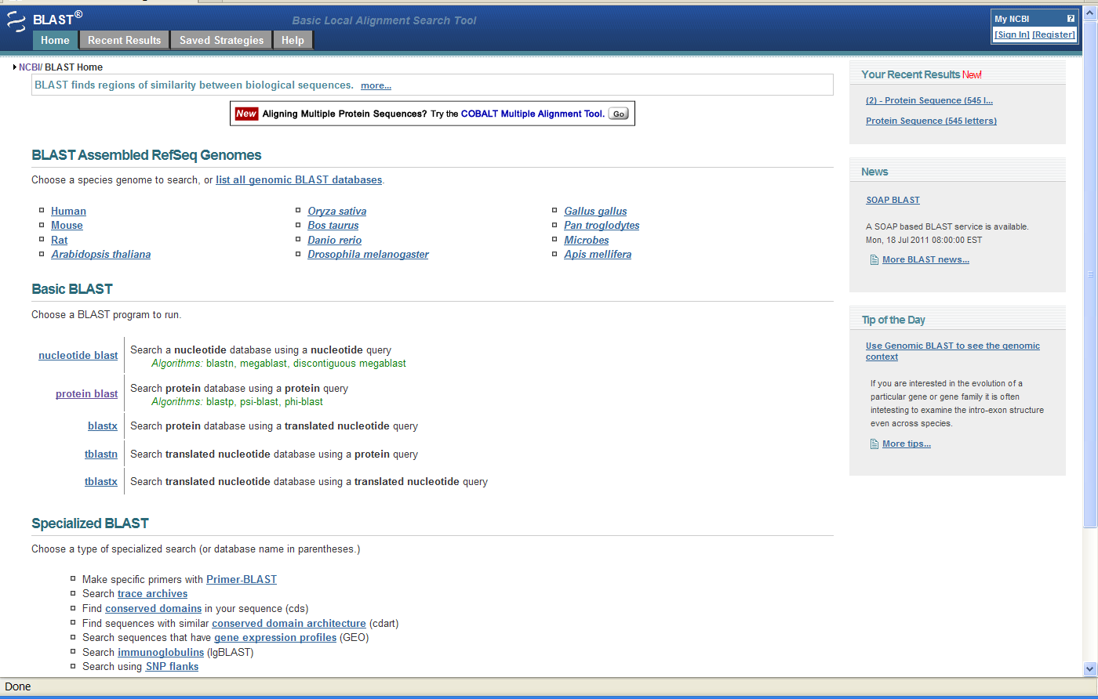
Sequence Similarity via BLAST
For function, we generally ask
the computer to compare the sequences of our favorite proteins
to others that have previously
been identified in some way.
Many exploit a very useful computer program, BLAST, for that purpose.
http://blast.ncbi.nlm.nih.gov/Blast.cgi

Slide 11
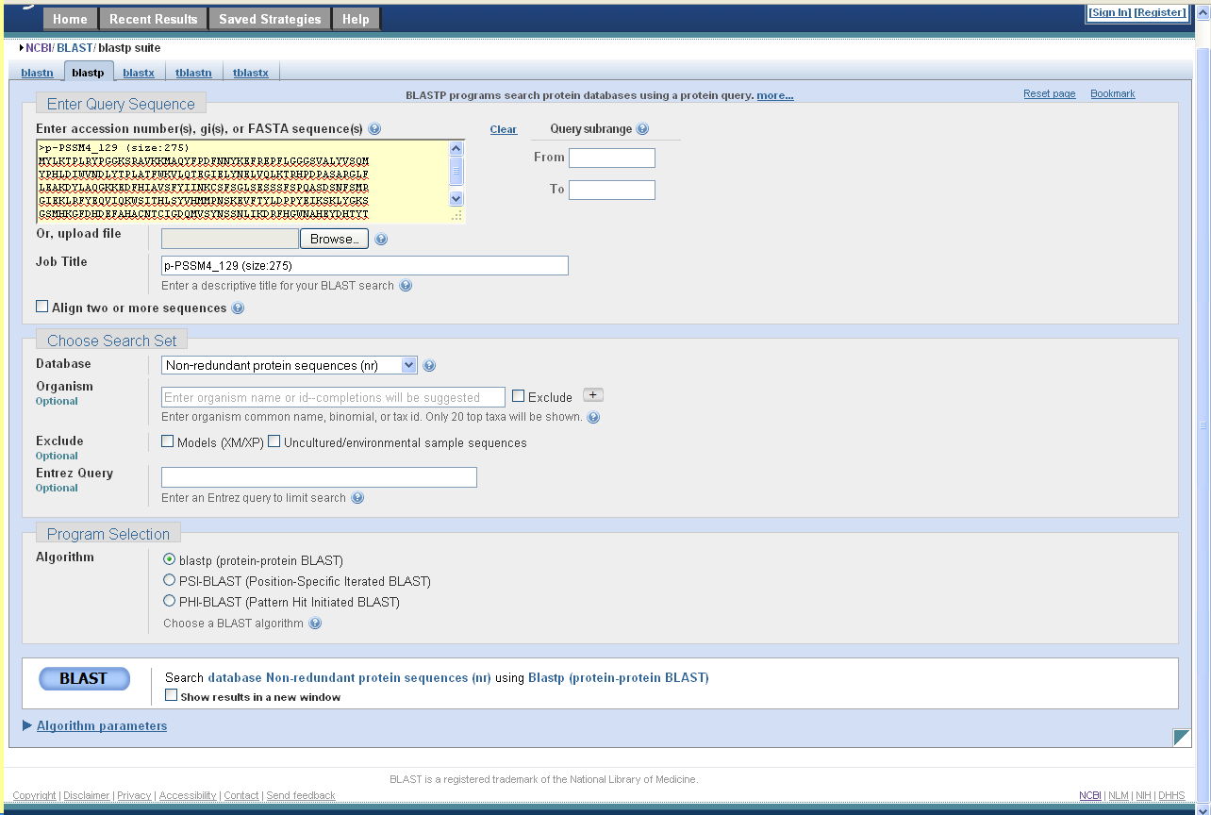
Sequence Similarity via BLAST
We need to provide the program
with the sequence of the protein
in some suitable form.
We need to figure out the various options (or ignore them).

Slide 12
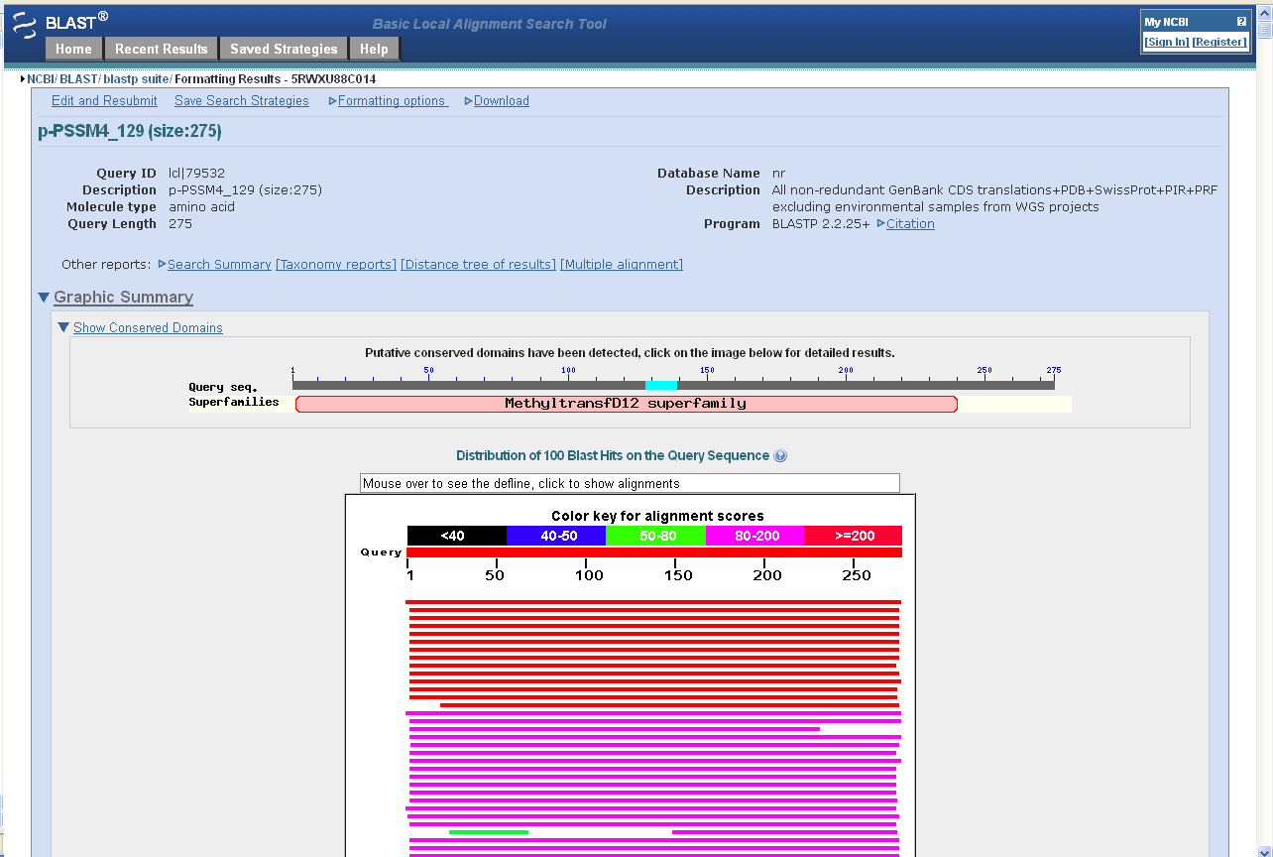
Sequence Similarity via BLAST
In return, we get back a list of similar protein sequences in a compact graphical format.
Or scrolling down…

Slide 13
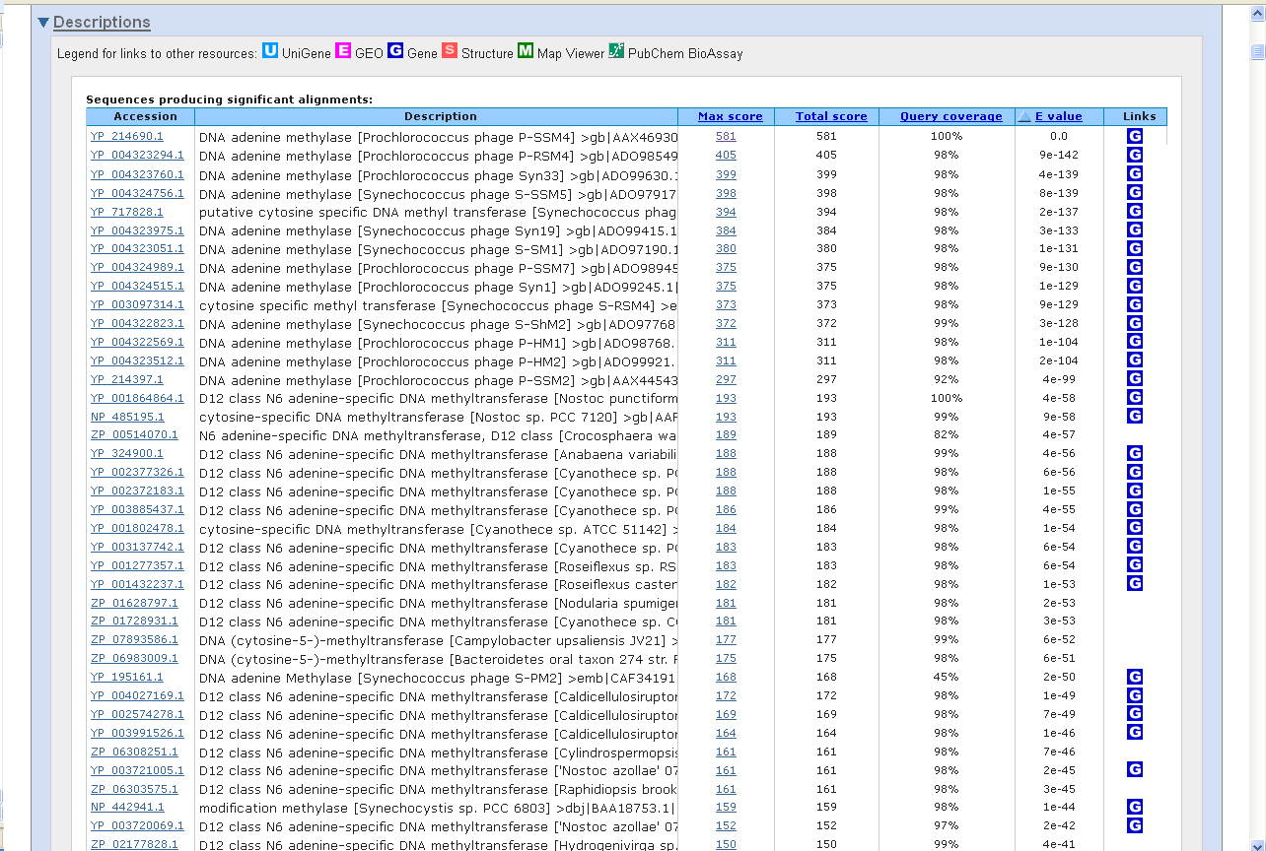
Sequence Similarity via BLAST
…a less compact format with more information -- the program decides exactly what information we see.
Certainly the given functions
of these similar proteins
is useful to know, but…

Slide 14
Sequence Similarity via BLAST
…notice that they give two contradictory answers as to
the function of my protein!
Some very similar proteins are annotated as “adenine methylases” while other very similar proteins are annotated as “cytosine methylases”
How could this happen?

Slide 15
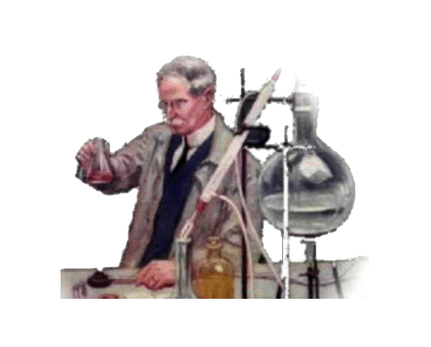
Sequence Similarity via BLAST
Serial Annotation Catastrophe
E. coli
DNA Adenine MTase
Well, once upon a time, an
adenine methyltransferase
(MTase or methylase) was characterized in the laboratory.

Slide 16
Sequence Similarity via BLAST
Serial Annotation Catastrophe
E. coli
DNA Adenine MTase
As new proteins were predicted from sequencing genomes, they were found (by computer) to be similar to the E. coli MTase.
Protein A
[DNA Adenine MTase]

Slide 17
Sequence Similarity via BLAST
Serial Annotation Catastrophe
E. coli
DNA Adenine MTase
Even newer predicted proteins were found (by computer) to be similar to the previously predicted proteins… and so on.
Protein A
[DNA Adenine MTase]
Protein B
[DNA Adenine MTase]

Slide 18
Sequence Similarity via BLAST
Serial Annotation Catastrophe
E. coli
DNA Adenine MTase
Meanwhile, another protein was characterized. It was distantly related to the E. coli protein, but it had different specificity
Protein A
[DNA Adenine MTase]
Nostoc
DNA Cytosine MTase
Protein B
[DNA Adenine MTase]

Slide 19
Sequence Similarity via BLAST
Serial Annotation Catastrophe
E. coli
DNA Adenine MTase
…but the computer annotators didn’t care! It still annotated new proteins according to the most similar protein it knew of.
Protein A
[DNA Adenine MTase]
Nostoc
DNA Cytosine MTase
Protein B
[DNA Adenine MTase]
PSSM4_129
[DNA Adenine MTase]

Slide 20
Sequence Similarity via BLAST
Serial Annotation Catastrophe
E. coli
DNA Adenine MTase
A human would say – “Wait! What’s important is the most similar protein whose function has been verified in the lab!”
Protein A
[DNA Adenine MTase]
Nostoc
DNA Cytosine MTase
Protein B
[DNA Adenine MTase]
PSSM4_129
[DNA Adenine MTase]

Slide 21

Sequence Similarity via BLAST
Serial Annotation Catastrophe
E. coli
DNA Adenine MTase
If we could apply that criterion, we’d get an answer almost certain to be more accurate.
Protein A
[DNA Adenine MTase]
Nostoc
DNA Cytosine MTase
Protein B
[DNA Adenine MTase]
PSSM4_129
[DNA Cytosine MTase]

Slide 22
Sequence Similarity via BLAST
Using knowledge not available to computer annotators, I can do the same thing here, masking Blast hits to proteins for which there is no experimental evidence.
If I do that…

Slide 23
Sequence Similarity via BLAST
The prediction changes!
…but is it correct? Is the similarity of my protein to an experimentally
proven methyltransferase
sufficiently compelling evidence?

Slide 24
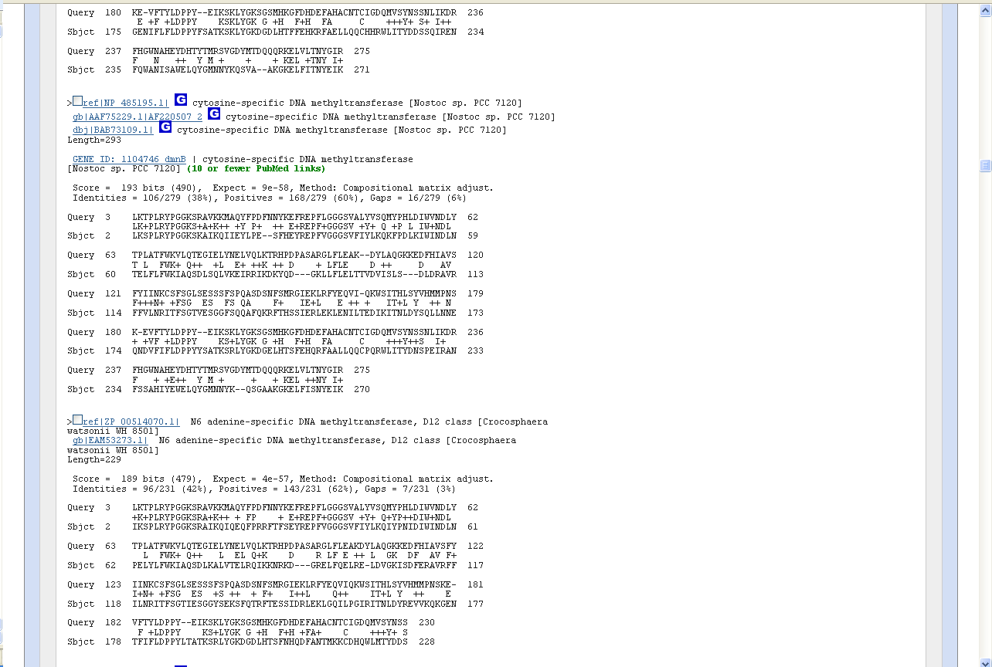
Sequence Similarity via BLAST
Back to the Blast result…
Blast provides an alignment of my protein, the query, with the known protein, the target. The E-value is a quick summary of the overall degree of similarity shown, but what is more compelling is the specific regions that are similar.
Are the similar regions those that are conserved in bona fide methyltransferases?
Does my protein share conserved amino acids typical of proven cytosene MTases?
To answer these questions we need a different tool.

Slide 25
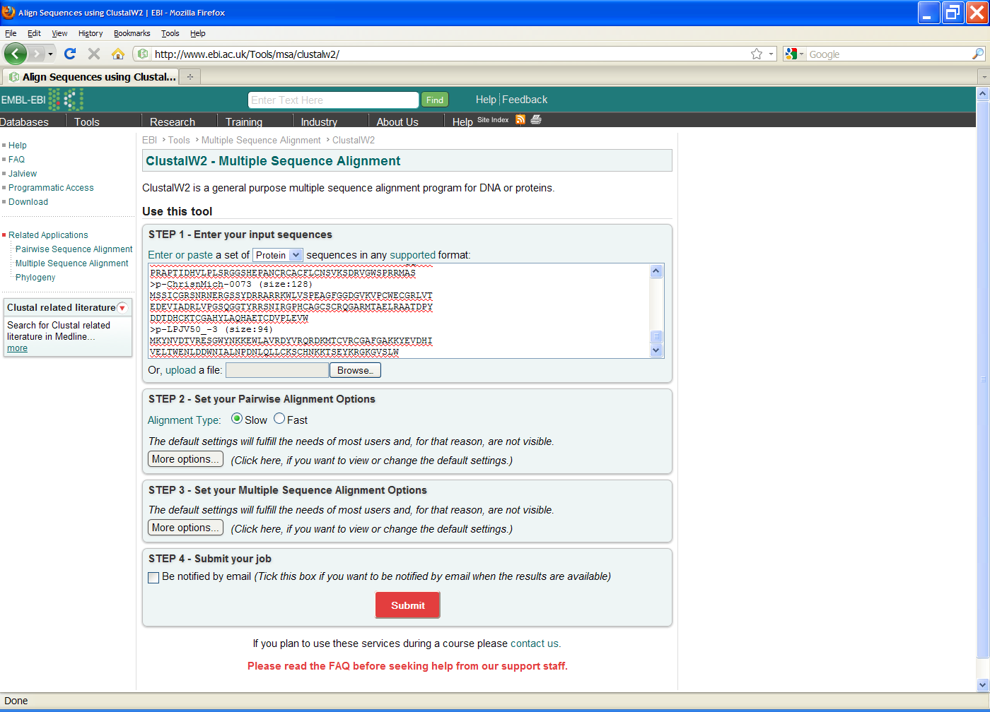
Sequence Alignment via Clustal
To compare my protein
with multiple MTases,
we need a multiple sequence alignment program.
I found one such,
ClustalW, on the web.
http://www.ebi.ac.uk/Tools/msa/clustalw2/

Slide 26
Sequence Alignment via Clustal
It presents another
interface to figure out.
This implementation wants to see the sequences to
be aligned in one of a
few specified formats.
One is FastA format.

Slide 27
Sequence Alignment via Clustal
Let's see if we can accommodate. Clicking
the target protein's link brings us to the target protein’s web page…

Slide 28
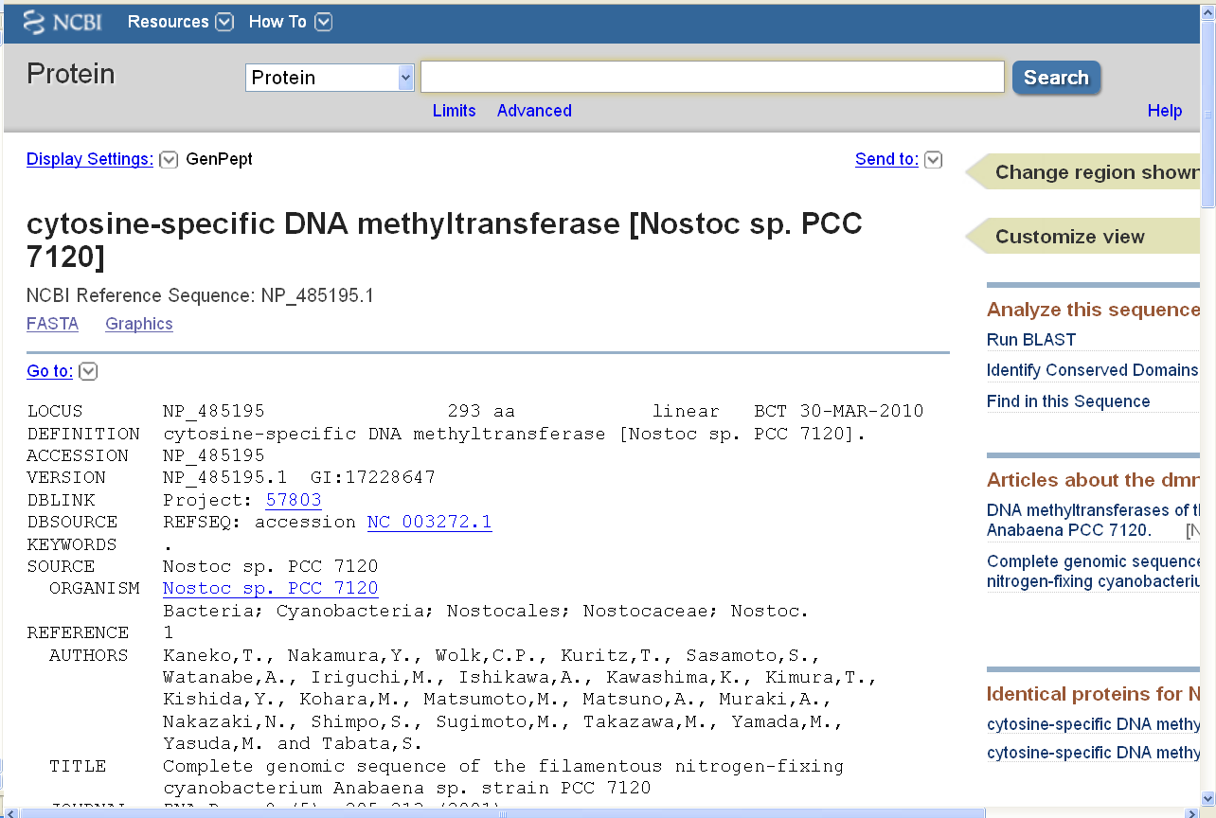
Sequence Alignment via Clustal
What we'd like to see is an
alignment of the full lengths of all the
pertinent proteins. We need their
sequences to feed to ClustalW.
Fortunately I know, figure out,
or am told how to get from
the target protein's page to
a display of its sequence in
the desired FastA format.

Slide 29
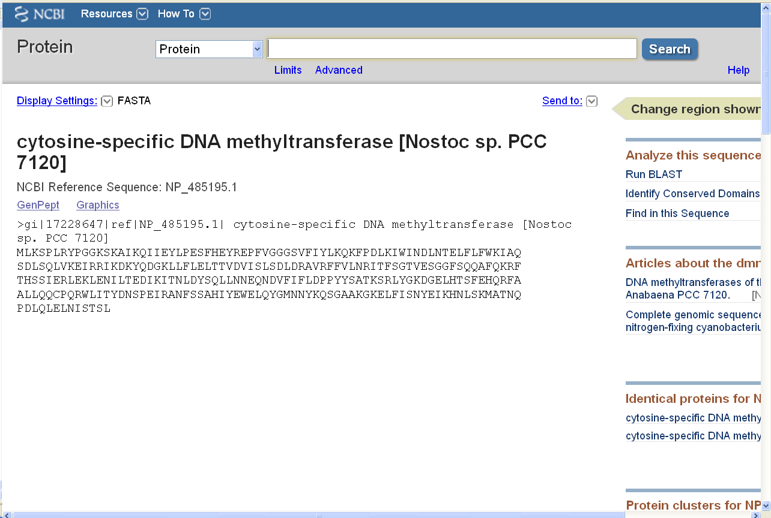
Sequence Alignment via Clustal
Now we can copy the sequence (and after similar series of clicks, the sequences of other matching proteins)….

Slide 30
Sequence Alignment via Clustal
…and paste them into an
on-line program that does
sequence alignments.

Slide 31
Sequence Alignment via Clustal
(There's still the matter of
options, but we can accept the
defaults and hope for the best)

Slide 32
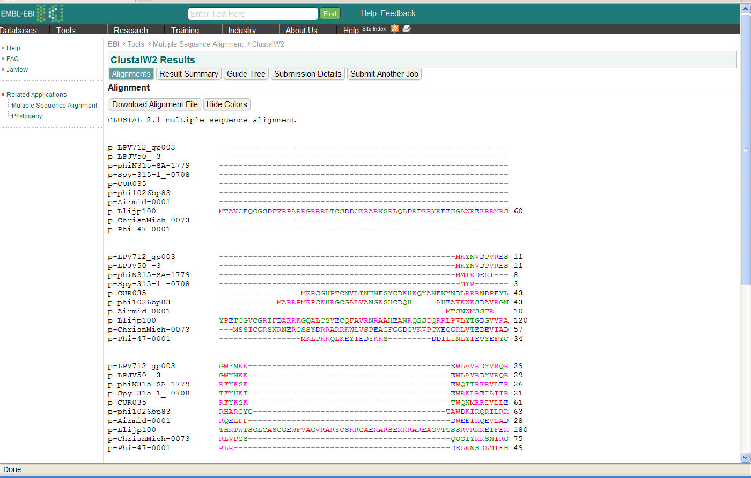
Sequence Alignment via Clustal
After a bit of work we
get a nice alignment that
may answer our question…
(…but after so long, what
was the question again?)

Slide 33
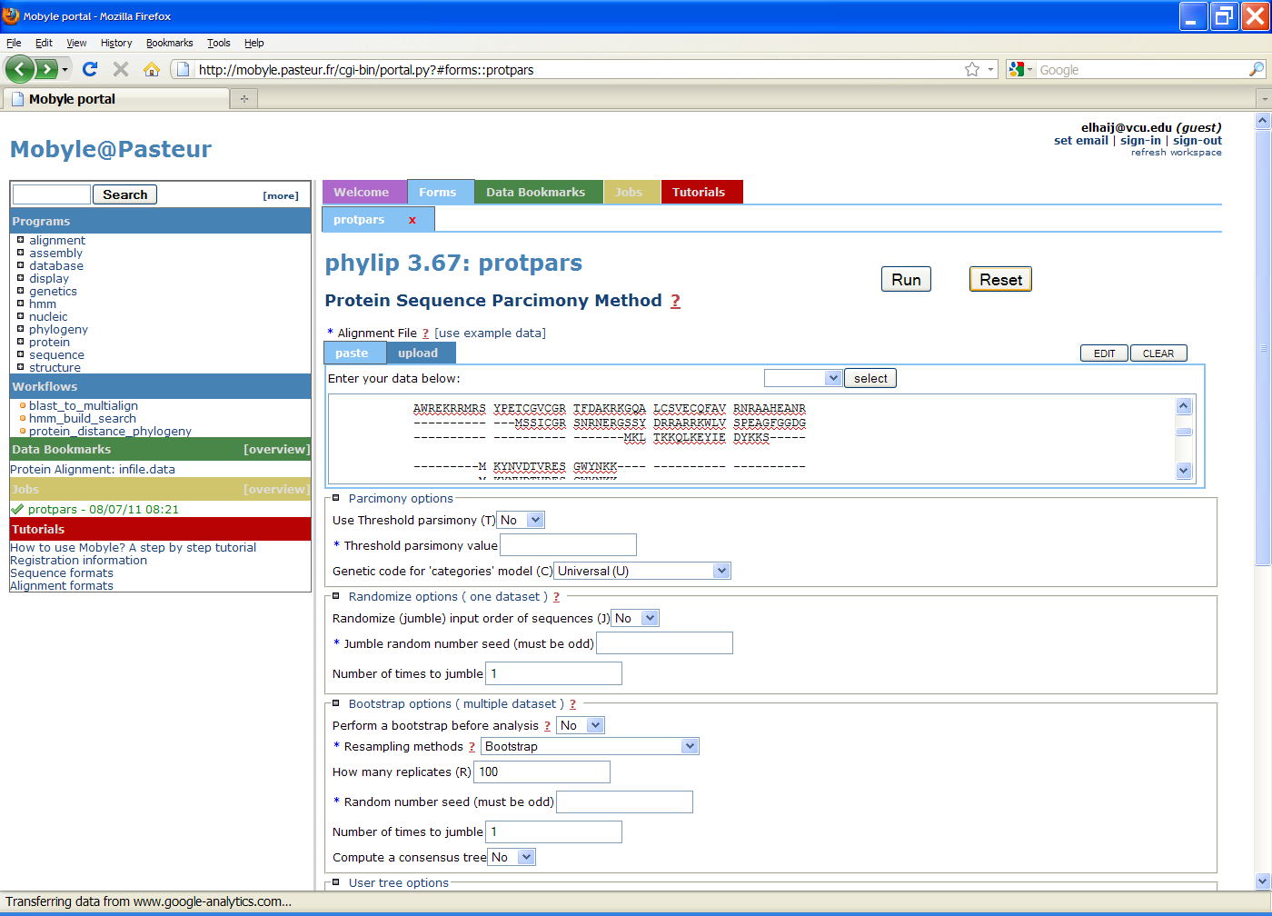
Phylogenetic Tree via Phylip
Or perhaps we want a
phylogenetic tree of the
target proteins plus our own,
to visualize the evolutionary relationships amongst them .
Again, I searched for a
program and found something plausible. Unfortunately,
it doesn't like FastA format.
http://mobyle.pasteur.fr/cgi-bin/portal.py#forms::protpars

Slide 34
Phylogenetic Tree via Phylip
OK. Again, I figure out the
interface, find a suitable format,
put my faith in default options,
and…

Slide 35
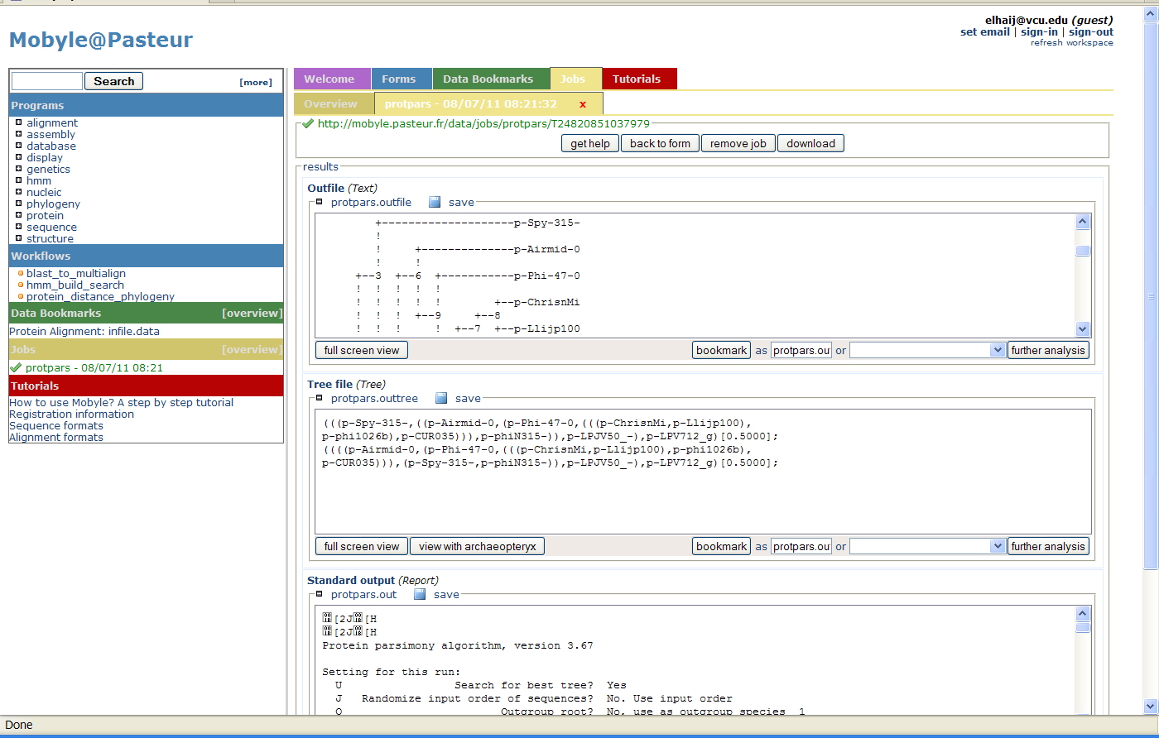
Phylogenetic Tree via Phylip
…and then there’s the matter of making sense of the output.
It is no wonder that few
people actually go through
such travails to get alignments
and trees of BLAST results.

Slide 36
Questions with Available Tools
Sequence similarity BLAST
Sequence alignment Clustal
Phylogenetic tree Phylip
That was the relatively easy
case, where tools already
exist to answer our question.
The problem was figuring out
how to use the tools and how to get them to interact with each other.

Slide 37
Questions Without Tools
Sequence similarity BLAST
Sequence alignment Clustal
Phylogenetic tree Phylip
Novel questions ? ? ?
What about more challenging
cases, questions for which
pre-made tools don't exist?
Let’s consider an example.

Slide 38
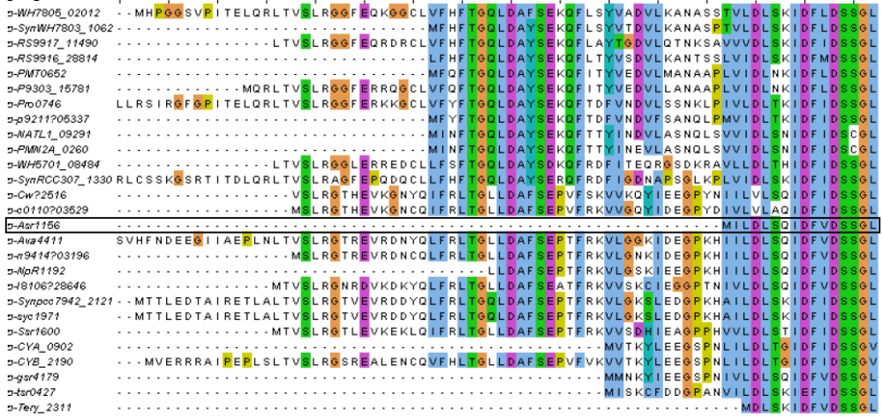
Questions Without Tools
Consider this alignment of highly conserved proteins. One, p-Asr1156, stands out. Is it truncated? Or (recall, ~8% of start codon calls are wrong) is this start codon mistaken? Maybe others are as well?
? ? ?

Slide 39
Questions Without Tools
We could address this
question by taking the
DNA sequence of the gene…
M I L D L S Q
... ATT GAT GAA GGC CCA AAG CAT ATT ATT CTG GAT CTT TCG CAA

Slide 40
Questions Without Tools
…and extending it backwards, translating as we go…
I D E G P K H M I L D L S Q
... ATT GAT GAA GGC CCA AAG CAT ATT ATT CTG GAT CTT TCG CAA

Slide 41
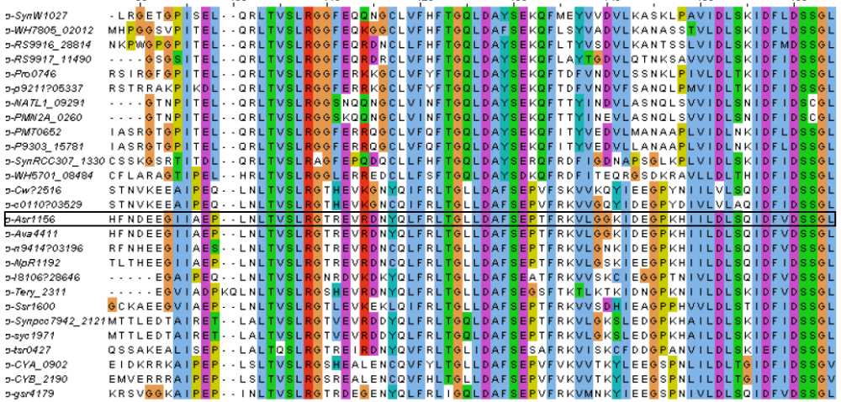
Questions Without Tools
…producing far more amino acid similarity!
I D E G P K H I I L D L S Q
... ATT GAT GAA GGC CCA AAG CAT ATT ATT CTG GAT CTT TCG CAA

Slide 42
Problem of Riches
Too much data
To summarize…
So much data and so many tools!
Who can be familiar with them all?
Who can find them when needed?
Too many tools
GACGCCAGATGTTGTTGGGCTGTTGGGAGCGGCCCGAGAACGTCGAAGAG TGGGAAGTCCCTGAGCATGAGGTGACAGCGCTCGTTGTGGACATGATGGC CCGGTTTGAGGTGTGGCGCATGTACTGCGACCCGTGGGGCTGGGATTCGA CGATCGCCGCGTGGGCGGGTCGTTTCCCGGATCGGGTTGTGGAGTGGGCG GTTGGCGGCGGCGGCAGTTTGAGGCGTGTGGCTGCTGCGACGCAGGGTTA TGCCGATGCATTGGCGACTGGCGACGCGGCGCTGGCTGCCAATGTGTGGC GACCGAAGTTTGTTGAGCATATGGGTCATGCGGGGCGGCGTGAGCTGAAG CTGGTGGACGATACAGGCCAGCCGCTGTGGGTGATGCAGAAGCAGGATGG CCGTTTGGCCGACAAGTTTGATGCTGCGATGGCGGGGATGTTGTCGTGGG AGGCGTGTGTTGATGCGCGTCGTGATGGTGCACGTCCGCGCCCGAAAGTG TTTGCGCCTAGACGGATCTACTAGTCGCCATAGAGACAGAGAGGGGGTCA GCTGTTGACTGCTTCAACGCCAGCGGAATGGCTCCCGGTATTGACGAAGC GTATCGACGACGGAATGTCGCGGGTGCGTTTGTTGGCGCGTTACTCCAAT GGGGATGCTCCGCTGCCCGAGTTGACGAGGAACACGTCTGCGGCGTGGCG TTCGTTTCAGCGTGAGGCGCGCACCAACTGGGGTCTGATGGTGCGTGACT CTGTTGCTGACCGGATCATCCCGAATGGCATCACGGTTGGTGGTTCTGCC GATAGTGATTTGGCGTTACGTGCACGGCGCATCTGGCGGGATAACCGCAT GGATTCCGTGTGTAAGCAGTGGGTCAAGTATGGGCTGGACTTCGGCGAGT CGTATTTGACGTGCTGGCGTCGTGATGACGGTACGGCGACGATCACAGCT GACTCTCCTGAAACGATGGTTGTCAGCGTTGACCCGCTGCAGCCGTGGCG GATCAGGTCCGCTATGCGGTGGTGGCGGGACCTCGATGCCGAGTCGGATT TTGCGATTGTGTGGTCGGGTGACGGGTGGCAAAAGTTCGCCCGTCCGTGC TTTGTGCAGTCGTCGTCCCGGCGCAGGCTGGTGACGCGAATCTCAGACTC GTGGGTTCCGGTTGGTGATGCTGTAGTGACCGGTTCGCCGCCGCCGGTGG TGGTGTACCAGAACCCTGATGGCATGGGCGAGGTGGAGCCTCACATTGAC ATCATCAACCGGATCAACCGGGCTGAGCTTCAGTTGTTGTCCACGATGGC GATCCAGGCTTTCCGTCAGCGGGCGTTGAAGTCGACGGAAAATGGGTTGC

Slide 43
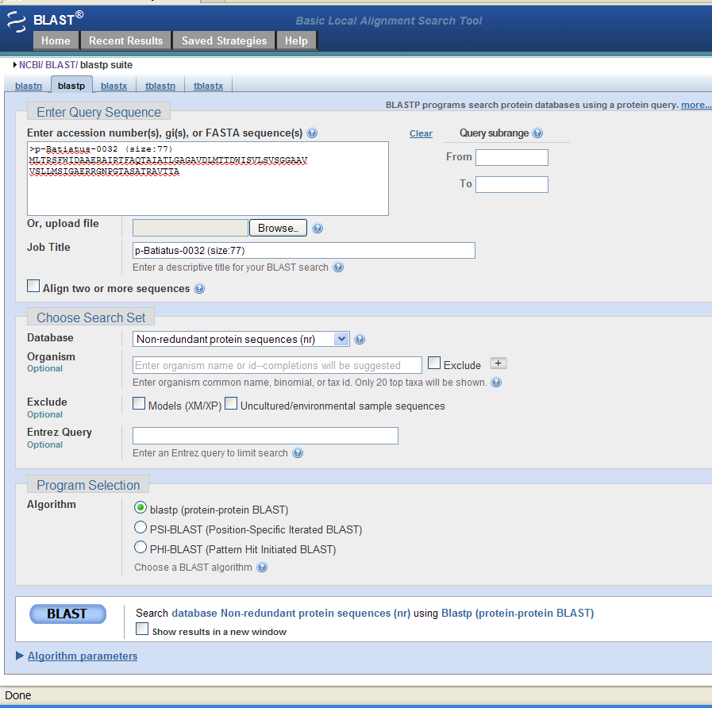
Problem of Riches
Too much data
To summarize…
And so difficult to talk with them!
Each one with a different language.
Too many tools
Too many interfaces

Slide 44
Problem of Riches
Too much data
To summarize…
Tools that are easy to describe in concept should be easy to devise,
but they certainly are not.
Too many tools
Too many interfaces
Too little flexibility

Slide 45
Problem of Riches
Too much data
Too many tools
Too many interfaces
What’s a solution?
Too little flexibility

Slide 46
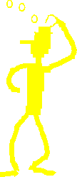

Problem of Riches
Too much data
Too many tools
Too many interfaces
What’s a solution?
Too little flexibility
Get a computer specialist?

Slide 47
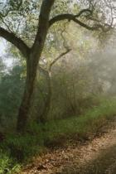
GATCAGGTCCGCTATGCGGT
GGTGGCGGGACCTCGATGCC
GAGTCGGATTTTGCGATTGT
GTGGTCGGGTGACGGGTGGC
AAAAGTTCGCCCGTCCGTGC
TTTGTGCAGTCGTCGTCCCG
GCGCAGGCTGGTGACGCGAA
TCTCAGACTCGTGGGTTCCG
That solution divides the labor.
The person who knows computers works with the raw data, often oblivious to what makes biological sense.
If a happy accident occurs, the kind from which fundamentally new insights springs, he won't recognize it as anything more than an irritating mistake.
His job is to defeat reality
and coerce it into readily comprehensible abstractions...
Reality

Slide 48

…, i.e. the results of the
programs we rely on.
Abstractions are great,
but sometimes…
GATCAGGTCCGCTATGCGGT
GGTGGCGGGACCTCGATGCC
GAGTCGGATTTTGCGATTGT
GTGGTCGGGTGACGGGTGGC
AAAAGTTCGCCCGTCCGTGC
TTTGTGCAGTCGTCGTCCCG
GCGCAGGCTGGTGACGCGAA
TCTCAGACTCGTGGGTTCCG
Abstractions
Reality

Slide 49
…the greatest progress comes when we can move back and forth between reality and abstraction, trying out different ways of looking at the world.

Slide 50
How can these problems be addressed?
Too much data
Integration
Too many tools
Too many interfaces
Tools and data are all in
one place and integrated.
You don't have to worry
about changing formats.
Too little flexibility

Slide 51
How can these problems be addressed?
Too much data
A single user interface
allows access to all tools.
Too many tools
Too many interfaces
Standardization
Too little flexibility

Slide 52
How can these problems be addressed?
Too much data
You can build tools with
a graphical language that understands concepts
of molecular biology.
Too many tools
Too many interfaces
Too little flexibility
Graphical programming

Slide 53

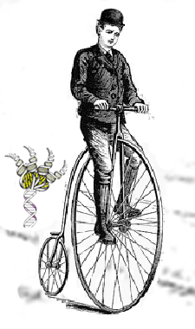
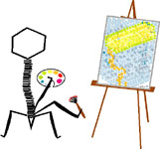
How can these problems be addressed?
Too much data
These are the problems addressed by two
unifying tools:
BioBIKE and PhAnToMe.
Too many tools
Too many interfaces
Too little flexibility
PhAnToMe
database
BioBIKE
interface

Slide 54
How can these problems be addressed?
PhAnToMe
database
Bacteriophage genomes 758
Eubacterial genomes 754
Eukaryotic genomes 0
PhAnToMe provides access to virtually all publically available phage genomes and most eubacterial genomes.
At present it does not
provide access to genomes
of eukaryotes or archaea
nor their viruses.

Slide 55
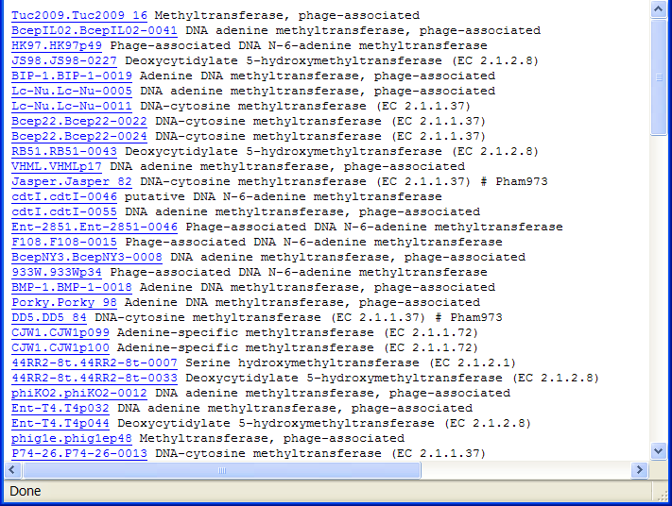
How can these problems be addressed?
PhAnToMe
database
Bacteriophage genomes 758
Eubacterial genomes 754
Eukaryotic genomes 0
Human-curated subystems 100’s
It addresses the issue of chaotic computer-annotation of genes by providing 100’s of human-curated categories.

Slide 56
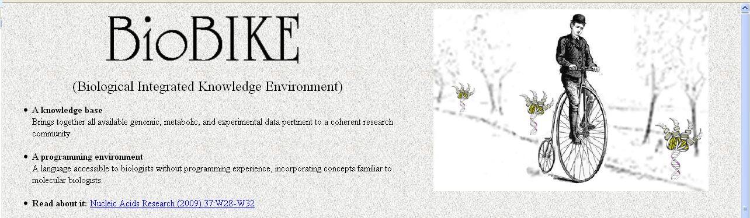
How can these problems be addressed?
In related tours I'll show
you examples of how the combination of PhAnToMe
and BioBIKE can make it easier to access, analyze, and annotate phage genomes.
BioBIKE provides a uniform environment through which to access existing tools or make your own.

Slide 57
How to cope with overwhelming information?
Reflections and Coming Attractions
I tried by means of a small example to illustrate the need for interoperability amongst the various tools available to biological researchers. You can learn how PhAnToMe / BioBIKE addresses this need in the tour: Integration of Tools.
That was not a difficult case to make. However, many biological researchers are surprised to hear the second and in my opinion more important claim: that they must have the capability of devising computational tools themselves. This case is made more completely in:
Humans, Computers, and the Route to Biological
Insights: Regaining Our Capacity for Surprise
J Comput Biol (2011) 18:867-878
BioBIKE’s solution can be seen in the tour Creating New Tools.

