Slide 1
Syntax and Conventions
Summary
Some people like to figure out a new resource by doing and following examples. Others want an overview before they dive in. This tour is for the second group.
This is best viewed as a slide show.
To view it, click Slide Show on the top tool bar, then View show.
Click to start

Slide 2
Syntax and Conventions
Slide #
What are functions?
Data types
Icons and their meanings
Screen windows
The Function Palette
How to get help
The Result Window and displays of results
Common pitfalls
Reflections and coming attractions
3 – 8
10 – 19
20 – 21
22 – 29
23 – 29
29 – 31
32 – 36
37 – 39
40
To navigate to a specific slide, type the slide number and press Enter (works only within a Slide Show)

Slide 3

Functions
SIN
Sine of angle
Angle
BioBIKE is built around functions.
You’re no doubt already familiar
with functions, which we may
think of as black boxes:
You give the box what it wants, and it returns to you what you want from it.
You give the SIN function an angle,
and it gives you the Sine of that angle.

Slide 4

Functions
Length
Entity
Likewise, the BioBIKE function LENGTH-OF wants an entity,
perhaps a gene or a genome.
You give LENGTH-OF a gene, and it returns to you the length of the gene.

Slide 5
Functions
Absolute value
of sine of angle
ABS
SIN
Angle
You can readily combine functions.
For example, give the SIN function an angle, then give its result to the ABS value to get the absolute value of the Sine.

Slide 6
Functions
Absolute value
of sine of angle
ABS
Sin (angle)
This is done by evaluating the
functions from the inside out.
First the SIN function is evaluated,
and then its box is replaced
by the value of that function.

Slide 7


Functions
Lengths of
possible
transposases
( List of possible transposases)
"transposase"
Similarly in BioBIKE, the result
of the inner-most function is handed
over to the outer function, which
acts on it to give the final result.

Slide 8

Functions
Lengths of
possible
transposases
"transposase"
When the functions are combined, they read almost like an English sentence.

Slide 9
Functions
Lengths of
possible
transposases
"transposase"
You may have noticed a possible ambiguity:
- Should LENGTHS-OF report the lengths
of each of the genes?
- Or should it report the length of the
entire list (how many genes)?
In other words, what type of data does it expect?

Slide 10
Data types
variable vs literal
Length
Entity
"icahLnlna bormA"
What would you expect if you asked
LENGTH-OF to tell you the length of a seemingly random collection of letters.
Counting them…

Slide 11
Data types
variable vs literal
Length
Entity
"icahLnlna bormA"
15
…you might arrive at the same answer
(if you count the space).

Slide 12
Data types
variable vs literal
Length
Entity
"icahLnlna bormA"
15
"Abraham Lincoln"
What about this collection of letters?

Slide 13
Data types
variable vs literal
Length
Entity
"icahLnlna bormA"
15
"Abraham Lincoln"
15
…Still 15. It makes no difference if they’re more meaningful to you.

Slide 14
Data types
variable vs literal
Length
Entity
"icahLnlna bormA"
15
"Abraham Lincoln"
15
Abraham Lincoln
But what if the quotation
marks are removed?

Slide 15
Data types
variable vs literal
Length
Entity
"icahLnlna bormA"
15
"Abraham Lincoln"
15
Abraham Lincoln
192
Then you’re referring not to the letters but to what they signify.
Abraham Lincoln happened to have a length of 192 cm.
In the first two cases you asked for the length of literals
(what is literally between quotation marks), while
the third case asked for what is represented
by the variable name, Abraham Lincoln.

Slide 16
Data types
variable vs literal
Length
Entity
"icahLnlna bormA"
15
"Abraham Lincoln"
15
Abraham Lincoln
192
US-presidents
What about this request? The entity is not in quotation
marks, so LENGTH-OF will consider what it represents.

Slide 17
Data types
list vs single value
Length
Entity
"icahLnlna bormA"
15
"Abraham Lincoln"
15
Abraham Lincoln
192
US-presidents
44
…and the length of the list of
US presidents is 44 presidents long.*
How can I get LENGTH-OF to
consider each president in the list?
*(in 2011)

Slide 18

Data types
list vs single value
Length
Entity
"icahLnlna bormA"
15
"Abraham Lincoln"
15
Abraham Lincoln
192
US-presidents
(188 170 189 163 …)
Specifying the EACH option asks the function to look inside the list and
produces quite a different result.*
*(Yes, James Madison was almost a foot shorter than George Washington)

Slide 19
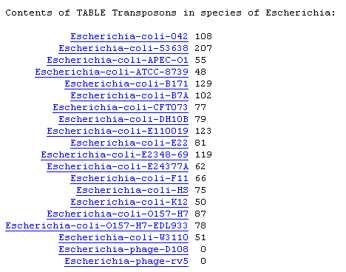
Data types
Others
There are many other useful data types in BioBIKE. For example,
the type Table is useful for storing and manipulating associated
data. (Computer types will think
of Tables as arrays and hashes).
But these are best learned
when they are needed.

Slide 20
Icons and their meanings
Function-name
Argument
(object)
Keyword
object
Flag
Function boxes may contain the following elements:
Function-name (e.g. SEQUENCE-OF or LENGTH-OF)
Argument: Required, acted on by function
Keyword clause: Optional, more information
Flag: Optional, more (yes/no) information
Example:

Slide 21
Icons and their meanings
Function-name
Argument
(object)
Keyword
object
Flag
The following icons to help you work with functions:
Option icon: Brings up a menu of keywords and flags
Action icon: Brings up a menu enabling you to execute
a function, copy and paste, information, get help, etc
Clear/Delete icon: Removes information you entered
or removes box entirely

Slide 22
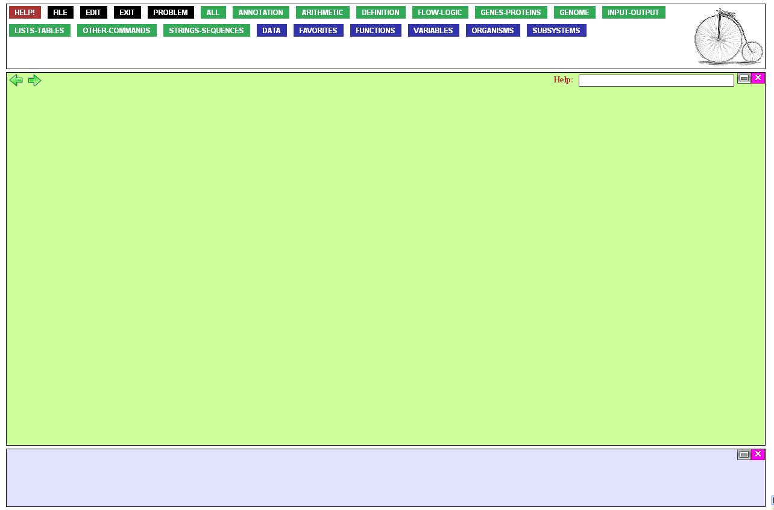
Function Palette
Workspace
The BioBIKE environment is divided into three areas:
Function palette: source of functions and data
Workspace: Where you construct and execute functions
Results window: Results returned by functions appear here.
Results Window

Slide 23
Function Palette
The buttons of the Function Palette can be loosely categorized as follows:
Green buttons, sources of functions
Blue buttons, sources of data
Black buttons, sources of various BioBIKE actions
Help

Slide 24
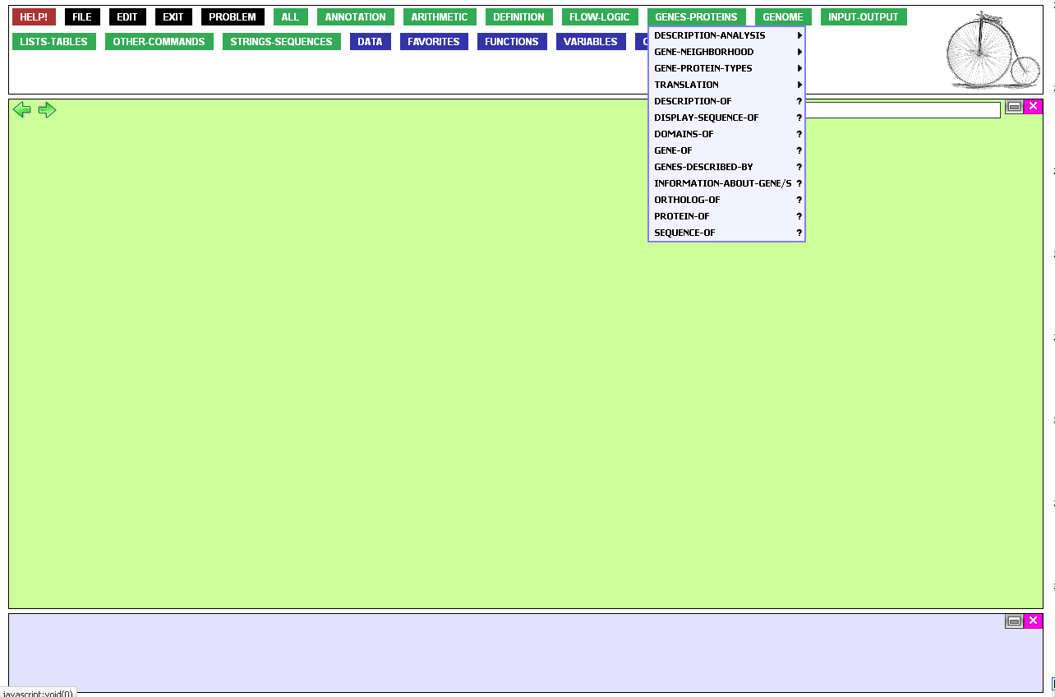
Functions may be found organized by focus in most of the green buttons, but
if you know what you’re looking for,…

Slide 25
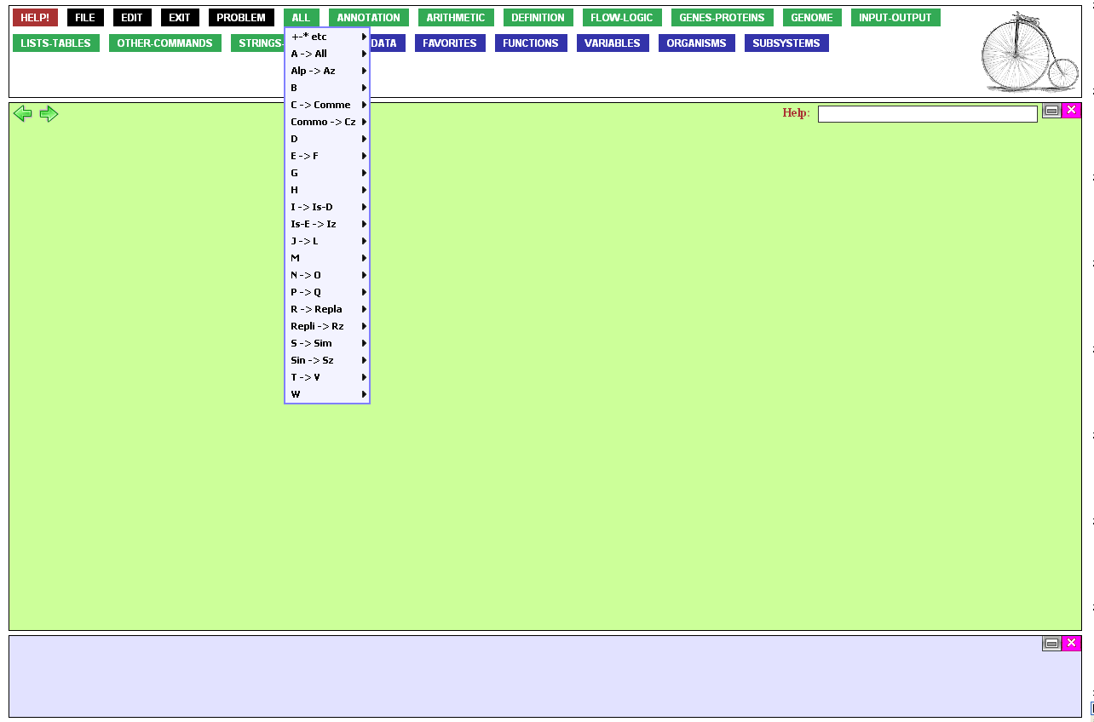
…it is often more convenient to
use the alphabetical All button.

Slide 26
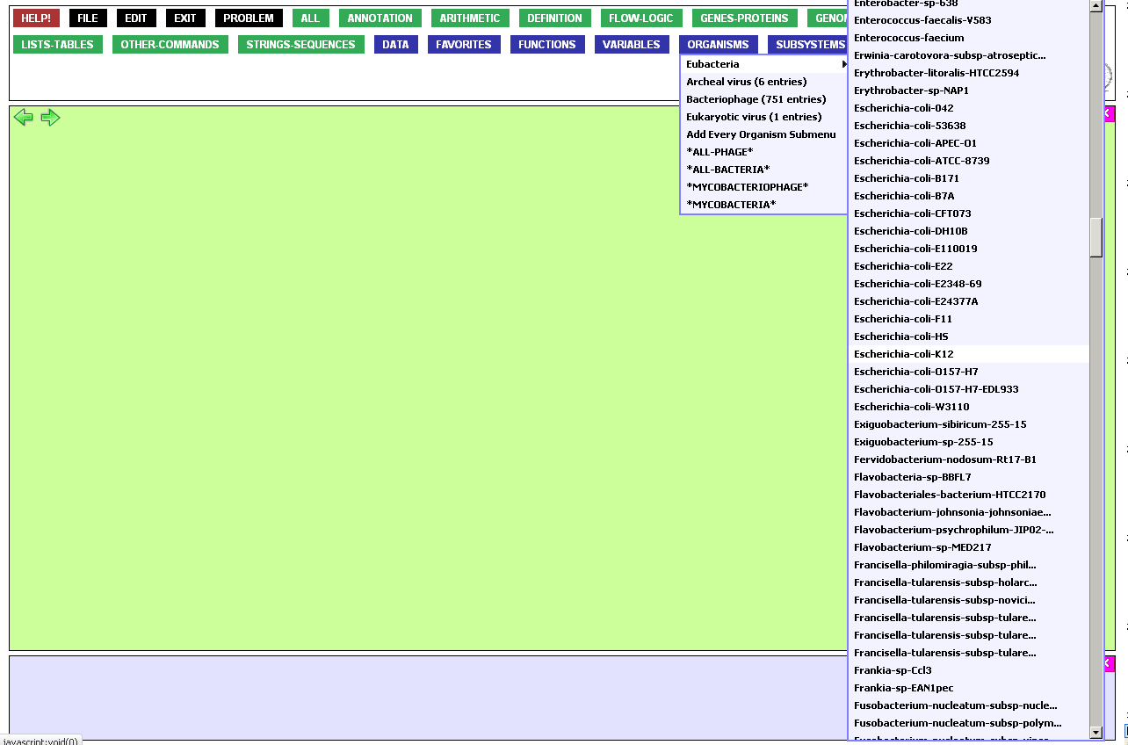
The blue buttons contain data,
for example an alphabetical list
of organisms and organism sets.

Slide 27
Three special buttons will not appear when you log in for the first time:
The Favorites button is automatically populated by functions you use frequently.
The Functions button is populated by functions that you define yourself.
The Variables button is populated by variables you define yourself.
These and other buttons make it
possible for you to avoid spelling errors

Slide 28
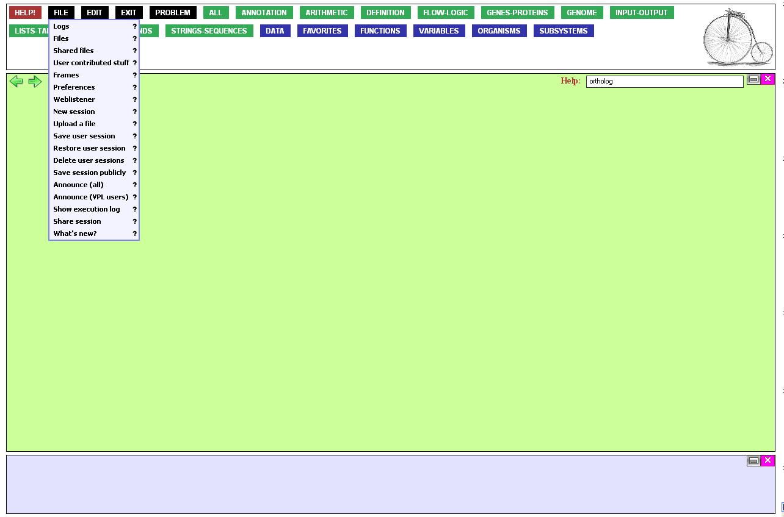
Many important actions are available from the File menu. Here are some:
Save / Restore user sessions. This allows you to save
what you have done and continue working at a later date
Show execution log: View a record of what you have
done, moment by moment. All logs are saved
automatically
Share session: Allow another user to watch as you work
User contributed stuff: Browse functions other users
have saved publicly.

Slide 29
Two very important black buttons on the function palette:
On-line help and examples
Something went wrong? Tell us!

Slide 30
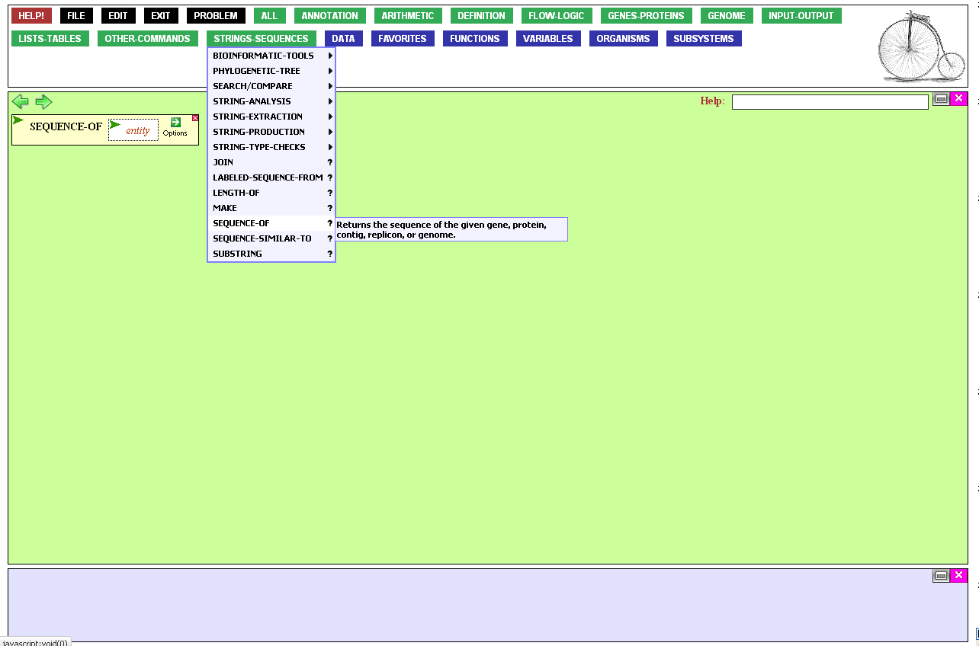
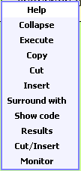
There are also three ways to get help on specific topics:
Clicking Help from the Action menu of a function
will usually get you to a function-specific help page.
Clicking the ? next to a function will do the same,
and mousing over it gives you a short description.

Slide 31

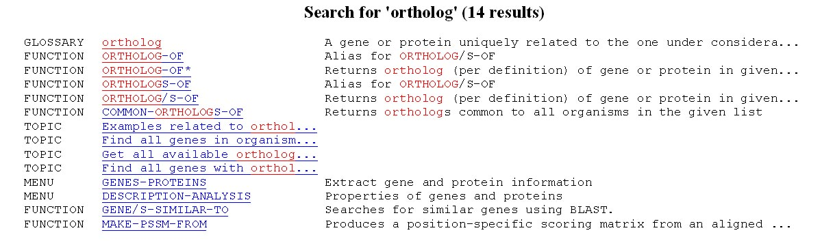
The third way to get specific help is to enter one or more terms into the Help box in the work space.
This will get you a list of links to help screens that may address your need.

Slide 32
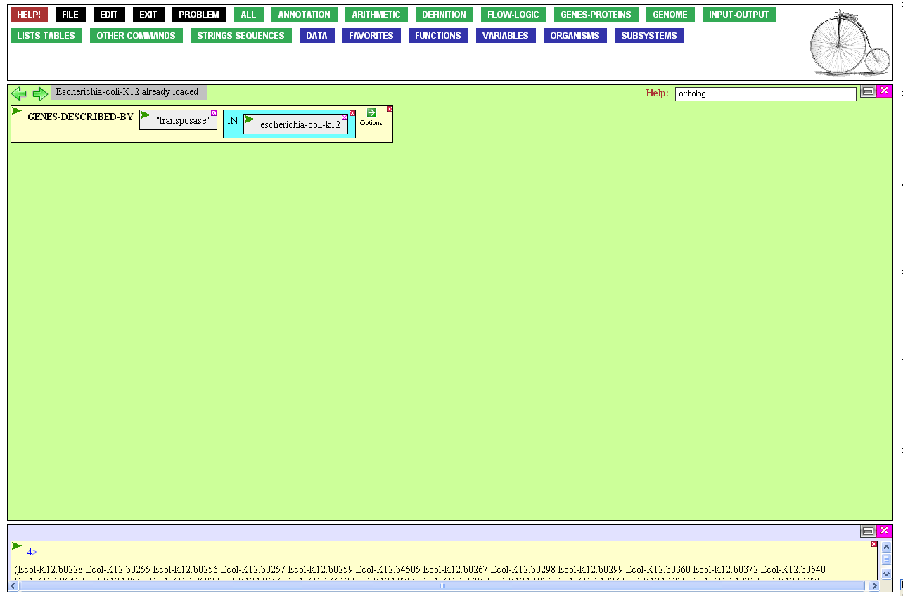
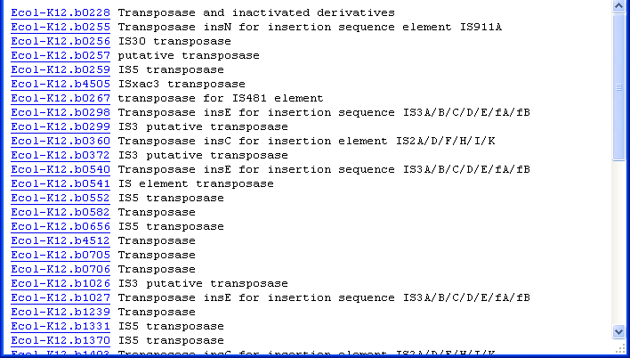
The Results Window shows the results returned by the functions you have executed. They are presented in a form used by BioBIKE and can serve as
input to other functions.
Many functions also display formatted output in a popup window. These results are invisible to BioBIKE, produced solely for your enjoyment.
Displayed results
Returned results
Results Window

Slide 33
It is possible to expand…

Slide 34
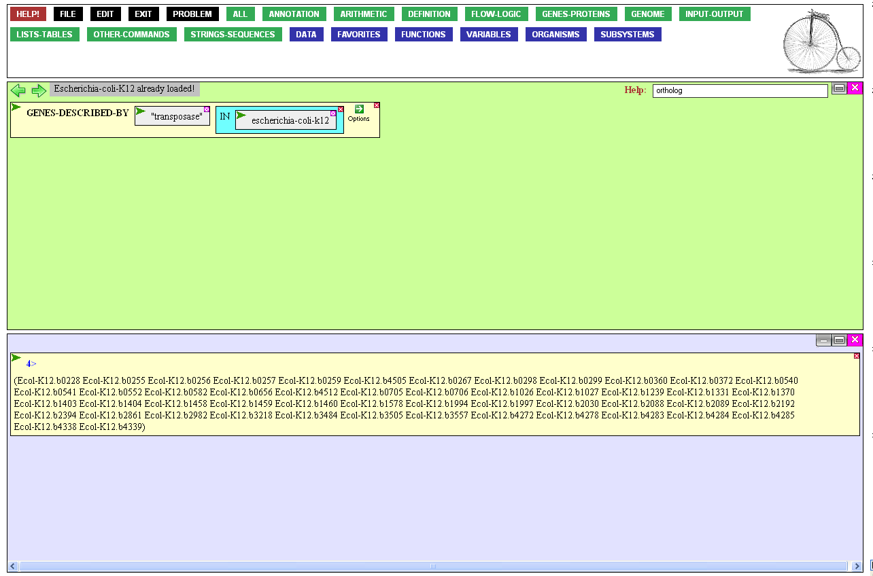
…or contract the Results Window as needed.

Slide 35

It is also possible to clear
the Result Window and/or Workspace when they get
too cluttered for your taste.

Slide 37
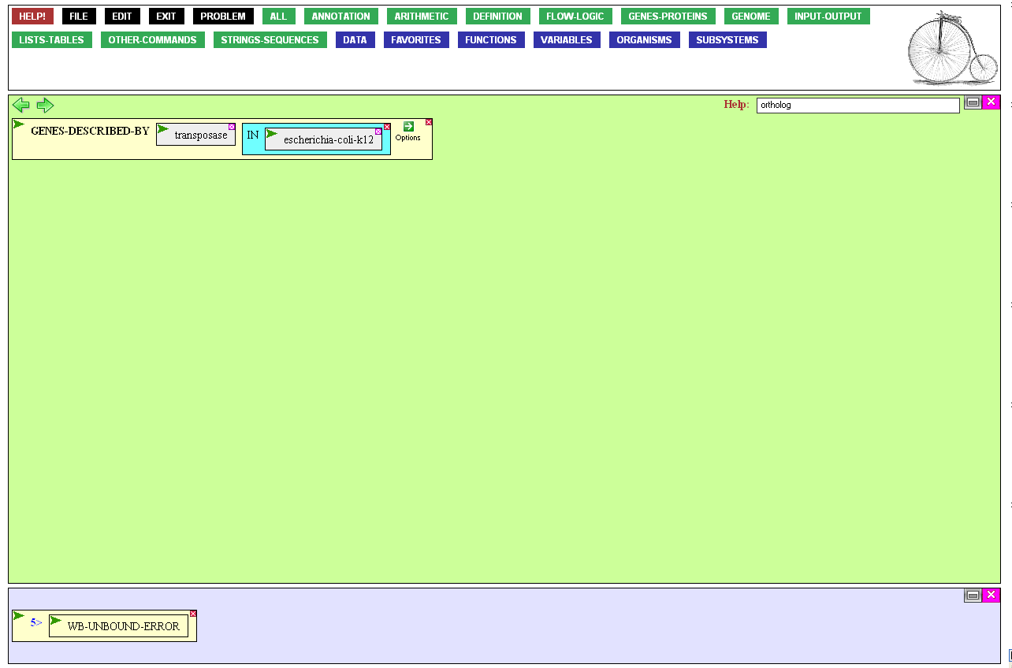
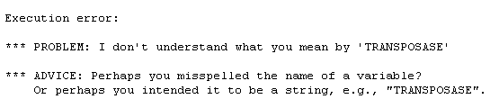
THIRD MOST COMMON PITFALL
Use of a variable when a literal was intended.
Click the box and add quotation marks.

Slide 38
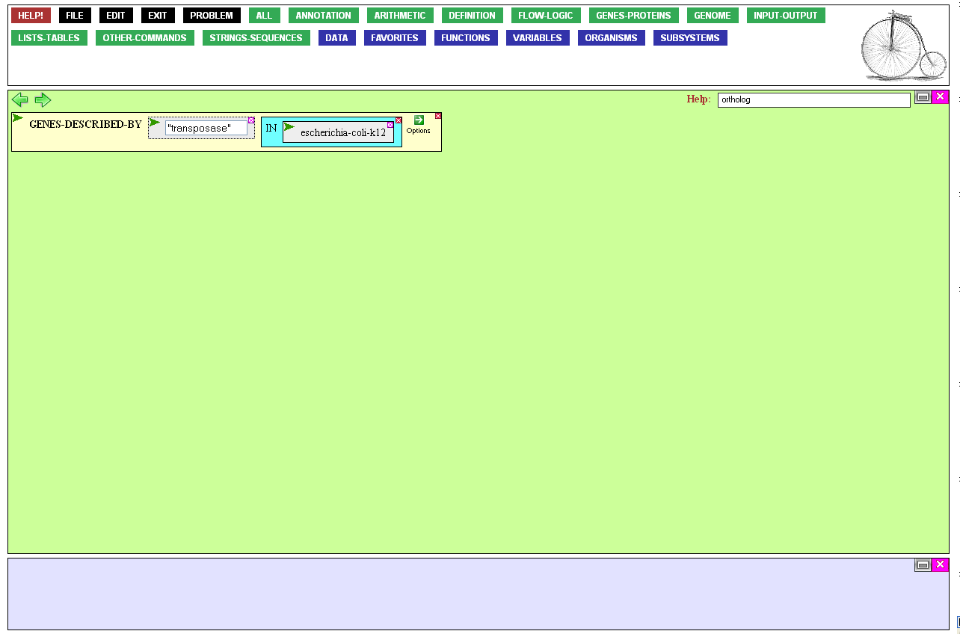
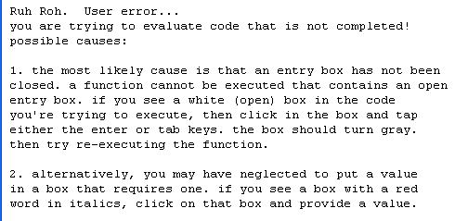
SECOND MOST COMMON PITFALL
Failure to close an entry box. If you
see a white box, the surrounding
function cannot be executed.
Click the box and press Tab or Enter

Slide 39
MOST COMMON PITFALL
Computers can’t think! (at least not yet)
Don’t believe BioBIKE will understand what you say. It will only do what you say.
Don’t believe that any computer is watching out for your interests. If
anything, they’re trying to find a
loophole in your instructions to
do you in every chance they get.

Slide 40
Syntax and Conventions
Reflections and Coming Attractions
If you came to this tour to get an idea of the basics of BioBIKe, then maybe you got it. However, it will disappear fast without seeing the basics used in action.
You might therefore take advantage of the other tours that focus on a keystroke-by-keystroke explanation of how specific biological problems might be addressed through BioBIKE.
Even more than that, you might take advantage of the wisdom of your fingers. Try out what you’ve read. Test the limits, predicting what you might receive back as a result. See if you think the same way about syntax as BioBIKE.

