Slide 1
Why study bacteriophages?
Bacteriophages are viruses that infect bacteria.
But who cares about bacteria?
Why should we concern ourselves
with their petty health problems?
This is best viewed as a slide show.
To view it, click Slide Show on the top tool bar, then View show.
Click to start

Slide 2
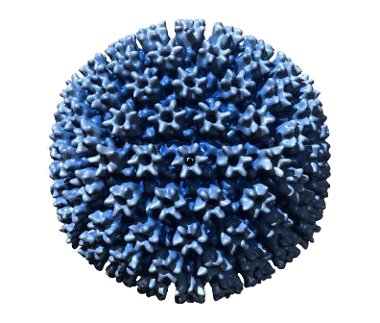

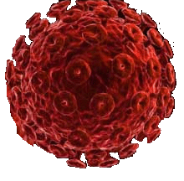
Why study bacteriophages?
Pathogenesis
cytomegalovirus
Human immunodeficiency virus
Human viruses… now THEY’RE interesting.
They cause diseases like AIDS and Herpes. Yum!
Can bacteriophages do anything like that?

Slide 3
Why study bacteriophages?
Pathogenesis
cytomegalovirus
Human immunodeficiency virus
Well, no -- they have no interaction with human cells.
They infect bacteria.

Slide 4
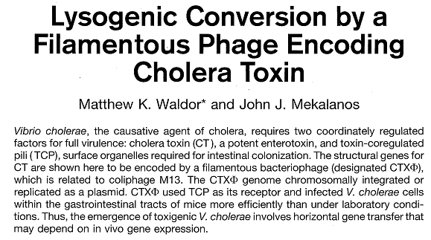
Why study bacteriophages?
Pathogenesis
Waldor MK, Mekalanos JJ (1996).
Science 272:1910-1914
But that doesn’t mean that bacteriophages
have nothing to do with pathogenesis in humans.
For example, it’s bacteriophage that convert a
harmless bacterium into the causative agent of cholera.

Slide 5
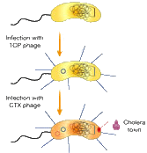

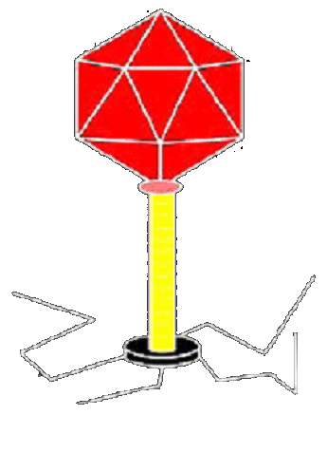
Why study bacteriophages?
Pathogenesis
Conversion of
Vibrio cholerae
to pathogenic strain
Harmless
strain
Waldor MK, Mekalanos JJ (1996).
Science 272:1910-1914
Cholera
toxin
Certain bacteriophages carry toxin genes
essential to the process of pathogenesis.
Under some circumstances, these phages
incorporate their DNA into the genome of the bacterium.

Slide 6
Why study bacteriophages?
Pathogenesis
Conversion of
Vibrio cholerae
to pathogenic strain
Harmless
strain
Waldor MK, Mekalanos JJ (1996).
Science 272:1910-1914
Cholera
toxin
Two such events, and harmless Vibrio cholerae
is converted to a potent human pathogen.

Slide 7
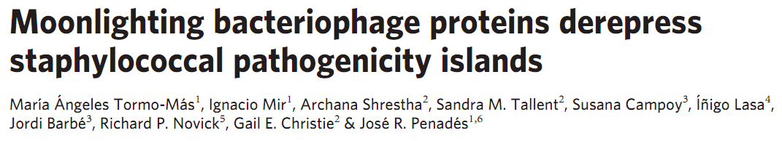
Why study bacteriophages?
Pathogenesis
Conversion of
Vibrio cholerae
to pathogenic strain
Harmless
strain
Waldor MK, Mekalanos JJ (1996).
Science 272:1910-1914
Cholera
toxin
And it’s not just cholera!

Slide 8
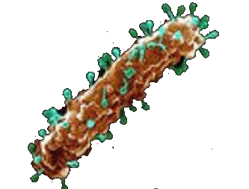
Why study bacteriophages?
Phage Therapy
And think about this –
some bacteria cause human disease, and if phage kill bacteria, perhaps they can be harnessed to function as intelligent antibiotics.

Slide 9


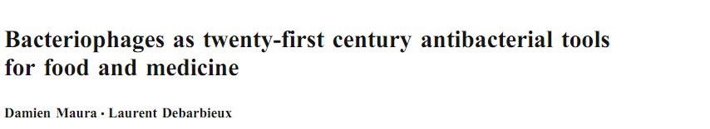
Why study bacteriophages?
Phage Therapy
Curr Opin Microbiol (2011) in press
This idea first arose in the 1920’s, but it mostly dropped out of sight with the development of chemical antibiotics.
Biotechnol Adv(2011) in press
With antibiotic resistance becoming increasingly alarming, the notion of phage therapy has made a comeback.
Appl Microbiol Biotechnol (2011) 90:851

Slide 10
Why study bacteriophages?
Basic Molecular Biology
But there’s more to life than us – vastly more.
And phage have played an inordinately large
role in our understanding of how life
works at the most basic level.
Consider…

Slide 11
Why study bacteriophages?
Basic Molecular Biology
Genetic mutation Luria & Delbrück (1943) Genetics 28:499
DNA as genetic material Hershey & Chase (1952) J Gen Physiol 36:39
Molecular nature of genes Benzer (1958) Proc Natl Acad Sci USA 45:1607
Nature of gene regulation Jacob & Monod (1961) J Mol Biol 3:318
Triplet genetic code Crick et al (1961) Nature 192:1227
Messenger RNA Brenner et al (1961) Nature 190:576
Restriction enzymes Arber & Linn (1969) Annu Rev Biochem 38:467
Recombinant DNA Lobban & Kaiser (1973) J Mol Biol 78:453
In each of these cases, phage have been at the center of
our discovery of a central feature of molecular biology.
Their simplicity makes them natural choices in the lab.

Slide 12
Why study bacteriophages?
Last, Greatest Frontier
In the last decade, rapid DNA sequencing has
made real the idea that we might get a global
picture of what is the breadth of life on earth.
Where is that breadth?

Slide 13
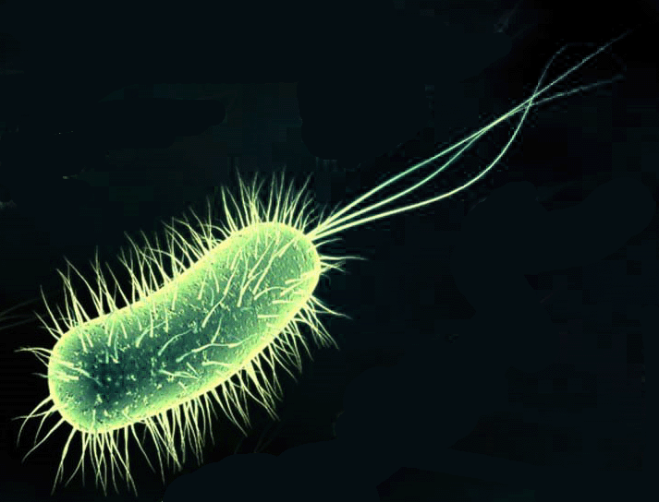


Why study bacteriophages?
Last, Greatest Frontier
Never mind pointless debates about what is “living”…
Phages are unquestionably biological entities, by far the most numerous on earth.
90% of biological entities on earth are bacteriophages.
The next most numerous category are bacteria.
Eukaryotes?
Virtually contaminants.
Estimated counts of biological
forms in environment

Slide 14

Why study bacteriophages?
Last, Greatest Frontier
Estimated counts of biological
forms in environment
Counts of DNA
sequences in GenBank
But if you consider what we STUDY, the
picture reverses. We have far more DNA
sequence information about animals, some about plants and bacteria, and very little about phages.

Slide 15


Why study bacteriophages?
Last, Greatest Frontier
Previously seen
Unknown
Viral genes
If you want to study the unknown, study phage.
70% of the genes of a typical phage are new to us.
The number is only 10% for a typical bacterium or eukaryote.

Slide 16
Why study bacteriophages?
Understand bacterial pathogenesis
Phage therapy
Basic molecular biology
Seek new insights from great unknown
Plus one more important reason…

Slide 17




Who studies bacteriophages?
Many fields of biological research
are (sad to say) cutthroat
Hmph. I’ve found it, but if I shout ‘Eureka’, then Black Bart over there will know I’ve found it.

Slide 18
Who studies bacteriophages?
In contrast,…
Hmph. I’ve found it, but if I shout ‘Eureka’, then Black Bart over there will know I’ve found it.

Slide 19


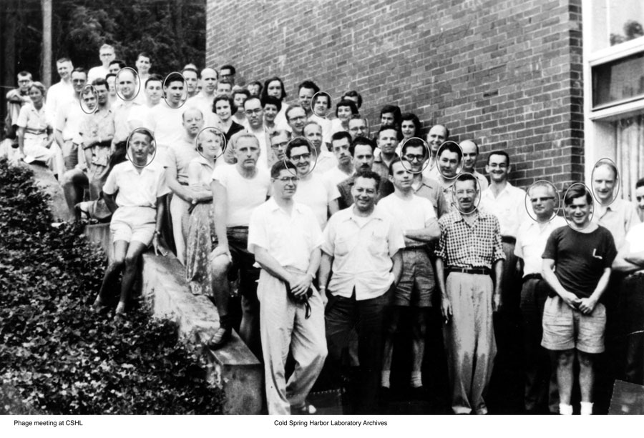

Who studies bacteriophages?
…phage biologists have traditionally
been a small, friendly bunch

Slide 20
Why study bacteriophages?
These people can
become your people
These biological entities can
become your biological entities

