Slide 1
Working With Local Genomes
Summary
One of the strengths of BioBIKE is that the environment is integrated with the data – you don’t have to worry about where the genome sequences are or in what format.
However, there may come a time when you HAVE to worry about such things, because the genome sequence is not in BioBIKE. You just sequenced it yourself. What then?
Well, then it is possible to import the sequence into BioBIKE. You will be able to use that genome sequence in much the same way as you use standard genomes.
This tour considers two cases: (1) You have one or more sequences with annotation; (2) Your sequences lack annotation.
This is best viewed as a slide show.
To view it, click Slide Show on the top tool bar, then View show.
Click to start

Slide 2
Creating New Tools
Slide #
Bring in sequence with annotation
Upload file from own computer
Use local sequence – Display its map
Bring in sequence lacking annotation
Upload file from own computer
Use local sequence – Find similar proteins
Reflections and coming attractions
3 – 30
5 – 10
23 – 30
31 – 59
37 – 42
49 – 59
60
To navigate to a specific slide, type the slide number and press Enter (works only within a Slide Show)

Slide 3
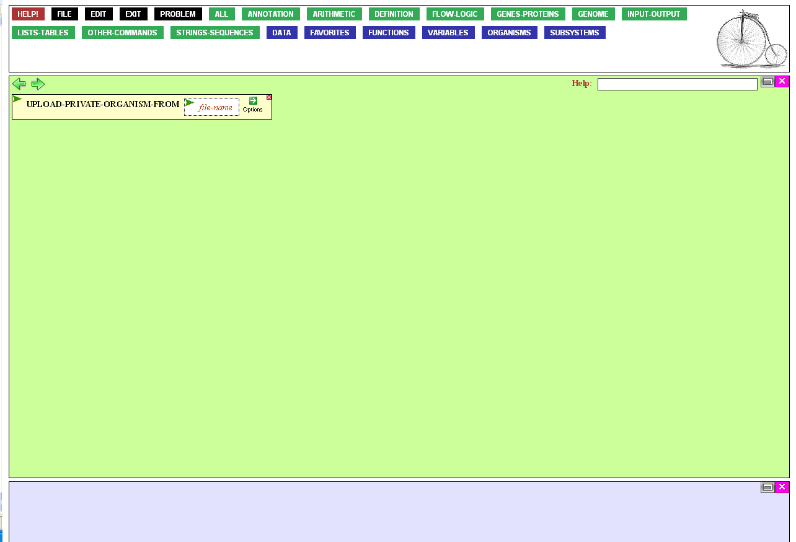

Suppose you have a newly
sequenced and annotated
genome, in Genbank format.
To get it into BioBIKE, you need to upload it, and… well, that’s about it.
To upload the sequence, mouse
over the Genome button…

Slide 4
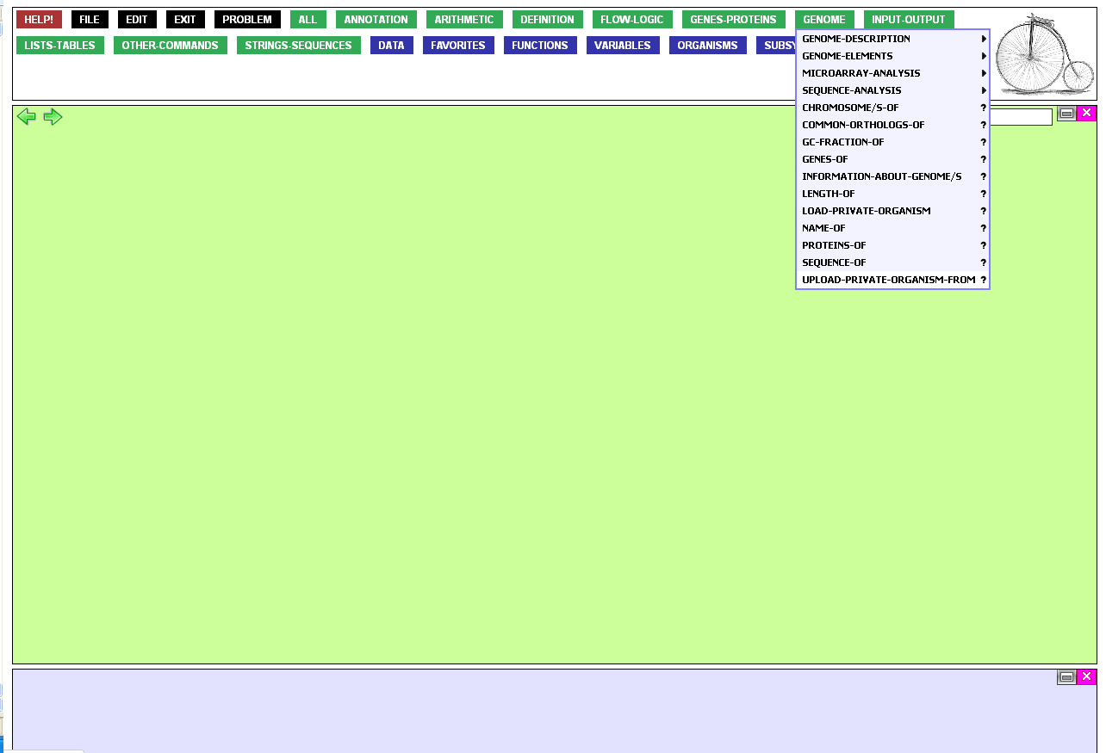
…and click UPLOAD-PRIVATE-ORGANISM-FROM.
Note that there is also a function called LOAD-PRIVATE-ORGANISM. Once you’ve uploaded the sequence from
your own computer through
the UPLOAD function, you
can access the sequence
through the LOAD function
(no file transfer necessary).

Slide 5

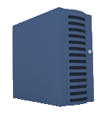
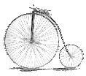
The function asks for a file-name. This is a file name in your BioBIKE directory on the server.
You’ll need to upload the sequence file from your own computer to that directory on the server and from there bring it into BioBIKE.
To do the first step, mouse
over the File button…

Slide 6
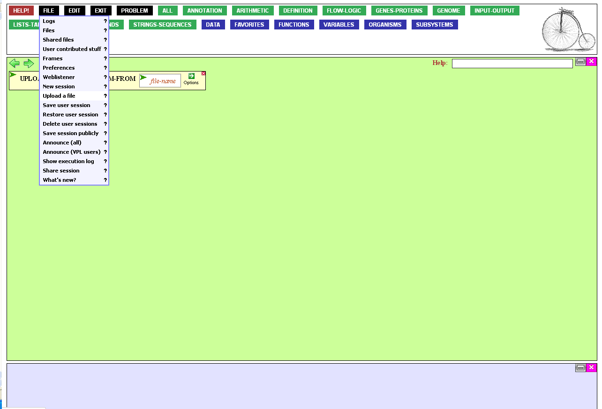
…and click Upload a file.

Slide 7
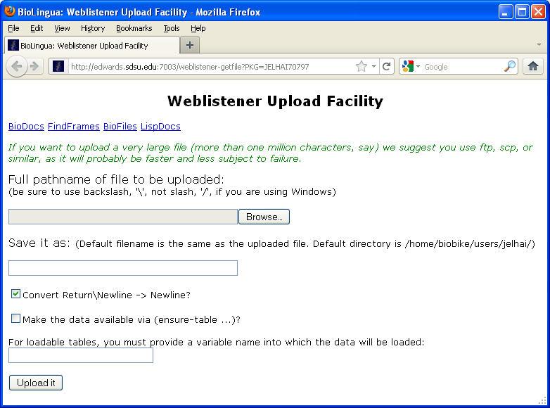
This brings up a dialog box that enables you to browse for the file on your computer.
Once you’ve done that…

Slide 8
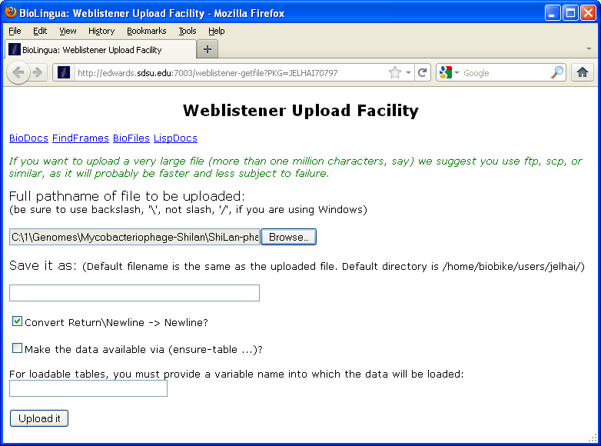
Click Upload it to transfer
it to the BioBIKE server.

Slide 9
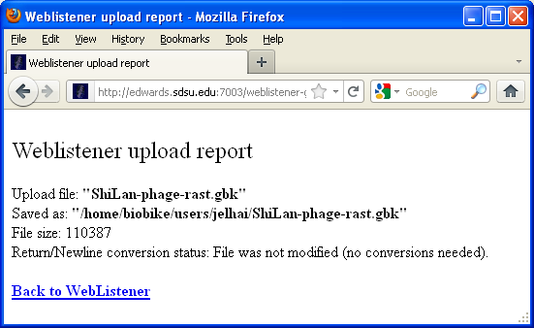
A receipt message will pop up.
Copy the file name from it…

Slide 10
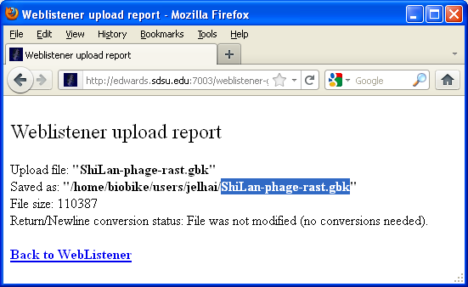
…and X out of the window.

Slide 11
Now we’re ready to supply
the function with the file
name it wants.
Open the file-name
entry box by clicking it.

Slide 12
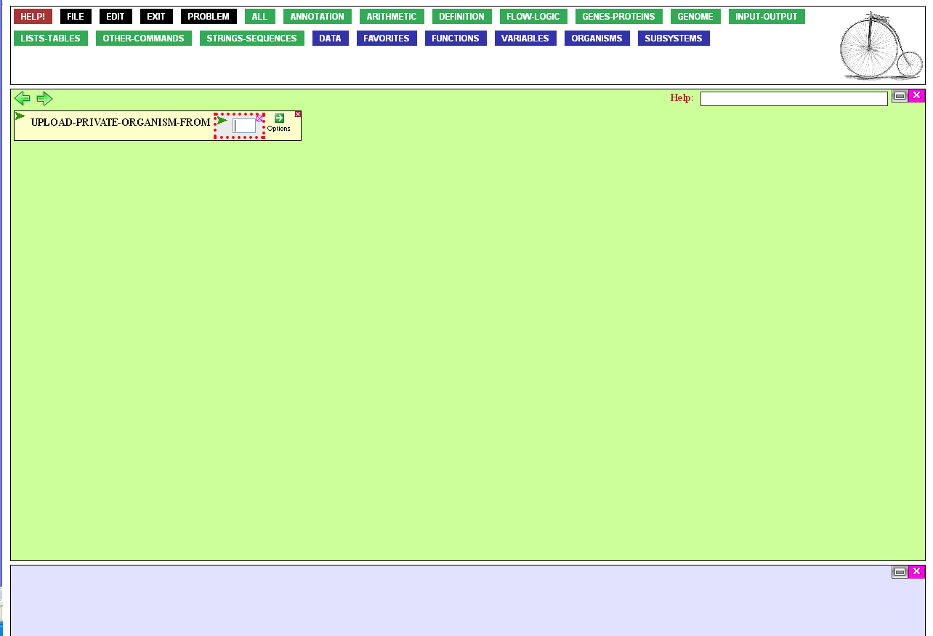
Then paste in the
file name you copied...

Slide 13
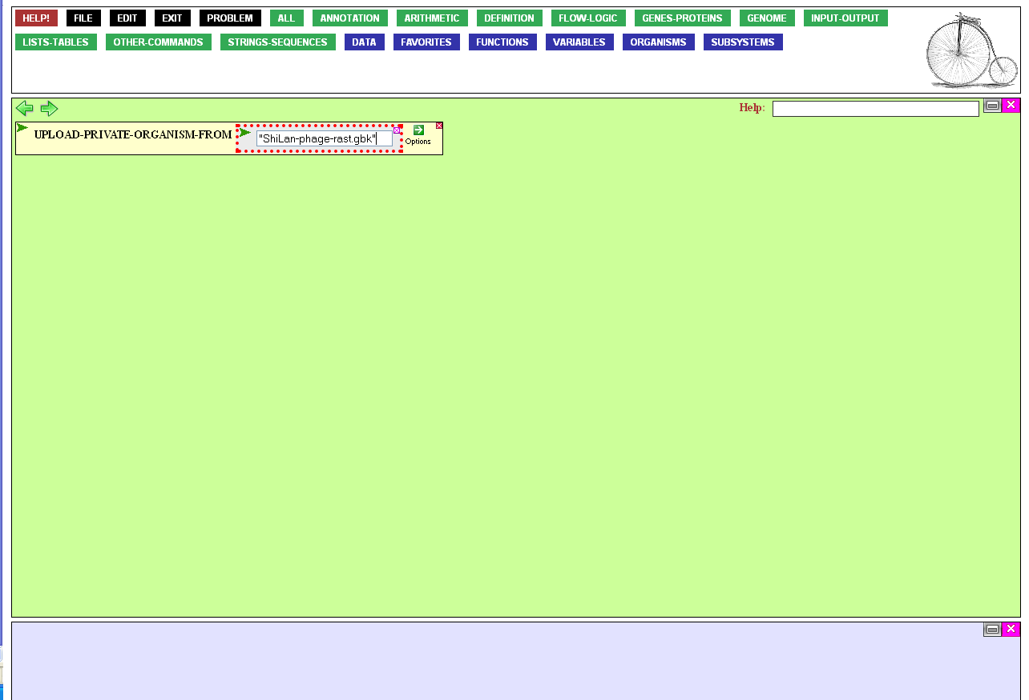
…and press Tab or Enter
to close the entry box.
This is important, as the
function cannot be executed
if any entry box remains open.

Slide 14
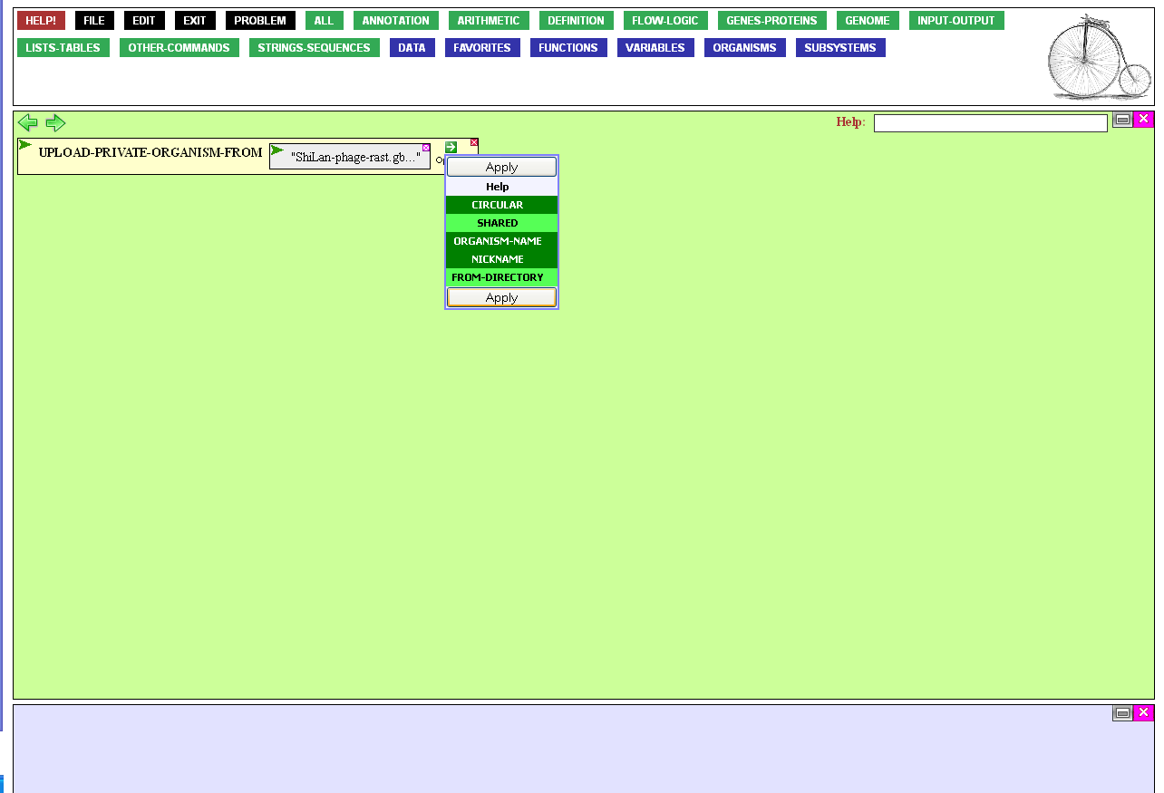

The function could be executed at this point, but then the system
would make up a name for the
phage, and I'd rather do that myself.
To supply a name, I'll alter
the workings of the function by
mousing over the Options icon…

Slide 15
…and click Organism Name.
While in the area, I might as well specify a reasonable nickname as well. Finally, I'll let BioBIKE know that the phage genome is circular.
Once all these options are selected, I click Apply.

Slide 16
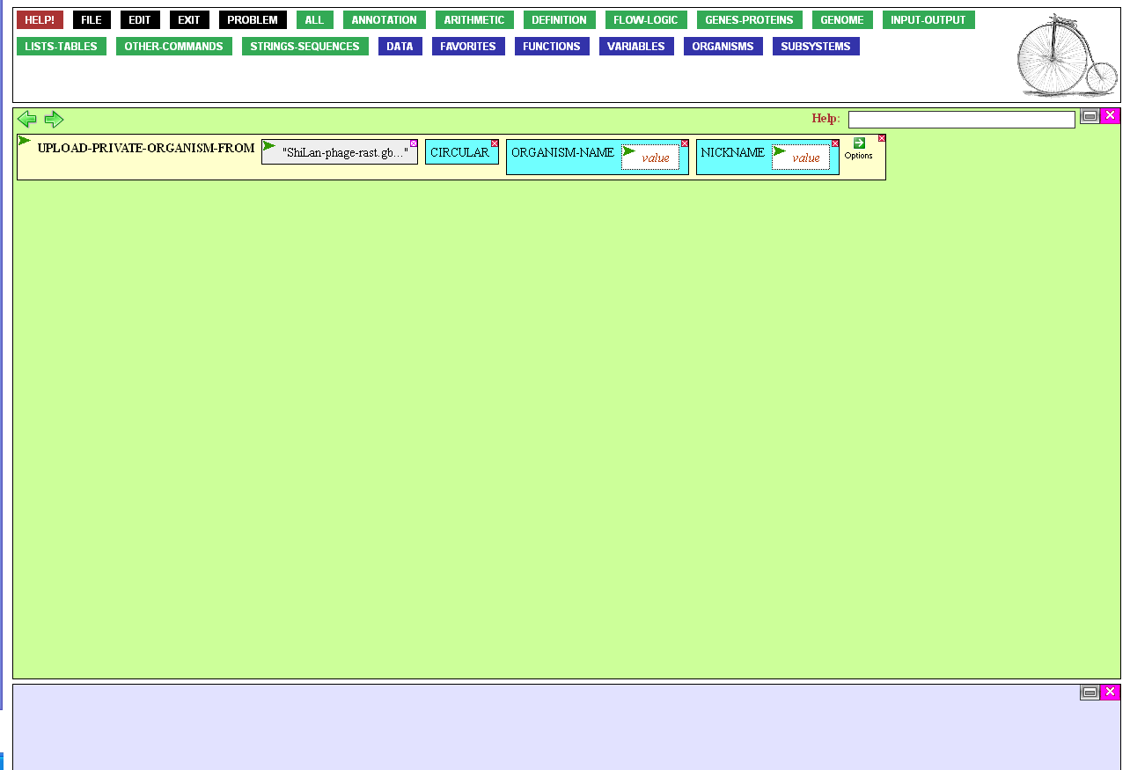
First the Organism-name.
I could open up the option's value
box by clicking on it and then type
the name I want, but the name I'm thinking of is much bigger than the
box. It would be more convenient
to have a larger input box.
Therefore, instead, I mouse
over the box's Action Icon,…

Slide 17
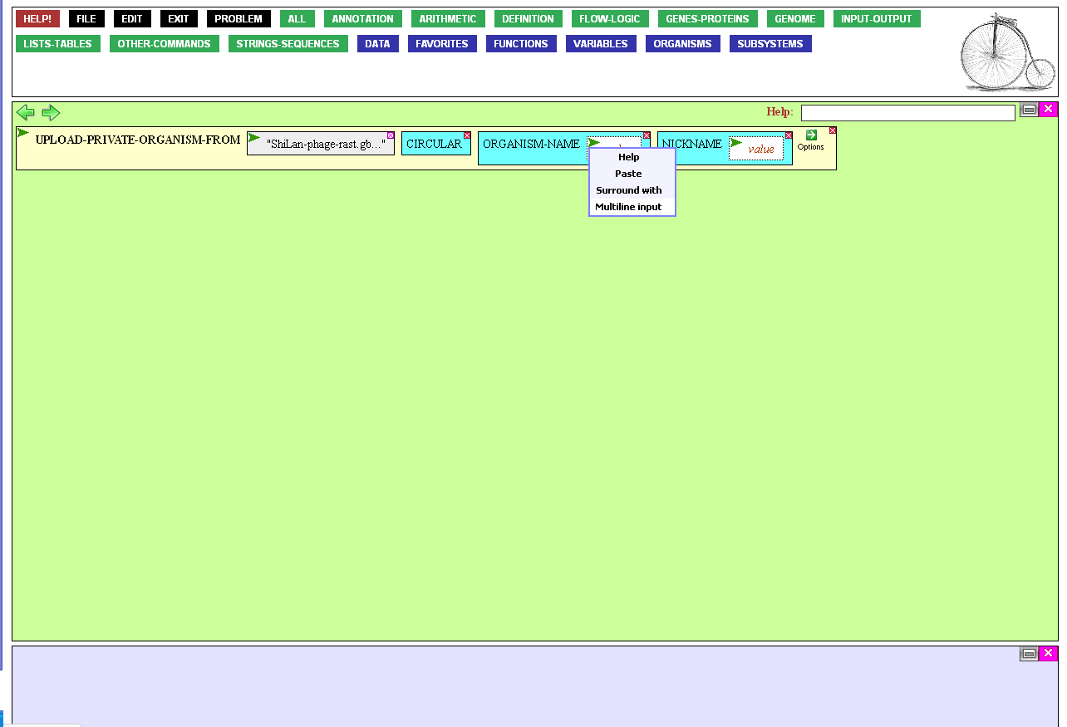
…and click the Multiline input option. This opens up a larger box
that expands to fit the text I enter.

Slide 18
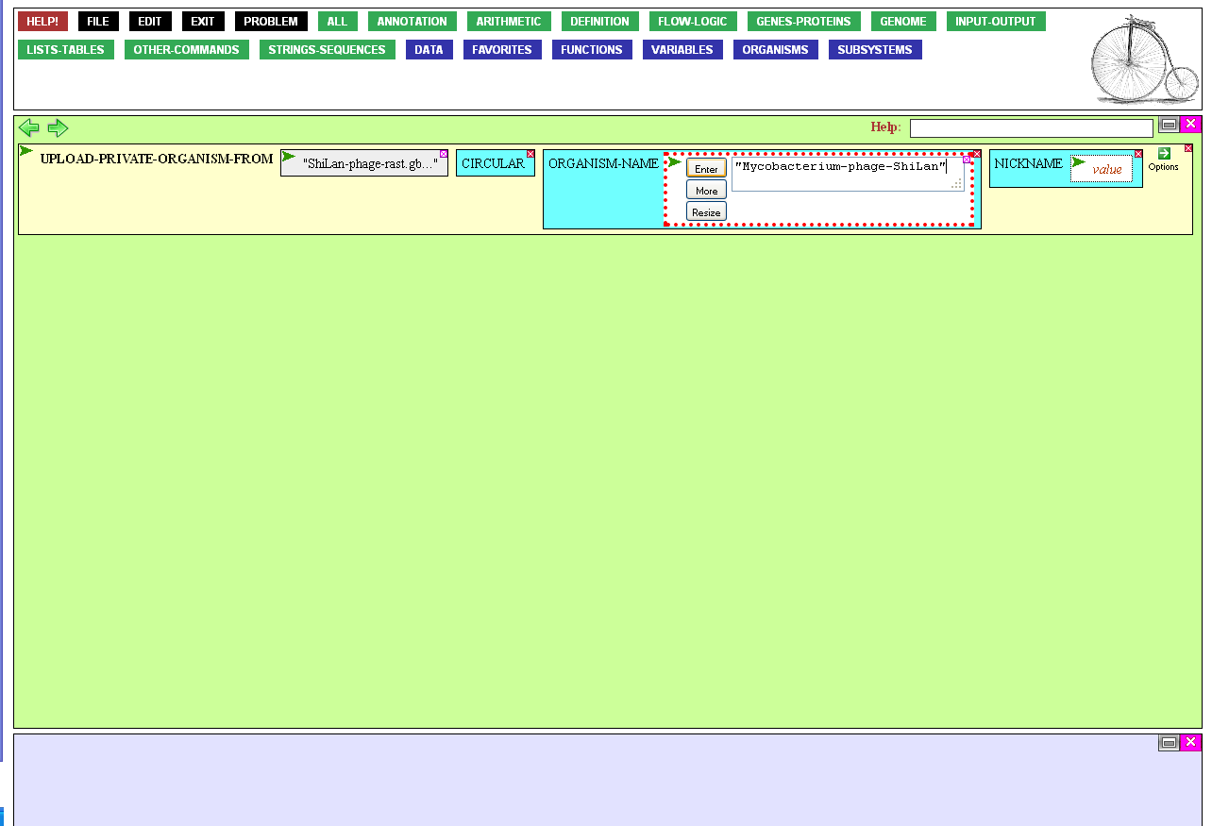
I enter the name of my choice, between quotation marks and containing no spaces.
Multiline input boxes allow you to
press Enter on the keyboard to move
to the next line. So that method is
unavailable to close the entry box.
I can either click the Enter button or simply press the tab key on the keyboard.
I do that, which moves me to the next entry box, governed by Nickname.

Slide 19
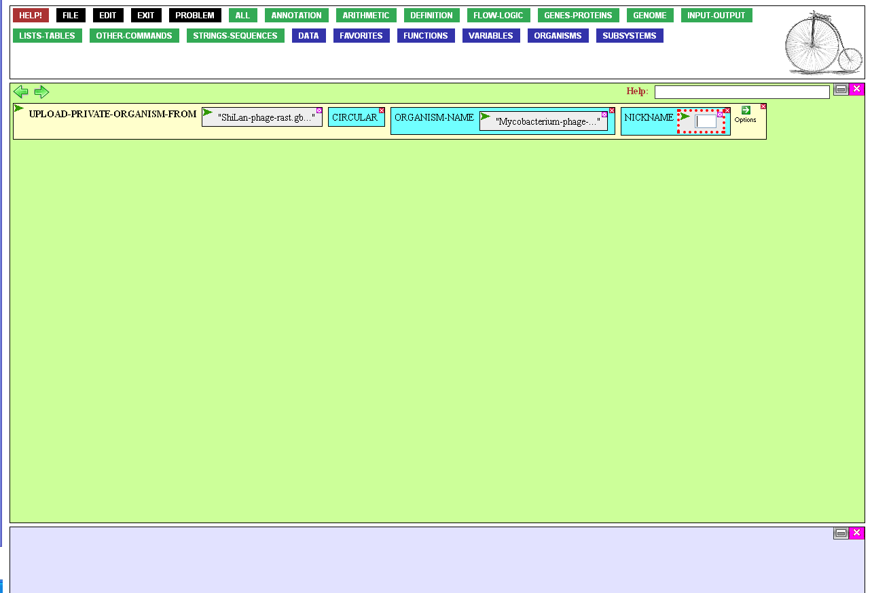
I enter the nickname of my choice, again between quotation marks with no spaces.
Then, I close the entry box by pressing either Enter or Tab on the keyboard.

Slide 20
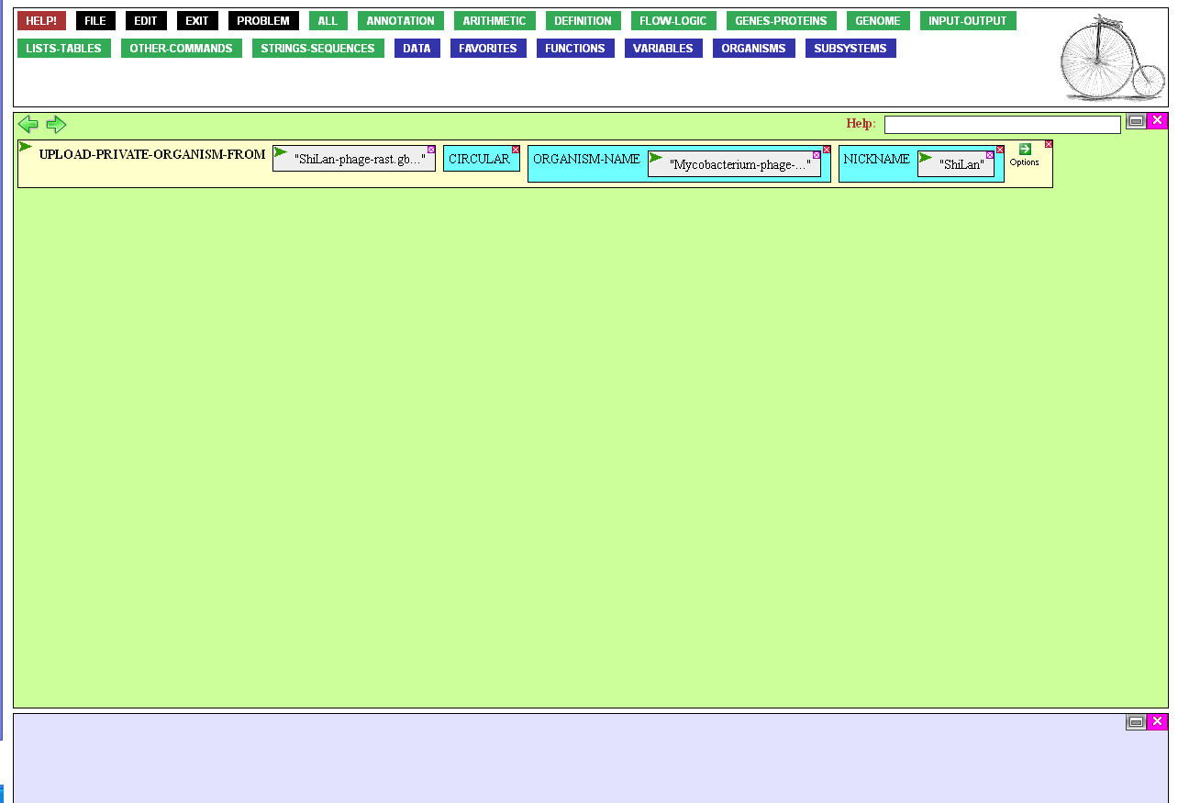
The function is ready to execute, by mousing over the function's Action Icon…

Slide 21
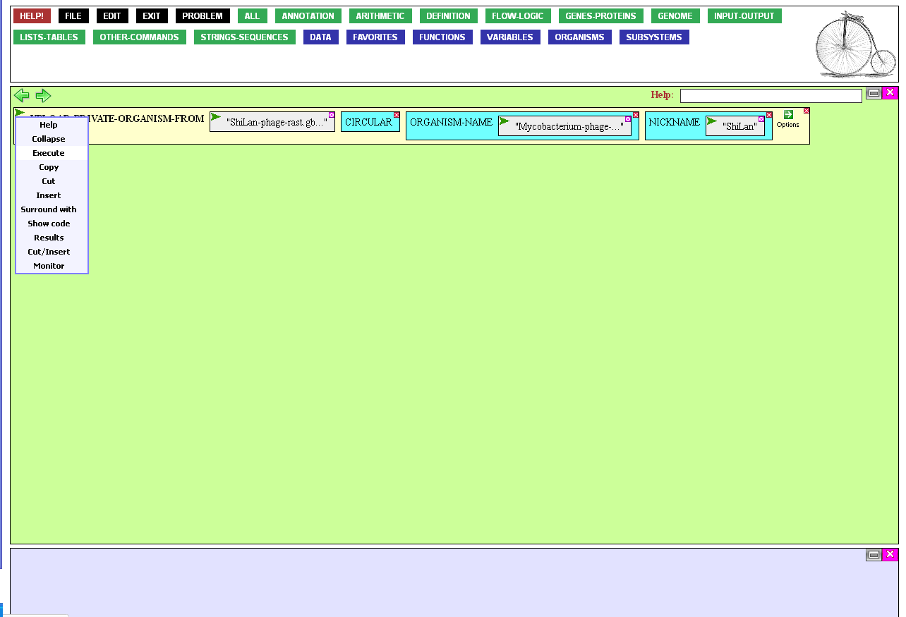
…and clicking Execute.

Slide 22


Nothing obvious seems to have happened, but actually the function has had a great effect.
First, the name of the phage has appeared in the Result Window, indicating a successful load. We'll see another effect in a moment, when we try to use the phage genome.
One thing we can do to assure ourselves
that the phage is there is to look at its
sequence. To do that, mouse over the
Strings-Sequences button…

Slide 23
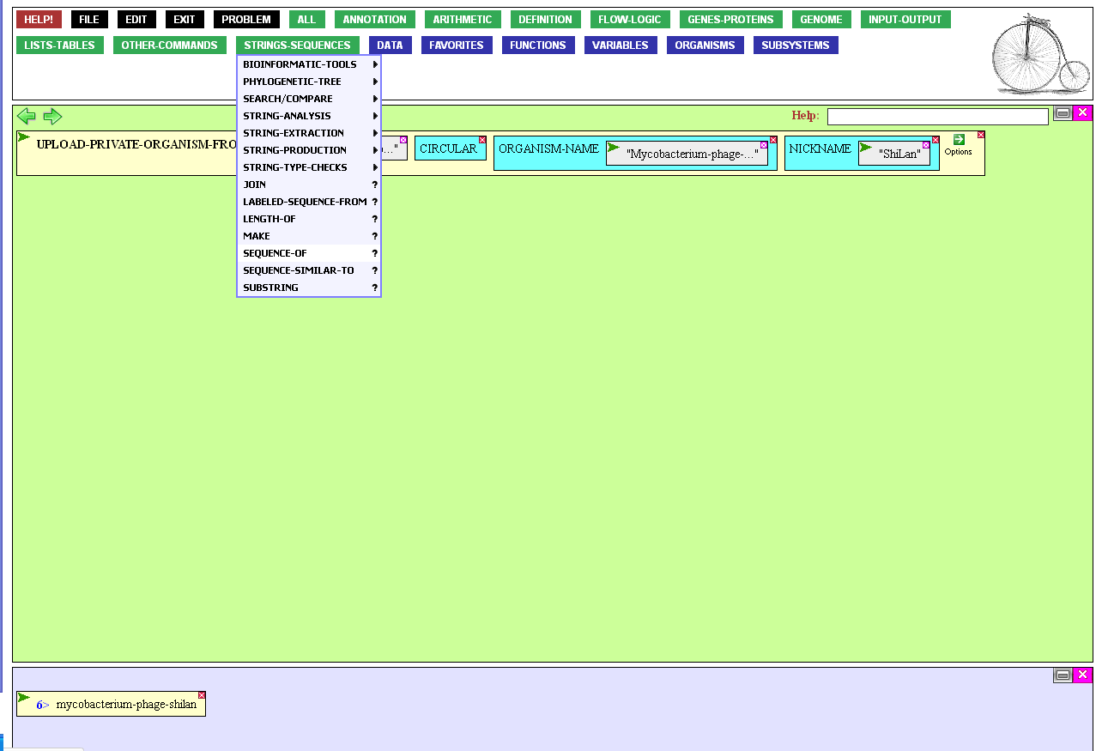
…and click SEQUENCE-OF.

Slide 24
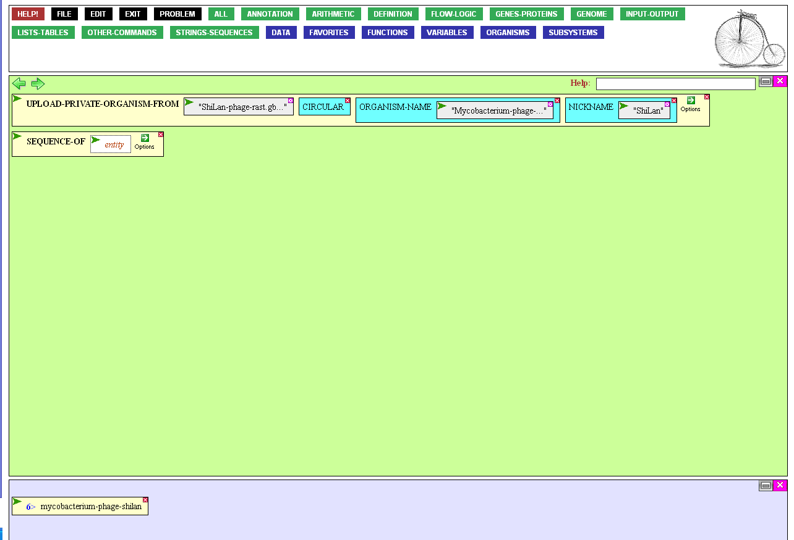
To specify what we want the
sequence of, click the entity
box to open it up for input…

Slide 25

…and then either type in the name (or nickname) of the organism, or better, mouse over the Variables button…

Slide 26
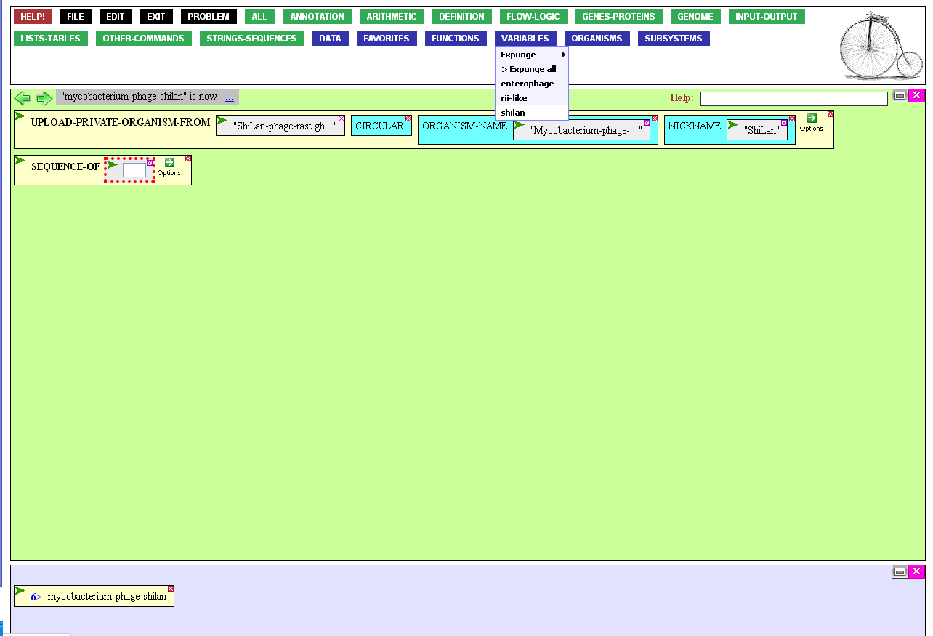
…and click the nickname I made for
the phage, now part of my language.

Slide 27
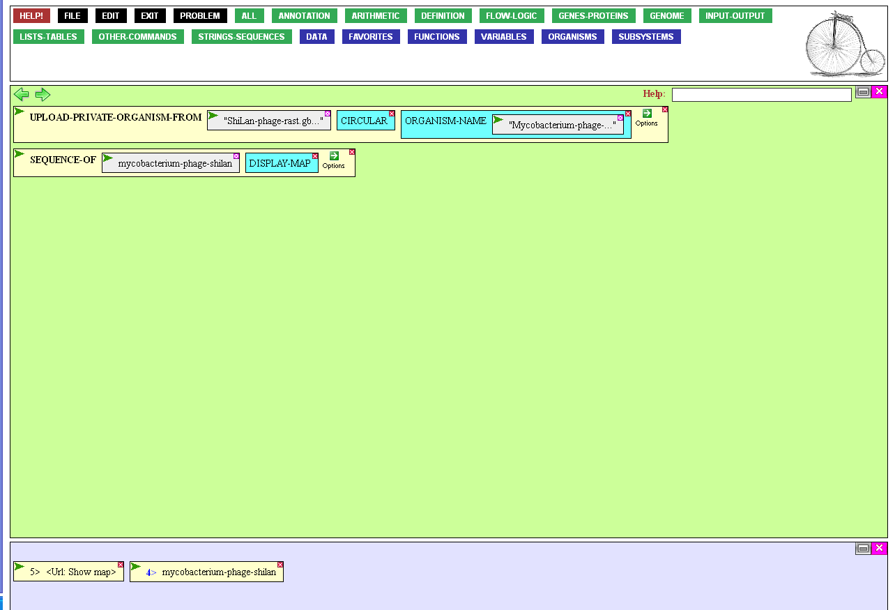


The function could now be executed, and I'd get the sequence of the phage displayed along with the annotation of the genes, but suppose that I wanted
a graphical display of the genome.
To get that, mouse over
the Options Icon,…

Slide 28
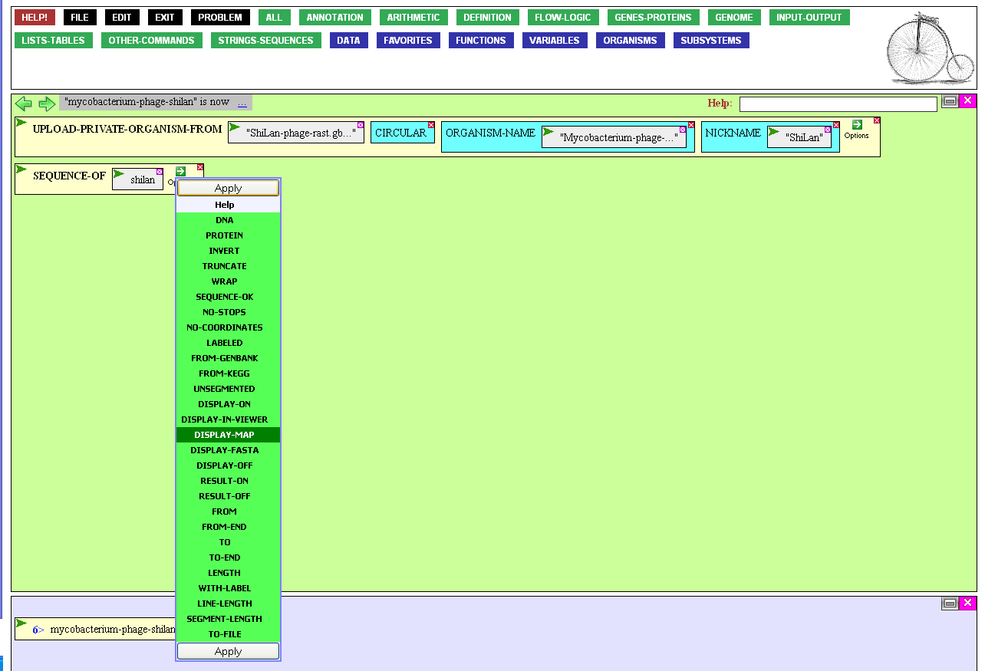

…and click the
DISPLAY-MAP option.

Slide 29
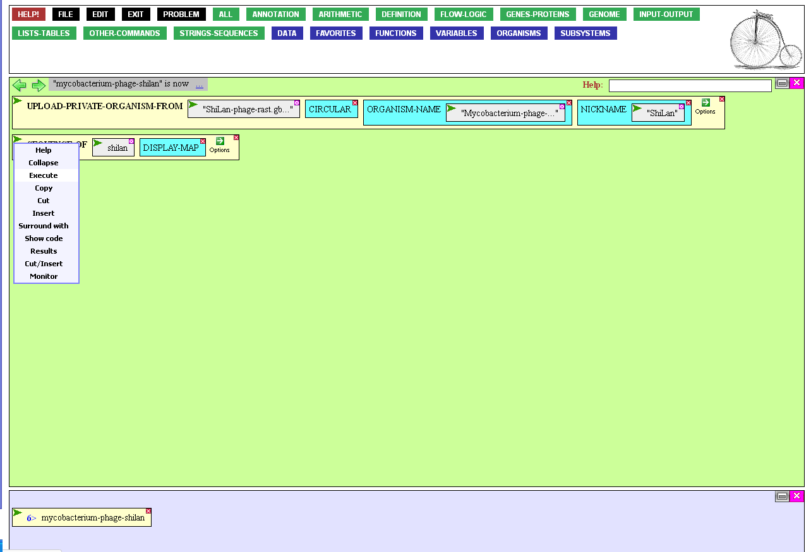
Now I execute the function, as before,…

Slide 30
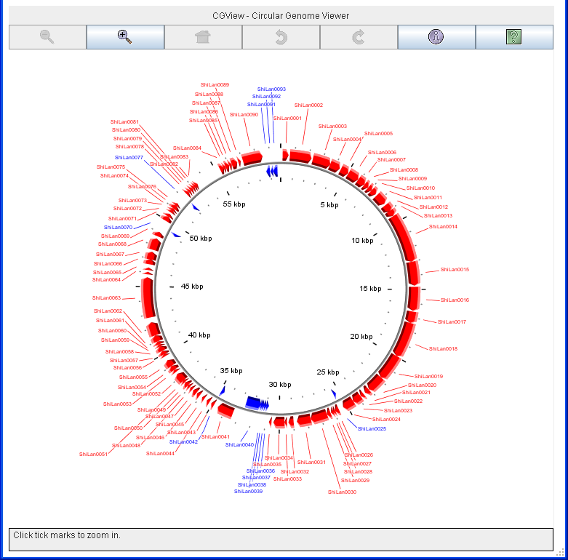
…and I'm rewarded for my efforts with a graphical map of the phage.

Slide 31
Now suppose that you have a newly sequenced phage, Charlie, that has not been annotated. All you have is the sequence.
Again, it’s simple to get it into BioBIKE,
but UPLOAD-GENOME... won’t
work, as that requires annotation.
Instead use a more general approach, defining a sequence as one you upload.
Start by mousing over
the Definition button…

Slide 32
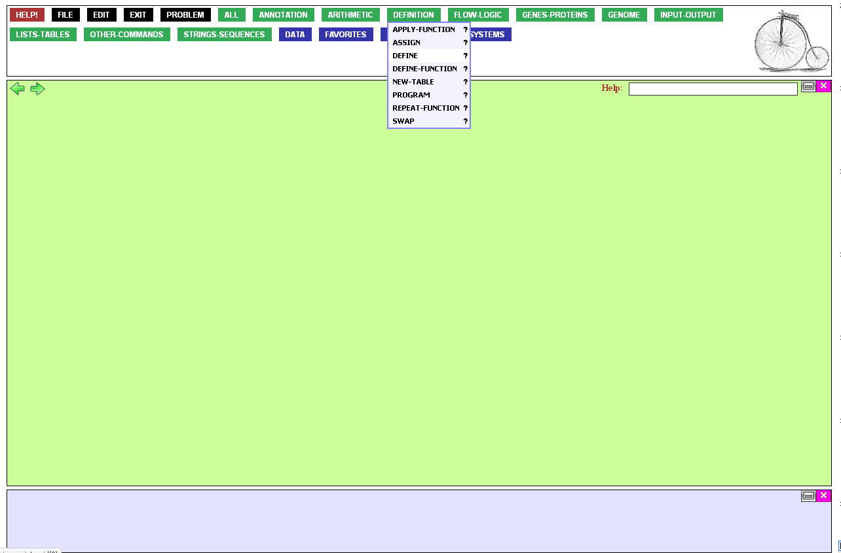
…and click the DEFINE function.

Slide 33
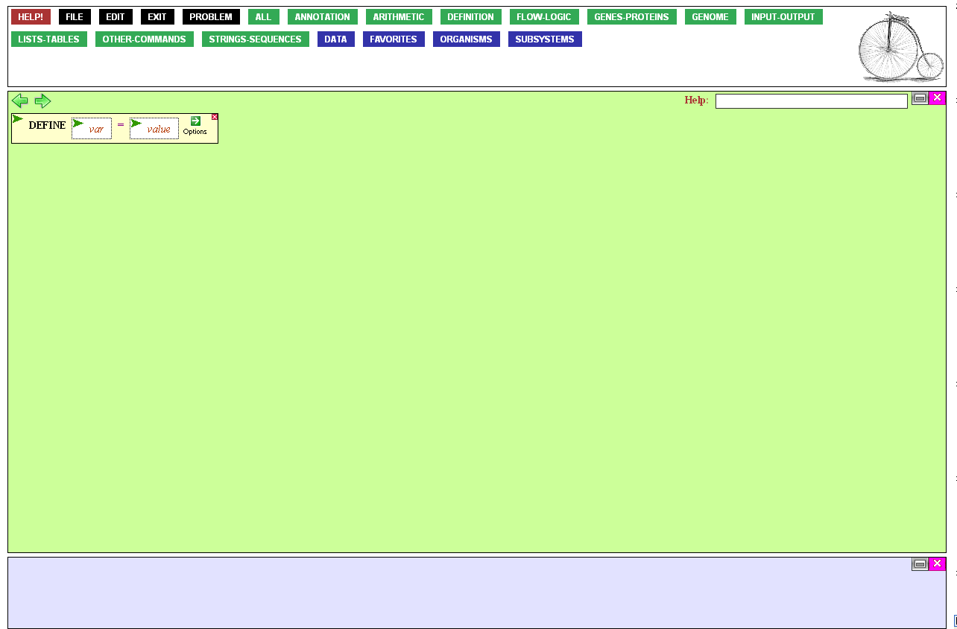
The DEFINE function requires two things: the name of the variable you are defining, and its value.
Start by clicking the
variable (var) entry box…

Slide 34
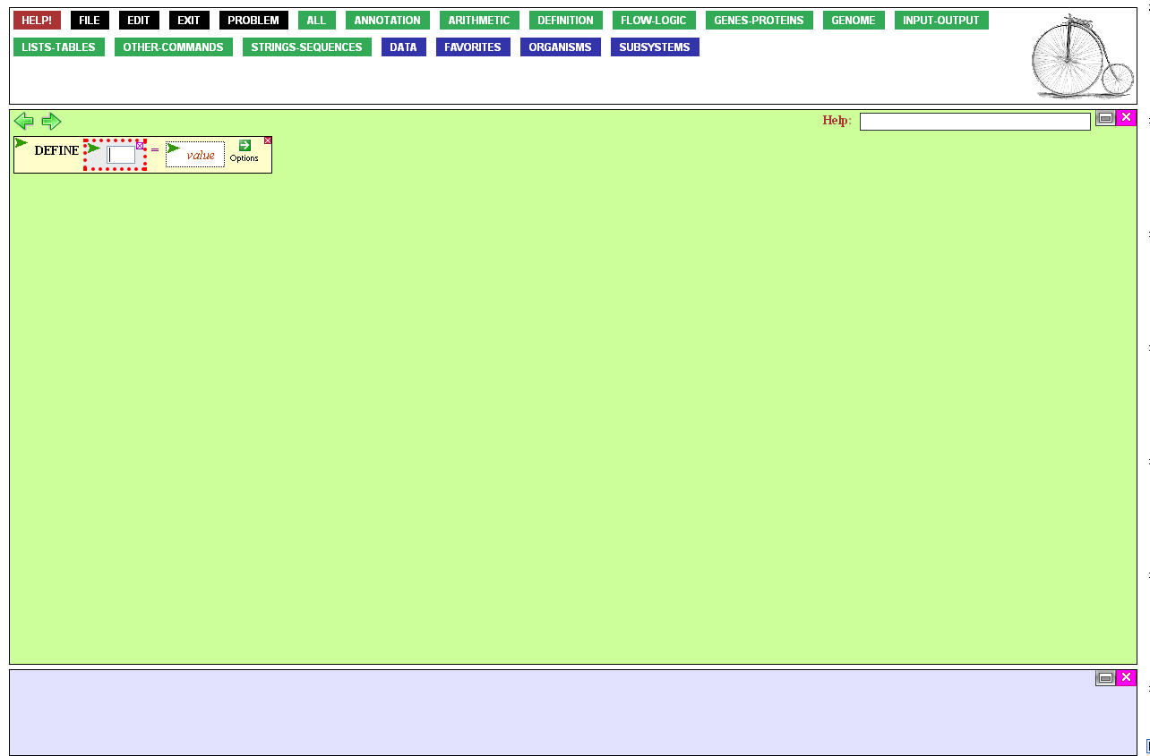
…and typing the name of the
sequence. I called it Charlie.
When you’re done, press the Tab
key to move to the value entry box.

Slide 35
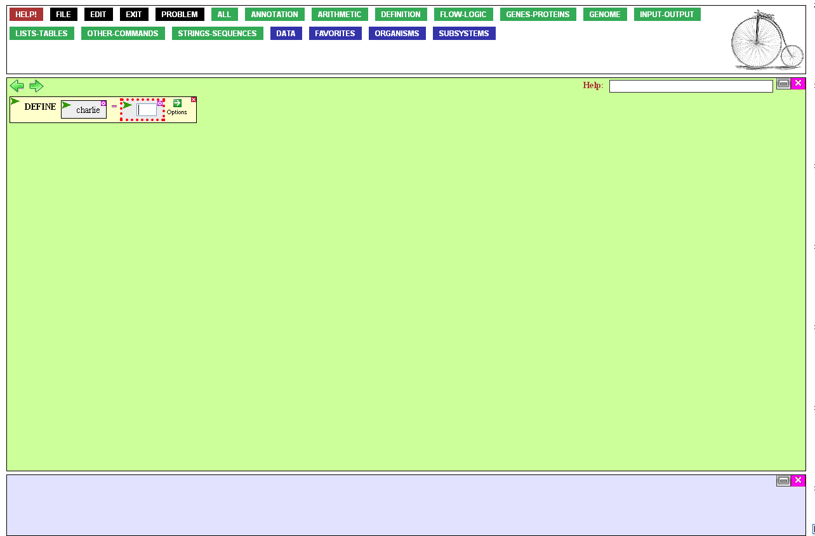
Charlie’s sequence exists only in a file on your computer at the moment. You’ll
need to upload that file to your directory on the server and read it into BioBIKE.
Reading, writing, and similar operations are found in the Input-Output menu. Mouse over that button…

Slide 36
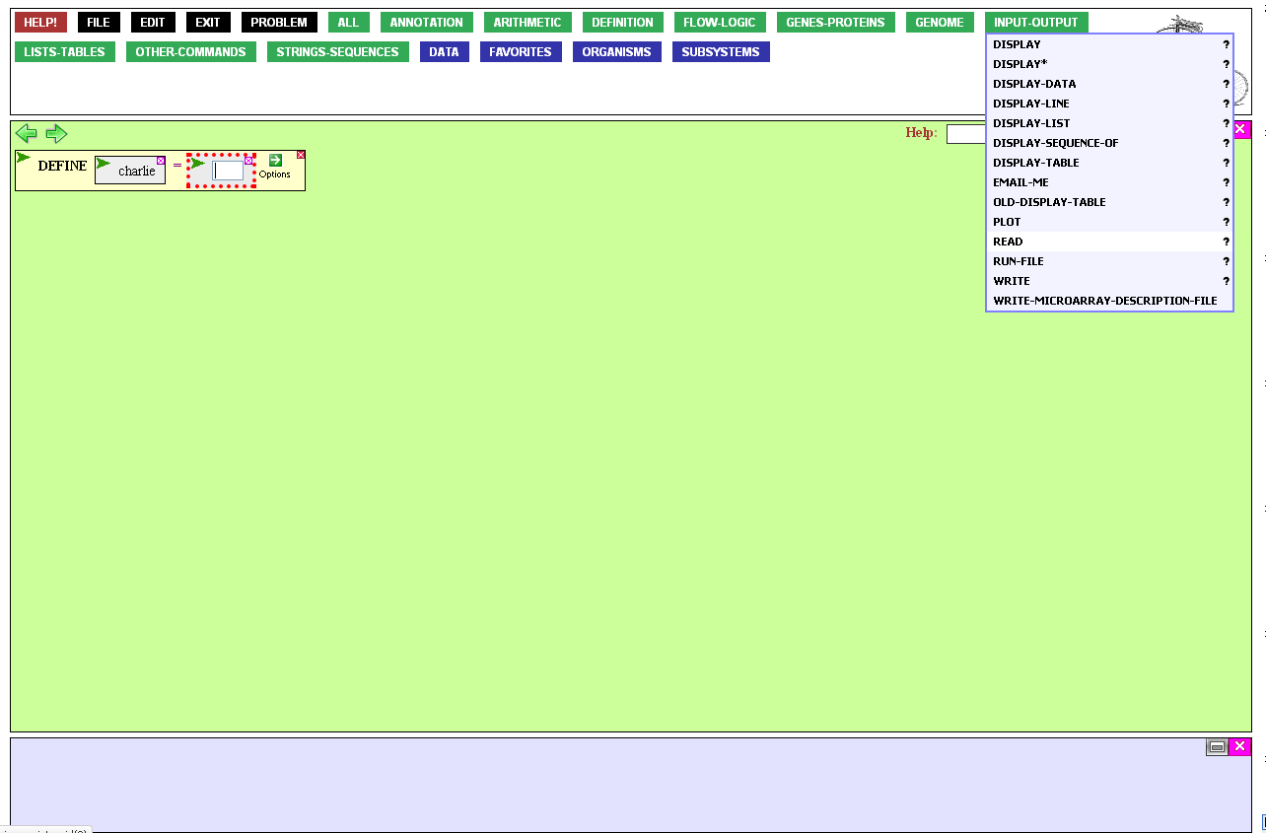
…and click READ.

Slide 37
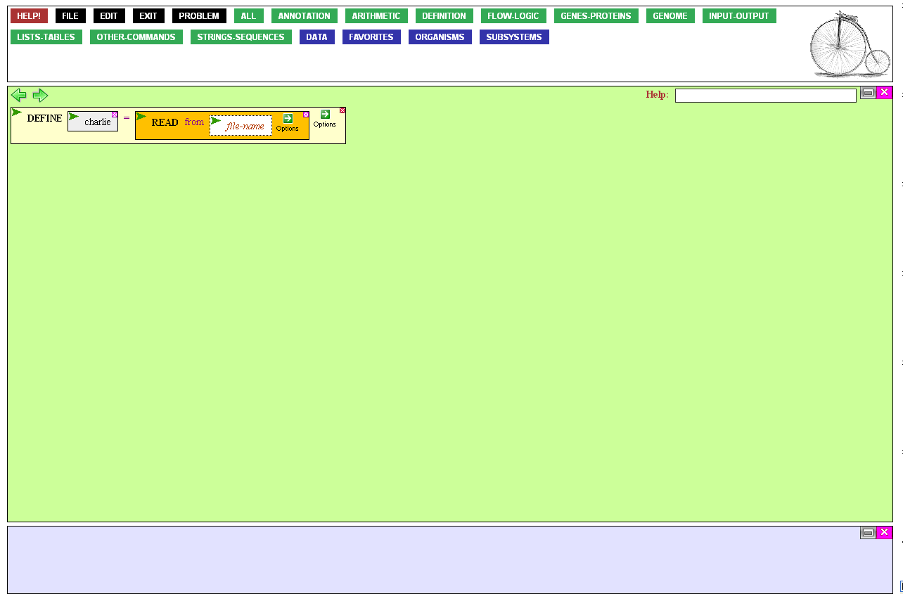
It is important to realize that this function reads from your directory on the server into BioBIKE’s memory.
You first need to upload
the file onto the server.
To do this, mouse over the File button…

Slide 38
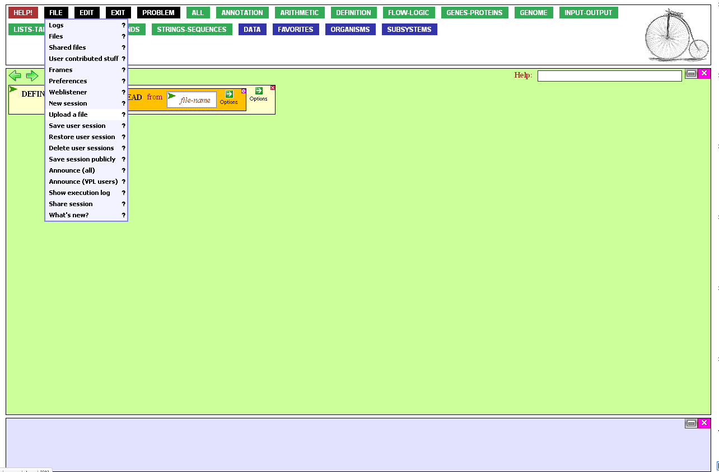
…and click Upload a file.

Slide 39
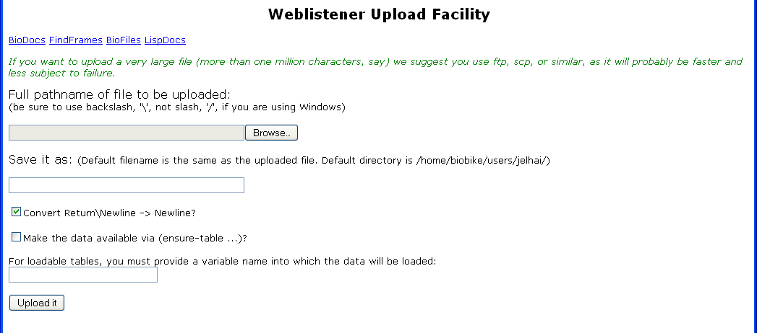
This brings you to a dialog box that enables you to find the file on your computer…

Slide 40
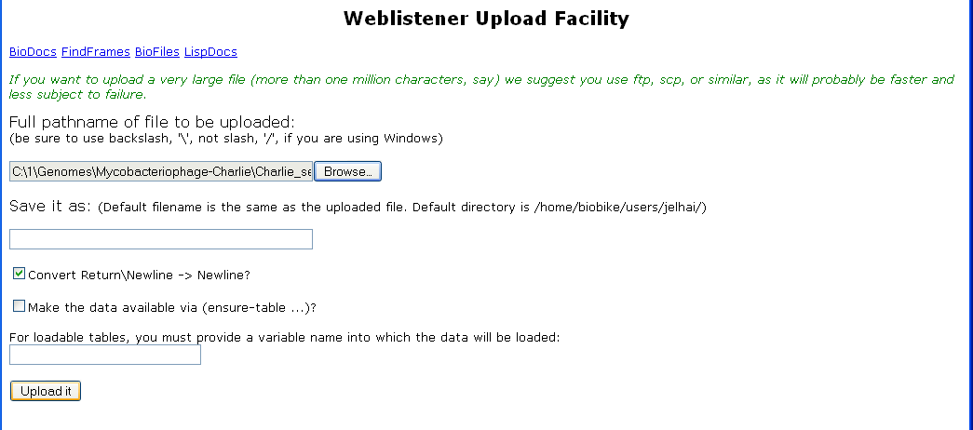
…and upload it.

Slide 41
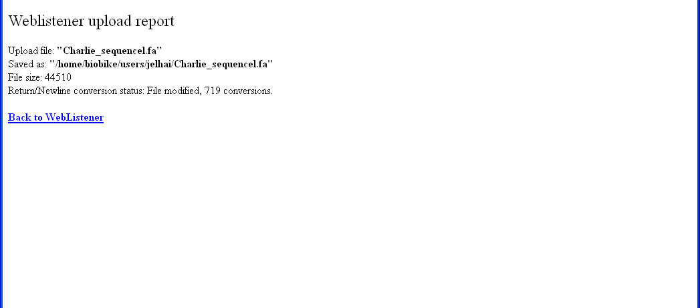
Once the task is accomplished,
highlight the file name…

Slide 42
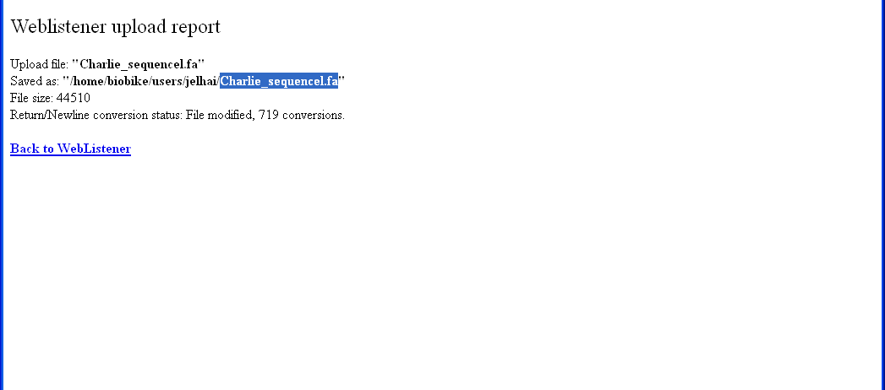
…and copy it.

Slide 43
Now we’re ready to fill in the
file-name entry box. Click it…

Slide 44
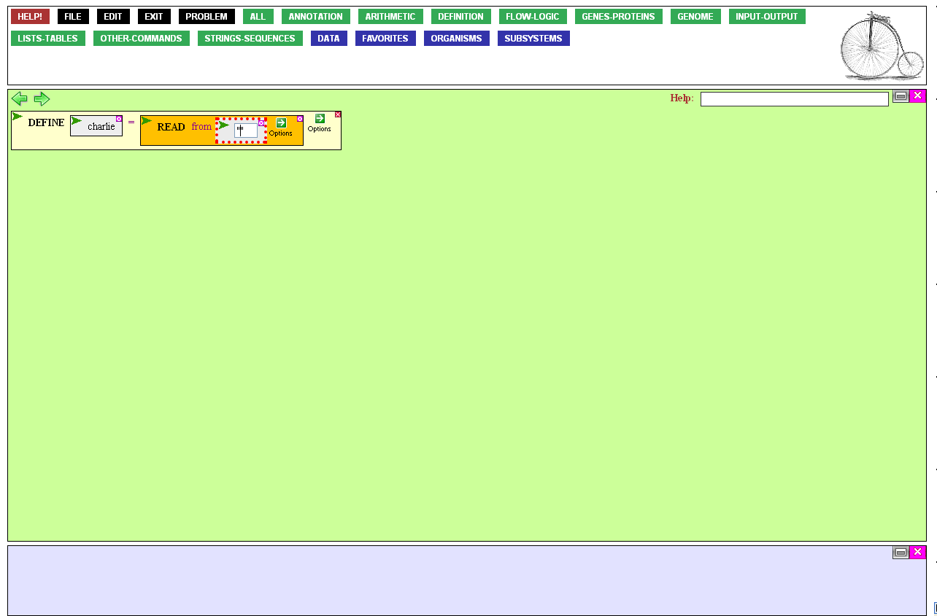
…type two quotation marks in
the open entry box, place
the cursor between them…

Slide 45
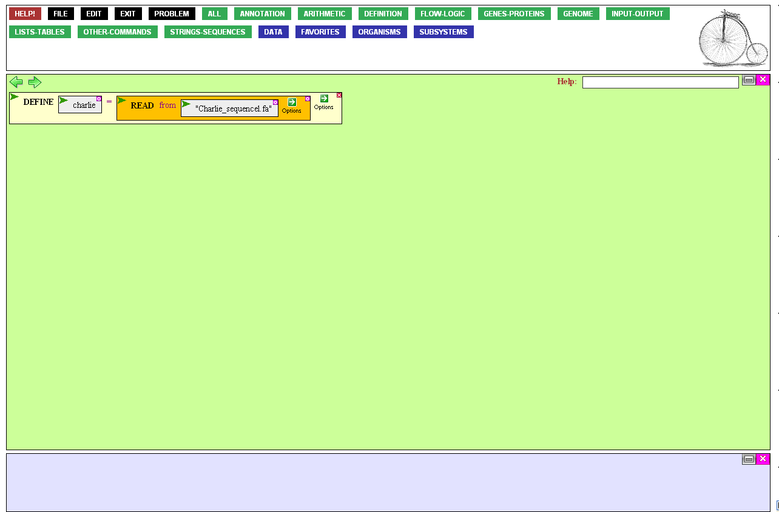
…paste in the name of the file,
and press the Enter key.
BioBIKE should be clever enough
to figure out what kind of file
you are uploading, but it isn’t.
Help it out by mousing
over the Options icon…

Slide 46
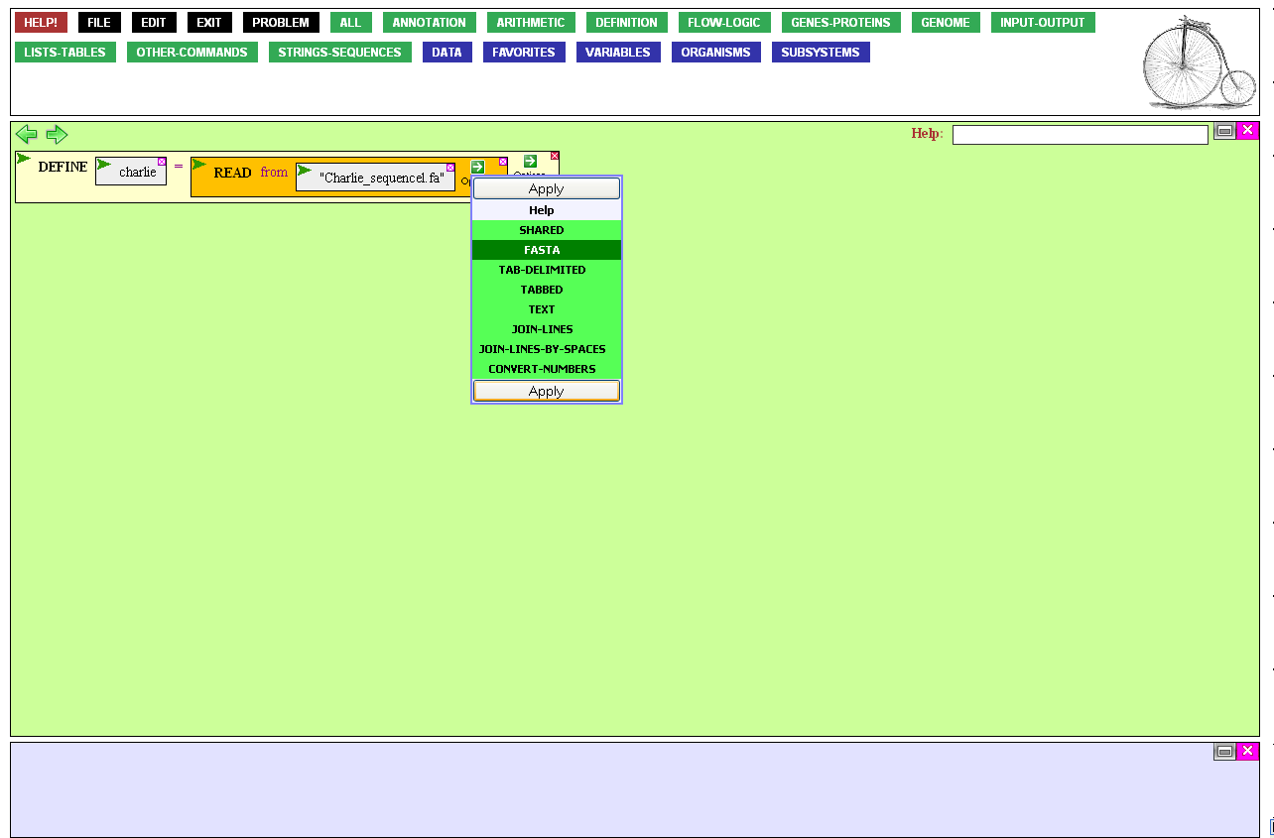
…and clicking FastA.*
There may be any number of
FastA-formatted sequences in the
file. If the sequence lacks a FastA header, that’s OK, but then only
one sequence may appear in the file.
*FastA format consists of a DNA or protein sequence preceded by a header line, identified by > as the first character:
>Charlie
GTCAAACATCCCTCCCGTGACGTGCCTGGTCCCGGGACGGCCCGTCAGCAAACAGCAGCA
AACGTGCAGCTCATCTCAGCAAACTTTGGAGGCCCGATGCGGCGTGATTGCGCGGTATGC
GGGCAAGCGTTCGAGGCGAAACGCCCGCAGGCGAAGTACTGCGGCGACACGTGCCGCAAG
CGTGCTCAGCGTGGCGGCATCGCGCAGCAGAAACACCAGCAGGCGCCGCCGGTTTCGTCT
. . .

Slide 47
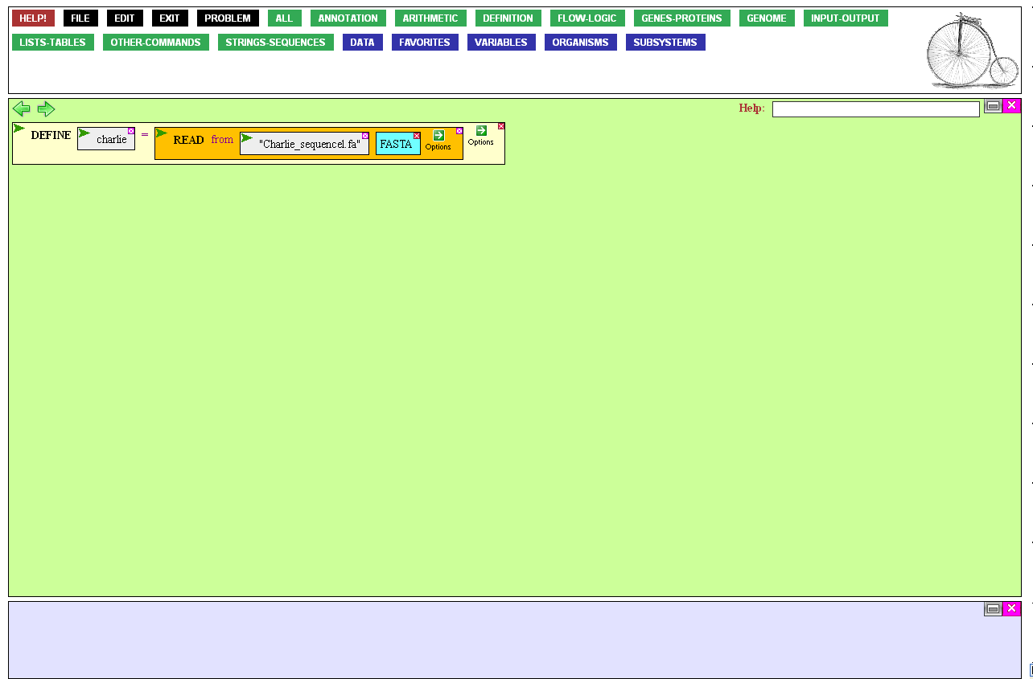
The function is now ready
to be executed, by mousing
over the Action Icon,…

Slide 48
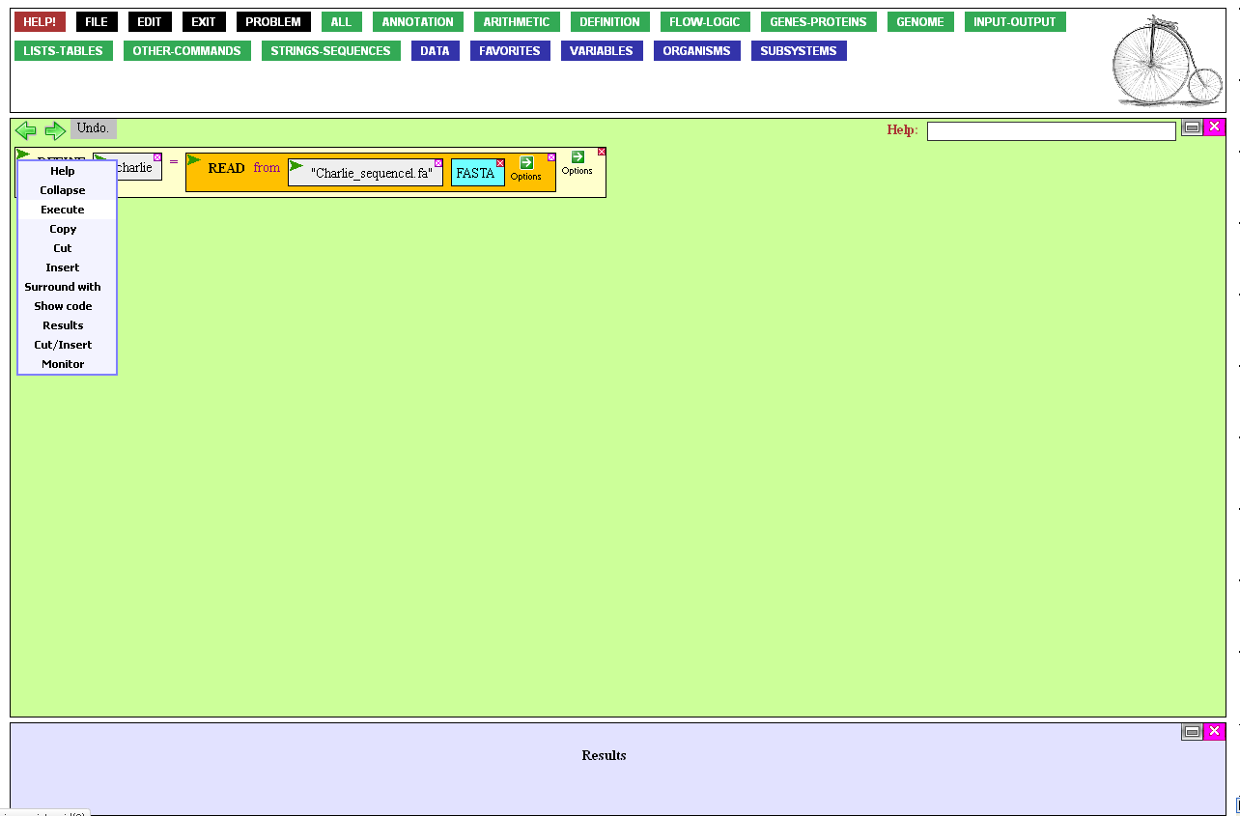
…and clicking Execute.

Slide 49
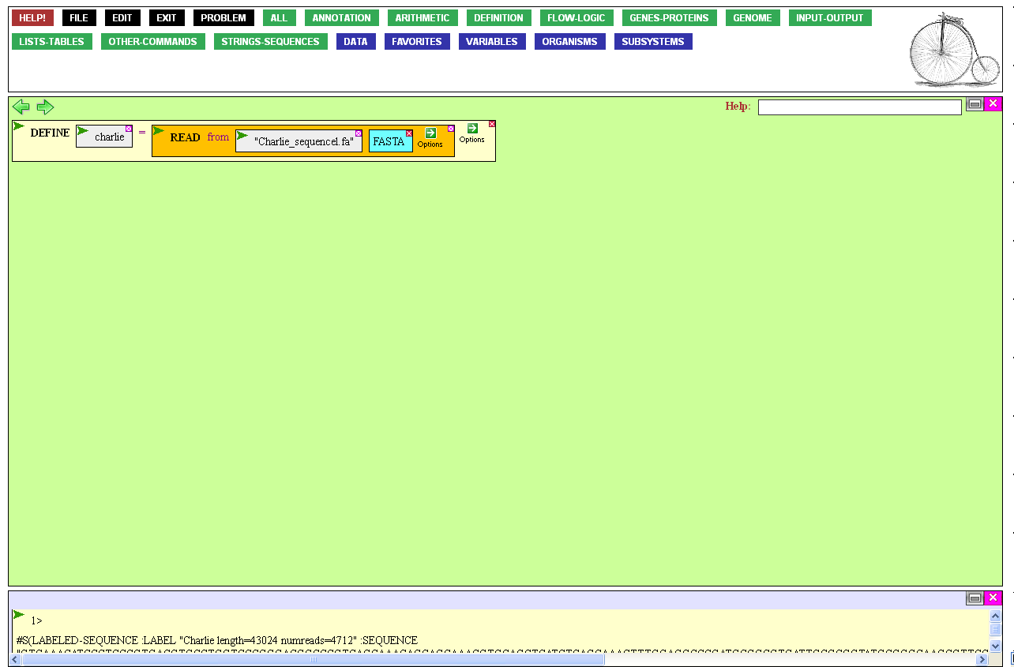
You’ll know that BioBIKE successfully read the file if the sequence (in machine-readable form) appears in the Result Window
What did we want to do with this sequence?
Well, one thing we can do is to determine
if Charlie contains any regions that could potentially encode proteins similar to
those of Shilan, another bacteriophage
that infects mycobacteria.
To do that, mouse over the
Strings-Sequences button…

Slide 50
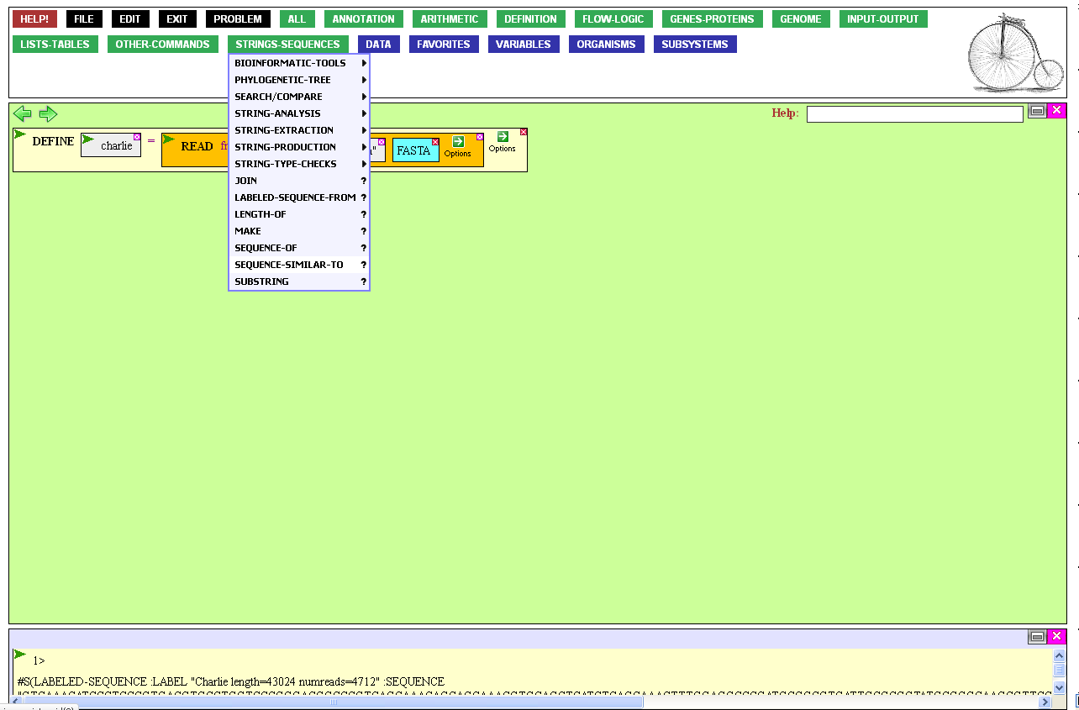
…and click SEQUENCE-SIMILAR-TO.
This function allows you to access Blast and other ways of finding similar sequences.

Slide 51
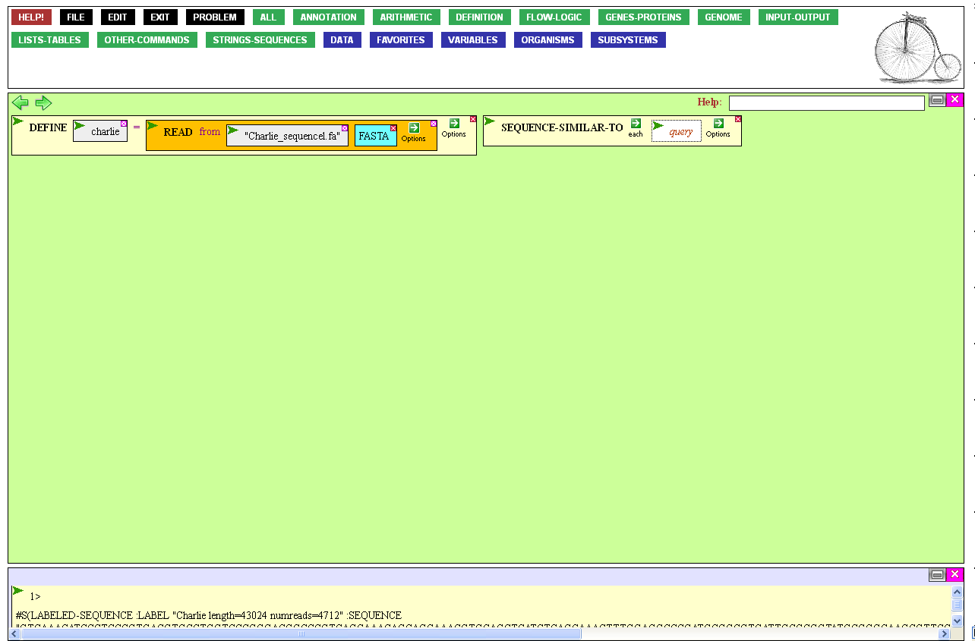
My goal was to determine whether sequences in Charlie were similar to sequences in ShiLan. I’ll treat Charlie as the query and ShiLan as the target of the search.
To set the query, click the query entry box,…

Slide 52

…and mouse over the Variables button…

Slide 53
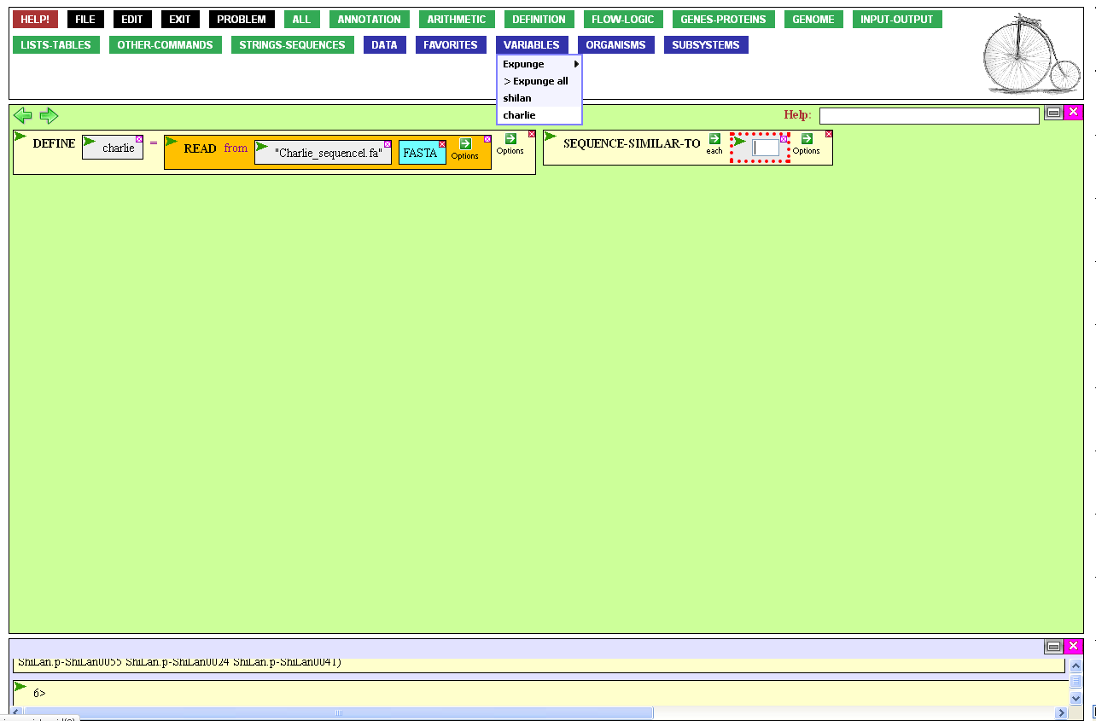

…to find the newly defined Charlie sequence.
Clicking it…

Slide 54

…brings it into the query entry
box and closes that box.
Executing this function would compare Charlie to every sequence known to
BioBIKE, often a good idea. This time, however, I just want to compare it to ShiLan.
To modify the operation of the function, mouse over the Options Icon…

Slide 55
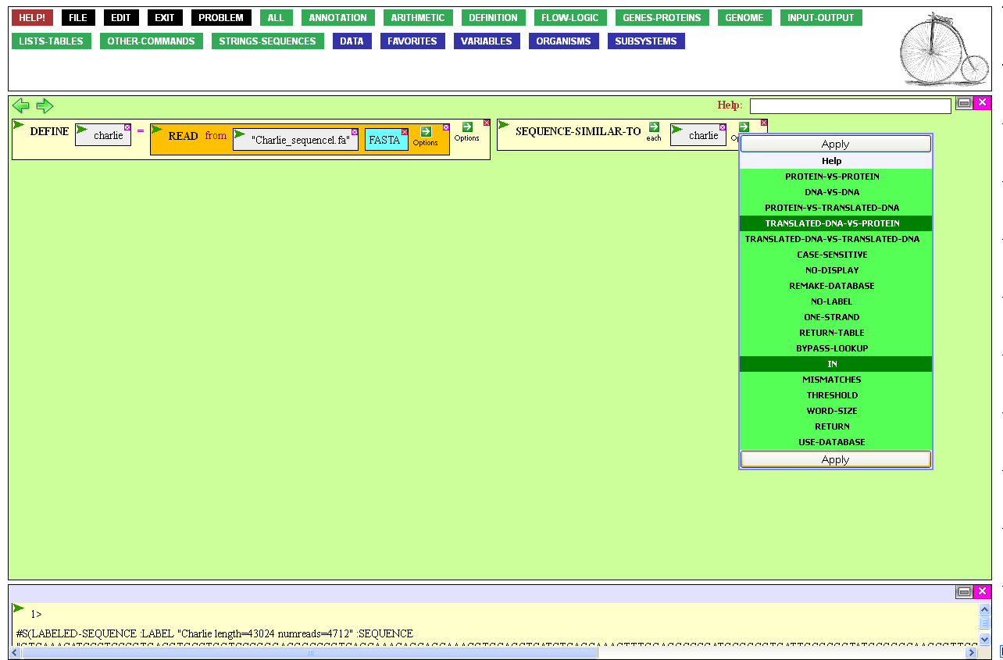
…and click the In option (so I can limit the search to ShiLan) and also click the Translated-DNA-vs-Protein option.
This is equivalent to BlastX (if you’re
familiar with Blast jargon).
Finally, click Apply to set the options.

Slide 56
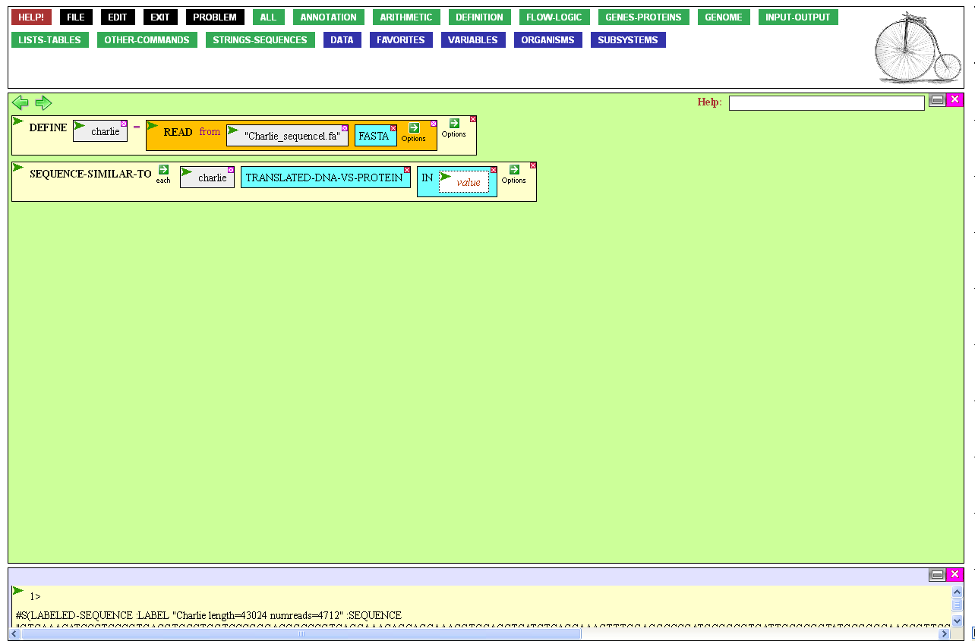
To specify ShiLan as the target, open the
entry box governed by In by clicking it,…

Slide 57
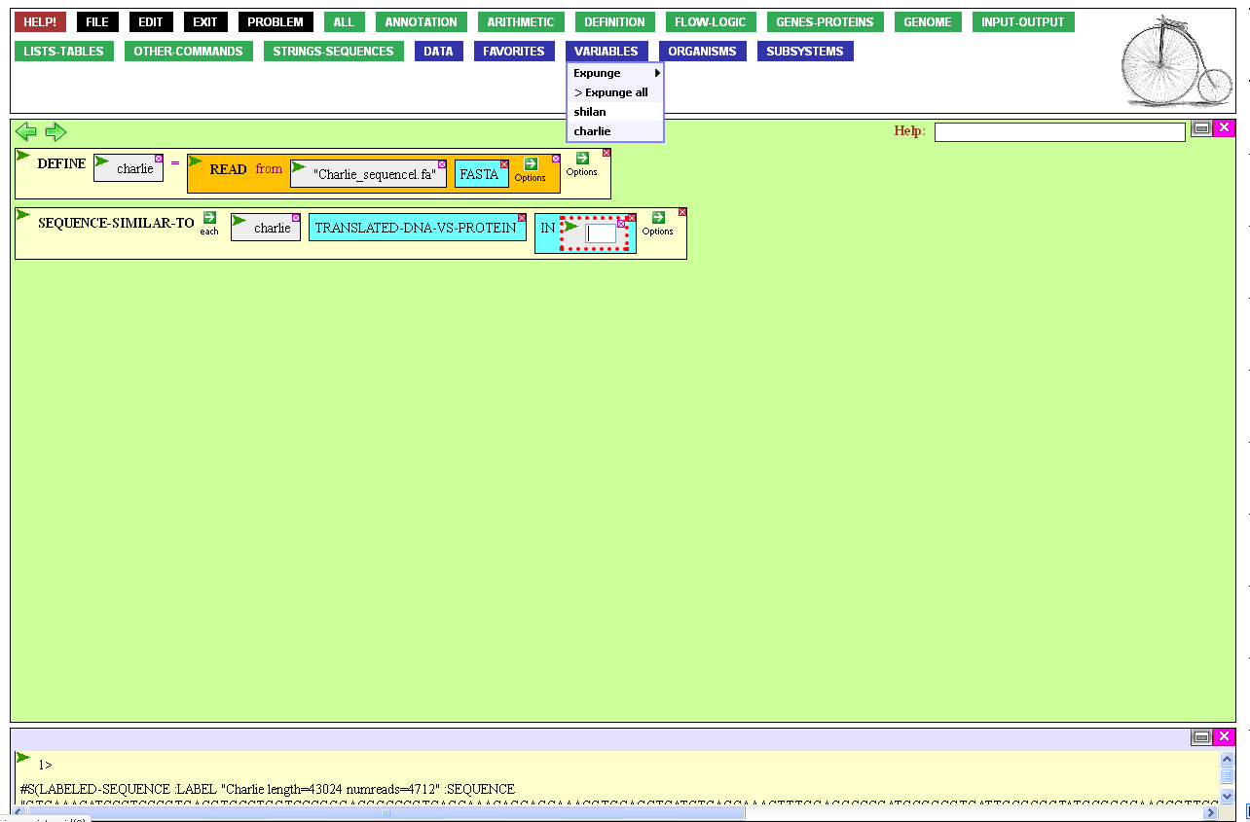
…mouse over the Variables
button, and click shilan.

Slide 58

The function is now ready to be executed.
You could execute is as you did DEFINE,
but just for some variation, execute it instead
by double-clicking the function’s name.

Slide 59

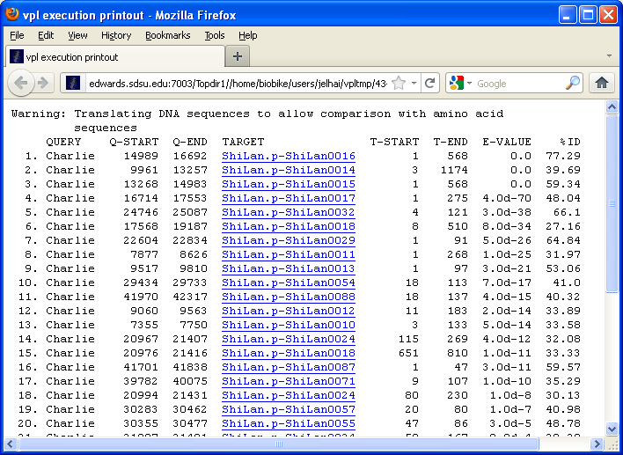
The result of the function is both
displayed in a separate window
(for easy reading) and in the
Result Window (as a source
of further computation).
There are evidently many regions of Charlie that potentially encode proteins similar to those of Shilan.

Slide 60
Working With Local Genomes
Reflections and Coming Attractions
You may be surprised at how different is the procedure to bring in a sequence with annotation compared to the procedure to bring in a sequence lacking annotation. The reason is that many BioBIKE functions are keyed to genes or proteins and work quite differently with raw sequences. BioBIKE considers the two things to be very different.
This tour did not list all the things you could do with your genome, because that would require listing almost the entire capabilities of BioBIKE. If you’re not sure what to do, consider going through one of the many other tours that focus on analysis. However, it is not as yet possible to annotate genes of local genomes.
If you’re concerned about others seeing your sequences, you might read BioBIKE and Security.

