Slide 1


What is a Gene?
A BioBIKE Tour
This tour companion presumes that you are following along in the tour What is a gene?, which can be found at the BioBIKE portal:
http://biobike.csbc.vcu.edu
in the Guided Tours of BioBIKE section.
The purpose of this tour companion is to help gain comfort in the conventions of BioBIKE so that you can complete the tour on your own.

Slide 2
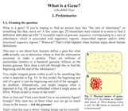
Read Section 1.A
on your own.
I’ll wait.

Slide 3

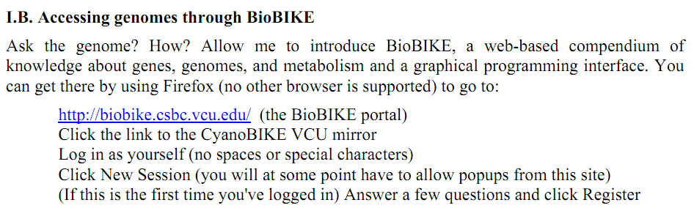
Now we reach the doing part of the tour, which will require BioBIKE...
…But wait! Read the fine print…
BioBIKE is guaranteed to run only on Firefox.
If you are using another browser, time to switch.
If you don’t have Firefox, then…

Slide 4

…time to get it (http://www.mozilla.org/products/download.html)
(and if you don’t put Firefox
first, BioBIKE won’t run)

Slide 5
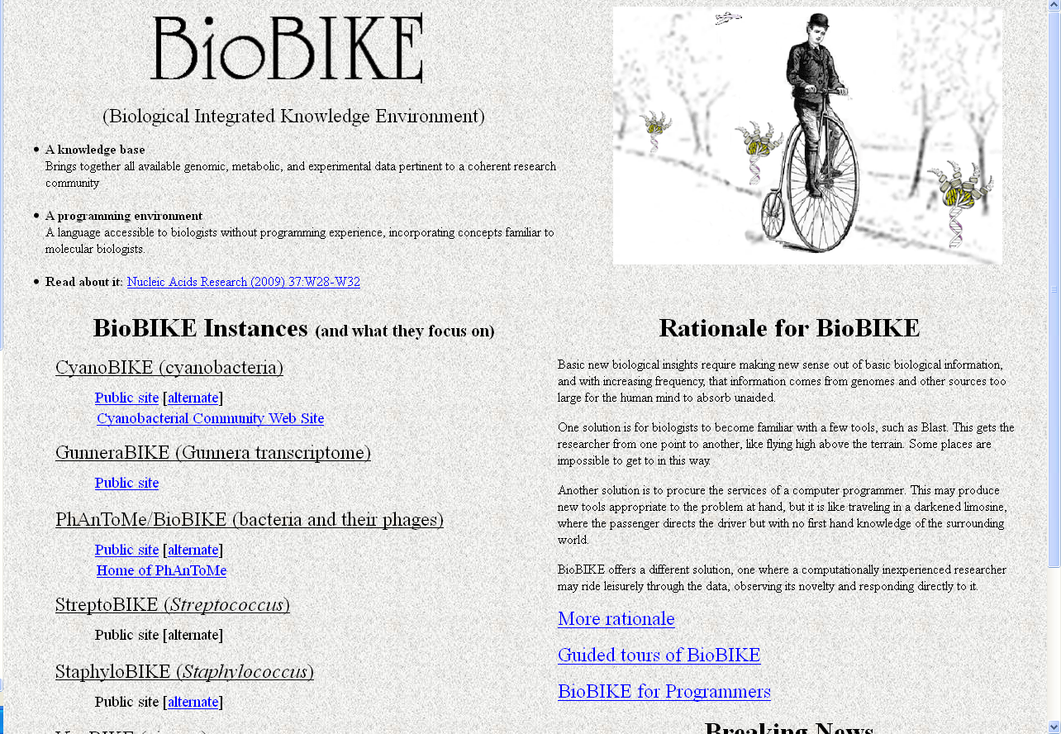
Now (in FireFox), go to the BioBIKE portal (http://biobike.csbc.vcu.edu/)
Click the CyanoBIKE Public site

Slide 6
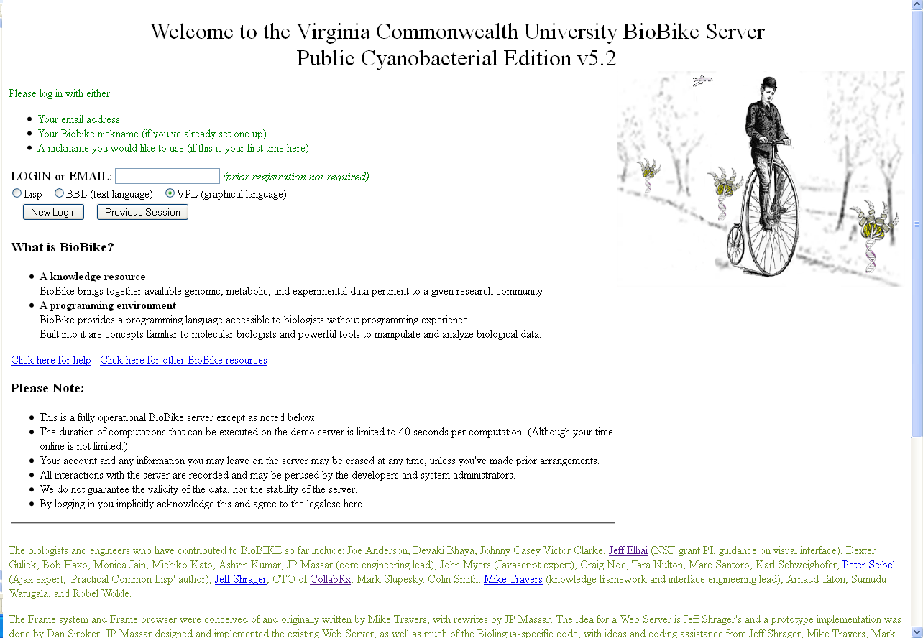
Type in a login name of your choice
(but no spaces)

Slide 7
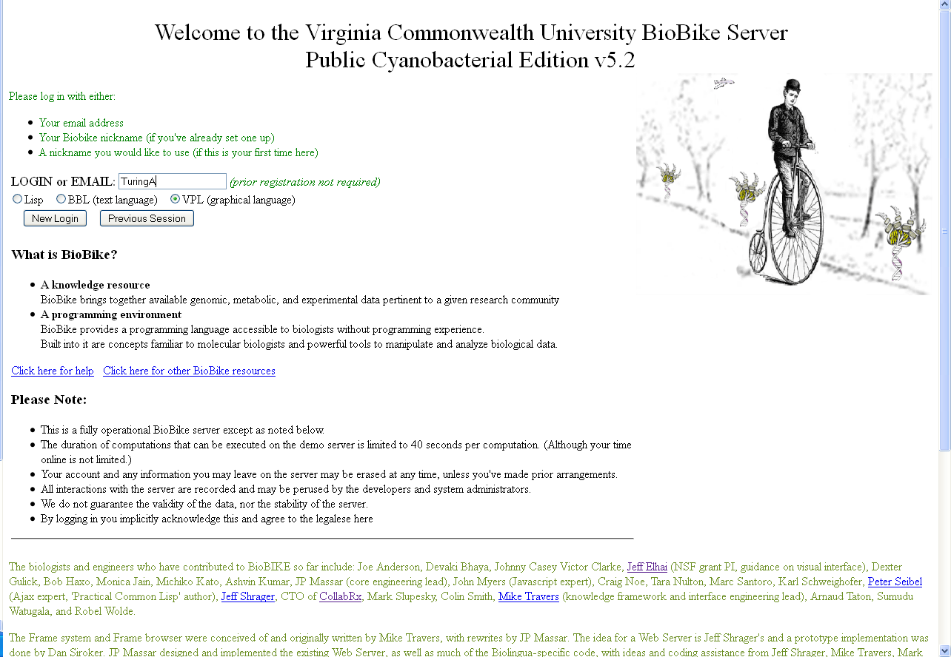
Then click New Login..
You’d click Previous Session
if you wanted to resume a session
you had already started.

Slide 8
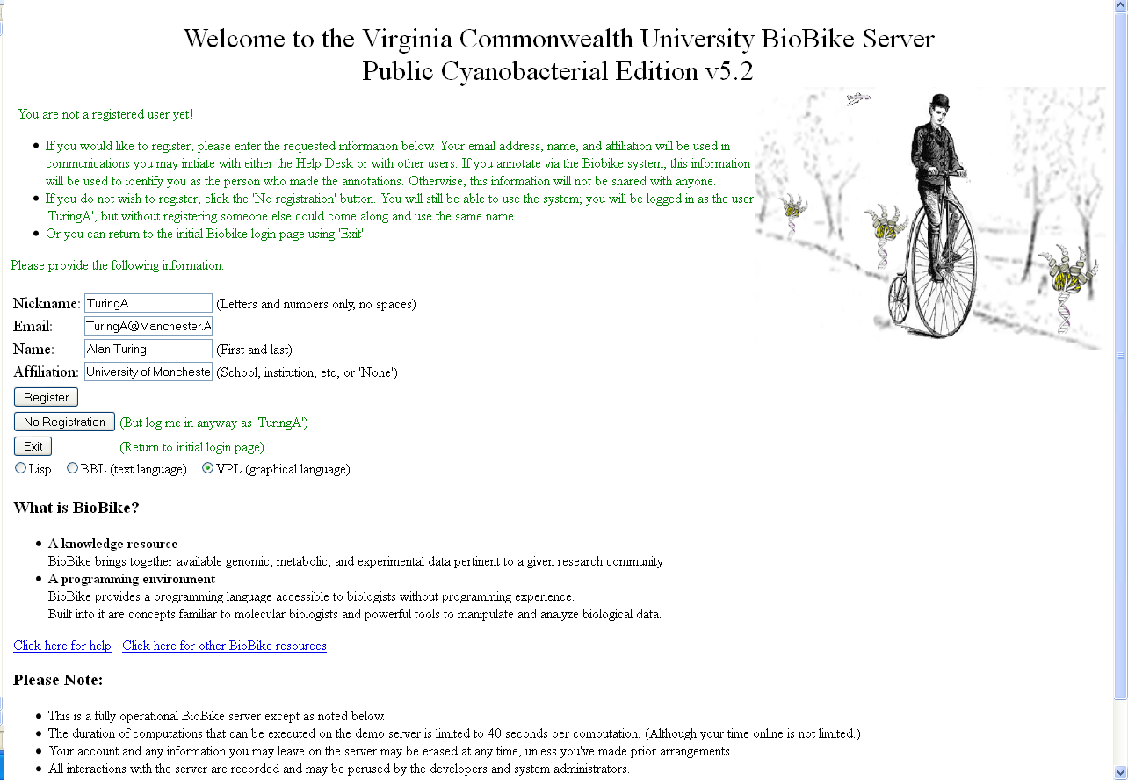
You can enter without registering
(by clicking No Registration), but registration is necessary if you
should ever want to communicate
with others within BioBIKE, or
change how genes are described.
Probably a good idea to register.

Slide 9
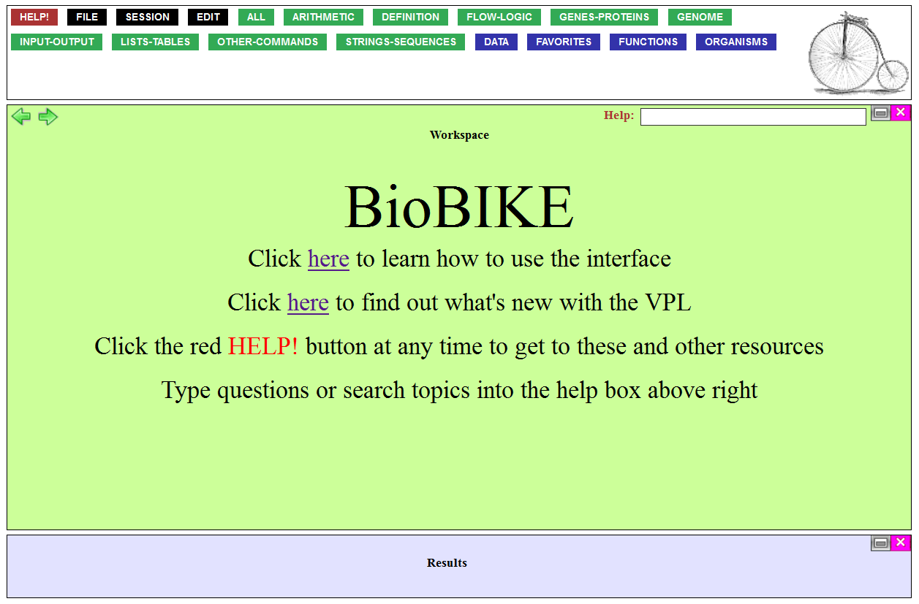
Well here we are... What next?
Before returning to the
What is a Gene? tutorial,
you can spend a bit of time understanding how BioBIKE works.
One way is to explore a tutorial concerning the BioBIKE interface.

Slide 10
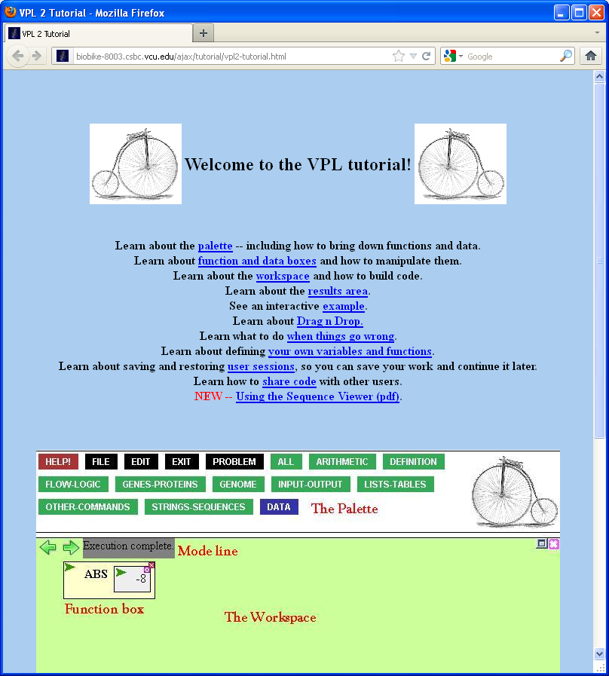
Another way is to
go to the Help facility.

Slide 11
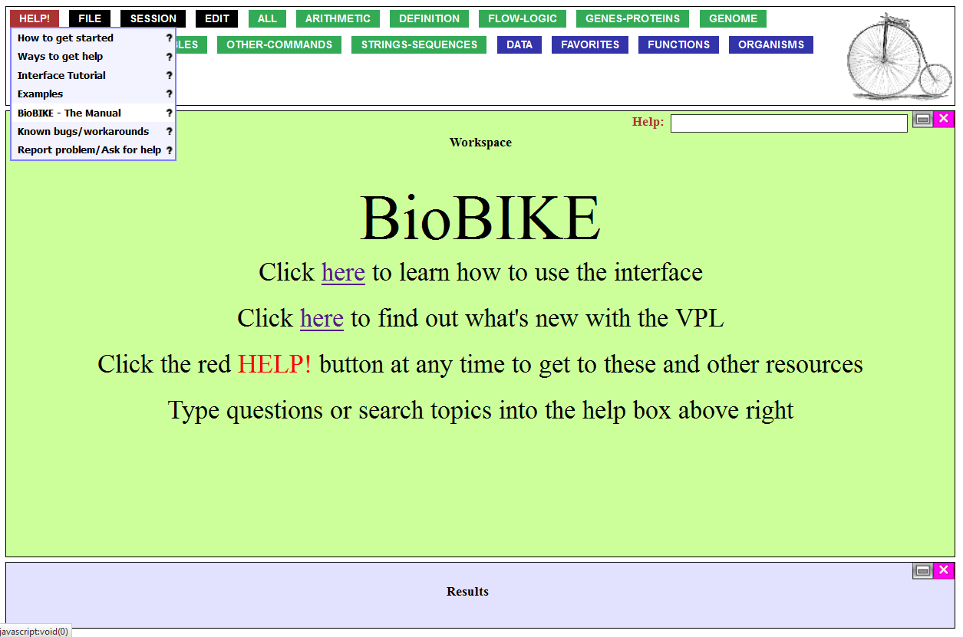
...click General Help…
...click General Help…

Slide 12
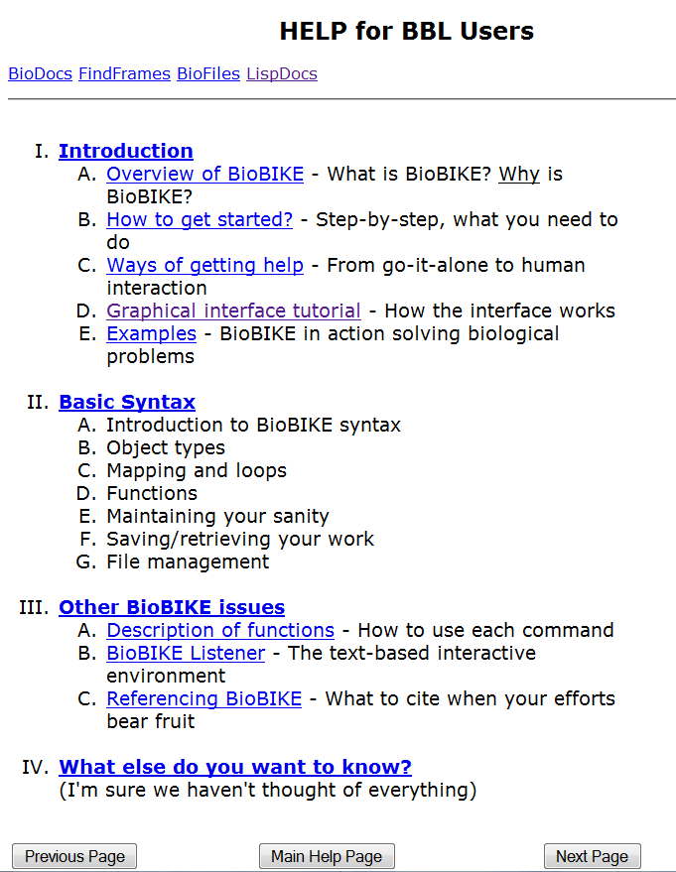
…and explore.
Basic Syntax is a
reasonable place to start.

Slide 13
And there’s always the search facility. Just type anything you want to know about in the Help box and press Enter.

Slide 14

If all fails, you can report a
problem to an actual human
through the Problem button.

Slide 15
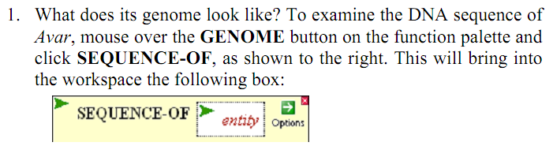
Back to What is a Gene.
Section 1.C suggests that
you find out what a DNA
sequence looks like by
using a function available
from the GENOME menu.
Where to find it?

Slide 16
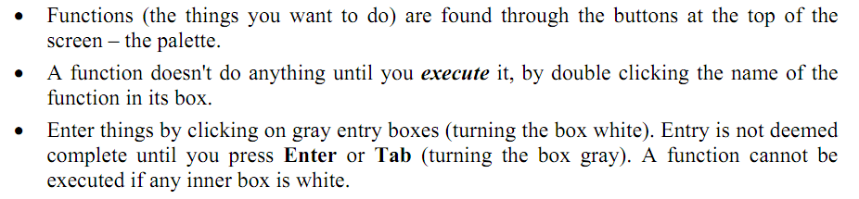
Fortunately, the previous section of the tour has anticipated this question.
Mouse over the button…

Slide 17
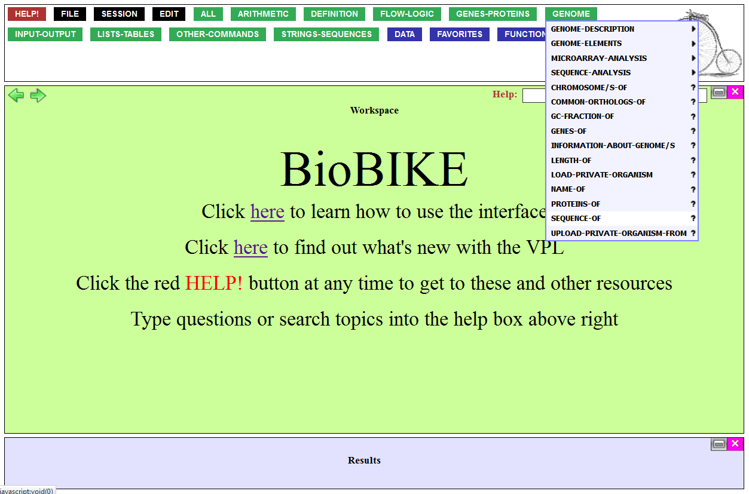
…which brings up a menu with SEQUENCE-OF on it.
Click that function.

Slide 18
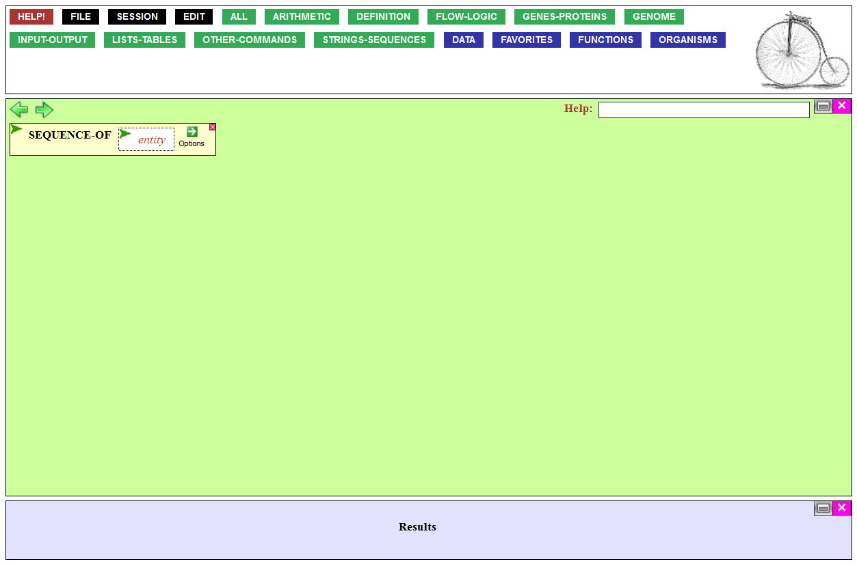
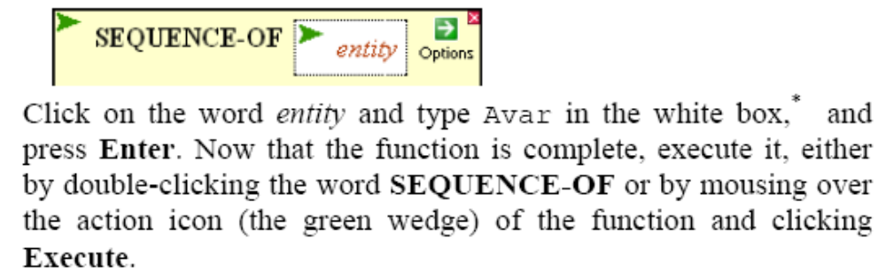
…and open the entity box for entry, so you can enter the name of the organism.

Slide 19
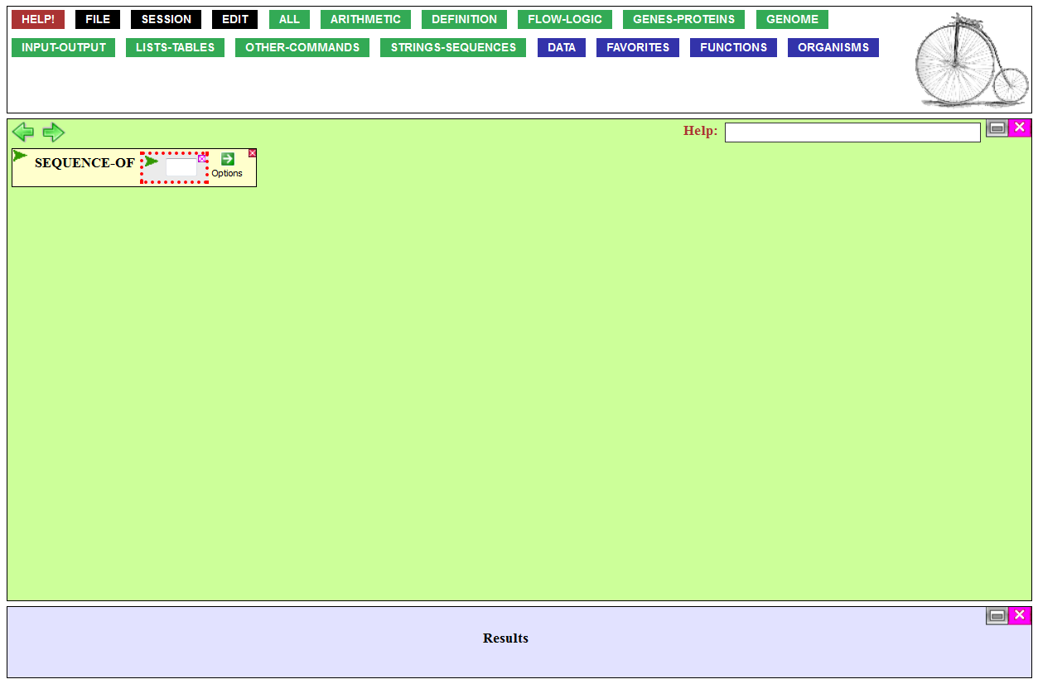
You know the box is open for entry because the entry area turns white, and the box is outlined in red dots.
Type Avar, the nickname
of the cyanobacterium Anabaena variabilis.

Slide 20

So where's the sequence?
Again, a hint in
Section I.B points the way: Nothing happens until the function is executed.
Do it.

Slide 21
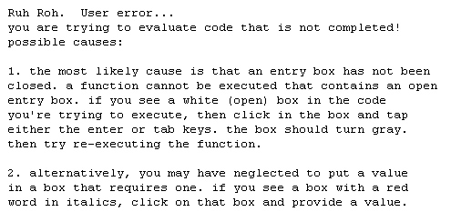
Something went wrong!
When that happens,
Read the error message!
If the message describes symptoms that seem to
apply, then consider
following its advice.

Slide 22

Failing to close an entry
box is the most common mistake people make.
Now that the entry box is closed, executing the
function should work.

Slide 23
Another way to execute functions (and do much else) is to use the Action menu, accessible by mousing
over the green wedge.

Slide 24
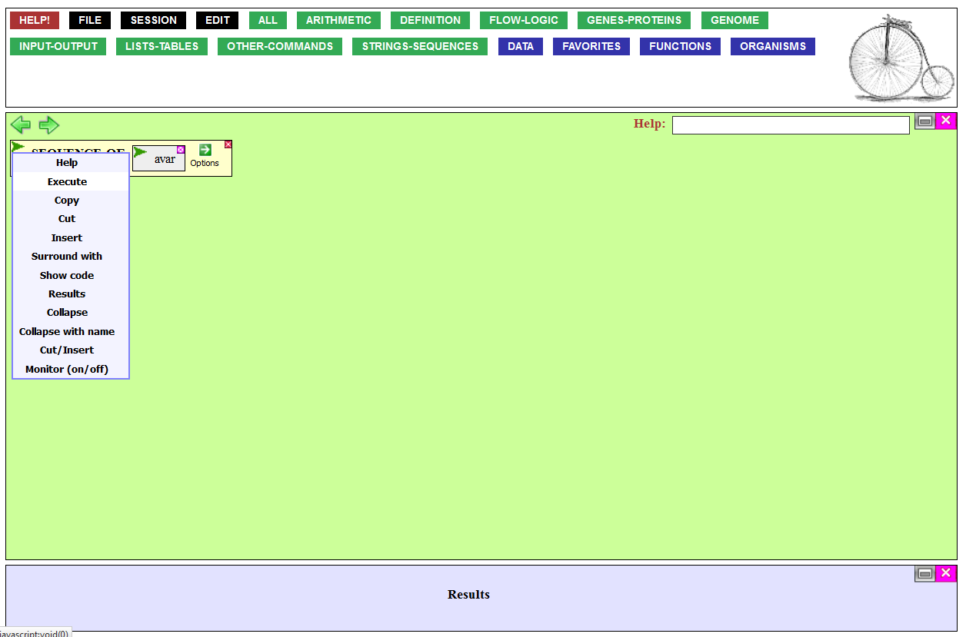
Click the Execute item
on the Action menu…

Slide 25
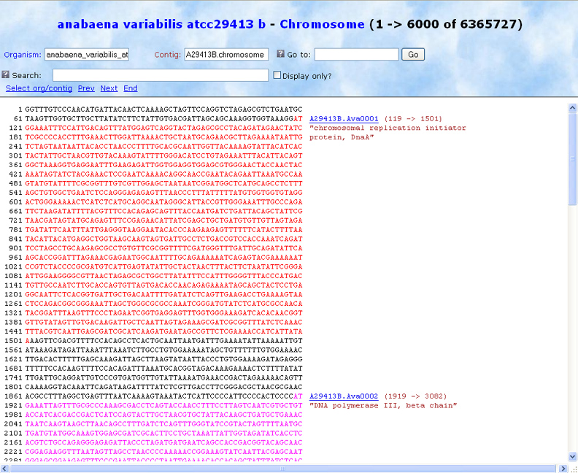
…and this screen
should pop up.

Slide 26
I hope that gives you the basic idea of how things
work in BioBIKE and how
the tour is trying to guide you.
Now try the rest on your own.
If you're not sure what to do, experiment! It's very unlikely that you'll break anything.

