Slide 1
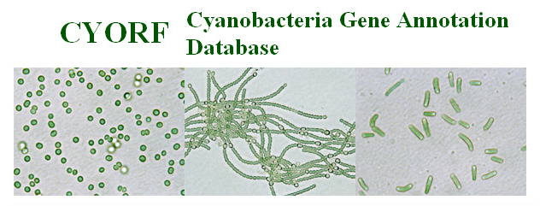
CYORF is a web-based resource that facilitates annotation of multiple genomes by a scientific community. The annotation is open to the public, but only registered members of the community may alter the database.
What follows is a representation of plans to expand CYORF's functionality and ease of use. To view CYORF in its current form, go to http://cyano.genome.jp/
This demonstration is best viewed as a slide show.
To do this, click Slide Show on the top tool bar, then View show.
Click to move on to the next slide.

Slide 2

sll1451 Edit
Close
New encyclopedia entry
BioBIKE
History
Propagate annotation
Help
Version: 1.2
Last annotator: Omata, Tatsuo Current annotator: Arnaud Taton
Last update: 2006-07-10 13:23:01
Justification
Organism: Synechocystis PCC 6803 Replicon: Chromosome Start: End:
Amino acid sequence: 275 amino acids
Nucleotide sequence: 828 nucleotides
Auto
1008321
1009148
View AA Sequence
View NT Sequence
Gene name(s):
Description:
Other descriptions:
nrtB
Exp'tal
ABC-type nitrate/nitrite transport system permease protein
Ref
A
CyanoBase: nrtB Nitrate transport protein NrtB
FUNCTION: 4 entries orthologs have 0 entries
View entries
View entries
STRUCTURE: 1 entry orthologs have 0 entries
View entries
View entries
REGULATION: 7 entries orthologs have 0 entries
View entries
View entries
EXPRESSION: 5 entries orthologs have 3 entries
View entries
View entries
MUTANTS: 0 entries orthologs have 2 entries
View entries
View entries
ORTHOLOGS/PARALOGS: 12 paralogs 9 orthologs
View entries
View entries
Views
Here is a portal to what is known about a well-studied gene, sll1451, from the cyanobacterium Synechocystis PCC 6803, as seen by a member of the cyanobacterialogical community. Gray boxes indicates information that can be changed. (click to continue)

Slide 3
sll1451 Edit
Close
New encyclopedia entry
BioBIKE
History
Propagate annotation
Help
Version: 1.2
Last annotator: Omata, Tatsuo Current annotator: Arnaud Taton
Last update: 2006-07-10 13:23:01
Justification
Organism: Synechocystis PCC 6803 Replicon: Chromosome Start: End:
Amino acid sequence: 275 amino acids
Nucleotide sequence: 828 nucleotides
Auto
1008321
1009148
View AA Sequence
View NT Sequence
Gene name(s):
Description:
Other descriptions:
nrtB
Exp'tal
ABC-type nitrate/nitrite transport system permease protein
Ref
A
CyanoBase: nrtB Nitrate transport protein NrtB
FUNCTION: 4 entries orthologs have 0 entries
View entries
View entries
STRUCTURE: 1 entry orthologs have 0 entries
View entries
View entries
REGULATION: 7 entries orthologs have 0 entries
View entries
View entries
EXPRESSION: 5 entries orthologs have 3 entries
View entries
View entries
MUTANTS: 0 entries orthologs have 2 entries
View entries
View entries
ORTHOLOGS/PARALOGS: 12 paralogs 9 orthologs
View entries
View entries
Views
All changes are logged, and one can view the record of changes by clicking the History button. Any change in the database generates e-mails to all prior annotators of the gene, alerting them to the change. (click to continue)

Slide 4
sll1451 Edit
Close
New encyclopedia entry
BioBIKE
History
Propagate annotation
Help
Version: 1.2
Last annotator: Omata, Tatsuo Current annotator: Arnaud Taton
Last update: 2006-07-10 13:23:01
Justification
Organism: Synechocystis PCC 6803 Replicon: Chromosome Start: End:
Amino acid sequence: 275 amino acids
Nucleotide sequence: 828 nucleotides
Auto
1008321
1009148
View AA Sequence
View NT Sequence
Gene name(s):
Description:
Other descriptions:
nrtB
Exp'tal
ABC-type nitrate/nitrite transport system permease protein
Ref
A
CyanoBase: nrtB Nitrate transport protein NrtB
FUNCTION: 4 entries orthologs have 0 entries
View entries
View entries
STRUCTURE: 1 entry orthologs have 0 entries
View entries
View entries
REGULATION: 7 entries orthologs have 0 entries
View entries
View entries
EXPRESSION: 5 entries orthologs have 3 entries
View entries
View entries
MUTANTS: 0 entries orthologs have 2 entries
View entries
View entries
ORTHOLOGS/PARALOGS: 12 paralogs 9 orthologs
View entries
View entries
Views
Any change must be justified, and the basis for any assertion is accesssible through the Justification box -- more on this later. (click to continue)

Slide 5
sll1451 Edit
Close
New encyclopedia entry
BioBIKE
History
Propagate annotation
Help
Version: 1.2
Last annotator: Omata, Tatsuo Current annotator: Arnaud Taton
Last update: 2006-07-10 13:23:01
Justification
Organism: Synechocystis PCC 6803 Replicon: Chromosome Start: End:
Amino acid sequence: 275 amino acids
Nucleotide sequence: 828 nucleotides
Auto
1008321
1009148
View AA Sequence
View NT Sequence
Gene name(s):
Description:
Other descriptions:
nrtB
Exp'tal
ABC-type nitrate/nitrite transport system permease protein
Ref
A
CyanoBase: nrtB Nitrate transport protein NrtB
FUNCTION: 4 entries orthologs have 0 entries
View entries
View entries
STRUCTURE: 1 entry orthologs have 0 entries
View entries
View entries
REGULATION: 7 entries orthologs have 0 entries
View entries
View entries
EXPRESSION: 5 entries orthologs have 3 entries
View entries
View entries
MUTANTS: 0 entries orthologs have 2 entries
View entries
View entries
ORTHOLOGS/PARALOGS: 12 paralogs 9 orthologs
View entries
View entries
Views
The opening screen serves as a table of contents, outlining what information is available, not only for the gene but also for orthologs (evolutionarily related genes) in other cyanobacteria. Click on FUNCTION to expand that section.

Slide 6
sll1451 Edit
Close
New encyclopedia entry
BioBIKE
History
Propagate annotation
Help
Version: 1.2
Last annotator: Omata, Tatsuo Current annotator: Arnaud Taton
Last update: 2006-07-10 13:23:01
Justification
Organism: Synechocystis PCC 6803 Replicon: Chromosome Start: End:
Amino acid sequence: 275 amino acids
Nucleotide sequence: 828 nucleotides
Auto
1008321
1009148
View AA Sequence
View NT Sequence
Gene name(s):
Description:
Other descriptions:
nrtB
Exp'tal
ABC-type nitrate/nitrite transport system permease protein
Ref
A
CyanoBase: nrtB Nitrate transport protein NrtB
FUNCTION: 4 entries orthologs have 0 entries
Compress entries
View entries
KEGG categories:
KO 01300 Environmental Information Processing
Auto
KO 01310 Membrane transport
Auto
KO 02010 ABC transporters
Map
Auto
KO 02050 ABC.SN.P, ssuC, tauC; sulfonate/nitrate/taurine transport system permease protein
Auto
Add a category
Physiological role:
Active transport of nitrate
Exp'tal
Ref
A
Exp'tal
Protein function: Transmembrane permease
Ref
A
Exp'tal
Protein family: Superfamily of ABC transporters
Ref
A
Add an assertion
STRUCTURE: 1 entries orthologs have 0 entries
View entries
View entries
REGULATION: 7 entries orthologs have 0 entries
View entries
View entries
This section supplies categories, such as Physiological role, into which annotators can place what they know about the function of the protein. To edit previous assertions, just type in the gray box. To add a new assertion, click the down arrow
next to Add an assertion. Try that now.
EXPRESSION: 5 entries orthologs have 3 entries
View entries
View entries
MUTANTS: 0 entries orthologs have 2 entries
View entries
View entries
ORTHOLOGS/PARALOGS: 12 paralogs 9 orthologs
View entries
View entries
Views

Slide 7
sll1451 Edit
Close
New encyclopedia entry
BioBIKE
History
Propagate annotation
Help
Version: 1.2
Last annotator: Omata, Tatsuo Current annotator: Arnaud Taton
Last update: 2006-07-10 13:23:01
Justification
Organism: Synechocystis PCC 6803 Replicon: Chromosome Start: End:
Amino acid sequence: 275 amino acids
Nucleotide sequence: 828 nucleotides
Auto
1008321
1009148
View AA Sequence
View NT Sequence
Gene name(s):
Description:
Other descriptions:
nrtB
Exp'tal
ABC-type nitrate/nitrite transport system permease protein
Ref
A
CyanoBase: nrtB Nitrate transport protein NrtB
FUNCTION: 4 entries orthologs have 0 entries
Compress entries
View entries
KEGG categories:
KO 01300 Environmental Information Processing
Auto
KO 01310 Membrane transport
Auto
KO 02010 ABC transporters
Map
Auto
KO 02050 ABC.SN.P, ssuC, tauC; sulfonate/nitrate/taurine transport system permease protein
Auto
Add a category
Physiological role:
Active transport of nitrate
Exp'tal
Ref
A
Exp'tal
Protein function: Transmembrane permease
Ref
A
Exp'tal
Protein family: Superfamily of ABC transporters
Ref
A
Add an assertion
Physiological role
Protein function
Protein family
Interaction
Cellular location
Other
The annotator can choose any listed category for an assertion (or Other) if no category fits. Categories makes it easier to find genes with specific properties (e.g. all genes of a certain family with no known physiological role). Click the CLOSE up triangle to zip up the box.
STRUCTURE: 1 entries orthologs have 0 entries
View entries
View entries
REGULATION: 7 entries orthologs have 0 entries
View entries
View entries
EXPRESSION: 5 entries orthologs have 3 entries
View entries
View entries
MUTANTS: 0 entries orthologs have 2 entries
View entries
View entries
ORTHOLOGS/PARALOGS: 12 paralogs 9 orthologs
View entries
View entries
Views

Slide 8
sll1451 Edit
Close
New encyclopedia entry
BioBIKE
History
Propagate annotation
Help
Version: 1.2
Last annotator: Omata, Tatsuo Current annotator: Arnaud Taton
Last update: 2006-07-10 13:23:01
Justification
Organism: Synechocystis PCC 6803 Replicon: Chromosome Start: End:
Amino acid sequence: 275 amino acids
Nucleotide sequence: 828 nucleotides
Auto
1008321
1009148
View AA Sequence
View NT Sequence
Gene name(s):
Description:
Other descriptions:
nrtB
Exp'tal
ABC-type nitrate/nitrite transport system permease protein
Ref
A
CyanoBase: nrtB Nitrate transport protein NrtB
FUNCTION: 4 entries orthologs have 0 entries
Compress entries
View entries
KEGG categories:
KO 01300 Environmental Information Processing
Auto
KO 01310 Membrane transport
Auto
KO 02010 ABC transporters
Map
Auto
KO 02050 ABC.SN.P, ssuC, tauC; sulfonate/nitrate/taurine transport system permease protein
Auto
Add a category
Physiological role:
Active transport of nitrate
Exp'tal
Ref
A
Exp'tal
Protein function: Transmembrane permease
Ref
A
Exp'tal
Protein family: Superfamily of ABC transporters
Ref
A
Add an assertion
STRUCTURE: 1 entries orthologs have 0 entries
View entries
View entries
REGULATION: 7 entries orthologs have 0 entries
View entries
View entries
The FUNCTION section also displays the metabolic categories of the Kyoto Encyclopedia of Genes and Genomes (KEGG) into which the gene has been placed and provides access to a graphical map of all related genes in Synechocystis.
Press Compress entries (just above the KEGG categories) to continue.
EXPRESSION: 5 entries orthologs have 3 entries
View entries
View entries
MUTANTS: 0 entries orthologs have 2 entries
View entries
View entries
ORTHOLOGS/PARALOGS: 12 paralogs 9 orthologs
View entries
View entries
Views

Slide 9
sll1451 Edit
Close
New encyclopedia entry
BioBIKE
History
Propagate annotation
Help
Version: 1.2
Last annotator: Omata, Tatsuo Current annotator: Arnaud Taton
Last update: 2006-07-10 13:23:01
Justification
Organism: Synechocystis PCC 6803 Replicon: Chromosome Start: End:
Amino acid sequence: 275 amino acids
Nucleotide sequence: 828 nucleotides
Auto
1008321
1009148
View AA Sequence
View NT Sequence
Gene name(s):
Description:
Other descriptions:
nrtB
Exp'tal
ABC-type nitrate/nitrite transport system permease protein
Ref
A
CyanoBase: nrtB Nitrate transport protein NrtB
FUNCTION: 4 entries orthologs have 0 entries
View entries
View entries
STRUCTURE: 1 entries orthologs have 0 entries
View entries
View entries
REGULATION: 7 entries orthologs have 0 entries
View entries
View entries
EXPRESSION: 5 entries orthologs have 3 entries
View entries
View entries
MUTANTS: 0 entries orthologs have 2 entries
View entries
View entries
ORTHOLOGS/PARALOGS: 12 paralogs 9 orthologs
View entries
View entries
Views
The REGULATION section contains information about that regions near the gene that are known to or suspected to regulate its expression and about the molecules that act on the gene. Open this section by clicking on View entries.

Slide 10
sll1451 Edit
Close
New encyclopedia entry
BioBIKE
History
Propagate annotation
Help
Version: 1.2
Last annotator: Omata, Tatsuo Current annotator: Arnaud Taton
Last update: 2006-07-10 13:23:01
Justification
Organism: Synechocystis PCC 6803 Replicon: Chromosome Start: End:
Amino acid sequence: 275 amino acids
Nucleotide sequence: 828 nucleotides
Auto
1008321
1009148
View AA Sequence
View NT Sequence
Gene name(s):
Description:
Other descriptions:
nrtB
Exp'tal
ABC-type nitrate/nitrite transport system permease protein
Ref
A
CyanoBase: nrtB Nitrate transport protein NrtB
FUNCTION: 4 entries orthologs have 0 entries
View entries
View entries
STRUCTURE: 1 entry orthologs have 0 entries
View entries
View entries
REGULATION: 7 entries orthologs have 0 entries
Compress entries
View entries
Exp'tal
Operon structure: nrtA-nrtB-nrtC-nrtD-???-narB (sll1450-sll1451-sll1452-sll1453-ssl2814-ssl1454)
Ref
A
Exp'tal
Regulator: Repressed by ammonium, induced by inhibition of ammonium assimilation
Ref
A
Regulator: Transcription enhanced by nitrite
Exp'tal
Ref
A
Promoter: Transcriptional start site identified as
Exp'tal
Ref
A
Promoter: Putative NtcA-binding site 22-nt upstream from -10 promoter element
Deduced
Ref
A
Promoter: Putative NtcB-binding site centered 24-nt upstream from putative NtcA-binding site
Deduced
Ref
A
Add an assertion
EXPRESSION: 5 entries orthologs have 3 entries
View entries
View entries
The REGULATION section also organizes knowledge in categories that the annotator can choose amongst. Focus on the last assertion. Someone has identified
a putative binding site for a protein, that may serve to regulate transcription.
How certain should we be that this is true? (click to continue)
MUTANTS: 0 entries orthologs have 2 entries
View entries
View entries
ORTHOLOGS/PARALOGS: 12 paralogs 9 orthologs
View entries
View entries
Views

Slide 11
sll1451 Edit
Close
New encyclopedia entry
BioBIKE
History
Propagate annotation
Help
Version: 1.2
Last annotator: Omata, Tatsuo Current annotator: Arnaud Taton
Last update: 2006-07-10 13:23:01
Justification
Organism: Synechocystis PCC 6803 Replicon: Chromosome Start: End:
Amino acid sequence: 275 amino acids
Nucleotide sequence: 828 nucleotides
Auto
1008321
1009148
View AA Sequence
View NT Sequence
Gene name(s):
Description:
Other descriptions:
nrtB
Exp'tal
ABC-type nitrate/nitrite transport system permease protein
Ref
A
CyanoBase: nrtB Nitrate transport protein NrtB
FUNCTION: 4 entries orthologs have 0 entries
View entries
View entries
STRUCTURE: 1 entry orthologs have 0 entries
View entries
View entries
REGULATION: 7 entries orthologs have 0 entries
Compress entries
View entries
Exp'tal
Operon structure: nrtA-nrtB-nrtC-nrtD-???-narB (sll1450-sll1451-sll1452-sll1453-ssl2814-ssl1454)
Ref
A
Exp'tal
Regulator: Repressed by ammonium, induced by inhibition of ammonium assimilation
Ref
A
Regulator: Transcription enhanced by nitrite
Exp'tal
Ref
A
Promoter: Transcriptional start site identified as
Exp'tal
Ref
A
Promoter: Putative NtcA-binding site 22-nt upstream from -10 promoter element
Deduced
Ref
A
Promoter: Putative NtcB-binding site centered 24-nt upstream from putative NtcA-binding site
Deduced
Ref
A
Add an assertion
EXPRESSION: 5 entries orthologs have 3 entries
View entries
View entries
Every assertion comes with a justification. In this case, the annotator says that the assertion was deduced from information but has no direct experimental proof.
Click on Ref to see the basis for the deduction.
MUTANTS: 0 entries orthologs have 2 entries
View entries
View entries
ORTHOLOGS/PARALOGS: 12 paralogs 9 orthologs
View entries
View entries
Views

Slide 12
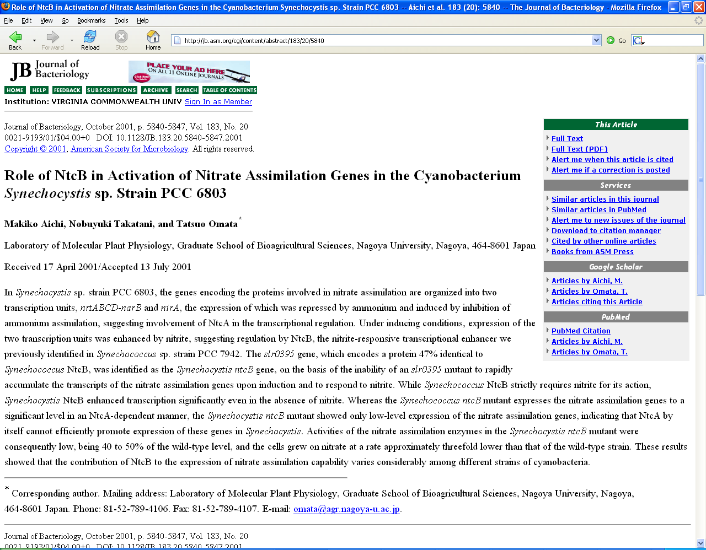
The Ref link brings you to an abstract. Evidently the annotator believed that somewhere in this article the authors deduced the existence of an NtcB-binding site. You can click on Full Text to see the details. For now, just X out of this window (red X box in upper right).

Slide 13
sll1451 Edit
Close
New encyclopedia entry
BioBIKE
History
Propagate annotation
Help
Version: 1.2
Last annotator: Omata, Tatsuo Current annotator: Arnaud Taton
Last update: 2006-07-10 13:23:01
Justification
Organism: Synechocystis PCC 6803 Replicon: Chromosome Start: End:
Amino acid sequence: 275 amino acids
Nucleotide sequence: 828 nucleotides
Auto
1008321
1009148
View AA Sequence
View NT Sequence
Gene name(s):
Description:
Other descriptions:
nrtB
Exp'tal
ABC-type nitrate/nitrite transport system permease protein
Ref
A
CyanoBase: nrtB Nitrate transport protein NrtB
FUNCTION: 4 entries orthologs have 0 entries
View entries
View entries
STRUCTURE: 1 entry orthologs have 0 entries
View entries
View entries
REGULATION: 7 entries orthologs have 0 entries
Compress entries
View entries
Exp'tal
Operon structure: nrtA-nrtB-nrtC-nrtD-???-narB (sll1450-sll1451-sll1452-sll1453-ssl2814-ssl1454)
Ref
A
Arnaud Taton
Virginia Commonwealth University
Exp'tal
Regulator: Repressed by ammonium, induced by inhibition of ammonium assimilation
Ref
A
Regulator: Transcription enhanced by nitrite
Exp'tal
Ref
A
Promoter: Transcriptional start site identified as
Exp'tal
Ref
A
Exp'tal
Promoter: Putative NtcA-binding site 22-nt upstream from -10 promoter element
Ref
A
Exp'tal
Promoter: Putative NtcB-binding site centered 24-nt upstream from putative NtcA-binding site
Ref
A
Add an assertion
EXPRESSION: 5 entries orthologs have 3 entries
View entries
View entries
Who says the article justifies the assertion? Perhaps one of the authors put this assertion into CyOrf, or perhaps someone else did. Passing the mouse over the A(nnotator) button will bring up the identity of the annotator, and clicking on it will generate an e-mail box. For this simulation, click on the button, then click again.
MUTANTS: 0 entries orthologs have 2 entries
View entries
View entries
ORTHOLOGS/PARALOGS: 12 paralogs 9 orthologs
View entries
View entries
Views

Slide 14
sll1451 Edit
Close
New encyclopedia entry
BioBIKE
History
Propagate annotation
Help
Version: 1.2
Last annotator: Omata, Tatsuo Current annotator: Arnaud Taton
Last update: 2006-07-10 13:23:01
Justification
Organism: Synechocystis PCC 6803 Replicon: Chromosome Start: End:
Amino acid sequence: 275 amino acids
Nucleotide sequence: 828 nucleotides
Auto
1008321
1009148
View AA Sequence
View NT Sequence
Gene name(s):
Description:
Other descriptions:
nrtB
Exp'tal
ABC-type nitrate/nitrite transport system permease protein
Ref
A
CyanoBase: nrtB Nitrate transport protein NrtB
FUNCTION: 4 entries orthologs have 0 entries
View entries
View entries
STRUCTURE: 1 entry orthologs have 0 entries
View entries
View entries
REGULATION: 7 entries orthologs have 0 entries
Compress entries
View entries
Exp'tal
Operon structure: nrtA-nrtB-nrtC-nrtD-???-narB (sll1450-sll1451-sll1452-sll1453-ssl2814-ssl1454)
Ref
A
Exp'tal
Regulator: Repressed by ammonium, induced by inhibition of ammonium assimilation
Ref
A
Regulator: Transcription enhanced by nitrite
Exp'tal
Ref
A
Promoter: Transcriptional start site identified as
Exp'tal
Ref
A
Exp'tal
Promoter: Putative NtcA-binding site 22-nt upstream from -10 promoter element
Ref
A
Exp'tal
Promoter: Putative NtcB-binding site centered 24-nt upstream from putative NtcA-binding site
Ref
A
Add an assertion
EXPRESSION: 5 entries orthologs have 3 entries
View entries
View entries
Enough about regulation. Click on the Compress entries button to return to the table of contents.
MUTANTS: 0 entries orthologs have 2 entries
View entries
View entries
ORTHOLOGS/PARALOGS: 12 paralogs 9 orthologs
View entries
View entries
Views

Slide 15
sll1451 Edit
Close
New encyclopedia entry
BioBIKE
History
Propagate annotation
Help
Version: 1.2
Last annotator: Omata, Tatsuo Current annotator: Arnaud Taton
Last update: 2006-07-10 13:23:01
Justification
Organism: Synechocystis PCC 6803 Replicon: Chromosome Start: End:
Amino acid sequence: 275 amino acids
Nucleotide sequence: 828 nucleotides
Auto
1008321
1009148
View AA Sequence
View NT Sequence
Gene name(s):
Description:
Other descriptions:
nrtB
Exp'tal
ABC-type nitrate/nitrite transport system permease protein
Ref
A
CyanoBase: nrtB Nitrate transport protein NrtB
FUNCTION: 4 entries orthologs have 0 entries
View entries
View entries
STRUCTURE: 1 entries orthologs have 0 entries
View entries
View entries
REGULATION: 7 entries orthologs have 0 entries
View entries
View entries
EXPRESSION: 5 entries orthologs have 3 entries
View entries
View entries
MUTANTS: 0 entries orthologs have 2 entries
View entries
View entries
ORTHOLOGS/PARALOGS: 12 paralogs 9 orthologs
View entries
View entries
Views
I notice that there are 9 predicted orthologs of this gene in cyanobacteria and 12 predicted paralogs (genes related by a duplication event). Click on View entries next to "orthologs" to learn more about them.

Slide 16
sll1451 Edit
Close
New encyclopedia entry
BioBIKE
History
Propagate annotation
Help
Version: 1.2
Last annotator: Omata, Tatsuo Current annotator: Arnaud Taton
Last update: 2006-07-10 13:23:01
Justification
Organism: Synechocystis PCC 6803 Replicon: Chromosome Start: End:
Amino acid sequence: 275 amino acids
Nucleotide sequence: 828 nucleotides
Auto
1008321
1009148
View AA Sequence
View NT Sequence
Gene name(s):
Description:
Other descriptions:
nrtB
Exp'tal
ABC-type nitrate/nitrite transport system permease protein
Ref
A
There are three putative orthologs highly similar to sll1451, annotated as nitrate transport proteins and coming with experimental justification. There is a fourth annotated as an HCO₃⁻ permease, with no justification. Maybe that annotation is wrong? Click on Views to look at the orthologs in a different way.
CyanoBase: nrtB Nitrate transport protein NrtB
FUNCTION: 4 entries orthologs have 0 entries
View entries
View entries
STRUCTURE: 1 entries orthologs have 0 entries
View entries
View entries
REGULATION: 7 entries orthologs have 0 entries
View entries
View entries
EXPRESSION: 5 entries orthologs have 3 entries
View entries
View entries
MUTANTS: 0 entries orthologs have 2 entries
View entries
View entries
ORTHOLOGS/PARALOGS: 12 paralogs 9 orthologs
View entries
Compress entries
Views
Ortholog E-value Description
syn:sll1451 5.0d-152 ABC-type nitrate/nitrite transport system permease protein
ava:Ava_4541 5.7d-97 ABC-type nitrate/nitrite transport system permease protein
gvi:glr2087 9.7d-97 probable bicarbonate transport system permease protein
ana:alr0609 2.2d-96 ABC-type nitrate/nitrite transport system permease protein
tel:tlr1351 6.3d-96 ABC-type nitrate/nitrite transport system permease protein
pmm:PMM0371 3.5d-53 putative cyanate ABC transporter permease protein
syw:SYNW2486 3.0d-52 putative cyanate ABC transporter permease protein
ter:Te?1547 5.4d-15 COG0600: ABC-type nitrate/sulfonate/bicarbonate transport system, permease component [
pmt:PMT0554 1.2d-9 ABC transporter, membrane component, glycine betaine/proline family
Exp'tal
Ref
A
Exp'tal
Ref
A
Auto
Exp'tal
Ref
A
Exp'tal
Ref
A
Exp'tal
Ref
A
Exp'tal
Ref
A
Auto
Auto

Slide 17
sll1451 Edit
Close
New encyclopedia entry
BioBIKE
History
Propagate annotation
Help
Version: 1.2
Last annotator: Omata, Tatsuo Current annotator: Arnaud Taton
Last update: 2006-07-10 13:23:01
Justification
Organism: Synechocystis PCC 6803 Replicon: Chromosome Start: End:
Amino acid sequence: 275 amino acids
Nucleotide sequence: 828 nucleotides
Auto
1008321
1009148
View AA Sequence
View NT Sequence
Gene name(s):
Description:
Other descriptions:
nrtB
Exp'tal
ABC-type nitrate/nitrite transport system permease protein
Ref
A
Currently the Ortholog Display is set to show the annotated descriptions of the genes and the degree of similarity (the E-value) of the gene with respect to sll1451. Click the Neighborhood button so that you can see the genetic neighborhood of the putative orthologs.
CyanoBase: nrtB Nitrate transport protein NrtB
FUNCTION: 4 entries orthologs have 0 entries
View entries
View entries
STRUCTURE: 1 entries orthologs have 0 entries
View entries
View entries
REGULATION: 7 entries orthologs have 0 entries
View entries
View entries
EXPRESSION: 5 entries orthologs have 3 entries
View entries
View entries
MUTANTS: 0 entries orthologs have 2 entries
View entries
View entries
ORTHOLOGS/PARALOGS: 12 paralogs 9 orthologs
View entries
Compress entries
Views
Ortholog E-value Description
ORTHOLOG DISPLAY
syn:sll1451 5.0d-152 ABC-type nitrate/nitrite transport system permease protein
ava:Ava_4541 5.7d-97 ABC-type nitrate/nitrite transport system permease protein
gvi:glr2087 9.7d-97 probable bicarbonate transport system permease protein
ana:alr0609 2.2d-96 ABC-type nitrate/nitrite transport system permease protein
tel:tlr1351 6.3d-96 ABC-type nitrate/nitrite transport system permease protein
pmm:PMM0371 3.5d-53 putative cyanate ABC transporter permease protein
syw:SYNW2486 3.0d-52 putative cyanate ABC transporter permease protein
ter:Te?1547 5.4d-15 COG0600: ABC-type nitrate/sulfonate/bicarbonate transport system, permease component [
pmt:PMT0554 1.2d-9 ABC transporter, membrane component, glycine betaine/proline family
Exp'tal
Ref
A
Blast score/annotation
Exp'tal
Ref
A
Neighborhood 10000 nt
Pfam mappings
Auto
Phylogenetic tree
Exp'tal
Ref
A
Exp'tal
Ref
A
ORTHOLOG DEFINITION
Exp'tal
Ref
A
Bidirectional best hit
Exp'tal
Best Blast hit (forwards)
Ref
A
Auto
Best Blast hit (reverse)
Auto

Slide 18
sll1451 Edit
Close
New encyclopedia entry
BioBIKE
History
Propagate annotation
Help
Version: 1.2
Last annotator: Omata, Tatsuo Current annotator: Arnaud Taton
Last update: 2006-07-10 13:23:01
Justification
Organism: Synechocystis PCC 6803 Replicon: Chromosome Start: End:
Amino acid sequence: 275 amino acids
Nucleotide sequence: 828 nucleotides
Auto
1008321
1009148
View AA Sequence
View NT Sequence
Gene name(s):
Description:
Other descriptions:
nrtB
Exp'tal
ABC-type nitrate/nitrite transport system permease protein
Ref
A
Now click the green GO triangle.
CyanoBase: nrtB Nitrate transport protein NrtB
FUNCTION: 4 entries orthologs have 0 entries
View entries
View entries
STRUCTURE: 1 entries orthologs have 0 entries
View entries
View entries
REGULATION: 7 entries orthologs have 0 entries
View entries
View entries
EXPRESSION: 5 entries orthologs have 3 entries
View entries
View entries
MUTANTS: 0 entries orthologs have 2 entries
View entries
View entries
ORTHOLOGS/PARALOGS: 12 paralogs 9 orthologs
View entries
Compress entries
Views
Ortholog E-value Description
ORTHOLOG DISPLAY
syn:sll1451 5.0d-152 ABC-type nitrate/nitrite transport system permease protein
ava:Ava_4541 5.7d-97 ABC-type nitrate/nitrite transport system permease protein
gvi:glr2087 9.7d-97 probable bicarbonate transport system permease protein
ana:alr0609 2.2d-96 ABC-type nitrate/nitrite transport system permease protein
tel:tlr1351 6.3d-96 ABC-type nitrate/nitrite transport system permease protein
pmm:PMM0371 3.5d-53 putative cyanate ABC transporter permease protein
syw:SYNW2486 3.0d-52 putative cyanate ABC transporter permease protein
ter:Te?1547 5.4d-15 COG0600: ABC-type nitrate/sulfonate/bicarbonate transport system, permease component [
pmt:PMT0554 1.2d-9 ABC transporter, membrane component, glycine betaine/proline family
Exp'tal
Ref
A
Blast score/annotation
Exp'tal
Ref
A
Neighborhood 10000 nt
Pfam mappings
Auto
Phylogenetic tree
Exp'tal
Ref
A
Exp'tal
Ref
A
ORTHOLOG DEFINITION
Exp'tal
Ref
A
Bidirectional best hit
Exp'tal
Best Blast hit (forwards)
Ref
A
Auto
Best Blast hit (reverse)
Auto

Slide 19
sll1451 Edit
Close
New encyclopedia entry
BioBIKE
History
Propagate annotation
Help
Version: 1.2
Last annotator: Omata, Tatsuo Current annotator: Arnaud Taton
Last update: 2006-07-10 13:23:01
Justification
Organism: Synechocystis PCC 6803 Replicon: Chromosome Start: End:
Amino acid sequence: 275 amino acids
Nucleotide sequence: 828 nucleotides
Auto
1008321
1009148
View AA Sequence
View NT Sequence
Gene name(s):
Description:
Other descriptions:
nrtB
Exp'tal
ABC-type nitrate/nitrite transport system permease protein
Ref
A
sll1451 and its putative orthologs are now represented as dark green arrows and drawn to scale. The genes orthologous to genes near sll1451 are shown in color. Three of the orthologs have similar gene neighbors as sll1451. (click to continue)
CyanoBase: nrtB Nitrate transport protein NrtB
FUNCTION: 4 entries orthologs have 0 entries
View entries
View entries
STRUCTURE: 1 entries orthologs have 0 entries
View entries
View entries
REGULATION: 7 entries orthologs have 0 entries
View entries
View entries
EXPRESSION: 5 entries orthologs have 3 entries
View entries
View entries
MUTANTS: 0 entries orthologs have 2 entries
View entries
View entries
ORTHOLOGS/PARALOGS: 12 paralogs 9 orthologs
View entries
Compress entries
Views
2000
4000
6000
8000
10000
syn:sll1451
ava:Ava_4541
gvi:glr2087
ana:alr0609
tel:tlr1351
pmm:PMM0371
syw:SYNW2486
ter:Te?1547
pmt:PMT0554

Slide 20
sll1451 Edit
Close
New encyclopedia entry
BioBIKE
History
Propagate annotation
Help
Version: 1.2
Last annotator: Omata, Tatsuo Current annotator: Arnaud Taton
Last update: 2006-07-10 13:23:01
Justification
Organism: Synechocystis PCC 6803 Replicon: Chromosome Start: End:
Amino acid sequence: 275 amino acids
Nucleotide sequence: 828 nucleotides
Auto
1008321
1009148
View AA Sequence
View NT Sequence
Gene name(s):
Description:
Other descriptions:
nrtB
Exp'tal
ABC-type nitrate/nitrite transport system permease protein
Ref
A
Click the top purple box to find out what gene it is…
It makes some sense for a nitrate metabolism gene to be in the same vicinity as a nitrate permease. Perhaps they're part of an operon? (click anywhere)
CyanoBase: nrtB Nitrate transport protein NrtB
FUNCTION: 4 entries orthologs have 0 entries
View entries
View entries
STRUCTURE: 1 entries orthologs have 0 entries
View entries
View entries
REGULATION: 7 entries orthologs have 0 entries
View entries
View entries
EXPRESSION: 5 entries orthologs have 3 entries
View entries
View entries
syn:sll1454
ferredoxin-nitrate reductase
2145 nt
MUTANTS: 0 entries orthologs have 2 entries
View entries
View entries
ORTHOLOGS/PARALOGS: 12 paralogs 9 orthologs
View entries
Compress entries
Views
2000
4000
6000
8000
10000
syn:sll1451
ava:Ava_4541
gvi:glr2087
ana:alr0609
tel:tlr1351
pmm:PMM0371
syw:SYNW2486
ter:Te?1547
pmt:PMT0554

Slide 21
sll1451 Edit
Close
New encyclopedia entry
BioBIKE
History
Propagate annotation
Help
Version: 1.2
Last annotator: Omata, Tatsuo Current annotator: Arnaud Taton
Last update: 2006-07-10 13:23:01
Justification
Organism: Synechocystis PCC 6803 Replicon: Chromosome Start: End:
Amino acid sequence: 275 amino acids
Nucleotide sequence: 828 nucleotides
Auto
1008321
1009148
View AA Sequence
View NT Sequence
Gene name(s):
Description:
Other descriptions:
nrtB
Exp'tal
ABC-type nitrate/nitrite transport system permease protein
Ref
A
If the conserved colored genes are part of an operon, then there should be enough nucleotides upstream from the first gene for a promoter, at least 50 nt. Click on the intergenic region (black line) just to the left of the bright green box to see how large it is…
CyanoBase: nrtB Nitrate transport protein NrtB
FUNCTION: 4 entries orthologs have 0 entries
View entries
View entries
STRUCTURE: 1 entries orthologs have 0 entries
View entries
View entries
REGULATION: 7 entries orthologs have 0 entries
View entries
View entries
EXPRESSION: 5 entries orthologs have 3 entries
View entries
View entries
MUTANTS: 0 entries orthologs have 2 entries
View entries
View entries
ORTHOLOGS/PARALOGS: 12 paralogs 9 orthologs
View entries
Compress entries
Views
2000
4000
6000
8000
10000
syn:sll1451
ava:Ava_4541
gvi:glr2087
ana:alr0609
tel:tlr1351
pmm:PMM0371
syw:SYNW2486
ter:Te?1547
pmt:PMT0554

Slide 22
sll1451 Edit
Close
New encyclopedia entry
BioBIKE
History
Propagate annotation
Help
Version: 1.2
Last annotator: Omata, Tatsuo Current annotator: Arnaud Taton
Last update: 2006-07-10 13:23:01
Justification
Organism: Synechocystis PCC 6803 Replicon: Chromosome Start: End:
Amino acid sequence: 275 amino acids
Nucleotide sequence: 828 nucleotides
Auto
1008321
1009148
View AA Sequence
View NT Sequence
Gene name(s):
Description:
Other descriptions:
nrtB
Exp'tal
ABC-type nitrate/nitrite transport system permease protein
Ref
A
Big enough! The bright green gene could begin an operon of nitrate-related genes. (click to continue)
CyanoBase: nrtB Nitrate transport protein NrtB
FUNCTION: 4 entries orthologs have 0 entries
View entries
View entries
STRUCTURE: 1 entries orthologs have 0 entries
View entries
View entries
REGULATION: 7 entries orthologs have 0 entries
View entries
View entries
EXPRESSION: 5 entries orthologs have 3 entries
View entries
View entries
Intergenic region
135 nt
MUTANTS: 0 entries orthologs have 2 entries
View entries
View entries
ORTHOLOGS/PARALOGS: 12 paralogs 9 orthologs
View entries
Compress entries
Views
2000
4000
6000
8000
10000
syn:sll1451
ava:Ava_4541
gvi:glr2087
ana:alr0609
tel:tlr1351
pmm:PMM0371
syw:SYNW2486
ter:Te?1547
pmt:PMT0554

Slide 23
sll1451 Edit
Close
New encyclopedia entry
BioBIKE
History
Propagate annotation
Help
Version: 1.2
Last annotator: Omata, Tatsuo Current annotator: Arnaud Taton
Last update: 2006-07-10 13:23:01
Justification
Organism: Synechocystis PCC 6803 Replicon: Chromosome Start: End:
Amino acid sequence: 275 amino acids
Nucleotide sequence: 828 nucleotides
Auto
1008321
1009148
View AA Sequence
View NT Sequence
Gene name(s):
Description:
Other descriptions:
nrtB
Exp'tal
ABC-type nitrate/nitrite transport system permease protein
Ref
A
What about the odd gene in the middle? It lies next to a gene dissimilar to any neighbor of sll1451. What is the downstream neighbor of glr2087? Click on the gray gene to the right of the dark green arrow representing glr2087.
CyanoBase: nrtB Nitrate transport protein NrtB
FUNCTION: 4 entries orthologs have 0 entries
View entries
View entries
STRUCTURE: 1 entries orthologs have 0 entries
View entries
View entries
REGULATION: 7 entries orthologs have 0 entries
View entries
View entries
EXPRESSION: 5 entries orthologs have 3 entries
View entries
View entries
MUTANTS: 0 entries orthologs have 2 entries
View entries
View entries
ORTHOLOGS/PARALOGS: 12 paralogs 9 orthologs
View entries
Compress entries
Views
2000
4000
6000
8000
10000
syn:sll1451
ava:Ava_4541
gvi:glr2087
ana:alr0609
tel:tlr1351
pmm:PMM0371
syw:SYNW2486
ter:Te?1547
pmt:PMT0554

Slide 24
sll1451 Edit
Close
New encyclopedia entry
BioBIKE
History
Propagate annotation
Help
Version: 1.2
Last annotator: Omata, Tatsuo Current annotator: Arnaud Taton
Last update: 2006-07-10 13:23:01
Justification
Organism: Synechocystis PCC 6803 Replicon: Chromosome Start: End:
Amino acid sequence: 275 amino acids
Nucleotide sequence: 828 nucleotides
Auto
1008321
1009148
View AA Sequence
View NT Sequence
Gene name(s):
Description:
Other descriptions:
nrtB
Exp'tal
ABC-type nitrate/nitrite transport system permease protein
Ref
A
A carbonic anhydrase is what you'd expect to be near a bicarbonate permease and not what you'd expect to be near a nitrate permease… so maybe the annotation is right! There's much more one could explore, but for now, click Compress entries.
CyanoBase: nrtB Nitrate transport protein NrtB
FUNCTION: 4 entries orthologs have 0 entries
View entries
View entries
STRUCTURE: 1 entries orthologs have 0 entries
View entries
View entries
REGULATION: 7 entries orthologs have 0 entries
View entries
View entries
EXPRESSION: 5 entries orthologs have 3 entries
View entries
View entries
gvi:glr2088
MUTANTS: 0 entries orthologs have 2 entries
View entries
View entries
Periplasmic beta-type carbonic anhydrase 705 nt
ORTHOLOGS/PARALOGS: 12 paralogs 9 orthologs
View entries
Compress entries
Views
2000
4000
6000
8000
10000
syn:sll1451
ava:Ava_4541
gvi:glr2087
ana:alr0609
tel:tlr1351
pmm:PMM0371
syw:SYNW2486
ter:Te?1547
pmt:PMT0554

Slide 25
sll1451 Edit
Close
New encyclopedia entry
BioBIKE
History
Propagate annotation
Help
Version: 1.2
Last annotator: Omata, Tatsuo Current annotator: Arnaud Taton
Last update: 2006-07-10 13:23:01
Justification
Organism: Synechocystis PCC 6803 Replicon: Chromosome Start: End:
Amino acid sequence: 275 amino acids
Nucleotide sequence: 828 nucleotides
Auto
1008321
1009148
View AA Sequence
View NT Sequence
Gene name(s):
Description:
Other descriptions:
nrtB
Exp'tal
ABC-type nitrate/nitrite transport system permease protein
Ref
A
CyanoBase: nrtB Nitrate transport protein NrtB
FUNCTION: 4 entries orthologs have 0 entries
View entries
View entries
STRUCTURE: 1 entries orthologs have 0 entries
View entries
View entries
REGULATION: 7 entries orthologs have 0 entries
View entries
View entries
EXPRESSION: 5 entries orthologs have 3 entries
View entries
View entries
MUTANTS: 0 entries orthologs have 2 entries
View entries
View entries
ORTHOLOGS/PARALOGS: 12 paralogs 9 orthologs
View entries
View entries
Views
Some knowledge, especially overviews and integrations, don't readily fit into the premade categories. It is always possible to click on the Encyclopedia button above to get to a Wikipedia-like interface, where you can enter free text. Try it!

Slide 26
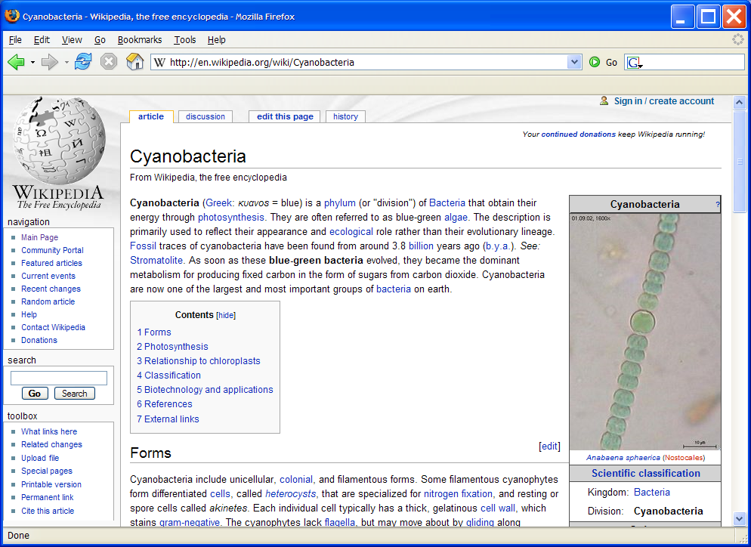
X out of this window.

Slide 27
This example illustrated:
- An interface to CyOrf that is currently under discussion
- How CyOrf can integrate the efforts of multiple annotators
Annotators anywhere in the world can add their particular knowledge and insights
- How CyOrf categorizes assertions
Categorizations, apart from organizing knowledge, makes searches easier.
- How CyOrf attaches justifications to each assertion
Justifications and references enable a visitor to make an independent decision as
to how much weight to give to an assertion.
- How graphical representations facilitate high-level insights
CyOrf may be accessed through CyanoBIKE: ixion.csbc.vcu.edu

