Slide 1
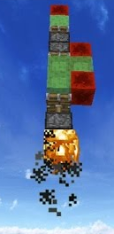
Part 1: Mekanism Mod adds a Rocket Engine Block (REB) to MineCraft. You can place the block against any block, object or mob, and then ignite it with a flint to launch! But before launching, you have to charge the REB with Redstone Flux (RF) by wiring it to a Redstone power source, like a Redstone Torch. Once hooked up, the REB batteries will charge at up to 15 RF per minute. The charging rate is determined by how far away the REB is from the Redstone power source, losing one RF per minute per block distance, as is usual for Redstone Flux. For example, if you were to wire the REB 10 blocks away from an RF torch, and did not have any repeaters, the REB would charge at 5 RF per minute (5 RF/min).
Write the equation for RF per minute (RF/min) that uses distance from the Redstone power source (with no repeaters). The equation should have a “15” and a “D” (for distance) in it:
RF Now try it out on the problem above:
---- =
min 5 RF/min=
An REB charges with 100 RF in 10 minutes. How many RF/Min is that?
How far is that REB from the Redstone source (or repeater)?
Write the equation out:
Part 2: An REB always fires for exactly 10 seconds, using all its RF, no matter how much RF it contains. The MineForce (MF) generated by an REB is determined by how much RF it fires per second. An REB containing 10 RF will fire 1 RF per second, creating 1 MF per second, for each of the 10 seconds that it fires. An REB containing 100 RF will fire at 10 RF per second, creating 10 MF per second.
Write the equation that determines the number of MF per second
that an REB will fire, given how much RF it has been loaded with. It will Force(MF)/second =
use the term “tRF” for the total RF that was loaded, and the number 10:

Slide 2
Part 3: Newton’s second law of motion is
Acceleration = Force ÷ Mass or, in letters: A=F÷M or A=F/M
1 MineForce (MF) creates an acceleration of 2 blocks per second per second (2b/s/s or 2b/s²) for a mass of 1 wood block equivalent mass (1 WBE – all wood blocks have the same mass).
Question: If you were to push one wood block (1 WBE) with one unit of MF for one second, from rest (that is, it starts out not moving at all), how fast (what Velocity, V) will it be moving after one second: V₁=_____ Blocks/Second (blocks per second, or: b/s). If we keep pushing with 1MF for another second, how fast will be be moving: V₂=_____ Blocks/Sec, and V₃=_______b/s. The little number under the V, as: V₅ is the number of seconds of acceleration. What is the general equation for this? V_{t}= _____________ (the equation will use “t”, the number of seconds, and “A” for the acceleration in b/s² units)?
Let’s suppose that the masses of mobs in WBE units are: Cows=2 WBE, Pigs=3, and any kind of rock block = 10 WBE.
Use another piece of paper to work these problems:
If you were to launch a cow with an REB loaded with 10RF, how fast would its “final velocity” be, that is, how fast would it be going when the REB stopped firing after ten seconds?
What is the final velocity of a rocket made of a pig and a cow standing on a stone block, launched by an REB that was loaded for 15 minutes from a source 5 units away (with no repeaters)?
How long would you have to load that same RBE (from 5 units away, as above) in order to get the same rocket to reach a final velocity of 120 blocks/second?

Slide 3
Use the equations from the previous page to complete these tables (D_{t} in the second table is distance from the start):
Payload | 1 cow | 1 cow and 1 pig | 1 cow, 1 pig, and 1 stone block | 1 cow | 1 cow and 1 pig | 1 cow, 1 pig, and a 1 stone block
Total mass (M)
Charge time (convert to minutes!) | 1 hour | 2 hours | 3 hours | 2 hours | 3 hours | 3 hours
Charge distance (no repeaters); figure RF/minute = _____________ | 10 blocks | 5 blocks | 10 | 5 | 5 blocks | 5 blocks
Total RF (tRF) based on the page 1 equation: tRF=____________
Force (MF/sec, same as RF/sec) F = _________________
A (Acceleration, in b/s²) A=F/M
 | A | V₀, D₀ | V₁/D₁ | V₂/D₂ | V₃/D₃ | V₄/D₄ | V₅/D₅ | V₆/D₆ | V₇/D₇ | V₈/D₈ | V₉/D₉ | V₁₀/D₁₀
1 cow |  | 0,0
1 cow and 1 pig |  | 0,0
1 cow, 1 pig, and 1 stone block |  | 0,0
1 cow |  | 0,0
1 cow and 1 pig |  | 0,0
1 cow, 1 pig, and a 1 stone block |  | 0,0
Can you guess what the equation is for the distance from the start after each time? D_{t}=

Slide 4
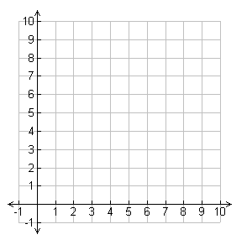
One day some animals raced to the top of Haystack Hill:
Mary Mouse started from the base (0 feet) and reached the top (10 feet) in 10 minutes.
Benny Bunny also started at the base, but reached the top in only 5 minutes.
Anita Ant started from her ant hole 7 feet up the hill, and reached the top in 9 minutes.
Wanda Worm started way up at 9 feet, but took 10 minutes to reach the top.
Tommy Turtle was asleep when everyone else started, so didn’t get started until 3 minutes into the race, but got to the top at the same time as Benny.
Feet
1
0
Start
Minutes
Mark the points described in the story on the chart, then draw a line representing each animal’s journey up Haystack Hill.
The equation of a straight line is: Y = sX+I. In this case, Y is the altitude and X is the time. s is the SLOPE, and i is called the “y intercept”: Where the line starts on the Y axis. The SLOPE (s) is calculated by dividing the “rise” (change in Y) by the “run” (change in X) of the (“rise-over-run”). For example, Anita went from 7 to 10 feet so her “rise” is 3 feet. She did this in 9 minutes (that’s her run): rise-over-run = 3/9 = ⅓^{rd}, so her slope (s) is ⅓^{rd}, and Anita started (i) at 7 feet, so the equation of her line is: Y = ⅓X+7.
Figure out the equations of the other four animals at the right. (Tommy’s i value is a little tricky – just try to estimate it!)
Aninta: Y = ⅓X+7
Mary: Y = __X+__
Benny: Y = __X+__
Wanda: Y = __X+__
Tommy: Y = __X+__

Slide 5
The universe is big. Really REALLY big! In fact, it’s infinite, which is even bigger than Really REALLY big!Just the part we can see, called the visible universe, is 15 billion parsecs across. Each parsec is about 3 light years, so the visible universe is about ______ billion light years across! In scientific notation, that’s 15x10⁹ light years! (15 followed by 9 zeros!)
The visible universe contains at least 100 billion (100,000,000,000 = 1x10¹¹) galaxies and the Milky Way, our galaxy is about 100 thousand (100,000 = 1x10⁵) light years across.
Light travels at about 300 thousand (300,000 = 3x10⁵) kilometers per second.
When you multiply numbers in scientific notation, you multiply the bases, and add the exponents. For example, you can multiply 300 by 4000 (which is: _______________) by representing 300 as 3x10² and 4000 as 4x10³. Then all you need to do is multiply the bases: 3x4=12, and add the exponents: 2+3=5, to get 12x10⁵ (which is the same as 1.2x10⁶), which is 1,200,000. Is that what you got too? Great! So...
For each of these, write down the multiplication using scientific notation, and then solve:
How far does light travel in a minute: _________________________________________ kilometers.
How far does light travel in a day: ____________________________________________ kilometers.
How far does light travel in a week: ___________________________________________ kilometers.
How far does light travel in a year: ___________________________________________ kilometers.
(You can do this from days – 365 days per year – but it’s easier from weeks: 50 weeks per year.)
So, finally, how many kilometers across is the whole visible universe? ___________________________

Slide 6

How to send pictures by secret code!
Tear the following page in half, and give one half to a friend.
In the upper left grid, secretly draw a block picture by filling in some of the boxes with a pencil, leaving the rest white. Your friend does the same on his page.
You will each encode your pictures and transmit them to the other to be decoded.
Complete the hexadecimal table to the right. You will each use it to encode your pictures into hexadecimal code.
Note that each hex digit encodes four bits. Let a filled in block be 1, and a white block be a 0. You should have two hex digits for each row of the picture. Here’s an example:
Now string all the hex digits into a single long string, and trade it with your friend.
Write the string you got into the table on the bottom left of your page, and then use the hex table in the other direction to decode your friend’s picture into the lower left grid. He’ll do the same with yours.
Finally, compare your pictures to see if you got them right!
Binary Decimal Hex
0 0 0 0 0 0
0 0 0 1 1 1
0 0 1 0 2 2
0 0 1 1 3 3
0 1 0 0 4 4
1 0 0 0 8 8
1 0 1 1 11 B
B D
1 0 1 1 1 1 0 1
1 1 0 1 13 D
(There’s a trick to filling this
table out quickly. See if you
can see the vertical patterns
in the binary columns!)

Slide 7
Your Drawing
Hex Code
Your Drawing
Hex Code
You fill this part in from your picture, and then send it to your friend
You fill this part in from your picture, and then send it to your friend
Remote Drawing
Hex Code
Remote Drawing
Hex Code
Your friend gives you these and you decode them into the picture.
Your friend gives you these and you decode them into the picture.

Slide 8
Start 1 2 3 4 5 6 7 8 9 10 11 12 13 14 15 16 17 18 19 20 End X
1
2
3
4
5
6
7
8
9
10
0 1 2 3 3 3 3 2 2 1 0
0 1 2 3 4 5 4 3X
Descriptive Statistics:
Drag Racing
You and a friend are going to drag race. You start with car #1, and your friend starts with car #10. Put a zero in the start block for each car. Cars can only change their speed by plus or minus 1 on each move. So the next speed for all cars will always be 1, and so they will always end up with a 1 in location 1. After that, you may change your speed by plus or minus 1 at any time, but you MUST have a zero speed in the End box, or else you either stop short and lose, or crash. In either case, you end up in the X block. We’ve already run one race of car 5 against car 6. Notice that car 6 went too fast and couldn’t get to zero speed by the end, so it crashed. (Your new speed is set before you move, so you end up with one less space between written numbers than your speed, which appears in the landing block. For example, car 5 sped up from 2 to 3 beginning at position 3, so it landed at position 6 with a speed of 3, which is why it jumped 3 forward.) Go ahead and race 1-4 against 10-7. See who can get there first without crashing!
Max Modal Sum of Number Average
speed speed speeds of Steps speed
1
2
3
4
5
6
7
8
9
10
3 3 20 10 20/11 = 1.8
5 4 22 8 22/8 = 2.75

Slide 9
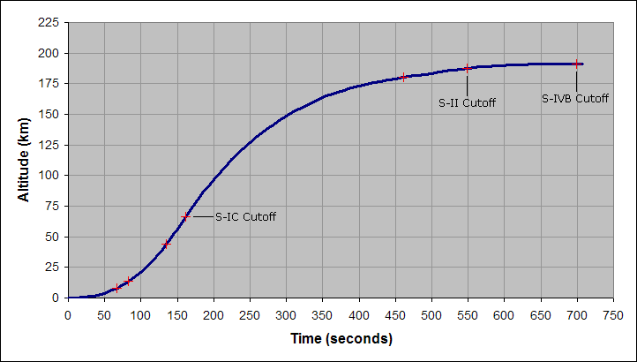
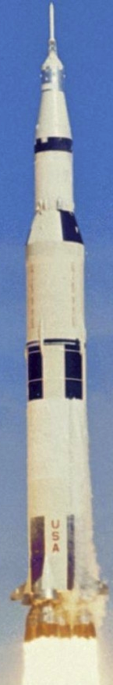
The Saturn V ("Saturn five") is a three-stage rocket developed to support the Apollo program for human exploration of the Moon. It is the tallest, heaviest, and most powerful rocket ever built, and holds the record for heaviest payload launched, at 140,000 kg (310,000 lb), which is how heavy the payload was that sent the Apollo mission to the Moon.
This graph shows a Saturn V’s flight plan into earth orbit. On the next page you’ll do some amazing calculations about the speed and acceleration of this massive rocket.

Slide 10
1. From the flight plan graph, fill in this time-altitude table for 50 second intervals (change km to meters):
0 sec | 50 sec | 100 | 150
0 m | 5,000 m | 25,000 | 52,000
2. Velocity (speed) tells us how something’s position changes over time. In this case, position is altitude. Every two numbers above will go into one number here (subtract the right number from the left one, and then divide by the number of seconds, which is 50). [For fun, in the third row multiply by 2.2 to calculate the rocket’s speed in miles per hour (mph)!]
0-50 | 50-100 | 100-150 | 150-200
100 m/s | 400 m/s | 540 m/s
220 mph
3. Acceleration tells us how something’s speed (velocity) changes over time. Once again, every two numbers in the above table (middle row – m/s) will go into one number here (again, subtract the right number from the left one, and the divide by the number of seconds, which is 50).
0-50 ➔ 50-100 | 50-100 ➔ 100-150 | 100-150➔ 150-200
6 m/s² | 2.8 m/s²
The units of position (altitude) are meters (m), but velocity is in meters-per-second (m/s), and acceleration is in meters-per-second-squared (m/s²), which can also be called meters-per-second-per-second (m/s/s). At each next level you divide by seconds, and each time you do this you add another “per second” (“/s”) to the units. The first time you go from meters (m) to meters-per-second (m/s), then from that to meters-per-second-per-second (m/s/s), which is also called meters-per-second-squared (m/s²).

Slide 11
A data structure is how computers store information in memory. A binary tree is a very common and important data structure. We’re going to learn about binary trees by playing a game called “Animals”. Here’s how it goes:
Ask a friend to think of an animal but not tell you what it is.
Start at the top of the tree (this is called the “root”), and ask the question there. (“Does it live on land?”)
Follow the branches according to the answers, until you get to an animal (this is called a “leaf”).
Say the animal at that point.
No
Lives on land?
Yes
Is huge?
Has four legs?
No
Yes
No
Yes
Fish
Whale
Person
Dog
No
Eats people?
Yes
Dog
Lion
This part was added when we guessed “dog”, but they were thinking of a lion instead.
If you’re lucky, you’ll have guessed the right animal. If not, here’s what to do:
Ask your friend what the right answer is. (For example, you might have guessed dog, but it was really a lion.)
Ask for a yes/no question that can tell the different between a lion and a dog. For example: “Does it eat people?”
Cross out “Dog” and write in the question (“Eats people?”).
Make a “yes” and “no” branch, just like the rest of the tree, coming from that question.
Put “Lion” on the “yes” branch and “Dog” on the “no” branch (or the whichever way it goes for the question).
Now you’re ready to start again with a new animal. Maybe swap who guesses each next animal.
On the next page there’s a larger area to make your tree, and some fun questions about the game.

Slide 12
Here’s the animals binary tree from the previous page. Go ahead and play with a friend until you get to the line at the bottom. (Try write small and neatly so you get a bunch more animals into the tree.)
No
Lives on land?
Yes
Is huge?
Has four legs?
No
Yes
No
Yes
Fish
Whale
Person
Eats people?
No
Yes
Dog
Lion
Why do you think this is called a binary tree? (Hint: Think about “Yes/No” and “1/0”)
We started out with 5 animals. How many are there in your final tree? ___
The length of a path through the tree is how many questions it takes to get to a leaf (animal)? For example, the path lengths at the start are: Fish:2, Person:2, Whale:2, Dog:3, Lion:3. Final lengths (just the numbers): __,__,__, __,__,__,__,__,__,__,__,__,__,__,__,__,__,__,
What is the average path length? (Starting out it’s: (2+2+2+3+3)÷5=12÷5=2.4): Yours:_____
Weird fact: 2 to the power of 2.4 (2^{2.4}) is approximately 5 (2^{2.4} = 5.3). Your result: 2 ^{to} the ____ =_______ (Use a calculator). This should be about the number of animals in the tree.
What this means is that you can store many more animals in the tree, than it takes questions to find them again!

Slide 13
A+B+C=18
A²+B²=C²
____=C
A=___
A=3
A=3
B=5
C=7
B=4
C=____
B=4
C=12
A+2B=24
_+_-_=12
_____=__
A=6
A=9
A=10
B=____
B=____
B=4
C=7
B=3
C=1000
3A=45
(B_C)_A=19
_____=A
A=____
A=5
A=11
A=____
A=____
B=6
C=4
B=2
C=121

Slide 14
A=10
B=2
A=3
B=30
_______=_______
_______=_______
C=10
D=10
C=0.2
D=18
A=60
B=4
____ =C
A=0.25
B=4
A=i
_______=_______
_______=_______
C=4
D=3
C=4
D=4
B=2
C=-1
A=30
B=5
A=3
B=27
_______=_______
_______=_______
C=0.5
D=3
C=0.2
D=15
A=3
B=81
A=45000000
B=4.5
_______=_______
_______=_______
C=2
D=2
C=10
D=7

