Slide 1
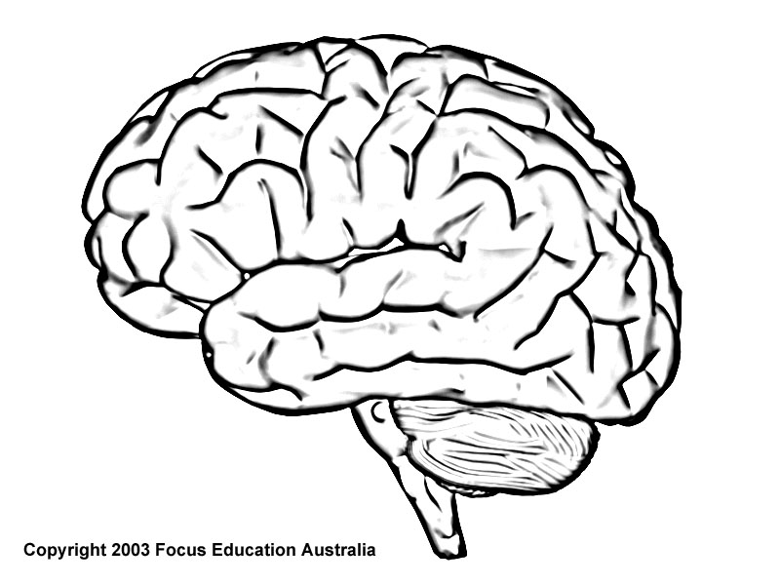


How Complex Strategies Work in the Brain and World
General Motor: Finger activity and cognitive skill sequencing
General Frontal: Activity initiation and in-process/attentional control
Motor Fingers
IPS: Number concept; possibly the primary NN hidden layer
QuasiMotor Attention
Internal Number
Hippocampus: Explicit number fact memory
Strategy Sequencing
Echoic Memory
Visual Fingers
Phonetic Hearing
General Visual: Seeing fingers
General Auditory: Turning phonetics into internal representations, and possibly operating the echoic buffers
Cerebellum: Smooth (Cognitive skill) Sequencing
Phonetic Saying

