Slide 1
Considerations Arising from an Updated Computational Model of Early Math Skills and Knowledge
Menon Lab: Christian, Lang, Shaozheng, Tanya
Interns: Archer, Eric, Myra, Roujia
SymSys: Jeff

Slide 2
Outline
Goals:
Insight on early math from computational modeling
Why early math?
It’s universal and clear.
Interaction between brain and math development
A brief (biased) history of computational models of math development
Approach:
Dual Neural Nets: Linguistic and Mathematical
Method Details and Results

Slide 3
Goals
Update computational models of mathematical development that have languished since the mid 1990s, and so haven’t benefited from two decades of brain science, esp. systems neuroscience and deep learning (esp. re timing).
See what insights into early math we can gain from trying a NN approach, and also by carefully thinking through the systems neuroscience and developmental timing of the problem (i.e., deep learning).

Slide 4
Why Early Math?
Math is universal.
Math has relatively clear correctness criteria and is easily measurable. (3+4=7!)
Math has relatively clear semantics.
Tons of data around just ten symbols!
However: Math comes in so early that it interacts with language and brain development in complex and interesting ways. (Both a blessing and a curse! Hard to do brain work!)

Slide 5
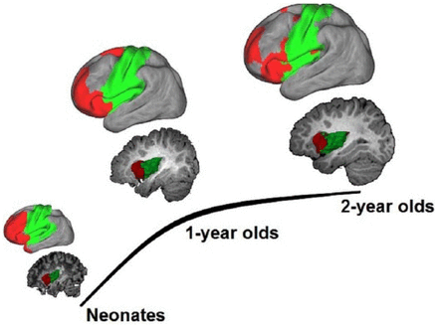
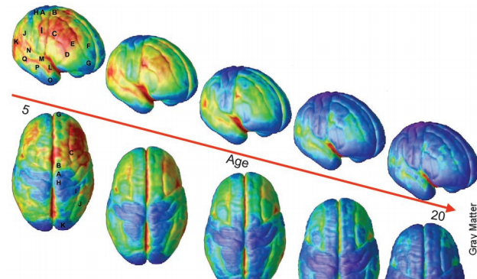
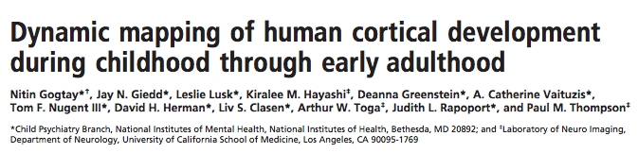
Interaction between math and brain development
Single digit addition
(up to 5+5)
Counting
Number Naming
0-2 Years
2-4 Years
4-6 Years
Functional Connectivity Plastic and Modifiable

Slide 6
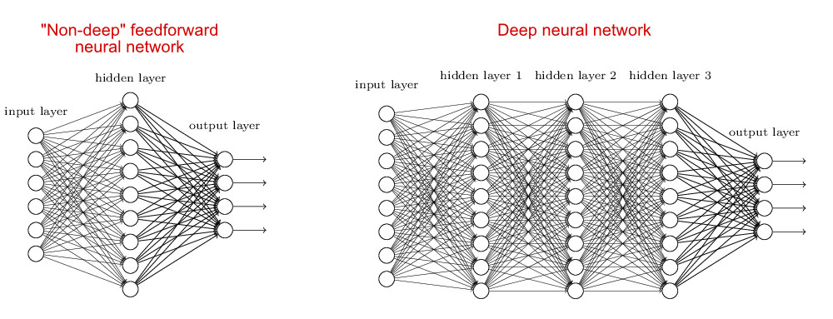
Our Approach
Single digit addition
(up to 5+5)
Counting
Number Naming
Non-number semanrtics
Number semantics
Addition Results
Strategies
Number and Language Association Layer
Addition Association Layer
Strategy Association Layer
Words (including both number and non-number)
Addend 1 number semanrtics
Addend 2 number semanrtics
“Language” network
Trained Early
“Addition” Network
Train Later

Slide 7
Method Details
Basic representation (-1→1), tanh asymptote
Diff. representations/orthogonality
Language training (250 set v. 20 set v.
Counting pretraining
Parameter search method
Analysis methods
How language training is moved to addition addends
The problem of individual identity (starting with random values)

Slide 8
Results
Language
Basic learning
Different representation/orthogonality
Non-Language Addition
Basic learning
Counting pretraining effect
Error effect
Combined Language → Addition
Same set of experiments with pre-trained language input

