Slide 1

Signing Into Apps with Azure B2C
Jeff Stagg – Phidiax, LLC
Microsoft Gold Partner – Provider of Cloud Solutions

Slide 2
Introduction
Jeff Stagg
Senior Collaboration and Cloud Architect – Phidiax, LLC

Slide 3
Agenda
OIDC Overview
Azure B2C Overview
Library App Overview
Connect B2C
Setup Authorization

Slide 4
OIDC Overview
OpenID Connect
Identity layer on top of OAuth 2.0 protocol
OpenID Handshake
Client sends request to Identity Provider
Identity Provider authenticates user
Identity Provider requests consent to act on behalf of user
Identity Provider responds with ID Token and Access Token
Client sends request to Resource Provider with token for access
Resource Provider responds with requested authorized data

Slide 5



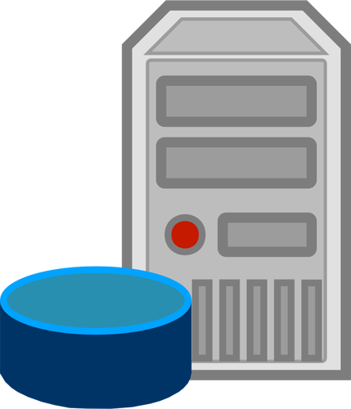

OIDC Handshake
User
Client App
1
8
User visits Client App, asking Client App to act on User’s behalf
Client App redirects User to Auth Server to authenticate
User authenticates and authorizes Client
Auth Server redirects User to Client with id token
Client sends id token and its credentials to Auth Server for access token
Auth Server authorizes credentials and sends Client an access token
Client sends request to Protected Resource with access token
Protected Resource sends resources to Client
7
2,3
4
5
6
Authorization Server
Protected Resource

Slide 6
Azure B2C
Identity and Access Management
Built on Azure AD
Can provide your own sign-up / login pages or use default
Use OpenID Connect(OAuth), SAML
Easily configure multi-factor authentication
Pricing
https://azure.microsoft.com/en-us/pricing/details/active-directory-b2c/
https://azure.microsoft.com/en-us/pricing/calculator/

Slide 7
Library Application
Library has public and private books
.Net Core API
/public is an open, insecure API endpoint
/private is a secure API endpoint requiring authentication
Middleware dictates JWT authentication
Front-End Angular App
Authenticates user via Azure B2C
Calls API endpoints to get public and private books
Azure B2C
Stores users for application
Allows user to Register / Login / Logout

Slide 8
Setup Azure B2C
Create new Azure B2C Tenant
Link to subscription
Add application to B2C
Create SignUp / SignIn Policies
Add Scope to read
Add API access for new scope

Slide 9
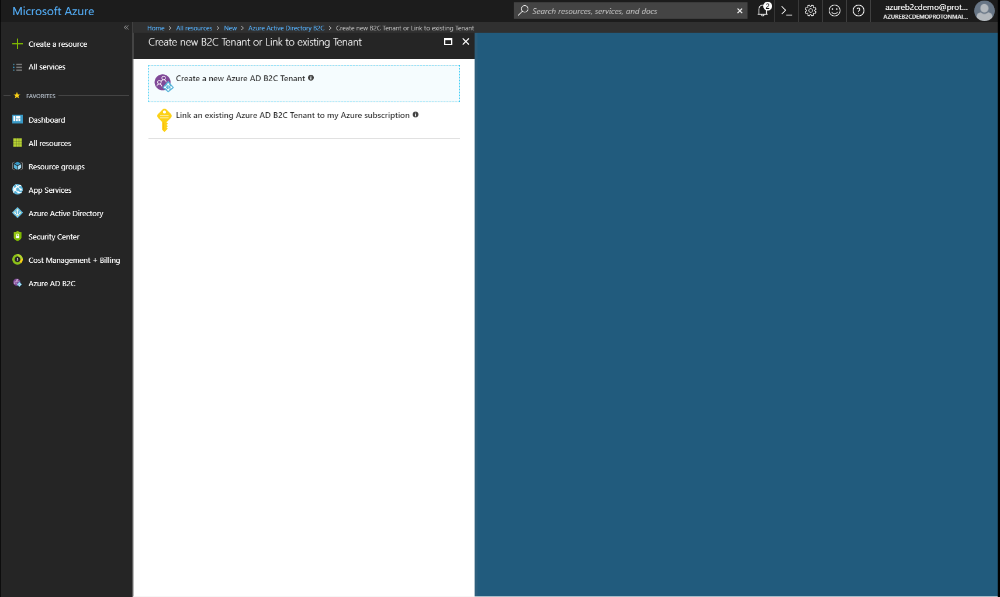
Create New Azure B2C Tenant

Slide 10
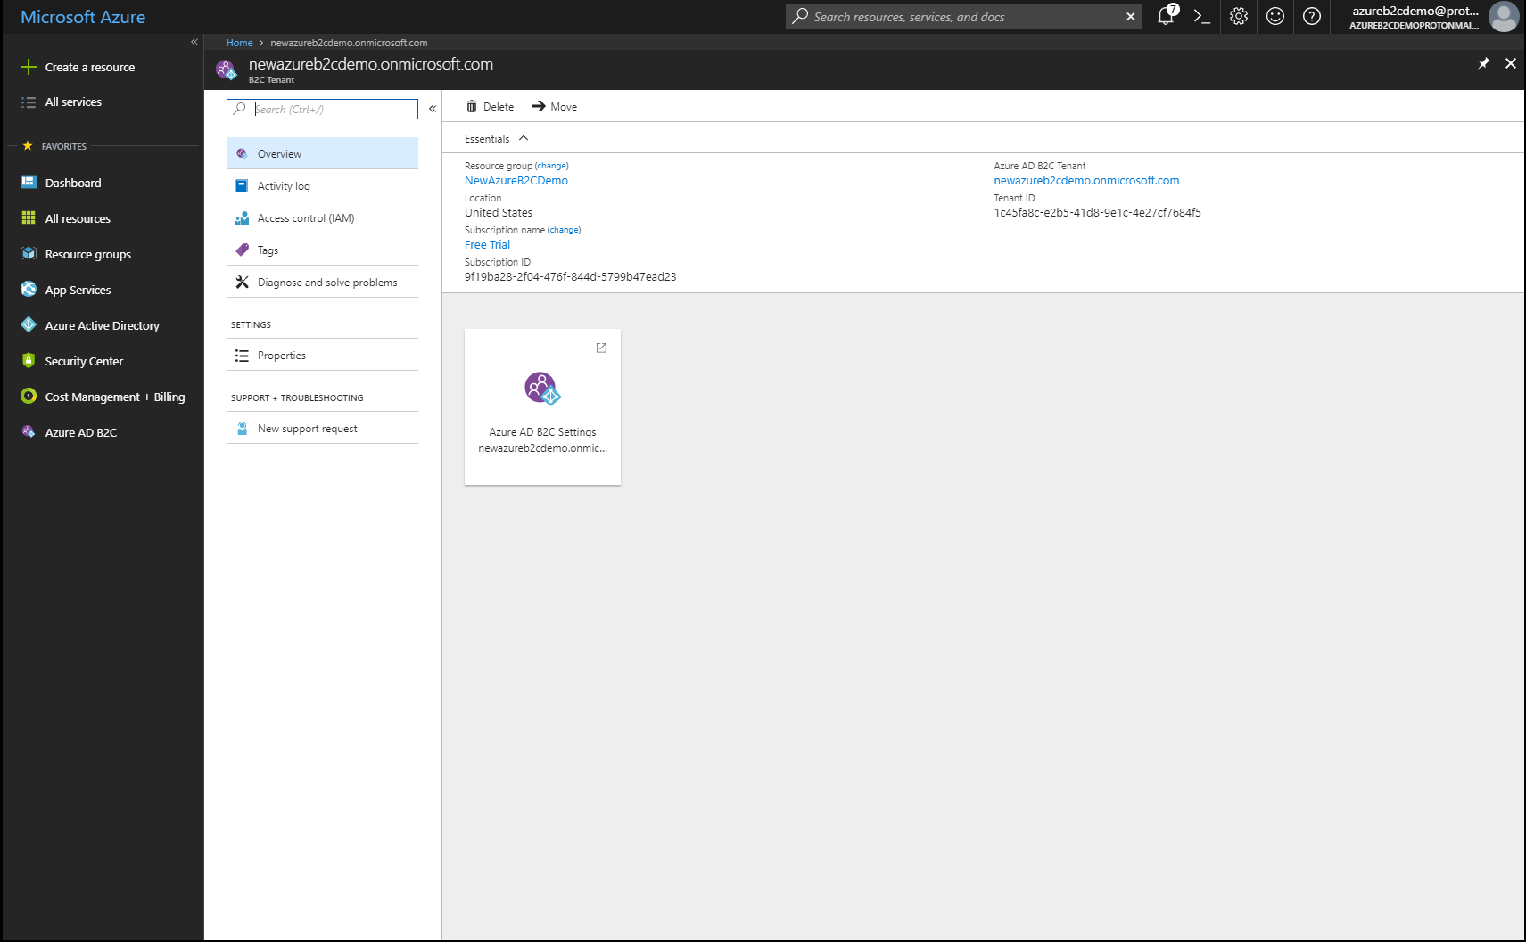
Link to Subscription

Slide 11
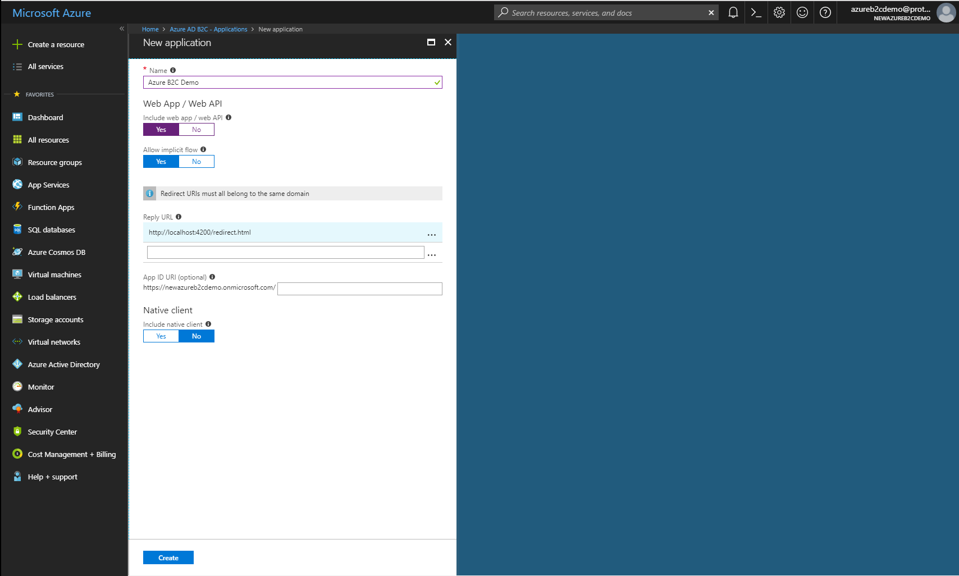
Add Application with Web API

Slide 12
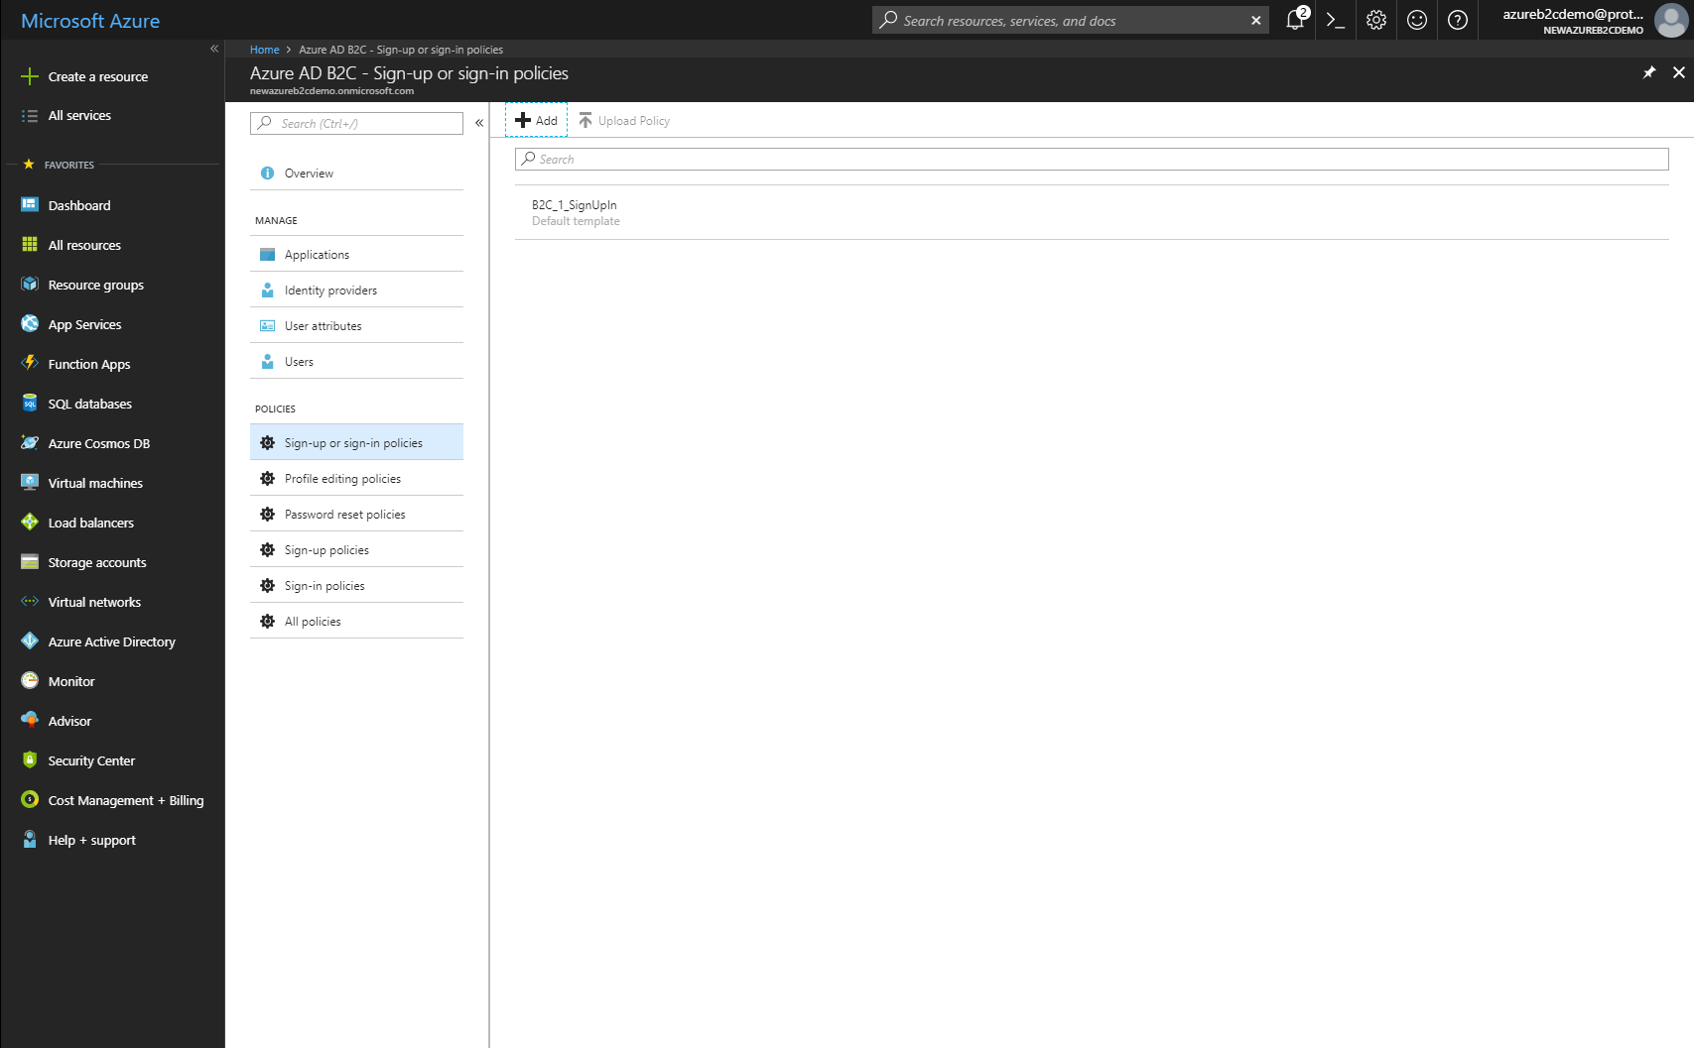
Create SignUp / SignIn Policies

Slide 13
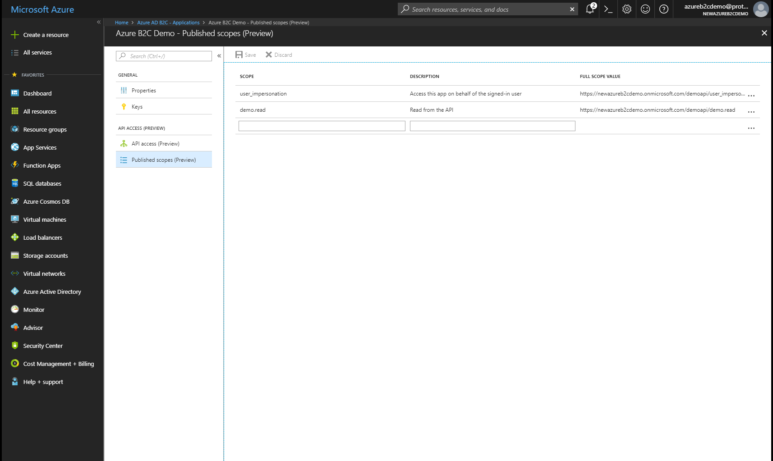
Add Scopes

Slide 14
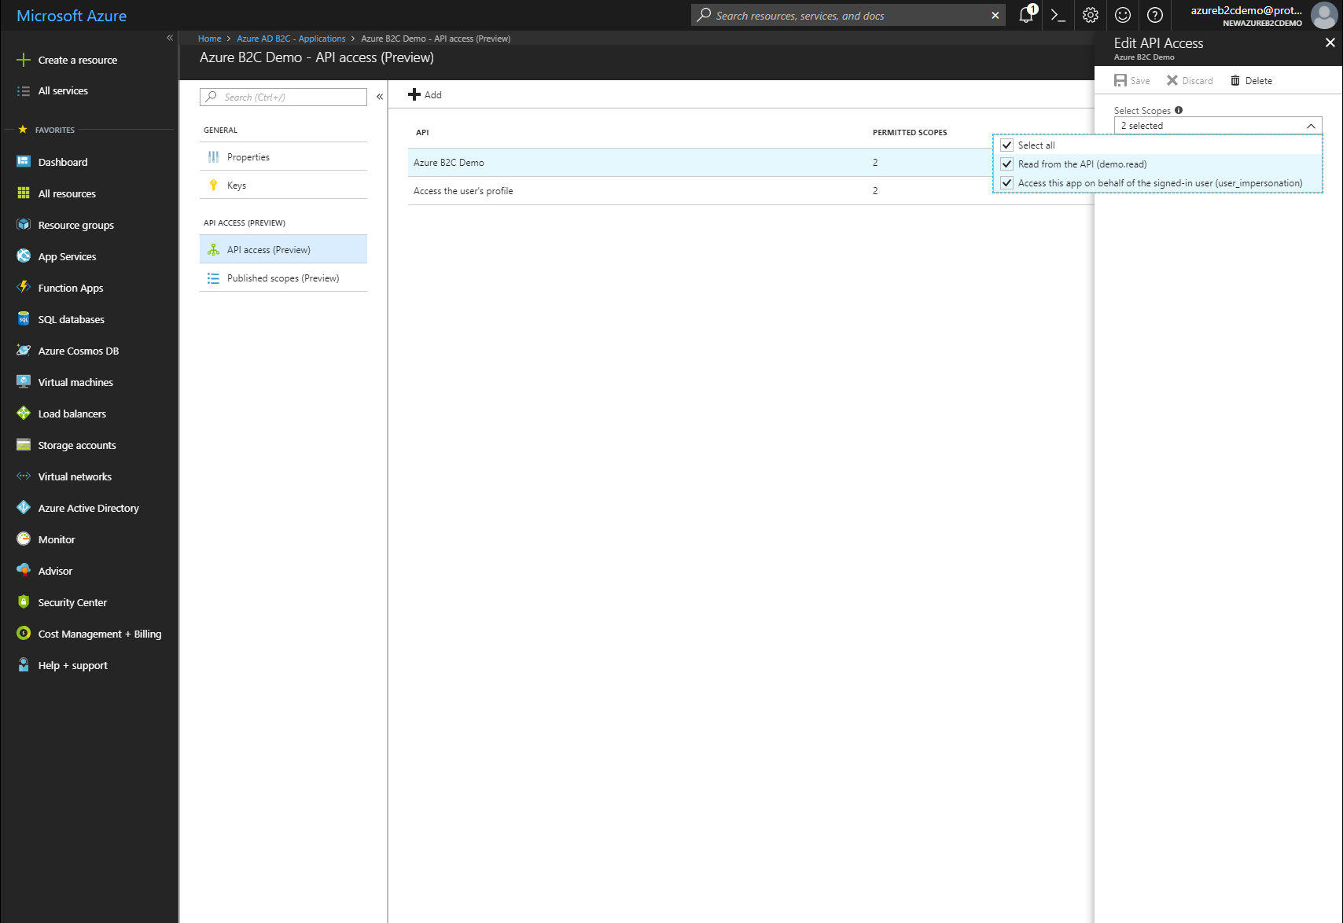
Allow Scope Access

Slide 15
Setup Authorization
https://github.com/jeffstagg/Library
API
Add Authorize header to secure controller
Add middleware in Startup.cs
Angular Client
Install angular-oauth-oidc-client
https://github.com/damienbod/angular-auth-oidc-client
app.module.ts
Configure plugin with B2C account
app.component.ts
Check authorization on init / clear on destroy
Create sign-up/sign-in logic
Send Bearer token with Authorization header for secure endpoints

Slide 16
Resources
Library App
https://github.com/jeffstagg/Library
Angular Plugin
https://github.com/damienbod/angular-auth-oidc-client
Azure B2C
https://azure.microsoft.com/en-us/services/active-directory-b2c/

Slide 17

Questions?

