Slide 1
Web Components with Polymer
Jeff Tapper
Digital Primates
@jefftapper / @digitalprimates

Slide 2
Who am I?
Senior Consultant at Digital Primates
Building next generation client applications
Developing Internet applications for 20 years
Author of 12 books on Internet technologies

Slide 3
Who are you?
?

Slide 4
What are Web Components?
Web Components are an attempt to let you write custom components that can be used like this:
<body>
Sales:<br>
<my-super-cool-chart id="coolChart">
</my-super-cool-chart >
</body>

Slide 5
How do they work
Web Components are a combination of several w3c specifications
Custom Elements
Templates
Shadow Dom
HTML Imports

Slide 6
What is Polymer?
A library built on top of Web Components.
Allows us to use Web Components today in modern browsers which don’t yet support Web Components
3 main pieces
A set of polyfills
Web application framework
Set of UI components

Slide 7
What are we covering?
Web Components, specifically:
What in the world are web components?
What problem are they trying to solve?
How do they work?
Can I actually use these things?
What does it mean to my app/development process?

Slide 8
Life on the Edge
Web Components are a next generation technology.
As of this moment, they do not work in their entirety in all browsers
However, a good portion of the functionality is available in Chrome and Opera

Slide 9
So, is it real?
Yes!!!
Web Component support is actually here today. Even though they are not fully supported in all browsers, Polymer and Polyfills allow use in most modern browsers today

Slide 10
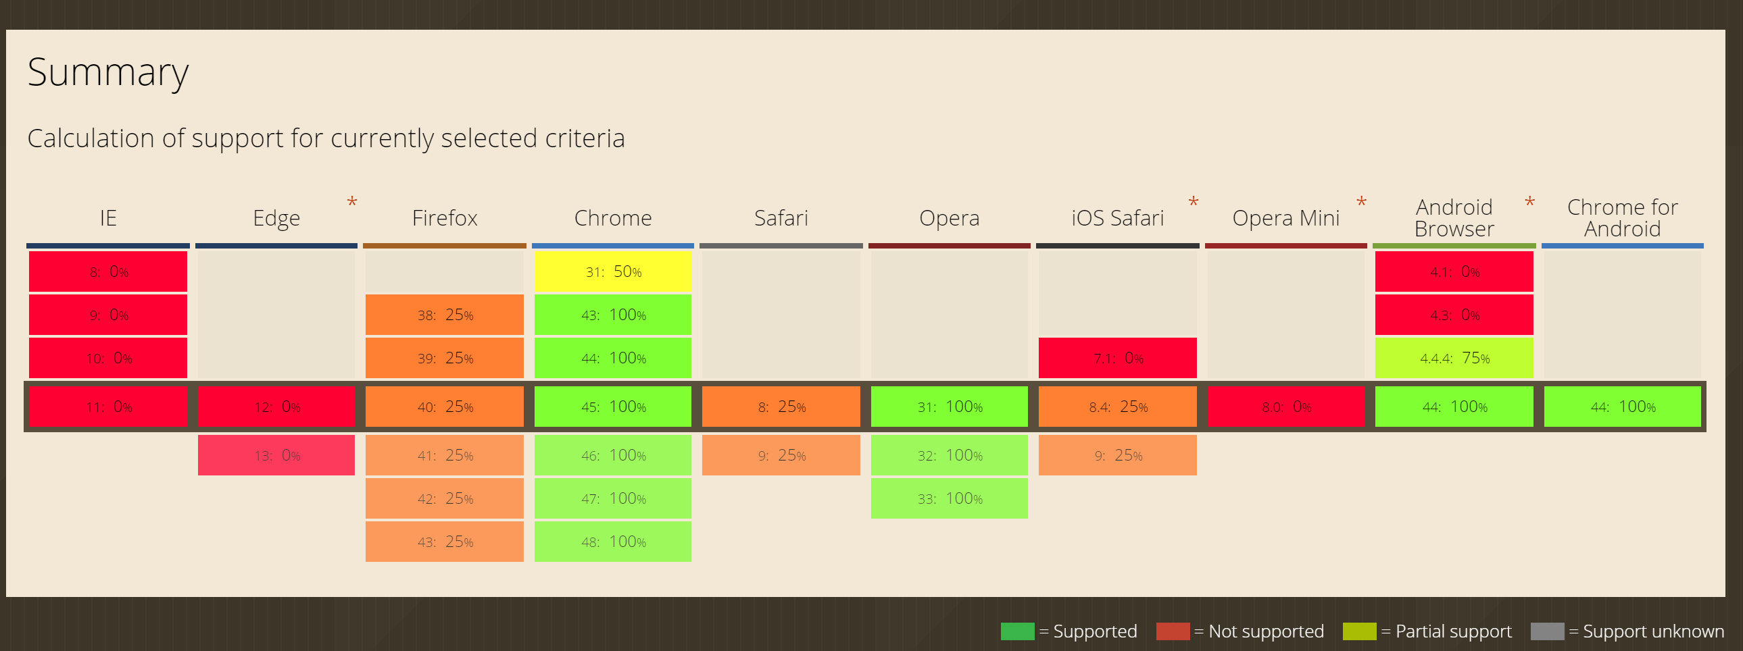
Where can I use this today?

Slide 11
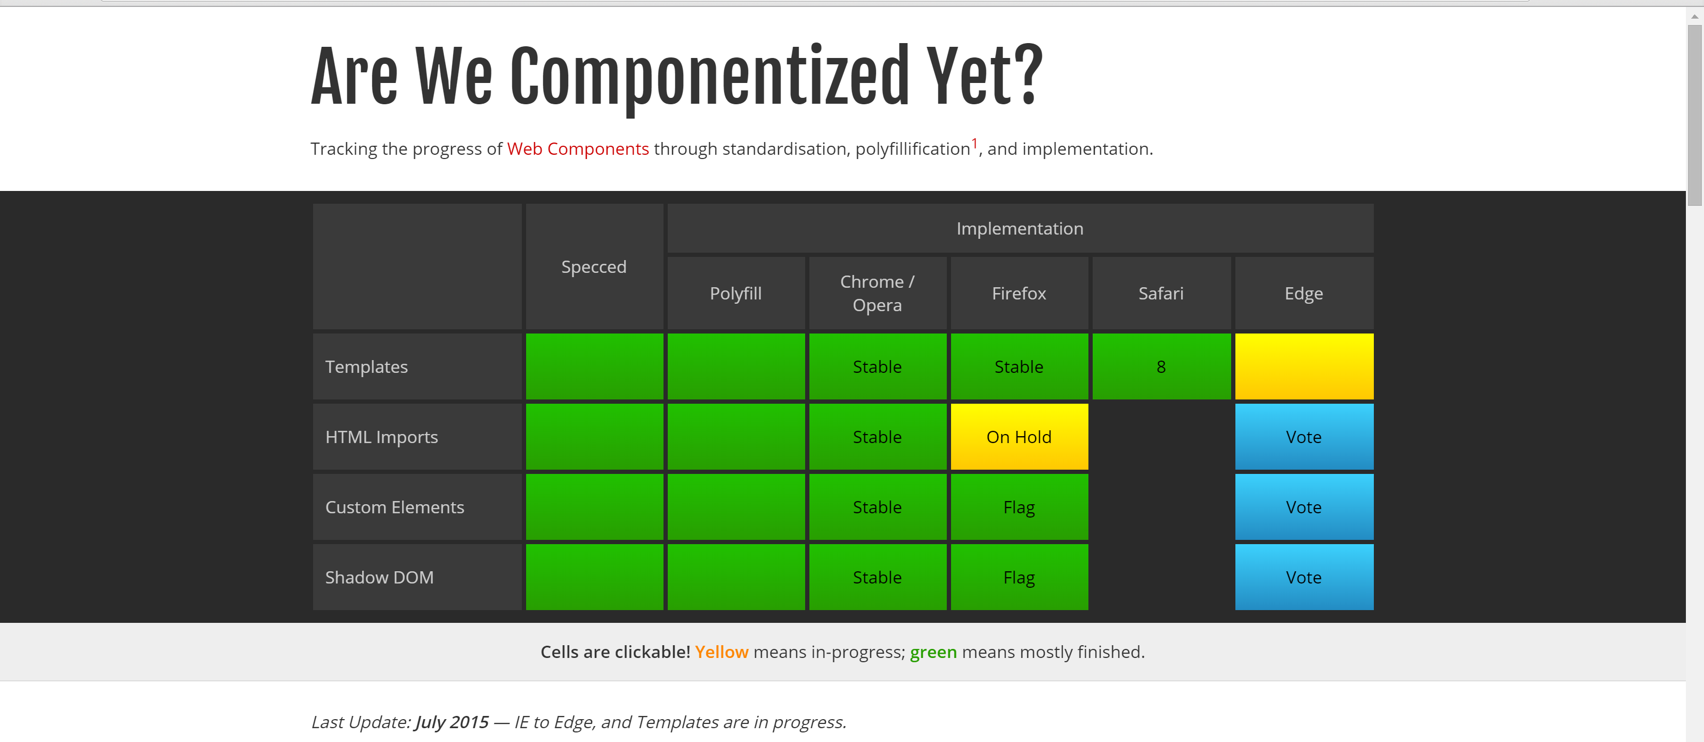
Always finding the latest and greatest
http://jonrimmer.github.io/are-we-componentized-yet/

Slide 12
Why are they important?
A few minor reasons you may like the idea, first:
Encapsulation
Manageable Reuse
Hiding complexity and implementation
Dealing with duplicated IDs
Dealing with CSS scoping / propagation
Ease of Distribution
Appropriate technology choices
Markup in markup, not in code

Slide 13
How do they work?
Web Components are a series of Working draft specifications:
HTML Templates
http://www.w3.org/TR/html-templates/
Shadow DOM
http://www.w3.org/TR/shadow-dom/
Custom Elements
http://www.w3.org/TR/custom-elements/
HTML Imports
http://www.w3.org/TR/html-imports/

Slide 14
Example Application
Twitter-button
created by Zeno Rocha
source code available at
https://github.com/social-elements/twitter-button
http://localhost/poly/twitter-button-master
Language Application
created by Michael Labriola
http://localhost/poly/

Slide 15
Templates
The concept of templates is prolific and nearly self-explanatory. Their use takes a bit more effort:
Inactive DOM Fragment
Easily Clone-able
Easily Change-able

Slide 16
Templates
You define them with the template element
<template id="productTemplate">
<div>
<img src="">
<div class="name"></div>
<div class="description"></div>
</div>
</template>
This is parsed but it’s not active. It’s not rendered.

Slide 17
Shadow DOM
Shadow DOM is at the heart of the whole component concepts
It’s encapsulation
Its used by the browsers today to implement their own controls
Ultimately its about hiding implementation details and exposing an interface

Slide 18
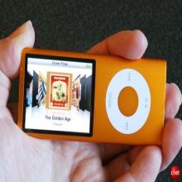
Shadow DOM
The name and the technical explanation sometimes get in the way of the concept.
Put simply, the user sees this:
Photo by Photo by: Mark Kaelin/TechRepublic

Slide 19
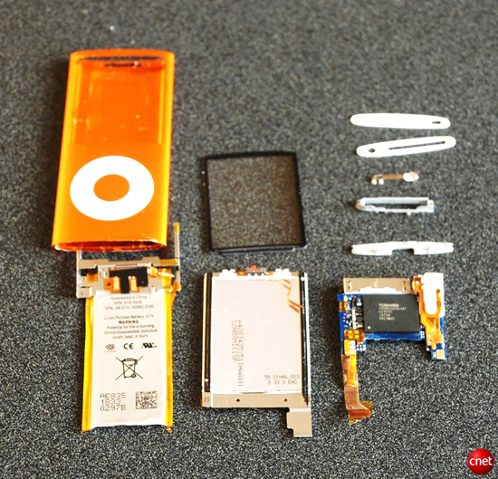
Shadow DOM
The browser sees this:
Photo by Photo by: Mark Kaelin/TechRepublic

Slide 20
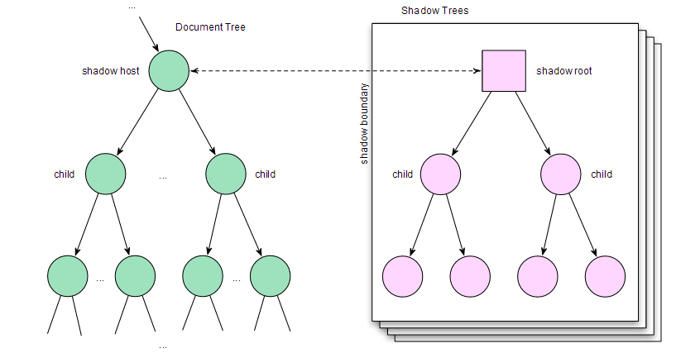
Shadow Host/Root

Slide 21
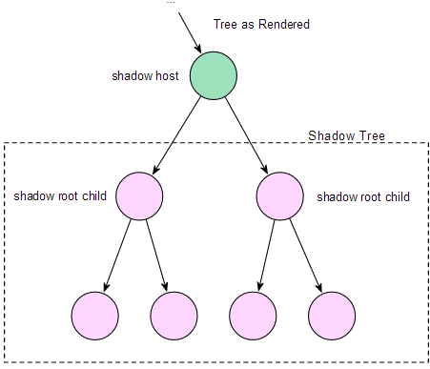
Rendering

Slide 22
Styles
The Shadow also forms a boundary. Styles don’t cross unless you let them. So you to keep control of this area

Slide 23
Styles
This, by default, goes both ways… meaning we aren’t worried about collisions.
Outside styles don’t
affect shadow content
Styles defined in here
are scoped locally

Slide 24
HTML Imports
HTML imports are about importing and sharing HTML content.
Why? Well, reuse, it facilitates the reuse of templates and provides us a fundamental need if we are going to share an encapsulated chunk we might call a component.
<link rel="import" href="goodies.html">

Slide 25
HTML Imports
Last word on this…
Imports aren’t supported in Firefox yet, however, there are polyfills.
Imports are blocking. So, your page will act as though it needs this content before it can render.

Slide 26
Custom Elements
Elements are the key to putting this together.
Custom Elements are DOM elements that can be defined by a developer.
They are allowed to manage state and provide a scriptable interface.
In other words, they are the shell of what will become our component

Slide 27
Custom Elements
Defining a custom element like this:
<polymer-element extends="button" name="fancy-button">
</polymer-element>
Allows you to use that custom element in your own markup:
<div>
<fancy-button></fancy-button>
</div>

Slide 28
Custom Elements
You can use the concepts we previously discussed, templates, Shadow DOM, etc. from within a custom element.
Further, custom elements give you a set of Lifecycle callbacks so you can know things like when you are inserted into the DOM, removed and ready.
This means you can define the visual aspects of a custom element in mark up and the code in script.

Slide 29
Creating in JavaScript
<my-tag></my-tag>
var proto = Object.create(HTMLElement.prototype);
proto.createdCallback = function (){
this.textContent = 'This is my tag';
};
document.register('my-tag',{prototype:proto});

Slide 30
Creating Custom Elements
Pure JavaScript
X-tags: framework developed by Mozilla
Polymer: framework developed by Google
Each provides lifecycle events you can use

Slide 31
Component Lifecycle
createdCallback()
attachedCallback()
detachedCallback()
attributeChangedCallback()

Slide 32
X-tags
xtag.register('x-frankenstein', {
lifecycle:{
created: function(){
alert("Look! It's moving. It's alive!");
}
}
});

Slide 33
Xtags Lifecycle Events
created
inserted
removed
attributeChanged

Slide 34
Polymer
<polymer-element name="say-hi">
<script>
Polymer('say-hi',{
whatToSay: 'Hi',
created: function(){
// do something
}
})
</polymer-element>

Slide 35
Polymer Lifecycle Events
created
attached
detached
attributeChanged

Slide 36
Conclusion
Web Components are real today.
Web Components are how we will be building Web Applications in the near future
Beware, all of the Web Component specifications are still Editors Drafts, and can change!
Polymer is a convenient way to build and use Web Components

Slide 37
Resources
http://www.w3.org/wiki/WebComponents/
http://www.polymer-project.org/
@polymer – officical twitter of the polymer project
@digitalprimates
@jefftapper
Code and slides can be found at https://github.com/jefftapper/presentations

Slide 38
Questions?
?

