Slide 1
Web Components with Polymer
Jeff Tapper
Digital Primates
@jefftapper / @digitalprimates

Slide 2
Who am I?
Senior Consultant at Digital Primates
Building next generation client applications
Developing Internet applications for 20 years
Author of 12 books on Internet technologies

Slide 3
Who are you?
?

Slide 4
What are Web Components?
Web Components are an attempt to let you write custom components that can be used like this:
<body>
Sales:<br>
<my-super-cool-chart id="coolChart">
</my-super-cool-chart >
</body>

Slide 5
How do they work
Web Components are a combination of several w3c specifications
Custom Elements
Templates
Shadow Dom
HTML Imports

Slide 6
Creating Custom Elements
Pure JavaScript
X-tags: framework developed by Mozilla
Polymer: framework developed by Google
Each provides lifecycle events you can use

Slide 7
Creating in JavaScript
<my-tag></my-tag>
var proto = Object.create(HTMLElement.prototype);
proto.createdCallback = function (){
this.textContent = 'This is my tag';
};
document.register('my-tag',{prototype:proto});

Slide 8
Component Lifecycle
createdCallback()
attachedCallback()
detachedCallback()
attributeChangedCallback()

Slide 9
X-tags
xtag.register('x-frankenstein', {
lifecycle:{
created: function(){
alert("Look! It's moving. It's alive!");
}
}
});

Slide 10
Xtags Lifecycle Events
created
inserted
removed
attributeChanged

Slide 11
Polymer
<polymer-element name="say-hi">
<script>
Polymer('say-hi',{
whatToSay: 'Hi',
created: function(){
// do something
}
})
</polymer-element>

Slide 12
Polymer Lifecycle Events
created
attached
detached
attributeChanged

Slide 13
What is Polymer?
A library built on top of Web Components.
Allows us to use Web Components today in modern browsers which don’t yet support Web Components
3 main pieces
A set of polyfills
Web application framework
Set of UI components

Slide 14
What are we covering?
Web Components, specifically:
What in the world are web components?
What problem are they trying to solve?
How do they work?
Can I actually use these things?
What does it mean to my app/development process?

Slide 15
Life on the Edge
Web Components are beyond leading edge.
As of this moment, they do not work in their entirety in all browsers
A good portion of the functionality is available in Chrome

Slide 16
So, is it real?
Yes!!!
Web Component support is actually here today. Even though they are not fully supported in all browsers, Polymer and Polyfills allow use in most modern browsers today

Slide 17
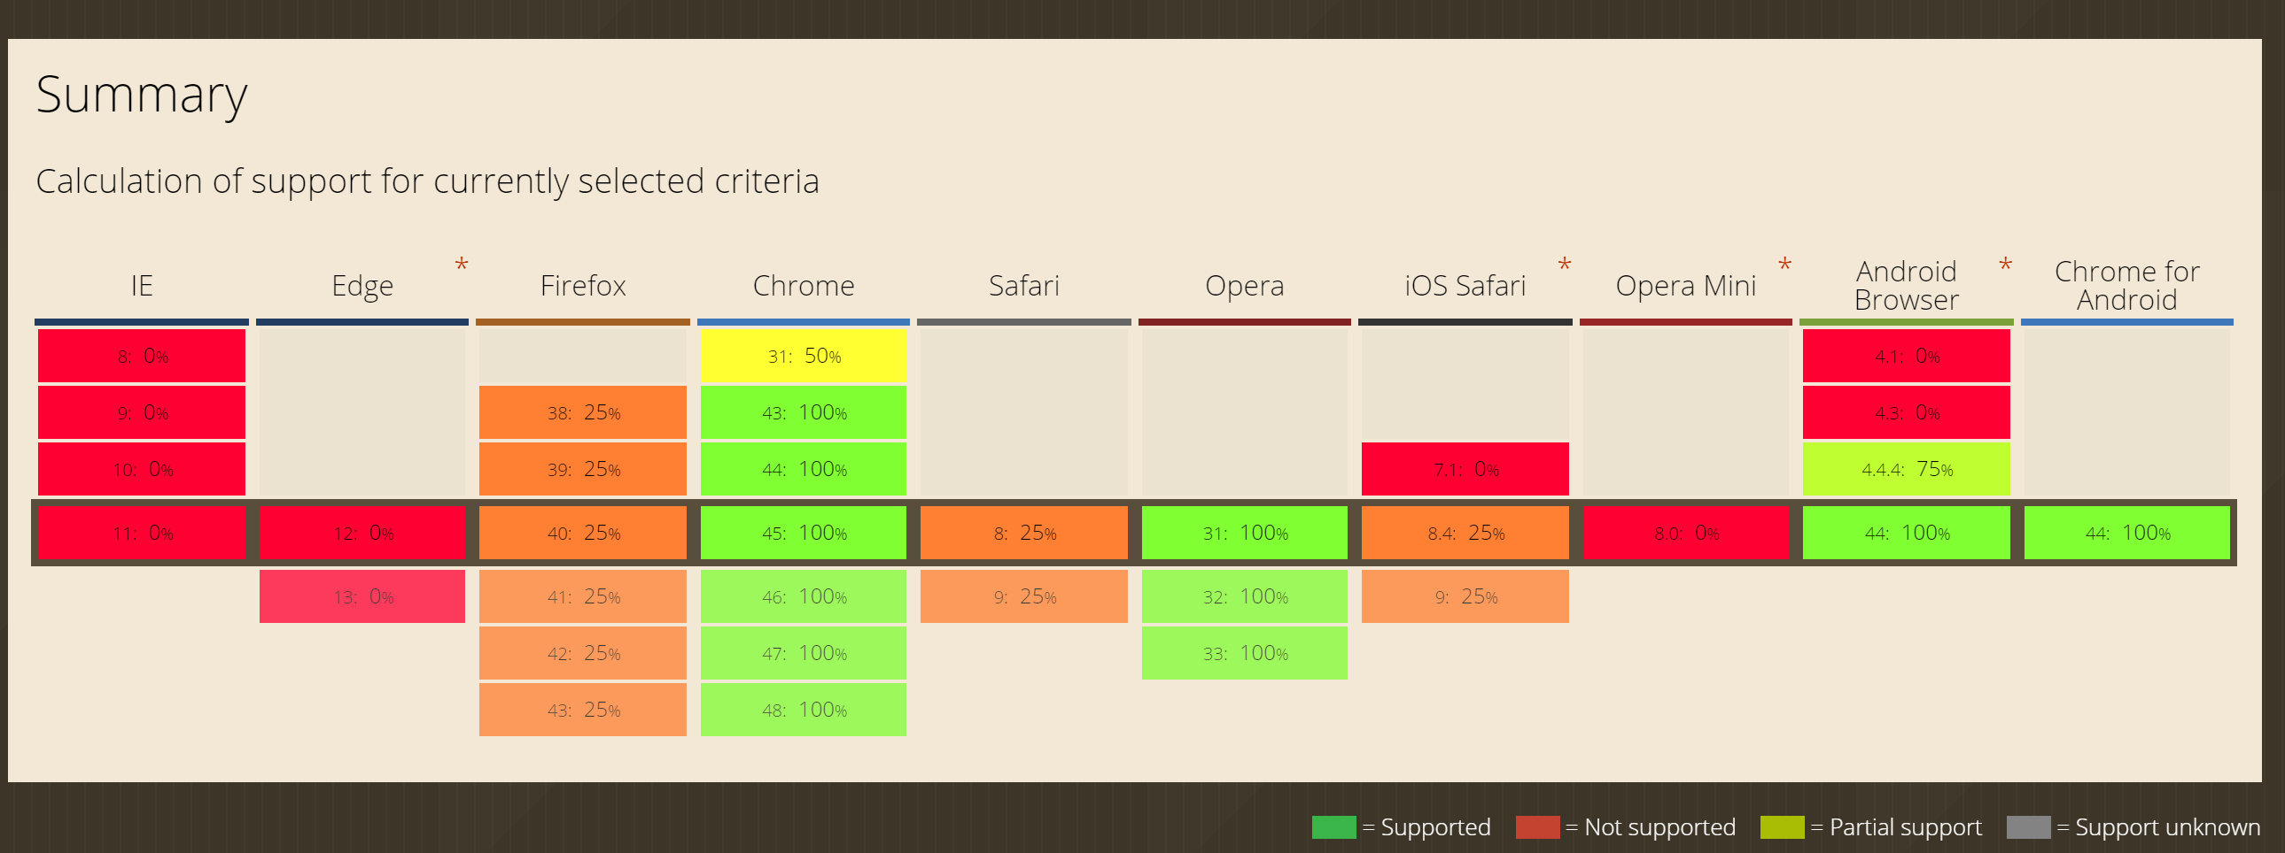
Where can I use this today?

Slide 18
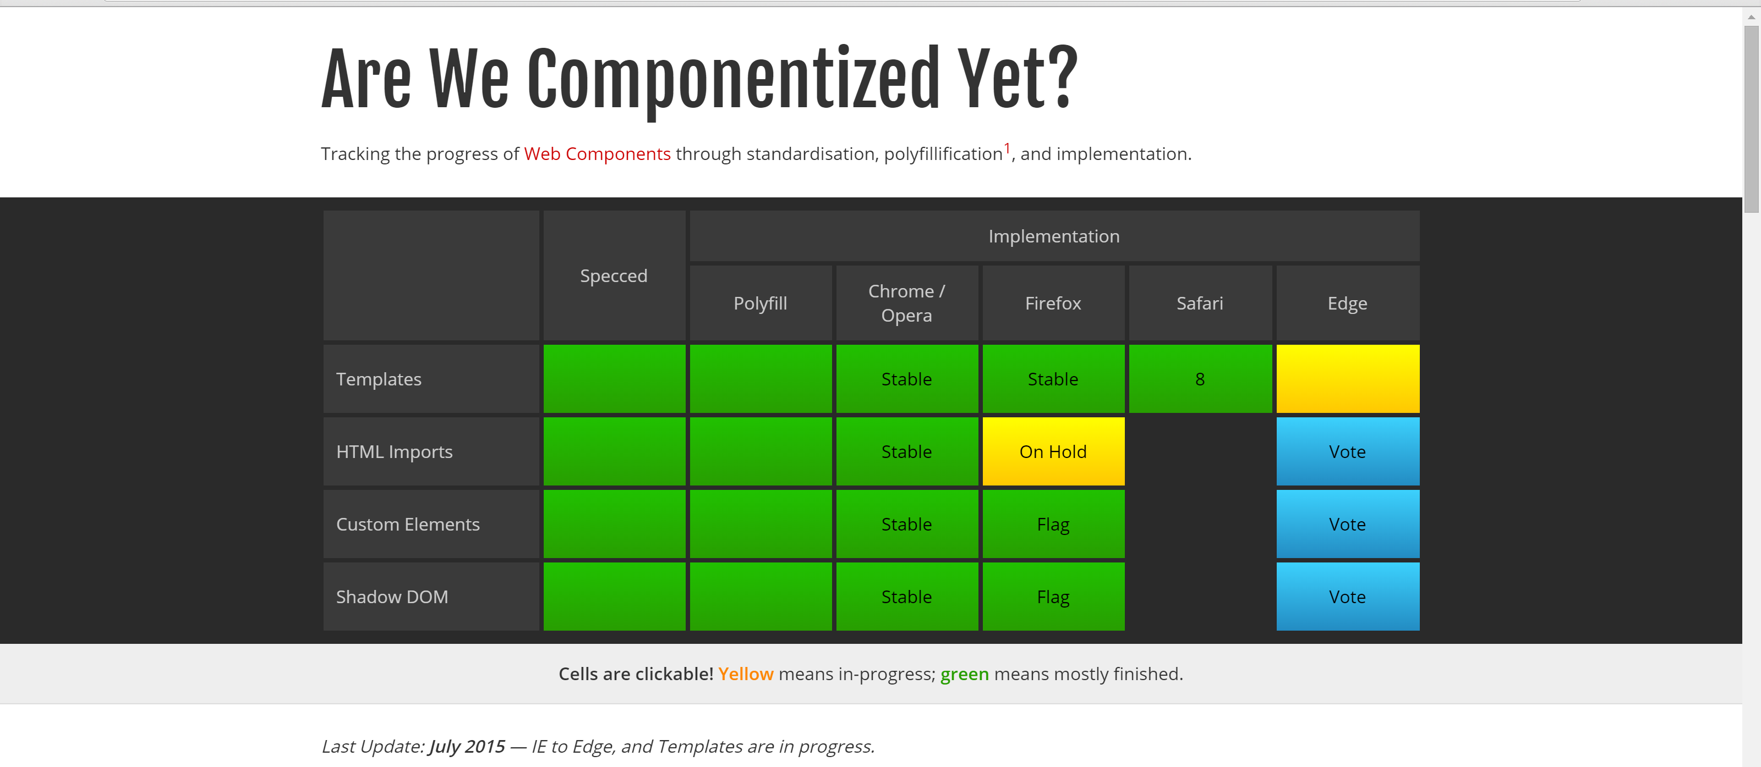
Always finding the latest and greatest
http://jonrimmer.github.io/are-we-componentized-yet/

Slide 19
Why are they important?
A few minor reasons you may like the idea, first:
Encapsulation
Manageable Reuse
Hiding complexity and implementation
Dealing with duplicated IDs
Dealing with CSS scoping / propagation
Ease of Distribution
Appropriate technology choices
Markup in markup, not in code

Slide 20
How do they work?
Web Components are a series of Working draft specifications:
HTML Templates
http://www.w3.org/TR/html-templates/
Shadow DOM
http://www.w3.org/TR/shadow-dom/
Custom Elements
http://www.w3.org/TR/custom-elements/
HTML Imports
http://www.w3.org/TR/html-imports/

Slide 21
Example Application
Twitter-button
created by Zeno Rocha
source code available at
https://github.com/social-elements/twitter-button
http://localhost/poly/twitter-button-master
Language Application
created by Michael Labriola
http://localhost/poly/

Slide 22
Templates
The concept of templates is prolific and nearly self-explanatory. Their use takes a bit more effort:
Inactive DOM Fragment
Easily Clone-able
Easily Change-able

Slide 23
Templates
You define them with the template element
<template id="productTemplate">
<div>
<img src="">
<div class="name"></div>
<div class="description"></div>
</div>
</template>
This is parsed but it’s not active. It’s not rendered.

Slide 24
Shadow DOM
Shadow DOM is at the heart of the whole component concepts
It’s encapsulation
Its used by the browsers today to implement their own controls
Ultimately its about hiding implementation details and exposing an interface

Slide 25
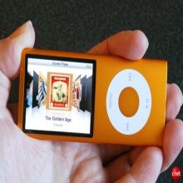
Shadow DOM
The name and the technical explanation sometimes get in the way of the concept.
Put simply, the user sees this:
Photo by Photo by: Mark Kaelin/TechRepublic

Slide 26
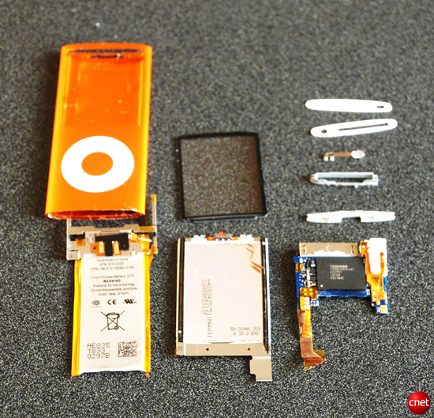
Shadow DOM
The browser sees this:
Photo by Photo by: Mark Kaelin/TechRepublic

Slide 27
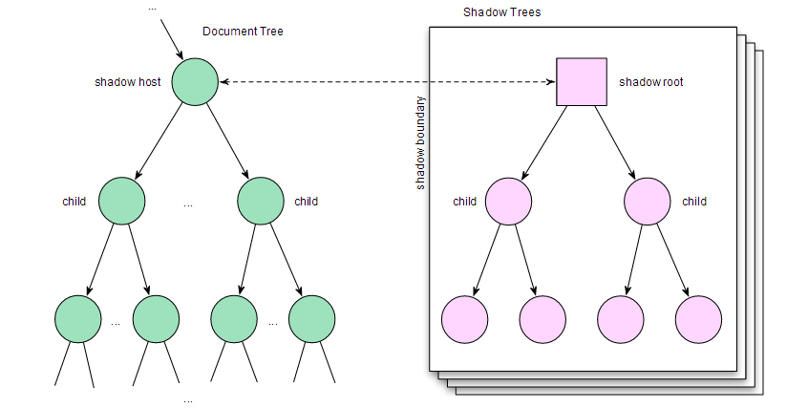
Shadow Host/Root

Slide 28
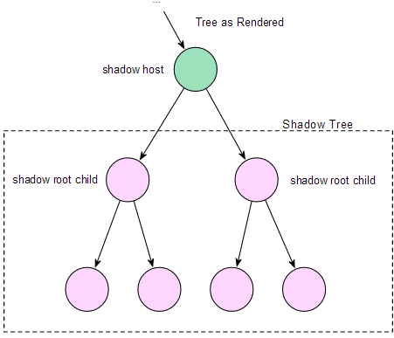
Rendering

Slide 29
Styles
The Shadow also forms a boundary. Styles don’t cross unless you let them. So you to keep control of this area

Slide 30
Styles
This, by default, goes both ways… meaning we aren’t worried about collisions.
Outside styles don’t
affect shadow content
Styles defined in here
are scoped locally

Slide 31
HTML Imports
HTML imports are about importing and sharing HTML content.
Why? Well, reuse, it facilitates the reuse of templates and provides us a fundamental need if we are going to share an encapsulated chunk we might call a component.
<link rel="import" href="goodies.html">

Slide 32
HTML Imports
Last word on this…
Imports aren’t supported pretty much anywhere yet, however, there are polyfills.
Imports are blocking. So, your page will act as though it needs this content before it can render.

Slide 33
Custom Elements
Elements are the key to putting this together.
Custom Elements are DOM elements that can be defined by a developer.
They are allowed to manage state and provide a scriptable interface.
In other words, they are the shell of what will become our component

Slide 34
Custom Elements
Defining a custom element like this:
<polymer-element extends="button" name="fancy-button">
</polymer-element>
Allows you to use that custom element in your own markup:
<div>
<fancy-button></fancy-button>
</div>

Slide 35
Custom Elements
You can use the concepts we previously discussed, templates, Shadow DOM, etc. from within a custom element.
Further, custom elements give you a set of Lifecycle callbacks so you can know things like when you are inserted into the DOM, removed and ready.
This means you can define the visual aspects of a custom element in mark up and the code in script.

Slide 36
Resources
http://www.w3.org/wiki/WebComponents/
http://www.polymer-project.org/
@polymer – officical twitter of the polymer project
@digitalprimates
@jefftapper
https://github.com/jefftapper/presentations

