Slide 1

Taxi duration IN NYC
IST 718 Big Data Analytics Rajalakshmi Venkateswaran, Jeffery Kao, Jay Mahapatra

Slide 2
Question/ Hypothesis
Question
Can we predict the trip duration of taxi rides in New York City based upon the following variables:
Pick-Up-Drop Off Time
Longitude and Latitude
Number of Passengers
Trip Duration
Collision Data
Traffic
Route Path
Based upon these variable can we find the optimal time to take a Taxi in in NYC?
Hypothesis
Collisions will have a substantial impact on the duration of a taxi ride

Slide 3
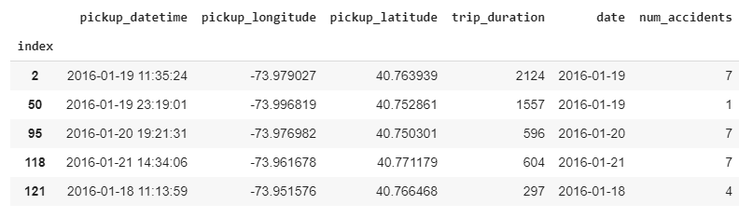
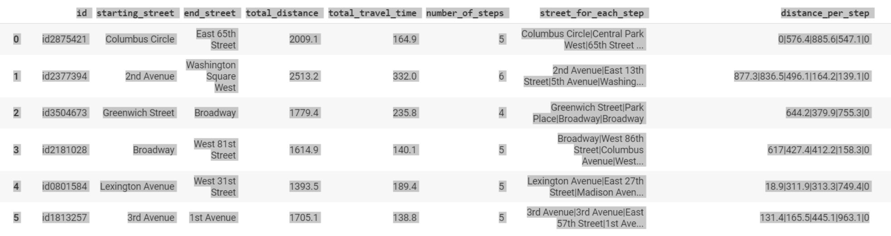
Data & Cleansing
Final Data Set for Model Training (Collisions)
To conduct this analysis we used taxi duration data from kaggle and combined it with collision data we found from the NYC collision data set to get an adequate training set.
In addition, we also grabbed OSRM data(Open Source Routing Machine) which is an implementation of a high-performance routing engine for shortest paths in road networks and combined it with taxi duration data.
Final Data Set for Model Training Collisions (OSRM)
Notes:
https://www.kaggle.com/c/nyc-taxi-trip-duration
https://www.kaggle.com/nypd/vehicle-collisions
https://github.com/PaulEmmanuelSotir/NYC_TaxiTripDuration/tree/master/NYC_taxi_data_2016/osrm

Slide 4
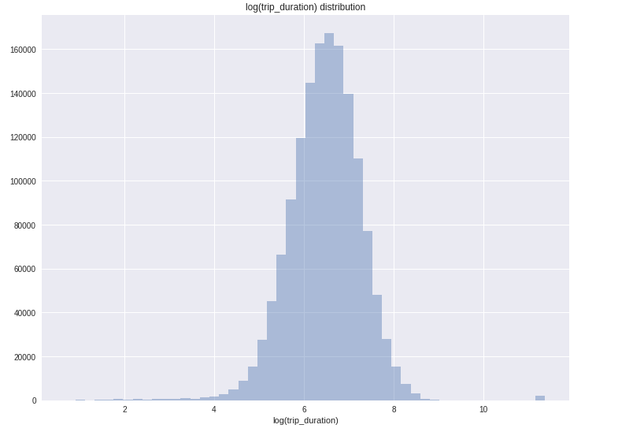
Trip Duration
Count of Trip Duration
Most Taxi trips in NYC are between 600-800 seconds long or 10-13 minutes.

Slide 5
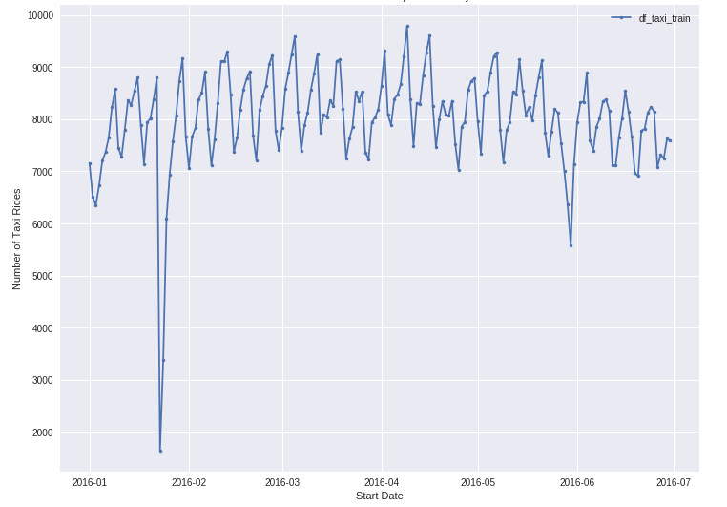
Number of Taxi Rides
Number of Taxi Rides Per Day
Daily taxi trips range between 6.5K-9.5K per day.
In addition, there is a regular seasonality to the data as the number of taxi rides lower on the weekends.
Outliers in the data can be attributed to bad weather days.
The large dip in early 2016 can be attributed to the “snowpacalypse” when weather was extremely cold and hard to traverse in a car.

Slide 6
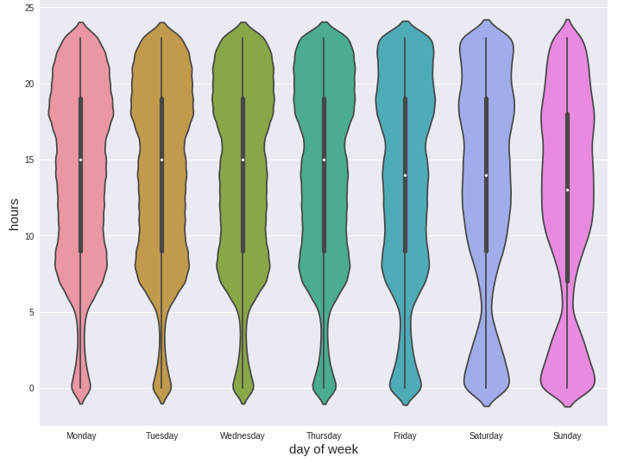
Number of Taxi Rides
Counts or Rides per Day by Hour
The seasonality of the trend is shown even further as we see most rides occur between 5pm-10pm Monday-Thursday but then shift to the early morning on Saturday and Sunday as people return from bars.

Slide 7
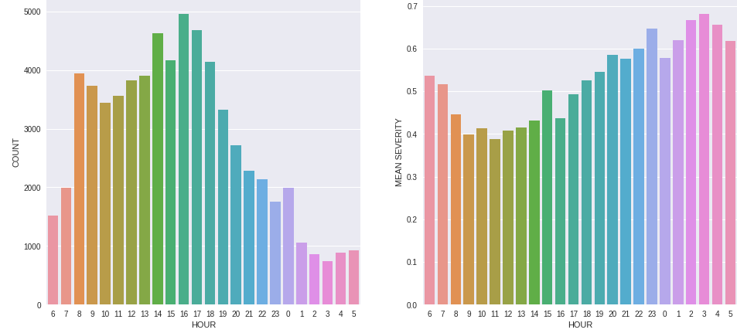
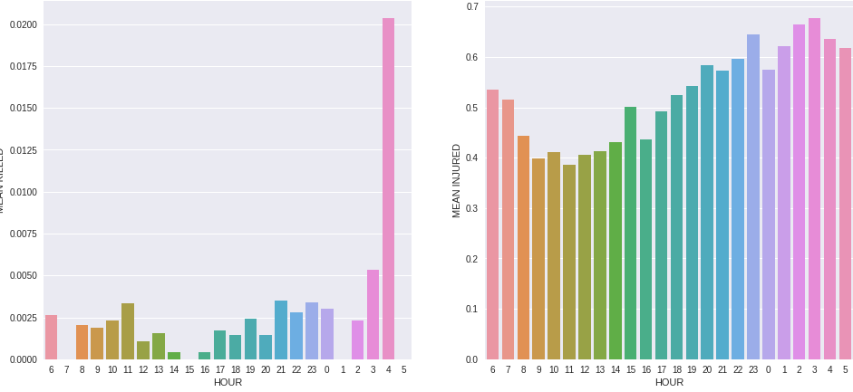
Accidents
Accidents per Hour
Severity of Accidents per Hour
Most accidents in NYC tend to occur in at rush hour in the morning between 8am and 9am as well as in the evening from 4pm-6pm as more drivers are on the road.
However, the severity of accidents and the likelihood to get into a potentially fatal accident occurs in the early morning hours between 1am- 5am.
Fatality per Hour
Injury per Hour

Slide 8
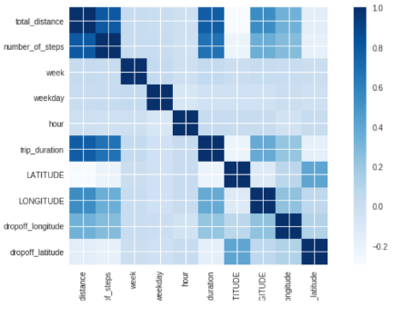
Correlation
Correlation Analysis
In running a correlation analysis we found, not surprisingly that:
Total distance is related to duration.
The number of steps it takes to complete a trip affects both distance and total duration.
Surprisingly, we also found that collisions are not strongly correlated to longer duration time.

Slide 9
Model
Model | Accuracy | Runtime
Linear Model (Collisions) | 1% | 15s
Linear Model (OSRM) | 61.5% | 60s
Random Forrest (OSRM) (estimator 20, max depth 80) | 79.8% | 165s
Random Forrest (OSRM) (estimator 100, max depth 60) | 80.35% | 882s
In running a linear model on collisions data we found the variable to be non-influential in predicting duration.
However, when we ran the linear model with OSRM data we saw accuracy increase by 61X's.
In addition, when we ran the OSRM data through a random forest model we saw accuracy increase by another 30%

Slide 10
Conclusion & Next Steps
Conclusion
Based on the models and the correlation matrix the number of stops and the route a taxi takes are the most important factors in determining the duration of taxi ride.
In addition, surprisingly, collision data is not a significant factor in affecting taxi duration.
To maximize the efficiency of taking a taxi, consider taking a taxi on the weekend between the hours and 5am and 9am and consider planning the route you want to take from point a to point b. In addition, try avoiding having others get in the taxi cab and going over bridges.
Next Steps
We only touched the surface of the ORSM data set. We would like to further explore some of the variables within the data set such as turn ratio to see if it is correlated to path route duration.

Slide 11

Thank you

Slide 12
Appendix

Slide 13
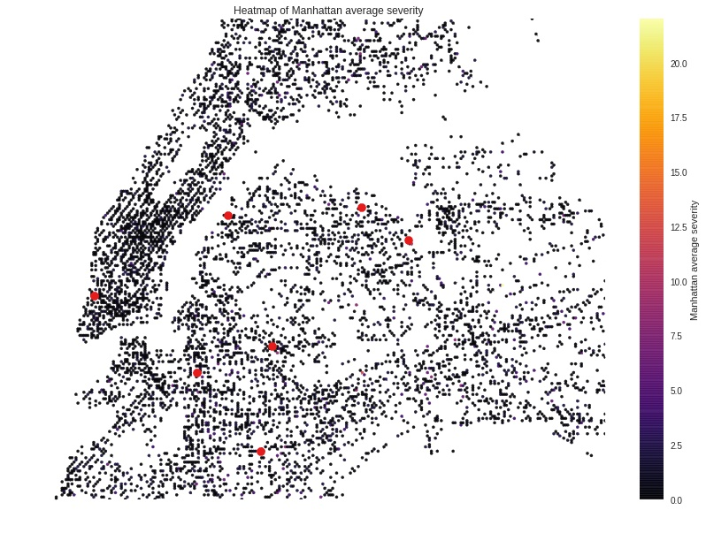
MAP
Higher severity accidents tend to occur at the junction to bridges and tunnels going to Manhattan.

