Slide 1

WIPRO NGA Program – LSP Batch
Capstone Project Presentation – 27-August-2024
Project Title Here – Wellness Management Program
Presented by - IWAM (Group-1)
www.rpsconsulting.in

Slide 2

Welcome
To
Wellness Management appointment booking
2024 - RPS Consulting all rights reserved

Slide 3
About Project
The Wellness Management Appointment Booking system is designed to streamline the process of booking and managing wellness-related appointments, such as fitness sessions, Yoga, therapy appointments, and health consultations. This application provides users with a convenient platform to register, log in, book appointments, and manage their bookings.

Slide 4
Project Details
1. We are making Wellness management System .In this project we are making log in system and registration system .After Successful login we can book the appointments and make the changes of appointment
2. As a new user we are required to sign up into the website in order to set up our account for booking the appointment.
3. If we are an existing user or if the account is already registered, we can move further in booking our appointment.
4. In order to book our appointment we will be required to choose the service, date and the timing of our choice in order to book the appointment.
5. After the appointment is booked the user will get the message that the appointment has been booked successfully.
6. The user will be then able to see the appointment or list of appointments they have booked and they will be able to update or delete the appointment as per their wish.
The user can navigate to the home page after that.

Slide 5
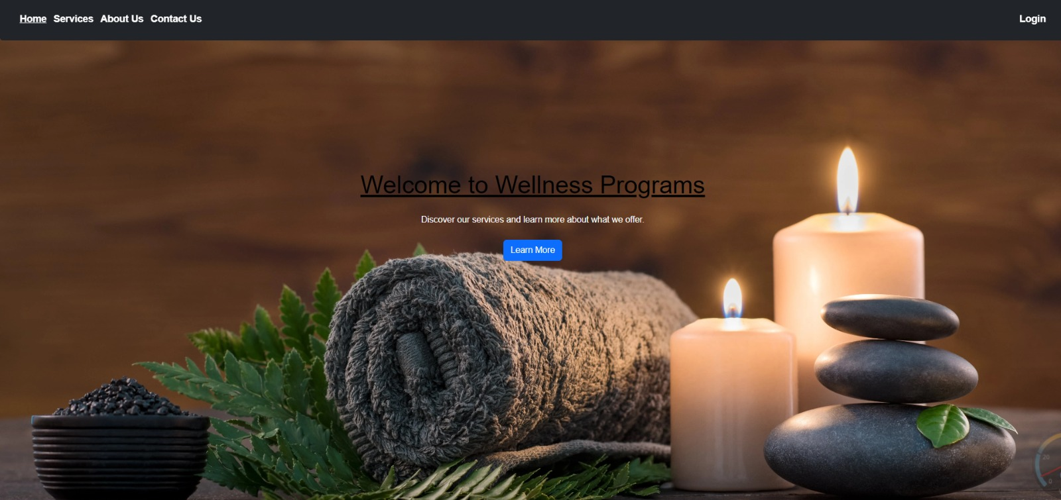
Home Page

Slide 6
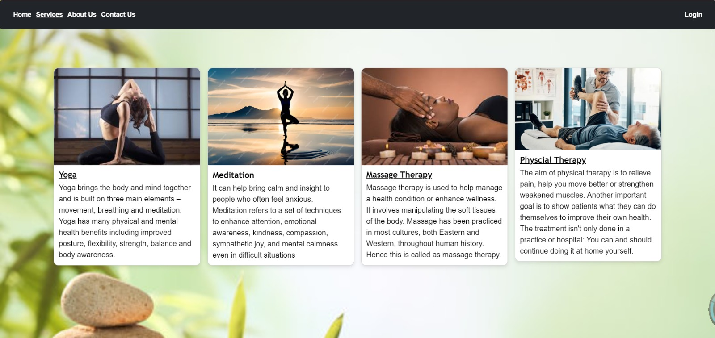
Service Page

Slide 7
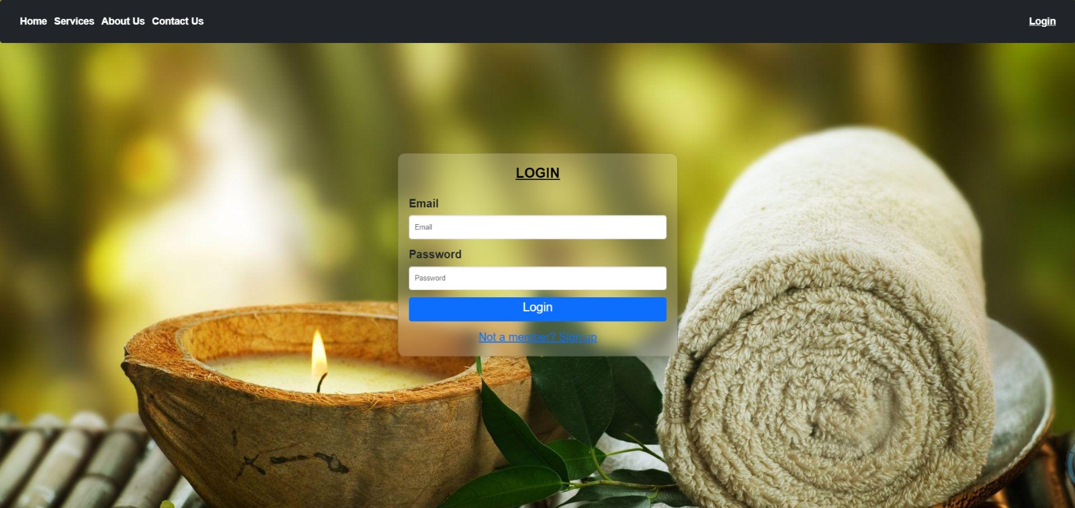
Login Page

Slide 8
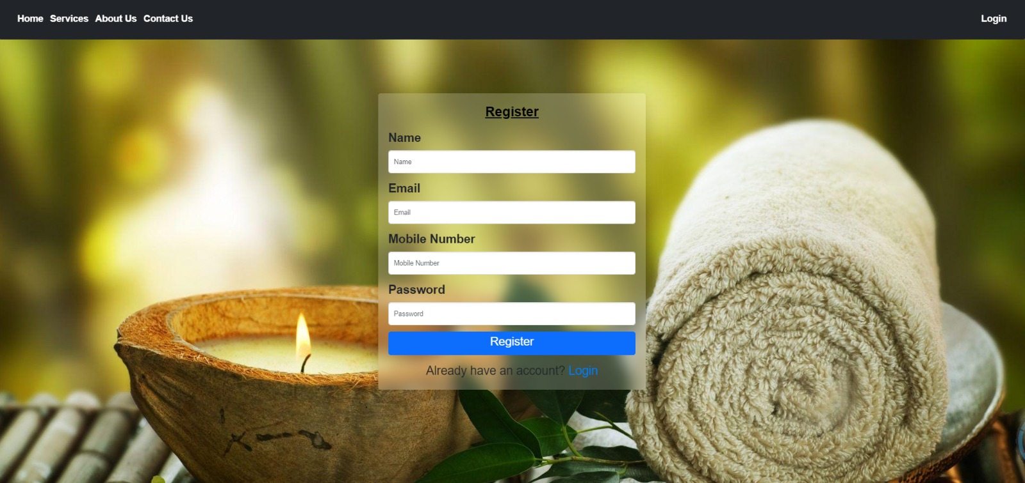
Register Page

Slide 9
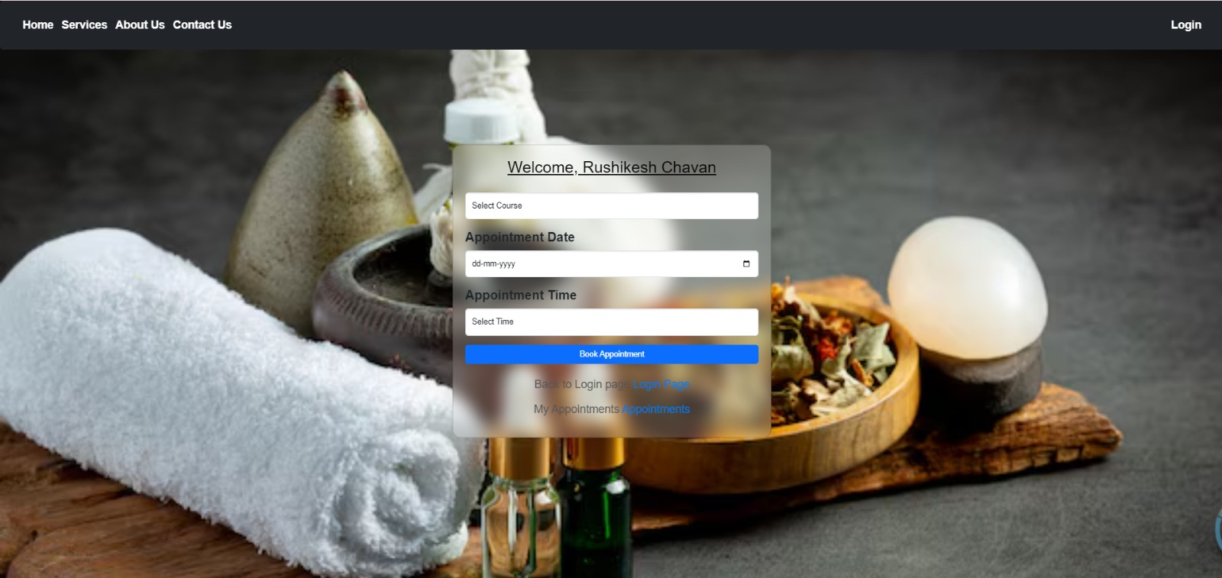
Appointment Page

Slide 10
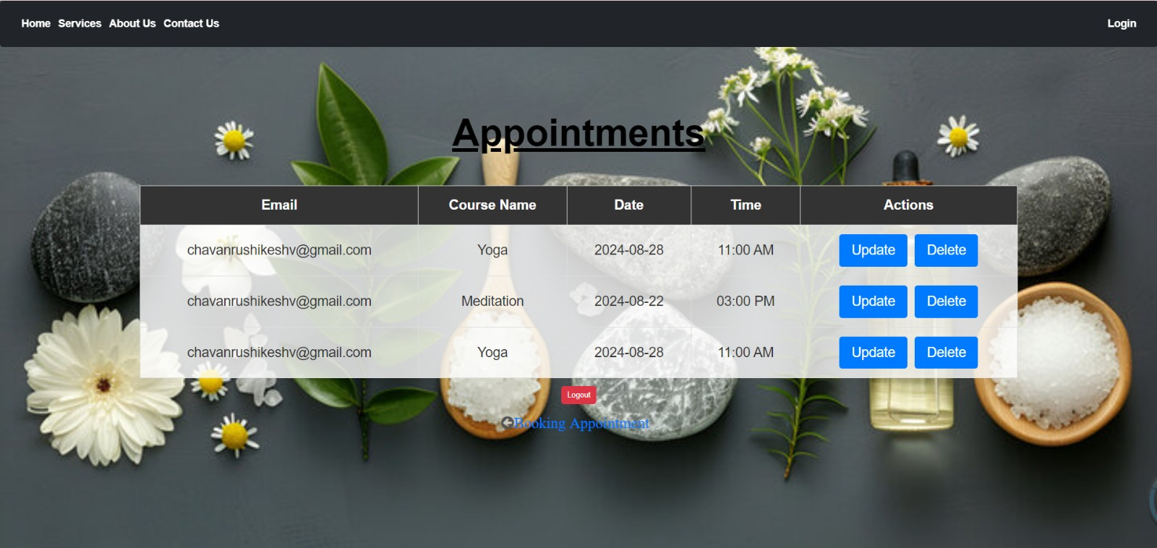
Appointments Details

Slide 11
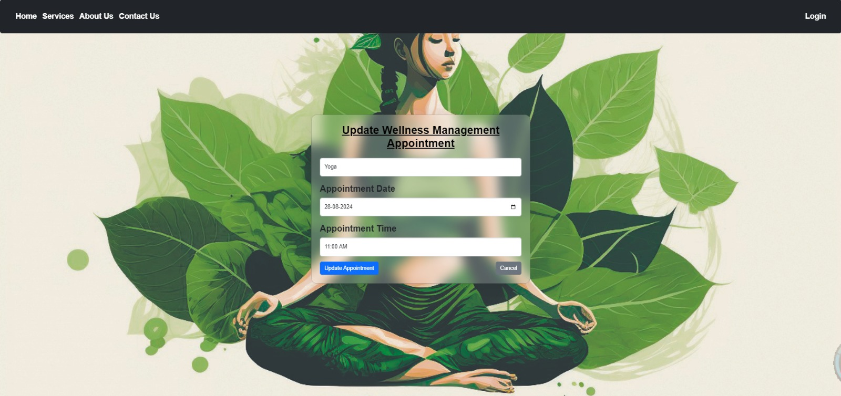
Update Appointment

Slide 12
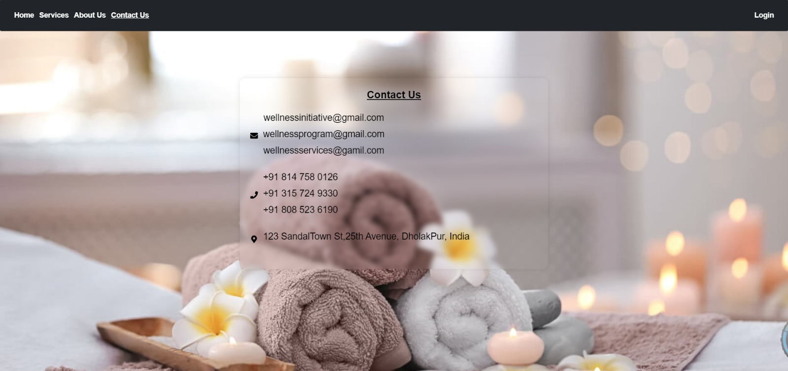
Contact US

Slide 13
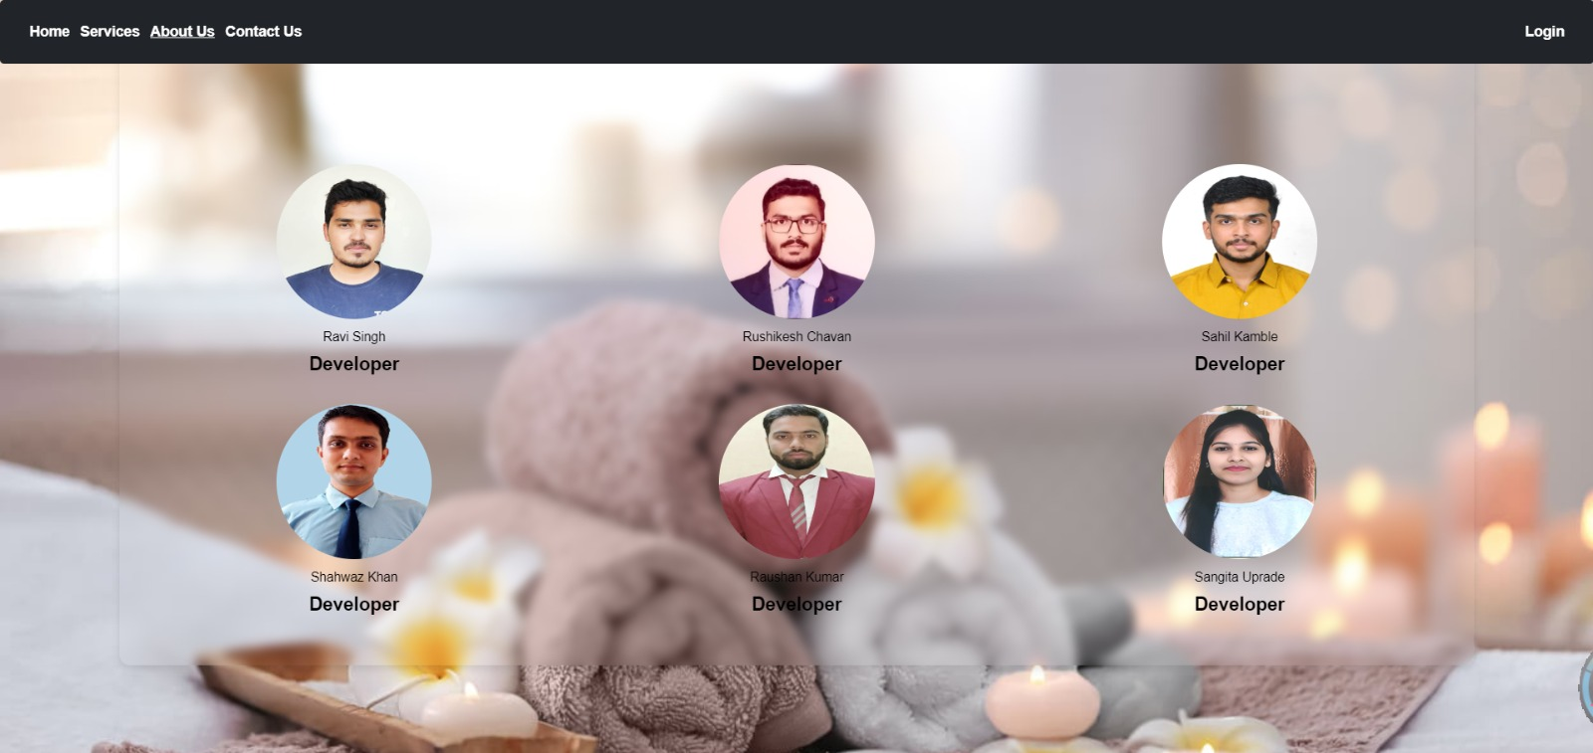
About Us

Slide 14
Technical Data
Frontend Technologies:
1.React
2.Bootstrap
Backend Technologies:
1.Core Java Concept
2.Springboot
3.Spring JPA
Database:
MYSQL

Slide 15
Teams
Ravi Prakash Singh
Rushikesh Chavan
Sahil Kamble
Shahwaz Khan
Raushan Kumar
Sangita Yograj Uprade

Slide 16
References
React :- https://www.w3schools.com/REACT/DEFAULT.ASP
Spring Boot :- https://spring.io/projects/spring-boot
Spring JPA :- https://spring.io/projects/spring-data-jpa
MYSQL/DB :- https://www.w3schools.com/MySQL/default.asp

Slide 17
Thank
You

