Slide 1

AWS Inspector
Automated Security Assessment Service
Small agent deployed to your EC2 instance
automatically assesses applications for vulnerabilities or deviations from best practices
software that was installed through the package manager is assessed for vulnerabilities
assessment produces a detailed list of security findings prioritized by level of severity
findings can be reviewed directly or as part of detailed assessment reports (from console or API)
Deep Security and AWS Inspector
Automated Mitigation
Run ds-findings.py against assessment findings
-- mitigate flag will automatically apply required IPS rule associated with remotely exploitable CVE finding
can easily be integrated in to lambda and other devops workflows/pipelines
https://github.com/deep-security/amazon-inspector

Slide 2

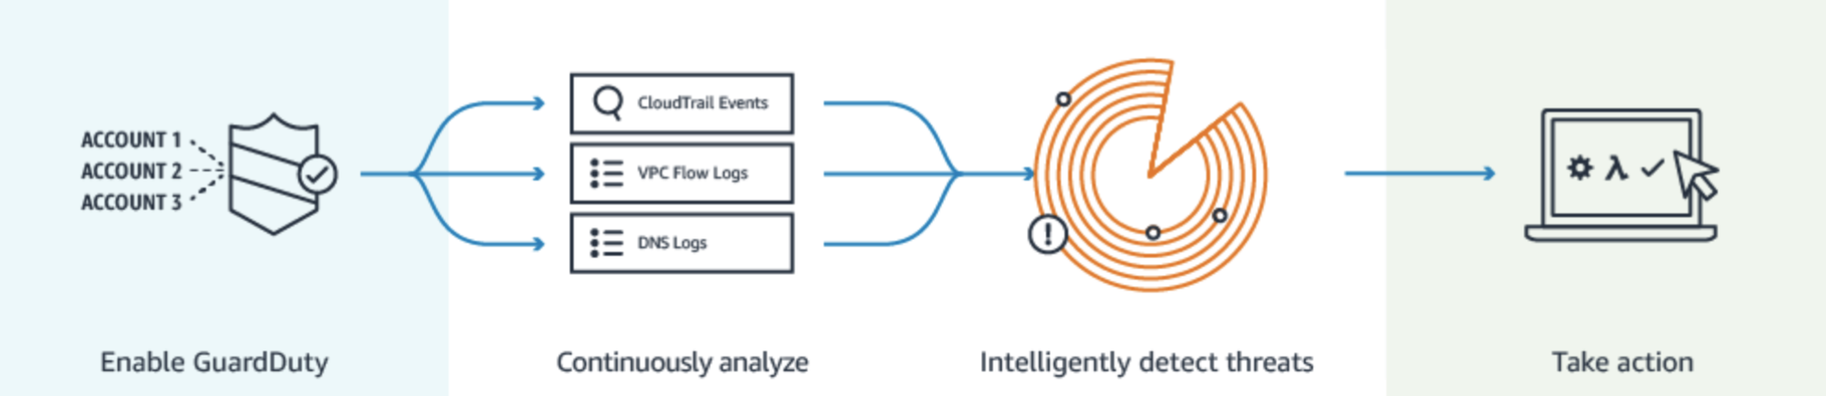
AWS GuardDuty
Cloud Scale Managed Threat Detection Service
aims to provide actionable threat intelligence for your AWS account and EC2 instances.
analyzes CloudTrail, DNS, and VPC Flow Log data to look for issues such as inbound port scans, possible backdoor access to your systems, unauthorized use of your account, and many other potential problems.
If GuardDuty determines there is an issue a finding is generated
findings can be found in the GuardDuty Management Console and can be sent to Amazon CloudWatch as an event.

Slide 3
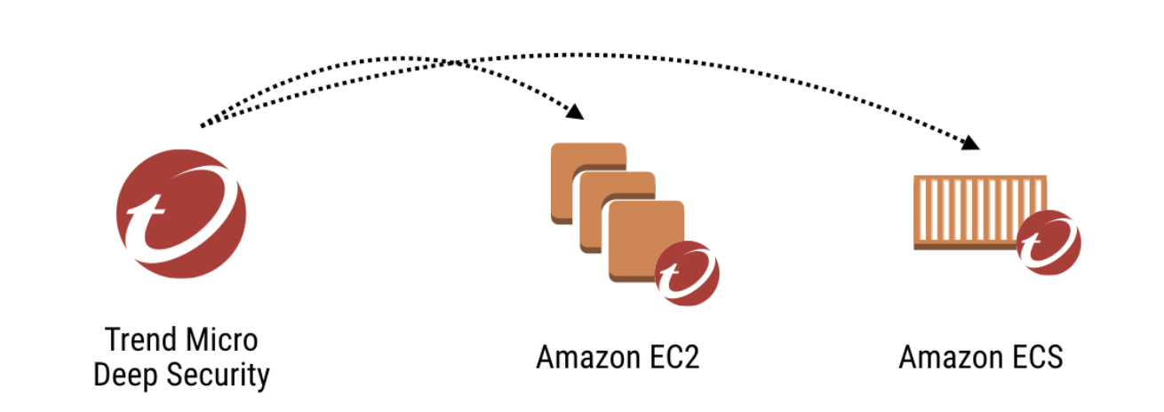
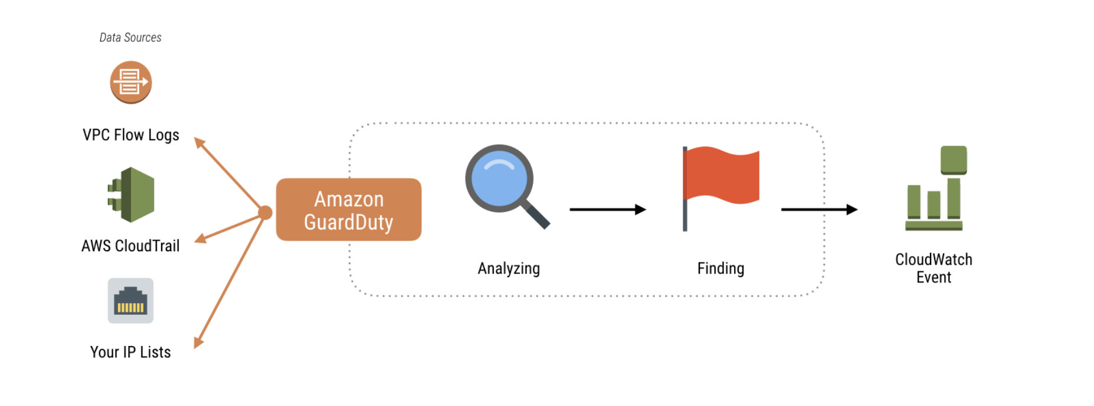
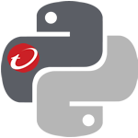

Deep Security and AWS GuardDuty
Integration Example
Malicious IP added to block list
DS Python SDK
Lambda
function

