Slide 1
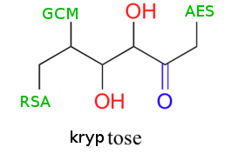
Kryptose™
“Simple & Secure”
Alexander Guziel (asg252)
Antonio Marcedone (am2623)
Jeff Tian (yt336)
Jonathan Shi (js2845)

Slide 2

Our mission…. (System purpose)
Memorizing different and high entropy passwords enhances security but it is hard
As a result, users often choose weak passwords

Slide 3

Our mission…. (System purpose)
Memorizing different and high entropy passwords enhances security but it is hard
As a result, users often choose weak passwords
Our system solves the problem, by securely storing all these passwords online
Users need to remember only one Master Password

Slide 4

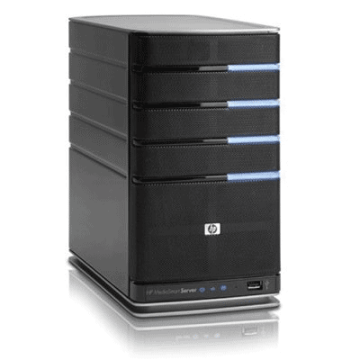


Threat model
Server access
threats
Communication
threats
User/Client
Safe Zone
Server

Slide 5

Security Goals
Nobody except the user itself (not even Kryptose™‘s sys admin) should be able to learn or tamper with a user’s sensitive credentials.
The system shall prevent other principals from modifying the user’s master password or from deleting the accounts.
A user’s Master Password should not be disclosed to any principal
The server logs should be readable and modifiable only by the system administrator

Slide 6


One password to rule them all
Master Username
User-specific
Salt
Authentication Key
PBKDF2
PBKDF2
Master Password
Encryption Key
*/x#$>daWj8+4jgh90”83;4;fd5uu~t3wfj:fiig^&’u438u
Sensitive Credentials
AES-GCM

Slide 7

Other features
We use TLS1.2 with perfect forward secrecy.
The client authenticates the server with a Certificate by our own CA (no hostname verification, but we only sign certificates for ourselves).
The server collects Tamperproof Logs
Encryption using AES in GCM mode.
Reference Monitor

Slide 8

Testing
Junit tests for the cryptographic functionalities and the reference monitor ( >70% coverage, with manual inspection of the missing parts)
Integration and unusual context testing for the SSL communication code (weak SSL versions are not accepted, certificates are actually checked, we only accept our own certificates and exclude the trust anchors from the OS store)
Extensive usage testing for the rest of the code and program logic

Slide 9
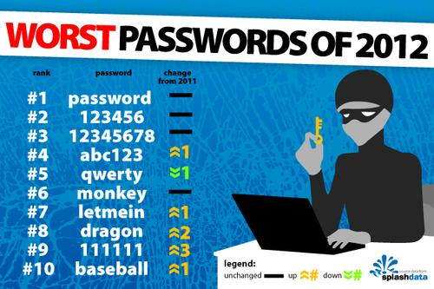
Limitations….

Slide 10

Technical Limitations….
Java DOES NOT guarantee to clear memory.
No CRL check during SSL communication
No hostname validation (not a problem)
PBKDF2 is (slightly) vulnerable to attacks with specialized hardware (a new standard is on its way)
No offline functionality
No protection against attacks to Availability
Server logs can leak access patterns and usage habits to a malicious sys admin

Slide 11
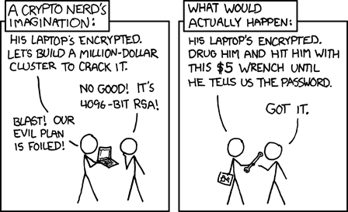
More Limitations…..

Slide 12
Security Elements
Authentication: The use of an authentication key (derived from a Master Password only known to the user) ensures that only the intended principals can access their own credentials. Logs are protected by a key known to the administrator and not stored in the system.
Authorization: A reference monitor (UserTable.java) analyzes all requests before they are handled to guarantee.
Audit: Tamperproof server logs contain all the requests received by the server, with data on the principals making those requests.
Confidentiality/Integrity : Stored credentials are encrypted and can only be read by the user.

Slide 13
Thanks!

