Slide 1
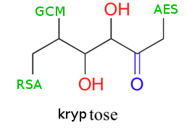
Kryptose™
“Simple & Secure”
Alexander Guziel (asg252)
Antonio Marcedone (am2623)
Jeff Tian (yt336)
Jonathan Shi (js2845)

Slide 2
What we should cover (delete later)
Your team personnel.
Your system's purpose.
Your threat analysis.
Your most important security goals.
The design of the security of your system, including any trade-offs you made and any shortcomings you're aware of in your final system.
How your project incorporates each of the essential security elements.

Slide 3
Meet the team…
Antonio
Interface with Cryptographic libraries
Junit and integration testing

Slide 4
Your system's purpose

Slide 5
Your threat analysis

Slide 6

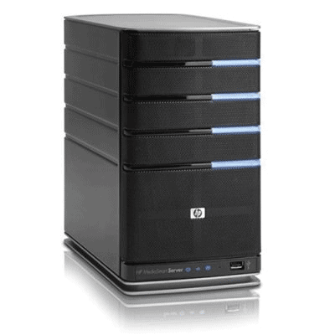


Threat model
Dolev-Yao
Network Adversary
User/Client
Safe Zone
Server

Slide 7
Your most important security goals.

Slide 8
The design of the security of your system, including any trade-offs you made and any shortcomings you're aware of in your final system.

Slide 9

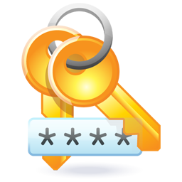

One password for encryption and authorization
PBKDF2
Master Password

Slide 10
How your project incorporates each of the essential security elements.

Slide 11
Thanks!

