Slide 1
AGRICULTURAL CLIMATE
RISK ASSESSMENT
Evidence-based climate risk analysis for six Kenyan agricultural regions, 2015–2024
Prepared for the Ministry of Agriculture and Livestock Development
MIT 8334 Data Analytics & Visualization · Capstone Presentation · Group 4

Slide 2
OVERVIEW
What we'll cover
01
The brief
Client, task, and the six questions we were asked to answer
02
Data & method
Open-Meteo API, 6 regions, 10 years, cleaning & QA
03
Statistical analysis
Trend regression, ANOVA, correlation
04
Findings
Which regions carry the most climate risk, and why
05
Recommendations
What the Ministry should do next
Group 4 · Agricultural Climate Risk Assessment
2

Slide 3
THE BRIEF
Six regions, one climate-risk question
Client
Ministry of Agriculture and
Livestock Development
The six questions we set out to answer
Which region receives the most reliable seasonal rainfall?
Data source
Which region has the longest / most frequent dry spells?
Open-Meteo Historical
Weather API, 2015–2024
Which locations see the most heat-stress days (>30°C)?
Regions
How do long-rains vs. short-rains patterns differ?
Trans Nzoia · Uasin Gishu
Meru · Narok · Nyeri · Machakos
Which regions carry the highest climate production risk?
What climate-smart interventions should follow?
Group 4 · Agricultural Climate Risk Assessment
3

Slide 4
METHODOLOGY
From raw API data to evidence
01
02
03
Retrieve
Assess quality
Clean
One Open-Meteo /v1/archive call per region — 7 daily variables, 3,652 days each
Missing values, duplicates, 3×IQR outliers, calendar completeness, logic checks
De-duplication, linear interpolation, derived season & heat-stress-day fields
04
05
06
Analyze
Visualize
Deploy
Linear regression trend test, one-way ANOVA, Pearson correlation
6 charts covering temperature trend, rainfall reliability, seasonality, and heat/drought risk
Interactive Streamlit dashboard with filters, map, and drill-down
Group 4 · Agricultural Climate Risk Assessment
4

Slide 5
DATA QUALITY ASSESSMENT
A clean foundation for the analysis
>99.7%
0
<0.5%
3×IQR
Calendar completeness across all six regions
Rows failing the temp-max ≥ temp-min logic check after cleaning
Missing values, resolved by within-region linear interpolation
Outlier rule used — wide enough to keep real weather extremes
Cleaning steps applied
De-duplicated (date, region) records
Linear interpolation for missing temperature & precipitation readings
Derived fields: year, month, day-of-year, rainfall season, heat-stress-day flag
Group 4 · Agricultural Climate Risk Assessment
5

Slide 6
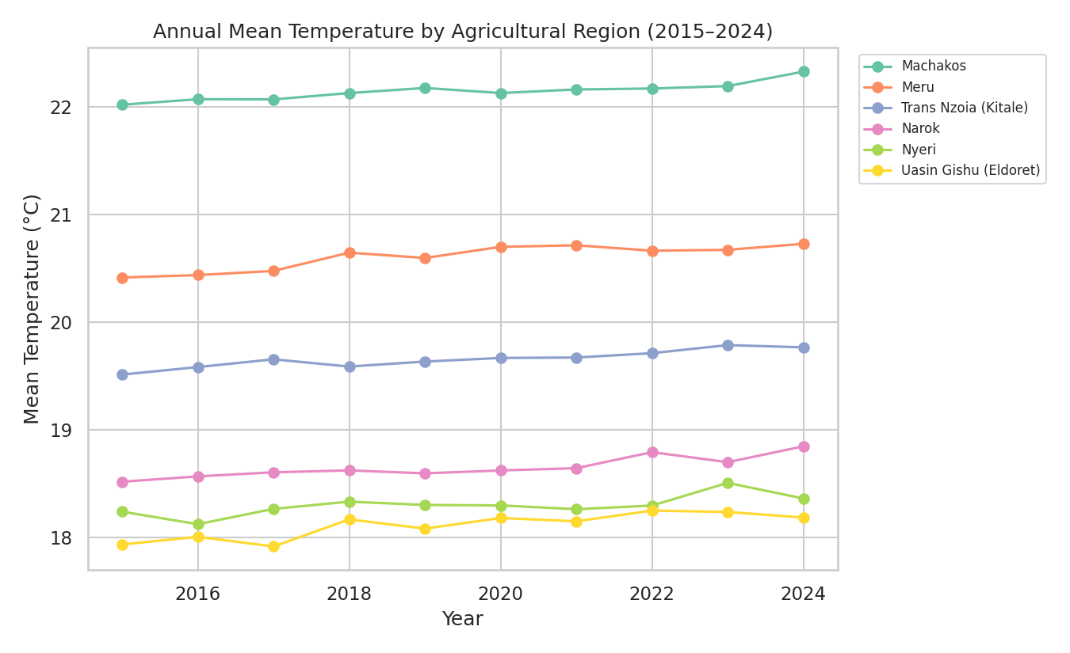
FINDING 1 · WARMING TREND
All six regions are warming — some faster than others
Fastest warming
Meru
+0.0345°C / year
(p = 0.0007, statistically significant)
Linear regression confirms a statistically significant (p < 0.05) warming trend in every one of the six regions over 2015–2024 — this is a structural shift, not noise.
Group 4 · Agricultural Climate Risk Assessment
6

Slide 7
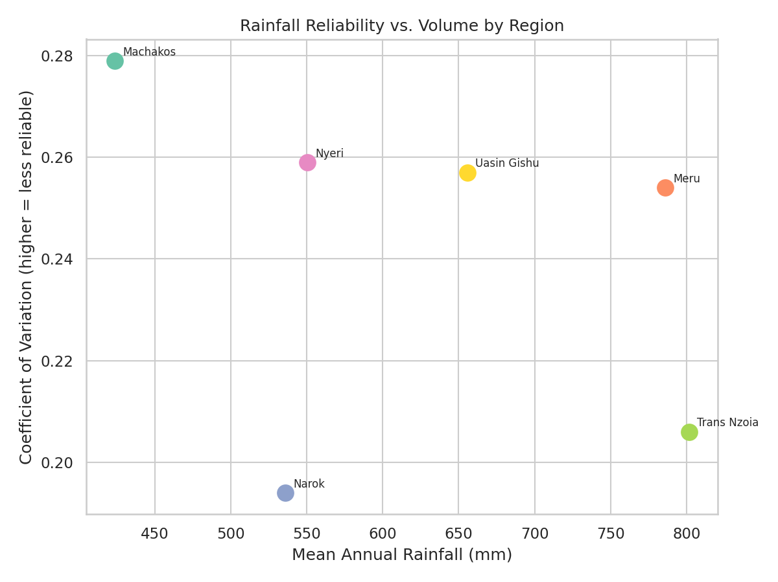
FINDING 2 · RAINFALL RELIABILITY
Volume and reliability are two different risks
Most reliable
Narok · CV 0.194
535.7 mm mean annual rainfall
Least reliable
Machakos · CV 0.279
423.6 mm mean annual rainfall — highest year-to-year risk
Group 4 · Agricultural Climate Risk Assessment
7

Slide 8
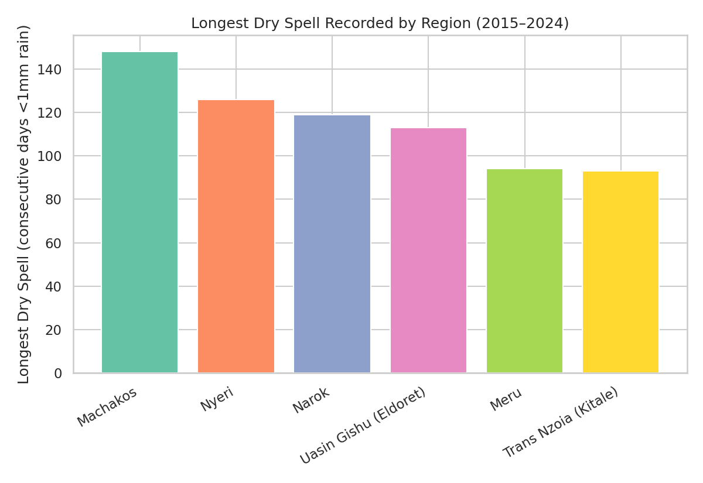
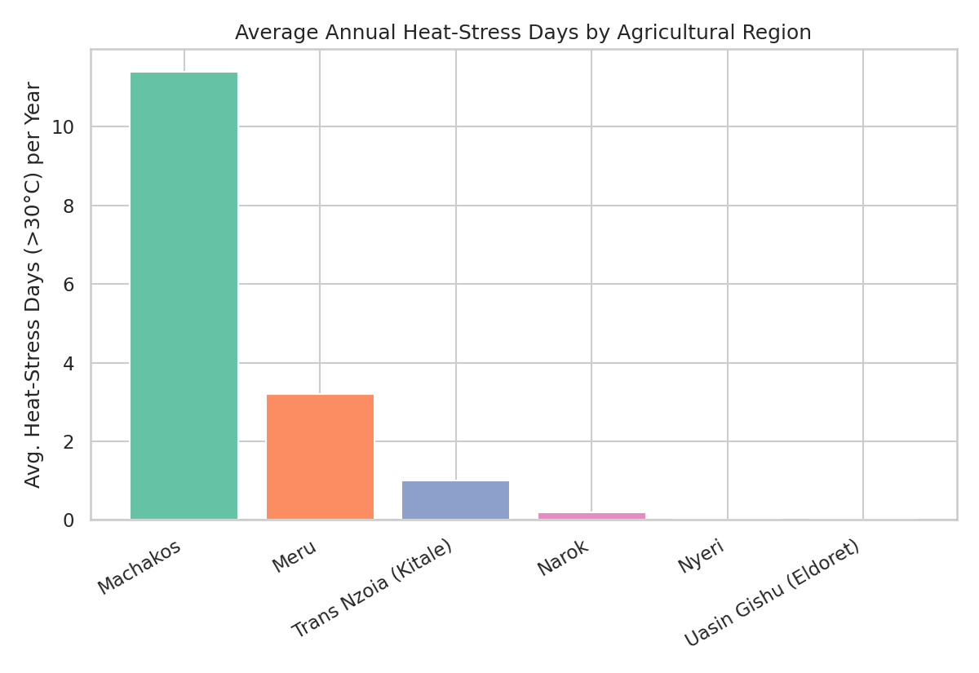
FINDING 3 · DROUGHT & HEAT RISK
Dry-spell duration and heat-stress days
Group 4 · Agricultural Climate Risk Assessment
8

Slide 9
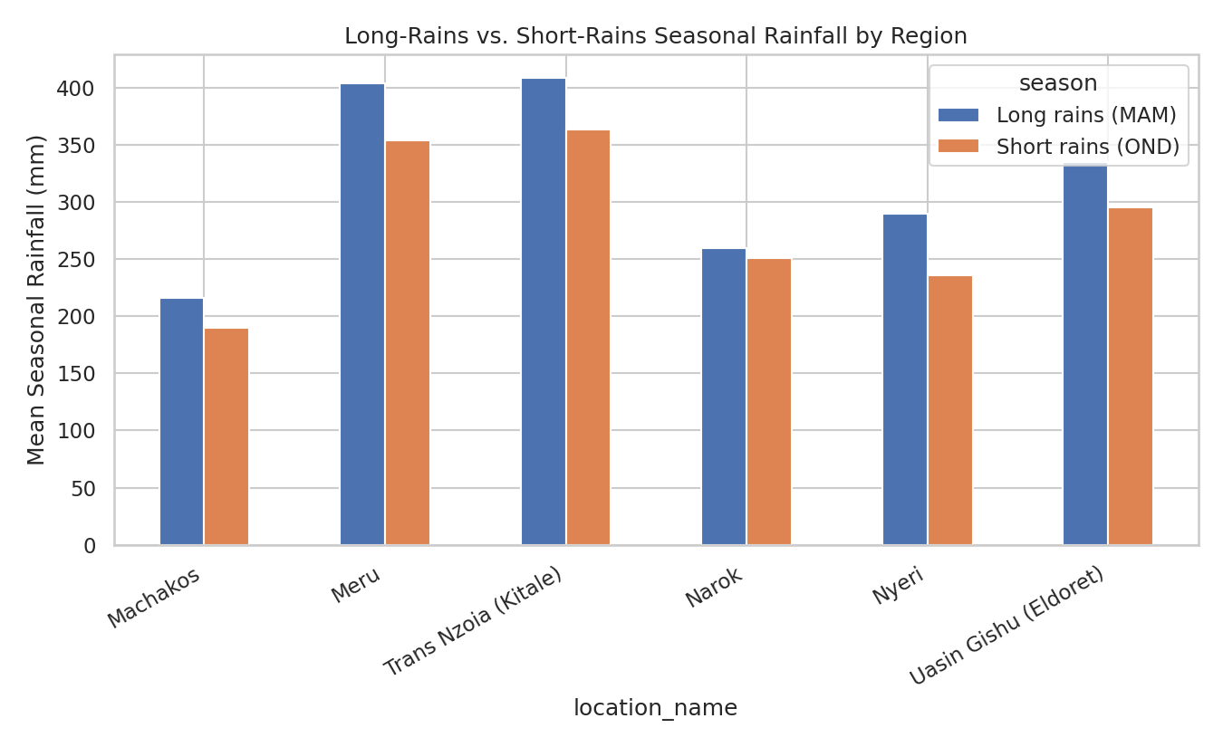
FINDING 4 · SEASONALITY
Long rains vs. short rains — and is the difference real?
One-way ANOVA
F = 777.24
p = 0.000000
Rainfall differs significantly across the four seasonal windows (p < 0.05) — confirming Kenya's bimodal rainfall pattern statistically, not just visually. Regions with the largest MAM/OND gap carry more single-season dependency risk.
Group 4 · Agricultural Climate Risk Assessment
9

Slide 10
RECOMMENDATIONS
What the Ministry should do next
1
Drought-tolerant seed rollout
2
Small-scale irrigation investment
Target regions with the longest dry spells and highest rainfall CV ahead of long-rains planting.
Water-harvesting infrastructure in the least rainfall-reliable region, sized to the measured dry-spell length.
3
Heat-tolerant interventions
4
Diversify planting calendars
Livestock and crop-shading measures where heat-stress days are highest.
Reduce single-season dependency where the MAM/OND rainfall gap is largest.
5
Live early-warning dashboard
6
Prioritise compound-risk regions first
Re-run this same Open-Meteo pipeline monthly to track trends in near-real time.
Fund regions scoring worst on multiple indicators, not just one, in the first investment wave.
Group 4 · Agricultural Climate Risk Assessment
10

Slide 11
Thank you
Questions & oral defence
Data · Notebook · Dashboard · GitHub repository available on request
Group 4 · Agricultural Climate Risk Assessment
11

