Slide 1
DoD XML Management
Dr. Glenda Hayes, MITRE
ghayes@mitre.org
Open Forum on Metadata Registries – January 23, 2003

Slide 2
Agenda
Background
Market-Driven Data Strategy
  Visibility
  Coordination
  Guidance
Revised DoD Data Strategy
Improve Interoperability While Reducing Development Time and Cost

Slide 3
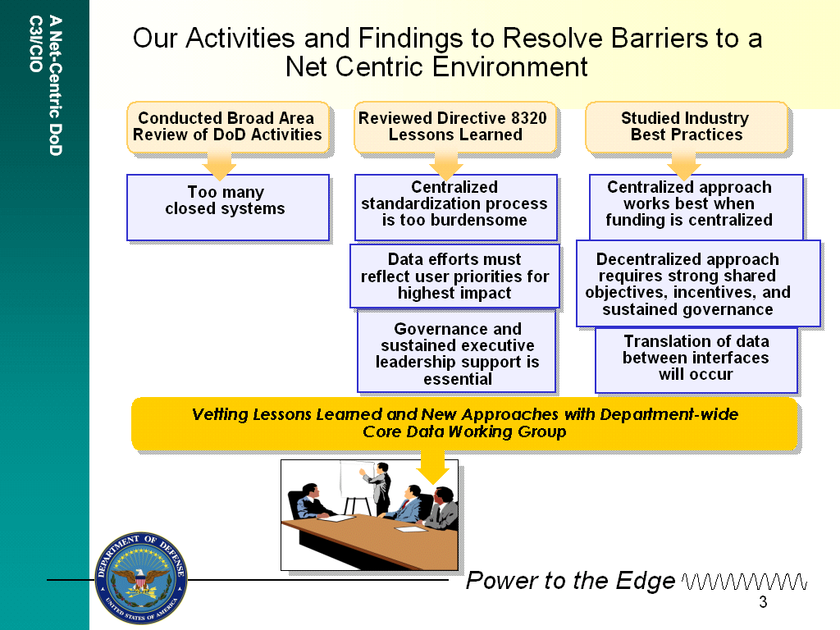
Theory v. Practice

Slide 4
Management Options
Contrasting Styles
What will work for the DoD?
TIGHT
DoD has:
C2
Intelligence
Finance
Personnel
Weather
Geospatial
Transportation
Records Mgmt
Training
Security
Legal
Medical
Veterans
Postal
And more…
Top-down, “Command”
versus
“Market”
SPECTRUM OF CONTROL
Recommended Approach:
Market with Some Controls
LOOSE
Notes:
This is the key question that XML forced us to grapple with. Exactly what kind of management are we talking about? XML is typical of new information technologies. Powerful, easy to implement, highly volatile, even chaotic, and rapidly expanding into a wide variety of domains with very little in the way of autocratic guidance.
Well . . . Remember the Communists? What do you get when you try and drive a complex adaptive system such as a national economy with a Top Down, Command approach?? Among other things, you get a GREAT BIG BUREAUCRACY. Lots of policy-makers, middle managers, and low level checkers. And most often it’s rigid, unresponsive, slow to adapt . . . in a word: INEFFECTIVE.
Well, today’s information systems environment is VERY big, diverse and complex, with many many players, government and commercial, and many-to-many relationships, and it’s certainly NOT under anyone’s control (NOT EVEN Microsoft’s!!). What we have is BOTH an increasing demand for and an evolving supply of information products or services surging around in one of the hottest markets ever known! In situations like this, you not only CAN use market forces to do some managing. You’ve GOT to!
And of course we all learned in History 101 that there ARE significant hazards with TOTAL unconstrained “laissez-faire” capitalism, SO our Publish&Subscribe marketplace needs some rules, some controls, a staff of referees, maybe a light weight board of governors here and there.

Slide 5
Key Management Mechanism
Developers and Warriors
Asking for Help!!
What data is available?
Which data is better?
Who has it?
How do I get it?
  Market Visibility & Accessibility
Notes:
Now we can’t harness market forces without implementing some key mechanisms. The kinds of questions we’re getting from a new generation of Developers and Warrior-customers are giving us some BIG clues about what is required.
Today’s developers and warriors recognize that there is a tremendous volume and variety of data resources being hooked up to our networks, and they are asking for guidance. Asking for someone and/or something to answer these kinds of questions for them. What information resources are on a given network? What specific data can they provide? Which ones are authoritative? What is the technical nature of these resources? How can I connect to them? How can they be hooked together to fuse data?
To answer those questions, the first thing we need to do for BOTH developers and warriors is make easily visible and accessible a selection of important metadata. Not just once, but on an ongoing basis. Everything from URLs to general product or service descriptions to specific APIs and other “in-use” vocabularies have to be dynamically exposed in some consistent manner in some consistent, probably “virtual” place.
Here, I want you to take away one of our most basic principles. Any market-driven management approach has a fundamental prerequisite: Visibility! You can’t manage what you can’t see. You can’t use something if you don’t know it exists. To the extent that this metadata service actually HELPS developers and warriors by answering their data exchange requirements, by reducing risk, cost and schedule, they’ll buy into using it.

Slide 6
Data Management Requirements
Minimum:
  “Available” Data must be made visible* and accessible
Then:
  Avoid Conflicting Data. Ensure uniqueness (at least!)
  Facilitate Data component re-use (Interoperability and savings)
  Publish relationships
  Provide for open, participatory Community Data configuration control
  Achieve convergence where possible
  *”You can’t manage what you can’t see!”

Slide 7
Visibility

Slide 8
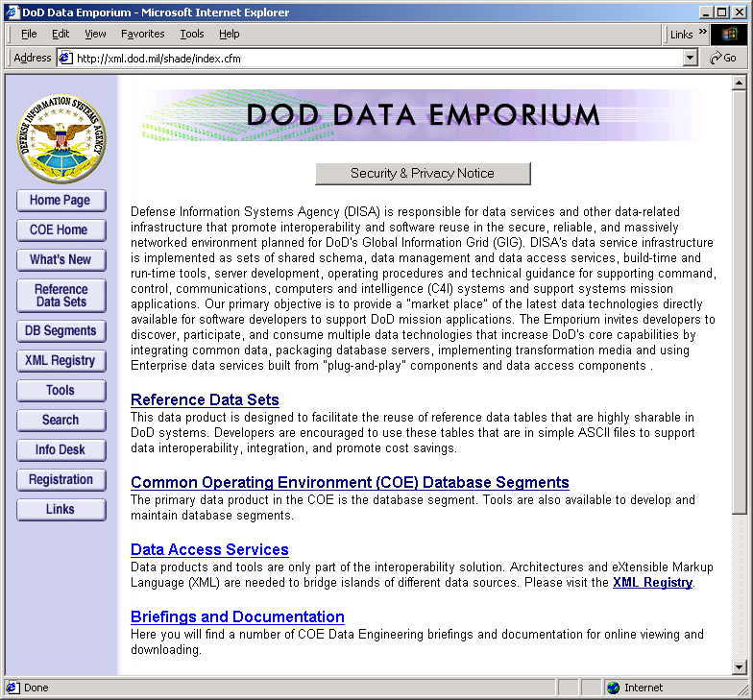
DoD Data Emporium
Build Time Metadata Discovery Service
http://xml.dod.mil
“One Stop” Publish & Subscribe for:
  Build Time Metadata Registration
  Re-usable Data Components
  Information Community Management
Vending:
  Database Segments
  Reference Sets
  Transformations
  XML
  Data Tools
  More Products soon (e.g., ontologies, translations)
Web-based!
  Purpose: visibility and re-use, not standardization through mandate!
Notes:
Now here’s our metadata registry supporting a Discovery Service for user-developers and program overseers – “one-stop shopping” for all your Build-Time metadata needs. Our XML Registry is one part, one “gallery” of this Data Emporium. Other parts of the Data Emporium are:
Reference data sets (the data structure for frequently used indexes and codes like country code packaged WITH valid values)
Data base segments (Pre-packaged for easy installation relational database schema also with valid values where available)
Again, the purpose of the Emporium is mainly to register “in use” data in various forms, SQL, UML, XML, and to provide an easy way for developers to download data components for re-use. We accept that there are inconsistencies and overlaps. The important thing is to get these “commodities” into a market and see who’s “buying” what.
Parenthetically, we’re still working on the market’s ability to track activity with respect to certain data commodities, BUT I can tell you that right now, the Emporium is drawing more than 100 hits per day. Not bad for a geeky little site. I’ll show you statistics for the XML Registry later.

Slide 9
DoD XML Registry Features
IOC: 19 May 1999; Current Version: 3.1
Information Resource Visibility, Navigation, and Registration
  Search/Browse Filters for Discovery & Reuse
  On-Line Submission Processing
  Subscription Services
Context Identification
REST-based API (using http, uri, xml)
Synchronized Components on Multiple Networks
Community of Interest (COI) Registration
Multiple Feedback Mechanisms
  http://xml.dod.mil/xmlreg/user/feedback.cfm
  Public XML Venue
  Namespace Managers’ Forum
On-Line Registry Administrative Features
DoD XML Registration Policy signed by ASD(C3I) & USD(AT&L)
http://xml.dod.mil
Notes:
The DoD XML Registry provides useful information on XML basics, the mechanics of the Registry, the process of registration, and the list of approved Communities of Interest/Namespaces. The Registry provides a filtering capability to constrain the search space. The “What’s New” button alerts the developer to new and upcoming capabilities that will be available in the next release. A .pdf of the signed DoD XML Registration Policy is available there also. From the Info Desk, links are available so you can launch an email directly to DISA’s data engineering team or post a message to the NCES Data Newsgroup. This “Clearinghouse” function on the Registry is something that was directed by USD AT&L, and it has proved VERY valuable is evolving higher quality service.

Slide 10
DoD XML Registry
Supporting Discovery & Reuse of Components
Information Resources
  Document
  Domain Value Set
  XML Attribute
  XML Element
  XML Sample
  Schema
  Schema Data Type
  Stylesheet
  Source Code
Associations
  Contains
  IsNewerVersionOf
  IsConstrainedByDomain
  DescribedBy
  IsXMLSpecFor
  IsQualifiedByAttribute
  IsDerivedFrom
Nodes = Information Resources
Arcs = Associations
Example:
messages.xsd (Schema) IsXMLSpecFor air_to_air_refueling_combined_task_message (XML Element)
Notes:
XML components and their relationships to other XML components are specified in submission packages. The specific types of XML components (or nouns) are listed under the label “Information Resources.” The relationships (or verbs) are constrained to the terms listed under the label “Associations.” This noun-verb-noun structure provides the developer with a mechanism to integrate newly registered components into the larger Registry structure. The browser interface to the Registry provides navigation through this directed graph.

Slide 11
Sample of Registered
Nodes and Arcs
Legend
schema
air_to_air_refueling_combined_task_message
(element)
simpleType
element
Contains
XML
DescribedBy
IsXMLSpecFor
imagery_intelligence
(element)
air_to_air_refueling_combined_task_message.xml
(sample XML)
Contains
abbreviated_security_classification
(element)
messages.xsd
(schema)
DescribedBy
IsDerivedFrom
DescribedBy
IsConstrainedByDomain
sets.xsd
(schema)
abbreviated.security.classification.901.2
(simpleType)
DescribedBy
DescribedBy
composites.xsd
(schema)
abbreviated.security.classification.901.2
(Domain Value Set - XML)
fields.xsd
(schema)
DescribedBy

Slide 12
DoD XML Registry
“Posts” XML to every seat on the GIG
Users Discover and Pull XML they are cleared for -
Unclassified (Open)
  NIPRNET w/Internet Access
  http://xml.dod.mil/xmlreg
Unclassified (Sensitive)
  Open Registry contents plus
  “password protected” components
  NIPRNET with Internet Access
  http://xml.dod.mil/xmlreg
Secret
  Unclassified (Sensitive) content plus
  secret components
  SIPRNET
  http://diides.ncr.disa.smil.mil
Top Secret (SCI)
  Secret content plus SCI components
  JWICS
  Available Dec 02
Top Secret (SCI)
Secret
Unclassified (Sensitive)
Unclassified (Open)
Synchronized Components on Multiple Networks
XML building blocks available at every keyboard
NEW!
Notes:
As of 26 Mar 2002, the Secret instance of the DoD XML Registry has become operational. This instance was created to provide one-stop shopping for the developer working on the SIPRNET who may need access to open, sensitive, and secret components. The components that intersect multiple instances are synchronized.
The integrated Broadcast System (IBS) is the first to register their classified schema (DTD format).
We also have a strong metadata coordination effort going with the Intelligence Community (IC). They will be standing up an instance of the Emporium/Registry on JWICS before New Years. Thereafter, IC and DoD will work together to evolve Emporium capabilities . . . And ensure interoperable metadata services for both communities.

Slide 13
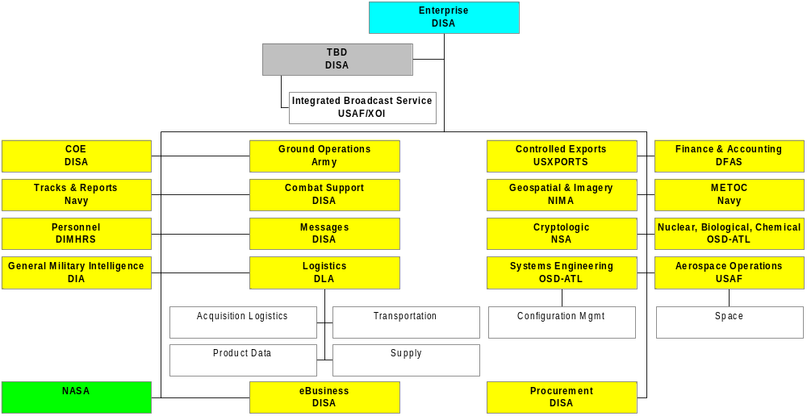

DoD XML Registry
Communities of Interest
Other Proposed
MASINT
Document
Training
Health Affairs
Formal Process to Establish New COIs

Slide 14
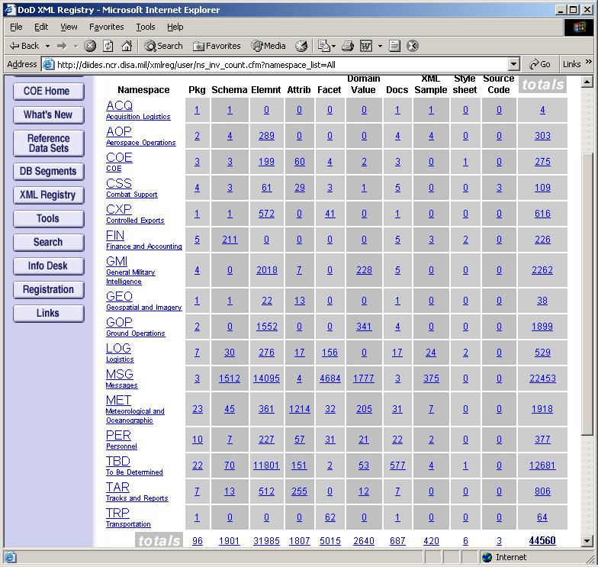
DoD XML Registry
Current Inventory
Current As of 20 Jan 2003
Includes Password-protected Components (USMTF, etc.)
Notes:
Provided on this slide is the current inventory, grouped by information resource type that were registered as of last month. You can see a great deal has happened without any serious compulsion. Today’s developers understand what this is all about and are keen to participate. Much of this has the status of “developmental,” but that’s just fine! As ASD(C3I) says, “Post before you Process.” Developers are letting each other see what they’re working on, hoping to head off divergence.

Slide 15
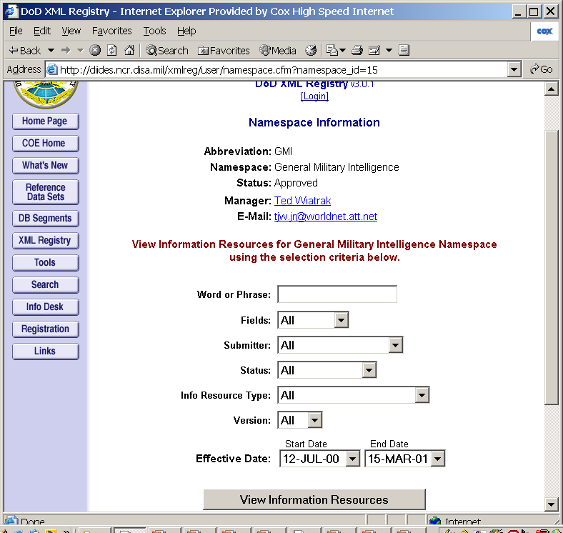
Namespace Search Filter
Name, Definition, Comment, All
Developmental,
Operational…
Submitters to this COI
Status relevant to this COI
Effective Dates in Submissions
IRs registered in this COI
Responding to Customer Feedback

Slide 16
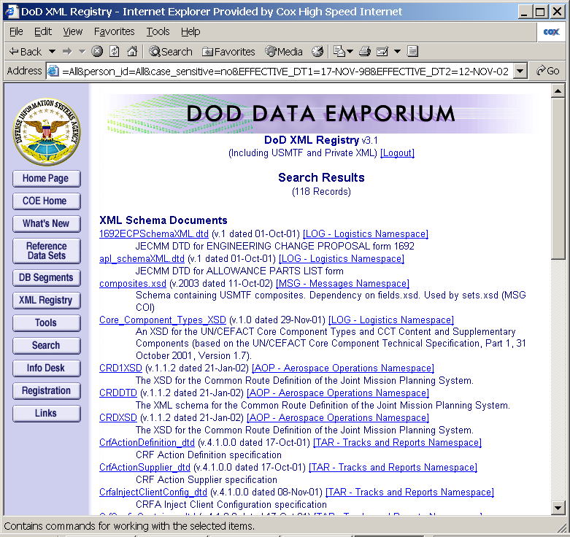
Search Results
Name
COI
Date
Version
Definition
Responding to Customer Feedback

Slide 17
DoD XML Registry’s REST-ful API
Representational State Transfer (REST)
  Web service via HTTP (Get, Post, Submit), URI, & XML
  Included as 1 of 3 WSDL v1.2 Bindings (HTTP/1.1 GET/POST)
DoD XML Registry REST-ful service
  Search
    HTTP Method: GET
    URI: described in http://xml.dod.mil/xmlreg/user/ws_rest_based_search.doc
    XML return: ws_result.xml

Slide 18
DoD XML Registry’s REST-ful API
Reference Implementations
Demo Reference Implementation
  Download N Schemas from Registry
  MS Access 2000 + MS XML Core Services Service Pack 4
  Disk Space: 1.6M (app)
  Download: 391K (zipped)
Supplementary Registry Tool
  Updateable XML Registry Snapshot
  MS Access 2000 + MS XML Core Services Service Pack 4
  Command-Line winzip (wzcline.exe)
  Disk Space: 41M (app) + 135M (file space)
  Download: 14M (zipped app)
To be available from the DoD XML Registry

Slide 19
Coordination

Slide 20
DoD XML Registry
Engineering-level Processes
DISA Engineering
Staff
COI/Namespace
Managers’ Forum
Supports
Operates,
Participate in
Maintains
Governs/Coordinates
Acts as Registry CM Board
Hosts
Namespace Managers & WGs
Namespace Managers & WGs
Namespace Managers & WGs
DoD XML Registry
Registry Ops Staff
Controls/Displays on Web
Consults & Submits
to/Downloads from XML Registry
Participates in
DATATWG
SSD-MD (Public XML Forum)
Participates in
DOD Developer

Slide 21
DISA XML Coordination
Venues
  Public XML Venue (SSD-MD)
    http://diicoe.disa.mil/coe/aog_twg/twg/ssdmd/ssd-md_page.html
  Namespace Mgrs Forum (NSMF)
    https://portal.mitre.org (Private Portal hosted by MITRE)
  Federal CIO XMLWG
    http://xml.gov
    http://xmlregistry.nist.gov/xml-gov/
  NIST Namespace Management Workshop
    http://xw2k.sdct.itl.nist.gov/namespaceWS/index.htm
Email and Newsgroup
  dataemp_support@fgm.com
  http://diides.ncr.disa.mil/shade/feedback.cfm
  news://coenews.ncr.disa.mil/coenews.data
And LOTS of Briefings…

Slide 22
Public XML Venue
Semi-Structured Data & Metadata Subpanel (SSD-MD)
Objectives
  Develop specifications and/or schema
  Select metadata standards and tools
  Evolve schema repository / visibility mechanisms / versioning management
  Provide guidance for tag terminology
  Develop “enhanced” XML editors for coded XML docs
  Develop application interpreters for XML
  Explore Reference implementations
  Keep up on X-technologies
NCES XML Coordination
Done Here!
See DOD XML Registry “Links”
Notes:
The SSD-MD is the XML technical forum for DoD, and it is where we expect to do a LOT if NCES coordination. There will a lot of other metadata technical coordination and other NCES venues for it, but this SSD-MD will continue to be VERY important for covering the XML angle.
For more information and schedule, see:
http://diicoe.disa.mil/coe/aog_twg/twg/ssdmd/ssd-md_page.html
Briefings also available at:
http://transfer.mitre.org/STF40-49/44/26044/transfer/XML/SSD_Meetings

Slide 23
DoD XML Registry Coordination
Namespace Managers Forum
NSMF Objectives:
Propose, review, and implement DoD XML policy
Develop and promote best practices in XML
Seek opportunities for convergence
Define Registry requirements, oversee development and operation
Determine what metrics to use, analyze and make recommendations to DoD and other policies (I&RTS, JTA)
Review proposals for additional namespaces and make recommendations to AOG.
Participate, Respect, and Influence industry, international and coalition metadata (XML) standards
Notes:
For more information, see:
http://transfer.mitre.org/STF40-49/44/26044/transfer/XML/Xml_NSMF/
For COI Mgrs and support staff, see:
https://portal.mitre.org/NSMF (contact Glenda Hayes/MITRE for access)
For schedule, see:
http://diicoe.disa.mil/coe/aog_twg/twg/ssdmd/ssd-md_page.html

Slide 24
Convergence Task Forces
Addressing Specific Joint Data Issues
TBD Namespace Consolidation – DISA & NSMF
  Identify redundancies in TBD
Delivery Address Pilot – DFAS, LOG & USPS
  “Address” Schemas
Data Transformation Pilot – DISA & NIMA
  FIPS 10-4 & ISO 3166 Country Codes: Representation and Cross-reference
XML Conventions Proposal – DISA & Service PEOs
  Naming Conventions
  Transport Guidance
Enterprise Discovery Metadata – C3I, DISA & IC*
  on NCES C2&I Pilot Critical Path, see Walker Presentation (Friday morning)

Slide 25
Guidance

Slide 26
Responsible XML Development
Use the DoD XML Registry to:
  Identify reusable components
  Subscribe to change notifications
  Register new components
Participate in XML venues
Coordinate with namespace managers
Do NOT Develop XML in a Vacuum!
Notes:
In summary, are aim is responsible XML development.

Slide 27
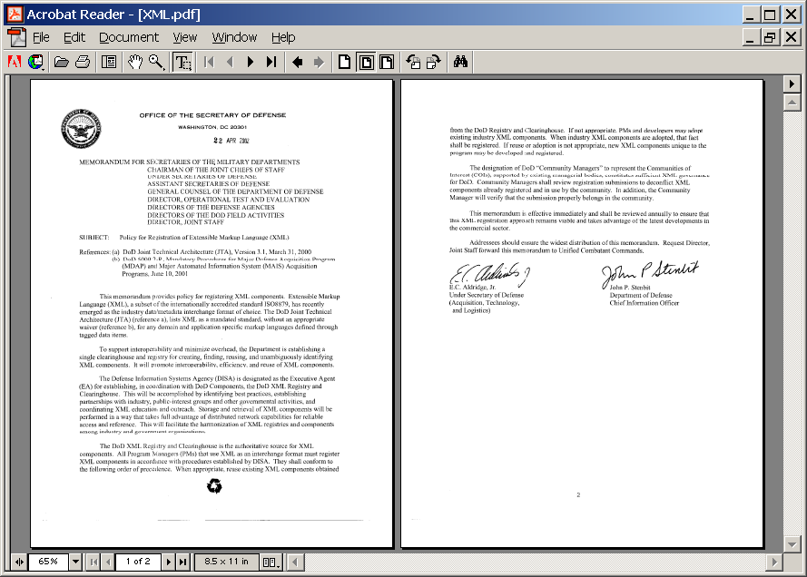
DoD Policy for XML Registration
ASD(C3I) & USD(AT&L) signed 22 Apr 2002
XML Component Registration
Consult DoD Registry before creating new components and reuse existing XML where practical
Indicate planned use of XML components by formally subscribing to them
Consult other Registries before inventing new XML
Register any additional XML or recommend modifications
Community of Interest Namespace Formation
Formed “as required” when someone will agree to manage
Requirements for new Namespaces staffed with:
  Existing Namespace Managers
  Senior Service/Agency engineers
  Flag Level Review Board
http://xml.dod.mil/xmlreg/user/Documents/XML.PDF
Notes:
Now here is the DoD XML Registration Policy signed 22 Apr 2002
These are essentially the same as the first rules we got “blessed” (over 2 years ago) as COE approved guidance for XML. These rules fit ASD C3I’s TPPU paradigm. No surprise . . . they are aimed at promoting metadata visibility so that system builders can easily find and pull XML to re-use. If you’re building a data service, the rules say . . . Before you burn resources and create something from scratch, take a look in the Emporium and see if what you need is already there! Common sense. If you find stuff you like, download it - copy and paste – into your program and, oh-by-the-way, fill out a little form so the market knows you’re using it, and can keep you up on any changes, can allow you , in essence, to have a say in its configuration management. Common sense. And where you DO need to create something new, well . . . Register it so others can see it IF their system needs to talk with your system or so they can apply it to create other interoperable capabilities. Re-use of commercial or other government XML is encouraged where there is no appropriate DoD material. But when a developer does use Commercial XML he must register that fact in the Emporium.
And then at the management level, in searching the Registry, do you find existing Communities of Interest (COI) that “fit” your stuff or does there need to be another COI added. If so, is there someone who feels strongly enuff to actually sponsor a Community, provide a couple of admin staff-years to run a coordination venue etc. If so, there’s a process to vet a new COI and “post” it so other users can find it.

Slide 28
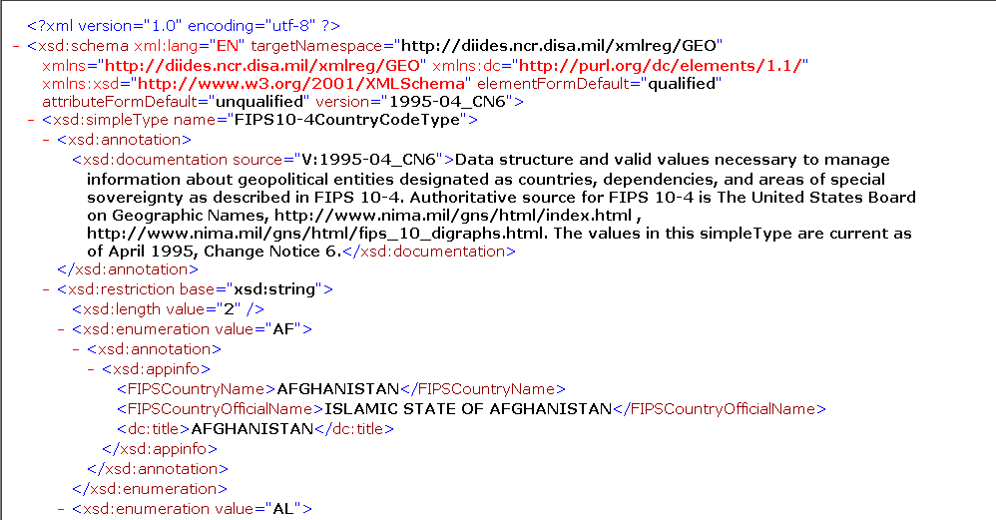
FIPS10-4CountryCodeType
Domain Source: DOD Data Emporium RefSet
“lang” tag
documentation
Data Type, Data Size
XML Elements: UpperCamelCase
XML Attributes: lowerCamelCase
Types: UpperCamelCase + Type
enumeration “meaning” via Dublin Core tag
Notes:
Use annotation/documentation for elements, attributes, types to provide documentation
Use annotation/appinfo <dc:title> to provide meaning for enumeration values
Use UpperCamelCase for elements, lowerCamelCase for attributes
Use UpperCamelCase for types and append “Type” to differentiate types from elements
To create tag for aggregations, append “List” to contained element name
Include xml:lang tag within schema and xml instance where needed.

Slide 29
Data Strategy

Slide 30
Emerging DoD Data Strategy
ASD (C3I) Principles
“Post” Data as early and as widely as possible
Empower Users to pull whatever they want
Clearly identify Data maintenance authorities
Decompose Data Management
  Communities of Interest (COIs)
  Build-Time and Run-Time
Exploit Market Forces
  Visibility (Allows data producers and consumers to find each other)
  Supply and Demand (“Incentivizes” timely, high quality production)
  Market Metrics (Allows adjustments for investment to follow value)
  TASK - POST - PROCESS - USE (TPPU)…..
Notes:
The Assistant Secretary of Defense for whom our Agency works, is formulating a new Data Strategy that will emphasize metadata and Information Age forms of metadata management. Here are some key principles underlying the new data strategy . . .
From a technical standpoint, data is made universally accessible across the network via Enterprise-level supporting infrastructure, what we call Net-Centric Enterprise Services (NCES), with user access limited only by explicit policy. Data is published on wide area networks at various classification levels and maintained by responsible authorities that are clearly identified.
Data is posted early on (before lengthy processing) and then followed up with “value added” at frequent intervals. Data producers cannot know all potential user contexts. So, users are offered all available data and empowered to pull whatever they want. This is at the heart of net-centricity. You may have heard ASD C3I refer to this process as TPPU (Tee Poo).
Data management activities are decomposed into two categories, Build Time and Run Time. Build Time refers to information system development aimed at defining and prioritizing requirements for and designing, engineering, integrating, testing, fielding and further evolving hardware/software capabilities for deployment on the GIG. Run Time refers to operating those capabilities once deployed on the GIG to carry out the missions of the Department.
Market forces are exploited to govern data in both Build Time and Run Time. Management is centered around “Communities of Interest” (COIs) that are forming naturally as developers coordinate “up front” to engineer capabilities for high volume network interactions and users then exploit those capabilities to generate, discover and exchange data.
As part of both Build time and Run time activities, data managers within COIs (including an enterprise level COI) form teams as required to identify information exchange requirements, agree on forms and formats, deploy and operate authoritative sources, and articulate business rules for governing information exchange. Focus, scope, longevity and composition of these teams are variable. This approach places decision-making close to stakeholders in key organizations with the expertise, motivation and control of resources required to address pressing data issues. Cross cutting issues are addressed at the enterprise level.
Designation of authoritative sources, data access controls, evaluation of content and many other decisions are primarily Run-Time management activities. These activities are supported by metadata collection and management capabilities deployed as part of NCES. Build Time decisions on design, acquisition and deployment of data resources to fulfill specific user needs are also supported by NCES. And Build-Time metadata collection also supports Run Time Discovery, Security and Mediation services.
These Build Time capabilities, specifically those we’ve fielded to support XML management, are what I’m going to focus on today.

Slide 31
Data Transformation Strategy
Towards Net-Centric DoD Data Policy
DOD XML Policy pilots new Strategy
  ASD(C3I) & USD(AT&L) 22 April Memo requires XML Registration and defines rules
  XML Registry and Governance being extended to cover other data forms (e.g., data elements, message formats, data base structures, etc)
Revision of 8320 guidance
  ASD(C3I) 3 Jan Memo “Planned Changes to DoD Data Administration and Cancellation of Associated Procedures”
  Capitalizes on new technology and lessons learned
  Covers full range of data regimes (Run-time as well as Build-time)
  Leverages commercial standards
  Governed through Communities of Interest (COI)
  Emphasizes registration for visibility over top down standardization
Integrates DDDS content into Comprehensive DoD Metadata Services (DoD Data Emporium + Net Centric Enterprise Services)
  Selects and Cleanses DDDS data worth salvaging
  Associates Data Standards and Engineering Components
Legacy 8320 capability in Maintenance Mode
  Maintaining DDDS operations in parallel

Slide 32
Lessons-Learned
Registration (posting) and Access (Pulling) must be simple and efficient – capability v. simplicity hard to balance
  Developers also want Run-Time access for applications
Robust Discovery services are required
Convergence process needs to be codified
  Implementation deadlines are key drivers
Better metrics required
  Make subscription mandatory?
Anticipated Benefits:
  Cost, Schedule and Interoperability improvements
  Requirements, convergence opportunities and players more visible
Unanticipated Benefits:
  Metadata Quality Improvements
  Clearinghouse more active than expected

Slide 33
Questions?

Slide 34
What’s the benefit?
For the Program Manager
  Re-use registered components
    Faster, Cheaper, Lower Risk
For Management
  Metrics for Acquisition Oversight
For the end-user in Run Time
  Better data understanding & consistency

Slide 35
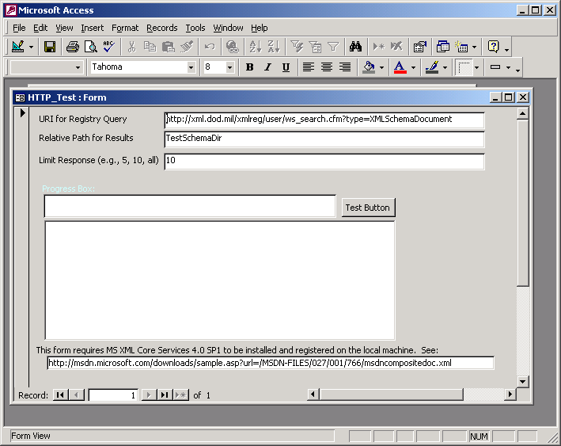
Reference Implementation

Slide 36
Pseudocode
Query Registry for IRs where IR type is Schema
  http://xml.dod.mil/xmlreg/user/ws_search.cfm?type=XMLSchemaDocument
  Results are returned in an XML document
    Name
    IRFetchString
Process each result in XML document
  Use MSXML2.XMLHTTP40 (methods: open, send; property: responseText)
    HttpReq.open "GET", IRFetchString, False
    HttpReq.send
    HttpReq.responseText
  Create new directory for each item (to ensure uniqueness)
  Write “responseText” to file

Slide 37
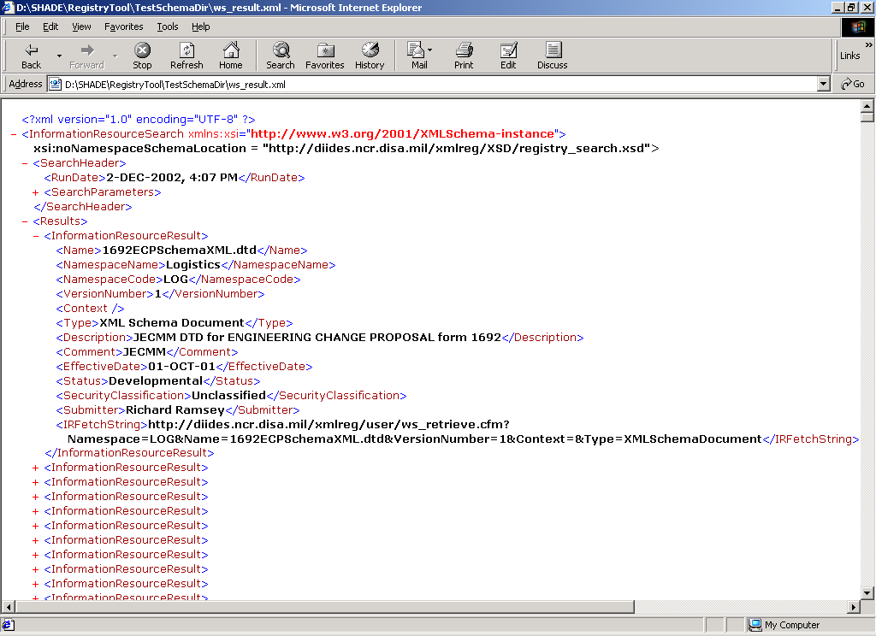
Structure of REST API
Query Results

Slide 38
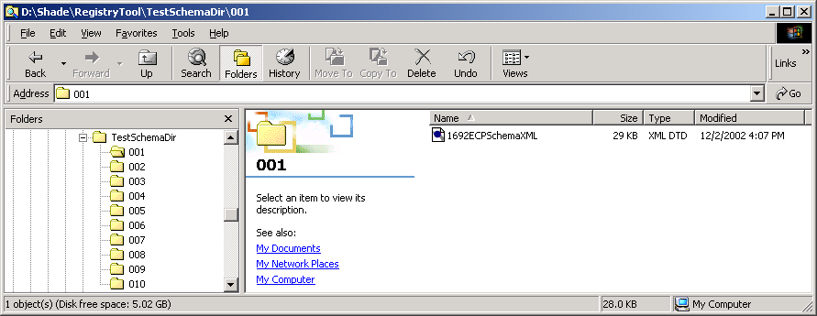
Output from
Reference Implementation

Slide 39
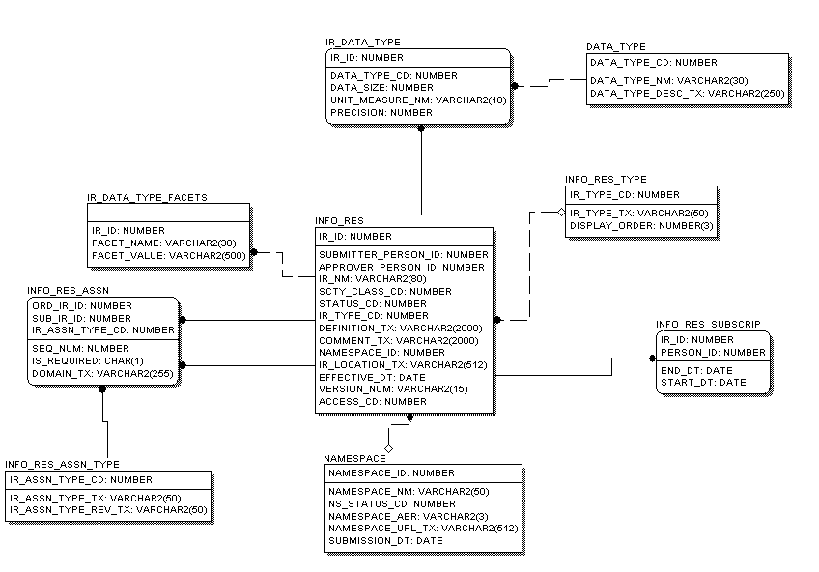
DoD XML Registry
Schema
Displaying Registry Core Only!

Slide 40
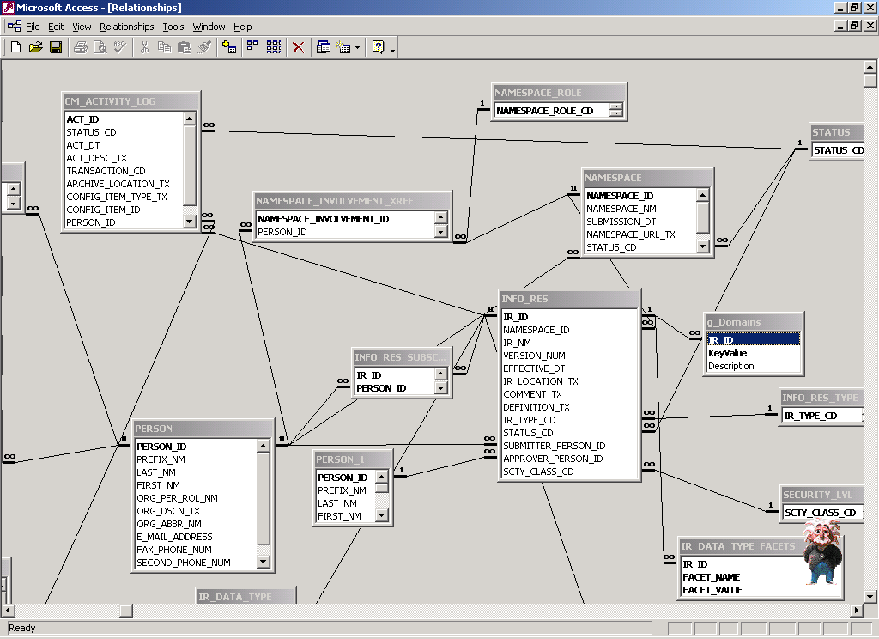
XML Registry Snapshot
DB Schema
DB Schema enforces Identity & Referential Integrity
Import Services enforces Add’l Registry Business Rules
  Logical Keys
    Namespace
    Name
    Version
    Information Resource Type
Physical DB Deviations
  String Size > 255 = Memo
    VarChar(2000) = Memo

Slide 41
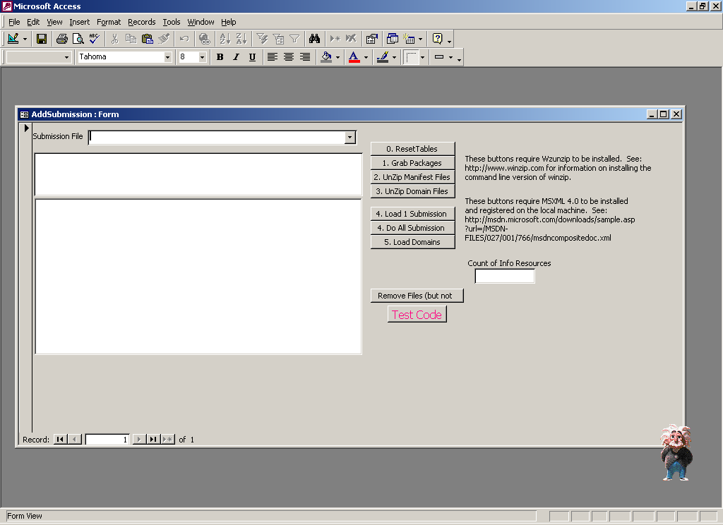
XML Registry Snapshot
Add New Packages

Slide 42
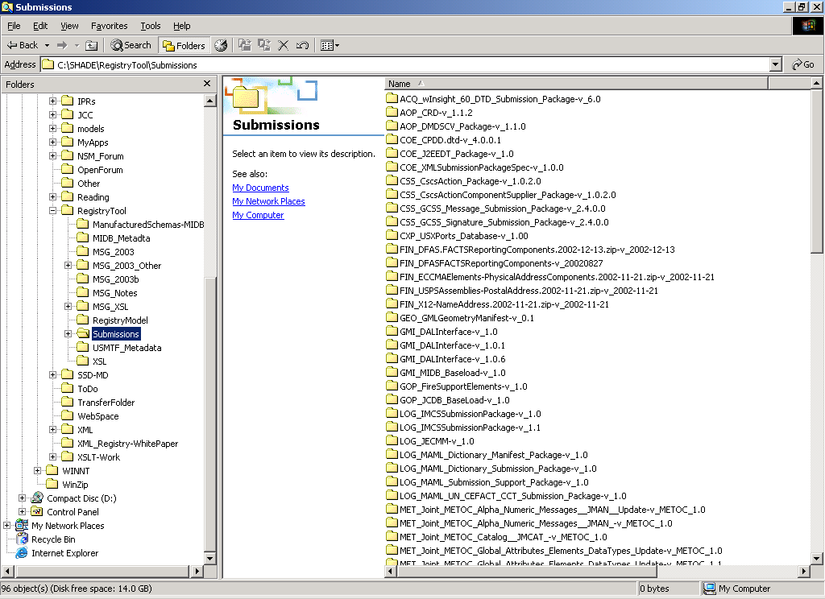
XML Registry Snapshot
Locally Stores Submission Pkgs

Slide 43
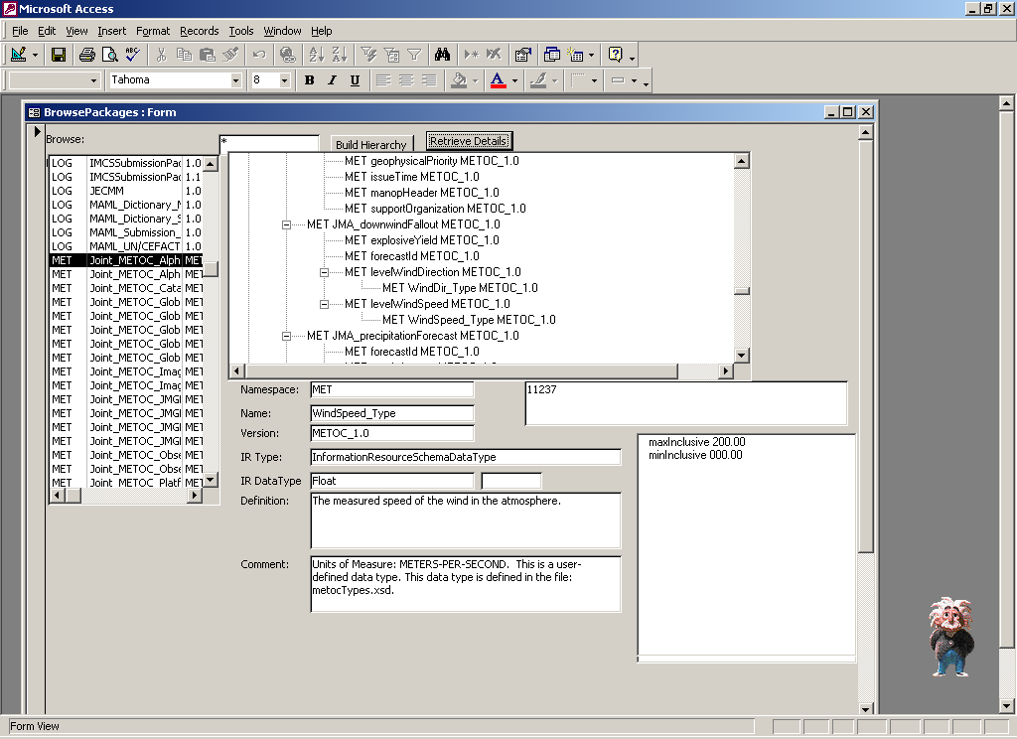
XML Registry Snapshot
Browse Packages

Slide 44
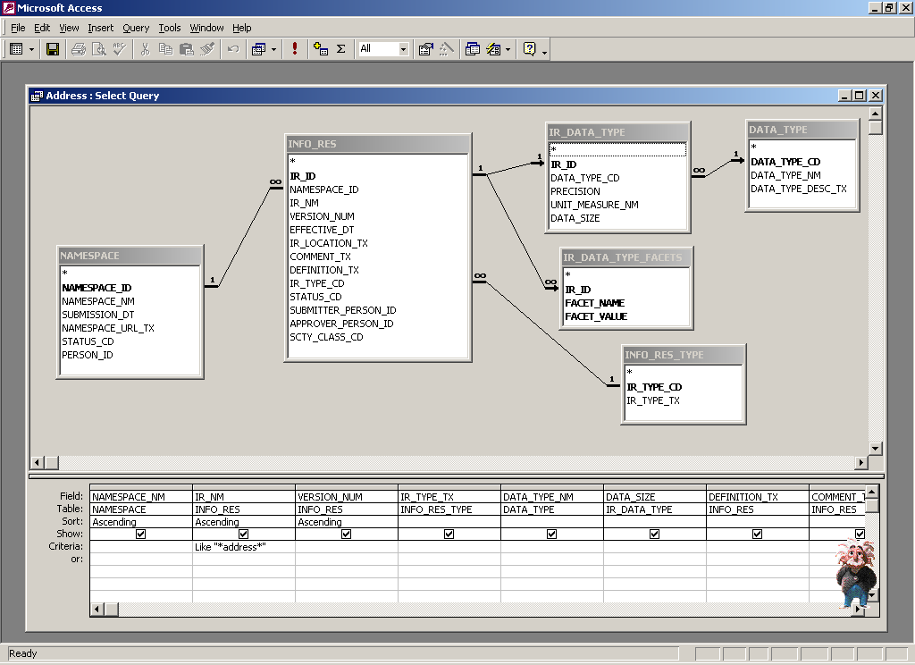
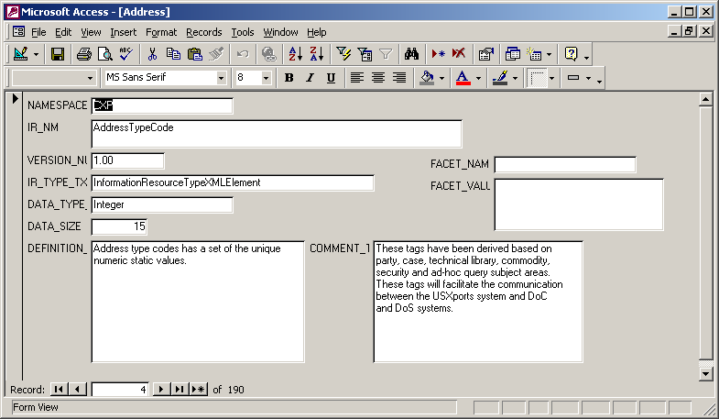
XML Registry Snapshot
Ad Hoc Queries

Slide 45
Data Engineering Proposal
Briefed to DoD XML Registry Namespace Mgrs’ Forum
  Guidelines for NEW XML
  Revised per Comments (e.g., use of Dublin Core for enumeration meaning)
  FIPS and ISO Schemas + XML Mapping Doc Under Review by GEO COI Mgr (Pam Stephens, NIMA) for registration in GEO
  To be considered as candidate for “Enterprise”
Comments Welcome!!
  ghayes@mitre.org

Slide 46
Public XML Venue
Semi-Structured Data & Metadata Subpanel (SSD-MD)
Meetings
  Bi-monthly at MITRE, with VTC support
  20 Meetings since Jan 1999
Topics
  DoD XML Efforts
    XDBI, XIS, ASAS, MLDB, XMLMTF, Space XML, WAWF & DoDAAC, DLIS, DAML, PDML, ngJBI, DiMeS, XML Component Engineering, XML Convergence Task Force
  Registry Enhancements & COI Status Briefs
  Specifications & Architectural Styles
    XMI, CWM, SOAP, XML Schema, ebXML Registry, Topic Maps, REST
  XML Conventions/Guidelines
    Navy, AF, COE Proposed
  Consortium Efforts
    OASIS UBL, NIST, OpenGIS, OMG, ISO 11404
  Vendor Briefings
Notes:
18 Meetings since 1/99
Next Mtg: 9/12, MITRE-Wilson (McClean, VA)

Slide 47
DoD XML Registry
Customer Service Transactions
’01 Emporium “hits” = approx 24K (100/day)
  XML Registry = 50-plus/day
  Other Emporium pages = approx 50/day
XML Component Re-use
  Army Intelligence Data Integration
  GCCS-I3 XML Target Folders
  JMPS to re-engineer w/GMI vocabulary
  Ground Moving Target Indicator
Clearinghouse Function
  25 - 30 Q&A transactions/mo
Initial Convergence Task Forces
  Logistics/DFAS lead: Alcon to agree on “Postal Address”
  Proposed Conventions and Normative Schemas
Notes:
Now we are sometimes asked where the DoD XML Registry IS actually being used. This illustrates the level activity we are seeing so far.
XML in ASAS, ASPO's TES, INSCOM's OSALAT, CI/HUMINT
AFTADS, FBCB2, AMDWS, GCCS- A, ASAS, IMETS, CSSCS, ISYSCON, DTSS, MCS, TAIS

Slide 48
What’s the benefit?
For the Program Manager
  Re-use registered components
    Faster, Cheaper, Lower Risk
For Management
  Metrics for Acquisition Oversight
For the end-user
  Pragmatic Approach for Understanding & Consistency

Slide 49
Process for Creating a New Namespace
Contact DISA Team
  Jim Pipher (703-882-1367), pipherj@ncr.disa.mil
  Stan Davis (703-882-1373), davis2s@ncr.disa.mil
  Toni Weir (703-882-1366), weirt@ncr.disa.mil
  Glenda Hayes (703-883-7175), ghayes@mitre.org
Present case informally
  Describe need and scope
Pre-Brief case to Namespace Mgrs Forum
  Discussion and feedback
Brief case to senior DoD engineers
NCES PM notifies proposer & DoD CIO

Slide 50
COI Proposal Content
Slides and/or Voice Track
What COI is being proposed?
What is the scope of the proposed COI? Provide sample XML.
How will the proposed COI relate to other existing COIs?
How will the COI impact relate to key DoD systems?
What organization will manage the COI?
Why is the organization being proposed as COI manager the most appropriate group to serve this role? (what is their authority? Is there an alternative to this org?)
What data does the COI manager produce and/or manage?
What larger bodies does the org participate in? (e.g., Personnel namespace mgr serves on both OMG and ISO bodies)
How does the COI mgr intend to provide the “coordination function” within his COI? Is there an existing coordination body that can be leveraged?
Has the proposed COI mgr POC briefed this proposal to the Namespace Mgrs Forum?
Is the proposed COI mgr POC prepared to participate in the SSD-MD and Namespace Managers Forum?

Slide 51
COI Management Tasks
CM for Collections of XML Components
Coordinate Stakeholders
  Establish and Run Coordination Venue(s)
  Resolve Issues within Namespace
  Coordination across Namespaces (bilateral, multilateral and/or via Namespace Mgrs Forum)
Oversee Development of XML Documents, DTDs, XSL style sheets
Submit Information Resource Packages to XML Registry
Vet Information Resources and Publish Status
Perform Versioning
Participate in Namespace Mgrs Forum and SSD-MD (public XML venue)

Slide 52
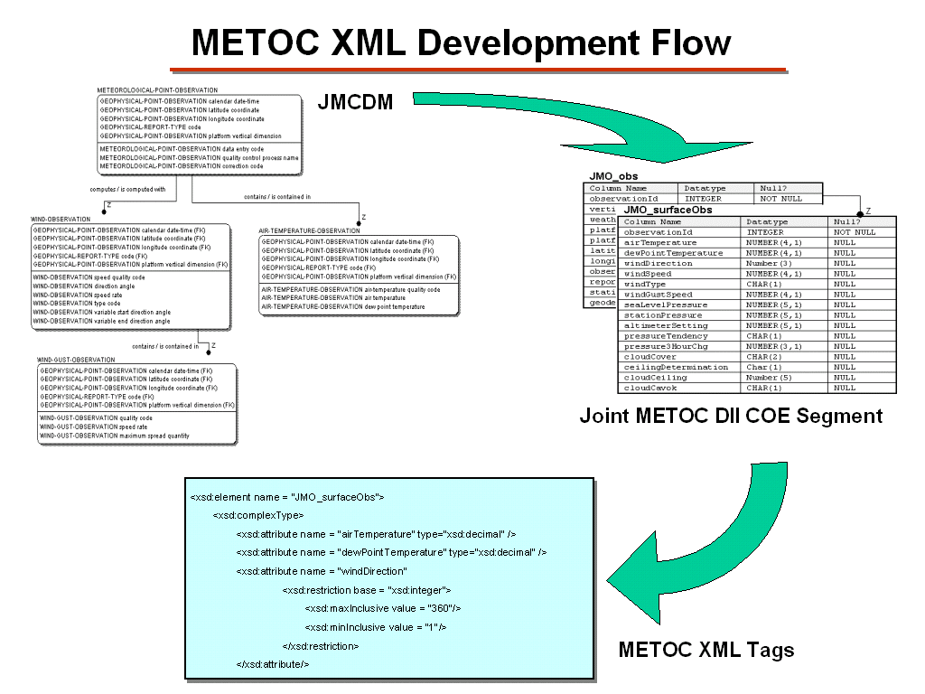
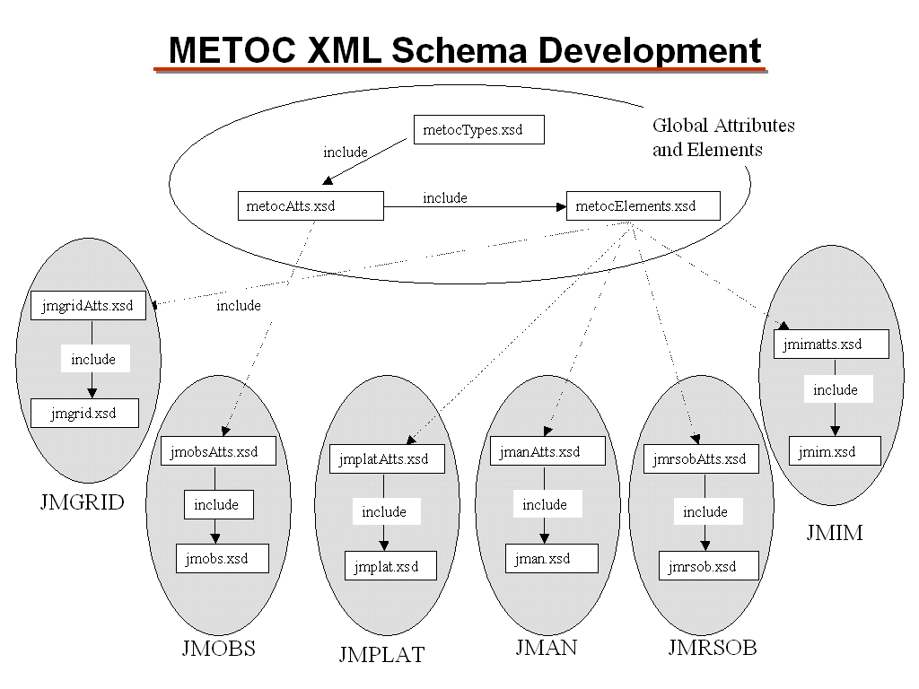
Each COI Determines Its Management Process
<xsd:element name = "JMO_surfaceObs">
<xsd:complexType>
<xsd:attribute name = "airTemperature“ type=“xsd:decimal“ />
<xsd:attribute name = "dewPointTemperature“ type=“xsd:decimal“ />
<xsd:attribute name = "windDirection“
<xsd:restriction base = "xsd:integer">
<xsd:maxInclusive value = "360"/>
<xsd:minInclusive value = "1"/>
</xsd:restriction>
</xsd:attribute>
Courtesy of METOC, Elizabeth Warner

Slide 53
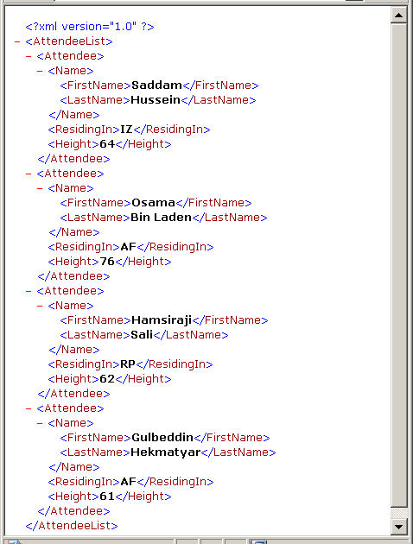
Working in a World of Codes
Many communities use codes to serve as proxies for enumerated domains
The codes become the effective standard
Use of codes present challenges for training new users
XML in a browser
But, what if…

Slide 54
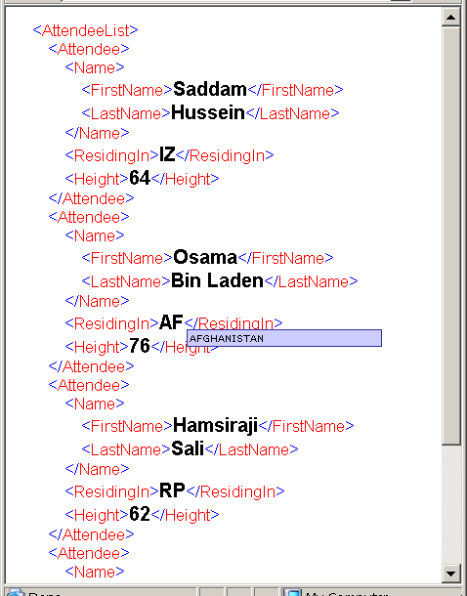
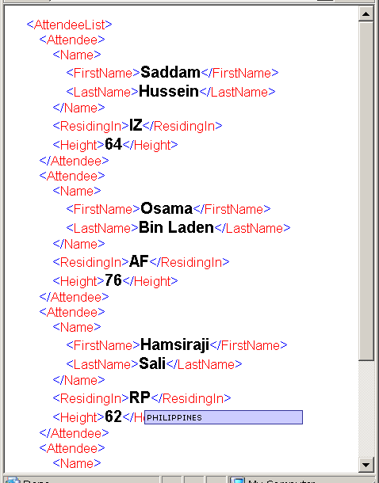
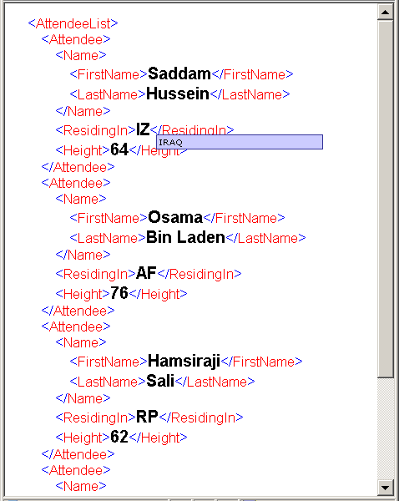
With Common Encoding of
Code “Meanings”
Tools to leverage additional semantics
  Browsers via “Mouseover event” (proposed to Microsoft & Mozilla)
  Exploit via XSL for display
Reduced End-User Training, Improved Readability
Relevant for Military Messaging and EDI
Tomorrow’s XML browser?

Slide 55


Mapping Standard Domains
FIPS and ISO Country Codes
Both standards exist, neither can be ignored
Challenge for interoperability
Transforms needed
FIPS Qty: 262
ISO Qty: 239
Qty w/Same code
93
US
US
Qty not in FIPS
3
Qty not in ISO
26
FX
GZ
UM
IZ
IRAQ
TP
WE
IQ
Qty w/Different code
143
Notes:
GZ = Gaza Strip
WE = West Bank
IZ, IQ = IRAQ
FX = Metropolitan France, European part of FRANCE (FR); excluding GF, GP, MQ, NC, PF, PM, RE, TF, WF, YT
UM = UNITED STATES MINOR OUTLYING ISLANDS, Includes i.a. Baker Island, Howland Island, Jarvis Island, Johnston Atoll, Kingman Reef, Midway Islands, Palmyra Islands, and Wake Island
TP = East Timor, Includes the enclave of Oa-Cussi

Slide 56
Domain Mapping Challenge
Reuse of simpleTypes and complexTypes is less contentious than reuse of elements
Lack of common standard for neutral mapping of simpleTypes
  No xpath representation for simpleTypes
<LivingIn>
<LivingIn>
<country>
<CC>
<Allegiance>
<Country>
<CountryOfResidence>
<Nationality>
<COUNTRY>
<XYZ>
Using FIPS
Using ISO

Slide 57
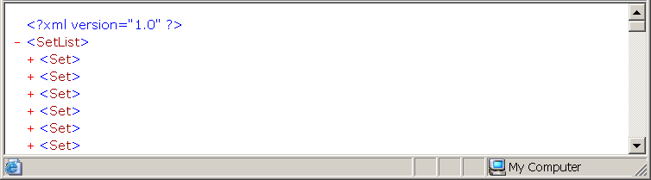
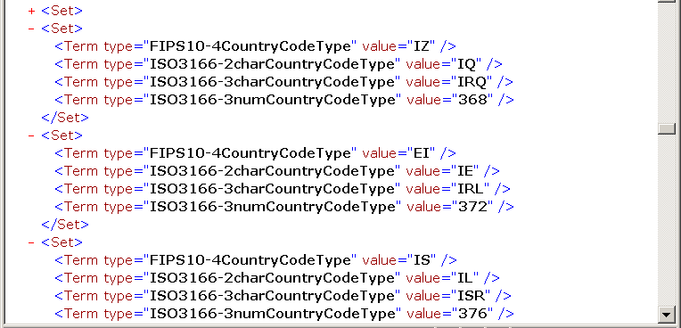
Neutral Mapping of simpleTypes for machine translation
IRAQ
Proposed Representation
Ireland
Israel

Slide 58
Using Mapping Representation With Translator
From FIPS-ISOMapping.xml:
<Set>
<Term type="FIPS10-4CountryCodeType" value="IZ" />
<Term type="ISO3166-2charCountryCodeType" value="IQ" />
<Term type="ISO3166-3charCountryCodeType" value="IRQ" />
<Term type="ISO3166-3numCountryCodeType" value="368" />
</Set>
Your Translator
From MyEnemies.xsd:
<xsd:element name=“LivingIn"
type="FIPS10-4CountryCodeType">
From BadBloke.xsd:
<xsd:element name=“Residence"
type="ISO3166-2charCountryCodes">
From MyEnemies.xml
<LivingIn>IZ</LivingIn>
From BadBloke.xml
<Residence>IQ</Residence>
FIPS
ISO

Slide 59
Proposed DISA Conventions for New* XML
Preference for W3C XML Schema Recommendation
Use annotation/documentation for elements, attributes, types to provide documentation
Use UpperCamelCase for elements, lowerCamelCase for attributes
Use annotation/appinfo <dc:title> to provide meaning for enumeration values
Use explicit Data Types rather than inline definitions
Use UpperCamelCase for types and append “Type” to differentiate types from elements
For aggregation tags, append “List” to element name
Include xml:lang tag within schema and xml instance where needed.
Limit the use of “generic” tags (e.g., no “item” tag)
Express tie-back to XML Registry
* Not intended for evaluating suitability for reuse

Slide 60



From Build-Time to Run-Time
Composing NCES-based Architectures
Build-Time
Plug-in/unplug
Run-Time
Data Emporium
Discovery & Meditation
Vocabulary Management
NCES Discovery
Catalog
Plug-in
Metadata
(XML)
Transformation
Service
Data/Metadata Components
Network Check-in
Registration Process
Development
GIG
Install & physical
connection
Security
Registry
Other NCES
Finished
Capbility
“Custom” Components
From Builders
Router
Firewall
COTS Components
From Vendors
Other Capabilities

