Slide 1
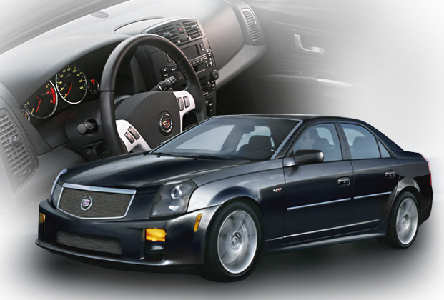
From Zero to One Hundred
Enterprise Architecture at GM
Enterprise Architecture Conference
Richard Taggart
Chief Architect
General Motors Corporation

Slide 2
Advantage is built on the ability to Maneuver!
“Some win through speed…use swiftness to wear them out…get the upper hand through extraordinary swiftness …be as fast as lightning that flickers before you can blink “
“Adaptation means not clinging to fixed methods, those that can face the unprepared with preparation are victorious….the ability to gain victory by changing and adapting to the opponent is called genius”

Slide 3
The ability to Maneuver is based on EA !
In the Information Age, the ability to maneuver is based on the malleability of an organization’s systems.
The malleability of your systems is based on Enterprise Architecture.
Enterprise Architecture is the weaponry of the Information Age.

Slide 4
Intellectual Capital Maturity Model ™
 | Models | Processes | Components | Solutions | Organization
Unrecognized
Recognized
Chaotic
Organized
Assetized
Managed
Valued
Monetized

Slide 5
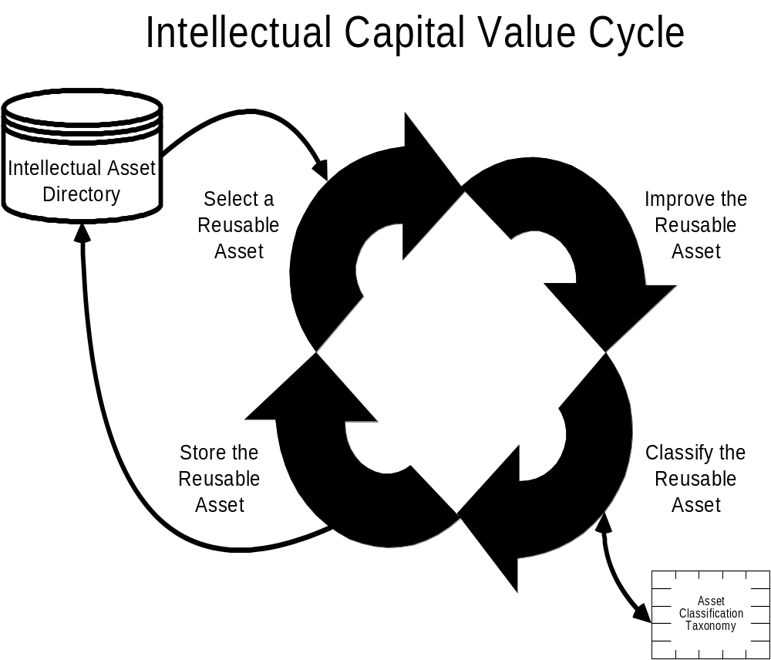

Slide 6
Enterprise Architecture has been a powerful contributor to success:
Enable I.T. as a catalyst of business change
  Go Global
  Go Common
  Go Fast
Real Time Digital Business
$1 Billion reduction in I.T. costs
  Application Inventory cut in half

Slide 7
But Enterprise Architecture, as a relatively new practice, has many issues within the industry….
Fuzzy Definition
No consistency of deliverables
No foundational standards
No common methodologies
No certification
Limited Reuse
No commonality between sourcing vendors (and often none within sourcing vendors)
….SO EA is now an Art Form, Not an engineering discipline

Slide 8
GM, the Industry, and Government will benefit if Enterprise Architecture can move towards an engineering discipline…
Clear Definitions
Consistency of deliverables
Foundational standards
Common methodologies
Certification
Reuse
Commonality between and within sourcing vendors

Slide 9

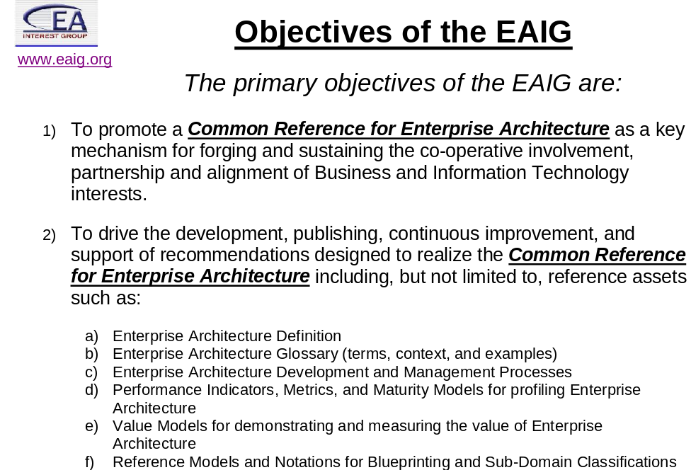




Enterprise Architecture Interest Group
GM is a Founding Member:
Very Successful Startup:
  Workgroups formed: EA Metamodels, EA Tools, EA Use Cases
  Strong interest from many more potential members
EAIG: http://www.eaig.org/

Slide 10

www.EAIG.org
EAIG Has 7 Primary Objectives:
To promote a Common Reference for Enterprise Architecture as a key mechanism for forging and sustaining the co-operative involvement, partnership and alignment of Business and Information Technology interests.
To drive the development, publishing, continuous improvement, and support of recommendations designed to realize the Common Reference for Enterprise Architecture , including reference assets such as:
  Enterprise Architecture Definition
  Enterprise Architecture Glossary (terms, context, and examples)
  Enterprise Architecture Development and Management Processes
  Performance Indicators, Metrics, and Maturity Models for profiling Enterprise Architecture
  Value Models for demonstrating and measuring the value of Enterprise Architecture
  Reference Models and Notations for Blueprinting and Sub-Domain Classifications

Slide 11
www.EAIG.org
EAIG Has 7 Primary Objectives:
To promote awareness and understanding of the value of Enterprise Architecture and the Common Reference for Enterprise Architecture at the CxO level.
To foster practical cross-member communication, interchange, and leveraging of Enterprise Architecture related artifacts, processes, concepts, and knowledge between organizations that are looking to exploit the potential of Enterprise Architecture.
To provide a forum for Professional Growth in the Discipline and Practice of Enterprise Architecture including opportunities for Training and Certification.
To maintain and operate an efficient and active global alliance of organizations to drive the EAIG’s progress in realizing these Objectives.
To influence industry vendors and service providers in the design and provision of Enterprise Architecture tools and services, and enlist them in assisting and contributing towards the realization of EAIG’s Objectives.

Slide 12
EA Meta-Models
EA Meta-Models represent logical constructs and requirements for the main elements of a Framework:
Some Meta-Models being defined by the EAIG include:
Planner Perspective:
1) Classes of Entities Model
2) Classes of Functions Model
3) Classes of Locations Model
4) Classes of People Model
5) Classes of Events Model
6) Classes of Motives Model
Owner Perspective:
7) Business Semantic Model
8) Business Process Model
9) Business Logistics Model
10) Workflow and Supervisory Model Between
Classes of People
11) Business Event and Cycle Model
12) Business Motives Model

Slide 13
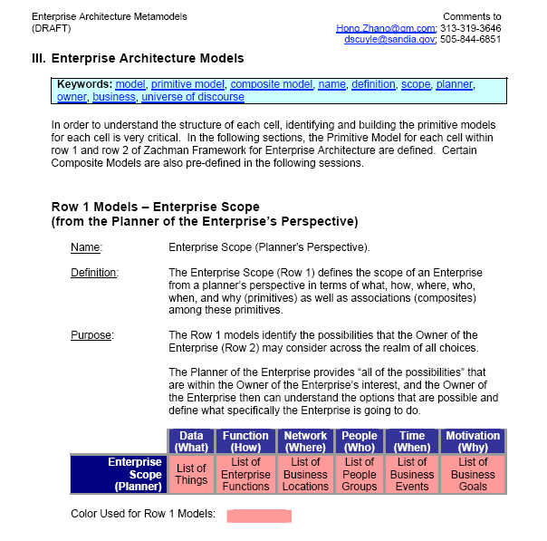
EA Meta-Models

Slide 14
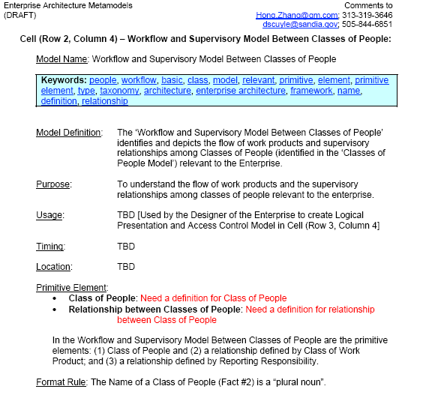
EA Meta-Models

Slide 15
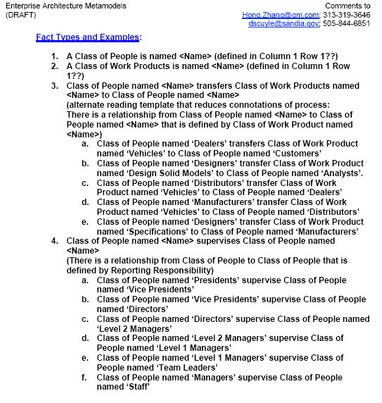
EA Meta-Models

Slide 16
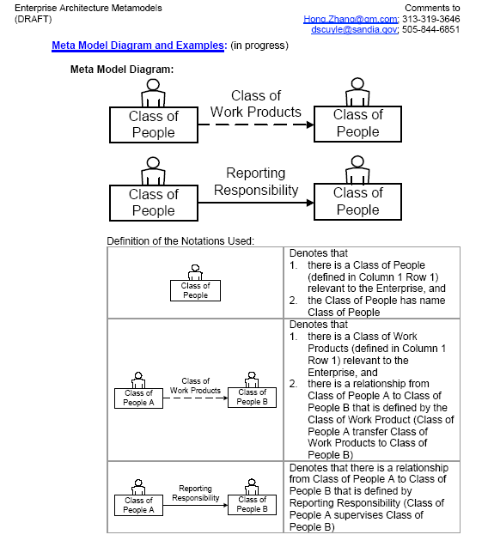
EA Meta-Models

Slide 17
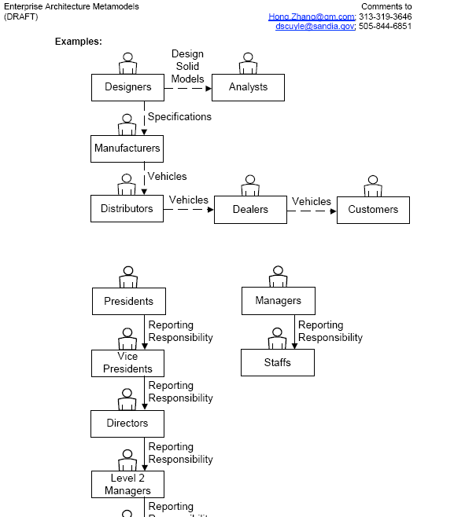
EA Meta-Models

Slide 18
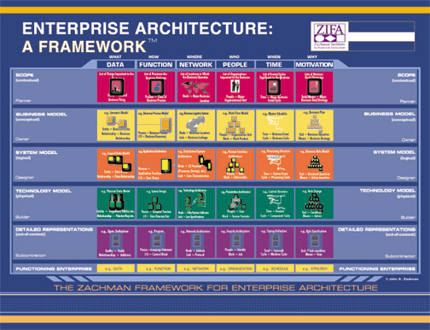
GM’s EA Framework

Slide 19
GM and the Zachman Framework
 | DATA (What) | FUNCTION (How) | NETWORK (Where) | PEOPLE (Who) | TIME (When) | MOTIVATION (Why)
SCOPE (Planner) | Hierarchy of Business Data Groups | Hierarchy of Business Functions | Hierarchy of Business Locations | Hierarchy Of Organizational Units | Hierarchy of Business Events | Hierarchy of Business Goals
BUSINESS MODEL (Owner) | Business Semantics Model | Business Processes Model | Business Logistics Model | Business Roles & Responsibilities Model | Business Master Schedule | Objectives / Strategies / Policies / Restrictions
SYSTEMS MODEL (Designer) | Logical Data Model | Logical Application Model | Logical Infrastructure Model | Logical Human Interfaces & Access Control Model | Logical Event Responses Model | Logical Business Rules Model
TECHNOLOGY MODEL (Builder) | Physical Data Model | Physical Application Model | Physical Infrastructure Model | Physical Presentation & Security Model | Physical Event Control Model | Physical Business Rules Model
DETAILED REPRESENT-ATIONS (Subcontractor) | Detailed Representation of Deployable Database & Data Access Components | Detailed Representation of Deployable Application Components | Detailed Representation of Deployable Infrastructure Components | Detailed Representation of Deployable Presentation & Security Components | Detailed Representation of Deployable Event Control Components | Detailed Representation of Deployable Business Rule Components
FUNCTIONING ENTERPRISE | Deployed Data | Deployed Application Components | Deployed Infrastructure Components | Organized People, Deployed Presentation & Securities Components | Deployed Event Control Components | Implemented Business Strategy
Common Business Reference Models
Common Systems Reference Models
Common Technology Reference Models
Common Operation Reference Models

Slide 20
SAP Tactical Analysis
 | DATA (What) | FUNCTION (How) | NETWORK (Where) | PEOPLE (Who) | TIME (When) | MOTIVATION (Why)
SCOPE (Planner) | Hierarchy of Business Data Groups | Hierarchy of Business Functions | Hierarchy of Business Locations | Hierarchy Of Organizational Units | Hierarchy of Business Events | Hierarchy of Business Goals
BUSINESS MODEL (Owner) | Business Semantics Model | Business Processes Model | Business Logistics Model | Organization Roles & Responsibilities Model | Business Master Schedule | Objectives / Strategies / Policies / Restrictions
SYSTEMS MODEL (Designer) | Logical Data Model | Logical Application Model | Logical Infrastructure Model | Logical Human Interfaces & Access Control Model | Logical Event Responses Model | Logical Business Rules Model
TECHNOLOGY MODEL (Builder) | Physical Data Model | Physical Application Model | Physical Infrastructure Model | Physical Presentation & Security Model | Physical Event Control Model | Physical Business Rules Model
DETAILED REPRESENT-ATIONS (Subcontractor) | Detailed Representation of Deployable Database & Data Access Components | Detailed Representation of Deployable Application Components | Detailed Representation of Deployable Infrastructure Components | Detailed Representation of Deployable Presentation & Security Components | Detailed Representation of Deployable Event Control Components | Detailed Representation of Deployable Business Rule Components
FUNCTIONING ENTERPRISE | Deployed Data | Deployed Application Components | Deployed Infrastructure Components | Organized People, Deployed Presentation & Securities Components | Deployed Event Control Components | Implemented Business Strategy
GM
Business
Functions
SAP
Operation
Locations
GM
Business
Units
GM
Business
Drivers
Servers
Running
SAP

Slide 21
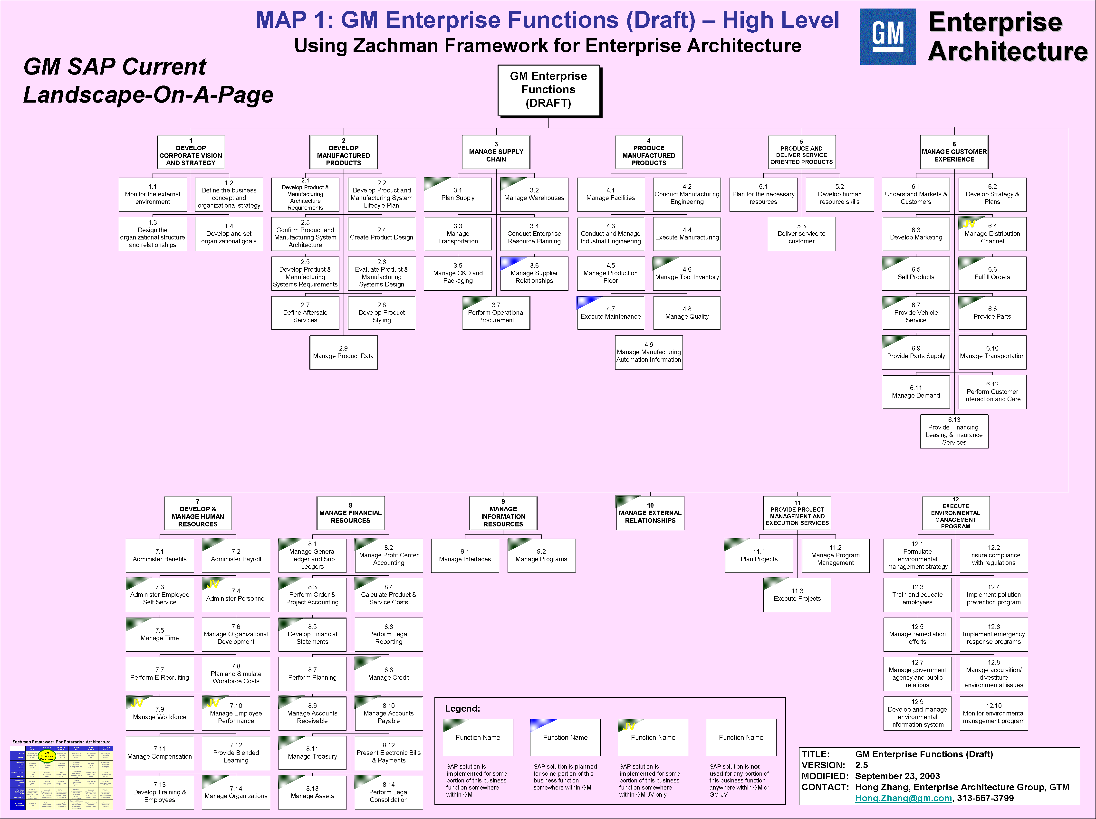

Slide 22
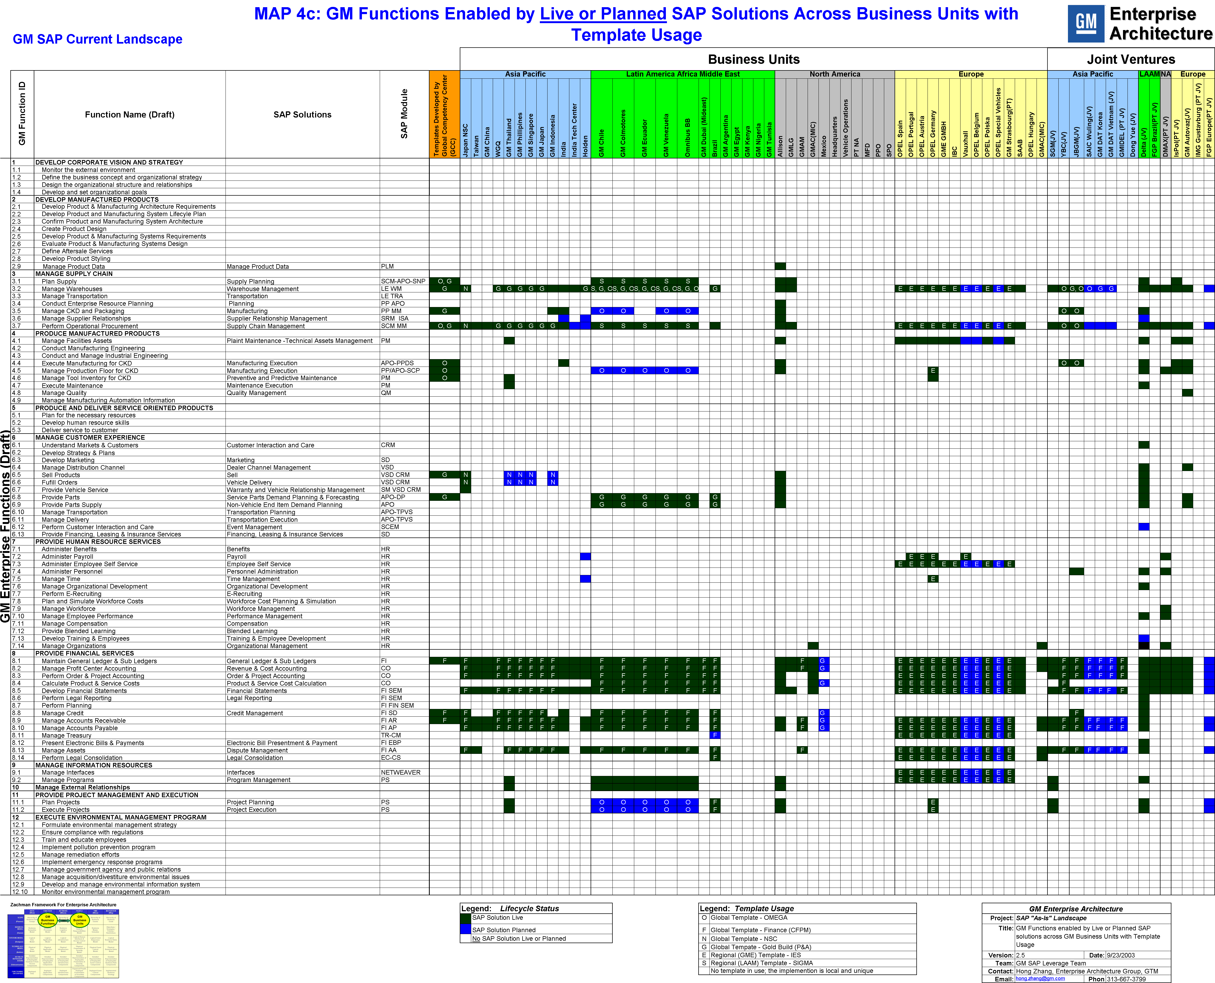

Slide 23
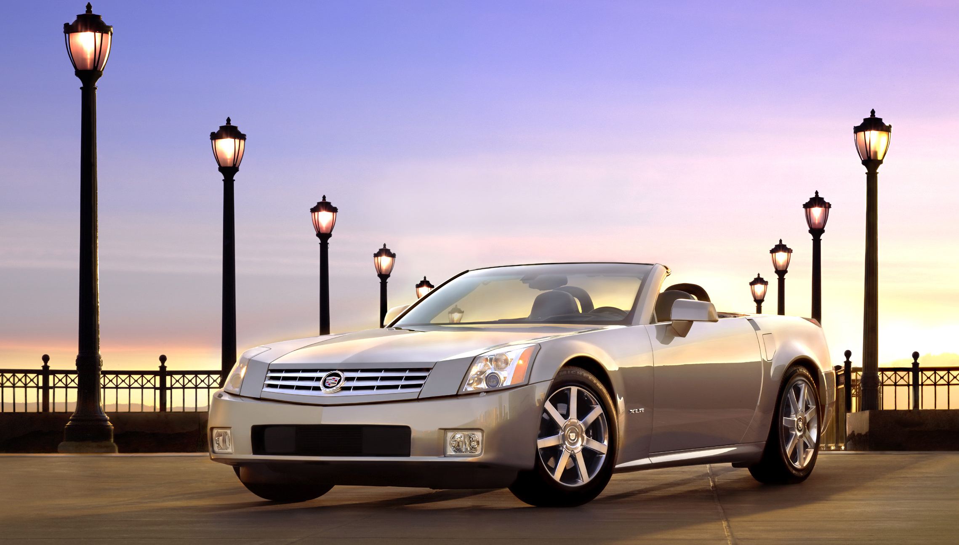
GM: A Great Car Company!
Notes:
Xlr hand built car in our bowling green kentucky facilitty. Corvette museum across the street.
I you havent’ looked at a gm product lately, try it out.
24 hour test drive.

