Slide 1
JAD, PD, RAD – SENG 613
Samuel Lee
Max Zhang, Qian
Stephen Ford

Slide 2
JAD, PD, RAD Agenda
Introduction
JAD
PD
RAD
Comparisons

Slide 3
What has the most impact on software productivity and quality?
Steve McConnell – Rapid Development (McConnell 1996)
  “We now know with certainty that peopleware issues have more impact on software productivity and quality than any other factor”
  “technology is not the answer; the most effective practices are those that leverage the human potential of their developers”
  JAD and PD are all about the people factors
  RAD is all about …

Slide 4
Introduction
What is JAD?
  Joint Application (Development / Design)
  Congregated, multi-disciplinary, facilitated process
  A well-functioning group will always outperform excellent individuals working alone.
History
  IBM (Canada) 1970’s
  The content has evolved and the process has been maintained.

Slide 5
Exercise 1

Slide 6
Roles in JAD
Session Leader (Facilitator)
  Expert at and committed to the process
  Excel at group processes (forming, norming, storming, performing)
  Needs to be trained – first choice, not last
Scribe
  Ensures comments, issues, facts, decisions, questions are recorded (verbatim where possible)
  Excels at the tools – CASE, Word
  Active participant – seeking clarity on wording and meaning

Slide 7
Roles in JAD
User Representatives
  Must have knowledge, authority, experience
  Good listener
IT Representatives
  Good listener
  Contributes technical information
Executive Sponsor
  Pays the bills
  Makes the final decisions on issues

Slide 8
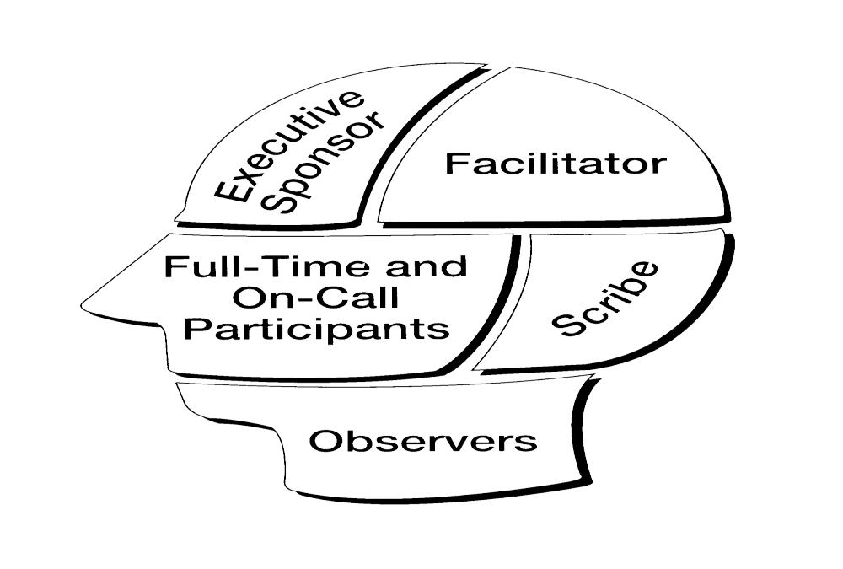
How to select JAD Team
[Wood, Silver]

Slide 9
Selecting an Executive Sponsor
Right personality
Strong influence in the organization
Must have authority to make decisions
Not afraid to make decisions

Slide 10
Selecting a Facilitator
Must be impartial
  For system development project, the facilitator ideally comes from neither the user area nor the programming department.
    Ex. IBM’s concept called the Development Center or place JAD staff in a group separate from IS.
Communicate well
Lead groups

Slide 11
Selecting a Facilitator (Cont.)
Summarize discussions
Sensitive to group dynamics and company politics
Ability to steer groups away from unnecessary details and tangents
For systems development projects should have a good understanding of data-processing concepts.

Slide 12
Selecting a Scribe
Good working knowledge of the business area
Good analytical skills
Expertise in JAD documentation tool
Good notes taking skills
Good technical writing skills
Clear handwriting

Slide 13
Selecting Participants
Commitment is essential
It’s a balancing act
  Want enough people to have full representation and decision power in all areas but at the same time must keep the session small enough to be productive.
  For systems development project, a suggested ratio is five users to two IS people.

Slide 14
Selecting Observers
Should not be involved in any of the decision making
Allow them to answer questions, but nothing more.
Muzzle them completely.

Slide 15
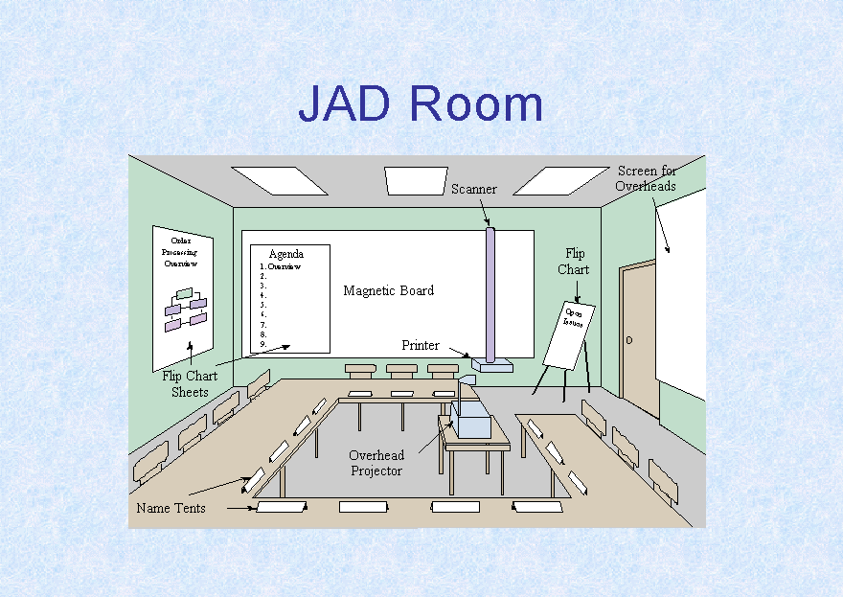
Traditional JAD Room
[Messinger]

Slide 16
Five Phases of JAD
JAD Project Definition
Research
Preparation
The Session
The Final Document

Slide 17
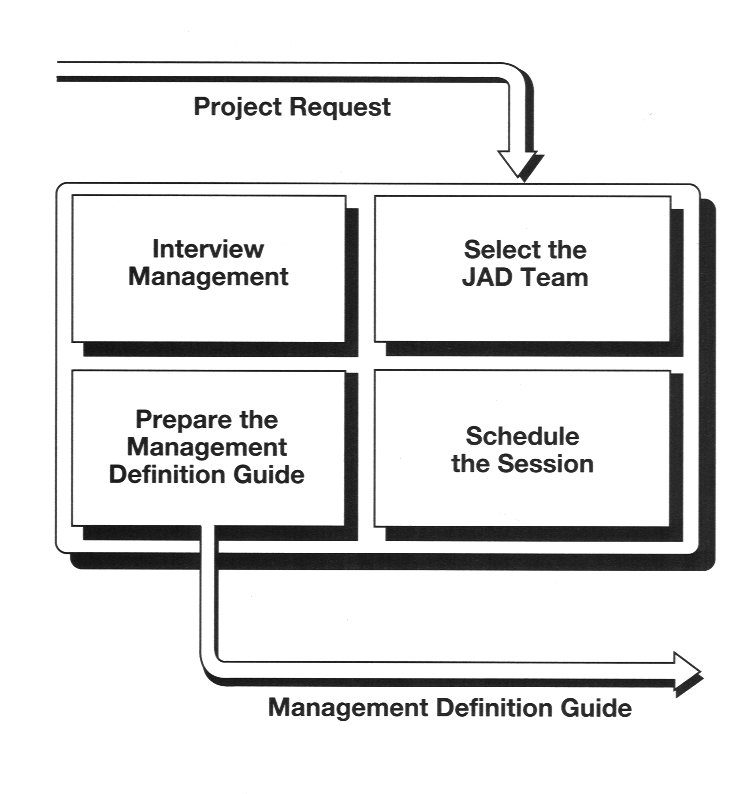
Phase 1
JAD Project Definition
[Wood, Silver]

Slide 18
JAD Project Definition (Cont.)
Interview Management
Identify what management wants from the project
  Purpose
  Scope
  Objectives
  Business process
  Constraints
  Resource requirements
  Assumptions
  Open issues

Slide 19
JAD Project Definition (Cont.)
Interview Management
Information from the management interview is then used to produce:
  Management Definition Guide
  Select the JAD team
  Schedule the session

Slide 20
JAD Project Definition (Cont.)
Management Definition Guide
Defines what management wants from the project
Written from management’s perspective and includes the purpose, scope, and objectives of the project

Slide 21
JAD Project Definition (Cont.)
Scheduling the Session
Length of the session
  Depends on the project (One day session are not uncommon but typically three to five days session)
Half day or full day session
Location of the session
When to hold the session

Slide 22
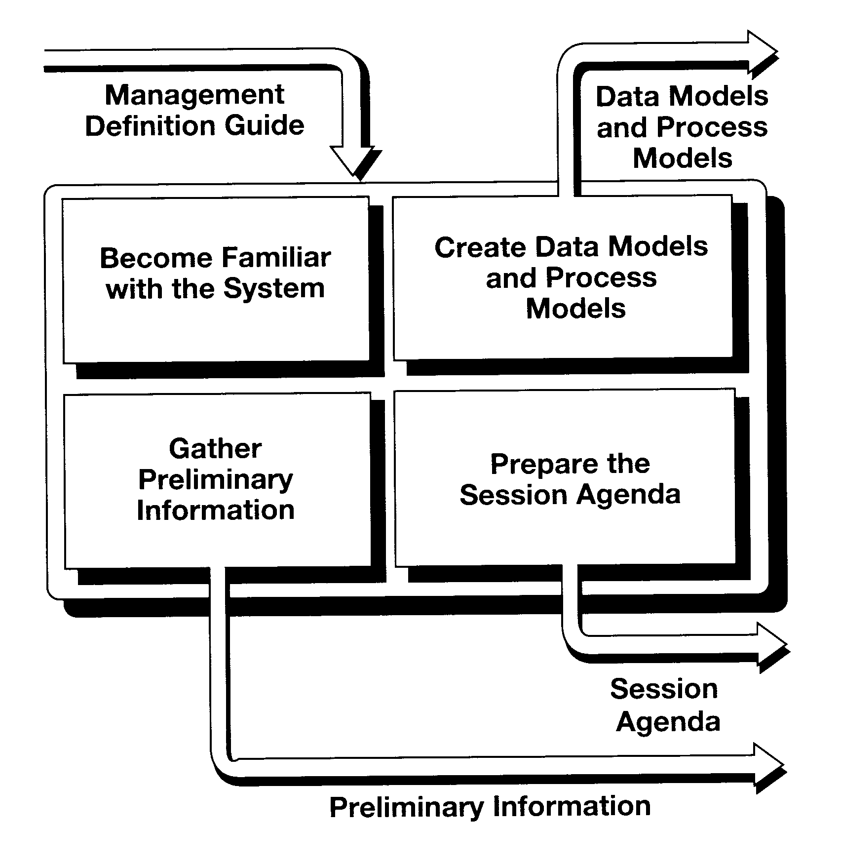
Phase 2
Research
[Wood, Silver]

Slide 23
Research (Cont.)
Get familiar with the system
Setup meetings with the people in the business area and IT departments
Observe their working environment
Observe the workflow
Existing hardware
Project history
Keep your perspective on a higher level

Slide 24
Research (Cont.)
Documenting data requirements
Identify the groupings of data used
Define the data element (or attribute) names and descriptions
Define the relationship between the data groups
Most companies build these data models using entity-relationship diagrams (ERDs)

Slide 25
Research (Cont.)
Documenting Business Processes
Define the rule for using the data
Many types of diagramming techniques are available.
  E.g. decomposition diagrams, process dependency diagrams, matrices, data flow diagram ….

Slide 26
Research (Cont.)
Gathering preliminary information
Gathering information about the business requirements
May want to gather information on screens, reports, or processing requirements for system development projects

Slide 27
Research (Cont.)
Session Agenda
No two JAD session agenda are alike but it can contain the following
  Introduction
  Strategic plan
  Corporate policy
  Data requirements
  Business processes
  Regulations
  Security issues

Slide 28
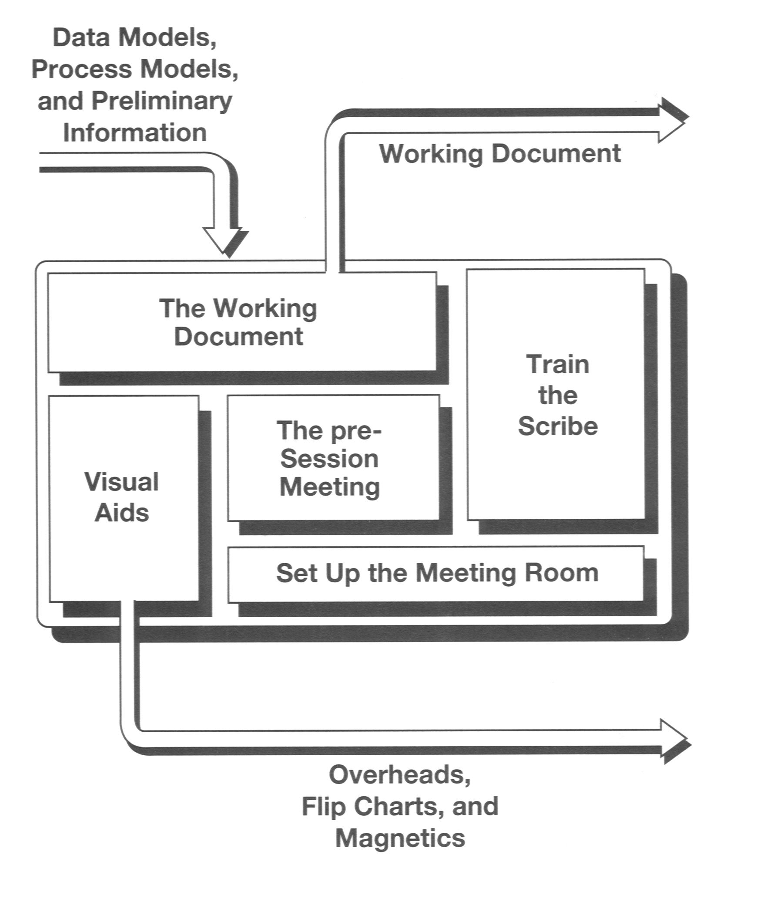
Phase 3
Preparation
[Wood, Silver]

Slide 29
Preparation (Cont.)
Training the scribe
Unless the scribe had done this role before, you do need to prepare the scribe for this role.
  Summarize the role of the scribe
  Describe JAD process
  Discuss the project
  Describe JAD session

Slide 30
Preparation (Cont.)
Visual aids
Help the participants focused
Clarify the decisions being made
Example of visual aids:
  Overhead projection
  Electronic white boards
  Computer screen projection units
  Flip charts

Slide 31
Preparation (Cont.)
Pre-session meeting
A week before the session with the purpose of:
  Establish management commitment
  Summarize JAD process
  Distribute and discuss working document
  Establish group rapport

Slide 32
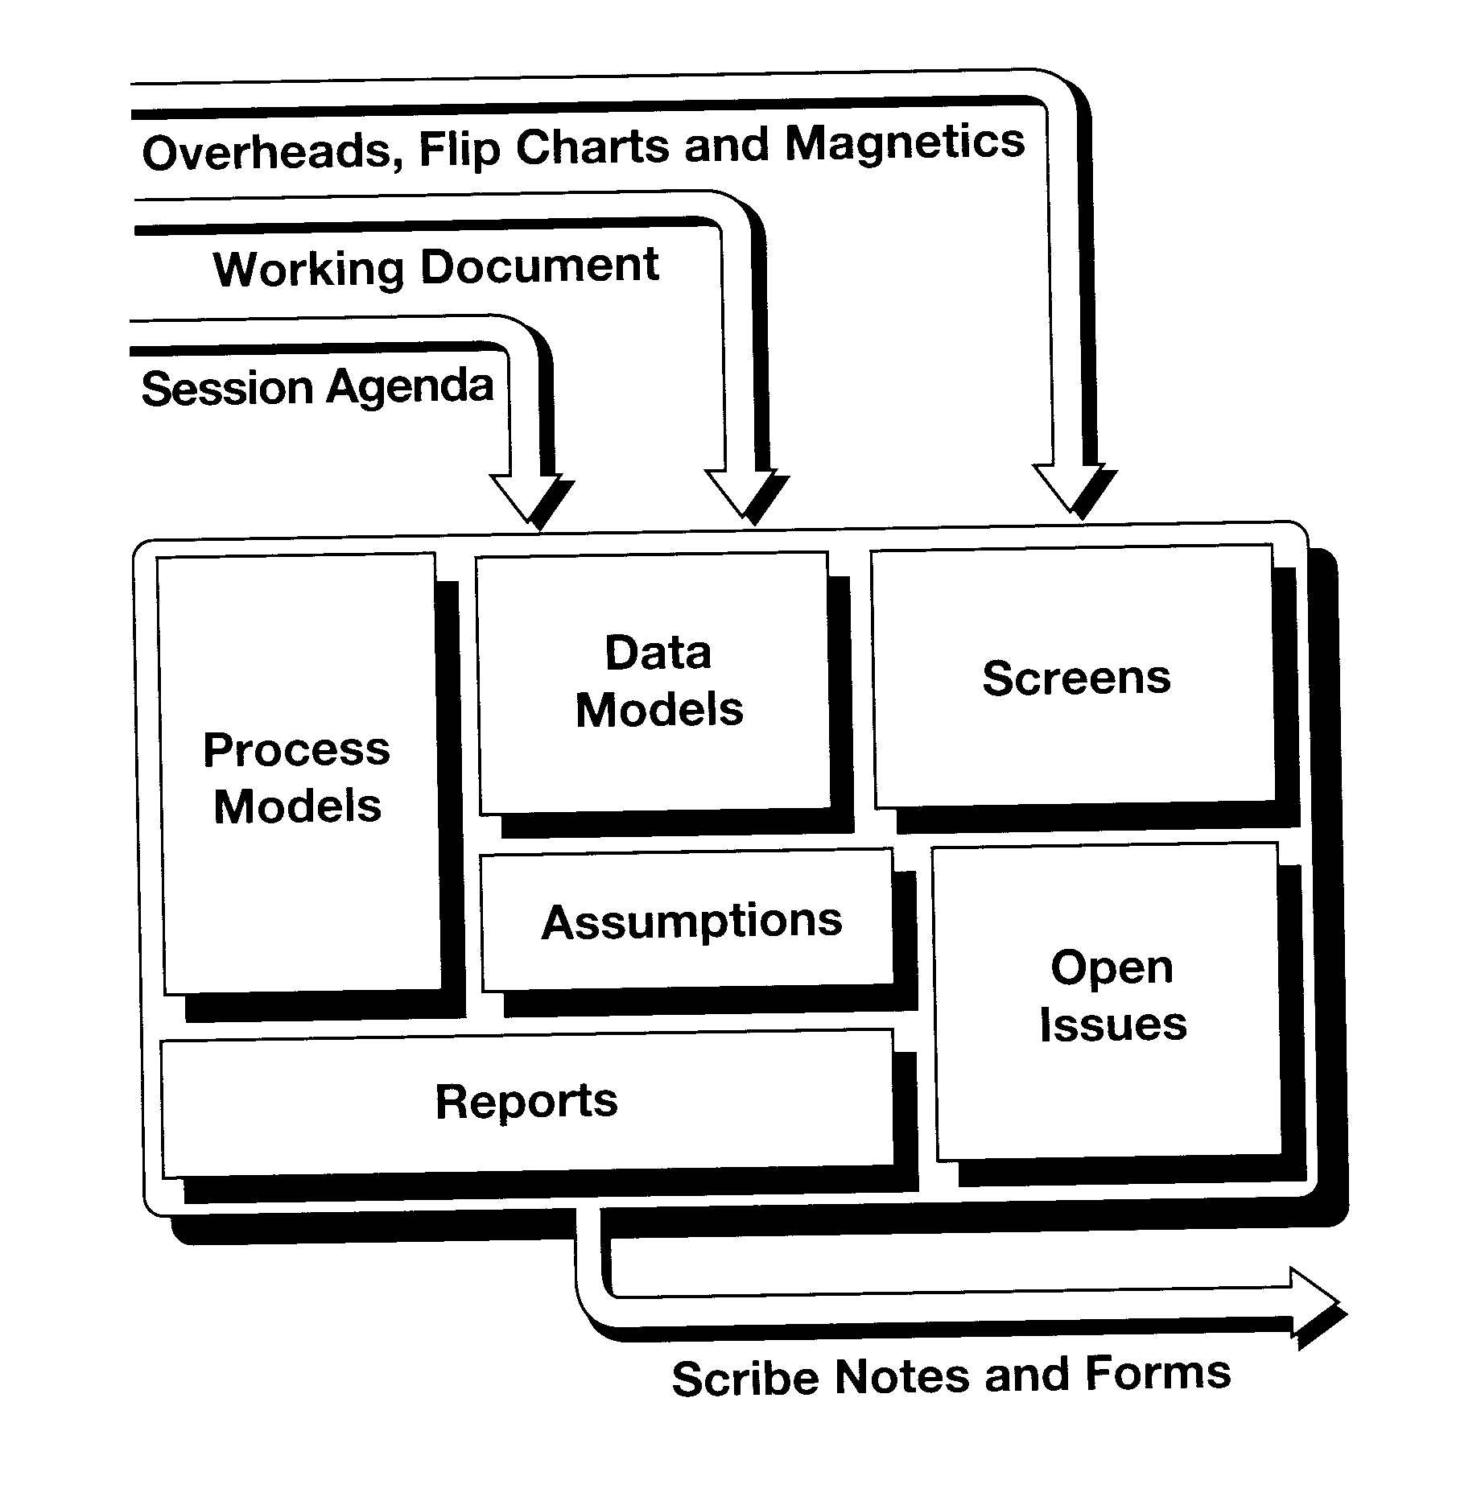
Phase 4
The Session
[Wood, Silver]

Slide 33
The Session (Cont.)
Screens
Define how people enter information into the system via computer screens.
Two types to defining screens:
  Screen flow
  Screen design
  Reports
Defines all output from the system which includes any other printouts

Slide 34
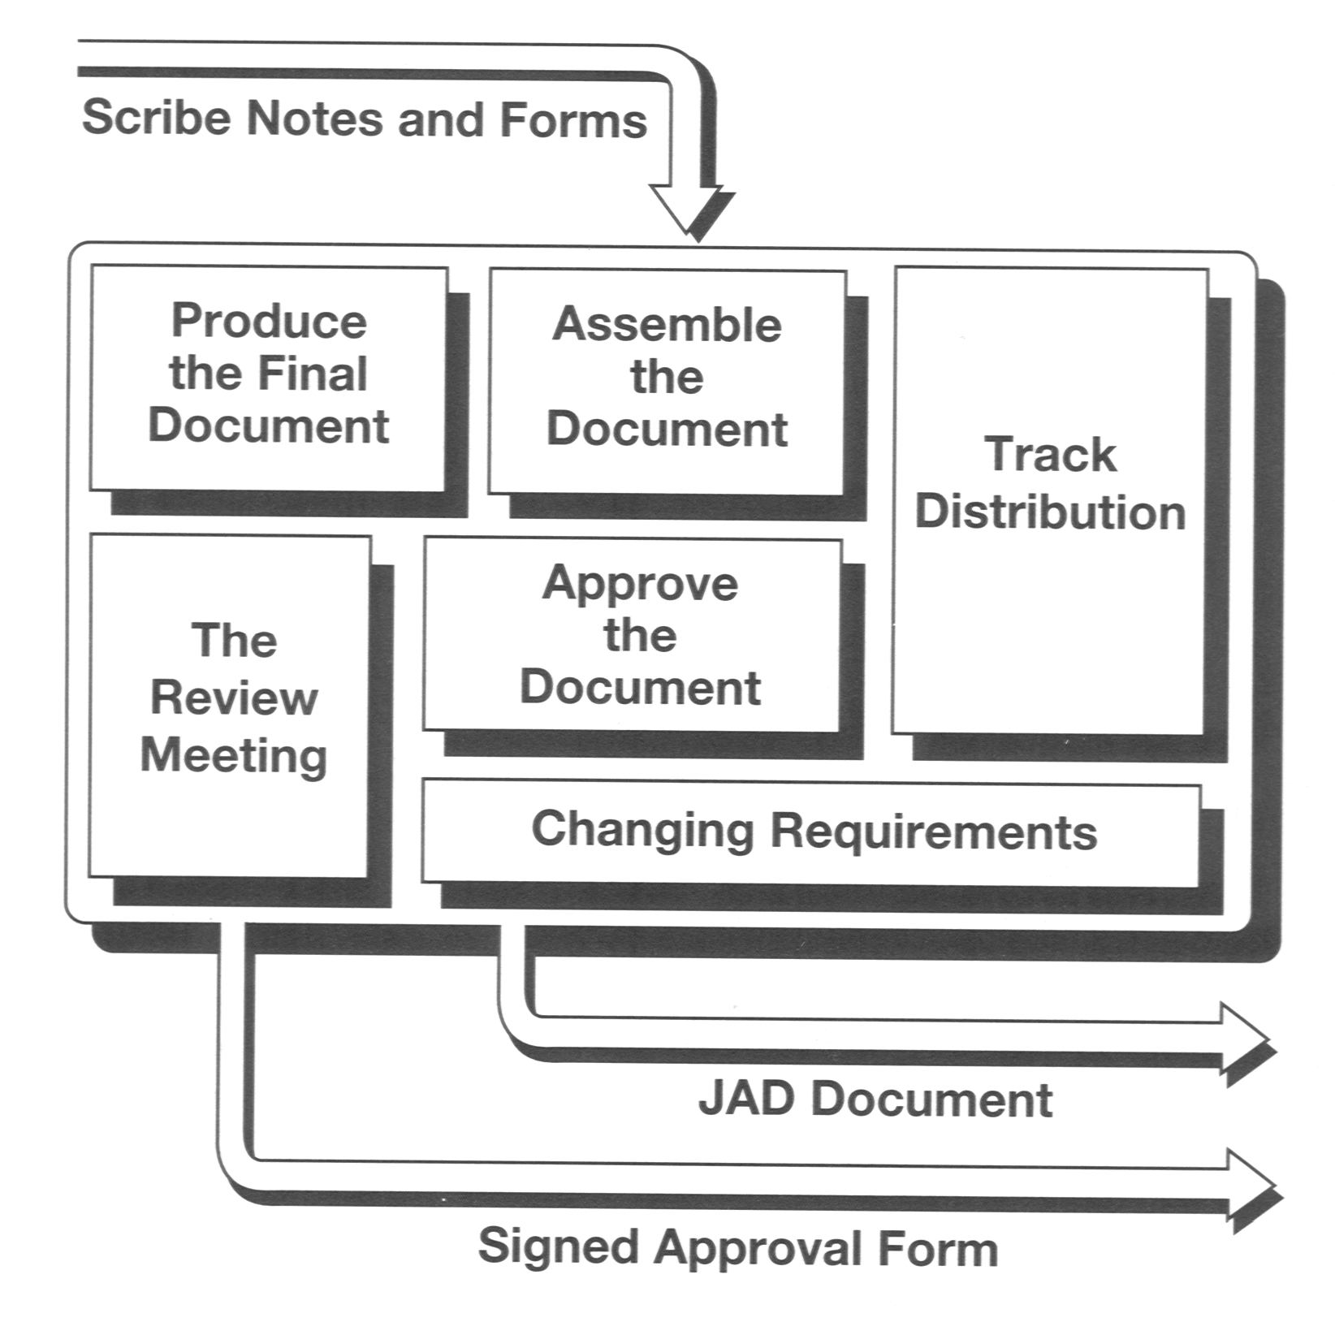
Phase 5
The Final Document
[Wood, Silver]

Slide 35
JAD Strength
Reduces cost and saves time
Simultaneous input from key users
Conflicts and discrepancies can be identified
A sense of system ownership
Suits projects with tight timelines and schedules
Improved System quality and productivity
Enhanced communication and relationship between business users and IT professionals

Slide 36
JAD Weakness
Could require more than one JAD sessions
Strong, opinionated users could dominate
Not suitable for highly computational systems
Requires key users to attend

Slide 37
Guidelines for successful JAD
Use experienced and skilled facilitators
Get Executive sponsor’s commitment and support
Get the right person to participate
Set clear, well understood and obtainable goals
Plan detailed agenda and stick with it

Slide 38
Guidelines for successful JAD (cont.)
Define deliverables clearly in advance
Keep technical jargon to minimum
Produce final document quickly

Slide 39
When is JAD used
According to Hathaway & Associates the JAD can be used in
  Requirements gathering
  Business rules
  Data Modeling
  Process Engineering
  Business Analysis
  Workflow Modeling
  Quick Fix Design
  Test Case Identification
  Test Planning

Slide 40
Automated JAD
JAD tasks can be automated and there are various of software tools that are available today.
  MeetingWorks
  Ventana Corp’s GroupSystem

Slide 41

Modern JAD Room
[Ventana]

Slide 42
Participatory Design

Slide 43
Agenda
Introduction
History
PD in North America
PD Guidelines
PD vs. Other Approaches
PD limitations and solutions
Conclusion

Slide 44
What is PD
Participatory Design (PD) is a set of diverse ways of thinking, planning, and acting through which people make their work, technologies, and social institutions more responsive to human needs.
    -- PDC 2000

Slide 45
The Purpose of PD
Give users a voice in the design process
Enable technical and non-technical participants to participate equally
Provide an opportunity for developers to meet, work with and understand their users
Provide a forum for identifying issues
Provide an opportunity to get or enhance user buy-in
Increase the productivity

Slide 46
History
Originated in Scandinavia in 1970s.
  LO-NAF collaborate to increase the workers’ influence on their own jobs.
  Worker Protection and Working Environment Act
  NJMF (Norwegian ), DEMOS (Swedish), DUE (Danish)

Slide 47
The results of the first wave
Success in political objectives
  increase the influence of the workers' voice
Failure from a technical point of view
  Lack of product options
  Hard to participate in vendor design
  Lack of technical options to support PD

Slide 48
Communication in PD
 | User's Present Work | New System | Technological options
Abstract knowledge | 1 Relevant structures of users’ present work UNDN | 2 Visions and design proposals UNDN | 3 Overview of technological options DN
Concrete experience | 4 Concrete experience with users’ present work UHDN | 5 Concrete experience with new system UN | 6 Concrete experience with technology options DHUN

Slide 49
The techniques to support Communication in PD
Techniques to support Abstract knowledge
Techniques to support Concrete knowledge
A list of techniques

Slide 50
Second Wave
When
  In the early 1980s
Who
  Several Scandinavian research institutions and the Nordic Graphical Union
What
  UTOPIA a more successful PD example

Slide 51
New philosophy
First wave – user has the power to control his / her environment
Second wave – user has the knowledge to improve his / her work

Slide 52
The techniques and limitations of UTOPIA
The techniques used by UTOPIA
  Design-by-doing
  Involved mock-ups and simulations
  Originate the “tools perspective”
Limitations of UTOPIA
  Too narrow
  In lab not in workplace

Slide 53
PD spreads out
Florence Project (1984 – 1987)
  "application perspective"
  Recognize that more than one kind of user needs to be involved in the design
FIRE (1992 – 1994)
  Integrated business model

Slide 54
Trends in PD
Research in the 1990s on how to facilitate a participatory design process in which end-users can influence the system focus on user involvement in the actual design process.

Slide 55
PD in North America
PD is not widely used in North America
  Organization Structure
  Culture
  High initial costs and time
ETHICS (Effective Technical and Human Implementation of Computer-based Systems)
  Enid Mumford 1986,1989
  12 steps approach covers the whole life of a development project

Slide 56
ETHICS (1)
Specify Work Mission
Describe Present Work Activities and Needs
Consider Job Satisfaction
Decide what needs to change
Set Efficiency, Effectiveness and Job Satisfaction Objectives
Consider Organizational Options

Slide 57
ETHICS (2)
Reorganize: Principles for good organizational design
Choose a Computer System
Train Staff
Redesign Jobs
Implementation
Evaluation

Slide 58
Guidelines for PD (1)
Respect the users of technology, view every participant in a PD project as an expert in what they do, as a stakeholder whose voice needs to be heard.
Recognize that workers are a prime source of innovation
View systems as networks of people, practices, and technology embedded in particular organizational contexts.

Slide 59
Guidelines for PD (2)
Understand the organization and the relevant work on its own terms, in its own settings.
Be conscious of one's own role in PD processes; try to be a "reflective practitioner."

Slide 60
Guidelines for PD (3)
Address problems that exist and arise in the workplace, articulated by or in collaboration with the affected parties, rather than attributed from the outside.
Find concrete ways to improve the working lives of co-participants

Slide 61
Guidelines for PD workshop
Ensure you have a thorough knowledge of the problem domain—what systems are currently in use and what are the workplace issues?
Ensure you have considered at least one potential solution. You may or may not present this solution during the workshop.
Prepare scenarios.
Prepare an agenda. Ensure that you understand clearly the purpose of each agenda item, and the techniques you will use to achieve it.
Confirm attendees and ensure all participants are notified of dates and times. If appropriate, send out a short kit explaining what will happen in the workshop.
Book an appropriate room—participants must be comfortable during the workshop. Ensure the room has flipchart, sufficient table space, and a whiteboard.
Ensure you have all materials required—Butcher's paper, pens, sticky notes.

Slide 62
Compare – Professional System
Expert Systems Design
  A system is Expert
  Offer lots of functions to help people resolve the problem
PD design
  A system for Experts
  Take what the users really need into account

Slide 63
Compare – Usability Engineering
Usability Engineering – iteratively design and evaluate the product by the data from users. (Utility, Learnability, Efficiency, Errors, Satisfaction)
Same
  designing for the user
  focusing design on what the user needs
Different
  UE cost less money and time
  PD is less risk

Slide 64
Compare – Value Sensitive Design
Value sensitive design
  human values such as freedom of speech, rights to property, accountability, privacy, and autonomy are considered when software is being designed.
  The idea behind Value Sensitive design is that the way engineers create new software or hardware makes it more suitable for some jobs over others.
Compare
  VSD is more theoretical
  It might be a way to improve the software

Slide 65
Limitations of PD
It’s good for in-house design but it faces significantly greater challenges and obstacles in the development of mass-produced off-the-shelf software applications and systems.
existing organizational structures may not support development practices

Slide 66
PD for mass product design
Problem
  The development team is only responsible for implementing the design idea
Resolution
  Users participate in product definition and product development
  Developers participate in creating the product definition

Slide 67
PD for mass product design – challenges
Motivating the Developers to work with users
Identifying Appropriate Users
Obtaining and Motivating Users
Properly Utilizing Potential users

Slide 68
Conclusion of PD
Support to articulate the product concept
Support analyze the problem situation from users
Support communication between people
Identify quality attributes of efficiency, effectiveness and satisfaction

Slide 69
RAD
The Dynamics of “Fast”
What is RAD? How do you RAD?
What has become of RAD?
How does RAD fit into RE?

Slide 70
The Dynamics of “Fast” from McConnell 1996
Tradeoffs: Time (schedule), money, quality
Efficient Development: balance all three
  Schedule – faster than average
  Economy – costs less than average
  Quality – better than average
Sensible RAD – tilts towards time ** this is our RAD **
  Schedule – much faster than average
  Economy – costs a little less than average
  Quality – a little better than average quality
All out RAD (aka code like hell)
  Schedule – fastest possible
  Economy – costs more than average
  Quality – worse than average quality

Slide 71
What is RAD?
RAD is a way to deliver systems very fast
  The longer a project, the greater its likelihood of failure
It is a lightweight approach
Uses proven technology effectively
Make the solution fit within the capabilities of the tools (hammer?)
RAD is not Quick and Dirty with a thin veneer of discipline
RAD operates where the 80 / 20 rule applies
RAD can’t be used in all situations

Slide 72
What is RAD? http://whatis.techtarget.com
RAD (rapid application development) is a concept that products can be developed faster and of higher quality through:
Gathering requirements using workshops or focus groups
Prototyping and early, iterative user testing of designs
The re-use of software components
A rigidly paced schedule that defers design improvements to the next product version
Less formality in reviews and other team communication

Slide 73
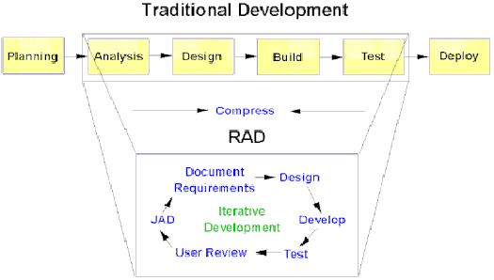
What is RAD? (CASEMaker)

Slide 74
When to use RAD
Business objectives are well defined and narrow
Data for the project already exists
Decisions can be made by a small number of people
The project team is small (6 or less)
The technical architecture is defined and clear and the key technology components are in place and tested
Technical requirements are reasonable and well within the capabilities of the technology being used.
(from GanttHead.com)

Slide 75
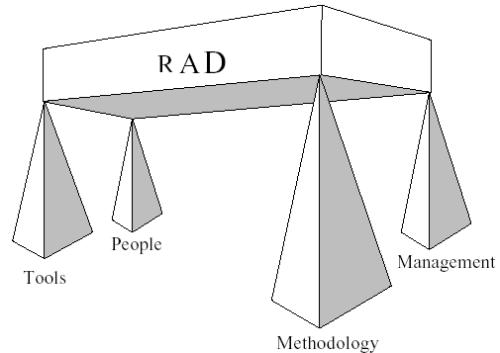
RAD – According to James Martin

Slide 76
People – Hybrid Teams
Team size: about 6
Spend on their training
Includes full-time user
Co-locate if possible
Multi-talented developers: fulfill all roles

Slide 77
Methodology
JAD and JRP as necessary
Frequent tangible working results (echoes of XP?)
Evolutionary Prototyping
RAD is agnostic about techniques as long as they are proven and focused

Slide 78

Management
RAD usually assumes that the requirements phase is done as usual (Cross)
Timeboxing – visibility (McConnell 96)
  Based on the Boehm Spiral lifecycle (Cross)
  Customer sees results regularly
Compress the tasks and deliver often

Slide 79

Tools
CASE tools
  From Excelerator to Rose
  Round trip tools
Version control
Visual prototyping
Team scheduling – collaboration
Automated testing
Code generation

Slide 80
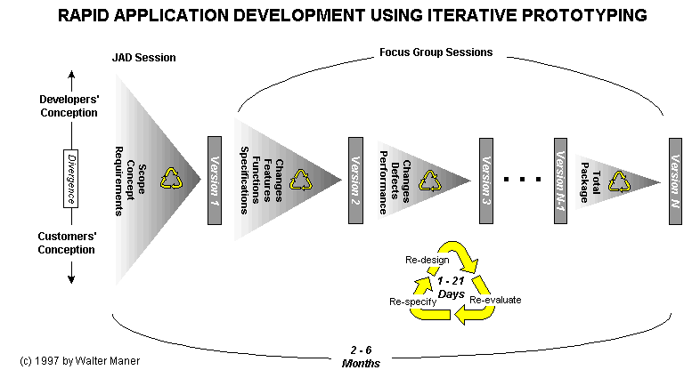
Maner (Bowling Green State University)

Slide 81

Feature Oriented RAD - FORAD
FORAD – Feature Oriented RAD
C3 Technologies

Slide 82
RAD according to Hirschberger
A very structured approach typically relying on small well trained teams, use of evolutionary prototypes, and rigid limits on development time frames
Up front investment in producing a suitable investment
Populate with just the right tool suite
Use the Spiral Model lifecycle
Object-oriented methods to reduce rework
Automated code generators
Users employ their own query tools, report generators

Slide 83
What has become of RAD?
DSDM (Dynamic Systems Development Method)
  “the standard for Rapid Application Development”
  Added method around tools
  Sees itself as a custodian of RAD
  Has close links with The Agile Alliance

Slide 84
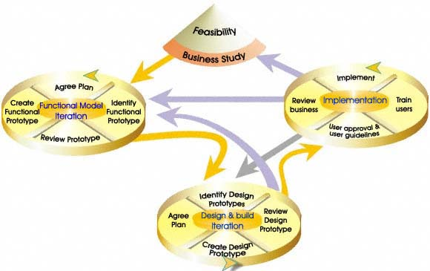
DSDM Method

Slide 85
What has become of RAD?
Methodologists overshoot what practitioners need leading to a lightweight version
  Agile group
  XP - RAD is XP when it grows up (nearly)
  Frameworks / Patterns
  Software Reuse
  CBD – component based development

Slide 86
Pros and Cons of RAD
Pros
  Good systems fast
  Good use of proven technology
Cons
  Lacking rigor, leading to systems that do not scale
  Raise expectations to unreasonable levels

Slide 87
RAD – How does it fit into RE?
Even though many criticize the RAD approach as being overly ad hoc in nature, it must be remembered that the reason for its popularity throughout the 1990s was that it was perceived as providing significant customer value -- that is, a working prototype was generally considered of much greater value to the typical business customer than 100 pages of dataflow diagrams, entity-relationship diagrams, and other formal documents produced by a heavy methodology (Highsmith and Yourdon)
IKIWISI – “I’ll know it when I see it” meets WYSIWYG

Slide 88
RAD – How does it fit into RE?
Does RAD fit into RE?
  Macaualy doesn’t mention it

Slide 89
Software development Status
Concept
In
User’s Head
Formal
Specified
SR
Deliver
and
maintain
translation
translation
Specified
in SRS
Implement
and
Test
translation
translation

Slide 90
Software develop Process
Covert vague concepts to specification
Convert specification to Formal method description
Convert Formal method descript to Code
Convert Code to final product

Slide 91
Technical coverage
 | JAD | PD | RAD | CR | QFD | SASD | SSM
1 | X | X |  |  |  |  | X
2 | X | X | X | X | X | X | X
3 | X | X | X | X | X | X | X
4 | X | X | X | X | X

Slide 92
The features of the approaches
Articulate the concept
Communication between people
Analyze the problem
Adapt to changing requirements
Create the solution

Slide 93
The supported features
 | JAD | PD | RAD | CR | QFD | SASD | SSM
1 | X | X |  |  |  | X | X
2 | X | X |  |  |  |  | X
3 |  |  | X | X | X | X
4 | X | X |  |  |  |  | X
5 |  |  | X | X | X | X

Slide 94
JAD vs. PD
Similarities
  Support direct communication between designer and user
  User centered design
Differences
  Users are information source in JAD
  Users are critical role in PD

Slide 95
JAD vs. RAD
Similarities
  Users and designers are working together
Differences
  RAD is more concerned with speed
  RAD is more tools dependent
  RAD is more technical centred

Slide 96
JAD vs. Cleanroom
Similarities
  Concern with correctness of Software
Differences
  JAD needs social skills, Cleanroom needs mathematics.
  JAD is user centred; Cleanroom is quality centred
  JAD can be the information source for Cleanroom

Slide 97
JAD vs. QFD
Similarities
  Group session techniques
  Require facilitators
  Require the project team to work with the customer
Differences
  JAD is user centred design QFD is quality centred design
  JAD need directly communication with user; QFD doesn’t need

Slide 98
JAD vs. SSM
Similarities
  Session techniques
  Both iterative
  Both take the work environment into account
  Both can deal with changing requirements
  Both emphasize the behaviour of the system
Differences
  SSM is Goal-driven, which is to produce a new system
  SSM emphasizes Control and Monitoring

Slide 99
JAD vs. SASD
Similarities
  Communication with user
  Find out what is users’ need
Differences
  JAD is more a group session, SASD uses interviewing users and analyzing documents
  JAD is more iterative process, SASD is more waterfall based
  JAD can generate the input for analysis by SASD

Slide 100
References - PD
http://cse.stanford.edu/classes/cs201/projects-00-01/participatory-design/
http://hci.stanford.edu/bds/14-p-partic.html
http://www.cpsr.org/program/workplace/PD.html
http://www.infodesign.com.au/usability/participatorydesign.html
http://www.poetics.org/redesign/pd-mgt.htm
http://www.participatorydesign.com/
http://www.teced.com/ue-pd.html

Slide 101
References – RAD
McConnell 96 – Rapid Development, McConnell, Steve; Microsoft Press 1996
FORAD http://www.ccubetech.com/products.html
Cross, Stephen E., Toward Disciplined Rapid Application Development http://www.dacs.dtic.mil/awareness/newsletters/technews2-1/disciplined.html
Hirschberg, Morton A., Rapid Application Development: A Brief Overview http://www.dacs.dtic.mil/awareness/newsletters/technews2-1/rad.html
Highsmith, J. and Yourdon, E. in Cutter Consortium Technology Trends http://www.cutter.com/consortium/freestuff/bttr0005.html
Maner, Walter; Rapid Application Development http://csweb.cs.bgsu.edu/maner/domains/RAD.htm
GanttHead Rapid Application Development Process http://www.gantthead.com/Gantthead/process/processMain/1,1289,2-19516-2,00.html
DSDM Consortium http://na.dsdm.org/index.asp

Slide 102
References JAD
http://netmation.com/docs/bb12.htm
http://www.carolla.com/wp-jad.htm
http://www.credata.com/research/jad.html
http://www.credata.com/research/methodology.html
http://www.processrenewal.com/courses/sdjad98.html
http://www.thehathaway.com/JADFacilitation.html
http://www.thinkdigitalmedia.com/service/jad.html
http://www.utexas.edu/hr/is/pubs/jad.html
[Silver/Wood] Jane Wood, Denise Silver, Joint Application Development, John Wiley & Son Inc., 1995
[Messinger] http://disc.cba.uh.edu/~jake/classes/disc3369/ppt/ch10n.ppt
[Ventana] http://www.ventana.com/rooms_CSC.html

