Slide 1

CMMI
ER Model of CMMI Processes
By
Teresa Sletten
Altech Services Inc.

Slide 2
Introduction
Introduction to ER Modeling Process
The Information
Break Down the Sentence
Entity Relationship Parsing of Sentences
Entire Model
Flat Model

Slide 3
Introduction (cont.)
Project Management Processes Flat Model
Layering Techniques
Layered Look
Project Management Process
All Layers
Top Level: Project Management Processes

Slide 4
Introduction (cont.)
Top Level: Process Management Processes
Top Level: Engineering Processes
Top Level: Support Processes
Top Level: Acquisition Processes
The Final Step
Integrated Model
Observations

Slide 5
Introduction (cont.)
Summary
Validating Altech Processes

Slide 6
Introduction to ER Modeling Process
Break down each sentence into basic elements
The elements of the sentences are made into a model
The raw model is layered
The layered model is organized and polished

Slide 7

The Information
The Quantitative Project Management process area applies quantitative and statistical techniques to manage process performance and product quality.
Quality and process performance objectives for the project are based on those established by the organization. At a minimum, the process variation experienced by subprocesses that is critical to achieving the project’s quality process performance objective is understood.

Slide 8
Break Down the Sentence
The Quantitative Project Management process area applies quantitative and statistical techniques to manage process performance and product quality.
Techniques – noun
To manage – infinitive
Process – adjective
Performance – noun
Product – adjective
Quality - noun
Quantitative – adjective
Project - adjective
Management - adjective
Process (area) – noun
Applies – verb
Quantitative – adjective
Statistical – adjective

Slide 9
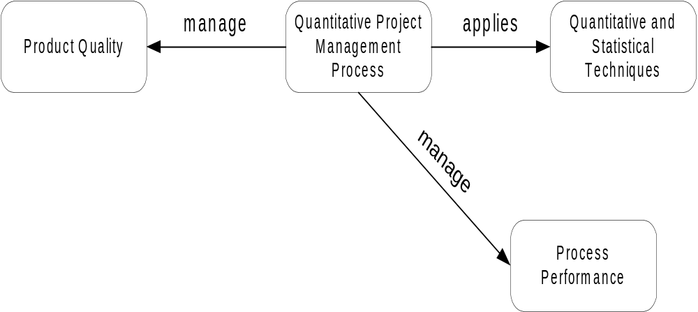
Entity Relationship Parsing of Sentences
Make a entity for each noun and add any attributes (the adjectives).
Connect the entity with a line labeled with the relationship (verb).

Slide 10
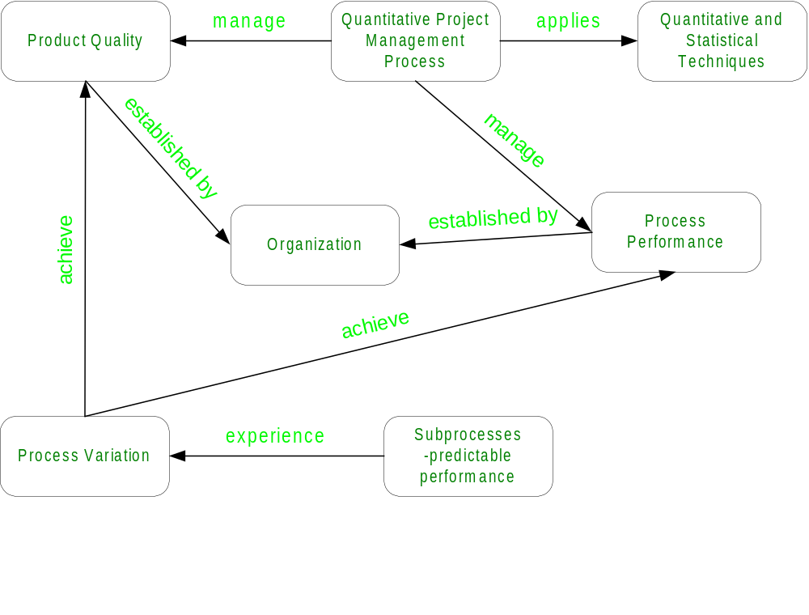
Entire Model
The Quantitative Project Management process area applies quantitative and statistical techniques to manage process performance and product quality.
Quality and process performance objectives for the project are based on those established by the organization.
At a minimum, the process variation experienced by subprocesses that is critical to achieving the project’s quality process performance objective is understood.

Slide 11


Flat Model
As more sentences are incorporated into the model, it begins to resemble a spider’s web.
The model becomes complex and cumbersome…

Slide 12
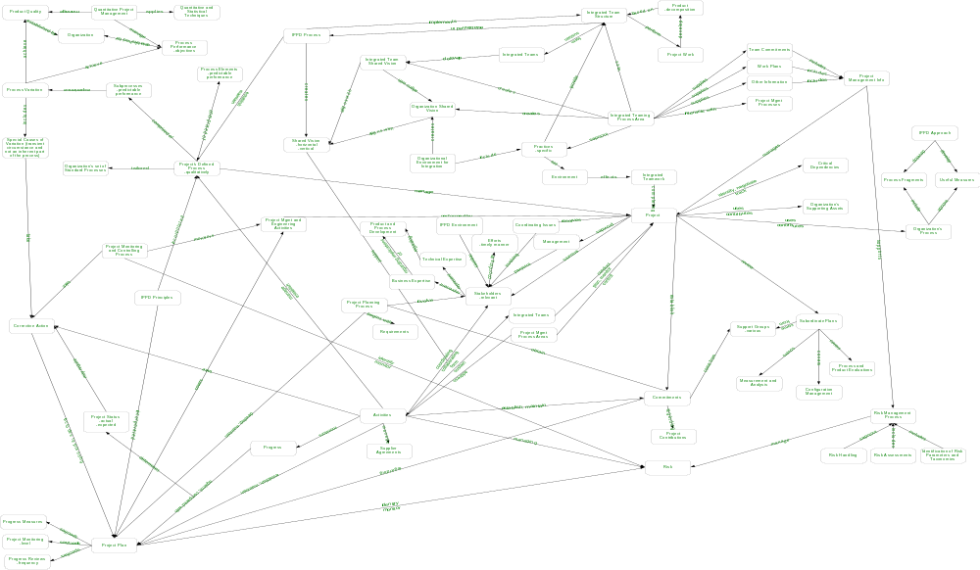
Project Management Processes Flat Model

Slide 13
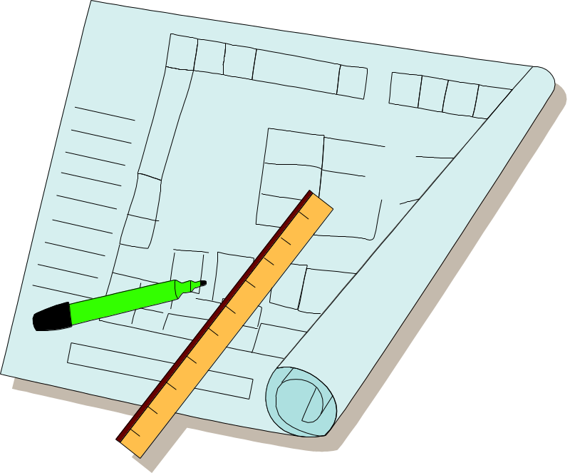
Layering Techniques
Make the flat model as readable as possible
Using strictly applied structural and then semantic techniques, collect clusters and suppress them into layers
Using analyst judgment, complete layered model

Slide 14
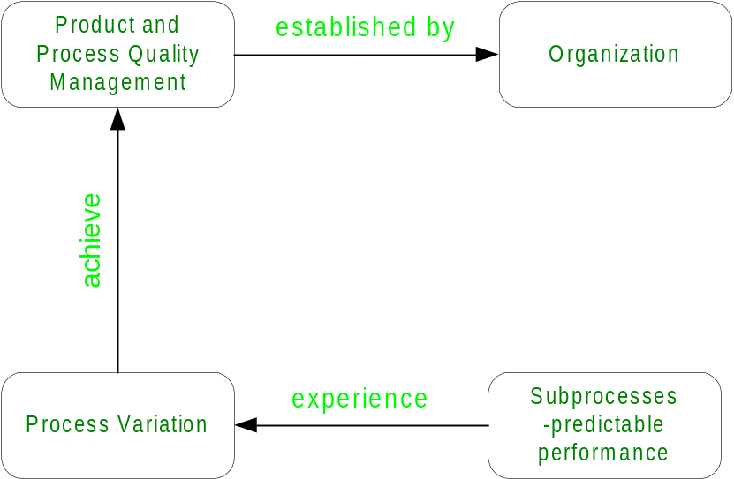
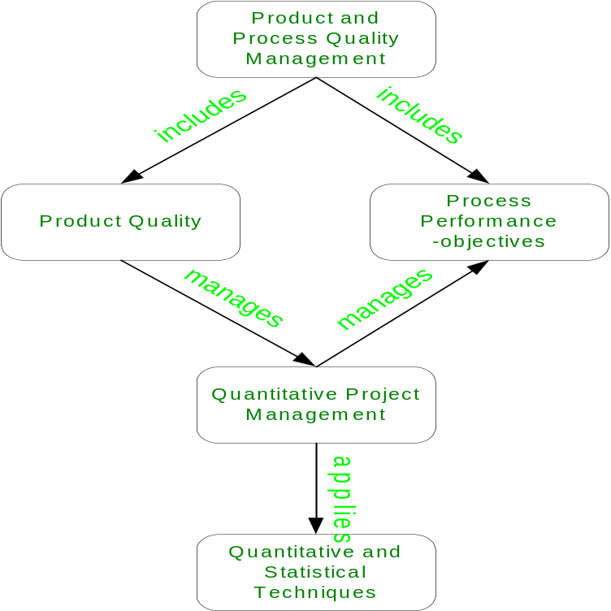
Layered Look
The Top Level Model
- this may still need to be layered
One Level Down
- this model is connected to the top level through Product and Process Quality Management

Slide 15
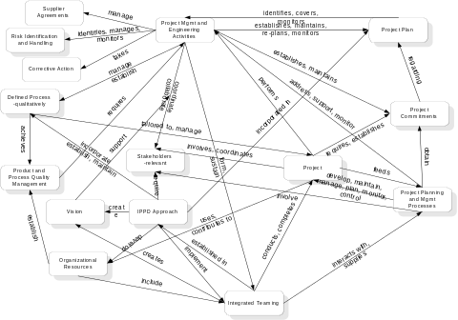
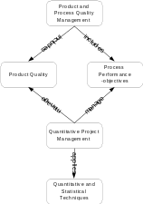
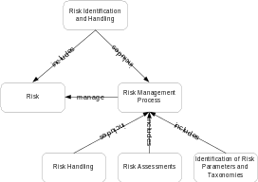
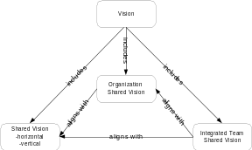
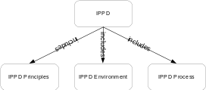
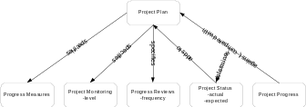
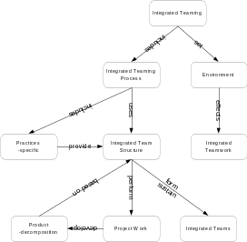
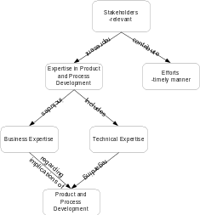
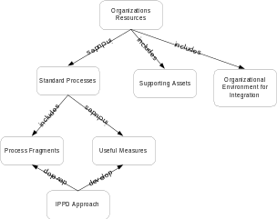
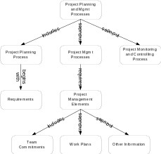
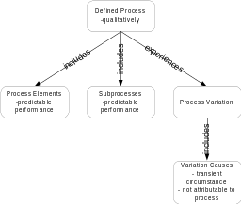
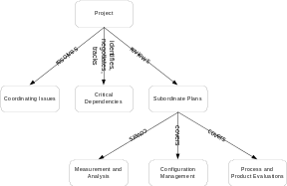
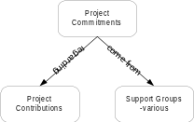
Project Management Process
All Layers

Slide 16
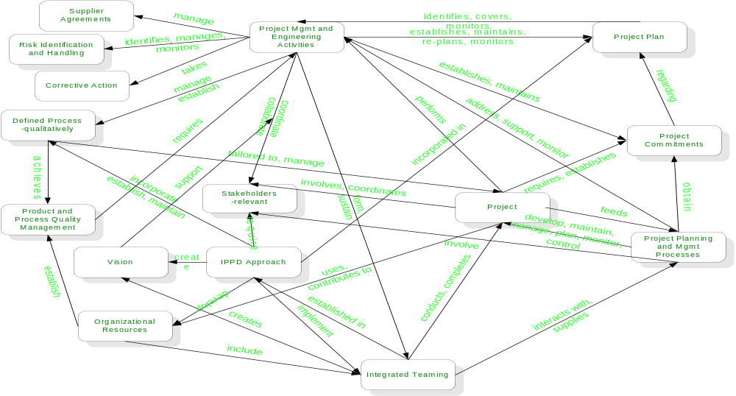
Top Level: Project Management Processes

Slide 17
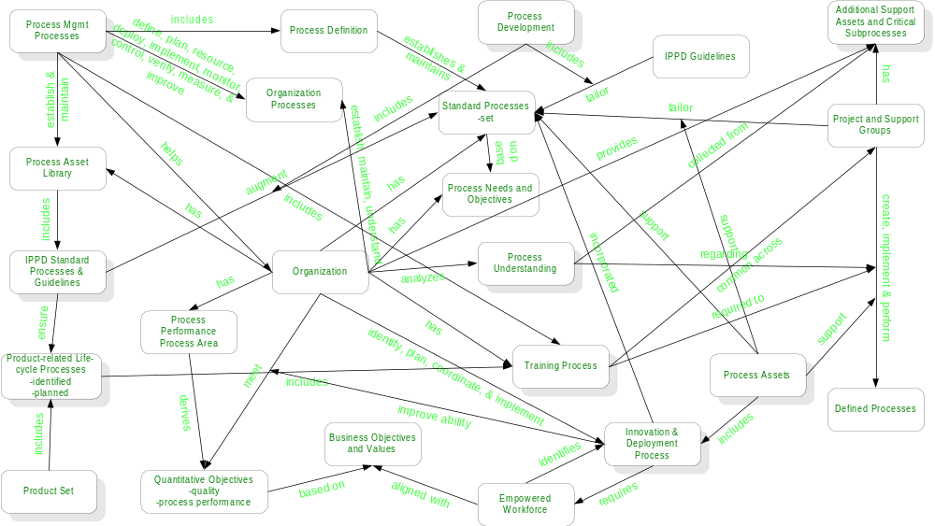
Top Level: Process Management Processes

Slide 18
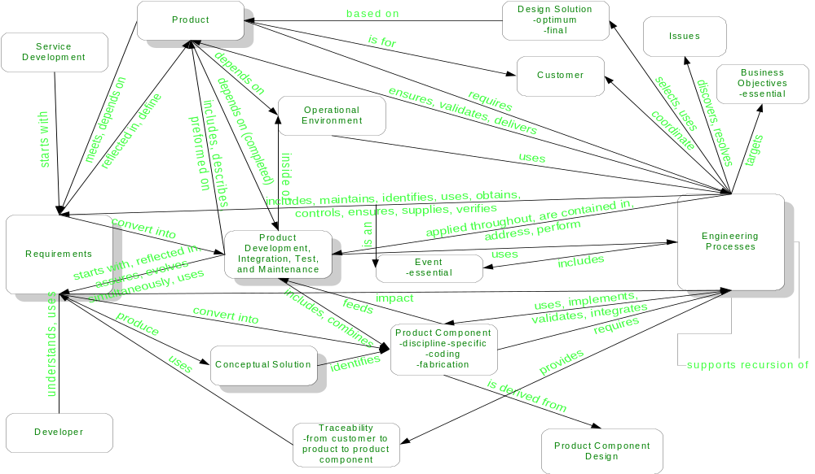
Top Level: Engineering Processes

Slide 19
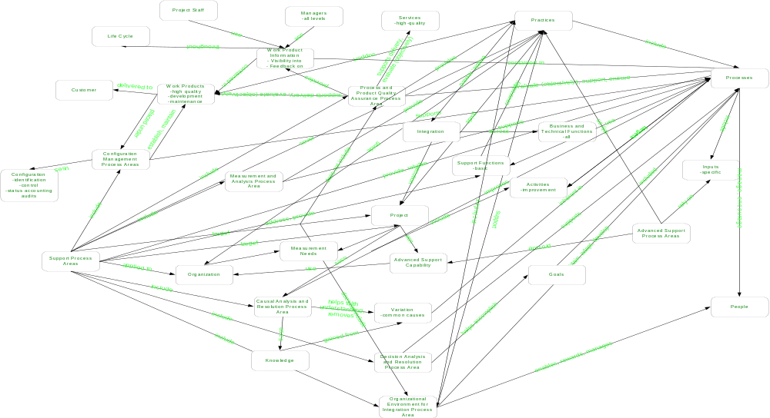
Top Level: Support Processes

Slide 20
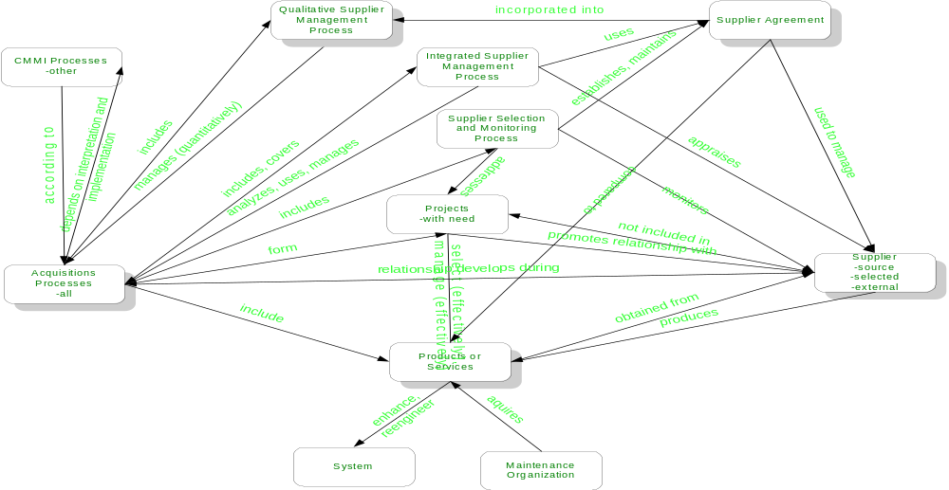
Top Level: Acquisition Processes

Slide 21

The Final Step
Take the five separate models and combine them into one model
Refactor the combined model
Organize and polish the combined model

Slide 22
Integrated Model
Work in Progress

Slide 23

Observations
Obvious different writers for different sections
Identifying primary keywords during semantic analysis for compression

Slide 24
Summary
Create flat models from chapter 5 of the CMMI document
Layer flat models
Integrate layered models together into one comprehensive layered model

Slide 25
Validating Altech Processes
Altech is developing processes using standards:
  CMMI draft version 1.02d, staged (serial text)
  IEEE Software and System Standards
  EIA/ANSI 632
  ISO 15288
  Other best practices
Altech is taking a model based approach to developing internal processes (UML)
This CMMI ER modeling will be converted into object models which will contribute to validating Altech Processes

