Slide 1
Cerebra Inc.
Fuse. Interpret. Automate.
SICoP Meeting
CEREBRA, INC.
September 2005

Slide 2


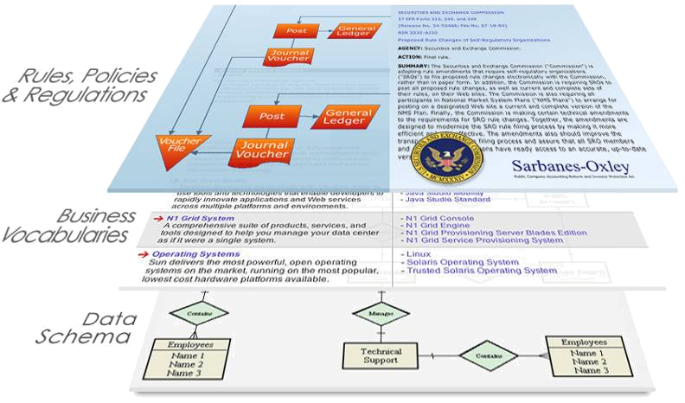



THE SOLUTION
Creating a Logical Layer using Open Standards
Fusion | Interpretation | Action
Fuse assets [data, metadata, rules, services and documents] into a cohesive whole
Interpret the meaning of assets in the right context, securely, and within policy
Automate on the explicit and implicit facts within corporate information assets
RDBMS/Marts/EII
By inserting a logical layer, domain experts can easily create run-time accessible logical models integrating data, concepts and information.
Customers and Experts describe this layer:
  “Information Grid” – Oracle
  “Adaptive ERP Solutions” – Cisco & Microsoft
  “Missing Logical Layer” – Gartner
  “MetaData-Driven Automation” - Many
Business Applications
B
A
-
SOBA’s
X
C
Z
Y
-
-
-
-
-
Hyperion
Documentum
Siebel
Peoplesoft, SAP
Salesforce
Clear Text/Email/Documents
The X product was unveiled today at the mega-conference with a list price of C; further extending Y with new features that will drive market forecasts for Z.
Java/OO/MDA/Domain
Class myClassX {
public String Z = ‘NULL’;
public int A = 0;
... }
EAI / EII
EIM Logic Layer
DATABASE
IP
One view of many possible views:
A = “price”
B = “name”
C = “$50.00
W = widgetType
X = widgetFoo
Y = widgetZed
Z = NASDMarketN
Production Rules
XML/SOA/Grid/Services
Individual layers support data OR business vocabularies OR rules/policies – not all
Stove-Piped Applications & SOBAs try to unify it all, but make integration & meaning difficult
if{
product=X
or product=Y
and type=W
} then {
market=Z
}
<process>Billing</process>
<invoice><item id=123456>
<product name=‘A’>C</product>
<product name=‘B’>X</product>
</item><invoice>

Slide 3
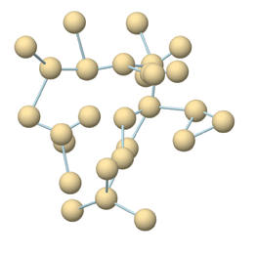
CEREBRA® SUITE
An Enterprise Platform
CEREBRA WORKBENCH
Web-based UI for metadata, vocabulary, security and policy lifecycle management
MANAGE
CEREBRA
REPOSITORY
CEREBRA
CONSTRUCT
Collaborative object repository for metadata, vocabulary, logic, security and policy management
PERSIST
MAP
Ontology engineering and external source mapping from within a familiar MS Visio framework
REASON
CEREBRA SERVER
Commercial-grade inference platform, providing industry-standard query, inference and management capabilities with emphasis on scalability, availability, robustness, external instance retrieval and 100% correctness

Slide 4





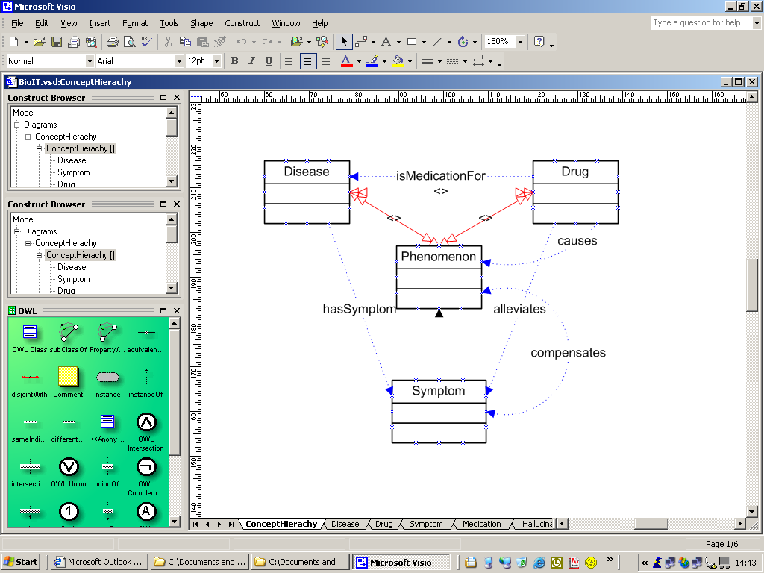


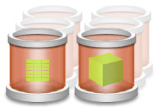


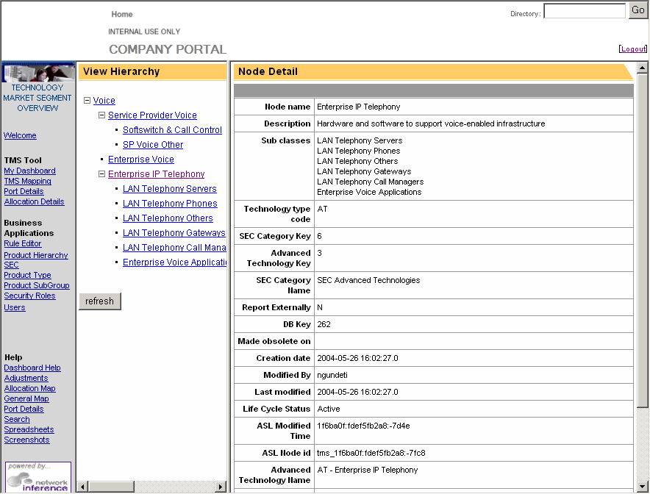


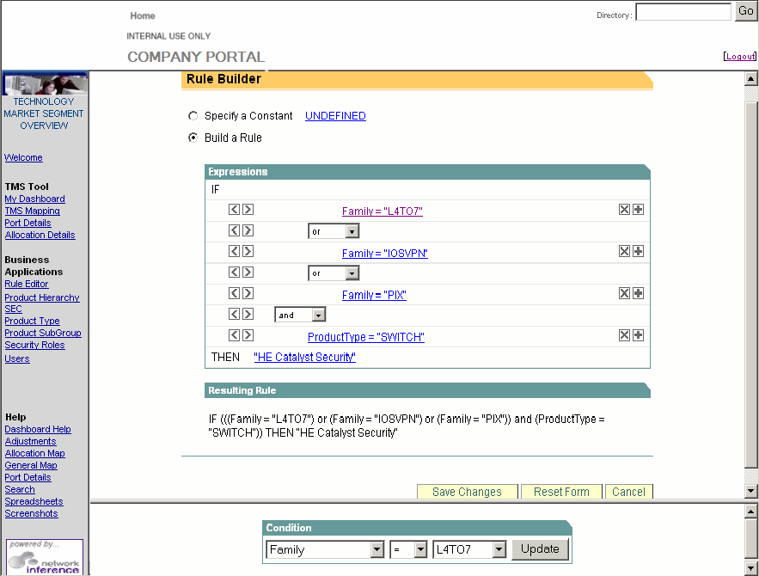
DEPLOYING CEREBRA®
Reducing Deployment Friction
IMPORT
OPTIMIZE
EXTEND
REVISE
Existing Artifacts
Architects/Engineers
Central Repository
Domain Experts
Integrators (via APIs)
ANALYZE
DEPLOY
Business Analysts
EXTEND
Domain Experts

Slide 5
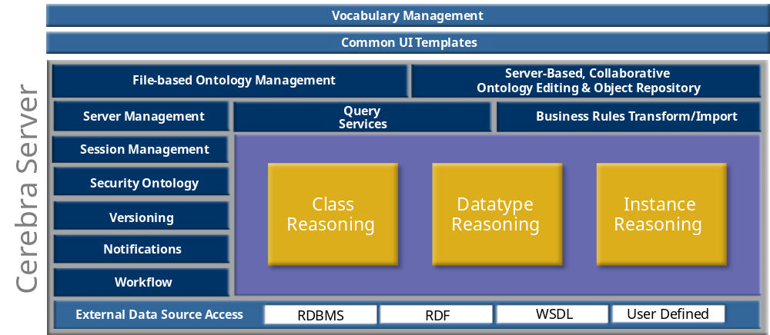

CEREBRA® SUITE
CEREBRA Server

Slide 6

Open World Demonstration

Slide 7
Scenario:
Multinational Mobile Telephone Co.
Managing just-in-time value chain:
  Manufacturing,
  Distribution &
  Marketing/promotions
Sensitive to:
  Supplier, assembly& distributor issues
  Shipper problems
  World events
They Must:
  Fuse information from different data feeds, both internal and external
  Interpret findings in terms of business context, company policies, and international restrictions or compliance
  Automate key actions across distributed service grid to provide just-in-time adaptation

Slide 8
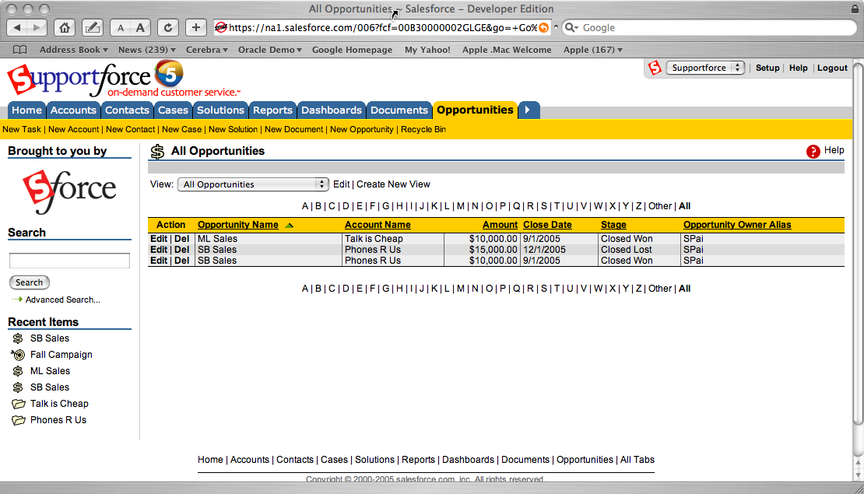
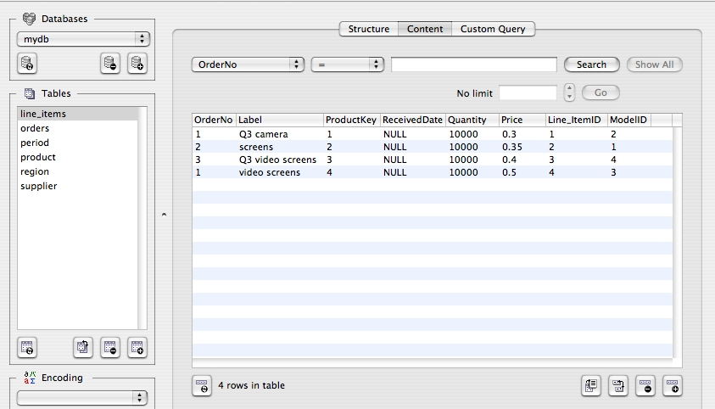
= ?
+

Slide 9
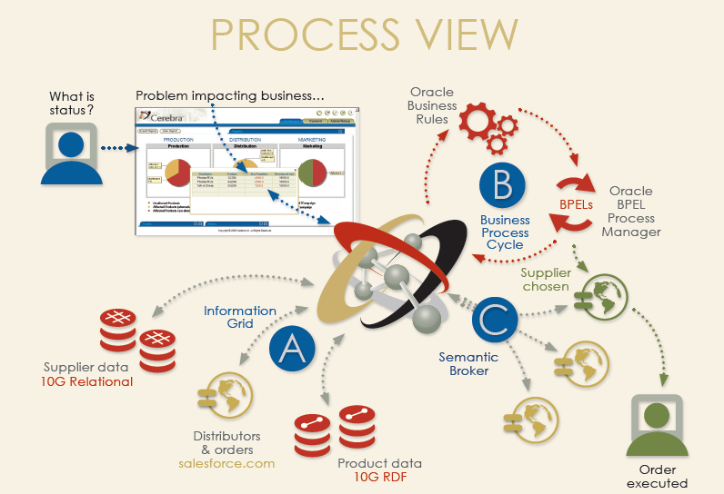

Slide 10
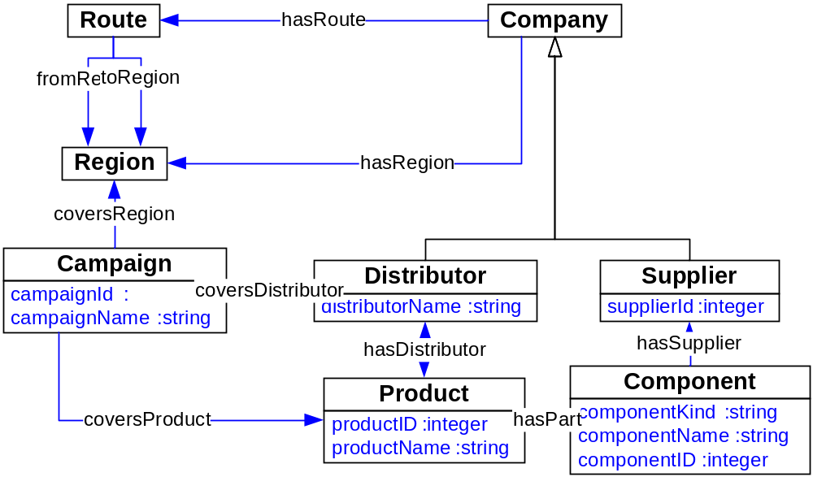
Fuse
The domain model describes how key business concepts relate to one another and how they relate to data sources

Slide 11
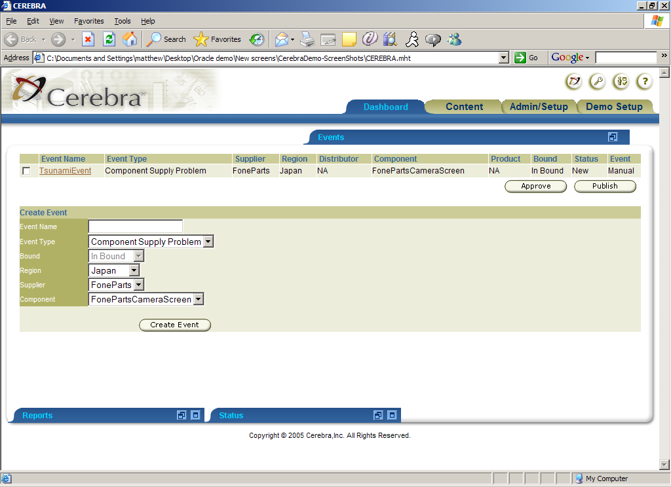
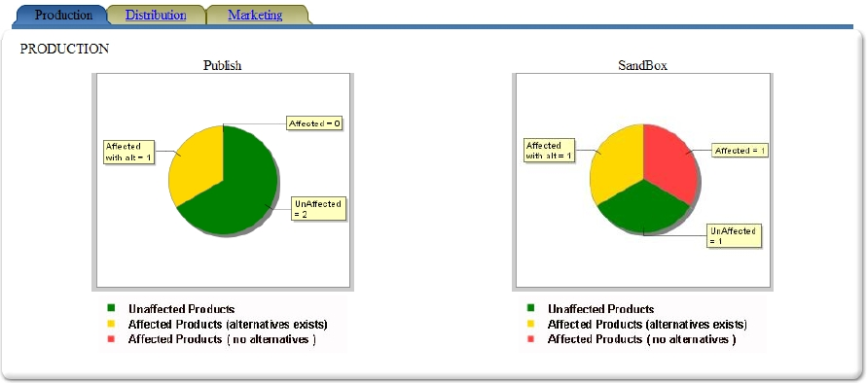
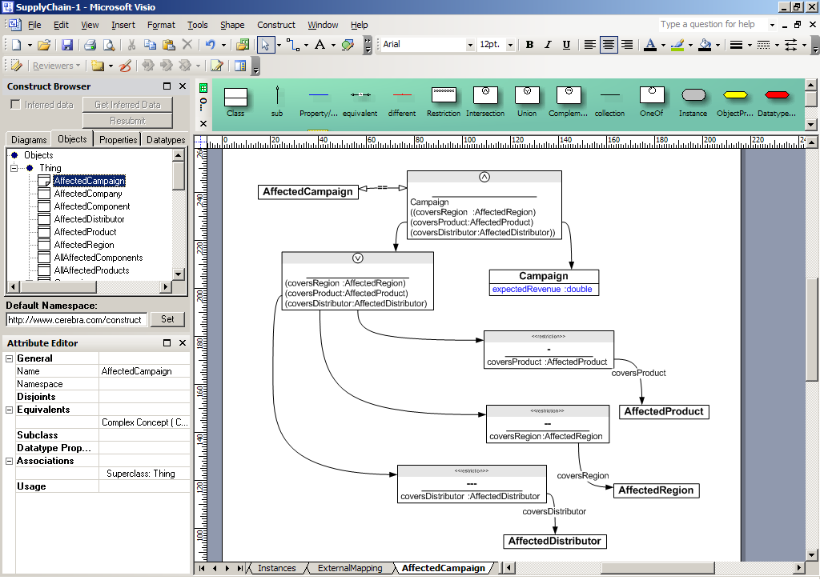
1
4
2
3

Slide 12


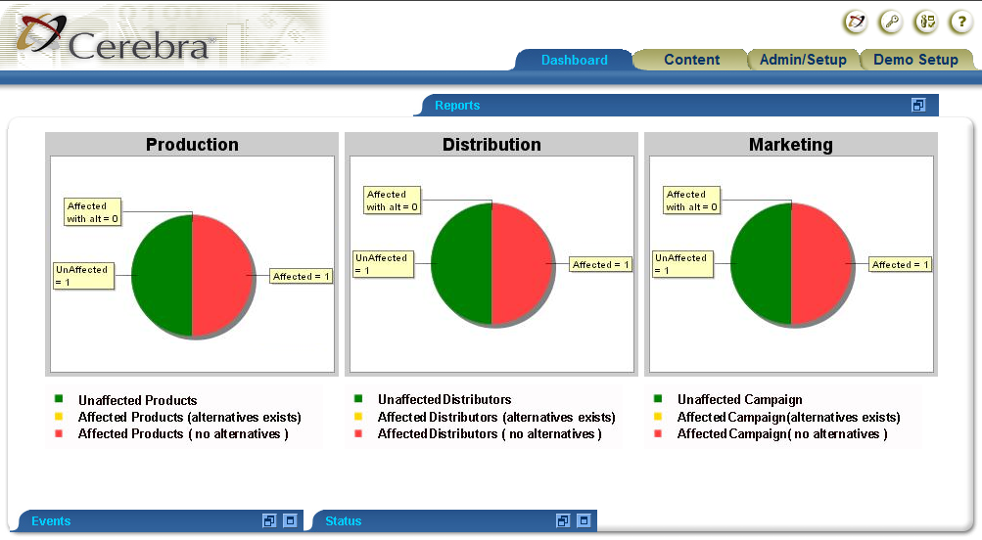
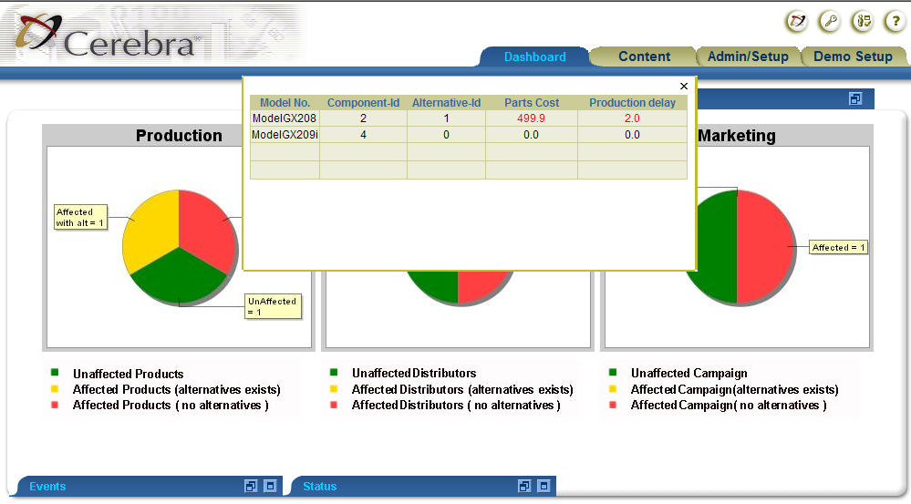

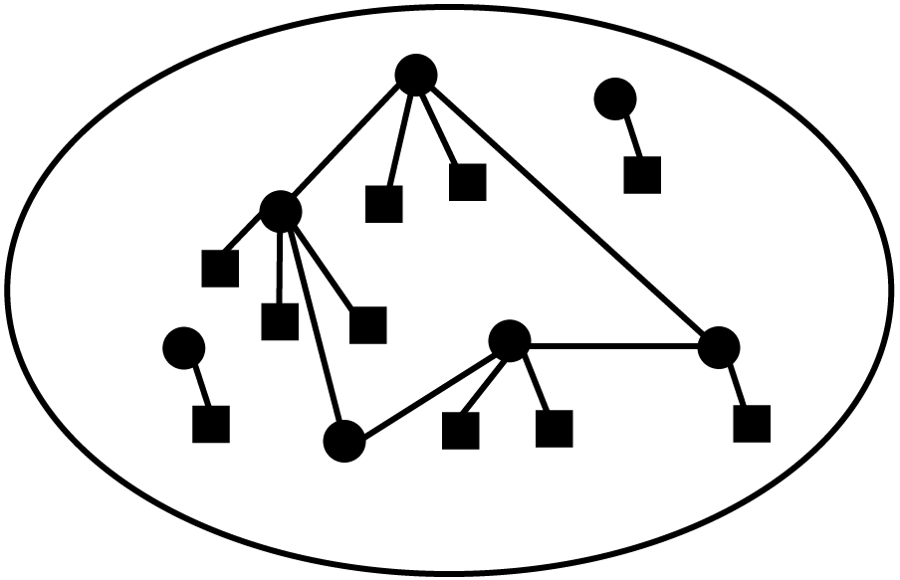



FUSE and INTERPRET
What’s the status of production and distribution
BAM update: Component supply problem
What’s the cost impact of dynamic events?
What options do I have?
What If: Supplier goes under
Cerebra
Policies, domain and data models
Models
Models
Models
Supplier data - RDB
Distributors & order salesforce.com
Product data – Oracle Spatial

Slide 13
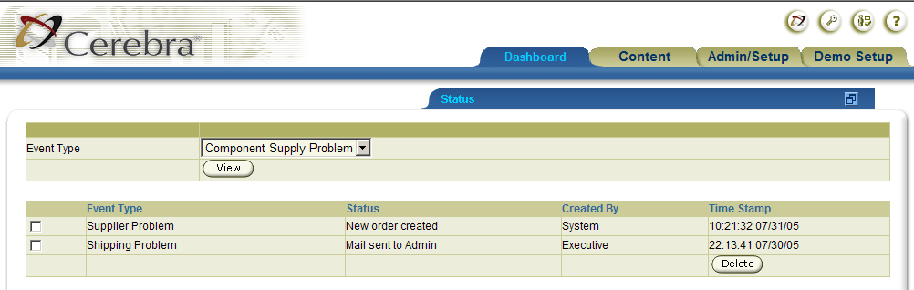




INTERPRET and AUTOMATE
I need to order a replacement part
Buy 1000 from the new supplier
Here is the service and inputs/outputs I use
Order confirmed

Cerebra semantic lookup
Cerebra semantic broker
#
$
These are the components I make
Here are the services I provide and inputs/outputs I need

Slide 14
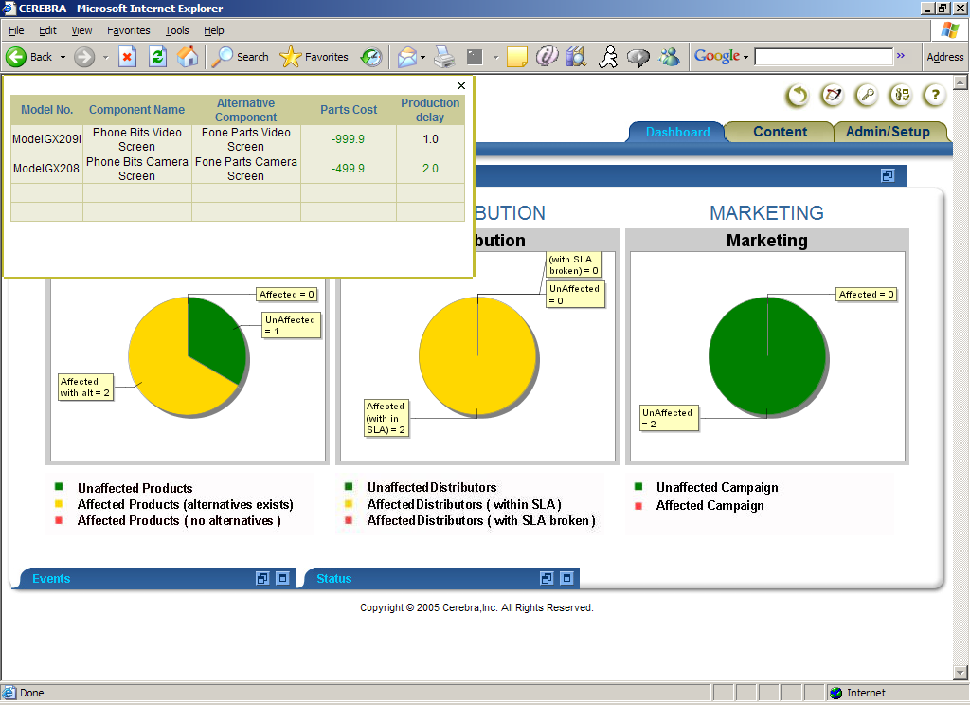

Slide 15
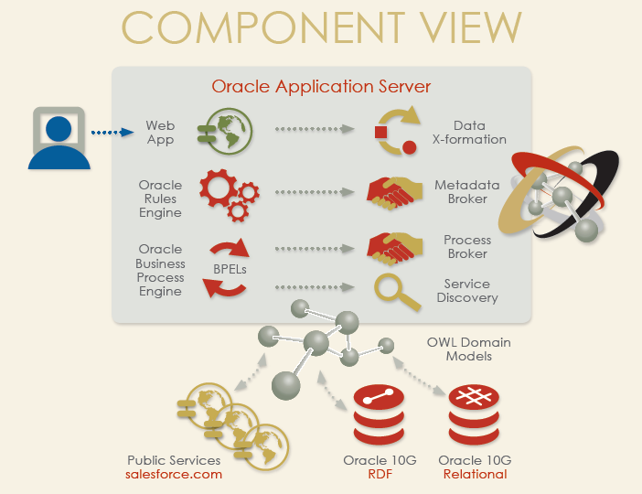

Slide 16
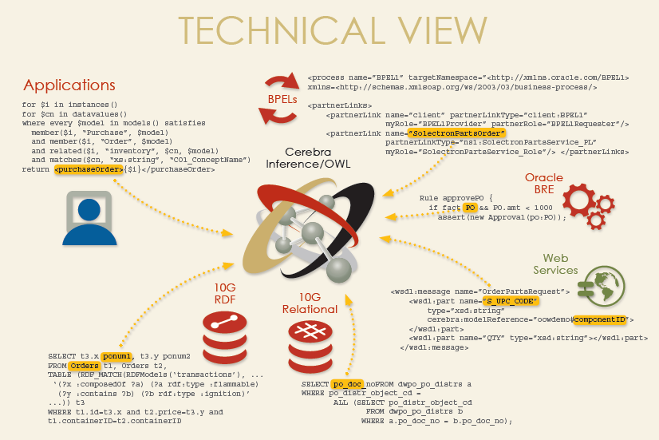

Slide 17
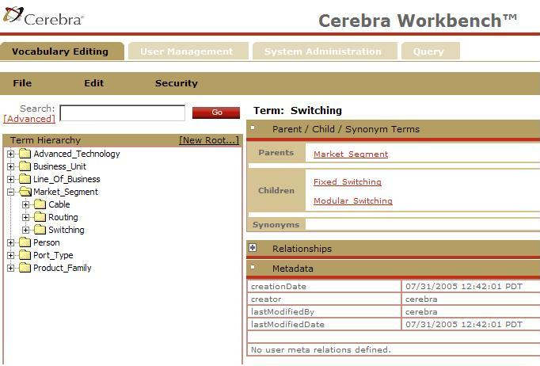
CEREBRA® WORKBENCH & REPOSITORY
CEREBRA Server

Slide 18
CEREBRA® SUITE
An Enterprise Platform
CEREBRA WORKBENCH
Web-based UI for metadata, vocabulary, security and policy lifecycle management
MANAGE
CEREBRA
REPOSITORY
CEREBRA
CONSTRUCT
Collaborative object repository for metadata, vocabulary, logic, security and policy management
PERSIST
MAP
Ontology engineering and external source mapping from within a familiar MS Visio framework
REASON
CEREBRA SERVER
Commercial-grade inference platform, providing industry-standard query, inference and management capabilities with emphasis on scalability, availability, robustness, external instance retrieval and 100% correctness

