Slide 1
Compromises along the Way
Delivering Knowledge Management Services in a Consulting Firm
Martha K Heyman, MLIS

Slide 2
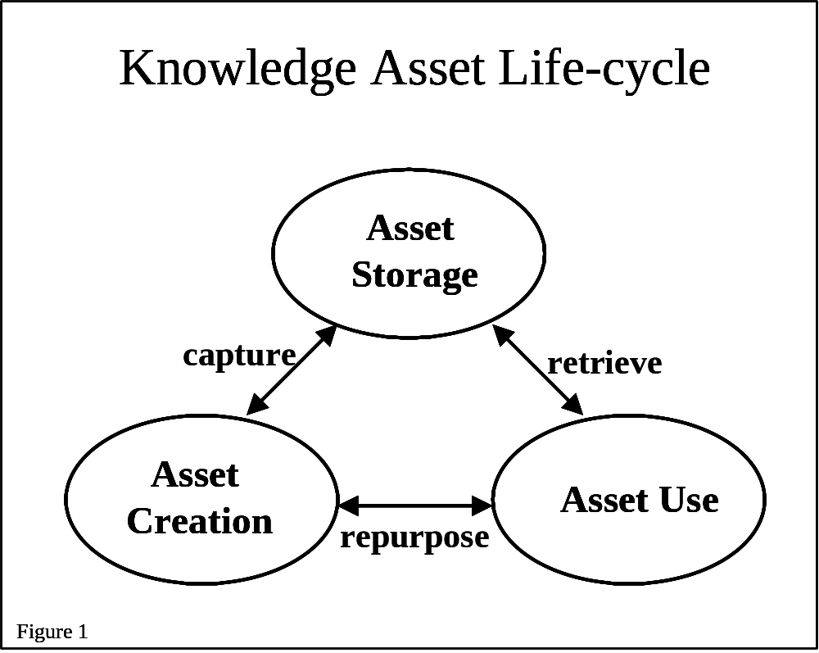
Scope of Discussion

Slide 3
Context Matters –
Knowledge Environment Varies
Where the firm competes determines business model
  Different core competencies,
  Different corporate processes
Business model constrains how knowledge assets can be effectively managed
  Determines nature of the knowledge asset life-cycle
  Influences the nature of the knowledge assets

Slide 4
Knowledge life-cycle varies
Consulting Firm
  High rate of creation
  Closely linked with revenue generation
  Short-term value
  High churn
Chemical Manufacturer
  Slow rate of creation
  Distant link with revenue generation
  Long-term value
  Slow turn-over

Slide 5
Characteristics of knowledge assets vary
Consulting Firm
  Repurposed
  Rarely used “as is”
  Knowledge components more valuable than total asset. (Parts are greater than the sum of the parts.)
Chemical Manufacturer
  Rarely repurposed
  Frequently re-used
  Complete asset more valuable than the components (Sum is greater than the parts.)

Slide 6
Consulting Firm Structure
Seven industry practice areas
Mfg
Health
Care
Comm.
Consumer
Business
Energy
Public
Sector
FSI
Strategy &
Operations
People
Technology

Slide 7
In Theory, There are Standards
Intent is to ensure….
  sustainable and consistent access to the knowledge assets over time and across disciplines
  the right content collected, at the right time, in the right format and stored in a manner facilitating fast and accurate retrieval at the right time

Slide 8
Compromise One
Manage knowledge where it’s created, but do that within a global system.
Knowledge and value are created at the practice area level
If literally managed at the practice area level there would be
  multiple silos of knowledge in the firm with
  no cross-fertilization between practice areas.
Avoid silos by using a single firm-wide repository for the knowledge assets.

Slide 9
Compromise Two
No single scope defined for the mega-collection within the repository.
Scope is an aggregation of the practice areas’ business needs
  One area may focus on collecting only proposals
  Another may focus on completed project deliverables
  First collection focused on supporting sales efforts
  While the second focused on supporting service delivery

Slide 10
Compromise Three
Inconsistent indexing of content………
Inconsistent use of meta-data fields
  Author vs. Content Owner
  Content Type
A few practice areas assign controlled terms to their content
  But each does it differently
  And the terms are not generally known outside the practice area

Slide 11
Compromise Four
Follow the money, regardless of the ‘true’ nature of the asset.
Indexed based on which Practice Area is credited with the revenue
A large pharmaceuticals firm indexed to:
Manufacturing<Process<Chemicals
rather than
Health Care<Life Sciences<Pharmaceutical Manufacturing

Slide 12
Compromise Five
The sky is not always blue, even when it is.
Ideal:
  Content primarily discusses manufacturing issues, so it is indexed with ‘manufacturing’.
What really happens:
  Content is also indexed based on “who might want to see it”
  Content is tagged to manufacturing and consumer business

Slide 13
Compromise Six
Retain outdated content because it is fresh content for someone else.
Work could be insignificant for the industry practice area,
Work may represent either
  the core competency,
  a best practice
  or be cutting edge service delivery
  for the competency practice area.

Slide 14
Barely Contained Chaos
Consensus process
Trade-offs between practice area needs
Succeeds at supporting business objectives across the firm

Slide 15
Why Does it Work?
Not really compromises – iterative process to identify a finer level of granularity
Standards applied against knowledge “packets” within the knowledge asset, not against the asset itself
Multiple sets of standards cohabitating
Minimal costs, maximum flexibility

