Slide 1
OEAM Data Strategy
EA Management Review
Salt Lake City
February 15-16, 2006
Luigi Tenore, Director, Information Management Service

Slide 2
Agenda
Motivation
Assumptions
Where we are
Strategy
Current initiatives

Slide 3
Motivation
Improve service to veterans
  Solution of “Seamless Transition” problem
  “One-Stop Shopping” for services
JEC and PMA objectives
  “One of President Bush’s 14 management priorities is to improve cooperation between DoD and VA by sharing information technology, data, facilities, and staffing …”
  www.omb.gov
Reduce operating and development costs

Slide 4
Assumptions
Improvements to veteran service are data-driven and data-intensive
Full leverage of the VA and DoD common population offers a major return on investment
Must distinguish between core enterprise data and Administration-specific data
Some degree of decentralized data management must be maintained
Administration work should be leveraged whenever possible

Slide 5
Where We Are Now
Significant legacy problem
  Data tightly coupled to applications
  Many ad hoc interfaces for data sharing
Pockets of modernization driven by Administrations
Heterogeneous environment
No overarching policy/governance for data management
Lack of common technical standards
As-Is poorly documented, data is not “visible”

Slide 6
Strategy - Objective
Data Architecture Transformation centered on:
  OneVA Data Layer
  Common Services Environment (SOA)

Slide 7
Strategy – Data Architecture Transformation
OneVA SOA: A layer of common services is available to
applications. Applications can thus be “smaller” and largely contain only
complex business logic, resulting in lower maintenance and development
costs, faster access to data, and more accurate service to Veterans.
B
B
B
B
B
B
A
A
A
A
A
A
Common Services Environment
Today: data resources are tightly coupled
to applications. Many interfaces are required.
OneVA Data Layer
OneVA Data Environment logically includes both
enterprise core data accessible via the Common
Services Environment as well as non-core data
that resides within LOB databases
B
I
B
A
A
B
I
B
I
I
A
A
I
D
D
B
A
D
I
D
B=Business Line
A=Application
D=Data
I=Interface
I
D

Slide 8
Strategy – Supporting Layers
Common Services Environment
OneVA Data Layer
Core
Data
Administration
Data
Data Description (DRM, CIM, LDM, etc.), MDR
Common Standards (metadata, modeling, xml, etc.)
Policy and Governance
Data Requirements (Enterprise, LOBs)

Slide 9
Strategy – OneVA Data Environment
Comprised of both Core Enterprise Data and Administration-specific data
Managed as an enterprise resource
  Common standards and guidelines for data management and documentation
  Centralized metadata registry
  Common configuration management practices
Core Enterprise Data common to all will be managed centrally
LOB-specific data will be managed by the Administrations

Slide 10
Strategy – Core Enterprise Data
Core Enterprise Data used across Administrations and business lines must be standardized and made available in a well documented set of common interfaces
  Standardization of core enterprise data will be led by OEAM/DAS, with Administration expertise and assistance
  Standardization of other data domains will be conducted within appropriate COIs
Demographic data is core enterprise data because it is used by virtually all components of the enterprise

Slide 11
Strategy – Common Services Environment
A OneVA SOA allows new systems being developed within the Administrations to access core enterprise data
Legacy systems modified over time to use the SOA
Calling application does not know where a transaction will run, how it is implemented, or where the data actually resides
SOA-related benefits to VA
  Creates reuse opportunities
  Reduces the need to “reinvent the wheel”
  Reduces application size and complexity
  Enables faster “time to market”
  Lowers maintenance costs

Slide 12
Strategy – How?
HOW DO WE GET WHERE WE WANT TO GO???

Slide 13
Core OEAM Data Strategies
Lead the process of defining and implementing core policies, processes, practices, and governance structures for Data Architecture and Data Management
Identify, standardize, and consolidate all core enterprise data
Design and implement a set of enterprise-level data services to unify and streamline the availability of core enterprise data
Consolidate and centralize data management resources and infrastructure supporting core enterprise data
Lead the architecture transformation process

Slide 14



Current Initiatives – Methodology
Methodology Phases
Document
As-Is
Implementation
Define
Principles
Define
To-Be

Slide 15
Current Initiatives – Governance Structure
Executive
VA DMDR
VA DRM
Sponsor
Enterprise Architecture Council
Data
Architecture
Service
Data Management Board
Technical Standards Committee
Data Management Program Office
Business Data Advisory Workgroup
Data Standardization Committees
Administration
VHA
VHA
NCA
Architects
SME
Data
Steward
OneVA Data Layer
Communities of Interest
•
Healthcare Delivery
Developer
DBA
•
Healthcare Administration
•
Benefits Delivery
•
Benefits Administration
•
Reporting

Slide 16
Current Initiatives – Core Enterprise Data
VA/DoD Data sharing IPT
  Consolidate and standardize DMDC data feeds
Administrations Data sharing IPT
  Consolidate and standardize inter-administration data

Slide 17
Current Initiatives – Common Services
Definition of standard APIs for access to core enterprise data (1st with LGY PIR)
Identity Management Concept
  Hybrid approach
  Correlation service between VA and external partners
  Unique VA ID internally
  May leverage existing VA capabilities, such as the MPI
  Initially for veterans and beneficiaries but to be extended to all persons of interest (employees, contractors, etc.)

Slide 18
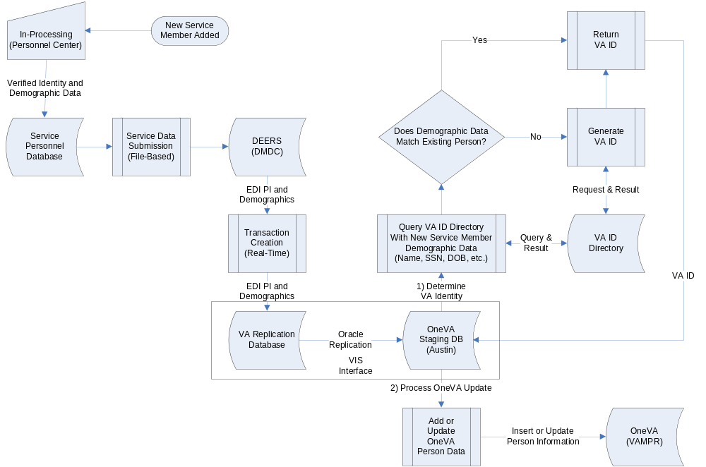
Current Initiatives – ID Management

Slide 19
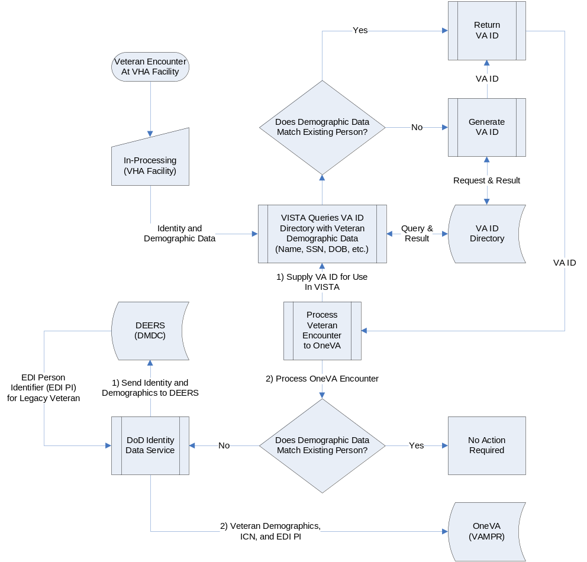
Current Initiatives – ID Management

Slide 20
Current Initiatives - DMPO
Data Management Program Office to own and manage core enterprise data
In 2007 exhibit 300
DAS is working on defining DMPO roles and responsibilities
Modeled on DoD DMDC

Slide 21
Strategy – Putting it all together
Administrations (VBA, VHA, NCA)
External Partners
DoD/DMDC/MHS
Legacy
Applications
Upgraded
Applications
New
Applications
HHS, SSA,
Others
DoD Health
(MHS)
CHCS II
Patient
Information
Direct Interaction
with LOB DBs for
Application Data
and Interaction with
Data Access Layer for
Person ID/Demographic
Core Enterprise Data
Interaction with
Data Access Layer for
Person ID/Demographics
and Interaction with LOB DBs
Directly or with Data Access
Layer for Application Data
Health/Clinical Data (VHA)
CHDR/BHIE/FHIE
Person
Information
Direct
Interaction with
LOB DBs for Person Information and Application Data
DEERS
DoD Person
Data
Repository
OneVA Common Services Environment
VIS Interface
Real-Time Oracle Replication
Data Access
Layer (APIs)
VA ID Directory
(Person Services)
Correlation
Service
OneVA
(VAMPR)
VADIR
LOB DB
LOB DB
LOB DB
Administration Specific Data
Business Line Data
Core Enterprise Data
Veterans and all Person Data
OneVA Data Environment

Slide 22
Q&A
????????

