Slide 1

Data Management Functional Framework
Mark Mosley
Dataspace, Inc.
DAMA Chicago
5/3/2006 Revision

Slide 2
Data Management Functional Framework
Defines the scope and basic concepts of the Data Management (DRM, IRM) function
Developed, owned and offered by DAMA International and the DAMA Foundation
A two dimensional matrix
  9 Data Management Functions
  7 Environmental Elements
Outlines the content of the Data Management Body of Knowledge (DMBOK) document
  Modeled after the PMI PMBOK’s Project Management disciplines
A guide to help:
  Define an Enterprise Data Management Strategy
  Assess Data Management Efforts
  Establish the Context for Data Management Programs and Initiatives
  Develop an IT Curriculum (for Higher Education Institutions)
  Organize DAMA Initiatives
Copyright 2006 DAMA International -- All Rights Reserved

Slide 3
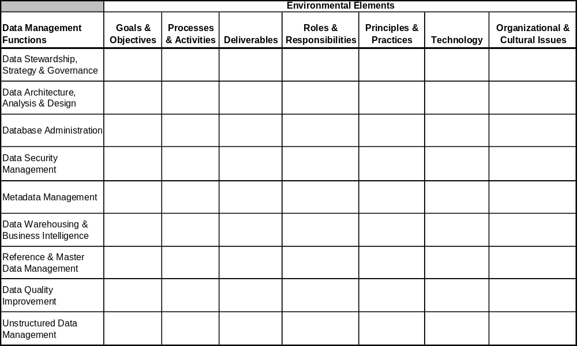
Data Management Functional Framework
Copyright 2006 DAMA International -- All Rights Reserved

Slide 4
Data Management Functions
Unstructured Data Management
Data Architecture, Analysis & Design
Data Quality Improvement
Database Administration
Data Stewardship, Strategy & Governance
Reference & Master Data Management
Data Security Management
Data Warehousing & Business Intelligence
Metadata Management
Copyright 2006 DAMA International -- All Rights Reserved

Slide 5
Data Management Functions
Data Stewardship, Strategy and Governance
  Establish and Supervise Data Resource Management Within IT
  Identify & Coordinate Business Data Stewards
  Establish and Coordinate the Data Stewardship Council
  Define & Maintain a Data Strategy
  Develop & Maintain Data Policies
  Manage Data Issues
  Estimate Data Value & Data Management Cost
  Justify & Budget For Data Management Programs
  Oversee Data Management Programs, Projects & Services
  Enforce Data Management Policies & Standards
  Publicize & Promote Data Management
Copyright 2006 DAMA International -- All Rights Reserved

Slide 6
Data Management Functions
Data Architecture, Analysis and Design
  Establish and Maintain the Enterprise Data Architecture
    Apply Architectural Frameworks
    Develop / Maintain the Enterprise Data Model
    Develop Performance Measurement Model
    Perform Information Value Chain Analysis
    Develop / Maintain Data Integration / Master Data Management Architecture
    Develop / Maintain Data Warehousing / Business Intelligence Architecture
    Develop Unstructured Data Architecture Deliverables
    Align With Business & Technical Architecture
  Capture, Analyze & Control Data Requirements
  Perform Logical Data Modeling
  Perform Physical Data Modeling
  Develop / Maintain Modeling & Design Standards
  Conduct Data Model and Database Design Reviews
  Model Management (Model Version Control)
Copyright 2006 DAMA International -- All Rights Reserved

Slide 7
Data Management Functions
Database Administration
  Physical Database Design
  Database Implementation and Change Control
  Backup and Recovery
  Performance & Tuning
  Archival, Retention and Purging
  Data Technology Management
Data Security Management
  Data Privacy Standards Development and Implementation
  User Administration and Group Membership Administration
  Data View Administration
  Data Access Permission Administration
  Password Standards and Practices
  User Authentication
  Data Security Auditing
Copyright 2006 DAMA International -- All Rights Reserved

Slide 8
Data Management Functions
Metadata Management
  Metadata Architecture Development and Implementation
  Metadata Standards Development and Implementation
  Metadata Creation, Capture and Maintenance
  Metadata Storage, Integration and Sharing
  Data Lexicon, Glossary, Dictionary & Directory Management
  Metadata Repository Management
Data Warehousing and Business Intelligence
  Data Warehouse / Data Mart Implementation and Maintenance
  Business Professional Training & Support
  Enterprise Reporting
  Ad Hoc Query & Analysis
  OLAP Analysis
  Statistical Analysis
  Data Mining / Predictive Analysis (segmentation, cluster analysis)
  Scenario Modeling (“what-if” variable analysis)
Copyright 2006 DAMA International -- All Rights Reserved

Slide 9
Data Management Functions
Reference & Master Data Management
  System of Record Principles
  Customer Data Integration
  Product Data Integration
  Code Management
  Other Reference Data Management (Employees / Staff, Vendors, ...)
  Business Data Steward Control and Auditing
Data Quality Improvement
  Regulatory Compliance (SOX, etc.)
  Data Quality Auditing and Certification
  Data Quality Analysis (including Data Profiling)
  Data Cleanup Campaigns and Programs
  Data Quality Requirements Analysis
Copyright 2006 DAMA International -- All Rights Reserved

Slide 10
Data Management Functions
Unstructured Data Management
  Document Management
  Image Management
  XML Management
  Geospatial Data Management
  Content Management
  Taxonomy Management
  Knowledge Management
Copyright 2006 DAMA International -- All Rights Reserved

Slide 11
Data Management Functions
Unstructured Data Management
Data Architecture, Analysis & Design
Document Mgmt
Image Mgmt
XML Mgmt
Geodata Mgmt
Content Mgmt
Taxonomy Mgmt
Knowledge Mgmt
Enterprise Modeling
Value Chain Analysis
Data Integration Arch.
DW / BI Architecture
Logical Modeling
Physical Modeling
Design Stds
Model Mgmt
Data Quality Improvement
Database Administration
Regulatory Compliance
DQ Analysis / Profiling
DQ Audit & Certification
Cleanup Campaigns
DQ Rqmts Analysis
DB Design
DB Change Control
Backup & Recovery
Performance & Tuning
Archival & Purging
Technology Mgmt
Data Stewardship, Strategy & Governance
IT DRM Organization
Data Stewardship Council
Data Strategy Definition
Data Issue Management
Data Cost Management
Oversight & Enforcement
Reference / Master Data Management
Data Security Management
Data Privacy Standards
User and Group Admin
Access View Admin
Password Practices
User Authentication
Data Security Audit
Customer Data Integration
Product Data Integration
Code Management
Data Steward Control
Data Warehousing & Business Intelligence
Metadata Management
Metadata Arch
Metadata Standards
Capture & Maintenance
Integration & Sharing
Query & Reporting
Lexicons, Glossaries, ...
Repository Admin
DW / Mart Implementation
User Training & Support
Enterprise Reporting
Query & OLAP Analysis
Stat Analysis / Data Mining
Scenario Modeling
Copyright 2006 DAMA International -- All Rights Reserved

Slide 12
Environmental Elements
Processes & Activities
Organizational & Cultural Issues
Deliverables
Goals & Objectives
Technology
Roles & Responsibilities
Principles & Practices
Copyright 2006 DAMA International -- All Rights Reserved

Slide 13
Environmental Elements
Goals & Objectives
  Vision & Mission
  Business Benefits
  Long Term Goals
  Short Term Objectives
Processes & Activities
  Functional Decomposition
  Process Flow
  Use Case Scenarios
  Events & Triggers
  Phases & Steps
  Dependencies & Preconditions
Deliverables
  Inputs & Outputs
  Documents & Databases
  Assets & Resources
Roles & Responsibilities
  Business Roles
  IT Roles
  Skill Requirements
  Job Position Descriptions
Principles & Practices
  Fundamental Principles
  Methods, Techniques, Approaches
  Standards & Guidelines
  Conventions & Heuristics
  Implementation Recommendations
Technology
  Tool Categories
  Standards & Protocols
  Product Selection Criteria
  Learning Curves
Organizational and Cultural Issues
  Critical Success Factors
  Reporting Structure Alternatives
  Contracting Alternatives
  Resource Allocation
  Management Metrics
  Teamwork, Authority & Empowerment
  Shared Values & Beliefs
  Expectations & Attitudes
  Style & Preference Differences
  Rites, Rituals, Symbols
  Organizational Heritage
Copyright 2006 DAMA International -- All Rights Reserved

Slide 14
Environmental Elements
Processes & Activities
Function Decomposition
Process Flow
Use Case Scenarios
Trigger Events
Phases, Tasks, Steps
Dependencies
Organizational & Cultural Issues
Deliverables
Critical Success Factors
Reporting Structures
Management Metrics
Values, Beliefs, Expectations
Attitudes, Styles, Preferences
Rituals, Symbols, Heritage
  Inputs & Outputs
  Documents
  Databases
  Other Assets & Resources
Goals & Objectives
Vision & Mission
Business Benefits
Strategic Goals
Tactical Objectives
Technology
Roles & Responsibilities
Tool Categories
Standards & Protocols
Selection Criteria
Learning Curves
  Business & IT Roles
  Skill Requirements
  Job Descriptions
Principles & Practices
Generally Accepted Principles
Recognized Best Practices
Alternative Methods & Techniques
Implementation Recommendations
Copyright 2006 DAMA International -- All Rights Reserved

Slide 15
Guiding Principles Behind the DM Framework
Use short and recognizable terms
Use terms that get a CIO’s attention – capture mindshare
Take a CIO’s perspective of data management
Use terms that will continue to be valid over time
Limit the the number of items in each dimension and outline level to 9 items or less
Copyright 2006 DAMA International -- All Rights Reserved

Slide 16
How Would This Organize the DMBOK Document?
The first Chapter would be for the entire DM function
Followed by 9 more chapters – one per function
Each chapter would contain sections for each Environmental Element, in consistent order
Not every chapter needs to include every element
Each chapter would ends with a Recommended Reading list
  The DMBOK aspires only to be “the definitive introduction” to DM, not a complete description of any function
Appendices would contain additional supplementary articles and sample documents
Copyright 2006 DAMA International -- All Rights Reserved

Slide 17
How Does This Structure Help?
It helps us divide and share author responsibility
It helps us coordinate and integrate the work of multiple authors
It helps prompt the imagination of our authors, prompting them to consider each element
It helps readers find what they’re looking for
It helps us define our industry’s terms!
Copyright 2006 DAMA International -- All Rights Reserved

Slide 18
Next Steps
Recruit authors and reviewers for committee / editorial board
Develop a model of Data Management
Draft the Glossary
Draft a sample chapter
Draft Chapter One -- Overview
Draft Chapters Two and Three
Copyright 2006 DAMA International -- All Rights Reserved

