Slide 1
NHS Infrastructure Maturity Model (NIMM)
Overview
Andy Savvides
Technology Office
http://nww.connectingforhealth.nhs.uk/pspg/

Slide 2

The Challenges - Sound Familiar?
Not enough time to plan ahead, too many projects!
My Chief Exec needs a prioritised plan for infrastructure spend
I don’t like audits. I do like being advised on what needs improving.
How can I tell if a proposed infrastructure solution is right for me?
I know that my infrastructure needs improving, but what should I do first?
How can I get most value from my IT infrastructure investments?

Slide 3
Infrastructure Challenges
Important to have a plan - according to analysts, 70% of typical IT spend goes on IT Infrastructure! (run the organisation)
NHS IM&T Managers should not just rely on gut feel when setting investment priorities
Organisational changes in the NHS means that many IT infrastructures are in silos and badly managed
Some suppliers don’t create infrastructure solutions that NHS Trusts request, actually need or are ready for
Many NHS Trusts need help to build coordinated infrastructure improvement plans
Some key tasks often get overlooked because their impact on infrastructure is not obvious
Given the NHS environment, many trusts need help justifying and prioritising their infrastructure investment priorities

Slide 4
Maturity Model Features
Intuitive and easy to use IT management tool, developed in “plain English” by the NHS for the NHS
Calibrated to be realistic given NHS challenges and goals
Technology & vendor independent, focus is on capabilities, standards and NHS IT Infrastructure needs
Knowledge driven self assessment approach to capability benchmarking & planning
Introduces terminology & KPIs to improve clarity and consistency in describing maturity
Designed to help NHS Trusts become smart(er) buyers of Infrastructure solutions
Comprehensive - considers both the technology and management aspects of IT Infrastructure
NHS “owns” the model and will evolve it to reflect needs and changes in policy

Slide 5






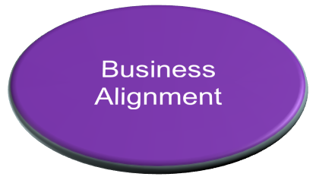
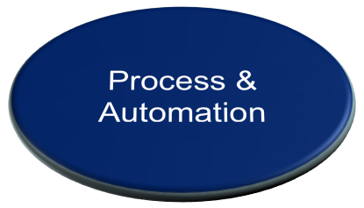


Management “Scope” of the Model

Slide 6



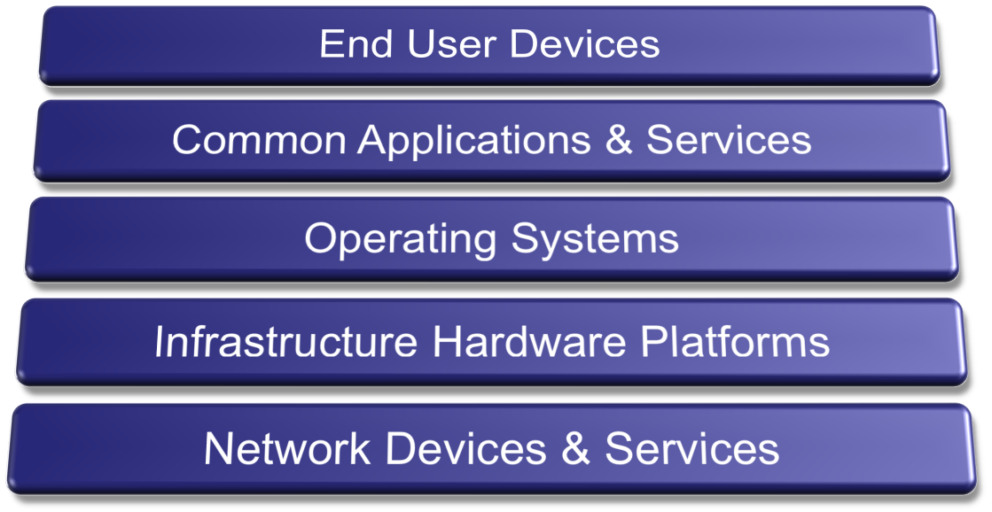
Technology “Scope” of the Model

Slide 7


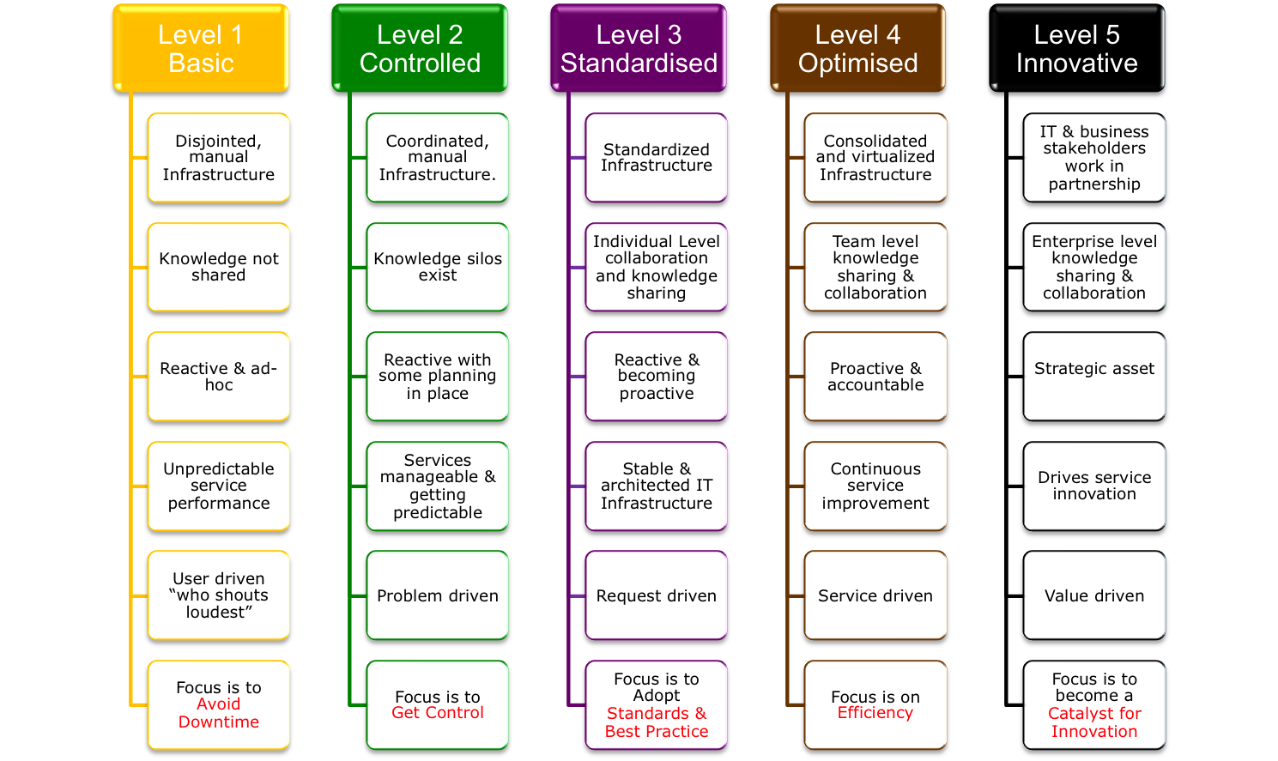
Infrastructure Maturity Level Summary

Slide 8
SAM Maturity KPIs (Level 4)
KPI Description | Metric
Availability of electronic records on software purchased or no longer used | Asset Management system used Records for >80% of software purchases
Policy for software purchase exists and enforceable | Policy exists and enforceable for >80% of purchases
Accountability for maintaining records | Formal central IT accountability exists, performance of this role measured every six months
On-going - Technology and process in place to track software installed | Coverage | Accuracy
 | Greater than 80% of PC estate | Greater than 80%
Ad-hoc - Technology and process to perform audit of software licensing position | Greater than 80% of PC estate | Greater than 80%

Slide 9


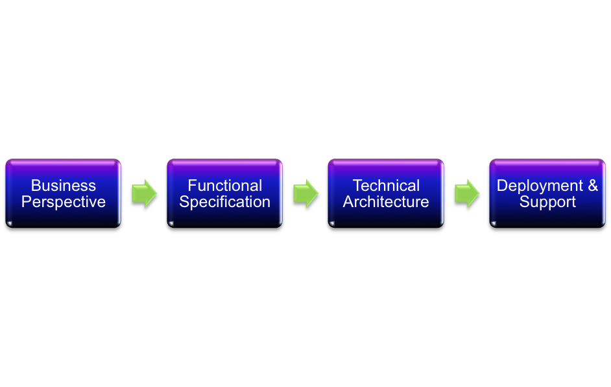




Collaboration Maturity
STAGE 1
ENVISIONING
STAGE 2
DESIGN
STAGE 3
RELEASE
Business Needs
Business Sponsored
Culture Driven
Technology Triggered
Systems Driven

Slide 10
Collaboration Maturity KPIs (Level 4)
KPI Description | Metric
Collaboration Strategy | A collaboration strategy exists however it may not be fully documented.
Governance | A dedicated group or function made up of IT and business stakeholders have been established with a defined Collaboration Steering Group charter.
Business Drivers for Collaboration | Business drivers have been developed with input from business areas. Business drivers have been formally validated by business stakeholders. The artefacts that now exist include: Prioritised list of Needs, Problems and Concerns (“NPC”) relating to collaboration. Prioritised list of initiatives which could address NPCs. High Level business case with clear identification of Vision & plan Set of collaboration initiatives Costs Expected outcomes Benefits Benefit measures.
Functional Specification | A functional specification does exist that describes the validated functional requirements for collaboration initiative including: Usage Scenarios User Requirements Business Requirements Conceptual Design
Technical Architecture | There is a technical architecture defined for collaboration technology. This architecture mainly follows generic best practice from the technology vendor.
Deployment & Support readiness | Technology is acquired, deployed and supported by the ICT department. Some “power users” have the ability to setup and share their own “installations” of collaboration products.
Programme Management | Collaboration solutions are seen as strategic solutions and programmes are directed by the business, delivered by ICT and sponsored by senior management.
People & Change | There is visibility and anticipation of the impact that collaboration technology will have on the way people work. End users are consulted early on in the projects and they are represented throughout the development life-cycle. Readiness programmes are in place for staff affected by collaboration technology.

Slide 11



Model is Part of the Maturity Lifecycle
Maturity Model
AS-IS Benchmark
Plan & Execute
Programme Management
Target Profile
Target
KPIs
Technology & Partner Selection
GAP Analysis
Roadmap
NHS EWAs

Slide 12

Feedback? Questions? Ideas?
andy.savvides@nhs.net

