Slide 1

CMMI: Integrating Software Engineering and Systems Engineering
Albuquerque SPIN Meeting
Wednesday October 3, 2001
Regina M. Gonzales, Ph.D.
TMA Corporation
Las Cruces, New Mexico

Slide 2
Software and Systems Culture
Narrow, detailed
Precise, theoretical, clean
Religious about methods/tools
Mathematics base is finite math & predicate calculus
Commercial product centered
Smaller, fast projects
Software centric
View systems engineers as stuffy and out of date
Academic arrogance
Generalist
Principle-based
Flexible application of whatever works
Mathematics base is differential calculus & probability/statistics
Management oriented
Defense product centered
Larger, longer projects
Very real-world and application domain oriented
View software engineers as spoiled teenagers
Software Ignorance

Slide 3
Historical Perspective
1940
1950
1960
1970
1980
1990
2000
Large-scale Complex Systems Engineering Practiced & Evolved
SWEng Infancy
SWEng Practiced & Evolved
1990 Cold War Ends
1987 TCP/IP
1981 IBM PC
1970 Seminal Papers on SA & VA, Unix,
ARPANET
1968 Apollo 8
1957 Sputnik, Cold War Begins
1954 Fortran
1945 Hiroshima
1941 Pearl Harbor

Slide 4
Observations
Software engineers are new eyes traversing old problems associated with complex systems
Defense orientation is a problem for software engineers
  i.e. Raytheon missile systems people talking about “new market opportunities”
Since 1994 I hear the word system more and more at the RE conferences
Systems Engineers are regularly using software engineering methods (UML) to analyze systems
In the past there has been no clear home for system engineering among the recognized academic communities, IEEE at the highest level is the best

Slide 5
Concerns
Cultural differences are getting in the way
Systems Engineering is a first order effect
Requirements are too important to be pioneered in the mainstream by a software centric or software ignorant viewpoint
The average software engineer has a narrow approach and avoids the messiness of the real world like deployment, aging, poor physical environments, chaos
The average systems engineer is too focused on management and verification of requirements rather than eliciting and modeling requirements

Slide 6
Definition of Capability Maturity
How capable is your organization of consistently delivering product?
How mature is your process such that it helps you to consistently meet your customers expectations?
It is not a canned process, it is a model that identifies process areas and practices that are important to achieving an organization with mature capability to consistently deliver to the customer.
It helps an organization set up process on a “first things first” basis.
Notes:
“Your organization can use a CMMI model to help set process improvement objectives and priorities, improve processes, and provide guidance for ensuring stable, capable, and mature processes.”

Slide 7
CMMI (Integrated)
There is a standards quagmire, including the many original flavors of CMMs
Maturation of Software Engineering and the reawakening of Systems Engineering
Integrated Product Development as a mainstream idea

Slide 8
Pieces of the Integrated CMM
Systems Engineering
  System as product focus
Software Engineering
  Software as product focus
Integrated Product and Process Development
  Methodology and process as product focus
Acquisition
  Management of supplied product and service as focus

Slide 9
Focus on Integration
The process areas are the same for all of the disciplines
All have goals, practices, typical work products, and informative components

Slide 10
Staged CMMI Model
Maturity Levels
Process Area 1
Process Area 2
Process Area 3
Specific Goals
Generic Goals
Specific Practices
Commitment to Perform
Ability to Perform
Directing Implementation
Verifying Implementation
Generic Practices

Slide 11
Maturity Levels
Initial – Level 1
Managed – Level 2
Defined – Level 3
Quantitatively Managed – Level 4
Optimized – Level 5
Notes:
Skipping Maturity Levels
Required, Expected, and Informative

Slide 12
Process Areas for Level 2
Requirements Management
Project Planning
Project Monitoring and Control
Supplier Selection and Monitoring
Measurement and Analysis
Process and Product Quality Assurance
Configuration Management

Slide 13
Process Areas for Level 3
Requirements Development
Technical Solution
Product Integration
Verification
Organizational Process Focus
Organizational Process Definition
Organizational Training
Integrated Project Management
Integrated Supplier Management
Risk Management
Decision Analysis and Resolution
Organizational Environment for Integration
Integrated Teaming

Slide 14
Process Areas for Level 4
Organizational Process Performance
Quantitative Project Management
Quantitative Supplier Management

Slide 15
Process Areas for Level 5
Organizational Innovation and Development
Causal Analysis and Resolution

Slide 16
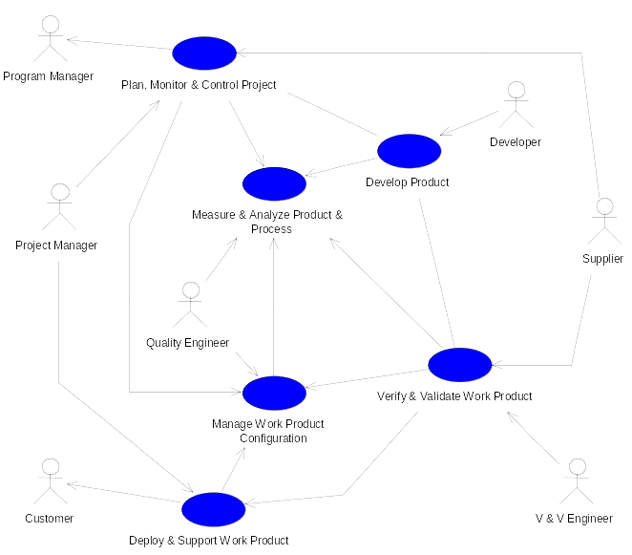
Altech Services Process Development and Institutionalization (ASPDI) Project

Slide 17
CMMI Process Area | Altech Deployment
Configuration Management & Change Control | Change Control Board (CCB), Rational Clear Case CM tool, Web deployment for subs
Integrated Project & Process Development (IPPD) | Entire team is contributing to process definition, Matrix management organization
Product & Process Measurement & Analysis | Defined metrics, Defined reports, Metrics database
Organizational Process Definition & Focus | Standard processes, Standard templates, CMMI traceability database, Standard documentation throughout that is configuration controlled
Organizational Training | ISO/CMMI/IEEE/EIA Process training, UML training, Rational tools training
Process & Product Quality Assurance | Weekly process meetings, Statistical Process Control (SPC)
Product Integration | Concept modeling of entire system, Managed requirements, Integration test plans & procedures
Project Planning, Monitoring, & Control | Web based deployment of Microsoft Project 2000, Integrated scheduling, Cost & progress monitoring process defined
Requirements Development & Management | Requirements elicitation & capture, Requisite Pro Requirements Management Tool supports Requirements traceability
Risk Management | Risk identification & mitigation process defined
Supplier Selection & Monitoring | Subcontractor performance criteria defined and applied
Systems Architecture & Design | Object-Oriented Analysis & Design using Rational Rose
Verification & Validation | V&V Plans done immediately, Formal inspections, Acceptance test plan & procedures

Slide 18
Altech Services Process Development and Institutionalization (ASPDI) Project (conti)
Process Development
Institutionalization of the Processes
Altech Services Processes Validation

