Slide 1


Slide 2
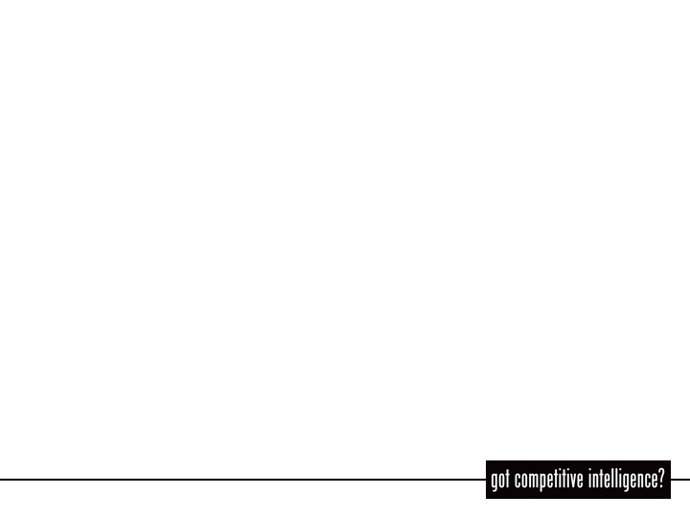

DONNA F. CAVALLINI
Principal, InfoFirst LLC, a research, competitive intelligence and marketing consulting firm serving professional service firms, industry organizations and companies, public and private.
&
SABRINA I. PACIFICI
Law Librarian, Founder, Editor, Publisher
LLRX.com (http://www.llrx.com)
and author, beSpacific.com – Accurate, focused law and technology news (http://www.bespacific.com)

Slide 3
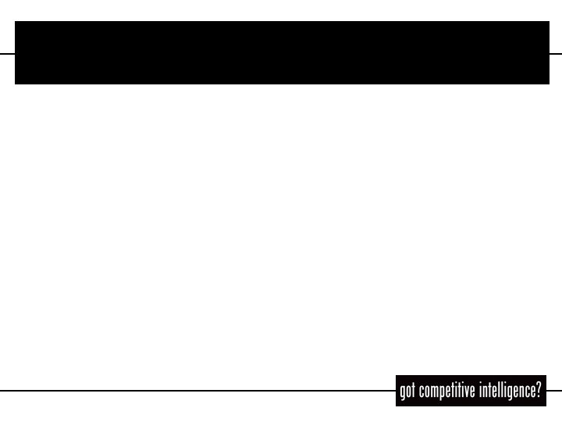
Presentation Outline
How to find and profile companies and people
  search engines, indexes and sites to locate corporate data websites
  and news
  business info web directories, databases, portals
Online tools for client/prospect monitoring
  e-newsletters, web editions of newspapers, journals, reports and
  news sources
  news aggregators and weblogs applications, techniques to use, and specific services
  web sources for TV broadcasts and radio transcripts
How to Follow Market Trends
Law Firm and Legal Industry CI
  sources for identification of company legal representation
  sources for lateral hiring - attorney bios
  benchmarking tools
  tools for competitor monitoring

Slide 4
Search Engines, Meta Search Sites and News Search
Ask Jeeves http://www.ask.com
Google http://www.google.com - search for company name, stock quotes
  Ex: stocks:dell
  use advanced search http://www.google.com/advanced_search?hl=en to narrow search parameters
Google News http://news.google.com/
  includes press releases
Google News Alerts http://www.google.com/alerts
Fagan Finder http://www.faganfinder.com/
  reliable, extensive portal to search engines, tools, apps, resources (highly recommended)

Slide 5
Search Engines, Meta Search Sites and News Search (con’t)
Google Alert (not affiliated with Google) http://www.googlealert.com
News Search Portal http://www.nieuwsbronnen.com/newssearchportal
Profusion Business Profiles http://www.profusion.com/nav?agt=0!4!&&queryterm=
  websites grouped by category to speed topical/targeted research associations, patents, publications, news, company profiles, marketing, etc.
Vivisimo www.vivisimo.com
  Clusty www.clusty.com
Yahoo! http://search.yahoo.com
  Yahoo! News! http://news.yahoo.com

Slide 6
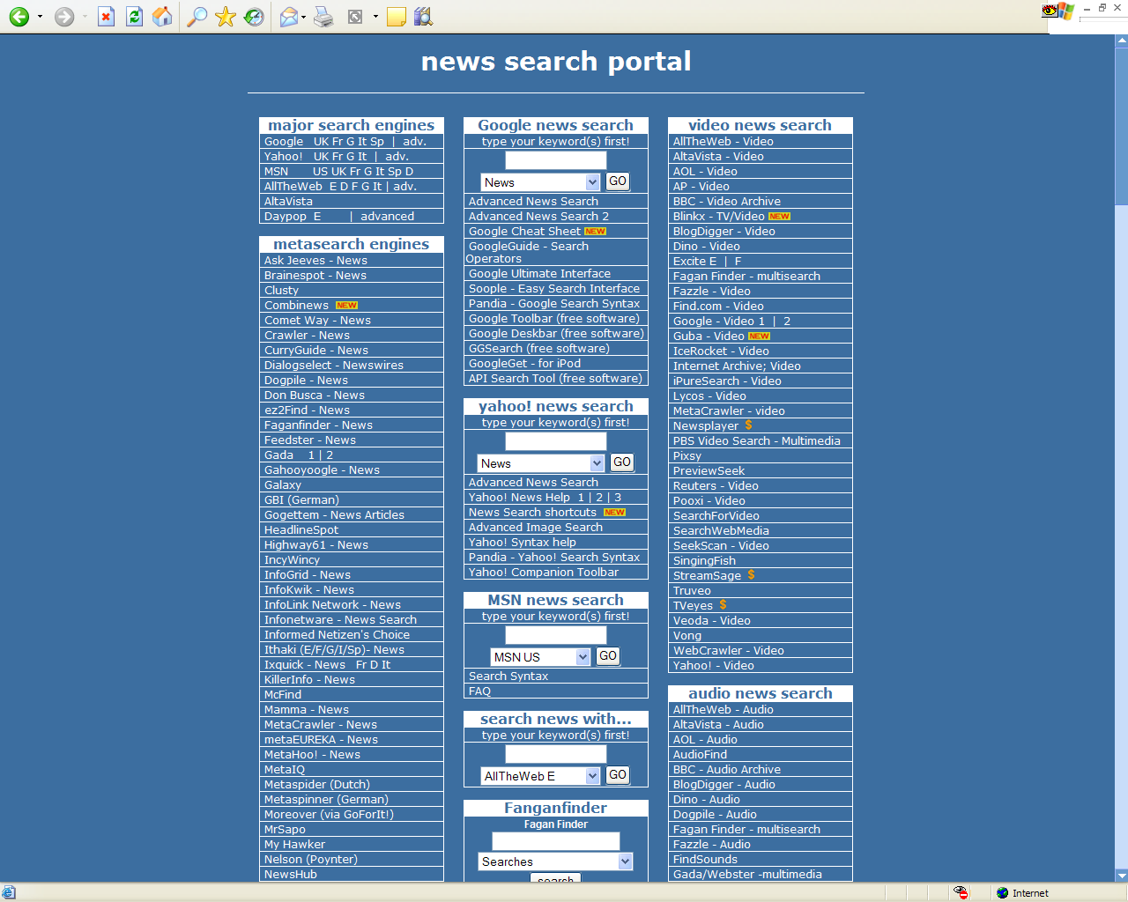
http://www.nieuwsbronnen.com/newssearchportal

Slide 7
Selected Business Info Websites
Business Wire
http://home.businesswire.com/portal/site/home/index.jsp
C-SPAN - http://www.cspan.org
CAROL - Company Annual Reports Online for the United Kingdom http://www.carol.co.uk
CBSMarketWatch - http://cbs.marketwatch.com (purchased by Dow Jones November 2004)
  monitor company news, press releases, national/global financial data (RSS feeds and email alerts available)
ChoicePoint Online - http://www.choicepointonline.com
CNN Money Company Research Lookup- http://money.cnn.com/news/crc
CNN Money, YellowBrix Industry Watch http://cnnmoney.yellowbrix.com/pages/cnnmoney/Headlines.nsp

Slide 8
Selected Business Info Websites (con’t)
Corporate Library, Companies, Directors & CEOs http://www.thecorporatelibrary.com/Research/default.html ($)
Dun & Bradstreet - http://www.dnb.com, subscription req’d
  Try ZapData http://www.zapdata.com
    build SIC code industry reports in real-time using up-to-date D&B business data
EIU.com - http://www.eiu.com
  country intelligence
Factiva - http://www.factiva.com
  news and business info, subscription req’d
Fortune Company Profiles - http://money.cnn.com/magazines/fortune/
  much of this data now requires subscription
Forbes 500s - http://tinyurl.com/3guk
  Largest corporations by sales, profits, assets and market value

Slide 9
Selected Business Info Websites (con’t)
Hoover’s Online - http://www.hoovers.com
  Browse reports by industry sector, by selected topics, reports by report type
  Some data requires subscription
Investext http://library.dialog.com/bluesheets/html/bl0745.html
KnowX.com - Public Records http://www.knowx.com free and fee
LIVEDGAR - http://www.gsionline.com/livedgar/index.html, subscription req’d (now owned by Thomson Corp.)
MSN Money - stock company reports, financial results, key ratios, income statements http://moneycentral.msn.com/investor/research/profile.asp

Slide 10
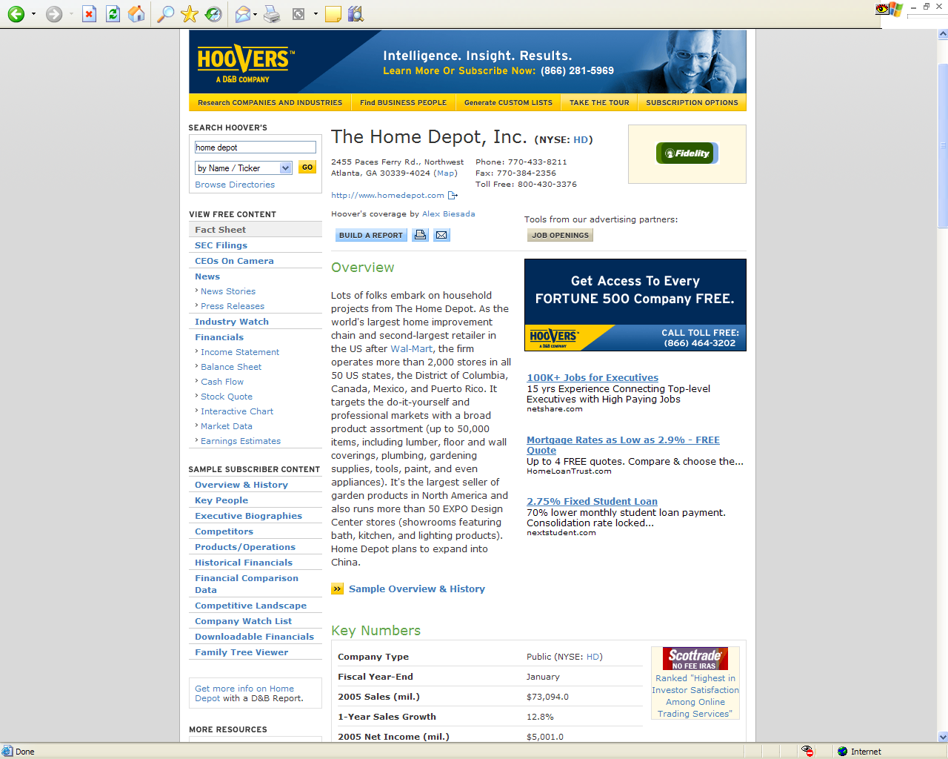

Slide 11
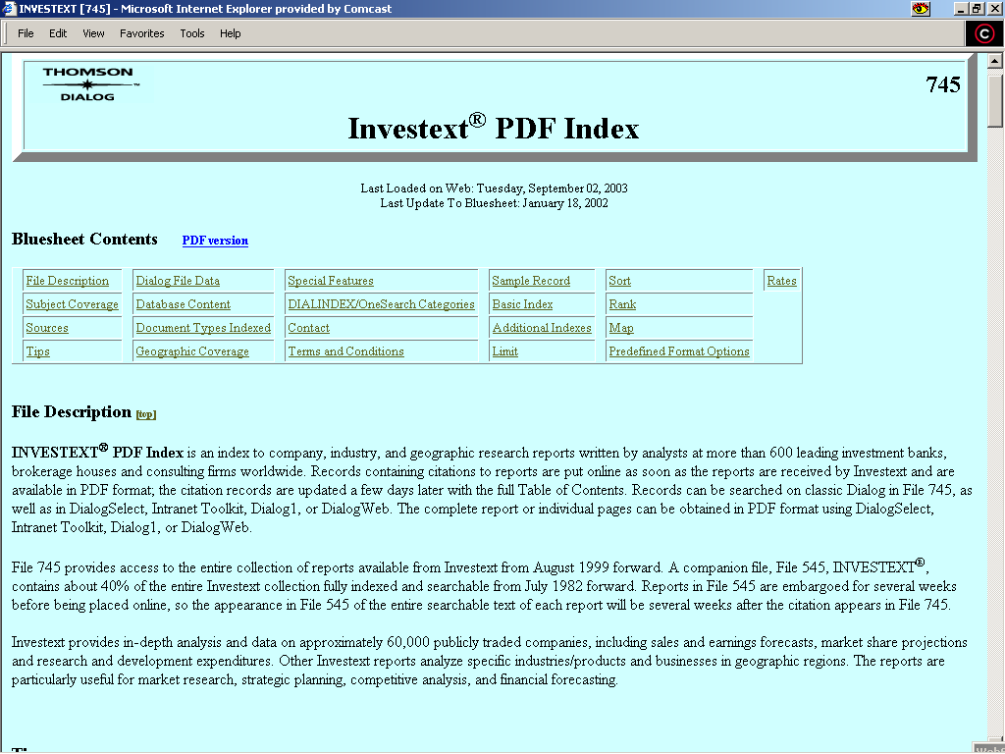
Dialog – Investext PDF, File 745 - http://library.dialog.com/bluesheets/html/bl0745.html

Slide 12
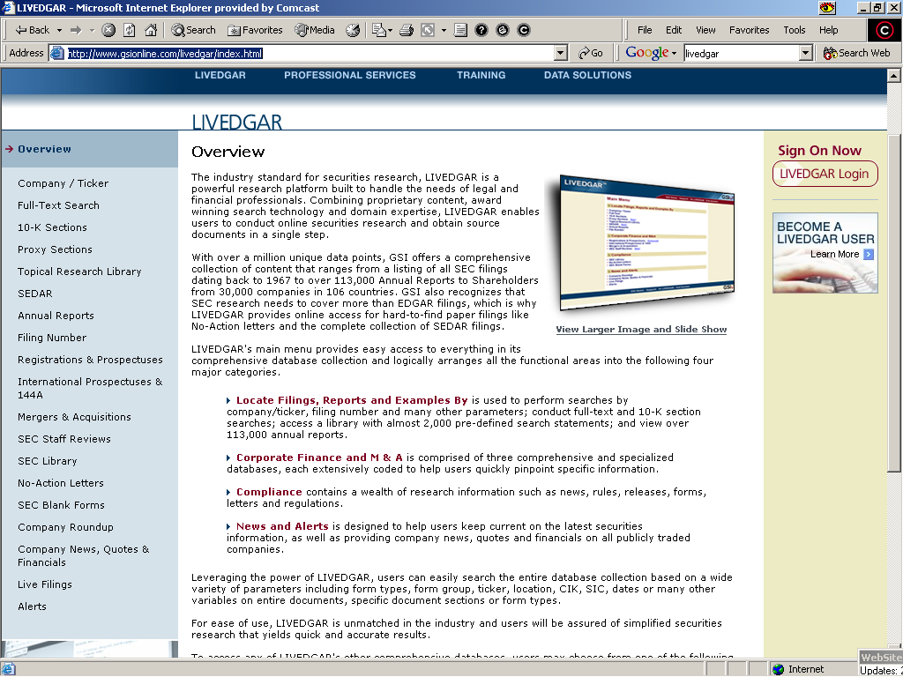
GSIOnline – LIVEDGAR

Slide 13
Selected Business Info Websites (con’t)
Moodys.com http://www.moodys.com/cust/default.asp subscription req’d
Report Gallery - http://www.reportgallery.com
  Annual reports and 10K reports in HTML and PDF format
Stocks and Stock Market Information from Reuters.com
  Headlines, company information/profiles, analyst research, industry watch. Some data requires subscription
  http://www.investor.reuters.com/StockEntry.aspx?target=/stocks
SEC Info - http://www.secinfo.com

Slide 14
Selected Business Info Websites (con’t)
Standard & Poor’s - http://tinyurl.com/3ikj subscription req’d
Financial News Archive via Yahoo, http://biz.yahoo.com/top.html
Mergerstat M&A Database - http://w3.nexis.com/sources/scripts/info.pl?156282 subscription req’d
Thomas Register http://www.thomasregister.com
subscription req’d
Yahoo Financial News by Provider http://us.biz.yahoo.com/top.html

Slide 15
Selected Online People Trackers
Accurint - http://www.accurint.com/, fee-based
AutoTrackXP – http://www.atxp.com, subscription/fee req’d
Dun & Bradstreet - http://www.dnb.com/US, subscription req’d
Forbes.com People Tracker – reg. req’d http://www.forbes.com/cms/template/peopletracker/index.jhtml
Lycos People Search - http://www.whowhere.lycos.com
Search Systems - http://www.searchsystems.net
  over 35,000 (and counting) free, searchable public records databases from across the country. Some databases, as indicated with $, are fee-based.
“Googling” a person: enter an individual’s name, “John Doe”
  Note: Google™ is a trademark identifying the search technology and services of Google Technologies Inc.

Slide 16
Web Directories and Portals
CEOExpress - http://www.ceoexpress.com/default.asp
  Links to dozens of reliable, business related resources (fee and free)
CI Resource Index - http://www.bidigital.com/ci
  Over 1,800 links to corporate & association data, books, newsletters, journals, seminars and more
Fuld & Company, Internet Intelligence Index™ http://www.fuld.com/Tindex/I3.html
  Links to over 600 intelligence-related sites
Lexis - http://www.lexis.com
MagPortal - http://www.magportal.com/c/bus
  magazine articles on business
Portal to International Business Resources http://globaledge.msu.edu/ibrd/ibrd.asp
Westlaw - http://www.westlaw

Slide 17
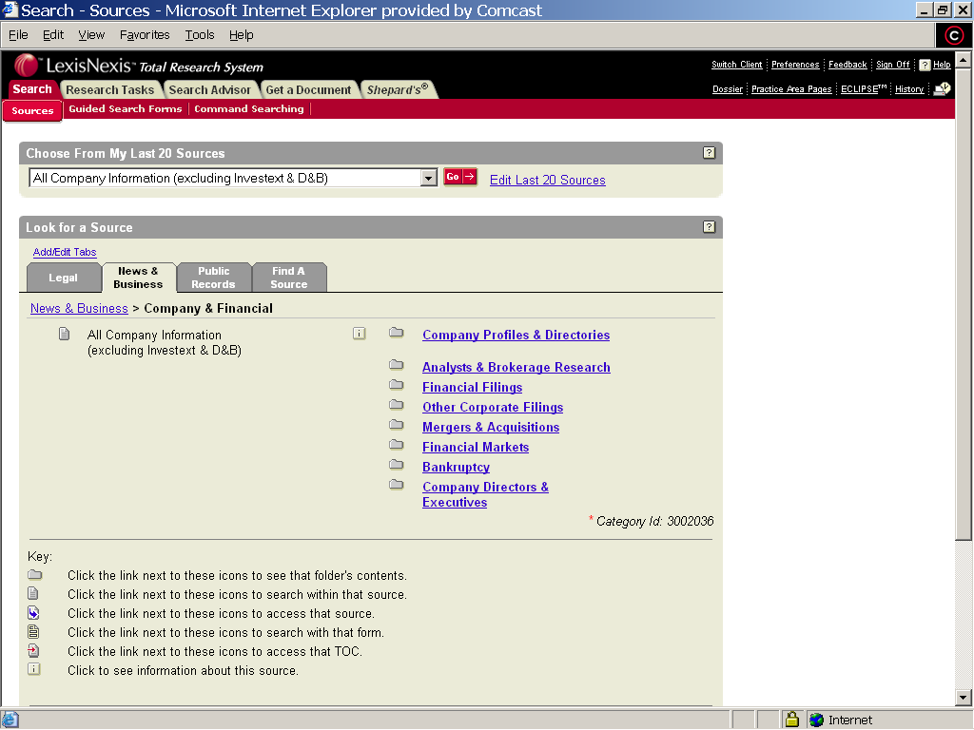

Slide 18
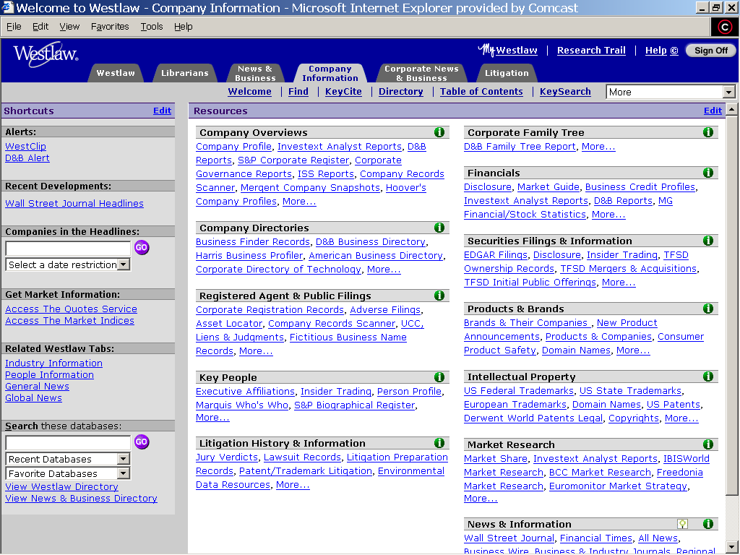

Slide 19
Web Directories and Portals (con’t)
Wall Street Executive Library http://www.executivelibrary.com
  Directory of over 1,450 sources that includes: national/international news; company and industry, government, marketing and advertising, statistics and economic research
Yahoo http://search.yahoo.com/bin/search?p=competitive+intelligence
  Pick and choose carefully from among this
  long list of sites that includes links to vendors, consultants, white papers, articles, and
  research tools

Slide 20
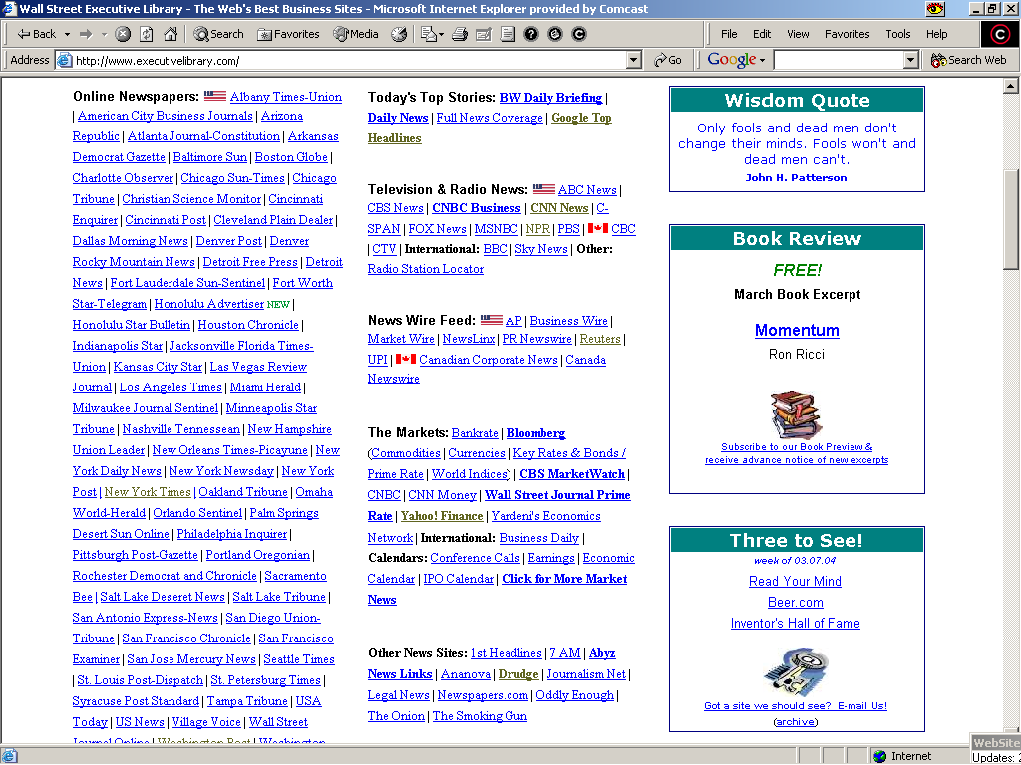

Slide 21
Television and Radio News Transcripts – including streaming audio/video
Bloomberg.com - Bloomberg Television http://www.bloomberg.com/tv $
Transcripts.TV - http://www.transcripts.tv $
  ABC News programming and other network news programs.
Federal News Service - http://www.fednews.com
  available via database, browser and RSS. $
NPR: Transcripts and CDs - http://www.npr.org/transcripts $
“The Television News Archive collection at Vanderbilt University is the world’s most extensive and complete archive of television news. The collection holds more than 30,000 individual network evening news broadcasts from the major U.S. national broadcast networks: ABC, CBS, NBC, and CNN, and more than 9,000 hours of special news-related programming including ABC’s Nightline since 1989.” $, http://tvnews.vanderbilt.edu
“TVEyes Video Search lets you search the Internet for TV clips” http://tveyes.com/ (free and fee)

Slide 22
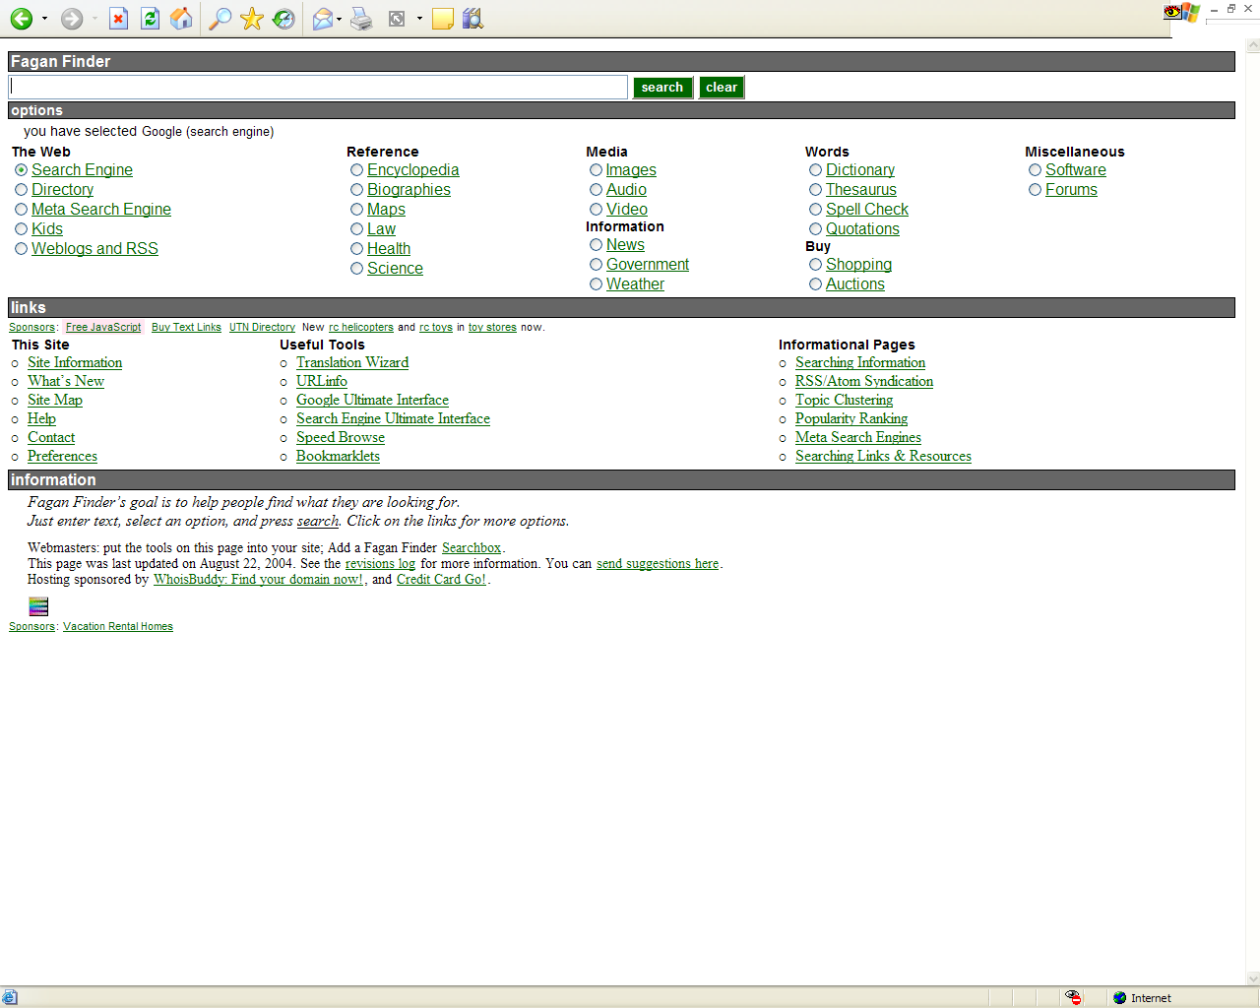
Fagan Finder - http://www.faganfinder.com/

Slide 23
News Alerts (con’t)
Dow Jones MarketWatch.com - http://www.marketwatch.com/news/default.asp?siteid=mktw
  e-Newsletters
  alerts via e-mail
  RSS feeds - http://www.marketwatch.com/rss/default.asp?siteid=mktw&dist=10mw&
Yahoo! Alerts - http://tinyurl.com/3mbqk
Law.com Daily Legal Newswire - http://www.law.com/newswire
  RSS feed, http://www.law.com/newswire_rss.xml
FindLaw email alerts - http://newsletters.findlaw.com/nl/
  daily opinion summaries, weekly opinion summaries, general topical newsletters
Legislative monitoring and tracking
  Gallerywatch.com - http://www.gallerywatch.com
  subscription only
  CapitolHearings.org - http://www.capitolhearings.org
  CSPAN - www.c-span.org
  THOMAS - http://thomas.loc.gov

Slide 24
E-Newsletters, Online Newspapers, Journals and News Sources
Biz Journals - http://www.bizjournals.com
Bloomberg – http://www.bloomberg.com
CNN Money - http://money.cnn.com
Financial Times - http://news.ft.com/home/us $
Forbes - http://www.forbes.com
Fortune - http://money.cnn.com/magazines/fortune/
Investors Business Daily - http://www.investors.com

Slide 25
E-Newsletters, Online Newspapers, Journals and News Sources (con’t)
Moreover - http://w.moreover.com/categories/category_list.html
  list of available news categories
Newsisfree - http://www.newsisfree.com
TheDeal.com - http://www.thedeal.com, subscription req’d
Time.com: Inside Business http://www.time.com/time/insidebiz
Wall Street Journal - http://online.wsj.com, subscription req’d
  The Journal’s morning, afternoon and evening report, delivered via email to registered subscribers: users may choose content/topics
  WSJ company and industry news trackers, for reg’d users
  WSJ Free Features, http://online.wsj.com
  Law Blog, http://online.wsj.com
Yahoo! Finance - http://finance.yahoo.com
Yahoo! Financial News - http://biz.yahoo.com/ne.html

Slide 26
Monitoring Trends, Companies and Products –
Selected News Aggregators and RSS Feeds
News Aggregators
  List and links to dozens of news aggregators - http://en.wikipedia.org/wiki/List_of_news_aggregator
  Dmoz open directory project - http://tinyurl.com/5gl6
    links to updated resources on news aggregators and RSS Web content syndication format
  Bloglines - http://www.bloglines.com
  NewzCrawler - http://www.newzcrawler.com
  NewsGator, runs in Microsoft Outlook - http://www.newsgator.com/home.aspx
  Rocket RSS Reader - http://reader.rocketinfo.com/desktop
  RocketInfo Desktop - http://www.rocketdesktop.com/index.html

Slide 27
Monitoring Trends, Companies and Products –
Selected News Aggregators and RSS Feeds (con’t)
RSS Feeds – Look for Orange Icon that says either RSS, XML or Atom
  ABCNews - http://abcnews.go.com/Technology/RSS/listIndex
  BBC - http://tinyurl.com/2wzug
  Bizjournals.com - http://www.bizjournals.com/rss_promo
  Forbes.com - http://www.forbes.com/fdc/rss.shtml
  Law.com RSS Feeds - http://www.law.com/service/rss.shtml
  MarketWatch http://www.marketwatch.com/rss/default.asp?siteID=mktw
  New York Times - http://www.nytimes.com/services/xml/rss
  NPR - http://www.npr.org/rss/
  Reuters - http://www.reuters.com/newsrss.jhtml
  Washington Post
  http://www.washingtonpost.com/wp-dyn/rss/index.html
  Yahoo! News - http://news.yahoo.com/rss

Slide 28
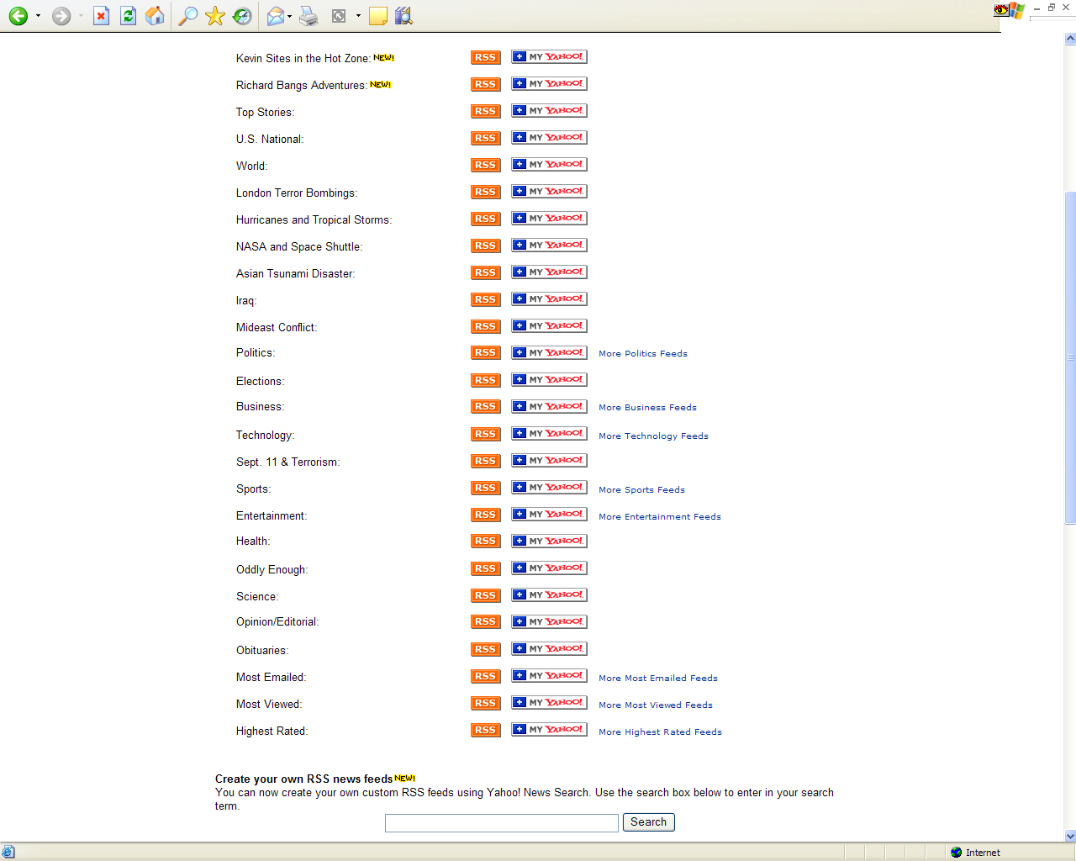

Slide 29
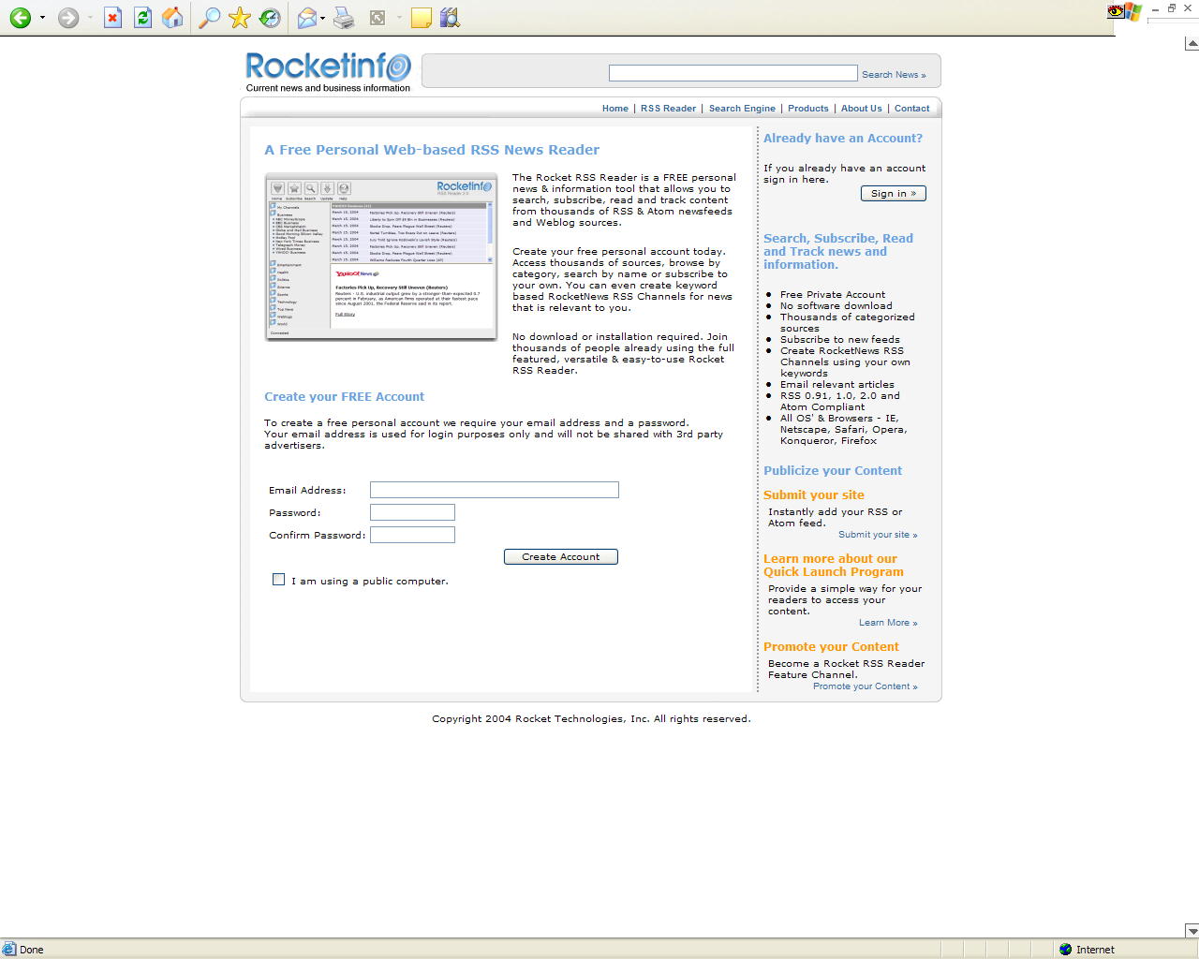

Slide 30
Identification of
Company Legal Representation
Martindale Hubbell representative client lists (Lexis) $
  http://support.lexis-nexis.com/Sample_Search/record.asp?ArticleID=career_marhub_search
Patent records - USPTO, www.uspto.gov
Trademark records - USPTO, www.uspto.gov
SDC Mergers & Acquisitions http://w3.nexis.com/sources/scripts/info.pl?173725 $
Secretary of State and Other Business Filings Databases http://www.llrx.com/columns/roundup29.htm
  includes links to fee and free sites
SEC filings
  SECInfo.com - http://www.secinfo.com
  LIVEDGAR - http://www.gsionline.com $
Disclosure Online Database-US Public Company Profiles (Lexis) http://w3.nexis.com/sources/scripts/info.pl?3723 $

Slide 31
Identification of
Company Legal Representation
All the resources below require either fee and/or registration
  ALM Lists and Rankings - http://www.law.com/career_center/lists_rankings.shtml
  Who Represents Corporate America, ALM http://www.law.com/career_center/lists_rankings.shtml
  Who Represents/Protects IP America http://www.ipww.com/
  Who Represents America's Biggest Companies http://www.law.com/career_center/lists_rankings.shtml
  Nelson’s Public Company Profiles http://web.nexis.com/sources/scripts/info.pl?165421

Slide 32
Identification of
Company Legal Representation (con’t)
The following resources are fee/subscription
  America’s Corporate Finance Directory http://www.lexisnexis.com/corpfinancedir
    also useful for identification of other outside service providers, including auditor, banker, pension manager, insurance carriers, investment banker, etc.
  Directory of Corporate Affiliations http://www.corporateaffiliations.com/content/cn_home.asp
  Standard & Poor’s Corporate Register http://web.nexis.com/sources/scripts/info.pl?3669

Slide 33
Identification of
Company Legal Representation (con’t)
Courtlink - http://www.lexisnexis.com/courtlink/online
CourtExpress - http://courtexpress.westlaw.com/
Caselaw searches, both state and federal,
via Lexis or Westlaw
Jury verdict and settlement databases
  For example the JV-ALL file on Westlaw has a standard field, ATTORNEYS, which identifies counsel to both plaintiff and defendant
Law firm websites - firm and practice specific entries, press releases, news, and client alerts

Slide 34
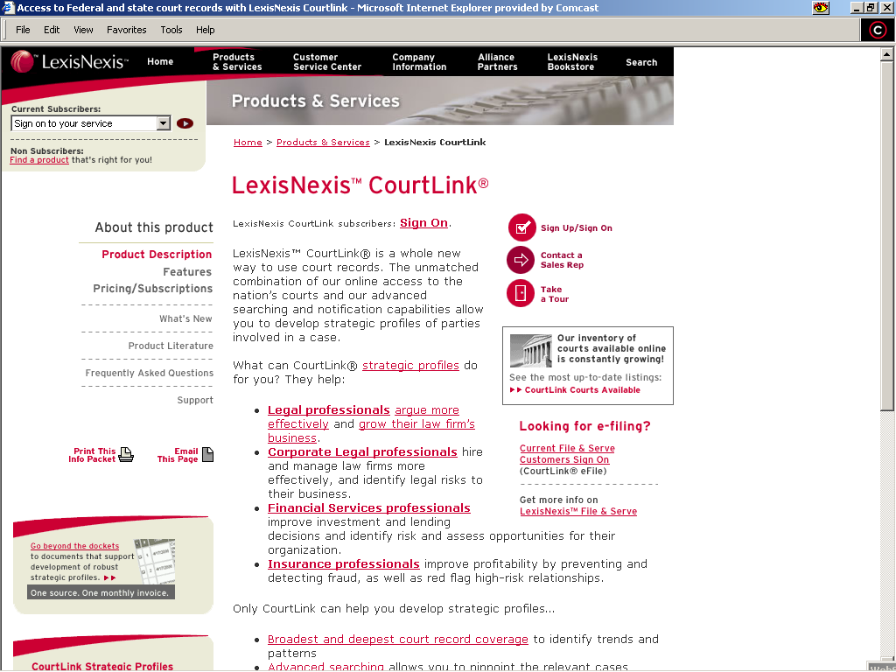
LexisNexis CourtLink – http://www.lexisnexis.com/courtlink/online/

Slide 35
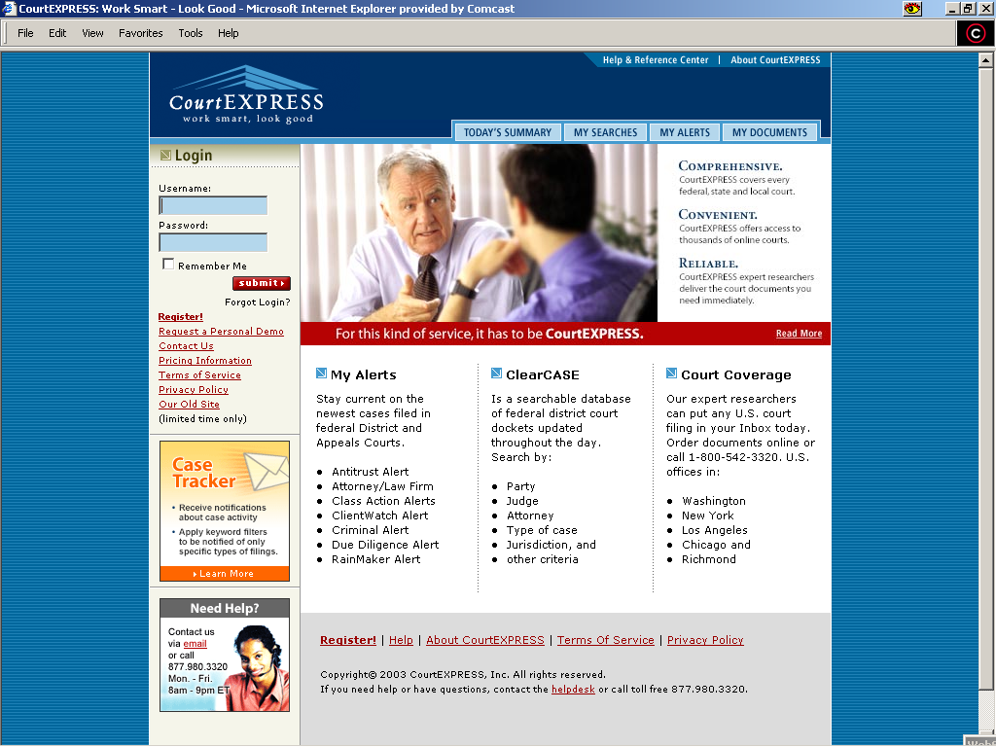
Court Docketing: CourtExpress.com, http://www.courtexpress.com

Slide 36
Lateral Hiring Tools – Attorney Bios
Martindale Hubbell - web or Lexis
Directory of Corporate Counsel
Marquis Who’s Who Directories
Law firm websites
Personal and professional weblogs
Search engines

Slide 37
Lateral Hiring Tools –
Attorney Bios (con’t)
ABA and state bar associations
Docketing tools
  Courtlink
  CourtExpress
Lexis/Nexis, Westlaw, Dialog, Factiva searches:
  case law, news, law reviews and law journals
Online journals including: Law.com, American Lawyer, Legal Times, National Law Journal, New York Law Journal

Slide 38
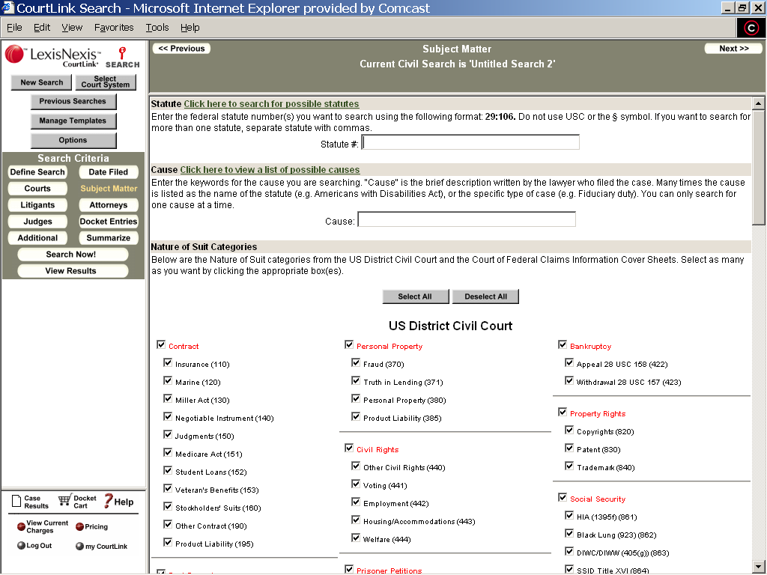

Slide 39
Online Tools for Competitor Monitoring
Website Trackers
  Copernic Agent - http://www.copernic.com
  WebSite Watcher - http://aignes.com
  Web2Mail - http://www.web2mail.com/lite/welcome.php
  ChangeDetection - http://www.changedetection.com
  Tracerlock - http://www.tracerlock.com
Westlaw Intraclips and Lexis Publisher
  http://westintraclip.westlaw.com
  http://www.lexisnexis.com/publisher/
  run in traditional media sources and legal newsletters for major law firm acquisitions, expansions, etc., plus press releases and job advertisements

Slide 40
Online Tools for Competitor Monitoring (con’t)
Who’s Mailing What http://whosmailingwhat.com
  sells competitive intelligence data on what kind of direct mail programs other major firms are conducting - category 586 is legal services
MarkMonitor http://www.markmonitor.com
  domain name filings provide insight into new law firm directions, service offerings

Slide 41
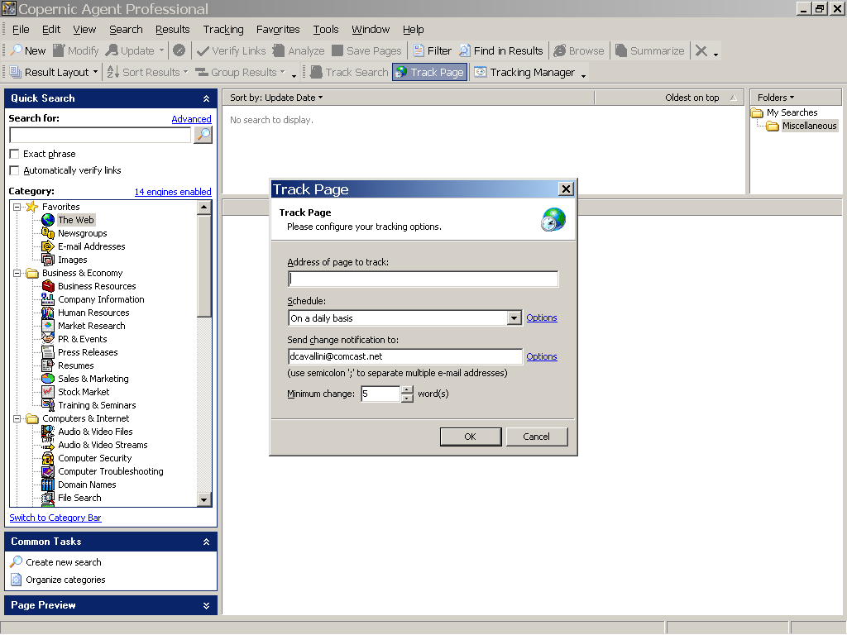

Slide 42
Benchmarking
ALM Research Online – http://www.almresearchonline.com
Altman & Weil Survey of Law Firm Economics
Vault’s Top 100 Most Prestigious Firms
American Banker’s Top Lead Legal Advisers - http://www.americanbanker.com/rankings.html?ranking=/MarketsMandA.html
NLJ 250
Chambers Global World’s Leading Lawyers http://www.chambersandpartners.com/
The Hildebrandt 2005 US Law Department Survey- http://tinyurl.com/bz9wy
Inside Counsel – 8th Annual Report of the Corporate Law Dept. - http://www.insidecounsel.com/issues/insidecounsel/pdfs/AnnualReport.pdf
NALP Forms http://www.nalp.org/content/index.php?pid=68
Counsel to Counsel http://www.martindale.com/xp/c2c/Overview/overview_intro.xml

Slide 43
How to Follow Market Trends –
Newsletters, Journals and Reports
Law Office Management &
Administration Report
Strategies: The Journal of Legal Marketing
Law Practice Management
Lawyer Marketing News
Marcus Letter on Professional Service,
Leadership & Management Directions
Legal Management
The Lawyers Competitive Edge

Slide 44
How to Follow Market Trends –
Newsletters, Journals and Reports (con’t)
The Journal of Law Office Economics and Management
NALP Bulletin
Law Firm Partnership & Benefits Report
Sugarcrest Report
Client Development Q&A
Hildebrandt Headlines

Slide 45
How to Follow Market Trends –
Special Reports
Courtlink Strategic Market
Analysis Reports
CourtExpress Litigation
Trend Reports

Slide 46
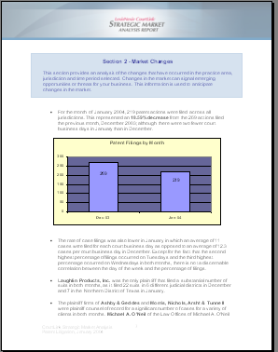

Slide 47
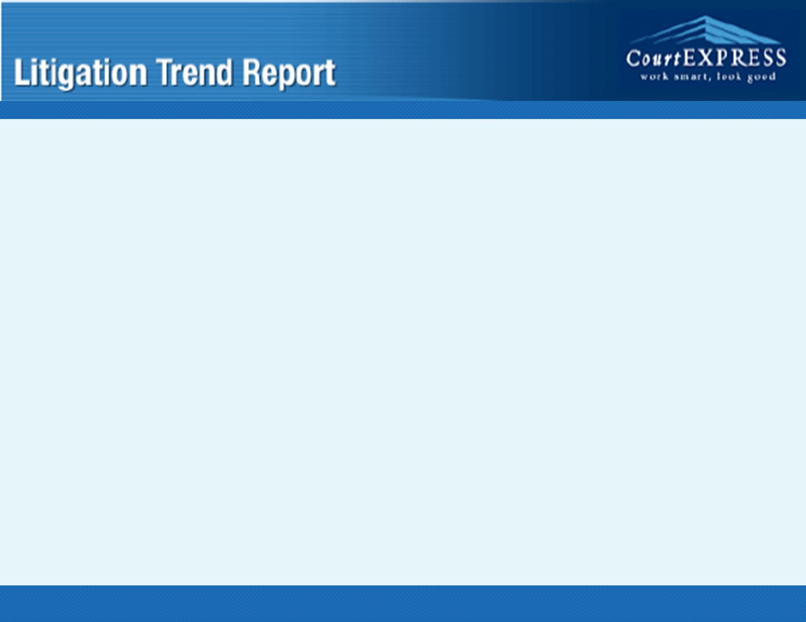
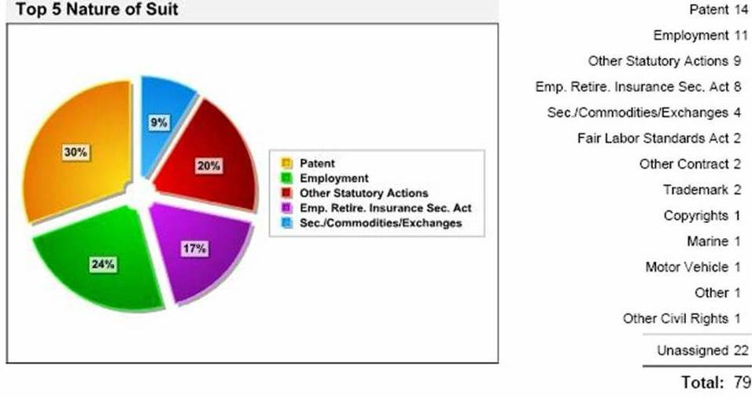
Litigation Trend Reports from CourtExpress.com

Slide 48
Selected Bibliographies, Guides & Books
Better Management.com - http://tinyurl.com/m69p
  Significant source of links to CI literature
Business Information Searcher http://www.dataresources.co.uk/bissample.htm
Competitive Intelligence Magazine http://www.scip.org/
Competitive Intelligence Resource Guide http://www.burkhardtresearch.com/guide/books.html
  More than one dozen recommended titles from the public and private sector

Slide 49
Selected Bibliographies,
Guides & Books (con’t)
Helicon’s Articles and Book Reviews on CI and Related Topics - http://tinyurl.com/3iiq
Business Statistics on the Web: Find Them Fast - At Little or No Cost,
by Paula Berinstein, Charles Cotton
Super Searchers on Competitive Intelligence, The Online and Offline Secrets of Top CI Researchers, by Margaret Metcalf Carr
Competitive Strategy: Techniques For Analyzing Industries And Competitors,
by Michael E. Porter

Slide 50
Thank you.

