Slide 1

Rational Unified Process
Best Practices for
Software Development Teams

Slide 2
Agenda
What is the Rational Unified Process
Implementing Best Practices
Phases, Iterations, Workflows and Activities
The Product
Implementing the Rational Unified Process
Software Economics
Case Study: Skandia IT
Summary

Slide 3
Rational’s Strategy
Process
drive
focus
Guidance
Customers
automate
syndicate
Automation
Acceleration
Tools
Services
amplify
guide

Slide 4
Rational’s Strategy
Process
drive
focus
Guidance
Customers
automate
syndicate
Automation
Acceleration
Tools
Services
amplify
guide

Slide 5
What Is a Process?
A process defines Who is doing What, When and How to reach a certain goal. In software engineering the goal is to build a software product or to enhance an existing one
New or changed
requirements
Software Engineering
Process
New or changed
system

Slide 6

The Problem...
Processes are not linked properly to tools, or are not properly automated
Process
?
Tool
If process is used, different functional teams use normally inconsistent processes and modeling languages
Requirements book
Test process
Analysis process
Design book
Most software projects use no well-defined process. Instead team members (re-)invent process as they go
?
?
?
?
?
?
?

Slide 7
Problems addressed by RUP
No repeatable process - results are lacking, unpredictable, and highly dependent on heroic programmers
Software that poorly fits user needs
Inability to deal with changing requirements
Tedious and expensive testing procedures
Discovery of serious flaws too late in the project
Software that’s hard to maintain and extend

Slide 8


Rational Unified Process (RUP)
Unifies best practices from many disciplines into a consistent full lifecycle process
Premier process for the UML, developed by the company that brought you the UML
Online mentor integrated with and supported by Rational tools
Applicable to a wide variety of applications and industries
Decrease Time to Market
Increase Predictability

Slide 9
Increased Team Productivity
All team members share
1 knowledge base
1 process
1 view of how to develop software
1 modeling language
Performance
Engineer
Database
Administrator
Release
Engineer
Project
Leader
Analyst
Designer /
Developer
Tester

Slide 10


The Unified Modeling Language (UML)
The Rational Unified Process and the UML —
developed hand-in-hand — by Rational
Contributions by major vendors
  Microsoft
  HP
  IBM
  Oracle
  Texas Instruments
  MCI SystemHouse
Standard through OMG

Slide 11
Rational Unified Process: Geneology
1981 1998
Requisite
Requirements Mgmt
Objectory
Use Cases OO Analysis
Abstraction
Encapsulation
Iterative Devel
Rational
OO Architecture
Visual Modeling
UML
RUP
Verdix
Cross-development
SQA
Automated Testing
Automated Branch/Merge
Dynamic Views
Replication
Runtime Error Detection
Pure-Atria

Slide 12
Agenda
What is the Rational Unified Process
Implementing Best Practices
Phases, Iterations, Workflows and Activities
The Product
Implementing the Rational Unified Process
Software Economics
Case Study: Skandia IT
Summary

Slide 13
Rational Unified Process
Describes the effective implementation of key “Best Practices”
Manage Requirements
Use
Component
Architectures
Develop
Iteratively
Model
Visually
Verify
Quality
Control Changes

Slide 14
1. Develop Software Iteratively
  An initial design will likely be flawed with respect to its key requirements
  Late-phase discovery of design defects results in costly over-runs and/or project cancellation
The time and money spent implementing a faulty design
are not recoverable

Slide 15
Waterfall Development
Requirements
Analysis
Design
Code & Unit
Testing
Subsystem
Testing
System Testing
T I M E

Slide 16
Waterfall Development: Risk vs. Time
Requirements
Analysis
R
I
S
K
Design
Code & Unit
Testing
Subsystem
Testing
System Testing
T I M E

Slide 17
Iterative Development
Requirements
Analysis & Design
Planning
Implementation
Initial
Planning
Management
Environment
Deployment
Evaluation
Test
Each iteration results in an executable release

Slide 18
Risk Profile of an Iterative Development
Waterfall
Staffing
Inception
Elaboration
Risk
Construction
Risk
Transition
Preliminary
Iteration
Architect.
Iteration
Architect.
Iteration
Devel.
Iteration
Devel.
Iteration
Devel.
Iteration
Transition
Iteration
Transition
Iteration
Post-
deployment
Time

Slide 19
Iterative Development Characteristics
  Critical risks are resolved before making large investments
  Initial iterations enable early user feedback
  Testing and integration are continuous
  Objective milestones provide short-term focus
  Progress is measured by assessing implementations
  Partial implementations can be deployed

Slide 20

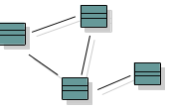

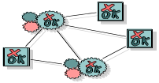
2. Manage Your Requirements
Elicit, organize, and document required functionality and constraints
Track and document tradeoffs and decisions
Business requirements are easily captured and communicated through use cases
Use cases are important planning instruments
Use-Case Model
realization
influenced by
verifies
Use Cases drives the work from analysis through test
Design Model
Implementation Model
Test Model

Slide 21
3. Employ Component-based Architecture
Design, implement and test your architecture up-front!
A systematic approach to define a “good” architecture
  resilient to change by using well-defined interfaces
  by using and reverse engineering components
  derived from top rank use cases
  intuitively understandable
Application-
specific
Business-
specific
Component-based Architecture with layers
Middleware
System-
software

Slide 22



4. Model Software Visually
Capture the structure and behavior of architectures and components
Show how the elements of the system fit together
Maintain consistency between a design and its implementation
Promote unambiguous communication
Sub Systems
Visual Modeling
raises the level
of abstraction
Classes
Code

Slide 23
5. Verify Software Quality
Create tests for each key scenario to ensure that all requirements are properly implemented
Unacceptable application performance hurts as much as unacceptable reliability
Verify software reliability - memory leaks, bottle necks
Test every iteration - automate test!
Cost
Software problems
are 100 to 1000 times
more costly to find
and repair after deployment
Development Deployment

Slide 24

6. Control Changes to Software
Control, track and monitor changes to enable iterative development
Establish secure workspaces for each developer
    Provide isolation from changes made in other workspaces
    Control all software artifacts - models, code, docs, etc.
Automate integration and build management
Workspace
Management
Parallel
Development
CM is more than just check-in and check-out
REPORT
ALERT
Build
Management
Process
Integration

Slide 25
Rational Unified Process
Provides guidelines, templates and tool mentors for the effective implementation of key best practices
Delivered through a web-enabled searchable knowledge base
Manage Requirements
Develop
Iteratively
Verify
Quality
Use
Component
Architectures
Model
Visually
Control Changes

Slide 26
Agenda
What is the Rational Unified Process
Implementing Best Practices
Phases, Iterations, Workflows and Activities
The Product
Implementing the Rational Unified Process
Software Economics
Case Study: Skandia IT
Summary

Slide 27
Process Notation
Describes a piece of work a worker may be asked to perform.
Activity
Worker
Signifies a role that may be played by an individual or a team of individuals in the development organization
Use-Case
Describe a
Use Case
Specifier
responsible for
Artifact
Signifies a piece of information that is produced, modified, or used by a process
Use Case
Use-Case
Package

Slide 28
Workers Are Used for Resource Planning
R
e
s
o
u
r
c
e
W
o
r
k
e
r
A
c
t
i
v
i
t
i
e
s
P
a
u
l
D
e
s
i
g
n
e
r
D
e
f
i
n
e
O
p
e
r
a
t
i
o
n
s
.
.
.
M
a
r
y
U
s
e
-
C
a
s
e
S
p
e
c
i
f
i
e
r
D
e
s
c
r
i
b
e
a
U
s
e
C
a
s
e
.
.
.
J
o
e
U
s
e
-
C
a
s
e
D
e
s
i
g
n
e
r
D
i
s
t
r
i
b
u
t
e
B
e
h
a
v
i
o
r
.
.
.
S
y
l
v
i
a
D
e
s
i
g
n
R
e
v
i
e
w
e
r
R
e
v
i
e
w
U
s
e
-
C
a
s
e
M
o
d
e
l
.
.
.
S
t
e
f
a
n
A
r
c
h
i
t
e
c
t
D
e
f
i
n
e
U
s
e
-
C
a
s
e
V
i
e
w
D
e
f
i
n
e
L
o
g
i
c
a
l
V
i
i
e
w
.
.
.
Each individual in the project is assigned to one or several workers

Slide 29
Process Architecture
Time
Phases
Process Workflows
Inception
Elaboration
Construction
Transition
Business Modeling
Requirements
Analysis & Design
Content
Implementation
Test
Deployment
Supporting Workflows
Configuration Mgmt
Management
Environment
Preliminary
Iteration(s)
Iter.
#1
Iter.
#2
Iter.
#n
Iter.
#n+1
Iter.
#n+2
Iter.
#m
Iter.
#m+1
Iterations

Slide 30
Phases in the Process
Major
Milestones
Inception
Elaboration
Construction
Transition
time
The Rational Unified Process has four phases:
  Inception - Define the scope of project
  Elaboration - Plan project, specify features, baseline architecture
  Construction - Build the product
  Transition - Transition the product into end user community

Slide 31
Inception Phase
  Purpose
    To establish the business case for a new system or for a major update of an existing system
    To specify the project scope
  Outcome
    A general vision of the project’s requirements, i.e., the core requirements
      Initial use-case model and domain model (10-20% complete)
    An initial business case, including:
      Success criteria (e.g., revenue projection)
      An initial risk assessment
      An estimate of resources required

Slide 32
Elaboration Phase
  Purpose
    To analyze the problem domain
    To establish a sound architectural foundation
    To address the highest risk elements of the project
    To develop a comprehensive plan showing how the project will be completed
  Outcome
    Use-case and domain model 80% complete
    An executable architecture and accompanying documentation
    A revised business case, incl. revised risk assessment
    A development plan for the overall project

Slide 33
Construction Phase
  Purpose
    To incrementally develop a complete software product which is ready to transition into the user community
  Products
    A complete use-case and design model
    Executable releases of increasing functionality
    User documentation
    Deployment documentation
    Evaluation criteria for each iteration
    Release descriptions, including quality assurance results
    Updated development plan

Slide 34
Transition Phase
  Purpose
    To transition the software product into the user community
  Products
    Executable releases
    Updated system models
    Evaluation criteria for each iteration
    Release descriptions, including quality assurance results
    Updated user manuals
    Updated deployment documentation
    “Post-mortem” analysis of project performance

Slide 35
Iterations and Phases
Releases
Inception
Elaboration
Construction
Transition
Preliminary
Iteration
Architect.
Iteration
Architect.
Iteration
Devel.
Iteration
Devel.
Iteration
Devel.
Iteration
Transition
Iteration
Transition
Iteration
An iteration is a distinct sequence of activities with an established plan and evaluation criteria, resulting in an executable release (internal or external).

Slide 36
Iteration Assessment
Iteration N Cost and
Schedule Actuals
Iteration N Assessment
Revised Risk List
Compare iteration actual cost, schedule, and content with iteration plan
Determine rework (if any) to be done
  Assign to future iteration(s)
Determine what risks have been eliminated, reduced, or newly identified in this iteration
Update project plan
Prepare detailed plan for next iteration
  Use revised risk list and select appropriate scenarios
Revised Project Plan
Total Cost
Overall Schedule
Scope/Content
Quality Assessment
for Iteration N
Test Results
Defect Density
Architecture Stability
Other metrics
Iteration N+1 Plan
Cost
Schedule
Content

Slide 37
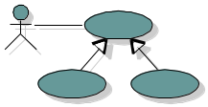

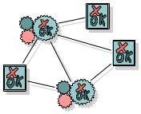
Models and Workflows
Each major workflow describes how to create and maintain a particular model
Business
Modeling
Business Model
Requirements
Workflow
realized by
Analysis Design
Workflow
Use-Case
Model
implemented by
Design
Model
Implementation
Workflow
verified by
Implementation
Model
Test Workflow
Test
Model

Slide 38
Bringing It All Together...
In an iteration, you walk through all workflows
Phases
Process Workflows
Inception
Elaboration
Construction
Transition
Business Modeling
Requirements
Analysis & Design
Implementation
Test
Deployment
Supporting Workflows
Configuration Mgmt
Management
Workflows group activities logically
Environment
Preliminary
Iteration(s)
Iter.
#1
Iter.
#2
Iter.
#n
Iter.
#n+1
Iter.
#n+2
Iter.
#m
Iter.
#m+1
Iterations

Slide 39
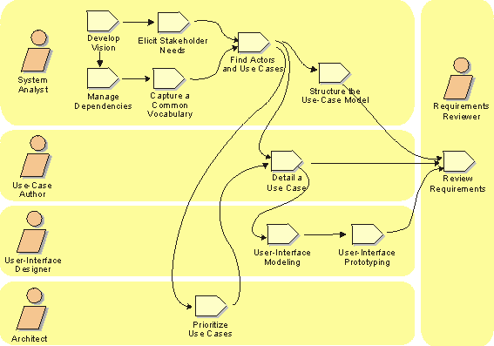
Example of a Workflow

Slide 40
Agenda
What is the Rational Unified Process
Implementing Best Practices
Phases, Iterations, Workflows and Activities
The Product
Implementing the Rational Unified Process
Software Economics
Case Study: Skandia IT
Summary

Slide 41
Process Delivery In the Past….
Thick binder on every developers shelf
….collecting dust…
hard to understand, hard to use, seen as driving overhead
not used

Slide 42
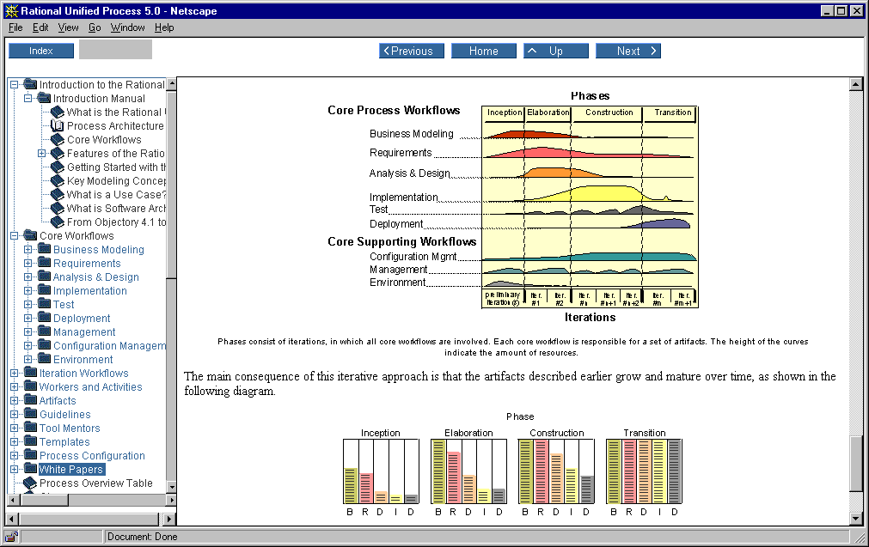
Rational Unified Process: Web-enabled
Interactive knowledge base accessible from tools
Powerful graphical navigation, search engine, index...
Guidelines, templates, tool mentors at your finger tips
Searchable
Accessible
Navigable
Easy to use

Slide 43
Knowledge Base Content
Extensive guidelines for all team members
Tool mentors (most Rational tools)
Templates
  Rational Rose (examples and template for how to structure your Rose models)
  Word (30+)
  SoDA (10+)
  MS Project
Development kit - guidelines, tools, templates for customizing the process
Access to Resource Center (white papers, updates, hints, and add-on products)

Slide 44
Tighter Integration with Tools
Visual Studio
Apex
Purify
Quantify
PureCoverage
VB Design
guidelines
Ada, C++ Prog.
guidelines
Rose
Tool mentors
Tool mentors
Report generation scripts
Stereotype icons
TeamTest
Rational Unified Process
Tool mentors
Test templates
RequisitePro
Requirement templates
ClearQuest
Tool mentors
CM guidelines
Change mgmt. guidelines
Tool mentors
SoDA
Tool mentors
Document templates
ClearCase

Slide 45
Rational Unified Process - Books
Included in the product
  Rational Unified Process - An Introduction, Philippe Kruchten, Addison-Wesley
Other recommended books
  Software Project Management - A Unified Framework, Walker Royce, Addison-Wesley
  Unified Modeling Language - An Application Guide, Booch, Rumbaugh, Jacobson, Addison-Wesley
  Unified Software Development Process, Jacobson, Booch, Rumbaugh, Jacobson, Addison-Wesley - coming Q1, 1999

Slide 46
Process Training
Courses
RUPO
Inception
Elaboration
Construction
Transition
Business Modeling
RMUC
Requirements
OOAD
Analysis & Design
Implementation
ASQ
Test
Deployment
CCM
Configuration Management
OOPM
Project Management
Environment
Preliminary
Iteration(s)
Iter.
#1
Iter.
#2
Iter.
#n
Iter.
#n+1
Iter.
#n+2
Iter.
#m
Iter.
#m+1

Slide 47
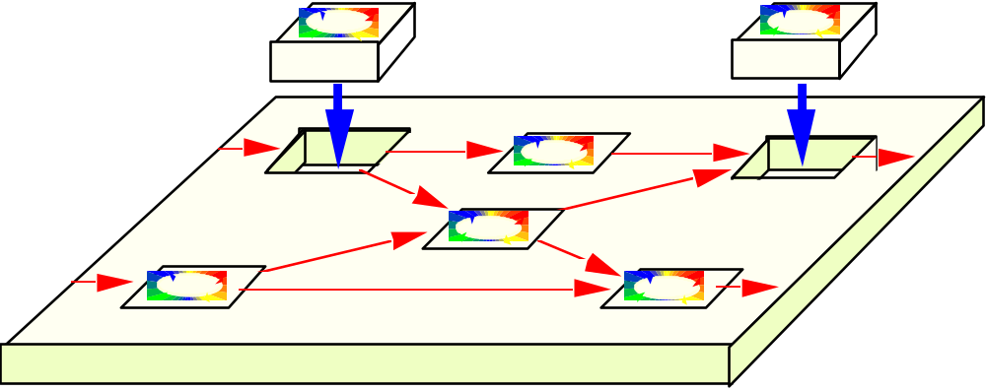
Rational Unified Process: Tailorable
Use in whole or in part
Tailor by creating a project-specific or organization-specific “Development Case”
Development kit - guidelines, tools and templates for customizing the process

Slide 48
Demo

Slide 49
Agenda
What is the Rational Unified Process
Implementing Best Practices
Phases, Iterations, Workflows and Activities
The Product
Implementing the Rational Unified Process
Software Economics
Case Study: Skandia IT
Summary

Slide 50
Approach 1 - The Interactive Knowledgebase...
Limited training
Decide what artifacts to produce
Look at the process when you need help producing the artifacts
Benefits increases over time as people start following the process…
Easy to adopt

Slide 51
Approach 2: The Full Scale Adoption….
Radical Improvements
“Members become
Mentors”
Further train and mentor each project
Evaluate
Pilot
Large Project 3
Pilot Project
Large Project 2
Large Project 1
Feed-back
Define and
Test a specific
Development Case
Establish
Process and
Support Environment
Development
Case
3-6 months
1 month
1-2 years

Slide 52
Agenda
What is the Rational Unified Process
Implementing Best Practices
Phases, Iterations, Workflows and Activities
The Product
Implementing the Rational Unified Process
Software Economics
Case Study: Skandia IT
Summary

Slide 53
What Makes Systems Complex?
Software
cost
Complex software costs
Performance constraints
Time-to-market pressures
Certification requirements
Distributed, real-time requirements
Size and geographic distribution of the engineering team
Reliability and fault-tolerance requirements
Rate of requirements and technology change
The interplay of these factors
Diseconomy of scale
size/scale
Software costs = E * (Size)^{P}

Slide 54
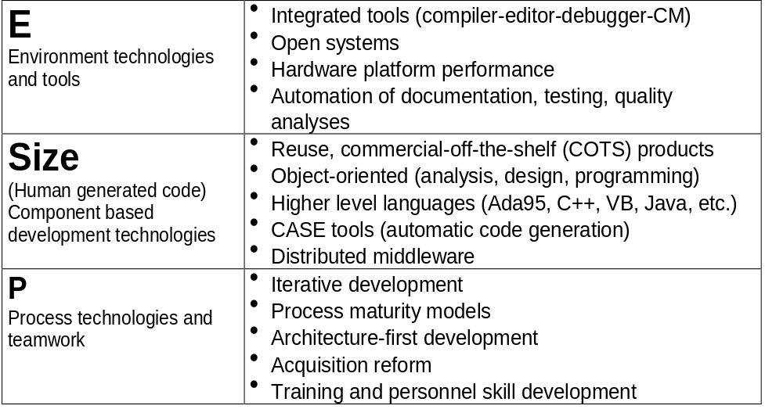
Current Software Technology Thrusts
Software Costs = E * (Size)^{P}

Slide 55
Next-Generation Cost Models
R&D Component
Production Component
Software cost = E _{Arch} (Size_{Arch} ) ^{PArch} + E _{App} (Size_{App} ) ^{PApp}
Team size: Arch: 5 to 10 S/W engineers Arch: 5 to 10 S/W engineers
Apps: 5 to 10 mission engineers Apps: As many as needed
Small and expert as possible Large and diverse as needed
Product: Executable architecture Deliverable, useful function
Production plans Tested baselines
Mission scenarios/models Warranted quality
Focus: Design and integration Implement, test, and maintain
Host development environment Target technology
Phases: Inception and elaboration Construction and transition

Slide 56
Next-Generation Cost Models
Risk resolution, low-fidelity plan
Schedule/technology driven
Risk sharing contracts/funding
Low-risk, high-fidelity plan
Cost driven
Fixed-price contracts/funding
N month design phase N/2 month production increments
$ or
time
^{P}_{Arch} ^{> 1}
$ or
time
^{P}_{App} ^{< 1}
Size/complexity
Size/complexity
Architecture-centric Development

Slide 57
Next-Generation Productivities
Today’s focus:
Maximize SLOC per staff-month
Tomorrow’s focus:
Minimize the amount of custom development
Component-Based Development

Slide 58
Automated Component-Based Development
Target Process
- - - - - - - - - -
100
90
80
Late Design
Breakage
70
Development
Progress
60
50
40
S/W Engineering
Experience
Range of reusable
domain-specific
assets
30
20
Conventional
Experience
10
Time
Integrated environments
Reusable components (architectures, instrumentation, etc.)
Platform independence
Integrated components (reuse, custom, COTS, adapted)
Off-the-shelf solutions to most of the difficult computer science issues

Slide 59
Agenda
What is the Rational Unified Process
Implementing Best Practices
Phases, Iterations, Workflows and Activities
The Product
Implementing the Rational Unified Process
Software Economics
Case Study: Skandia IT
Summary

Slide 60
Case Study - Skandia IT
Largest insurance company in the Nordic countries.
How Did Skandia IT Increase Productivity with 80% in a year?

Slide 61
Skandia IT 1996
Legacy systems could not be changed as fast as business required
EEC opened up border for international competition
Project performance unpredictable
Systems delivered often not meeting end user expectations
Difficult to attract experienced developers

Slide 62
Action Plan
Invest in Microsoft and Rational technologies
  Visual Studio, COM/DCOM, MTS, SQL Server
  Rational Rose, Rational Unified Process, Rational SoDA
Recruit top consultants and employees
Put employees through extensive on-the-job training program
Deploy a component-based architecture

Slide 63
Reuse and Architecture Team
Highly qualified staff of 20 developers / architects
Evaluated and customized tool environment
Evaluated and customized process
Developed reusable components
Put the architecture in place

Slide 64
System Architecture
Internet
Windows
Clients
VoiceBroker
New
Technologies
BusinessBus
LegacySystems
Image
Workflow
New
Systems
New
Technologies

Slide 65
Skandia IT 1997
10 projects - all on time
Independent Gartner Group Evaluation
  80% in-house productivity increase in 1 year
  40% more cost effective than Nordic average
Ahead of competition
No problems recruiting top personnel

Slide 66
Agenda
What is the Rational Unified Process
Implementing Best Practices
Phases, Iterations, Workflows and Activities
The Product
Implementing the Rational Unified Process
Software Economics
Case Study: Skandia IT
Summary

Slide 67
Rational’s Strategy
Process
drive
focus
Guidance
Customers
automate
syndicate
Automation
Acceleration
Tools
Services
amplify
guide

Slide 68
Why Rational Unified Process is the Right Choice
Developed by the company that created the UML
Unifies best practices from many disciplines into a full lifecycle process
Integrated with Rational’s tools
Online mentor on your desktop
Supported by comprehensive
professional education
Delivers unprecedented content to a low price

Slide 69
Goodies

Slide 70

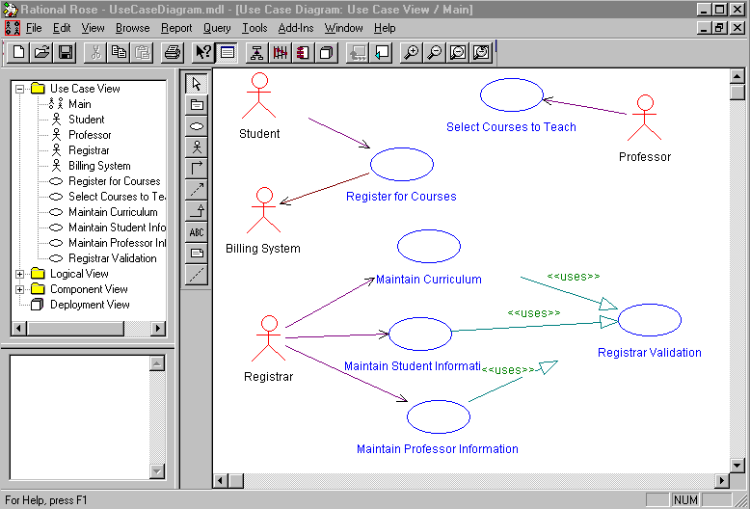
Use case diagram

Slide 71
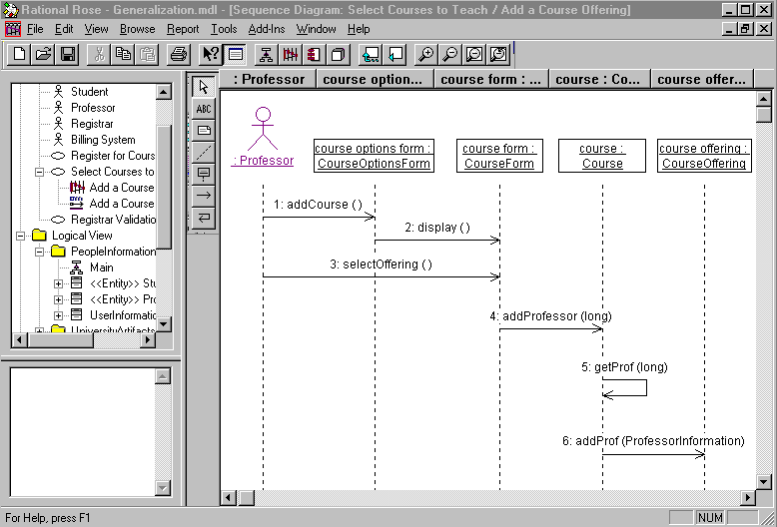
Scenario diagram

Slide 72
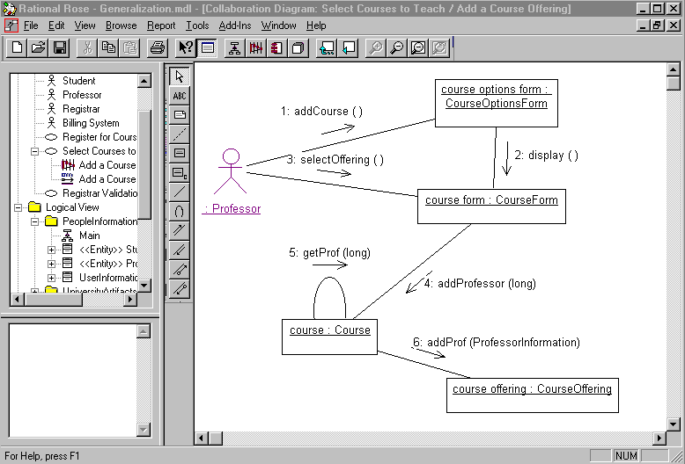
Collaboration diagram

Slide 73
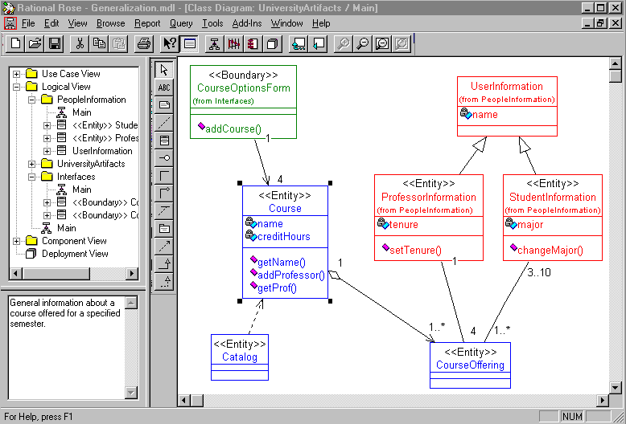
Class diagram

Slide 74
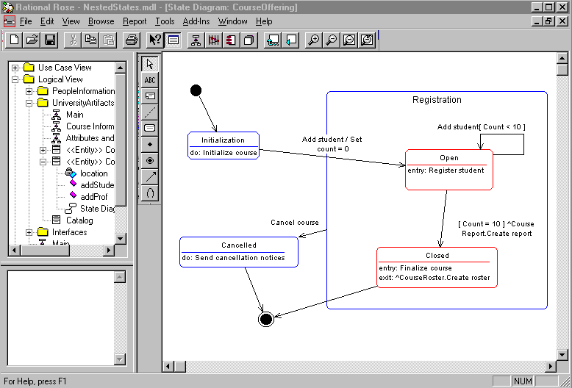
State transition diagram

Slide 75
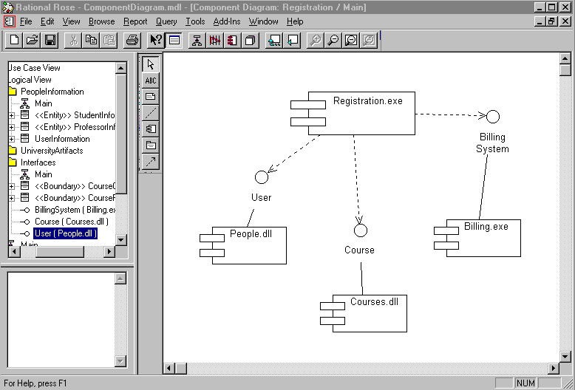
Component diagram

Slide 76
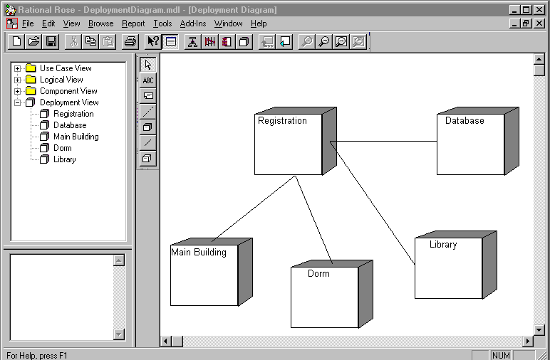
Deployment diagram

