Slide 1
Registry Facilities for the Exchange
of Statistical Data and Metadata
Bengt-Åke Lindblad, bengt-ake.lindblad@ec.europa.eu
Francesco Rizzo, francesco.rizzo@ec.europa.eu
Marco Pellegrino, marco.pellegrino@ec.europa.eu

Slide 2
Working Paper 8: Registry facilities
Introduction
Functions of the SDMX Registry
Registry Architecture
Development of the Eurostat SDMX Registry
Registry Content and Implementation
- Data Structure Wizard
- Exchange and management of reference metadata
- Implementation strategy
Standardisation of Metadata Concepts

Slide 3
What the SDMX Registry is
Implementation of SDMX standard, version 2.0
Application which is accessible to other programmes over the Internet (Intranet, Extranet) to provide information needed to facilitate the reporting, collection and dissemination of statistics.
Not concerned with the storage of data or reference metadata sets.
Index of a distributed database or metadata repository.
Generic form of technology used by applications and not directly by end-users.

Slide 4
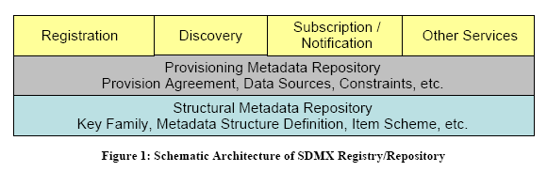
SDMX Registry Architecture
Structural Metadata Repository Layer
Provisioning Metadata Repository Layer
Data and Metadata Registry Layer
Subscription/Notification

Slide 5
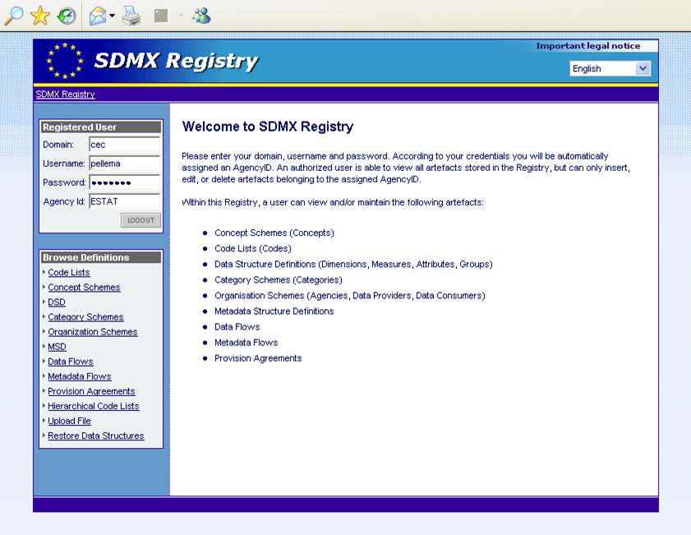
registry application

Slide 6
Development of the Eurostat SDMX registry
Development in 2006-2007
  Implementing the specifications from SDMX 2.0 standards
  Comprises three major blocks (Database, Web service, GUI)
  Enable NSI to obtain SDMX structure definitions and dataflow agreements
  Used as back-office application for other information systems (eDAMIS, SODI,…)
  Published as Open Source
Development in 2008
  As of March of 2008 under stress test
  Will be accessible by external organisations
  Will become the core of the “Metadata Handler” in Eurostat (providing a common environment for managing all kinds structural and reference metadata)
  Will provide services to users via GUI or associated applications such as DSW and to other applications via the web service
  Will replace the existing GESMES Structural Metadatabases used by Eurostat and ECB
  Will be complemented with other off-line and on-line applications and modules being developed for handling specific data or metadata objects

Slide 7
Use of registry architecture for metadata
The interoperability of reference metadata can be improved by:
  Defining Metadata Structures (MSD) based on a standard conceptual structure (ESMS)
  Generating reference metadata into SDMX-compliant formats
  Enabling direct transmission of SDMX-ML metadata using push/pull mechanisms
  Converting/editing metadata which are not yet in SDMX-ML
  Loading reference metadata into Eurostat’s metadata base
  Extracting and publishing reference metadata on the website
How?
By developing a registry architecture which can assist the users in performing the tasks described above.

Slide 8
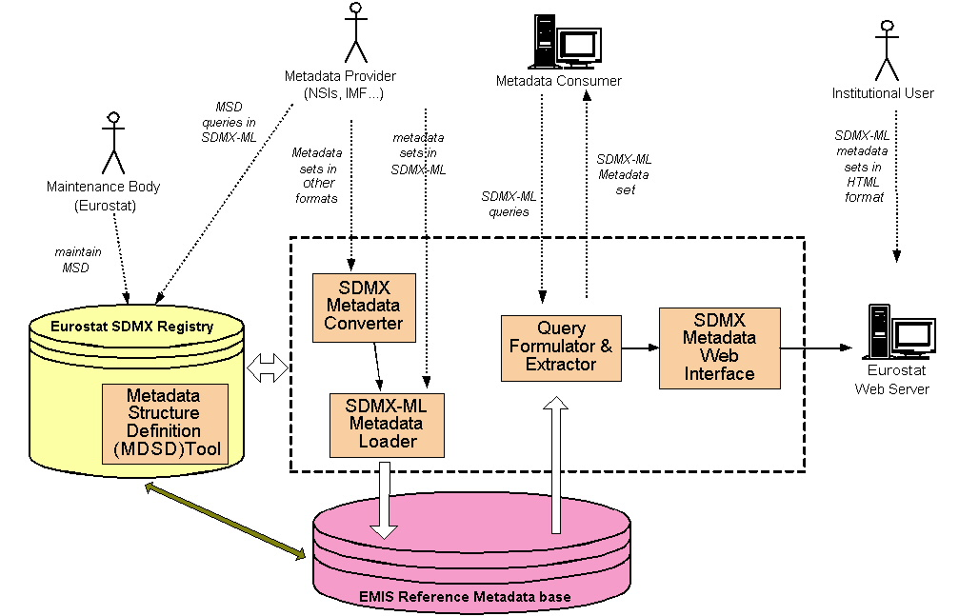
SDMX reference metadata architecture

Slide 9
SDMX Reference Metadata Editor
Web-based application intended to be used by the NSIs - metadata providers
Requires user authentication: CIRCA LDAP^{(*)}
Major Functionalities:
  Select and retrieve the MSD from the SDMX Metadata Registry
  Build dynamically an SDMX metadata template which can be filled-in by the metadata provider
  Fill (even partially) + store the SDMX-ML message in a local repository
  Dispatches the SDMX-ML metadata message to eDAMIS reception space and then to other Web Service modules for further processing
(*) Lightweight Directory Access Protocol: Authentication protocol
Notes:
requires user authentication (CIRCA LDAP);
create metadata in SDMX-ML format;
select the domain for which metadata should be reported;
preview metadata reports submitted in the past;
preview the reference period of the metadata report;
preview the filled metadata template and inform if there are parts that have not been completed (some parts should be mandatory);
save submitted responses and continue/upload unfinished parts of the template/questionnaire at a later stage;
manage versions of the metadata reports.

Slide 10
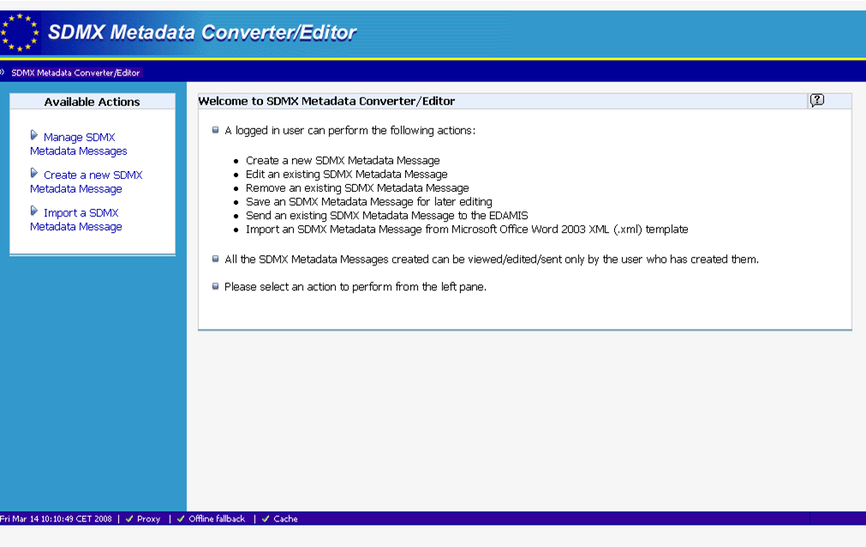
Metadata editor

Slide 11
For more info:
SDMX standards
http://www.sdmx.org/index.php?page_id=16#package
SDMX User Guide
http://www.sdmx.org/index.php?page_id=38
Implementation of SDMX registry specifications:
http://www.sdmx.org/index.php?page_id=52

Slide 12
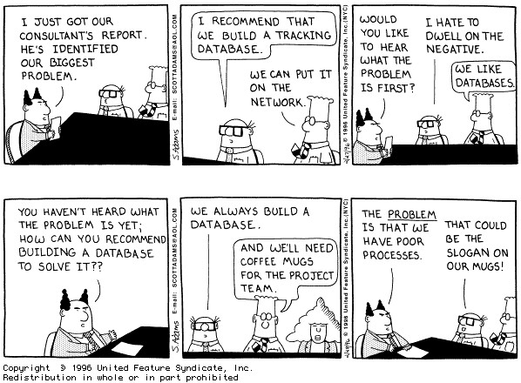
Databases and Business Processes

Slide 13
Thanks for your attention
Bengt-Ake.Lindblad
Francesco.Rizzo Marco.Pellegrino
@
ec.europa.eu

