Slide 1
VNU/ACNielsen
Fact Book Update
September 26, 2002

Slide 2
This document summarizes information obtained through primary and secondary sources as of September 26, 2002. While significant efforts have been made to ensure accuracy, it is possible that inaccurate information was obtained through these sources.
Please direct questions to:
Kim Sevonty
(973) 763-0863
Kim.Sevonty@infores.com
McCusker & Associates

Slide 3
Focus
> Focus
This assessment provides an overview of the strategic initiatives of ACNielsen and VNU as they affect ACNielsen. It includes updates since the first Fact Book release in November 2001.
It is intended as part of an ongoing competitive intelligence process by which VNU and ACNielsen will be tracked and analyzed to identify current and emerging threats and opportunities for IRI.
ACNielsen will be referred to as “ACN” throughout the document. Also, VNU’s business units Marketing Information and Media Measurement & Information will be referred to as “MI” and “MMI”, respectively.
Note: Side by side product comparisons can be found on the IRI Intranet.

Slide 4
> Table of Contents
Headlines
VNU
Overview
Organization Structure
Management
Strategy Scorecard
Financial Performance
Acquisitions & Divestitures
Internet Operations
Competition
Marketing Information
Overview
Strategy
Leveraging Synergies
6
11
12
14
15
17
23
26
29
32
34
37

Slide 5
> Table of Contents
ACN
Overview
Rankings
Organization Structure
Management
History
Products & Coverage
Product Overviews
Clients
Marketing
Financial Performance
Operation Leading Edge
Technology
Appendix: BASES
Claritas
Market Decisions
Spectra
40
41
42
43
44
45
50
67
70
76
81
82
88

Slide 6

> Headlines
VNU (public: Amsterdam exchange) is a media and information company headquartered in the Netherlands with 37,000+ employees and offices in 100 countries.
In 1998, VNU began a transition to recession resilient businesses such as marketing and media information and directories to complement its business information group because they offer “must have” information and involve long term contracts.
From 1998 to 2001, VNU acquired over 50 companies, mostly smaller marketing and publishing companies with the exception of its sizeable investments in ACNielsen (2001/$2.3 billion), Miller Freeman (2000/$0.7 billion), Nielsen Media Research (1999/$2.7 billion), ITT World Directories (1998/$2.1 billion).
With the end of 2001, VNU declared that it had completed its transition.

Slide 7
> Headlines
Revenues from VNU’s three* business units, marketing & media information, business information and directories, were $4.4 billion (∈4.8 billion) for 2001 and should be close to that level for 2002.
VNU’s strategy for going forward can be summarized as follows:
  Leverage the synergies among its existing and newly acquired subsidiaries
  Refine its Internet initiatives
  Continue global expansion
  Improve its capital structure
Given the condition of the economy and VNU’s capital constraints, it is likely that VNU will focus on improving existing businesses or making divestitures over the near term instead of making acquisitions.
* VNU often refers to four business units by splitting Marketing Information and Media Measurement & Information. Organizationally, it has taken measures to separate the two more permanently (refer to Organizational Structure).

Slide 8

> Headlines
ACN was acquired by VNU NV in February 2001.
ACN’s business falls into seven categories:
  retail measurement services,
  consumer panel services,
  customized research services,
  global solutions,
  decision support tools,
  merchandising software tools,
  and most recently modeling/analytics which was previously categorized under retail measurement.
ACN accounts for most of VNU’s Marketing Information Group’s $1.6 billion (∈1.8 billion) in 2001 revenue.
The strategy for Marketing Information can be summarized as follows:
  Develop new technology to improve quality, capabilities and speed of delivery as well as reduce costs and increase efficiencies.
  Strengthen retailer co-dependency; need to be invaluable to retailers.
  Leverage synergies among subsidiaries.

Slide 9
> Headlines
Organic growth for the first half of 2002 was 5%, for an estimated $625 million in revenue, compared to 7% for the prior year period and 6% for 2001.
ACN’s revenue mix has shifted some from Europe (47% to 40%) to the U.S. (22% to 30%) since 1995 as evidenced by 78% growth in U.S. revenue.
In the last several years, custom research has demonstrated the strongest growth (55% from 1999 to 2001) compared to retail measurement and consumer panel.
ACN achieved a 13% operating margin in 2001, higher than the 11% initially projected.
ACN is continuing with its Operation Leading Edge program in Europe to achieve operating efficiencies and financial targets which will yield ∈40 million in savings globally by the end of 2002.

Slide 11
VNU
> Overview
Founded: 1964
Public: EuroNext Amsterdam Exchange and U.S. OTC (VNUVY)
Products & Services:
  Marketing & Media information: market research, audience measurement and information for the entertainment industry
  Business Information: trade publications (140) and trade shows (125)
  Directories: primarily white and yellow pages in Europe (165)
Employees: Number %
  Marketing Information 24,234 65.3%
  Media Measurement & Information 7,685 20.7%
  Business Information 3,361 9.0%
  Directories 1,840 5.0%
  37,120
Industry Focus: strong in consumer packaged goods, media and entertainment
Geographic coverage: Subsidiaries in 18 countries, offices in 100 countries
Source: VNU web site, VNU annual report

Slide 12
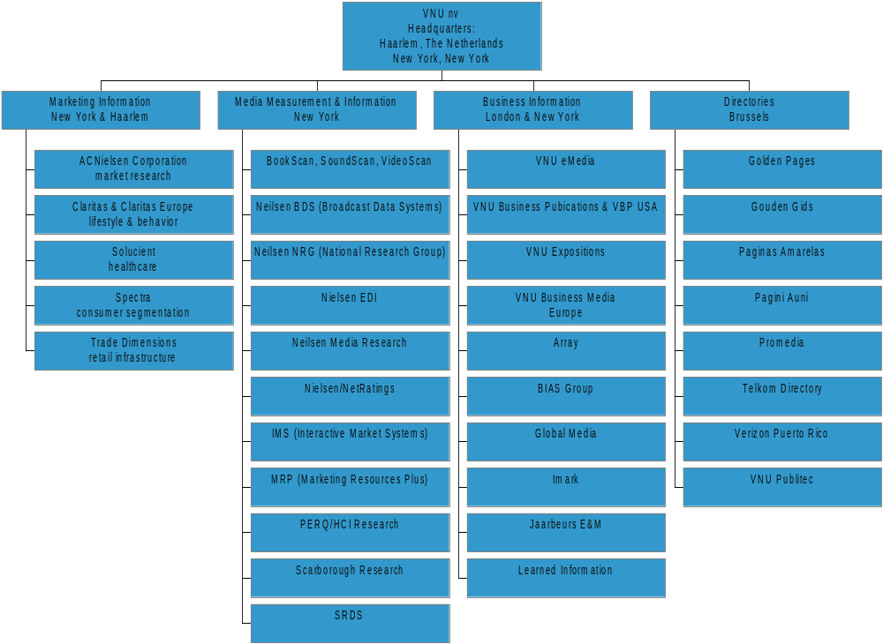
VNU is focused on four business units with completion of its transformation in 2001.
> Organizational Structure
Source: VNU web site, Business Wire

Slide 13
Some organization changes have taken place, more are expected.
> Organizational Structure
Subsidiaries under Marketing Information have been transferred to Media Measurement & Information.
  Broadcast Data Systems
  ACNielsen taken out of eRatings
VNU has branded a number of subsidiaries under Nielsen Media Research
  Nielsen BDS – Nielsen EDI
  Nielsen NRG – Nielsen/Net Ratings
A few consolidations of subsidiaries have been completed.
  IMS and MediaPlan
  Bill Communications and BPI Communications
A more definitive split, including financial reporting, between Marketing Information and Media Measurement & Information is anticipated.
The organizational realignment has de-emphasized geography.
VNU generally runs a decentralized organization and allows its subsidiaries to operate autonomously.
Source: VNU web site, Business Wire, New York Times

Slide 14
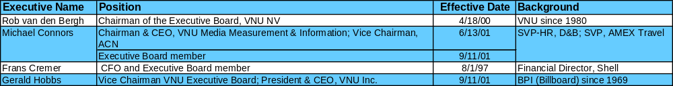
Overseeing the organization and establishing its strategy is the ten member VNU Board.
> Management
VNU has a four member Executive Board including two members out of its U.S. operations.
Three of the four executives have been in their positions for two or fewer years.
The six member Supervisory Board, which consists completely of outsiders, oversees the Executive Board.
Source: VNU web site

Slide 15
> Strategy Scorecard
The strategy established at the end of 2001 sets the stage for the new VNU organization
Score
VNU Strategy - End of 2001
Examples of Strategy in Action
Expand worldwide in marketing information
Expand with targeted business publications and trade shows in the US and Europe
Expand directories business (acquisitions and new related products) in Europe
Own market-leading branded information businesses
Achieve broader geographic mix of activities
Focus on high growth and high margin businesses
Operate under a conservative capital structure
Reduce dependency on cyclical sources of revenues
Exploit new media opportunities
Targeted Internet activities
Acquisition of Imark Communications and Publicaciones Profesionales; Jaarbeurs JV
Acquisition of Golden Pages, interest in Pagini Aurii
Kantar media research partnership in India
Nielsen Internet measurement in China
Deficit tangible net worth; weak debt coverage
Slight positive working capital in first half 2002
Invested in and formed partnership with MeasureCast, Internet audience measurement and demographic information
Discontinued Spott.nl, newmonday.com, VNUnet, Directories mobile telephone portal; Net rating and eRatings combination
Bitpipe research library partnership
Source: VNU web site & press releases, Business Wire, PR Newswire

Slide 16
> Strategy Scorecard
VNU has had varied success in its strategy thus far.
VNU has been strongest in geographic expansion, directories acquisitions, and realigning its Internet related operations.
Although the iMark acquisition and the Jaarbeurs joint venture are in line with the goal of expanding trade show and publications businesses, it is contrary to VNU’s desire to decease reliance on cyclical businesses.
  Trade show business is being adversely affected by the economy.
Worldwide growth in Marketing Information has been mixed.
  Over the last several years, the greatest revenue growth has occurred in the U.S. (78% from 1995 to 2001) and the Asia-Pacific region (53% from 1995 to 2001)
  However, Canada and Central America growth has slipped (-7% from 1995 to 2001).
Financial activities are not yet in line with stated objectives: capital market conditions and the economic environment are making it difficult for VNU to improve its capital structure.
  VNU did not receive as much as it had hoped for the sale of the Consumer and Education Information Groups.
  VNU issued ∈2 billion in medium term debt to repay the bridge loan associated with the ACN acquisition (30% of which was placed.)
Source: VNU web site, Business Wire, VNU press releases, ACN 10-K, VNU annual report

Slide 17
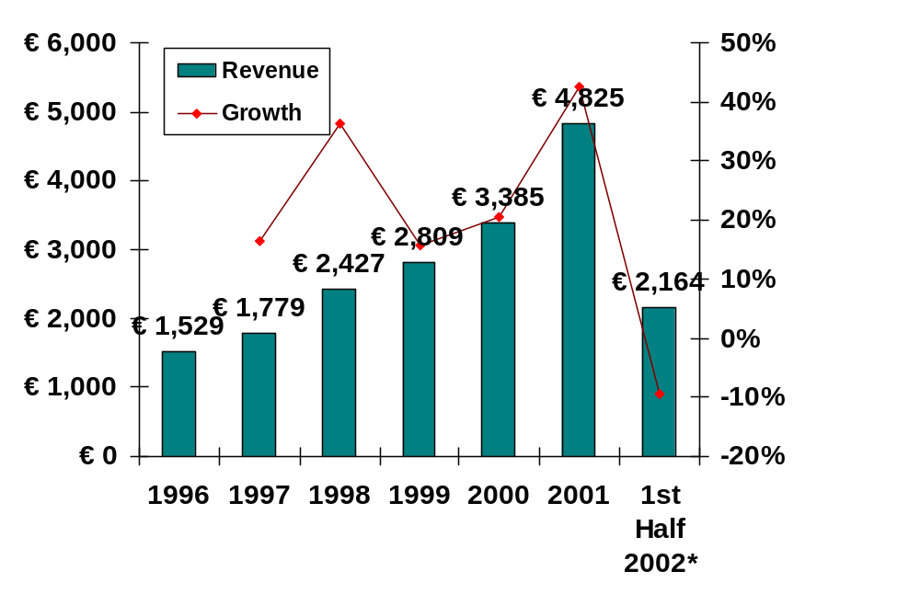
Top line growth in Marketing and Media Information has offset challenges in Business Information.
> Financial Performance
Revenue
The conclusion of the 2001 fiscal year coincided with the completion of VNU’s transformation.
  Three major business units, down from six
  Exit from consumer cyclical businesses (∈481 million of 2001 revenue)
On a pro forma basis, organic revenue “remained stable”.
* Growth compared to first half 2001
Top line growth in 2001 is primarily attributable to the acquisition of ACNielsen which had approximately $1.6 billion in revenue with 6% organic growth.
Nielsen Media Research reported 9% organic growth in 2001, despite the decline in the advertising industry.
Source: VNU first half 2002 press release, VNU 2001 results presentation and annual report, VNU web site

Slide 18
Through the first half of 2002, there has been some impediments to targeted revenue growth rates.
> Financial Performance
Revenue for the first half of 2002 was ∈2.2 billion.
The revenue decline in the first half of 2002 on a run rate basis* is due to:
  loss of Consumer Information Group and Educational Information Group revenue,
  timing issues at Claritas and Spectra.
  sub-optimal advertising environment impacting business information as well as increased seasonality of trade shows (e.g. previously once a year, now every other year, and
  a five week strike in Belgium affecting the directories business.
* ∈4.8 billion for 2001 v. ∈2.2 billion first half 2002 annualized.
Source: VNU first half 2002 press release and web cast, VNU web site

Slide 19
VNU maintains a positive top line outlook for Marketing and Media Measurement Information.
> Financial Performance
Marketing Information:
Media Measurement:
Business Information:
Directories:
Organic growth of 5-7% is expected. Custom research will continue to be affected by the economy, but is a small portion of revenue. Improved cooperation between subsidiaries should enhance results.
Anticipate organic growth of at least 8% (compared to advertising industry 1-2% for 2002-2004). Five percent operating margin improvement projected when Internet operations reach breakeven by the end of 2003.
Continued revenue decline will be mitigated by cost savings
Results similar to 2001 anticipated for 2002.
70% of revenue and 55% of operating income are expected to come from Marketing and Media Information.
Source: VNU analyst presentation

Slide 20
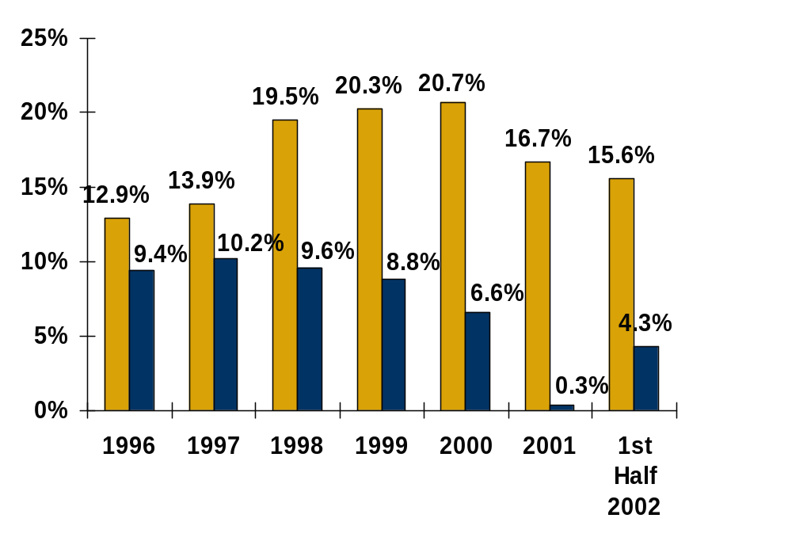
The pressure is on to return margins to the levels of the late 1990s.
> Financial Performance
The reduced operating margin in 2001 to 16.7% was due to lower operating margins at ACNielsen.
Cost savings are expected to continue with the exception of increased hiring in the marketing information group.
Cash earnings for 2001 came in at ∈416 million or 2% greater than 2000.
However, earnings per share were 3% lower than 2000 which was in line with the revised projections released in October 2001.
Operating and Net Margin
(before extraordinary items)
Net earnings would have been negative for the first half of 2002 had it not been for the Golden Pages acquisition.
Source: VNU first half 2002 press release and presentation, 2001 results presentation, VNU web site, VNU annual report

Slide 21
Balance sheet improvements are still in order.
> Financial Performance
VNU has worked towards improving its short term position.
  Working capital was a +∈19 million at June 30, 2002, compared to -∈494 million at December 31, 2001.
However, its interest coverage ratio slipped some from 4.1x at the end of 2000 to 3.1x at the end of 2001.
VNU’s debt load remains hefty.
  Long term debt at 6/30/02 was ∈3.7 billion and repayment efforts slowed during the first half of 2002.
  Debt Load 6/30/01 12/31/01 6/30/02
  Proceeds from debt ∈4,627 ∈1,113 ∈414
  Repayment of debt (1,750) (2,518) (528)
  Net effect to position 2,877 (1,405) (114)
VNU does maintain a ∈500 million line that has not been used.
Net worth is still negative on a tangible basis: -∈3.86 billion at June 30, 2002, compared to -∈5.77 billion at December 31, 2001.
Source: VNU first half 2002 press release and presentation, 2001 results presentation, VNU web site, VNU annual report

Slide 22
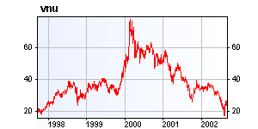
Rating agencies and stockholders have reacted according to VNU’s financial performance.
> Financial Performance
Moody’s and S&P downgraded VNU’s debt and issued a “negative outlook” during the first half of 2002.
VNU’s stock lost 75% of its value since early 2000. The stock price did respond slightly to the mid year earnings release.
Despite its financial challenges, VNU has continued its annual distribution of 30% of cash earnings to shareholders.
Five Year Stock Performance
Source: VNU press releases, Amsterdam Stock Exchange, Mizuho Research, Moody’s, S&P

Slide 23
Proceeds from divestitures were not sufficient to pay off acquisition bridge debt in 2001.
> Acquisitions & Divestitures
Proceeds/ (Purchase Price)
Sources and Uses
Date
Acquired remaining 40% of Entertainment Marketing Information Services (music, book & video POS)
Acquired ACN
Management buyout of the Educational Information Group
Sold Consumer Information Group to SanomaWSOY, Helsinki, Finland
Acquiring iMark (BtoB technology exhibitions and seminars)
Debt Issue*
1/19/01
(∈220) million
2/16/01
(∈2,500) million
8/28/01
∈195 million
10/1/01
∈1,250 million
8/3/01
(∈19) million
10/18/01
∈600 million
(∈694) million
* Only ∈600 million as part of a ∈2 billion offering
Source: VNU press releases, VNU 2001 annual report

Slide 24
Over the near term it is not likely that VNU will make any major acquisitions, but that it will focus on re-aligning core businesses.
> Acquisitions & Divestitures
Cash and capital constraints will impede acquisition abilities.
Acquisitions in 2002:
  The one main acquisition made thus far in 2002, remaining 63% of Golden Pages in Ireland, was financed with a share sale in May 2002 which generated ∈265 million in proceeds. (“Unusual for such a small deal.” - The Daily Deal)
  Other acquisitions included a 28% interest in a Romania telephone and business directory for $6 million and the purchase of a Spanish publisher and a 50% interest in an events organizer focused on the advertising and marketing industries.
  ACNielsen took control of LiquorScan which had been operating as a joint venture with Adams Business Research. (See Beer/Wine/Spirits Strategic Product Overview)
Source: VNU press releases, VNU 2002 first half results, Mizuho Research

Slide 25
Realignment is also including divestitures.
> Acquisitions & Divestitures
Divestitures in 2002:
  In April 2002, ACNielsen agreed to sell Vantis to Ipsos Group.
    Vantis had $10 million in 2001 revenue.
    It focused on the consumer electronics, high tech, automotive, durable goods, financial services, telecommunications, shipping services, entertainment, healthcare and alcoholic beverage industries.
    Marketing research services included consumer behavior, modeling, demand forecasting, product optimization, pricing, marketing plans, segmentation.
  In June 2002, it was announced that Claritas Europe would be selling the remaining interest in Abacus Direct Europe to DoubleClick.
    Abacus Direct Europe online marketing services was a 50/50 joint venture between Claritas Europe and DoubleClick.
    Started in 1998, Abacus Direct Europe tracks the buying habits of more than 26 million households through about 250 retail companies.
    Claritas will continue to provide data products to Abacus Direct Europe for the next five years.
  Valassis Relationship Marketing Systems (grocery store loyalty marketing), as of July 2002, is now 88% owned by Valassis Communications. The remaining 12% is owned by VRMS management and VNU. Although not a divestiture, it is an indication that VNU will not likely acquire VRMS. (VRMS no longer appears on VNU’s organization chart.)
Source: VNU press releases, Ipsos press release, DoubleClick press release, Valassis press release

Slide 26
VNU has been reassessing its Internet related operations.
> Internet Operations
During 2001, two Internet businesses, newmonday.com and VNUnet.com, were absorbed back into VNU operations.
Internet related activities continue as a financial drain, but are expected to reach breakeven by the end of 2003.
Internet Operations 2000 2001
Revenue ∈79 million ∈47 million
Costs 150 million 110 million
Operating Income ∈(71) million ∈(63) million
The acquisition agreement between Net Ratings and Jupiter Media Metrix was mutually terminated due to anticipated Justice Department intervention.
Source: VNU 2001 annual report and presentation, PR Newswire, Net Ratings

Slide 27
Internet audience measurement, via Net Ratings, is an operation viewed as having long term potential for VNU.
> Internet Operations
Background:
  The 80/20 joint venture between ACN and Net Ratings called eRatings was formed in 1999.
  At the beginning of 2001, VNU owned 63.5% of Net Ratings through Nielsen Media Research (57.4%) and ACN (6.1%).
  eRatings offered the Nielsen Net Ratings product which measures Internet experiences of over 225,000 users in 29 countries (an increase of 10 in 2001).
Net Ratings:
  Publicly traded (NASDAQ: NTRT) with a market capitalization that has declined substantially in the last year ($400 million to $183 million currently).
  Revenue for the year ended 12/31/01 were $23.5 million, a 15.2% increase over 2000. However, its net loss for the period was $17.6 million or 22.6% greater than 2000.
  Net Ratings is heavily dependent upon ACN for its International operations.
    Recently it received approval to conduct Internet measurement in China
  CPG clients include: Gillette, Kraft Foods, Unilever
  Net Ratings has been sitting on $320+ million in cash for the last several years.
Source: Business Wire, Nielsen press release, Net Ratings 10-K, WSRN.com

Slide 28
Net Ratings is pushing towards growth despite the failed Jupiter deal.
> Internet Operations
Net Ratings did acquire the 80% interest in eRatings (Internet audience measurement outside of the U.S.) held by ACNielsen, making it the sole owner.
  On 10/25/01 Net Ratings entered into an agreement to acquire the 80% interest in eRatings.com that it did not own for $16.4 million.
  President of eRatings will take over combined company
  By the end of 2001, ACN eRatings.com had expected to cover 90% of the world's Internet users in more than 30 countries.
It also acquired Jupiter Media Metrix European contracts, the services of AdRelevance, and DoubleClick’s @plan research data.
Net Rating announced in August 2002 that it will acquire a 52% interest in Net Value which has a 200k panelist “MegaPanel” in Europe and Asia.
NetRatings acquired DoubleClick's @plan products (attitudes and lifestyles) and formed a strategic multi-year research partnership that provides for the integration of Nielsen//NetRatings and @plan research data into DoubleClick’s ad management products and services. Under the data license and integration agreement, Nielsen//NetRatings and @plan research will be integrated into DoubleClick’s DART and MediaVisor products. NetRatings acquired the @plan products (plus 200 clients) for $18.5 million in cash and stock.
Source: Net Ratings 10-K, Net Rating press releases, PR Newswire, Net Value 2001 annual report

Slide 29
VNU considers the follow companies its competitive peers.
> Competition
2001 Revenue
($ in Billions)
Business Focus
Thomson: $7.2 Information to financial services, healthcare, legal, learning and scientific industries
Reed Elsevier: $6.6 Legal, corporate, government, medical, scientific publishing including Lexis-Nexis and Harcout General
Pearson: $6.2 Educational materials publisher; Financial Times
Reuters: $5.7 News and financial information; acquired Bridge Systems
McGraw-Hill: $4.6 Education, financial and business materials publisher
Wolters Kluwer: $3.4 Tax and legal affairs, business information, medical and scientific data, and education through print and electronic
Bloomberg: $2.8 Financial news, market data, and analysis
Dow Jones: $1.8 Wall Street Journal, financial magazines
IMS Health: $1.3 Sales management reports and market research services to the pharmaceutical and medical industries
Source: VNU presentation, Hoovers

Slide 30
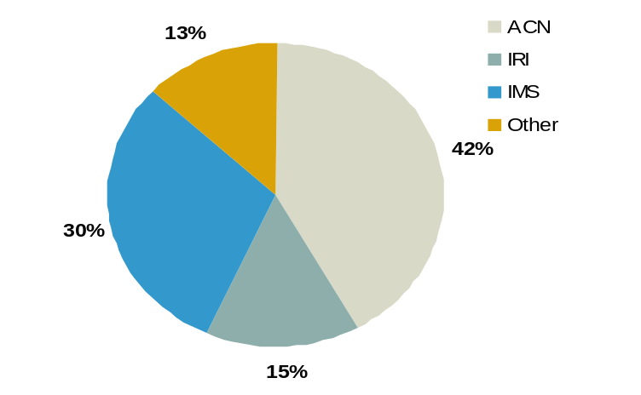
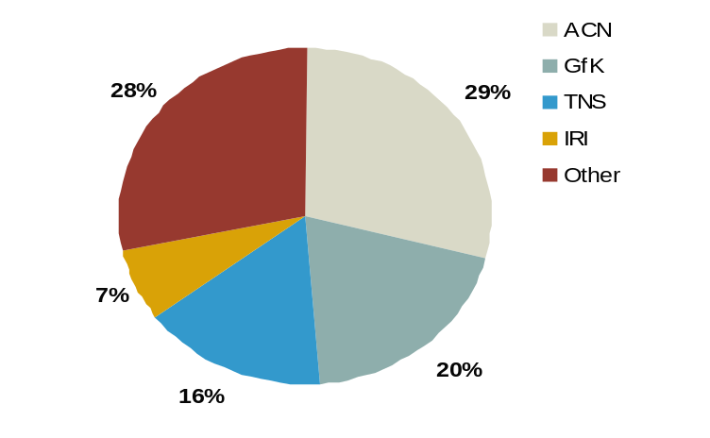
VNU/ACN has a different set of competitive peers.
> Competition
Marketing & Media Information Area
Key Competitors
IRI, IMS
IRI, TNS, GfK
TNS, IPSOS, GfK
MMA, InfoUSA, Acxiom
Advantages from ACN’s Perspective
global reach, brand equity, channel coverage, new products, 70+ years experience
global reach, 75-80% US market share
brand equity, proprietary methodologies
proprietary methodologies, MMM
Retail Measurement
Consumer Panel
Custom research
Modeling/Analytics
Global Retail Measurement Market Share
Global Consumer Panel Market Share
Source: VNU analysts presentation

Slide 31
Marketing Information

Slide 32
> Overview
Marketing Information consists of five subsidiaries.
VNU states that it has a 16% market share of the $13.3 billion global marketing information industry.
VNU expects 5% mid-term growth in marketing information.
Marketing Information subsidiaries:
  ACNielsen Corporation
  Claritas & Claritas Europe
  Solucient (36% ownership)
  Spectra
  Trade Dimensions
Revenue for this group was ∈1.8 billion in 2001.
ACN is estimated to account for most of this revenue.
Source: VNU analysts presentation

Slide 33
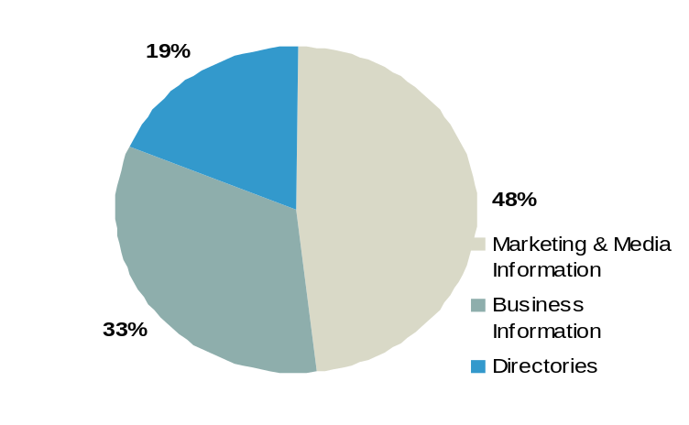
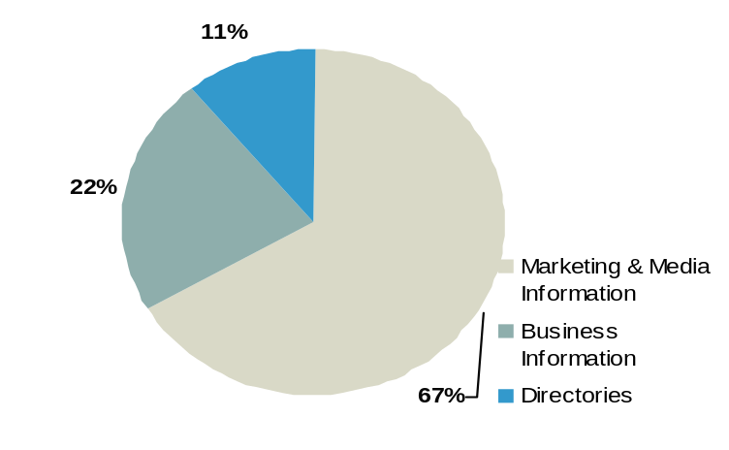
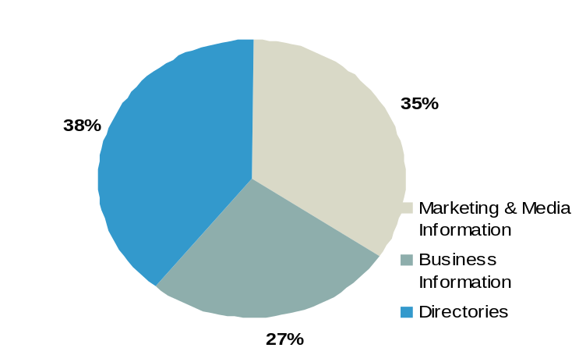
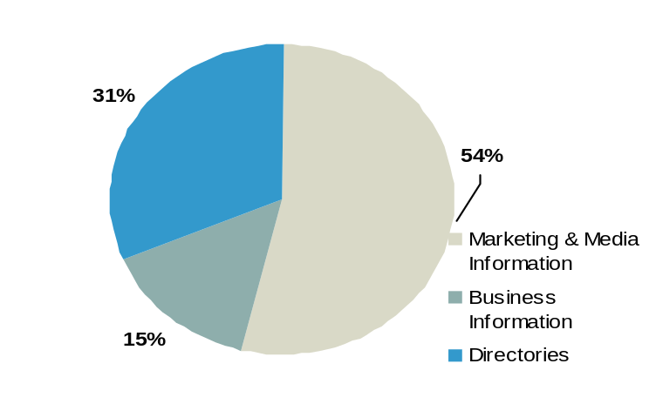
The ACN acquisition has greatly expanded VNU’s marketing information business.
> Overview
Ongoing Business Operations
Organic growth has tracked more favorably at 5-7% compared to VNU’s total organic growth of 1%.
ACN, however, is contributing a disproportionate amount to earnings.
2000 Revenue
2001 Revenue
Reported
Reported
2000 Operating Income
2001 Operating Income
Source: VNU 2001 results presentation, VNU web site

Slide 34
> Strategy
VNU has assessed its environment as part of developing its strategy for going forward.
Marketplace trends
  Globalization of markets, but demand for regional/local insights
  Continuing retailer and manufacturer consolidation
  Explosion of media/information sources coupled with consumer and media fragmentation
  Integrated marketing communications
  Client need to calculate revenue and ROI on marketing spend
  Internet
Global opportunities
  Fragmented global market with continued consolidation
  Client focus on top line growth
  Market demand driving efficiency in promotional and marketing spend
Obstacles and risks
  Global client pricing pressure
  Ability to execute retailer co-dependence strategy
  OLE completion in Europe
Source: VNU analysts presentation

Slide 35
> Strategy
Key Marketing Information initiatives focus on technology, retailers and subsidiary synergies.
Develop new technology to improve quality, capabilities and speed of delivery as well as reduce costs and increase efficiencies
  OLE in Europe for ∈40M in cost reductions by the end of 2002
  New business model: “Go-to-market new factory” for one number coding across Europe
Strengthen retailer co-dependency; need to be invaluable to retailers
  Act as catalyst for growth and product development
  Onsite people at key clients
  Establish trade areas to connect retailers to suppliers
  Develop/promote retailer specific products
  Counsel on new store site evaluations
Leverage synergies among subsidiaries
Use custom research as a strategic entry point into new countries with focus on target industries and anchor clients
“Retailers could be doing much more with their frequent shopper databases to segment their customers and to develop strategies around each segment to grow their overall business.” - Todd Hale, SVP - Consumer Insights
Source: BusinessWire, VNU analysts presentation

Slide 36
> Strategy
Marketing Information tactics vary according to age of products and clients.
Greater penetration of existing clients with existing products/services (e.g. client win backs)
CBP in US and the rest of the world
Expand MMM
Expand in new industries, e.g. financial services
Existing
Products
Global retailer products
Leverage global coding capability
Roll-out additional solutions for Answers
Media and marketing information integration
Expand into non CPG categories
New
Existing
Clients
New
Source: VNU analysts presentation

Slide 37

Consumer-Centric Marketing, spearheaded by Spectra, is one example of VNU leveraging the synergies between its subsidiaries
> Leveraging Synergies
ACN’s HomeScan, Scarborough’s HH Profiles, Valassis Frequent Shopper Data & Spectra’s Advantage software for segment targeting
Trade Dimensions TDLinx, Valassis Frequent Shopper Data and Spectra HH ShareCast for retail chain loyalty
Consumer Centric Marketing
Intro Targeter offered by ACN BASES and Spectra to identify high potential consumers for new brands
ACN’s Lifestyle Track assesses reach to Spectra targets
Spectra’s MediaPlan & LifeStyle Grid with Nielsen Media Research Volume Rating Points to allocate media spend
Core Target Analyzer: Joint effort of ACN BASES and Spectra to identify trial and repeat volume potential for each respondent
Source: VNU press releases, Spectra collateral material, Spectra Symposium (Note: copies of presentations are available.)

Slide 38
Other examples pertain to logistics, marketing and financial results.
> Leveraging Synergies
At the beginning of 2002, ACNielsen’s US headquarters consisting of 50 employees was moved from Stamford, CT, to VNU’s US headquarters in New York. Additionally the international operation in Pleasantville (Westchester County), NY, with 14 employees was moved to the New York site.
In lieu of separate conferences for ACNielsen (Category Masters) and Spectra (Consumer Centric Marketing), several of VNU’s subsidiaries will join together for one U.S. conference in March 2003.
VNU expects that its subsidiaries will meet promised financial targets and that the subsidiaries will work together for the benefit of the larger organization.
Source: Business Wire, ACN Category Masters Conference, New York Times

Slide 40
ACN became a private company again in early 2001 when it was acquired by VNU NV.
> Overview
Founded: 1923
Parent: VNU (OTC: VNUVY) acquired in February 2001
Products & Services: retail measurement, consumer panels, custom research, media measurement, decision support, modeling and analytics, merchandising, test marketing
Industry Focus: consumer goods, automotive, business services, durables, financial services, entertainment/media, health and beauty, hospitality, information technology, pharmaceuticals, telecommunications, utilities
Clients: more than 9,000
Geographic coverage: Americas, Europe, Asia Pacific, emerging markets; more than 100 countries.
Headquarters: New York, NY
Source: Crain’s New York Business, ACN web site

Slide 41
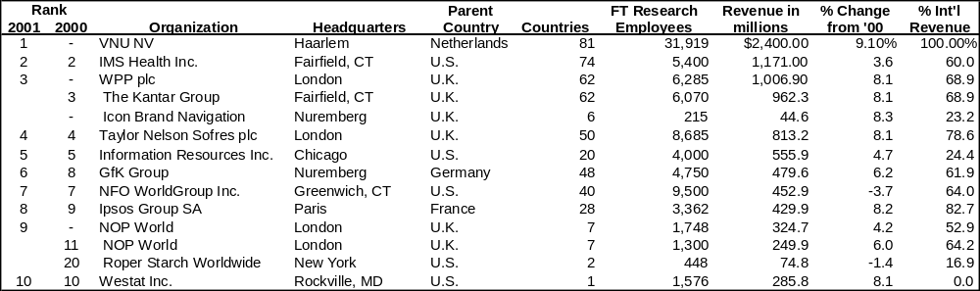
As part of the VNU organization it has climbed in industry ranking.
> Rankings
ACN, as part of VNU, ranked first in both the Honomichl Top 50 (marketing research companies in the U.S.) with $1.3 billion in research only revenue and the Honomichl Global (marketing research companies) Top 25 with $2.4 billion in global research only revenue.
ACN was announced as one of best places to work in technology according to IDG ComputerWorld in May 2002.
ACN was ranked #11 out of the 25 Best Places to Work in Chicagoland by Chicago Magazine, October 2000.
Source: ACN web site, Honomichl, Chicago Magazine, ComputerWorld

Slide 42
> Organization Structure
ACN functional areas have not changed post acquisition.
ACNielsen
Americas
Canada
Latin America
USA
Europe, Middle East, Africa
Asia Pacific
Corporate
BASES
Client Service
Legal
Finance
HR
Market Decisions
Account planning
Solution selling
Expectation management
Marketing ACN
Marketing
Systems/Operations
Coverage expansion
Capabilities defense
Analytics
Retail measurement services
Consumer marketing services
New product development
Decision support services
Data quality, efficient systems & operations
Brand equity and positioning
Channel expansion
Technology
architecture/applications
data architecture
database administration
Management
general & project
Business
requirements management
software quality assurance
technical publications
administrative support
New Business
Acquire business from competition
(focus on large clients)
Best practices in sales presentations
Competitive intelligence
Transition expertise
Needs assessments
Assist in renewals
Communications
Sales tools and promotion literature
Trade press relations
Issue-based advertising
Employee communications
Corporate events
Client communication
Trade events
Speakers bureau
e-Business
Research & implement new business opportunities
Business ventures with exchanges
State-of-art technology knowledge
Internet positioning
Source: ACN web site, former Nielsen employee interviews, BusinessWire

Slide 43
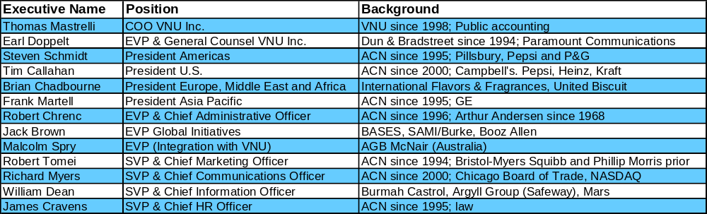
VNU, Inc. managers have been included on ACN’s Senior Management Team.
> Management
Three-fifths of ACN’s Senior Management Team has been with the company since the mid-1990s.
Experience levels and backgrounds are varied.
An Executive Vice President has been assigned responsibility for integration with VNU.
*
*Moving to VNU NV as Chief Legal Counsel in 9/02.
Source: ACN web site

Slide 44
The last fifteen years have been active with new product releases and acquisitions.
> History
1923: Company Founded
1933: Introduces measurement of drug and retail store sales
1934: Introduces measurement of food and dept store sales
1935: Invents concept of market share
1939: Opens first international office (Great Britain)
1963: Introduces measurement of mass merchandisers
1980: Launches National SCANTRACK service
1984: Acquired by Dun & Bradstreet
1988: NPD/Nielsen introduces national electronic HH panel
1988: Acquires LDS (SPACEMAN)
1992: Introduces Workstation
1993: Begins to offer warehouse based scanning information
1993: Begins LiquorScan service joint with Adams Business Research
1994: Acquires SRG, the market leader in Asia
1996: Becomes independent company
1997: Acquires EDI movie revenue tracking
1998: Launches ConvenienceTrack
1998: Acquires BASES Group
1998: Announces Hispanic Consumer panel
1999: Acquires full ownership of Market Decisions
1999: Enters JV with NetRatings (1st global internet measurement)
2000: Launches Operation Leading Edge
2000: Introduces LifeStyle Track in conjunction with Spectra
2001: Launches Category Business Planner
2002: Launched Consumer Pre*View
2002: Launches Rx/OTC Panel
Source: ACN web site

Slide 45
ACN’s products can be broken up into six categories
> Products & Coverage
Most of ACN’s business is generated through the sale of scanner and panel data and related services for retail measurement and consumer purchasing behavior.
ACN offers a full range of customized research services and global solutions.
  BASES: Simulated test marketing and pre-market sales forecasting for the CPG industry;
  Market Decisions: Live/in-store test marketing services
  Custom Surveys
  Qualitative Studies
  International Research: Research support services for companies seeking to establish a presence in foreign markets
ACN has also developed decision support tools as well as software tools focused on merchandising.
Source: ACN web site

Slide 46
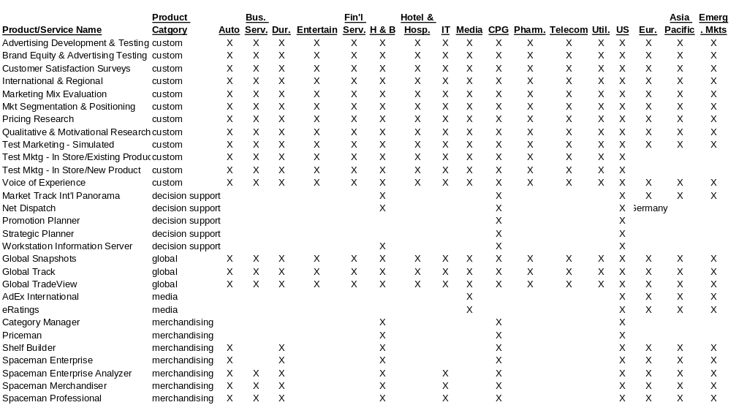
> Products & Coverage
Core products focus on Packaged Goods and Health & Beauty segments in the U.S.; custom services reach further.
Source: ACN web site

Slide 47
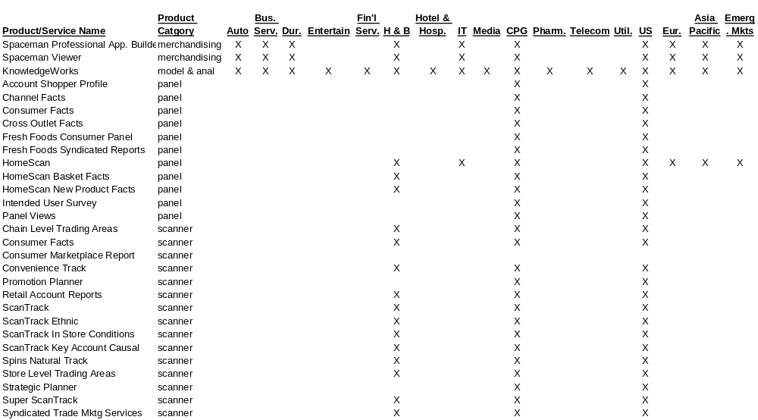
> Products & Coverage
ACN currently offers over 60 products.
Source: ACN web site

Slide 48
All major CPG outlets are covered by ScanTrack.
> Products & Coverage
Sample Stores
Channel
Stores
Markets
Other
Grocery
14,000
800 retailers
3,000
1,505 counties, 50 markets, 77% of $2M+ ACV
No census projection
Drug
13,700
480
8 markets + NY combined drug & mass
Projection using total drug ACV; sample 15%, audit 20%
All Outlets (Food/Drug/Mass) Combined Minus Wal-Mart
Wal-Mart via HomeScan
Convenience
80,000
1,250
30 markets
Projection by ACV
Club
BJ’s
census based
Military
Data from all US & overseas commissaries
Projection by ACV; display data from 75-100 commissaries
Liquor
379
11 markets + all of Florida
Projection based on DISCUS, causal available
Source: ACN web site, ACN representatives, IRI product comparisons

Slide 49
ACN has been expanding its panel solution to enhance the Wal-Mart and ethnic capabilities.
> Products & Coverage
Current
  Channels:
    Grocery
    Drug
    Mass
    Multi-outlet
    Club
  Households: 126,000, an increase of 57.5% since 12/31/99
        73,500 North American HH, 61,500 U.S. HH
  Urban and rural sample
  Retailers: 500+
  Markets: 23 local markets, 18 countries
  Causal: From panelist recall and manual record
Future
  Club channel
  “Mega Panel”: 200k HH panel with extended product coverage and additional channels
“HomeScan is unquestionably the gold standard in continuous household panel with over 70% market share” -Nick Sorvillo, SVP, ACN
Warehouse
Convenience
Computer
Mass
Mail order
Internet
Source: ACN web site, ACN representatives, IRI product comparisons, Category Masters

Slide 50
> Select Product Overviews
Answers
Beer/Wine/Spirits & On-Premise
Category Business Planner
Convenience
Ethnic/multicultural
In-Store Audit
Panel
  Channel Coverage
  Rx/OTC
Store Level Solution
Wall Street Solution
Wal-Mart Solution

Slide 51
Answers
> Select Product Overviews
Product
  Answers is ACN’s web portal that was launched in May 2002. The first decision support tools accessible on Answers were ACN’s Category Business Planner and Spectra’s InfiNet.
  Answers for retailers: “an integrated category management suite for retailers”
    Retail defined category structure
    Promotion
    Assortment
Update
  Added Sales Management Planner (SMP) to Answers in August 2002
    SMP provides:
      KPIs/Scorecards of key performance indicators
      Insights reports from HomeScan for detailed analysis of performance indicators, merchandising and promotion
      Alerts
Outlook
  The Answers portal is being pitched as “the tool to mine consumer insights”.
  ACN will continue to add decision support tools to the Answers platform as well as customized news, industry links, ACN information, and an industry collaboration platform for scorecards and best practices.
Pricing
Space management
Enhanced simulation and forecasting tools
Source: VNU analysts presentation, ACN press release, Category Masters Conference

Slide 52
Beer/Wine/Spirits & On-Premise
> Select Product Overviews
Products
  BeverageScan ScanTrack grocery and drug coverage (3,000 U.S. food stores and other large volume retail outlets, representing 38% of off-premise)
  ConvenienceTrack convenience store coverage of beer in 22 markets
  LiquorScan 379 liquor stores in 15 markets (11 plus all of Florida) with DISCUS projections; chain data for ABC Fine Wine & Spirits, Kappy’s, Goody-Goody, Spec’s Liquor Warehouse, Spirits Unlimited
  WineScan canned reports offered via WineryExchange; 35 markets updated monthly
  Featuretrac tracking of retailer feature ads
  Promotrac tracking of in-store display and POS placement
  Shelftrac tracking of retail distribution and product merchandising
  Pricetrac quarterly tracking of category wide product pricing
  Gift*Trac tracking of holiday gift pack activity
Update
  ACN ended its nine year joint venture with Adams Business Research by taking over LiquorScan in April 2002.
  There is no update on BAR*ometer on-premise sales data which was to be released by end of 2001 and developing NABCA data service for control states
  Texas has been added.
Source: ACN press releases and web site, McCusker & Assoc. B/W/S fact book, PR Newswire

Slide 53
> Select Product Overviews
Beer/Wine/Spirits & On-Premise
Update
  Trade Dimensions is helping B/W/S manufacturers track through shipment.
    Syndicated On-Premise database provides consistent framework for information about 600k outlets, including 270k on-premise.
    Clearly defined trade channels, including sub-channels, and ownership hierarchy
    Outlet facts include type of cuisine and types of liquor sold
Outlook
  ACN plans to expand LiquorScan with additional account-specific data, markets, and causal data, but may have been delayed due to Adams split.
Source: Category Masters Conference, Trade Dimensions press release

Slide 54
Category Business Planner
> Select Product Overviews
Product
  Introduced: July 2001
  Key feature: one-number system using retailer-defined category definitions
  Period: updates every 4 weeks; delivered 14 days after period close; 108 weeks of back-data
  Measure set: basic (does not include ACV, population or households)
  Additional data: HomeScan Panel data (category-level consumer demographics, updated annually)
  Reports: 52 issue driven templates (bucketed to create Category, Manufacturer, and Item Reviews)
  Delivery: first product to be delivered via ACN’s Answers Portal
  Clients: at least 10 retailers have agreed to participate and one manufacturer
Update
  Partnership requirements:
    Press release
    Town Hall meeting
    Endorsement letter
    Training/access to all category managers
  ACN continues to work with Accenture on identifying client category management needs.
  Expect annual sales of $10 million
Source: ACN Category Masters conference, VNU analysts presentation, VNU 2002 First Half webcast

Slide 55
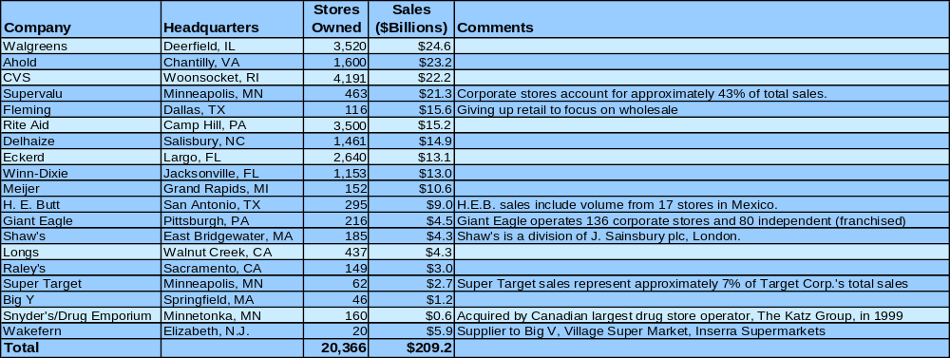
Category Business Planner
> Select Product Overviews
  Eighteen retailers have signed up for CBP, including 6 drug stores.
  These retailers represent over $200 billion in sales and more than 20,000 stores.
  Several, including Ahold, H.E. Butt, Shaw’s and Snyders, may open the door for international opportunity.
Source: ACN press releases, Supermarket News, Chains Store Age, Hoovers, Company web sites

Slide 56
Category Business Planner
> Select Product Overviews
Update
  Version 1.1 released in January 2002, displays sales by parent company
  Version 1.5 released in February 2002
    Product sales performance at UPC and characteristic level
    Share basis by department within retailer
    Customized alerts
  Accessible via Answers portal May 2002
  Baselines added in July 2002
  Eleven retailer codes had been completed as of August 2002
  Retailer templates can be populated by CBP as of August 2002
  30 manufacturers have made multi category purchases including Nestle, Reckitt Benckiser, and Welch’s
  There are 1,500 users/active seats.
Outlook
  Plan to build to 70% of total US ACV
  Enhance features and functionality
  Aggressively market to manufacturers
  Expand internationally in 2002 (ACN’s first international product)
Source: VNU mid year results conference call, VNU analysts presentation, Category Masters Conference

Slide 57
ConvenienceTrack
> Select Product Overviews
Product
  Introduced: April 1998
  Key feature: integration of c-store data with data from other channels
  Market/category coverage: non-alcoholic beverages, candy/gum, other tobacco, ice cream, frozen novelties, and energy bars in 30 markets; beer in 22 markets
  Period:monthly market level; weekly Level I data
  Measure set:100% scanner-based full fact set plus baselines; retailer account-level data; 55+ retailer specific data; NACS Level I and Level II
  Additional data: local market benchmarking available for audited (including beverage, other tobacco, candy/gum, beer, frozen novelties and bulk ice cream)
  Reports: reports from 14 retailers
  Retailers: Shell/Texaco, BP/Amoco, Crown Petroleum, Kum & Go, Stop-N-Go, Corner Store
Update
  ACN added meat snack coverage in 30 markets beginning in Q1 2002
  Added sales and promotion coverage for cookies, crackers, nuts and other salty snacks beginning in Q1 2002.
Outlook
  Expect announcement(s) coinciding with the Fall NACS conference.
Source: ACN press releases, PR newswire, Advertising Age, IRI product comparisons, Consumer Insights

Slide 58
Ethnic/multicultural
> Select Product Overviews
Product
  Ethnic Snapshots - retail scanning data and causal from geographical areas where a majority of the population is accounted for by a Hispanic or African-American population; national read available.
Hispanic Markets
Los Angeles
Miami
San Antonio
Chicago
New York
Houston
African-America Markets
Atlanta
Baltimore/Washington
Chicago
Memphis
  Hispanic Panel
    Santiago-Valdes Solutions developed with “standardized language segmentation strategies”
    acculturated and unacculturated Hispanic households
    across all outlets
  Consumer*Facts - compares UPC purchasing between African-American or Hispanic and non-African-American or Hispanic households with representative household samples through in-home scanning methodology; all-outlet purchase reporting
    Almost 900 categories and 110+ product groups
    Custom category definitions are available
Source: ACN press releases and web site, PR Newswire, Category Masters Conference

Slide 59
Ethnic/multicultural
> Select Product Overviews
Update
  Launching End-to-End Marketing Solution in partnership with Lumina/Cultural Access Group for Go-To-Market strategy consulting.
    Currently seeking clients to participate in a pilot.
Outlook
  ACN will be increasing the size of LA Hispanic panel to 1,500 through its agreement with Access Worldwide.
  The longer term plan is to extend the Hispanic panel to New York and a third market (possibly Miami or Texas) by mid-2003
  ACN plans to expand the Hispanic panel to the total U.S. in 2004.
  Roll-out of the Ethnic End-to-End Solution is planned for late in 2003.
Source: Category Masters Conference

Slide 60
In-Store/Audit
> Select Product Overviews
Product
  32,000 weekly store loads with 5,600 additional stores audited
  Advertisements from 900 newspapers
  Coupons from 50 versions of 21 national magazines
  Inserts from 110 newspapers
  360,000 featured items coded each week
  6,000-10,000 new UPCs encountered each week
  9,800 databases maintained with 5 years of product movement history
  99%+ on-time delivery
Update
  Audit services do not appear to be a focus for growth in the U.S. e.g. a ACN audit representative was not present at the Category Masters conference in August 2002.
Outlook
  Audit services will likely continue as a focus of retail measurement in new markets.
Source: VNU analysts presentation

Slide 61
Consumer Pre*View
> Select Product Overviews
Product
  In January 2002, ACN released panel-based joint product with the University of Michigan called Consumer Pre*View
    Research had been started in the summer of 2001.
  Consumer Pre*View serves as a leading indicator of consumer goods purchases based on consumer sentiment nine months prior.
  It can also be used to predict consumer attitudinal changes.
Update
  A strong marketing effort has been launched for this product with presentations at the FMI Show (May 2002) and Category Masters as well as appearances on CNBC and NBC’s Today Show.
  There have been no releases thus far regarding client acceptance.
  Additional research is being conducted on the behavioral impact of sentiment changes on specific channels and categories.
Outlook
  Channel and category will likely be required before clients will identify the derived value.
Source: VNU analysts presentation, Business Wire

Slide 62
Panel Rx/OTC
> Select Product Overviews
Product
  Three phase launch.
  HomeScan consumer survey first phase available in May 2002
    91k+ individual respondents, 65k HH, 23 ailments, 150+ Rx brands
    Another survey is scheduled for September 2002
  HomeScan Rx/OTC Panel phase two available by end of second quarter 2002.
    Nationally representative sample of 24k individuals
    Coverage of 30 ailments and 200 drugs
  Measures to analyze:
    Ailments being treated for products with multiple indications
    Compliance and persistence of usage
    Dual usage/replacement decisions for Rx and OTC
    Effectiveness of Rx marketing efforts directed at consumers
    Brand loyalty/switching
    Source of volume for OTC switch products
    New Rx/OTC switch product performance
    Impact of new Rx/OTC switch products on existing products
Outlook
  Phase three is scheduled for availability by the end of 2003
    Expands panel to 36k individuals, 15k HH
    Converts paper codebook collection to a new scanner with onboard codebook
Source: Consumer Insights, Category Masters

Slide 63
Store Level Data
> Select Product Overviews
Current
  Products: Store Level Solutions
  Introduced: June 2001
  Key features: integrated data and application tool; clustering capability that allows creation of custom store groups on-the-fly
  Market coverage: census retail trading area
  Measure set: select items, brands, subtotals and client-defined or ACNielsen syndicated category totals
  Reports: pre-formatted templates to identify issues such as items not selling, out-of-stocks, competitive pricing, price creep, cumulative distribution tracking, store importance, volume opportunities and quadrant analysis
  Delivery: CD-ROM delivery
Future
  Expect additional capabilities.
“...more and more marketers are looking at store-level information.” - Consumer Insights, June 2001
Source: ACN web site, Consumer Insights

Slide 64
Wall Street Solution
> Select Product Overviews
Current
  Product: Strategic Planner
  Introduced: Spring 2001
  Key features: specialty markets such as Ethnic, department or category views based on ACNielsen blue book product hierarchy
  Market coverage: 120+ syndicated markets (government-defined regions), total U.S. Grocery (including supercenters), Drug, (Mass ceased in 2002)
  Period: 3 years history with weekly data and 4-week cumes
  Measure set: 27 standard facts which can expand to over 200 with the use of the custom data dictionary
  Reports: subscriptions using Workstation Information*Server/NITRO; ad hocs via Service Bureau
  Delivery: updates every 4 weeks; via diskette or e-mail 5-7 days after period updates
Future
  Expect aggressive marketing
  Expect web delivery in the future
Source: ACN web site, ACN product purchase proposal, Category Masters conference

Slide 65
Wal-Mart Solution
> Select Product Overviews
Product
  Introduced: August 2001 (first delivery 10/25/01)
  Key feature: “only service that can provide price and “causal” (perceived deal) information”; 90%+ of HomeScan panelists shopped Wal-Mart in the past year.
  Period: first quarter 2000 - present
  Measure set: volume, price, feature, perceived deal, share, consumer information from HomeScan panel for total US plus four census regions; category, sub-category, brand level, sub-total, and private label detail
  Reports:
    grocery
    drug
    combined grocery/drug/mass with Supercenters and without Wal-Mart
    Wal-Mart Division One and Supercenter
  Delivery: available monthly two weeks after store data; seamlessly integrated into ScanTrack and accessed through standard tools
Source: Category Masters conference, Consumer Insights

Slide 66
Wal-Mart Solution
> Select Product Overviews
Update
  Added 6,500 households in C and D counties to panel
  Added five census regions in early 2002
  Six new solutions since initial release:
    Private Label Pricing Analysis - gaps and sensitivity
    Private Label Brand Impact Analysis - impact on brand and loyalty
    Custom Category Cross Outlet*Facts Report - outlet loyalty of core and occasional
    Supercenter Source of Business Analysis - business gains from other outlets and other retailers
    Key Item Report
    Demo-Fit Analysis - correlates key consumer segments in Wal-Mart to their product purchasing behavior
  A majority of ACN clients have “accepted” the Wal-Mart Channel product.
Outlook
  Nine way census division views were to be available by the end of the second quarter 2002.
  Adding ability to look at low penetration and frequency brands
No product coverage at the 2002 Category Masters.
Source: Category Masters conference, Consumer Insights

Slide 67
ACN conducts consumer satisfaction surveys and interviews via its relationship with Accenture.
> Clients
Results from a recent survey of ACN clients revealed the following requirements:
Top 12 Client Requirements
1. Client Service competency/consistency
2. Coverage extension
3. Data accuracy
4. Harmonization across countries
5. Software functionality
6. Pricing
7. Insights, not data
8. Faster delivery
9. Flexibility/customization
10. Reports & presentations
11. Improved data structures
12. More flexible delivery
Source: Category Masters, VNU analysts presentation

Slide 68
ACN’s service model is meant to address its clients’ top requirement of client service.
> Clients
Dedicated client service; senior mgmt attention; $10M+ revenue
Dedicated client service teams; $2M+ revenue
Dedicated managers $500K+ revenue
“Select” accounts under $500K revenue serviced via 800#
Source: IRI

Slide 69
The average ACN client spends two-thirds of a percent of its annual revenue on ACN contract services.
> Clients
CPG Clients
Allied Domecq
Barton Brands
Bristol Products
Brown Foreman
Campbell's
Coke USA/Bottlers
Colgate Palmolive
Coors
Cott
Del Monte
Diageo
Dr. Pepper/Seven-Up
Energizer
Fuji
General Mills
Georgia Pacific
Gillette
Glaxo SKB
Heinz
Hormel
Jim Beam
Kimberly Clark
Kodak
Kraft
Land O Lakes
Loreal/Maybelline
Malt-O-Meal
Merisant
Minute Maid
Nabisco
Nestle
Pfizer
Pharmacia
Philip Morris
Playtex
Power Bar
Procter & Gamble
RayOVac
Reckitt Benckiser
Sara Lee
SC Johnson
Tyson/IBP
Unilever/Best Foods
Welch’s
Whitehall
Wyeth
Top ten Marketing Information clients in 2001
First half 2002 client wins
Source: VNU analysts presentation, VNU 2002 First Half results, IRI, ACN press releases

Slide 70
ACN uses a number of vehicles to market itself.
> Marketing
Marketing/PR Vehicle
Examples
Publishing
Press mentions
Press releases
Announce study findings in conjunction with or in advance of industry or analyst conferences.
Newsletters to clients
Client involvement
Channel Blurring, Private Label, Dollar Stores and Global “What’s Hot” 2002 Studies
ACN quotes and use as a source for CPG related articles more common than others in the market research industry
Average 3-4 press releases per month with peaks tied to major conferences such as ACN’s Category Masters or National Association of Convenience Stores
Example: “billion dollar brands” findings released just prior to UBS Warburg Annual Global Consumer Conference.
Consumer Insights published quarterly since the beginning of 1999
“Star Council”; Accenture client interviews; case study presentations
Source: Business Wire, PR Newswire, Category Masters

Slide 71
ACN uses a number of vehicles to market itself.
> Marketing
Marketing/PR Vehicle
Examples
Non-client product supporters
Marketing alliance(s)
Trade shows, conferences, etc. booths and speaking engagements
Advertising
Web site
University donation
Accenture and Klein Consulting participated in Category Business Planner presentation at Category Masters
Crossmark and Lumina/Cultural Access Group partnerships
Upcoming events announced in Consumer Insights; presentations are the most common method of participation (see following pages)
Use of business to business agencies
Product descriptions, local language sites, search capabilities, press, employment
$500k in marketing research equipment donated to University of Arkansas Sam Walton College of Business
Source: Business Wire, PR Newswire, Arkansas Democrat-Gazette, Category Masters, ACN web site

Slide 72
ACN was a presenter or a sponsor at numerous industry conferences in 2001.
> Marketing
Conference
ACN Involvement
ARF Worldwide Advertising Conference
American Magazine Conference
Making Knowledge Work Conference
Beverage Digest Future Smarts Conference
Online Advertising 2001: The Future of Digital Branding Conference
Marketechics
Market Research Association Annual Conference
Strategy Research Institute - Ethnic Marketing Conference
Hardlines Conference - Retail Strategies Symposium
IIR Private Label Impact
National Association of Convenience Stores Convention
Presentation on consumer fragmentation and effective media strategies
Presentation on “Proving Magazine Effectiveness”
Case study of work with Information Mapping
Presentation on views of industry data
Sponsor
Exhibitor
BASES joint presentations with Opinionation and with Techneos Systems
Presentation of new research study
Presentation on “Women and Do-It-Yourself”
Presentation on “Profile of Private Label Consumer”
Exhibitor
Note: ACN announces future conference attendance for the quarter in Consumer Insights.
Source: ESOMAR, Magazine Publishers of America, Beverage Digest, World Research Group, influent.com, Marketing Research Association, PR Newswire, IIR, Hardlines

Slide 73
A number of 2002 presentations focused on the ethnic/ Hispanic consumer.
> Marketing
Conference
ACN Involvement
Store-Specific Merchandising & Marketing 2002
Consumer Pak 2002
National Frozen & Refrigerated Foods Association
Institute for International Research Private Label, Promotions and Marketing Mix Conferences
CMS Client Conference
National Association of Chain Drug Stores
Private Label Manufacturers Association Consumerama Conference
Association of Sales & Marketing Companies
Crossmark New Principles of Progress Conference
Institute for International Research Insights in Action Conference
International Productivity & Quality Center Conference
InterBev Conference
Marketing Research Association Conference
Pharmacy & Technology Conference
Presentations on increasing business with Hispanic customer base and understanding the Asian market
HomeScan Marketing and the Cultural Access Group joint presentation
HomeScan Marketing and the Cultural Access Group joint presentation
Presentations
Presentation on effective consumer promotions
Exhibitor
Presentation on private label acceptance by the Hispanic community
Tim Callahan presentation on the power of integrating information and business process
Presentation on insights from Wal-Mart Channel
Presentation on key CPG trends
Presentation on retail channel beverage sales
Sponsor
Presentation on understanding Rx/OTC consumer
Note: ACN announces future conference attendance for the quarter in Consumer Insights.
Source: Consumer Insights

Slide 74
ACN selects agencies with a business to business focus.
> Marketing
ACN has been a client of Slack Barshinger for nine years.
  Slack Barshinger helped ACN launch Category Business Planner.
    10-to-20-second online animated introduction on ACN’s web site
    Print ads, direct mail and online text advertising to drive CPG manufacturers and retailers to the web site.
    GMA Smartbrief ad: In the first week the ad ran, 462 readers clicked through to the Category Business Planner microsite.
  Slack Barshinger merged with USA Chicago in January 2002 bringing the staff to 50, client to 30, and billings to $50 million.
ACN has used Doremus, an Omnicom advertising agency that specializes in business to business and financial accounts. (They were listed as a client in early 2000, but are not currently noted on the Doremus web site.)
Source: Business Wire, PR Newswire, Slack Barshinger web site, Doremus web site

Slide 75

A major marketing alliance was formed last year with Crossmark.
> Marketing
Crossmark is the third largest national food broker in the U.S. behind Acosta and Advantage.
  Approximately $17 billion in billings; $320 million in revenue
  16% market share
  11,000 employees
  Headquartered in Plano, Texas with 61 offices in the U.S., Canada and Australia
  Clients and retailer relationships include Compaq, Hewlett-Packard, CompUSA Inc. and Blockbuster, Albertson's, Food Lion, Kroger, Safeway, Kmart, Wal-Mart, Target, Costco, Sam's, CVS, Eckerd, Rite-Aid, Walgreens, Home Depot, Lowe's, Gerber/Novartis plus 1,100 other manufacturers
Crossmark formed an alliance with AC Nielsen, effective August 1, 2001. In addition to using ACN’s Account Planner and Spaceman in servicing its clients, Crossmark is being incentivized to “market” ACN’s products to its clients.
The agreement with ACNielsen was expanded in early July 2002 to include Category Business Planner.
Source: ACN press releases, Plano Morning News, New York Times, Crossmark web site, Dallas Morning News

Slide 76
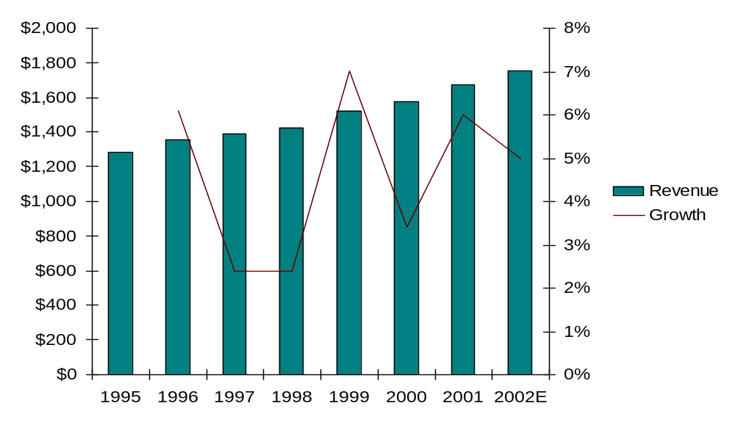
Revenue growth continues at its previous pace.
> Financial Performance
Marketing Information revenues for 2001 were ∈1.8 billion; ACN contributed most of that revenue.
During 2001 and the first half of 2002, ACN achieved 6% and 7% organic growth rates, respectively.
  Growth was equally attributable to client wins (CBP sales) and pricing increases.
Average revenue growth over the last six years has been 4.6%.
ACN Revenues 1995-2002E
$ in millions
Note: 2002 estimate assumes ACN maintains 5% growth for second half of the year; it is projected to be 5-7%.
Source: VNU 2001 annual report, ACN 10-Ks, VNU 2001 and first half 2002 results conference calls

Slide 77
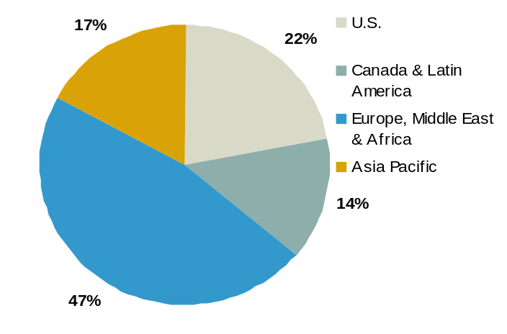
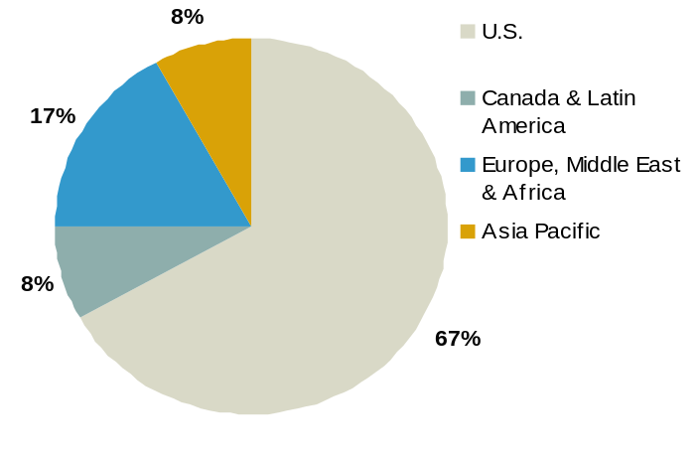
Revenue share has shifted some from Europe to the U.S.
> Financial Performance
Seventy percent of ACN’s revenue is generated outside of the U.S.
From 2000 to 2001, some of the revenue share that had been captured by the U.S. shifted back to Europe; however, the strongest growth since 1995 has been in the U.S.
Revenue - 1995
Revenue Growth 1995 to 2001
U.S. 78%
Canada & Central America -7%
Europe, Middle East, Africa 11%
Asia-Pacific 53%
Revenue - 2001
Source: ACN 10-K and 10-Q, VNU annual report

Slide 78
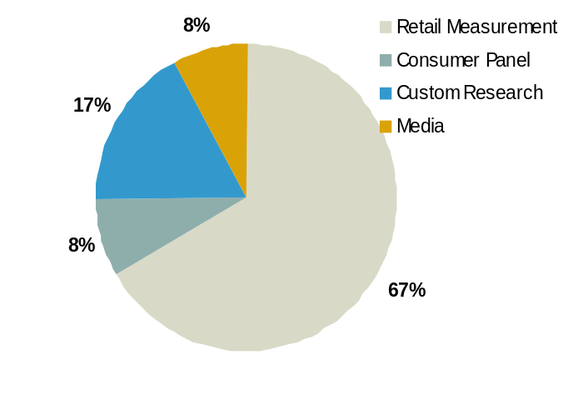
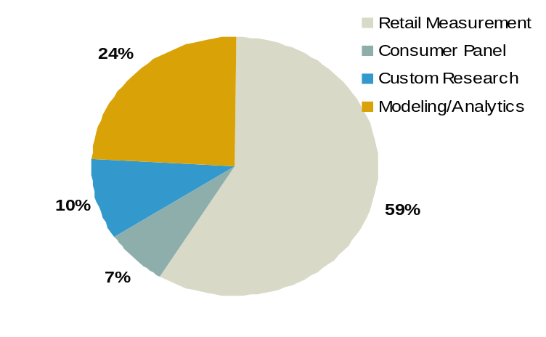
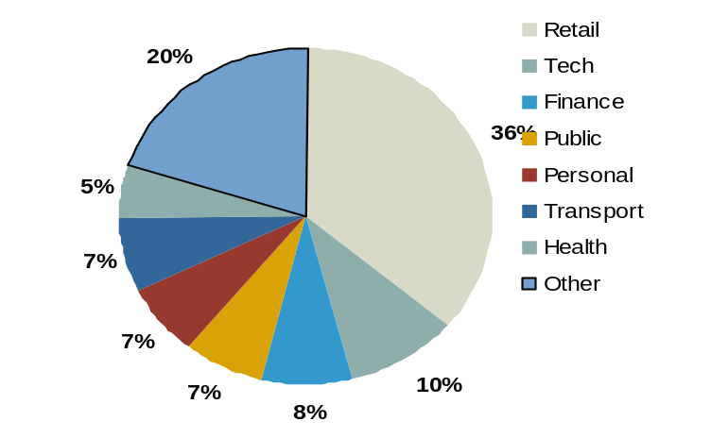
ACN revenue is derived from its worldwide presence in four key product/service groups.
> Financial Performance
Product Group Revenue Share
1999
2001
Retail measurement: 80 countries (20 via scanner, 60 with field audit)
Consumer Panel: 155k HH in 21 countries, 65k HH in the US
Modeling/Analytics: worldwide
Custom Research: 60+ countries
  Conduct to expand into new countries
  Focus on anchor clients
  Focus on target industries
Custom Research Revenue by Industry
Note: A breakout is not available for global solutions, decision support tools or merchandising solutions
Source: VNU first half 2001 press release, VNU web site, ACN 10-K

Slide 79
Custom research has been the strongest growth area for ACN.
> Financial Performance
1999 Revenue
1,022
122
259
122
2001 Revenue
987
117
167
401
% Change
+12.9%
-4.1%
n/a
+54.8%
n/a
Product/Service Group
Group Coverage
Retail Measurement
Consumer Panel
Modeling/Analytics
Custom Research
Media
80 countries (20 via scanner, 60 with field audit)
155k HH in 21 countries, 65k HH in the US
worldwide
Included in “Retail Measurement” in 1999; now broken out into KnowledgeWorks
60+ countries; use to expand countries
Focus on anchor clients & target industries
Moved to Nielsen Media
Custom research revenue grew 55% between 1999 and 2001.
  Smaller ad hoc projects, however, have been effected by the economic downturn.
Modeling/Analytics is likely responsible for retail measurement growth from 1999 to 2001.
Note: A breakout is not available for global solutions, decision support tools or merchandising solutions
Source: VNU first half 2001 press release, VNU web site, ACN 10-K

Slide 80
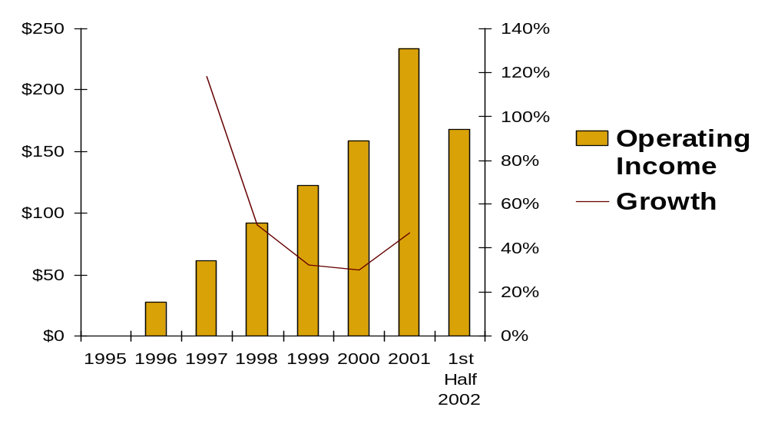
ACN achieved a 13% operating margin in 2001, better than the 11% projected.
> Financial Performance
ACN Operating Income 1995-2002E
$ in millions
Operating margin results were due to cost cutting measures including Operation Leading Edge.
Operation Leading Edge, which is developing a shared service center to streamline back office functions, will continue to have an impact on operating margins, but primarily in Europe.
ACN’s operating margin for the first half of 2002 was 9.6%.
Source: VNU corporate brochure, ACN 10-K, VNU 2001 annual report and 2002 First Half results

Slide 81
> Operation Leading Edge
OPERATION LEADING EDGE
Operation Leading Edge emphasis is now on Europe.
Operation Leading Edge Key Elements
Standardize data collection globally to enable highly customized analysis and data cuts by region (including cross-border) in format easily accessible by clients
  Process census data
  Produce extensive retailer services
  Produce reports for multiple Geographic areas
  Compete for cross boarder requests from clients
  Produce reports on cross border retailer activity
  Deliver formatted data to other VNU entities (e.g. BASES)
  Rollout new products rapidly
  Adopt retailer defined hierarchies
Develop capability to deliver all products via the Internet
∈40 million in global cost reductions by the end of 2002; ∈25 million in Europe alone.
Sources: Business Wire, VNU Annual Report, VNU analysts presentation

Slide 82




ACN uses the following technology vendors.
> Technology
Vendor
Vendor Description
ACN relationship
Provider of network computer hardware, software and related services
Mentioned by ACN (at Category Masters) as being a technology partner/Category Business Planner
Provider of systems software, including database management, application development, and application server software
Mentioned by ACN (at Category Masters) as being a technology partner/Category Business Planner
IBM
Computer hardware and software provider
Mentioned by ACN (at Category Masters) as being a technology partner/Category Business Planner
Offers more than 800 software products, including data access, security, and network management applications, which work across both mainframes and distributed computing environments
Mentioned by ACN (at Category Masters) as being a technology partner/Category Business Planner
Internet security software provider. Software lets companies set up virtual private networks for secure internal and remote communications
ACN recently won Check Point “Extensive VPN (virtual private network) Capabilities” award
Source: Category Masters conference, company web sites, Business Wire

Slide 83


Some will enhance delivery and communications.
> Technology
Vendor
Vendor Description
ACN relationship
Latin American mobile communications applications in partnership with Moviltek. Based in Miami, FL
ACN is a client
e-business and applications outsourcer, with headquarters in Teaneck, NJ. Employs 3,900+ professionals, services blue chip clients through 11 offshore development centers in India and sales and business development offices in the U.S., Canada and Europe. Formerly under D&B umbrella with IMS, D&B and AC Nielsen
ACNielsen was given an award by Cognizant for its Media Delivery 2000 product which aims to create an integrated media delivery system for ACNielsen Systems Asia Pacific, reducing the time-to-market of new analysis, and therefore the cost to customers
Nielsen Media Research is also a client.
Source: company web sites

Slide 84




A key relationship is with EDS, ACN’s data processing provider.
> Technology
Vendor
Vendor Description
ACN relationship
Provider of systems integration, network and systems operations, data center management, application development and field services
Handles ACN’s data processing
Provider of eSupport products and services for enterprise help desk and desktop services organizations
Used to increase end-user and IT productivity, decrease cost and delight users
Helps software organizations become more profitable by improving their software development and project management practices
ACN is a client
Professional services firm specializing in the design and development of B2B software applications
Developed ACN’s Priceman software
Source: Business Wire, PR Newswire, company web sites, interview with former ACN employee

Slide 85



ACN has enlisted these vendors in its collaborative efforts.
> Technology
Vendor
Vendor Description
ACN relationship
Provider of collaborative commerce solutions for the consumer goods industry
ACN is a client
Provider of knowledge management solutions
ACN is a client and presented at an Information Mapping conference. ACN knowledge management initiatives included the following:
developed a core set of product standards and business processes
implemented templates that provided a common look and feel to clients
implemented an Intranet that allows for global sharing of information and best practices.
4,000 employees have been trained since 1997 when the program began. Key knowledge of the company has been documented.
Provider of products and services that bring together live and on-demand collaboration, communication and eLearning needs in one platform
ACN is a recent client addition
Source: Business Wire, PR Newswire, company web sites

Slide 86


Market research solution providers include the following.
> Technology
Vendor
Vendor Description
ACN relationship
Supplier of online business information and research management software - survey, polls, panels, test marketing, etc. geared towards customers, employees or markets
ACN is a client
Provider of software for data analysis, business performance measurement, market research, and sales forecasting
ACN/BASES is using SPSS’s mrInterview, an end-to-end online research solution. The software has an open architecture and allows for integration with proprietary applications as well as added security features. According to an SPSS press release, ACN will use the software to offer clients web surveys.
SPSS software also allowed ACN to coordinate its PacRim offices, streamline its administration and derive the benefit of regional pricing and consistent products
eX Systems (acquired by SPSS at the end of 2000)
Japan based agent and distributor of SPSS market research solutions that specializes in market research services including consulting, technical support and training
ACN is/was a client
Source: Business Wire, PR Newswire, company web sites

Slide 87
Appendix

Slide 88

> ACNielsen BASES
Focus: New product launches
Web Site: acnielsenbases.com
Founded: Founded by BoozAllen in mid 1970’s; acquired by ACN in June 1998
Locations: Covington, KY; Westport, CT; Parsippany, NJ; Chicago, IL; Markham,
Ontario
Coverage: Work completed in 55 countries
Revenue: 1999 sales estimated at $80 million
Employees: N/A
Industries: CPG, pharmaceutical (OTC)
Clients: Alberto Culver, Andrew Jergens, Bayer, Bristol-Myers Squibb, Campbell,
Brands, Clorox, Coca-Cola, Colgate-Palmolive, ConAgra, Dannon, Gillette,
GlaxoSmithKline, H. J. Heinz, Henkel, Johnson & Johnson, Kellogg's, Kimberly-
Clark, Kraft Foods, M&M Mars, Nestle, Novartis, Ocean Spray, PepsiCo, Pfizer,
Pillsbury, Procter & Gamble, Quaker Oats, Ralston Purina, Reckitt Benckiser,
S C Johnson, Unilever, Amgen, Aventis, Aviron, Allergan, Berlex, Bristol-Myers
Squibb, Eli Lilly, Galderma, GlaxoSmithKline, Grey Worldwide, Johnson &
Johnson, Pfizer
Source: BASES web site, McCusker & Associates

Slide 89
> ACNielsen BASES
Products/Services:
  Have evaluated 30,000 concepts and 9,000 products
  970 validations performed
  Average forecast within 9% of sales
  Invest 5-10% annually in research and development
Concept Screening
Concept Development
Concept/ Product Development
Positioning/ Marketing Strategy
New Brand Launch
Managing Existing Brand
Restage
Test Market
PreBases
Bases I
Bases II
Price Advisor
Launch Targeter
Restager
Volumetric concept screening
Assess consumer reaction to concepts
Assess consumer reaction to concepts & products; forecasting
Analyze impact of retail price on volume
Target high volume potential consumers
Evaluate profitability of brand restage
Source: BASES web site, McCusker & Associates

Slide 90

> Claritas
Focus: Marketing information resources and segmentation tools
Web site: www.claritas.com
Founded: 1971
Locations: San Diego, CA
Coverage: US and Europe
Revenue: $70.7 million (est.) in 2001
Employees: 500
Industries: Financial services, retail, restaurant, real estate, communications,
energy, media, agency, automotive, business to business, Internet
Clients: 10,000 clients including Starbucks, Staples, Marriott, McDonalds,
Texaco, Bank of America, CVS, Lowes
Source: company web site, One Source
Notes:
Pat Doble: Group Marketing Director

Slide 91
> Claritas
Products/Services:
  Data
    Business
      Automotive: database of 27,000 dealerships
      Business Facts on 10 million businesses
      County Business Patterns by SIC code
      Crime Risk Assessment
      Grocery Stores comparison for total receipts for 36,000+ stores with sales of $1+ million
      Restaurants counts for chains and large independents in over 40 categories
      US Schools location and enrollment for K-12
    Healthcare
      DRG/ICD-9 Demand current and projected demand for healthcare by area
      Financial data for 500+ HMOs and 5,000 hospitals, information for 10,000 nursing homes
      Information on 570,000 physicians
      Demographics on seniors
    Communication and Energy, Financial and Media data
    Consumer
      Annual survey of 150,000 households about financial, media and lifestyle habits
      Consumer Buying Power projected household spending for over 300 products and 57 Yellow Pages headings by market
      MediaMark, Scarborough, Simmons, Polk
    Demographics data: census data, current year and projections, GIS ready data, workplace demographics
    Geographic data
    EEO and Labor data
    Internet Users Profiles with NetRatings
Source: company web site

Slide 92
> Claritas
Products/Services:
  Segmentation
    ConneXions - household-level segmentation system for targeting video, voice and data services
    MicroVision - segmentation and consumer targeting system that classifies every U.S. household into one of 50 segments
    PRIZM segmentation and consumer targeting system that classifies every U.S. household into one of 62 segments
    P$YCLE and LifeP$YCLE 42 segment household level segmentation for financial services
    Custom
  Software
    Compass - industry specific, customizable marketing analysis tool that integrates data
    ConsumerPoint - target marketing system using proprietary and third party data
    iMark & iMark Online - customer, site and market analysis with remote access to proprietary and third party data
    InfoMark - PC and CD based marketing information and analytical solution
    Intelliserv - online accessible cross-sell solution; links online and offline marketing efforts
    iXPRESS - quick access market and site analysis
    PrecisionCode - solution for coding including geocoding
    iModel - site and market assessment application integrating Claritas models
    Custom
  Express: Marketing Databases, Consumer & Business Profiles, Custom Projects, Customer Segmentation, List Services for Prospecting, Market Analysis & Mapping Software, Market Area Reports & Map
  Product Support
Source: company web site

Slide 93
> Claritas
Partnerships/Alliances:
  Product Enhancement
    NRB shopping center data
    Trade Dimensions
  Association/Alliance Partners
    International Council of Shopping Centers
    CoreNet Global real estate management executives professional organization
    Self Storage Association
  Segmentation Partners - Campaign Strategy, Media Planning & Measurement
    Arbitron broadcast radio ratings
    JD Power & Associates automotive consumer studies
    Marketing Systems Group market research
    MediaMark Research national media/product consumption
    Media Metrix web demographics/ratings
    National Cable Communications spot cable TV ad placement
    Nielsen Media Research TV ratings
    RelevantKnowledge web demographics/ratings
    Scarborough Research local market multi-media/qualitative
    Simmons Market Research national consumer survey
    Tapscan Worldwide media research, planning, and software buying
  Segmentation Partners - Product & Consumer Research
    Belden Associates newspaper research & consulting
    Claritas Market Audit financial services marketing survey
    DK Shifflet & Associates consumer travel attitudes & behavior
    Gallup consumer research
    Greenfield Online online marketing research
    Information Resources packaged goods/scanner data
    International Demographics local market, multi-media, retail study
    Ipsos-NPD marketing research
    Market Facts custom panel research
Source: company web site

Slide 94
> Claritas
Partnerships/Alliances (cont.):
  Segmentation Partners - Product & Consumer Research (cont.)
    Medstat Group/Inforum healthcare marketing
    Mendelshon Media Research affluent media habits/lifestyles
    Millward Brown Intelliquest Internet & wireless marketing research
    NFO WorldGroup panel market research
    NPD Group consumer research
    SRI International values & lifestyle system
    Survey Sampling sampling systems
    TNS Telecom telecommunications research
    Travel Industry Association of America travel industry research & marketing
  Segmentation Partners - Direct Marketing & Data Management Services
    ADVO direct marketing/list services
    American Lists Council list services
    Database America direct marketing services
    Direct Mai l & Computer Services list services
    Eagle Marketing/EVA-Tone direct marketing/service bureau
    Experian Information Services direct marketing/list services
    Fin Pro financial services analytics
    Focus USA list services
    Gage Marketing processor
    InfoUSA direct marketing services
    Market Data Retrieval list services
    Media Marketing processor
    Quality Education Data educational market lists/marketing services
    Services Group list services
    Sunflower Group direct marketing services
Source: company web site

Slide 95
> Claritas
Partnerships/Alliances (cont.):
  Segmentation Partners - Service Partners
    ACS database management/service bureau
    Acxiom database management/service bureau
    American Cleraing House service bureau
    Automaotive Directions service bureau
    CSG Systems service bureau
    Customer Management Services service bureau
    Data Productions Services database management/service bureau
    Datamark service bureau
    Data Mentors service bureau
    Document XPress direct marketing/service bureau
    Dynamic Marketing Services service bureau
    Eagle Direct service bureau
    Eagle Marketing service bureau
    Enertex Marketing service bureau
    Epsilon service bureau
    Equient service bureau
    Experian Information Services service bureau
    Harte-Hanks service bureau
    InfoUSA service bureau
    Marketing Communications service bureau
    May & Speh service bureau
    MSGi Direct service bureau
    New Sources donor targeting for fund-raising/service bureau
    Sargent service bureau
    Select Systems service bureau
    The Allant Group service bureau
    Third Wave Research service bureau
    TransUnion service bureau
    Wiley Brothers banking service bureau
Source: company web site

Slide 96
> Claritas
New Products/Initiatives:
  Released latest version of iMark Online in May 2002 which gives access to all Claritas data
  Analytical Services Group launched
  Incorporated 2000 census data by May 2001
  Claims to be the leader in investing for data research and development
Management:
  CEO & Presdient: Bob Nascenzi. CEO since 1999
  CFO: Tom Compogiannis
  VP Marketing: Kathleen Dugan
  VP Sales: Steve Egge
  VP Software Product Management: Eric Cohen. Former CACI International
Source: company web site, Haverstick Consulting

Slide 97

> ACNielsen Market Decisions
Focus: Custom in-store research
Web Site: marketdec.com
Founded: Founded in 1977; Remaining 55% acquired by ACN in July 1999
Locations: Covington, KY; Paramus, NJ; Schaumberg, IL
Coverage: U.S – Seven primary testing markets in metropolitan areas, with
capability to conduct testing in nearly any major market, 150 CATI
stations in three centers
Revenue: 1999 sales estimate: $20 million
Employees: N/A
Industries: Broad focus - 18 industries
Clients: N/A
Source: Market Decisions web site, McCusker & Associates

Slide 98
> ACNielsen Market Decisions
Products/Services:
  Multidimensional scaling, perceptual mapping, GIS mapping, conjoint & discrete choice analysis, factor analysis, regression, data mining, cluster analysis, discriminant analysis
  Advertising testing and tracking
  Business to business studies
  Customer retention studies
  Economic impact analysis
  Employee surveys
  Focus groups (on & offline)
  Forecasting studies
  Image Surveys
  Intercepts
  Interviews
Pricing:
  Ranges from $100,000 to $ 1,000,000+, depending upon number of stores/markets, length of test, etc.
  Market assessment
  Membership studies
  Multi-mode surveys (on & offline)
  New product testing
  Planning studies
  Public issues polling
  Public policy research
  Satisfaction research
  Segmentation studies
  Usability testing
  Yield-loss studies
Source: Market Decisions web site, McCusker & Associates

Slide 99

Solucient
> Select VNU Subsidiaries
Overview
  Background:
  Performance:
  Pricing:
  Methodology:
  Geography:
  Industries:
  Clients:
Services
  Advertising testing and tracking Business to business studies Customer retention studies Economic impact analysis Employee surveys Focus groups (on & offline) Forecasting studies Image Surveys Intercepts Interviews Market assessment Membership studies Multi-mode surveys (on & offline) New product testing Planning studies Public issues polling Public policy research Satisfaction research Segmentation Studies Usability Testing Yield-loss studies
Source: Solucient web site

Slide 100

> Spectra Marketing
Focus: Specialized market research and software
Web site: www. spectramarketing.com
Founded: 1988
Locations: Chicago, IL. offices in San Francisco, Hackensack, NJ; Lancaster, PA;
Bradenton, FL
Coverage: U.S.
Revenue: $20.8 million+ (1997)
Employees: 160
Industries: consumer packaged goods, retail
Clients: See following page
Source: spectramarketing.com, claritas.com, Nexis

Slide 101
> Spectra Marketing
Clients
  Allied Domecq
  Anheuser-Busch
  Big Y Foods
  Campbell Soup
  Clorox
  Coca-Cola
  Colgate-Palmolive
  Con-Agra
  Coors Brewing
  Del Monte Foods
  E&J Gallo Winery
  Eastman Kodak
  Eckerd
  Frito-Lay
  General Mills
  George Weston Bakeries
Giant Eagle
Gillette
GlaxoSmithKline
HamiltonBeach Proctor-Silex
HEB Grocery
Hershey Chocolates
Hormel Foods
Iams
Johnson & Johnson
Kelloggs
K-Mart
Land O’Lakes
Lowes Foods
M&M Mars
McCormick & Company
Miller Brewing Company
Nestle
Pennzoil Quaker State.
Pepsi
Procter & Gamble
Reckitt Benckiser
Sara Lee
SC Johnson
Schering Plough
Schick
Sunbeam
SuperValu
Wal-Mart
Whitehall Robins
Winn-Dixie
Source: Spectra conference attendee list

Slide 102
> Spectra Marketing
Products/Services:
  Spectra Grid “the industry standard for describing key consumer segments”
  Enlighten: demographics of store shoppers
    12 million key observations through “Quick Facts”
    develop and generate presentation ready reports
  Advantage: segmentation and targeting software tool
    “Payback of $4.50 for every $1.00 invested”
  Localizer:
    Add-on to Advantage
    profiles buyers of products and shoppers of retailers through a modeling process
    uses store census data and account specific shopper data
  InfiNet
    Spectra’s modularized web platform
    Consumer Selling 1-2-3 first module made available Q1 ‘02”; site selection module will be released next. Others to follow include media and marketing research.
    Starting with inclusion of syndicated data; plan to add retailer store data with in 2 years. 2000 census as well as updated Spectra Lifestyle segmentations to be released in the second quarter of 2003.
Source: spectramarketing.com, collateral materials

Slide 103
> Spectra Marketing
Products/Services (cont.)
  MediaPlan
    BrandFx: brand planning flow chart system
      local and enterprise wide roll-ups; international features
      integrates with other media/marketing systems
    Adventory: national TV inventory allocation system
    RollUp: consolidates media plan flow charts
    VRPs (volume rating points): allows user to create volume/ROI based media flighting patterns and allocation of ad spending across dayparts, networks, program types, and individual shows
    WebRF: media planning tool on the web
  Joint products
    Launch Targeter - ACNielsen, BASES and Spectra product to identify high potential consumers for new brands
    Core Target Analyzer - ACNielsen, BASES and Spectra product to identify trial and repeat volume potential for each respondent
    LifeStyle Track - ACNielsen and Spectra product combined sales data with the Spectra LifeStyle grid
  Spectra & MediaPlan Consumer Mix Modeling™
    Service integrates consumer targeting (Spectra) response analysis and links to marketing execution. Instead of using one response for a market, can break the impact down by consumer target or across the Spectra Grid.
    Link to Spectra database, which identifies where most responsive households are and how they can be best reached, e.g. analyze particular market and rank local, regional or national newspapers for the optimal distribution of FSIs to the most coupon-responsive households.
Source: spectramarketing.com, collateral materials, ACN Fact Book

Slide 104
> Spectra Marketing
Partnerships/Alliances: N/A
New Products/Initiatives: N/A
  Partnership with ACN to create Lifestyle Track™ consumer-centric tracking in 8/00
  John Lawlor named president 6/01
Management
  President: John Lawlor
  SVP Product Management: Libbey Bartlett
  Former IRI:
    Paul Flugel team that developed Spectra MMM
    Anne Penniston director of channels & data vendor management
Source: Spectra conference materials, ACN Fact Book

