Slide 1
Market Research Industry and Overview of AIG Competitors
April 8, 2002

Slide 2
This document summarizes information obtained through primary and secondary sources as of April 8, 2002. While significant efforts have been made to ensure accuracy, it is possible that inaccurate information was obtained through these sources.
Please direct questions to:
Kim Sevonty
(973) 763-0863
Kim.Sevonty@infores.com
McCusker & Associates

Slide 3
Focus
This assessment provides an overview of the current market research industry including key players and trends. It also includes a sample database of companies providing market research products, services and consulting. The database can be used as an ongoing reference and for identification of potential acquisition candidates and partners.
In a continued effort to make “fact book” materials available regarding IRI competitors, this document includes company overviews for 20 companies that compete with IRI’s Analytic Insights Group.

Slide 4
> Table of Contents
Headlines 5
Market Research
Industry Revenues & Growth 7
Spending by Geography 8
Spending by Industry 10
Spending by Type of Research 12
Internet Spending 14
Number of Companies & Growth 16
Companies in the Industry 17
Industry Trends 20
Companies 22
Advanis
Applied Information for Marketing
Media Marketing Assessment
Burke Marketing Research
Bruzzone Research Company
Cannondale Associates
DDB Matrix
Elrick & Lavidge
Heller Research
Hudson River Group
Ipsos-ASI/Ipsos-NPD
Meyers Research Center
Management Science Associates
Marketing Analytics
Millward Brown
Promotion Decisions
Sawtooth Technologies
Spectra Marketing
Willard Bishop
ZS Associates

Slide 5
> Headlines
Total worldwide market research revenue was approximately $15.2 billion for 2000 with the U.S. market accounting for approximately 39% or $5.9 billion.
Market research growth was 9% in 2000 and has been experiencing a slightly declining trend since 1997.
Spending by world region stayed relatively consistent on a percentage basis from 1999 to 2000.
The top five countries in spending account for 72% of total world wide market research revenue.
CPG accounted for approximately 28% of market research spending in the U.S. in 2000. Although CPG was down relative to the other industries, it still experienced a 14% growth rate from 1997 to 2000.
However, automotive (89.6%), financial services (69.2%), Media & advertising (50.3%) and pharmaceutical/healthcare (34.6%) all had stronger growth.
New product development research ($491.1M) and attitude and usage studies ($355.3M) experienced the greatest relative growth and percentage growth in the U.S. from 1999 to 2000 compared to the other types of research.

Slide 6
> Headlines
Market measurement and media audience research still account for half of all market research spending; however, market measurement represents a smaller portion of the market.
Online market research continues to grow (52% in 2001), but still only represents 5.6% of total market research spending.
Copy testing, sales tracking and ad/brand tracking saw the most growth online.
The number of small research companies (1-4 employees) increased according to (latest available) 1998 and 1999 figures while mid-sized firms (50-99 employees) were the most common acquisition targets.
International advertising and media conglomerates continue to buy marketing research firms.
Despite acquisition activity over the last number of years, the industry remains relatively fragmented.
Market research companies and CPG manufacturers are partnering with technology providers in an effort to better leverage the Internet and/or to develop tools to help marketers maximize marketing investments.

Slide 7
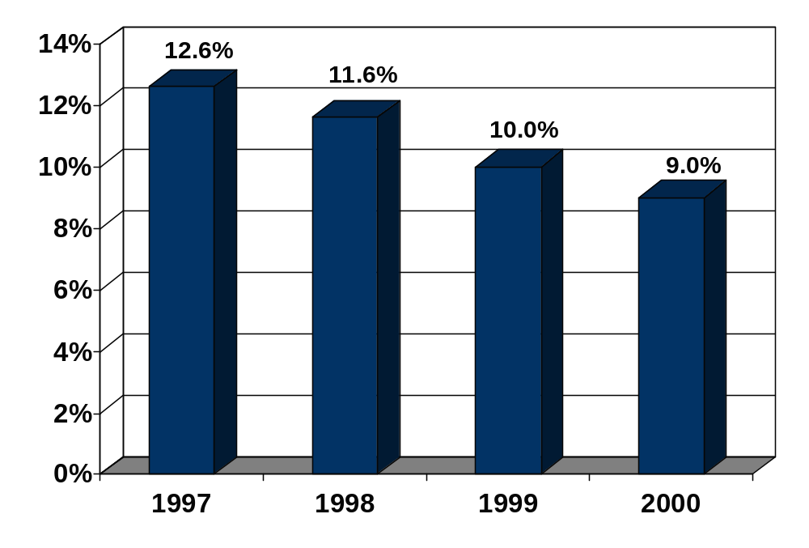
> Industry Revenues & Growth
Worldwide market research revenue totaled $15.2 billion in 2000, an increase of 9% compared to the prior year.
Since 1997, the industry has experienced a declining growth rate.
Growth rates are based on U.S. Dollars; on a local currency basis, growth in real terms was closer to 5% in 2000.
Worldwide Market Research Revenue Growth Rate
Source: ESOMAR

Slide 8
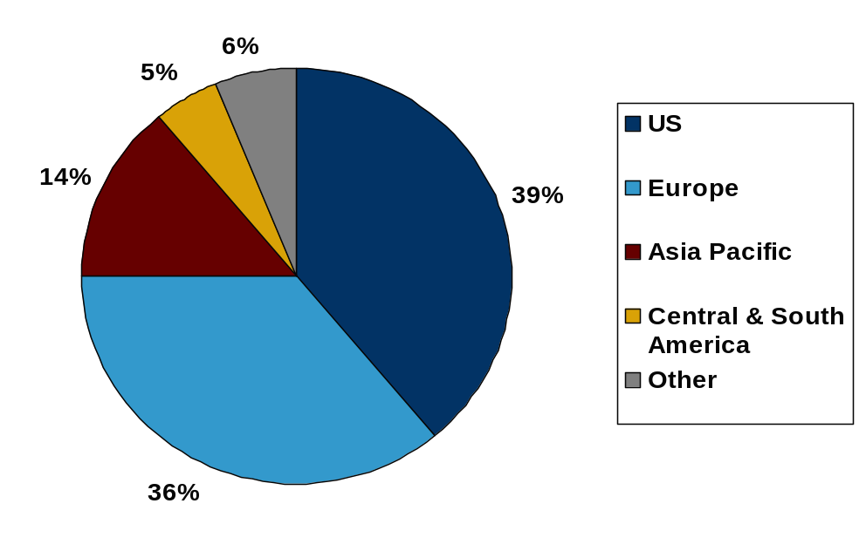
> Spending by Geography
The geographical split of market research spending saw a slight shift to more spending in the U.S. v. Europe from 1999 to 2000; however, most of this was due to the decline in other currencies relative to the U.S. Dollar.
Asia Pacific and Central & South America each experienced 1% growth.
2000 Market Research Revenues by World Region
as a Percentage of Total Market Research Revenues
Note: Based on estimates for 67 countries
Source: ESOMAR

Slide 9
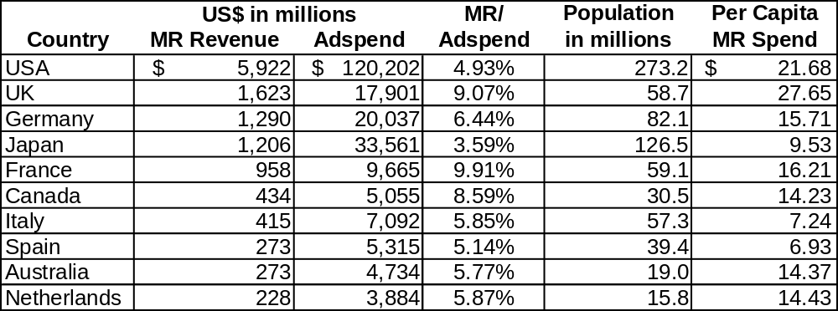
> Spending by Geography
The U.S. is by far the largest dollar spender on market research products and services at $5.9 billion.
Relative to advertising spending and population, the UK spent the most on market research followed by the U.S., France and Canada.
The rank order of the top 25 countries did not change from 1999 to 2000.
The top five countries account for 72% of the total world market.
The top 25 countries account for 95% of the total world market.
2000 Market Research Revenues by Country
with per US$ Ad Spend and per Capita
Those countries experiencing 20%+ growth rates include: Mexico, China, Korea, Malaysia and Romania.
Source: ESOMAR, McCusker & Associates analysis

Slide 10
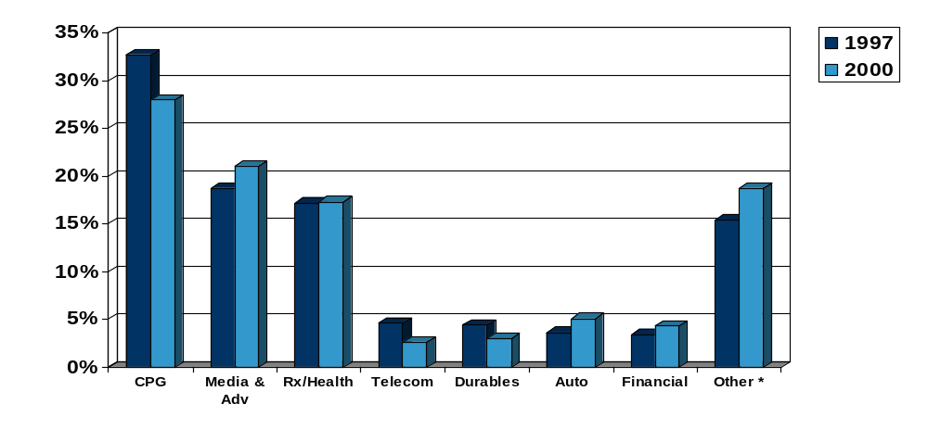
> Spending by Industry
CPG, Media & Advertising and Pharmaceutical/Healthcare accounted for two-thirds of U.S. industry revenues in 2000.
Consumer goods and telecommunications spending dropped relative to the other major industry spenders.
1997 v. 2000 Percentage of Total U.S.
Market Research Revenue by Industry
* Other: Includes 3.6% Technology industry in 2000 not separated out in 1997.
Note: Based on survey of top 50 U.S. MR firms.
Source: Inside Research

Slide 11
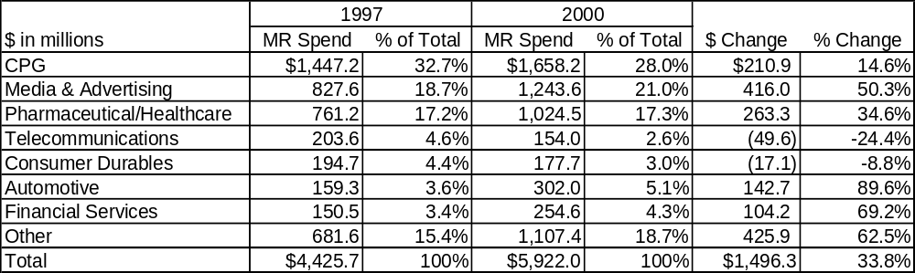
> Spending by Industry
Of the largest market research spenders, automotive and financial services have shown the greatest increase in spending from 1997 to 2000 at 89% and 69%, respectively.
Media & Advertising spending on market research has grown 50% over the same period, indicating perhaps that more companies are contracting for market research through their media agencies.
1997 v. 2000 U.S. Market Research
Spending and Growth by Industry
Despite a relative decline in spending, revenue from CPG increased 14.6%.
Market research budgets of CPG companies average 0.8%-1.0% of sales compared to non-CPG companies which have averaged 0.2-0.7% of sales.
Sources: Inside Research, McCusker & Associates analysis, Sixth Annual CCG Benchmarking Study

Slide 12
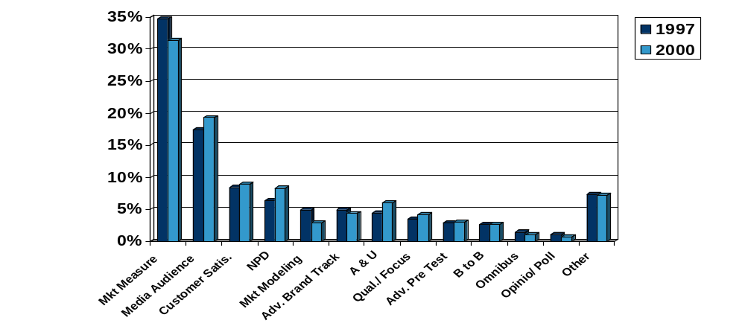
> Spending by Type of Research
Market measurement, which includes syndicated or custom retail/panel/surveys for market size and share, and media audience research, which includes testing, accounted for half of U.S. market research spending in 2000.
Market measurement showed the greatest relative decline while new product development and attitude & usage had the largest relative gains.
1997 v. 2000 Percentage of Total U.S. Market Research Revenues by Type of Research
Source: Inside Research

Slide 13
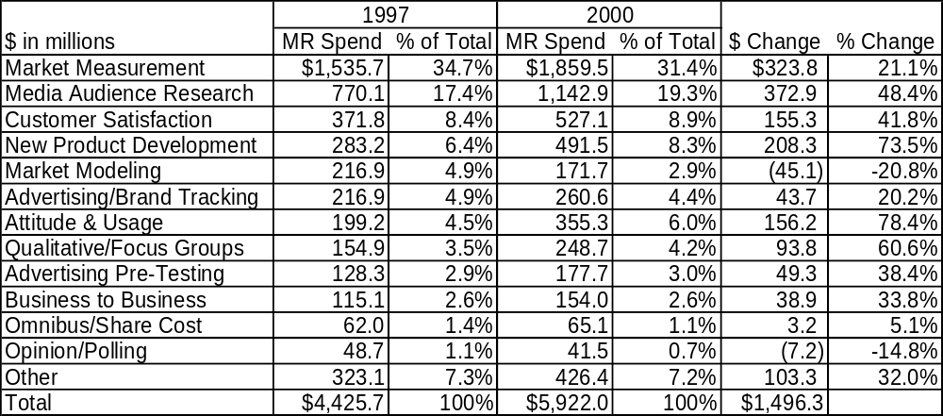
> Spending by Type of Research
Attitude & Usage and New Product Development market research have grown 78.4% and 73.5%, respectively, from 1997 to 2000.
Market modeling had the most significant decline in revenue on a percentage basis at 20.8%, while opinion research and polling declined 14.8% in an election year.
1997 v. 2000 U.S. Market Research
Spending and Growth by Type of Research
Source: Inside Research, McCusker & Associates analysis

Slide 14
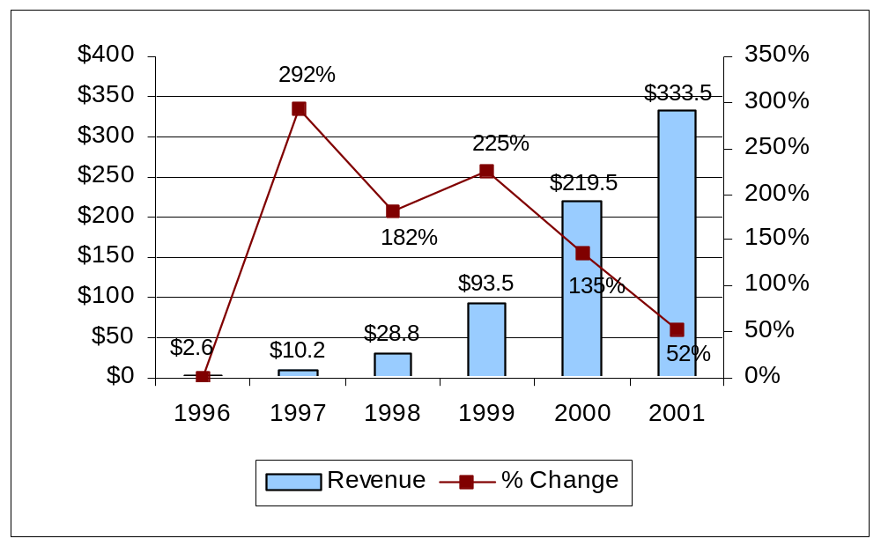
> Internet Spending
Online market research continues to play an increasing role in research; however at $333.5 million or 5.6% of total market research revenues, 2001 Internet related revenues were not as high as the $415.7 million expected.
The actual growth rate was 52% and it is projected that 2002 revenues will grow 46% to $488.9 million.
1996-2001 U.S. Internet Market Research Revenue - 30 Companies
$ in millions
NOTE: Revenues are for a 30 company sample estimated to represent 85% of the total market.
Source: Inside Research

Slide 15
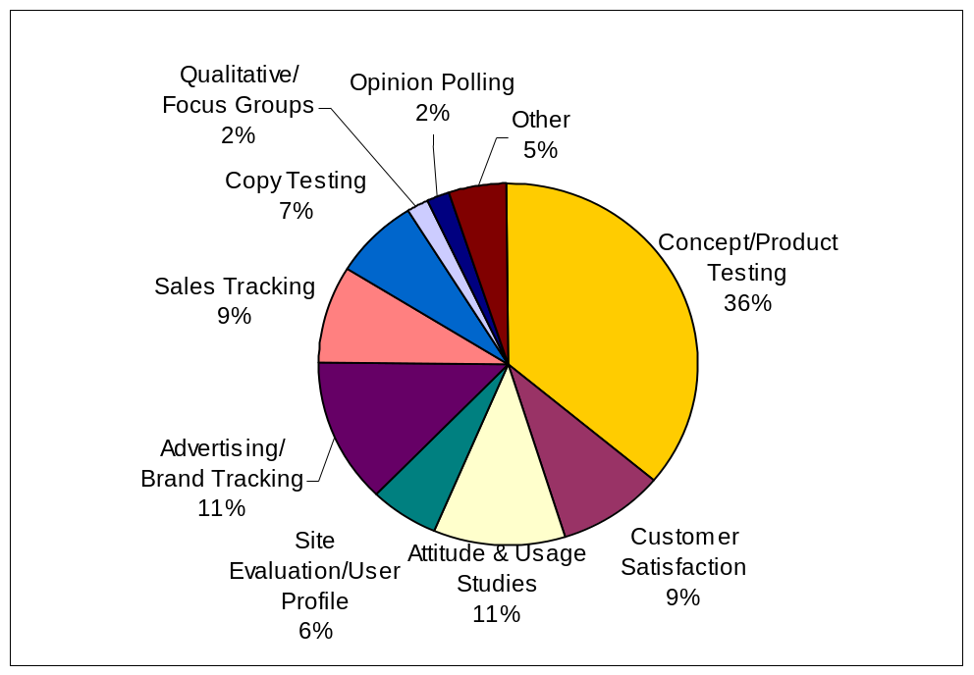
> Internet Spending
Ninety-five percent of Internet research replaced other traditional methods compared to 81% in 1999.
Concept and product testing is the largest type of market research being conducted online and it continues to grow: 36% of revenues versus 31% in 2000.
2001 Internet Market Research Revenue
by Type of Research
Significant revenue growth:
  Copy testing 2.6x
  Sales tracking 2.0x
  Ad/brand tracking 1.7x
Percentage of total decreases:
  Customer satisfaction 6%
  Site eval./user profiles 5%
  attitude & usage 3%
Source: Inside Research

Slide 16
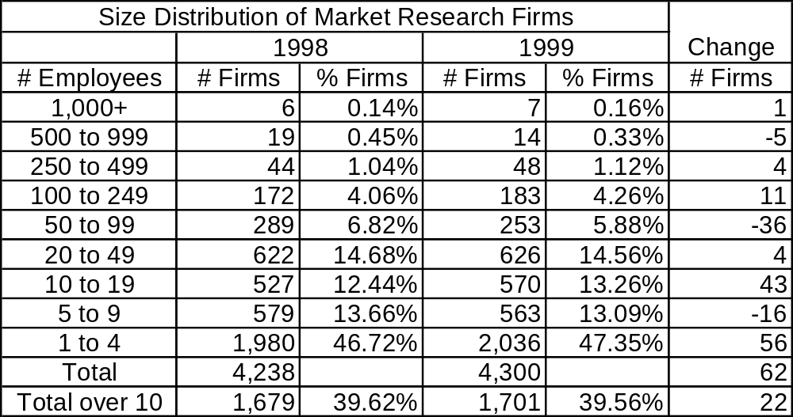
> Number of Companies & Growth
Approximately 40% of market research companies have more than 10 employees.
Fifty-six additional small companies, those with one to four employees, emerged between 1998 and 1999 while 36 mid-size companies and a few of the largest companies perhaps fell victim to mergers. It is likely that this trend continued through 2001.
1998 and 1999 Size Distribution of Market Research Firms
Source: U.S. Census Bureau County Business Patterns, McCusker & Associates analysis

Slide 17
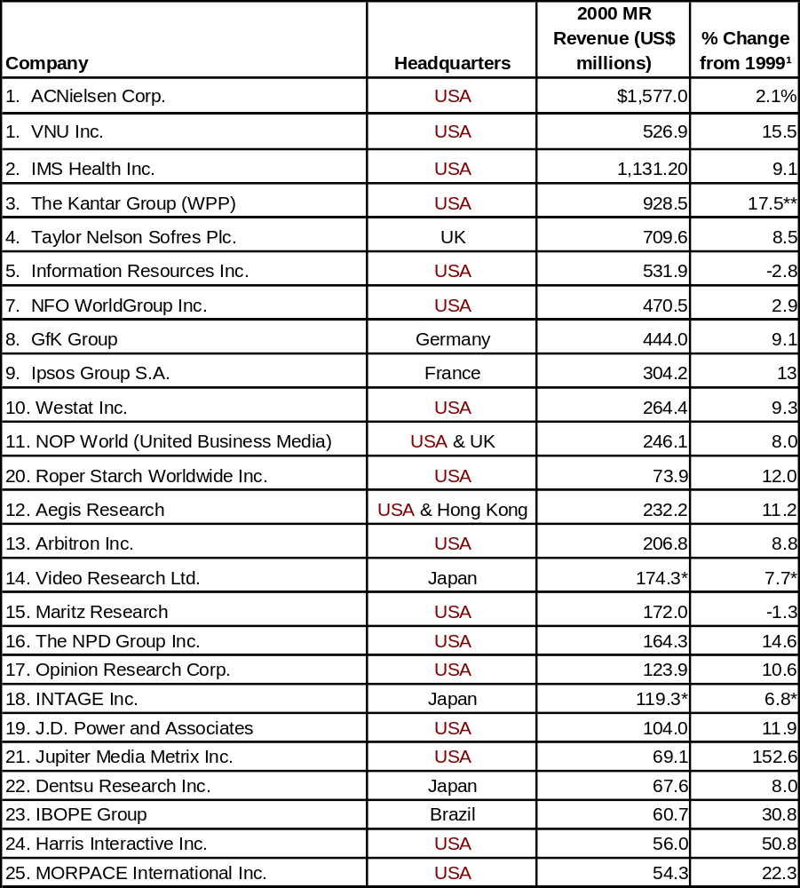
> Companies in the Industry
The worlds 25 largest market research companies accounted for $2.7 billion or 17.8% of revenue in 2000.
Top 25 Market Research Companies
Combined since ranking was published.
Combined since ranking was published.
NOTES:
1. Rate of growth from year to year is based on home country currency and has been adjusted so as not to include revenue gains or losses from acquisitions or divestitures.
* For fiscal year ending 31 March 31 2001.
** Constant currency basis.
Source: Honomichl

Slide 18
> Companies in the Industry
In 1999, there were 4,300 market research companies.
A sample database consisting of 358 companies suggests the following:
  70% of the companies offer both some form of data collection, other than through partners, as well as market research analysis.
    Many of these companies call themselves “full-service” because they can take one area of research, e.g. brand equity, from design to data collection to data analysis.
  Almost half of the companies have Internet capabilities.
    In most cases, this means data collection, but in some cases it also means data delivery
  Focus groups are one of the most common methods of data collection.
  Of those companies specifying their market research consulting services:
    43% conduct concept/product testing
    30% offer strategic consulting
    28% have advertising testing capabilities
    20% generate some type of pricing studies
    17% provide sales related consulting
  Out of those companies for which industry coverage information is available, close to 80% focus on or have expertise in more than five industries.
Despite a large number of acquisitions over the last number of years, the industry is still rather fragmented.
NOTE: The database has been developed over the course of one year and does not necessarily represent complete and current information for each company.
Source: McCusker & Associates market research industry sample database

Slide 19
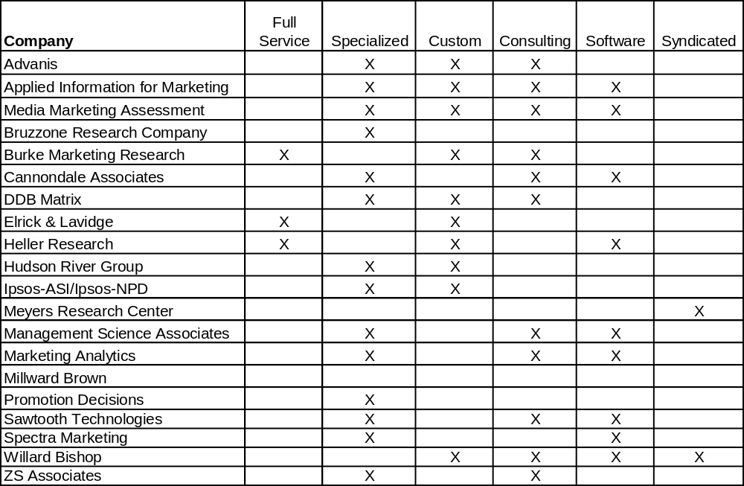
> Companies in the Industry
Twenty companies have been identified as commonly competitors to IRI’s AIG.
Most of the companies are specialized in that they do not offer a full range of market research capabilities. They instead focus on certain types of analysis such as advertising testing.
AIG Competitors
Source: McCusker & Associates market research industry sample database

Slide 20
> Industry Trends
Major advertising agencies continue to expand their market research business because it is counter-cyclical and complementary to advertising.
  Brand Economics brand management (econometric modeling) and strategy consulting formed as Stern Stewart & Co. subsidiary out of collaboration with Young & Rubicam its consumer brand attitude database and technology
  IPG’s purchase of NFO; Formation of DDB Matrix; Aegis Research
Manufacturers are establishing or partnering with technology vendors to leverage the Internet for market research.
  ArcLight Systems venture to provide aggregated real-time pharmaceutical sales to drug makers via the Internet is launched with support from Albertsons, Cardinal Health, CVS, K-Mart, Wal-Mart and others
  Market Tools, SPSS, SAS, P&G, General Mills and WPP strategic relationship regarding Market Tools zIntelligence Internet based market research tools integration (preceded by a $20M investment).
  Intermedia Advertising Group launches TV advertising effectiveness system in development with Tricon, Coca-Cola and Unilever.
Source: PR Newswire, MSNBC.com, CASRO, Marketing News

Slide 21
> Industry Trends
More software providers are entering the world of marketing and market research through partnerships with existing industry participants.
  Experian made an equity investment in Twenty-Ten and will play a roll in developing Behavioral Targeting System.
  Seibel Systems made a $5 million equity investment in SPSS; joint sales and technology integration opportunities
  EMS and Retail Vision Systems announce co-marketing alliance to deliver integrated demand driven solutions with store level data.
Links are attempting to be made between online and offline behavior.
  Knowledge Networks and comScore announce system connecting consumers’ Internet usage with retail buying behavior.
CPG companies are increasing online advertising spending and market research.
  Frito-Lay (increased budget 5.5% to 8.0% of its total advertising budget)
  P&G, General Mills
Multi-outlet media companies are signing cross-marketing agreements.
  Unilever and Pepsi have signed on with AOL
Source: Business Wire, Canadian Corporate News, Supermarket News

Slide 22
Company Overviews

Slide 23
Advanis
Applied Information for Marketing
Media Marketing Assessment Company
Bruzzone Research Company
Burke Marketing Research
Cannondale Associate
DDB Matrix
Elrick & Lavidge
Heller Research
Hudson River Group
Ipsos-ASI/Ipsos-NPD
Meyers Research Center
Management Science Associates
Marketing Analytics
Millward Brown
Promotion Decisions
Sawtooth Technologies
Spectra Marketing
Willard Bishop
ZS Associates

Slide 24

> Advanis
Focus: Specialized custom research based consulting
Web site: www.advanis.ca
Founded: 1990
Ownership: Private
Related: Advanis Field Research services subsidiary
Locations: Edmonton, Alberta; Guelph, Ontario; Stamford, CT; Gainsville, FL
Coverage: U.S. and Canada
Revenue: $5-7 million
Employees: 30
Industries: Financial services, telecommunications, technology, international
Clients: N/A
Source: advanis.com, strathcona country, infoUSA
Notes:
Key Players:
Dick Rogers: President, US Operations

Slide 25
> Advanis
Products/Services:
  Customer behavior-based business and consumer research specialist
  Pricing
  Product design
  Brand Value
  Targeting customers
  Customer franchise management
Partnerships/Alliances: N/A
New Products/Initiatives: N/A
Management: N/A
Source: advanis.com
Notes:
Key Players:
Dick Rogers: President, US Operations

Slide 26

> Applied Information for Marketing
Focus: Custom specialized research based consulting and software
Web site: www.aimmax.com
Founded: Founded 1988
Ownership: April 2000 acquired by Aegis $13.2 million*
        August 2001 merged with Aegis sub Media Marketing Assessment
Related: MMA
Locations: Wilton, CT
Coverage: U.S. and Canada
Revenue: $8.5 million in 1999 revenue; 50% growth per year
Employees: 50
Industries: Consumer packaged goods
Clients: Armour Swift-Eckrich, Bristol-Myers Squibb, Cadbury Beverages, ConAgra Frozen Foods,
        Fort James, General Mills, ConAgra Grocery Products, Kraft Foods, Lipton, Unilever,
        National Foods, Weight Watchers Gourmet Food Company, Heinz, Hunt Wesson, Fort James
Source: aimmax.com, McCusker & Associates Pricing Solutions Providers Assessment

Slide 27
> Applied Information for Marketing
Products/Services:
  BusinessMax (Business Planning Platform) - customizable suite of tools, including statistical and rules based models, for sales and marketing planning that integrates varying sources of data (IRI, Nielsen or other).
    PriceMax
      quick forecast of impact of long term pricing alternatives (including competitors) on volume & profit / runs pricing scenario analysis
      national, regional, and local impact of pricing decisions on volume and profit
      impact of pricing actions on manufacturer business in specific retail customers
      non-scan baseline via shipping data
      tailored trade plans to long-term pricing strategy
      updates pricing information continuously
    CouponMax - markets, spending and time allocation to maximize coupon program performance
    PromoMax - target and allocate promotion dollars to the customer level
    TradeMax - trade planning and trade fund management
    DemandMax - demand planning and forecasting
Source: aimmax.com, McCusker & Associates Pricing Solutions Providers Assessment

Slide 28
> Applied Information for Marketing
Partnerships/Alliances: NA
New Products/Initiatives:
  Aegis Research formed in March 2001; will be a key focus for Aegis
  Consulting initiatives launched in April 2001 through the merger with MMA
  Hired a business development officer in May 2001
Management:
  CEO: Jose Astray, 25 years experience, former IRI
  Chief Development Officer: John Manuli, 20 years experience, former IRI, ACNielsen and MSA
Source: aimmax.com, McCusker & Associates Pricing Solutions Providers Assessment

Slide 29

> Media Marketing Assessment Company
Focus: Custom specialized research based consulting and software
Web site: www.mma.com (dated)
Founded: 1989 by Ed Dittus
Ownership: Sold to Carat Group in 1997; August 2001 merged with Aegis subsidiary
        Applied Information for Marketing
Related: AIM
Locations: Wilton, CT
Coverage: U.S. and Canada
Revenue: N/A
Employees: N/A
Industries: CPG, non-CPG
Clients: See following page
Source: mma.com, McCusker & Associates Pricing Solutions Providers Assessment
Notes:
Pat Doble: Group Marketing Director

Slide 30
> Media Marketing Assessment Company
Clients:
  Bayer
  Best Foods
  Campbell’s Soup
  Chesebrough-Pond’s
  Clorox
  Coca Cola
  ConAgra
  Fox
  Johnson & Johnson
  Kraft
  Levi
  Strauss
  M&M/Mars
  Miller Brewing
  Nabisco
NBC
Pepperidge-Farms
Philips
PepsiCo
Procter & Gamble
Ralston-Purina
Reckitt & Colman
Sara Lee
Sears
SmithKline Beecham
The Gap
Tropicana
Unilever
Vlasic Foods
Warner Lambert
Source: Mix Drivers competitive deck
Notes:
Pat Doble: Group Marketing Director

Slide 31
> Media Marketing Assessment Company
Products/Services:
  Marketing mix consulting - market-by-market multiple regression on time series data and clustering techniques to determine nature and extent of the mathematical relationships between marketing/other factors and consumer behavior
    Two to three year analysis period recommended to adequately read carry-over effects of advertising on business results, particularly if there is corporate umbrella advertising.
    Weight, decay, timing and saturation modeled independently by market and advertising component
    Diagnostics assist in determining optimal flighting patterns and probable consequences of budget shifts.
  Proprietary software
    Goal Seeker - two modules
      Simulator - uses 52 week volume and support levels which can be adjusted up or down using quarterly or annual intensity factors.
      Optimizer - algorithm for budget or volume) across geographies and marketing vehicles
    Smart Scheduler - plans and optimizes advertising schedule
      carry-over effect of advertising
      law of diminishing returns
      changing cost of advertising
      seasonality
      interactions with other marketing events
      market level response to advertising
  AdWorks - joint study with IRI to measure effectiveness of TV advertising for CPG using Nielsen Media Research’s Monitor-Plus and 1995-96 data; released in 1998.
analyzed simultaneously
Source: mma.com, McCusker & Associates Pricing Solutions Providers Assessment

Slide 32
> Media Marketing Assessment Company
Partnerships/Alliances: NA
New Products/Initiatives:
  Institute for International Research “Marketing Mix Modeling for Profitable Sales” Conference presentation entitled: Online & Offline Marketing Impacts on Web Site Traffic; March 2002
  Per 7/00 press releases: MMA evaluates in-store programs by ActMedia (shopping cart, overhead aisle and shelf-talker advertising, electronic couponing) and Catalina Marketing (targeted, post-purchase couponing)
Management:
  CEO: Randolph Stone. Joined MMA in 1991 from Nielsen Marketing Research. Previously with Burke
  COO: Sunil “Sunny” Garga. With MMA since inception; also previously with Burke
  EVP Sales & Co-founder: Jan Fish-Brown. Previously with Burke
  Former Principals: Neil Canter now with IRI and Jim Friedman
  Former EVP & Europe GM: Bob Ivins. Joined in 1998 to build non-US business. Former Data Resources and Nielsen. Left in February 2001.
Source: aegis web site, iirusa.com, Mix Drivers competitive deck

Slide 33
> Burke Marketing Research
Focus: Full service custom research based consulting
Web site: www.burke.com
Founded: 1931
Ownership: Private; part of Burke Inc.
Related: Burke Customer Satisfaction Associates
        Burke Strategic Consulting Group
        The Training & Development Center AIM
Locations: Cincinnati, OH; 5 other U.S. offices Atlanta, Denver, Dallas, Philadelphia, San Francisco
Coverage: International
Revenue: $49 million, approximately 2% growth
Employees: 700
Industries: Broad
Clients: N/A
Source: burke.com
Notes:
Key Players:
Dick Rogers: President, US Operations

Slide 34
> Burke Marketing Research
Products/Services: “branded protocols”
  Brand equity - The Master Brand Equity Index:
    loyalty measured by Burke’s Secure Customer Index measuring customer satisfaction, commitment and advocacy
    image includes corporate and performance measurements
    value, e.g. brand/price trade-off or direct questioning
  Choice modeling & analysis
    preference structure modeling using conjoint analysis and discrete choice modeling
    COSMOS consumer ratings of products supplemented by additional ratings of the individual features
    CHOICESTM individual-level discrete choice approach that provides source of volume and cannibalization estimates
  Concept testing
    CPS (concept potential system) generates a concept potential score which is the maximum sales potential a product could generate if 100% awareness and 100% distribution
  ICE (information, communications, entertainment) research
  Image research
    MIRRORS (market image research) - attribute ratings of each competitor in a given market
  Internet research
  Need/gGap research - Benefit Deficiency Analysis (dual scaling) benefits consumer wanted v. what they got; quantitative
Source: burke.com
Notes:
Key Players:
Dick Rogers: President, US Operations

Slide 35
> Burke Marketing Research
Products/Services (cont.):
  Price and value research
    PRIMAR - elasticity; estimates share of consumer preference and revenue for different competitors at different prices; identified non-linearities
    PricePoint - proprietary model for pricing new/revolutionary products
  Product research - monadic, paired comparison, sequential monadic, repeat pair product tests
  Product sampling evaluation
  Purchase decision
    STAGES traces customers through “funnel” from awareness to heavy usage to provide better understanding of how customers re acquired or lost
  Qualitative research - traditional, affinity, natural focus groups; dyads, triads, mini groups and super groups; one-on-one depth interviews
  Segmentation
Source: burke.com
Notes:
Key Players:
Dick Rogers: President, US Operations

Slide 36
> Burke Marketing Research
Partnerships/Alliances:
  Infratest-Burke, partner for international research
New Products/Initiatives:
  ACNielsen Burke Institute (50,000 participants in 27 years) and TTDC to be combined in ACN Burke joint venture named the Burke Institute; announced 2/7/02
Management:
  Chairman: Ronald Tatham, Ph.D.
  President: Michael Baumgardner, Ph.D.
  SVP & GM: Joe Ottaviani. Responsible for custom market research
  VP Corporate Marketing Services: Jim Roberts
  VP: Bart Gamble. Specializing in high-tech at the home office
  Account managers/client service VPs: Charles Eden, Todd Jacobson, Don Keeble, Brenda Landy, Tom Mooney, Tara Marotti, Mike Pietrangelo, Jodie McInerney, Marcy Welk, Tammy Wise
Source: burke.com, press release
Notes:
Key Players:
Dick Rogers: President, US Operations

Slide 37

> Bruzzone Research Company
Focus: Specialized market research
Web site: www.bruzzone-research.com
Founded: 1976
Ownership: Private
Related: N/A
Locations: Alameda, CA
Coverage: U.S.
Revenue: $1 million
Employees: 6
Industries: Broad, but mostly consumer goods
Clients: See following page
Source: bruzzone-research.com, infoUSA
Notes:
Key Players:
Dick Rogers: President, US Operations

Slide 38
> Bruzzone Research Company
Clients:
  adidas Grey Advertising Pacific Bell
  Allstate GTE Pacific Gas & Electric
  Anheuser-Busch, Inc. Helene Curtis Pepsi-Cola
  AT&T Hewlett-Packard Polaroid
  Bank of America Holiday Inns WW Quaker Oats
  BlueCross BlueShield Home Savings Ralston-Purina
  Cellular One Honda Rice-A-Roni
  Century Communications Honeywell Saatchi & Saatchi
  Champion Spark Plug Intel Safeway Stores
  Coca-Cola IBM Sears
  Dairy Council of Calif. Kaiser Permanente Shafer Advertising
  Dataquest Kodak 7-Eleven
  DDB Needham WW Leo Burnett Seven-Up Co
  Delta Dental Plan Levi Strauss Shell
  First Union Lucky Stores Sony
  Foote, Cone & Belding Mail Boxes Etc. Southwestern Bell
  Ford Motor Co. MasterCard Starbucks
  Fujitsu McCann Erickson Symantec
  General Electric Miles Laboratories J. Walter Thompson
  General Foods MJB Toshiba
  General Mills Montgomery Ward Volvo
  General Motors Ogilvy & Mather Warner Bros.
  Gillette Ogilvy Center/R&D Wang
  Golden Grain Owens Corning Wells Fargo Bank
  Goodyear PC World Wendy's
Source: bruzzone-research.com
Notes:
Key Players:
Dick Rogers: President, US Operations

Slide 39
> Bruzzone Research Company
Products/Services:
  Tracking Studies
  Post Testing
  Ad Testing
  Ad Tracking
  Pre-testing
  Copy Testing
  Copy Research
  Advertising Research
  “Exploratory” - consumer needs, preferences, attitudes
  Marketing mix model development
Partnerships/Alliances: N/A
New Products/Initiatives:
  Don Bruzzone chaired an IIR conference on marketing mix modeling in 3/02.
Management:
  President & Founder: Donald Bruzzone. 35 years experience, widely published and quoted
  Director of Sales: Paul Shellenberg
Source: bruzzone-research.com
Notes:
Key Players:
Dick Rogers: President, US Operations

Slide 40

> Cannondale Associates
Focus: Specialized research based consulting and software
Web site: www.richmix.com, cannondaleassoc.com
Founded: 1992
Ownership: Private
Related: N/A
Locations: Wilton, CT; office in Evanston, IL
Coverage: U.S.
Revenue: $5-10 million
Employees: 40
Industries: Consumer packaged goods focus; experience in others
Clients: General Mills, Kraft Foods, Ocean Spray
Source: cannondaleassoc.com, Kraft press release, Dole press release, P&G annual report, US Business Directory

Slide 41
> Cannondale Associates
Products/Services:
  RichMix™ Efficient Product Assortment
    Quantifies transferable consumer demand that occurs when specific items are added or delisted from a category.
    Works at the individual store level, combining Point of Sale, consumer, and profitability data
    Developed in partnership with General Mills
  Frame™ Business Analysis System
    Brand/product strengths and weaknesses and competitor Activity
  Midas™ Trade Spending Evaluation
    Integrates Point of Sale data and trade spending
  Ginsu ABC™ Profitability Analyzer
    Uses Activity Based Costing with retailer profit information and Point of Sale data to determine category and item specific profitability.
    Can be incorporated in RichMix
  Retail PerforMax™ Profitability Analyzer
    Version of Ginsu ABC for use in the field by a sales force or broker organization
  PriceRite pricing optimization
    uses proprietry modeling of store-level price point/gap thresholds
  Custom Solutions
Source: cannondaleassoc.com

Slide 42
> Cannondale Associates
Products/Services (cont.)
  Expertise:
    category management
    trade spending
    benchmarking
    organizational design
    channel development
  Annual syndicated surveys with leading retailers and manufacturers covering category/loyalty management, trade spending, and “the power ranking” which assesses retailers and manufacturers that are setting the standard of performance as rated by their trading partners
    A number of significant CPG manufacturers press release or quote their “power ranking” in their annual reports
  Shopper Genetics - proprietary analytical process using basket level frequent shopper data for insight into shopper behavior
Source: cannondaleassoc.com, pvg.generalmills.com, Yahoo

Slide 43
> Cannondale Associates
Partnerships/Alliances: N/A
New Products/Initiatives: N/A
Management:
  Partners frequently quoted
    Ken Harris
    Paul Crnkovich
    Don Stuart
    John Carlson
Source: cannondaleassoc.com, yahoo

Slide 44
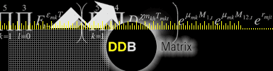
> DDB Matrix
Focus: Custom specialized research based consulting
Web site: www.ddbmatrix.com
Founded: 1999
Ownership: Omnicom Group (NYSE: OMC)
Related: DDB Worldwide (second largest agency network in the U.S. and third in
the world, with 206 offices in 99 countries and billings of $15.3 billion),
BBDO Worldwide, TBWA Worldwide, US agencies including Goodby,
Silverstein & Partners and GSD&M, Agency.com
Locations: Chicago (analytics) London (econometrics)
Coverage: International
Revenue: N/A
Employees: N/A
Industries: Not specified
Clients: Tyson L’eggs, McDonalds, Unilever, Ameritech, Louis Kemp, Land’s
End, FTD, Pep Boys, Busch Entertainment, Volkswagen
Source: ddbmatrix.com, Mix Drivers competitive deck
Notes:
Key Players:
Dick Rogers: President, US Operations

Slide 45
> DDB Matrix
Products/Services:
  Marketing mix analysis
  Consulting, analysis and tools to understand communications impact on business results
  Custom computer models to quantify the effects of current and previous marketing efforts on business results, using historical or test market data
  Forecasting the impacts of future changes to a brand's marketing support or its environment
  Consulting on the design and statistical analysis of in-market media tests
    Identifying factors that help or hinder brand growth
  Sales forecasts and simulations
    pooled cross-sectional time series regression
    logit/probit models
    ARIMA models
    Hierarchical Bayesian regression models
  Optimization of budgets & media vehicles
  New product launch monitoring
  Media weight tests
Source: ddbmatrix.com

Slide 46
> DDB Matrix
Partnerships/Alliances: N/A
New Products/Initiatives:
  Institute for International Research “Marketing Mix Modeling for Profitable Sales” Conference presentation entitled: Forecasting from Test Market results; March 2002
Management: N/A
Source: iirusa.com

Slide 47

> Elrick & Lavidge
Focus: Custom full service market research
Web site: www.elavidge.com
Founded: 1951
Ownership: Aegis Communications Group (specializes in CRM and eCRM/call
        centers) OTC: AGIS (2001 revenue down almost 20%; $16.9M loss)
        building sales and marketing; reducing debt
Related: N/A
Locations: Tucker, GA; Chicago, IL; Clarksville, TN; Kansas City, MO; Paramus, NJ
Coverage: U.S.
Revenue: $22.9 million, down 17.7%
Employees: 112+
Industries: Focus on consumer packaged goods, high-tech, financial services,
healthcare, telecommunications, utility and entertainment
Clients: “Half of the Fortune 100”
Source: elavidge.com, Dallas Morning News, infoUSA
Notes:
Key Players:
Harry E. Heller, Chairman
Arnold Diamond, President
Alan Levine, Exec. VP, Strategy and Marketing

Slide 48
> Elrick & Lavidge
Products/Services:
  Defining and predicting customer attitudes, motivations and behavior
  Strategic consulting
  In-Store behavior research
  Customer value analysis
  Market segmentation
  Product and concept testing
  Brand positioning
  Mystery shopping
  Qualitative Research
  Customer satisfaction, customer value analysis, and customer life cycle studies
  Market structure and tracking studies
  Data collection
    online
    in-store
    focus group
    in-person
    one-on-one
    telephone interviews; 160 CATI
Source: aegiscomgroup.com
Notes:
Key Players:
Harry E. Heller, Chairman
Arnold Diamond, President
Alan Levine, Exec. VP, Strategy and Marketing

Slide 49
> Elrick & Lavidge
Partnerships/Alliances: N/A
New Products/Initiatives:
  Elements of E&L's growth strategy include applications of advanced technology, applied marketing sciences, web-centric data management and ongoing analyses of the growth of online sales or transaction environments for corporate clients
Management: N/A
  President: Herman Schwarz
  VP Sales & Marketing: Roger Bacik
Source: elavidge.com, infoUSA
Notes:
Key Players:
Harry E. Heller, Chairman
Arnold Diamond, President
Alan Levine, Exec. VP, Strategy and Marketing

Slide 50

> Heller Research
Focus: Custom full service market research and software
Web site: www.hrgroup.com
Founded: 1972
Ownership: Private
Related: CyberResearch - Internet opinion research division with surveys and
        panel
Locations: Port Washington, NY
Coverage: U.S.
Revenue: $1-2.5 million
Employees: 18
Industries: Not specified
Clients: Not specified
Source: hrgroup.com, infoUSA
Notes:
Key Players:
Harry E. Heller, Chairman
Arnold Diamond, President
Alan Levine, Exec. VP, Strategy and Marketing

Slide 51
> Heller Research
Products/Services:
  Brand EquiTrack®
    Tracking program customized to each individual brand and market segment’s parameters and needs
    Adds virtually unlimited custom design and analysis to the usual tracking components
    Continuous interviewing, advertising awareness, impact assessment and marketing mix modeling
    Evaluates the impact of each marketing mix variable on both product sales and the product’s brand equity index
    Interpreted data measures effectiveness of message "bundle" relative to target group and indicates which components are the more potent at encouraging buying and building loyalty; highlights which parts of the "bundle" if any, require adjustment
    At client specified intervals: need state segmentation, brand image mapping, traditional need gap analysis, expected v. actual need gap analysis, marketing mix modeling, "Model Base" for new advertising platforms, derived importance and brand equity tracking and assessment.
  Sponsor Track
    measures impact of sports or event sponsorship
  Media Effectiveness Track
    measures the brand strength of media relative to competitive media
  Derived Importance attitudinal model
    Importance derived from product characteristics and images in a disaggregate mode
    Derived Brand Equity:
Source: hrgroup.com

Slide 52
> Heller Research
Products/Services (cont.):
  Tri-Matic Image Analysis
    correspondence mapping to describe brands in a category by attributes & characteristics, user imagery & usage and occasion & appropriateness
  Power Brand Strategy Study:
    “power brand model” measures brands according to competitive set and ratings in esteem, aspiration match, satisfaction, extendability
  Virtual Reality & Simulation Sciences
    mall-based interviewing network; variety of simulated environments
  Syndicated reports
  Data collection: mail, e-mail, face-to-face
  Strategy research
  New product development
  Concept and product research
  Advertising and communications research
  Tracking and market performance research and modeling
  Customer satisfaction research
  Results utilization
Source: hrgroup.com

Slide 53
> Heller Research
Products/Services (cont.):
  Qualitative
    Descriptive studies - profiling of specific groups in a population
    Explanatory studies - dynamics between a specific population and a topic
    Experimental studies - manipulation of a string of variables in order to measure the impact on consumers of an array of factors
  Qualitative
    In-depth consumer or professional, group or individual interviews
    Focus groups
    Mini-groups
Partnerships/Alliances: N/A
New Products/Initiatives: N/A
Management:
  Chairman: Harry Heller, PhD. Former Benton & Bowles Advertising and AHF Research. Very involved in trade organizations.
  President: Arnold Diamond, PhD. Former Benton & Bowles and McCollum/Spielman
Source: hrgroup.com, Yahoo

Slide 54


> Hudson River Group
Focus: Specialized custom market research
Web site: www.hudsonrivergroup.com
Founded: 1989
Ownership: Private
Related: N/A
Locations: Valhalla, NY
Coverage: U.S., Canada, France, Germany, Japan, United Kingdom
Revenue: $2.5-5.0 million
Employees: 27
Industries: See following page
Clients: See following page
Source: hudsonrivergroup.com

Slide 55
> Hudson River Group
Industries
  Automotive
  Automotive Parts
  Banking
  Beer
  Books
  Consumer Electronics
  Convenience Stores
  Credit Cards
Department Stores
Film and Camera
Frozen and Refrigerated Food
Health and Beauty Aids
Health Care
Internet
Liquor
Music
Nutriceuticals
OTC Drugs
Packaged Food
Quick Service Restaurants
Specialty Retail
Supermarkets
Telecommunications
Toys
Video Rental and Sales
Clients
  Accenture
  Ahold
  Allied Domecq
  Amazon.com
  Arm & Hammer
  AT&T
  AutoZone
  Bic
  Blockbuster
  Bush’s
Chase
Clairol
Colgate
Con Agra
DelMonte
Dole
Domino’s Pizza
Godiva
Health Alliance
Jergens
Kellogg’s
Kraft
Liberty
Macy’s
MasterCard
McCain
McNeil
Mead Johnson
Nabisco
Nestle
Polariod
Post
Quaker
RiceARoni
Sara Lee
Starbucks
Tampax
Tesco
WhiteHall Robbins
Source: hudsonrivergroup.com

Slide 56
> Hudson River Group
Products/Services:
  Marketing Mix Modeling
  Promotional Analysis
  Distribution/Velocity Analysis - best product mix for everyday v. promotion period
  Pricing Analysis - everyday pricing focus
  Competitive Analysis/Benchmarking: Proprietary Universal Model (PUM) database - relationship between marketing activity and brand characteristics in determining sales impact and ROI
  Operational analysis - cross sectional regression or neural network models
  Econometric analysis
  Category analysis
  Business & exception reporting
  Product portfolio management
  Application development
  Sales forecasting
  Marketing Effectiveness Project measures:
    Marketplace (Economic factors, seasonality, weather, demographics)
    Competitive Activity (Pricing, Promotion, Product News, Advertising)
    Client Marketing (Advertising, Direct Mail, Pricing, Distribution, PR, Sponsorships, Product News, Sampling, Special Packs, In-store promotion, FSI coupons/rebates, store windows
Source: hudsonrivergroup.com

Slide 57
> Hudson River Group
Products/Services (cont.)
  Simulators - Custom, PC-based, web enabled, network or desktop
    marketing mix
    forecasting
    optimization
    2003 marketing accounting - understand implications of accounting changes
  Advertising flow calculator - response and decay information
  Products/Services: Retainer Work
    Annual planning support
    BDI/CDI analyses
    Business reporting
    Buyer flow analyses
    Category growth analyses
    Competitive analyses
    Competitive interactions
    Competitive support shifts
    Consumer promotion evaluation
    Defense plan formulation
    Distribution analyses
    EDLP and other pricing strategy analyses
Exception reporting
Forecast development and tracking
Holiday/Seasonal evaluations
Impact of margin change analyses
Market segmentation
Panel data analyses
Price elasticity measurement
Private label analyses
Product line/SKU optimization
Promotional pricing optimization
Sales Force Presentations
Source of growth/decline analyses
Specialized merchandise analyses
Source: hudsonrivergroup.com

Slide 58
> Hudson River Group
Partnerships/Alliances:
  Ed Dittus, former CEO MMA in US
  Didier-Colmet Daage, the former chairman of Havas Media overseas
New Products/Initiatives:
  Launched independent company Planning Power Services (PPS) 1/1/01. First offering Media ROIntelligence is inexpensive, web-delivered modeling
  Partnering with media buying companies (e.g., MTW) to reach new clients
Management:
  Owner and President: Sean Rice
  Partner: Simon Dratfield
  Partner: Rick Watrall
Source: hudsonrivergroup.com, Mix Drivers presentation deck, ESOMAR, DigiTrends

Slide 59

> Ipsos-ASI/Ipsos-NPD
Ipsos-ASI
Ipsos-NPD
Focus: Specialized market research
Web site: www.ipsos-asi.com
Founded: 1962
Ownership: Ipsos since 1998; Paris: IPSO
Related: NPD, Angus Reid
Locations: Norwalk, CT
Coverage: 15 countries; North America,
Europe, Latin America and Asia
Revenue: E103 million, 12% organic growth
Employees: 230
Industries: Not specified, “advertisers”
Clients: See following page
Custom market research
www.ipsos-npd.com
March 2001 when Ipsos acquired
the market research division of NPD
Ipsos; Paris exchange: IPSO
ASI, Angus Reid
Uniondale, NY
International
E81 million
Not specified; products for consumer
goods, financial services, pharm-
aceuticals, publishing, services, vision
See following page
Source: MR News, Hoovers, ipsos-asi.com, ipsos-npd.com, McCusker & Associates panel assessment, S&P
Notes:
Key Players
Didier Truchot: Co-chairman, who founded the company in 1975.
Jean-Marc Lech, who has been Co-chairman since joining the company in 1982.
Pierre Giacometti, Chief Executive Officer of Ipsos France, is a specialist in opinion research. He also acts as International Director and is responsible for developing this activity within the Group.
Carlos Harding, Chief Executive Officer, who is in charge of the Group’s development. He is a specialist in marketing and advertising research.
Michael Hoppe, Chairman of Ipsos Deutschland, who founded the market research company, WBA, which merged with GFM-GETAS to create the current Ipsos Deutschland. He is in charge of the Group’s Internet strategy.
Simon Koovman,Chairman and CEO of Ipsos North America, is responsible for the Ipsos operations in this region. He is also chairman of the Ipsos-ASI global business unit.
Gustavo Lohfeldt, Chief Executive Officer of Ipsos-Novaction in Argentina. He is a specialist in market research and is in charge of developing the Group’s activities in Latin America. He is also member of the Media Metrix Latin America's board.
Dawn Mitchell, Chairman of Ipsos-UK. Mrs Mitchell is a media expert and is responsible for Ipsos’ Asian activities.
Angus Reid, Founding Chairman of the Angus Reid group, who is a specialist in opinion research, an activity that he is responsible for developing jointly with Pierre Giacometti. He is also involved in the Group’s expansion in North America.
Laurence Stoclet, Chief Financial Officer.

Slide 60
> Ipsos-ASI/Ipsos-NPD
Clients:
  Colgate-Palmolive
  Daimler-Chrysler
  Danone
  Ford
  General Mills
  Johnson & Johnson
  Kraft
  L’Oreal
  Oral-B Laboratories
  Pfizer Warner Lambert
  Procter & Gamble
  Reckitt-Benckiser
  Sara Lee
  SC Johnson
  Unilever
Source: ipsos-asi.com, ipsos-npd.com, McCusker & Associates panel assessment
Notes:
Key Players
Didier Truchot: Co-chairman, who founded the company in 1975.
Jean-Marc Lech, who has been Co-chairman since joining the company in 1982.
Pierre Giacometti, Chief Executive Officer of Ipsos France, is a specialist in opinion research. He also acts as International Director and is responsible for developing this activity within the Group.
Carlos Harding, Chief Executive Officer, who is in charge of the Group’s development. He is a specialist in marketing and advertising research.
Michael Hoppe, Chairman of Ipsos Deutschland, who founded the market research company, WBA, which merged with GFM-GETAS to create the current Ipsos Deutschland. He is in charge of the Group’s Internet strategy.
Simon Koovman,Chairman and CEO of Ipsos North America, is responsible for the Ipsos operations in this region. He is also chairman of the Ipsos-ASI global business unit.
Gustavo Lohfeldt, Chief Executive Officer of Ipsos-Novaction in Argentina. He is a specialist in market research and is in charge of developing the Group’s activities in Latin America. He is also member of the Media Metrix Latin America's board.
Dawn Mitchell, Chairman of Ipsos-UK. Mrs Mitchell is a media expert and is responsible for Ipsos’ Asian activities.
Angus Reid, Founding Chairman of the Angus Reid group, who is a specialist in opinion research, an activity that he is responsible for developing jointly with Pierre Giacometti. He is also involved in the Group’s expansion in North America.
Laurence Stoclet, Chief Financial Officer.

Slide 61
> Ipsos-ASI/Ipsos-NPD
Ipsos-ASI Products & Services:
  Next*Idea - identify effective advertising at storyboard stage
  Next*TV - in-home global copy testing
    measures ad breakthrough, related recall
    Copy Effect Index - predictor of potential in-market ad-driven sales
    Database of 25,000 advertising tests in over 25 countries
  Next*Print
    in-home in-magazine testing of magazine ads
    Measures recall and persuasion
    Standard sample is 150
  Next*Kids: Measures TV ad effectiveness among children
  Ad*graph tracking service (60 categories since 1986)
  Post*Testing
    Adapted for TV, cinema, outdoor, print or radio
    6,000 campaigns tested
    recall (one week after campaign), response curves based on audience habits, diagnostics
  Equity*Builder - brand equity in context of involvement, substitutability and pricing
  ASIES - TV ad testing among Hispanic consumers (joint with Garcia Research Associates)
Source: ipsos-asi.com
Notes:
Key Players
Didier Truchot: Co-chairman, who founded the company in 1975.
Jean-Marc Lech, who has been Co-chairman since joining the company in 1982.
Pierre Giacometti, Chief Executive Officer of Ipsos France, is a specialist in opinion research. He also acts as International Director and is responsible for developing this activity within the Group.
Carlos Harding, Chief Executive Officer, who is in charge of the Group’s development. He is a specialist in marketing and advertising research.
Michael Hoppe, Chairman of Ipsos Deutschland, who founded the market research company, WBA, which merged with GFM-GETAS to create the current Ipsos Deutschland. He is in charge of the Group’s Internet strategy.
Simon Koovman,Chairman and CEO of Ipsos North America, is responsible for the Ipsos operations in this region. He is also chairman of the Ipsos-ASI global business unit.
Gustavo Lohfeldt, Chief Executive Officer of Ipsos-Novaction in Argentina. He is a specialist in market research and is in charge of developing the Group’s activities in Latin America. He is also member of the Media Metrix Latin America's board.
Dawn Mitchell, Chairman of Ipsos-UK. Mrs Mitchell is a media expert and is responsible for Ipsos’ Asian activities.
Angus Reid, Founding Chairman of the Angus Reid group, who is a specialist in opinion research, an activity that he is responsible for developing jointly with Pierre Giacometti. He is also involved in the Group’s expansion in North America.
Laurence Stoclet, Chief Financial Officer.

Slide 62
> Ipsos-ASI/Ipsos-NPD
Ipsos-NPD Products & Services:
  Concept testing
    Concept/Tester.online - results from 300 respondent sample in one week
    optimization tools for pricing and reach/frequency
    traditional concept testing with web delivery
  Sales forecasting
    Concept/Forecaster.online - first year sales volume estimates for new product idea with results within two weeks of fielded survey
    ESP - full service simulated test market model
    ESP Volumedics - ESP for the pharmaceutical industry
  Product testing
    Product/Tester.online - monadic, protomonadic, paired comparison or sequential monadic testing
    traditional product testing with web delivery
  Brand building
    BrandBuilder (for packaged goods or services) - diagnoses brand performance based on loyalty measure compared to competition and Ipsos-NPD norms
  Web site evaluation
    SiteSelect - random selection of nth visitor to particpate in survey
    SiteSurfer - panel members sent surfing to competing web sites
  Industry Tracking - PharmTrends, BookTrends, LensTrends
Source: ipsos-npd.com, McCusker & Associates panel assessment
Notes:
Key Players
Didier Truchot: Co-chairman, who founded the company in 1975.
Jean-Marc Lech, who has been Co-chairman since joining the company in 1982.
Pierre Giacometti, Chief Executive Officer of Ipsos France, is a specialist in opinion research. He also acts as International Director and is responsible for developing this activity within the Group.
Carlos Harding, Chief Executive Officer, who is in charge of the Group’s development. He is a specialist in marketing and advertising research.
Michael Hoppe, Chairman of Ipsos Deutschland, who founded the market research company, WBA, which merged with GFM-GETAS to create the current Ipsos Deutschland. He is in charge of the Group’s Internet strategy.
Simon Koovman,Chairman and CEO of Ipsos North America, is responsible for the Ipsos operations in this region. He is also chairman of the Ipsos-ASI global business unit.
Gustavo Lohfeldt, Chief Executive Officer of Ipsos-Novaction in Argentina. He is a specialist in market research and is in charge of developing the Group’s activities in Latin America. He is also member of the Media Metrix Latin America's board.
Dawn Mitchell, Chairman of Ipsos-UK. Mrs Mitchell is a media expert and is responsible for Ipsos’ Asian activities.
Angus Reid, Founding Chairman of the Angus Reid group, who is a specialist in opinion research, an activity that he is responsible for developing jointly with Pierre Giacometti. He is also involved in the Group’s expansion in North America.
Laurence Stoclet, Chief Financial Officer.

Slide 63
> Ipsos-ASI/Ipsos-NPD
Ipsos-NPD Products & Services (cont.):
  Consumer intelligence
    Nightly Poll - IVR survey of 1,000; 48 hour delivery
    Panel/Express - poll answers or pre-identified group for follow-up within 7-10 days
    Insta-Vue - monthly cooperative mail survey; full sample of up to 25,000
  Qualitative research - online focus groups
  Panel:
    Home Testing Institute - 400,000 households/250,000 geographically and demographically balanced
    American Shopper - 12,000 households
    Canada Panel - 40,000 households balanced with 7 demographic variables
    Consumer Panel of Canada - 5,000 households
    Sufferers - 140,000 households by mail, 115,000 individuals via web
    NPD Online Panel (Ipsos 25% interest) - 2+ million with 60 vital statistics
    France (40,000), Spain (40,000), UK (35,000), Germany(30,000), Italy(20,000)
Source: ipsos-npd.com, McCusker & Associates panel assessment
Notes:
Key Players
Didier Truchot: Co-chairman, who founded the company in 1975.
Jean-Marc Lech, who has been Co-chairman since joining the company in 1982.
Pierre Giacometti, Chief Executive Officer of Ipsos France, is a specialist in opinion research. He also acts as International Director and is responsible for developing this activity within the Group.
Carlos Harding, Chief Executive Officer, who is in charge of the Group’s development. He is a specialist in marketing and advertising research.
Michael Hoppe, Chairman of Ipsos Deutschland, who founded the market research company, WBA, which merged with GFM-GETAS to create the current Ipsos Deutschland. He is in charge of the Group’s Internet strategy.
Simon Koovman,Chairman and CEO of Ipsos North America, is responsible for the Ipsos operations in this region. He is also chairman of the Ipsos-ASI global business unit.
Gustavo Lohfeldt, Chief Executive Officer of Ipsos-Novaction in Argentina. He is a specialist in market research and is in charge of developing the Group’s activities in Latin America. He is also member of the Media Metrix Latin America's board.
Dawn Mitchell, Chairman of Ipsos-UK. Mrs Mitchell is a media expert and is responsible for Ipsos’ Asian activities.
Angus Reid, Founding Chairman of the Angus Reid group, who is a specialist in opinion research, an activity that he is responsible for developing jointly with Pierre Giacometti. He is also involved in the Group’s expansion in North America.
Laurence Stoclet, Chief Financial Officer.

Slide 64
> Ipsos-ASI/Ipsos-NPD
Partnerships/Alliances:
  Ipsos-NPD has partnered for panel data in Asia with FAMS, JSR and MiC.
New Products/Initiatives:
  Continued expansion into more geographies; market research has been the most heavily invested
  Continue acquisitions and partnerships; build a better geographic mix.
    Asia/Japan, Central Europe
  Development of brands associated with Ipsos specialties
  Integration to be complete by 2003
    coordinate customer relations and business development
    concentrate production functions/share support systems
  Maximize use of the Internet.
    virtual survey center
    information delivery to clients
    efficient operations
  Organic growth of at least 8%; improve operating margin
Management:
  CEO Ipsos-ASI: Jim Thompson
  CEO & President Ipsos-NPD: Rupert Walters
Source: ipsos.com, McCusker & Associates panel assessment

Slide 65
> Meyers Research Center
Meyers Research Center
Focus: Syndicated research, full service custom market research
Web site: www.mrcisretail.com
Founded: 1977
Ownership: Private
Related: N/A
Locations: New York, NY
Coverage: US and Canada
Revenue: $8 million
Employees: 30
Industries: Consumer packaged goods, retail
Clients: See following page
Source: mrcisretail.com, infoUSA
Notes:
Dr. Alfred Kuehn: Founder and CEO

Slide 66
> Meyers Research Center
Clients
  America Online
  Bayer
  Clorox
  Colgate Palmolive
  Combe
  CVS
  Dairy Management
  Eastman Kodak
  Energizer Battery
  Frito-Lay
  General Mills
  Gillette Revlon
  James River
  Johnson & Johnson
  Kellogg's
  Kraft
  M&M/Mars
  McNeil Consumer Products
  Nabisco
Neutrogena
Ocean Spray
Pepperidge Farm
Pepsi-Cola
Pfizer
Philip Morris
POPAI
Private Label Manufactures Association
Proctor and Gamble
Ralston Purina
Sara Lee Hosiery
Schering Plough
S.C. Johnson
Seagrams
Taco Bell
Unilever
US Cellular
Warner Lambert
Whitehall Robbins
Source: mrcisretail.com
Notes:
Dr. Alfred Kuehn: Founder and CEO

Slide 67
> Meyers Research Center
Products/Services:
  Purchase Observation Studies - behavior observation and interview at time of purchase
    syndicated or custom
  Trade Smart Surveys - customized insight into supermarkets, drug chains, mass merchandisers, convenience stores, department stores, specialty outlets and other classes of trade at low cost
  Customized sales research and distribution checks - including controlled store test programs, test marketing, matched market design, sales tracking, scanner or vending audits
    integrates sales and survey data
  Mystery Shopping
  Source of Business Locator - locate and interview recent users of low incidence products and promotions
  POSER (point of sale effectiveness rating) scores consumer traffic, interaction and purchase from display
Source: mrcisretail.com
Notes:
Dr. Alfred Kuehn: Founder and CEO

Slide 68
> Meyers Research Center
Partnerships/Alliances: N/A
New Products/Initiatives: N/A
Management:
  Chairman: Gerry Meyers
  President: Arthur Zimbalist
  VP Sales: Jeff Friedlaender
  VP Operations: Michael Steigerwald
  CFO: Cindy Slutsky
Source: mrcisretail.com
Notes:
Dr. Alfred Kuehn: Founder and CEO

Slide 69

> Management Science Associates
Focus: Specialized research based consulting and software
Web site: www.msa.com
Founded: 1963
Ownership: Private
Related: MSA Process Automation Solutions & Services (PASS) for steel industry, MSA Focus for broadcast industry
Locations: Pittsburgh, Chicago, New York, Boston, Toronto, High-Point, NC; Cardiff Wales, Kuala Lumpur
Coverage: International
Revenue: $40 million; 18% average annual growth rate
Employees: 800+
Industries: Consumer packaged goods and other (see following page)
Clients: See following page
Source: msa.com, S&P’s Register of Corporations, IAC Company Intelligence, OneSource, Compaq case study
Notes:
Dr. Alfred Kuehn: Founder and CEO

Slide 70
> Management Science Associates
CPG more than 300 clients
  Adams Confections
  Bongrain Cheese USA
  Brown & Williamson
  Budweiser
  Clairol
  Coca Cola
  Fort James
  Georgia-Pacific
  Heinz USA
  Kellogg
  Kraft General Foods
  Lorillard Tobacco
  McLane Company
  Michelin Tires
  Pepsi Cola
  Philip Morris
  Pinkerton Tobacco
  Retail Services
  RJ Reynolds Tobacco
  Scott Paper
SmithKline Beecham
Thomas J. Lipton
United States Tobacco Company
Warner Lambert
Welch Foods Inc.
Non- CPG Industries
  Advertising
  Automotive
  Computer hardware
  Manufacturing
  Medical
  Media
  Steel
  Retail
Other clients in
  Financial services
  Real estate
  Universities
Source: msa.com, Mix Drivers competitive deck

Slide 71
> Management Science Associates
Products/Services:
  Research analytics - customized regression models integrated into scenario simulator
    Marketing Mix and Planning
      price, trade promotion, consumer promotion, competitive activity, distribution, advertising, new product introductions, seasonality, long term product trends, advertising decay, saturation/threshold effects, advertising half-life, copy evaluation, media plan evaluation
    Product Pricing [elasticity] - response and effect
    Product Merchandising - evaluation
    Product promotion - response and effect
  Consumer data analysis
    behavior & usage - all forms of panel data expertise
    brand choice modeling
    brand switching - MSA “invented brand mix shifting”; includes source of consumer and retail promotion response, comprehensive measure of competition, brand competition v. gain/loss, statistically modeled for tying causal factors to shifting results.
    buyer segmentation - proprietary multivariate technique takes advantage of panel data for complex continuous measures
    combination & multiple brand purchasing
    competitive set and market structure modeling
    integration with customer databases for predictive modeling & scoring
    new product planning, evaluation, forecasting - share and sales methods using panel data
    price & promotion efficiency - reach, redemption and response metrics
    consumer data design & analysis seminar
    weighting, projection & coverage solutions
Source: msa.com, Mix Drivers competitive deck

Slide 72
> Management Science Associates
Products/Services (cont.):
  Forecasting services
    New product forecasting - “Market Impact” predicts month by month sales up to three years and diagnostic measures
    sales & shipment forecasting
    long-term, demographic based forecasting
    custom forecasting software
  Trade analysis
    promotion frequency
    program duration
    promoted price threshold
    promotion response (retailer or manufacturer)
    SKU optimization
  Customer Centric Management
    database marketing
      promotion analysis, planning, tracking
      database marketing consultation
      customer database analysis, development & optimization
      forecasting, predictive modeling & statistical model development
    loyalty & fulfillment services
    campaign management
Source: msa.com, Mix Drivers competitive deck

Slide 73
> Management Science Associates
Products/Services (cont.)
  Data Management
    data source management/proprietary data cleaning and quality assurance
      Reseller Information System - performance based trade compensation and census level business intelligence
    supply chain management - census level retail shipment data
    vending data sources - partnership with Validata
      VendScape for manufacturers or operators; $3,000/month for basic report set
      allaboutvending.com
    wholesale trade services - Internet data transfer for participants of cigarette/smokeless and confection manufacturer reseller compensation programs
  Technology integration
    Decision support tools
      BusinessWEB - data access, manipulation and reporting via the Internet; partnership with Hyperion
      Analyst Work Station - ad-hoc access, time series data
      INsight - graphical reporting
    systems integration services - campaign management partnership with Paragren Technologies
    knowledge consulting
Source: msa.com, Hyperion web site, Mix Drivers competitive deck

Slide 74
> Management Science Associates
Partnerships/Alliances:
  Hewlett Packard
  Hyperion
  Intersolv
  Lotus
  Oracle
  Paragren
  SUN
New Products/Initiatives:
  C-Sense: decision support system for the convenience store industry
    partnership with Retail Services
    uses POS data
    web based
    20 standard reports covering category management, out-of-stocks, exception reporting; reports can be customized
    weekly updates
  Metal Supply Alliances - formed in 8/01 to purchase assets of MetalSite and ScrapSite; relaunched in 11/01
  Joint venture with Jovio formed 10/01 (proprietary TV and Internet viewer profiling and targeted delivery technology different from TiVo and Replay in that consumer can view commercials they want to see)
Source: msa.com, Mix Drivers competitive deck, Yahoo, Nexis.com

Slide 75
> Management Science Associates
New Products/Initiatives (cont.):
  Stewardship - audience management module (prevents “in MSA’s Gabriel traffic and billing system for cable TV networks made commercially available Q4 ‘01
  ProSanos (biomedical infomatics focused on use of clinically developed disease models) alliance announced 6/01 regarding biomedical informatics projects for pharmaceutical, biotechnology and healthcare industries; incorporation of clinical data
  Virtual Professionals of Canada (contractor of consortium of Ontario hospitals and psychiatric centers) partnership announced 3/02 to pursue opportunities in telemedicine and videoconferencing; MSA “acquired a significant financial interest” to “pursue additional medical business in Canada”. Initial project in telepsychiatry
Management:
  Chairman & CEO: Alfred A. Kuehn
  COO: Timothy McGuire (former dean of the University of Oregon business school and former student of Kuehn at Carnegie Mellon)
  EVP: Cathy A. Opsitnick
  SVP : Bernard J. Ryan
  CFO: William Tarlo, Controller
  VP Marketing & Sales: Alec Boright
  CTO: David B. Schmidt
  VP Human Resources: Mary Ann Victor
Source: msa.com, Yahoo, Mix Drivers competitive deck

Slide 76

> Marketing Analytics
Focus: Specialized research based consulting and software
Web site: www.marketinganalytics.com
Founded: 1991
Ownership: Private
Related: N/A
Locations: Evanston, IL
Coverage: U.S., Canada, Germany, Australia
Revenue: $2.5 million (estimated)
Employees: N/A
Industries: Consumer packaged goods, retail
Clients:
Bristol Meyers Squibb
Cadbury Schweppes
Campbell’s
Entenmann’s
Kraft
Miller
Nestle Frozen Foods
Oscar Meyer
Sears
Tropicana
Source: marketinganalytics.com, US Business Directory

Slide 77
> Marketing Analytics
Products/Services: “sales response modeling”
  Coefficient Generator - automated modeling software for marketing mix, pricing, advertising, promotion, segmentation, supply chain forecasting, ECR
    portable, scalable, open, SAS-based
    millions of models since 1992
    marketing programs and non-controllable factors (e.g.) weather and competition
    Uses advanced statistical techniques, i.e. hierarchical shrinkage estimators with sign constraints, sophisticated Empirical Bayesian estimation procedures
    Database of variables provides centralized control over properties, calculation method, and correct sign
    Database of models controls specifications, pooling, interactions and hierarchical shrinkage structures
    Competitive set management
    Advertising copy and campaign management
    Automated model testing
    Model quality control, outlier detection and correction
    Mega-capacity, generating millions of models overnight
  Optimization - marketing resources allocation for sales and profit maximization
    “interior point” algorithm
    advanced, non-linear techniques
  Marketing Analytics Planner - sales and profit simulation based on historical analysis and marketing plan
    Gantt chart or spreadsheet
    inputs from Coefficient Generator
    advertising lifts by individual campaign; account for weight, decay rate and saturation
Source: marketinganalytics.com, Mix Drivers competitive deck

Slide 78
> Marketing Analytics
Products/Services (cont.)
  Analytics Online
  Consulting
    marketing mix modeling
      regression analysis, empirical Bayesian shrinkage estimators
      Store Group models to eliminate aggregation bias
      advertising models by individual campaign; responses by region or consumer segment
      focus on highly automated marketing mix models (virtually all model tailoring is automated in the software).
      used for high-level budget allocations.
    advertising - decay, saturation, copy effectiveness, daypart and copy length differences, halo and trademark effects
      joint model development with Millward Brown
    forecasting - regression based, time series based, neural nets, by consumer segment
    pricing -
      techniques to avoid biases (Store Group model) and stabilize estimates (shrinkage estimators)
      geographies down to HH
      elasticities for regular and promoted prices
    online sales analysis
      identify drivers of sales
      calculate campaign ROI
      estimate halo of online marketing on store sales and vice versa
      “due to” (cause) analysis online and stores
    consumer and retail promotion - sales lift and ROI
    consumer segment models - marketing response, strategy and campaign ROI
Source: marketinganalytics.com

Slide 79
> Marketing Analytics
Partnerships/Alliances:
  Announced 4/1/02 joint Coefficient Generator/IRI Mix Drivers offering
New Products/Initiatives: N/A
Management:
  Founder & CEO: Ross Link. Former Booz Allen & Hamilton and Kraft
  Staff experience in 100 product categories:
    Grocery and C-Stores: Cheese, milk, frozen entrees and pizza, snack foods, ice cream, baked goods, carbonated beverages, powdered soft drinks, beer, soup, pasta, cereal, spaghetti sauce, salsa, coffee, creamers, juice, yogurt, candy, salad dressing
    Department Stores: Men’s and women’s clothing, tools, hardware, computers, stereos, TVs, jewelry, luggage, appliances, furniture, shoes, toys, carpeting, paint, sporting goods
    Fast Food Stores
Source: marketinganalytics.com, IRI press release

Slide 80

> Millward Brown
Focus: Custom market research
Web site: www.millwardbrown.com
Founded: N/A
Ownership: The Kantar Group (WPP) NASDAQ: WPPGY
Related: Intelliquest, Precis, Kantar Media Research, Diagnostic Research
Locations: Naperville, IL
Coverage: 56 offices in 30 countries, regular work in over 60
Revenue: $350 million revenue, half from ad hoc research
Employees: 2,270 full time/4,000 part time
Industries: Consumer packaged goods, retail
Clients: See following page
Source: millwardbrown.com
Notes:
Key Players
Robert D. Meyers: Group Chief Executive
Eileen Campbell: President, MB North America
Fabian Hernandez: Regional Head, Latin America
Sharon Potter: Joint Managing Director, MB UK
Sue Gardiner: Joint Managing Director, MB UK
Nigel Hollis: Group Director of Statregic Planning & Devp’t
Andrea Bielli: Managing Director, Mainland Europe
Mike Gettle: CFO
Catherine Gathani: Managing Director, MB Asia
Tony Incalcatera: SVP, Managing Partner, MB IntelliQuest
Tony Wheller: CEO, MB Australia
Pam Olsen: SVP, Managing Partner, MB IntelliQuest
Tamas Geczi: CEO, Central & Eastern Europe
Andy Farr: Group Research & Development Director
Jean McDougall: Group Director of Communications & Mktg

Slide 81
> Millward Brown
Clients:
  Allied Domecq
  AT&T
  Benckiser
  Boots
  Cadbury Schweppes
  Coca-Cola
  Danone
  Disneyland
  Duracell
  Ford
  General Motors
  Guinness
  H’aagen Dazs
  Henkel
  Johnson & Johnson
Kimberly Clark
Kraft
Levi Strauss
Marks & Spencer
Marriot Lodging,
Nestle Rowntree
Pepsico
Pfizer
Quaker
Reckitt & Colman
SCA Hygiene Products
SmithKline Beecham
Sony
Warner Lambert/Welcome
Unilever
Source: millwardbrown.com

Slide 82
> Millward Brown
Products/Services:
  ATP (Advanced Tracking Program): studies on consumer brand campaign awareness
  ATPIntelligence: ATP delivered weekly via Internet
  BrandDynamics: proprietary brand equity measurement, past marketing investment ROI, advice on moving brand forward
    BrandDynamicsPyramid: graphic of customer relationship with brand
    BrandSignature: identifies marketing activity for focus
    BrandVoltage: brand growth potential
    BrandDynamics Map: client brand v. 7 typologies
  Customer Dynamics: profile of customer franchise v. competition, identifies and quantifies defection risk and when, diagnosis for risk reduction, fully committed customer optimization, enables potential new customer determination
  EmployeeDynamics: uses attitudinal data to determine loyalty, what generates loyalty, degree of vulnerability
  KidSpeak: children’s research; uses other Millward Brown products
  Precis: media analysis system including media attention
  SalesDynamics: identifies areas of marketing mix driving sales; analysis includes diminishing returns, halo effect
    CPG (and Retailers), Non-CPG, Pharmaceutical (OTC and Rx)
    Modeling Factors (CPG):
      Price, Distribution, Trade (feature and display) and consumer promotions, Competitor activity, Advertising (TV - quantify short and long-term effects (using findings from ATP Advanced Tracking Program and questionnaires)
      What-if scenarios using software tools
Source: millwardbrown.com

Slide 83
> Millward Brown
Products/Services (cont.):
  Qualitative
    Perceptual Focus Interviews - focused on advertising
    AdDeveloper - potential of motivating brand positions
    BrandAction - why consumer in a marketplace behave as they do; in conjunction with BrandDynamics
  Custom solutions
  Online
    Audience Audit - profiles of site visitors over time
    BrandImpact - effectiveness and ROI of online advertising
    SiteImpact - consumer motivations, expectations and requirements
  Non-CPG Promotional activity that can be modeled:
    Direct mail
    Promotions such as “Reduced Call rate for 3 months”, introductory offer”, etc
    Non-CPG Modeling factors:
      Phone inquiries, Web site registration / visits, Press coverage / PR
    Non-CPG Industries:
      Automobiles, Internet companies, oil and gas services, telecommunications
  Can also account for:
      Delisting
      Strike Action
      Good or Bad PR
      Seasonal Effects
Source: millwardbrown.com

Slide 84
> Millward Brown
Partnerships/Alliances: N/A
New Products/Initiatives:
  3/02 Firefly - Thailand marketing consultancy acquisition
  Most new activity related to Intelliquest
  R&D department investment continues
Management:
  CEO: Robert Meyers with MB since 1986 went it acquired Ad Factors marketing where he was a principal
  President North America: Eileen Brown, joined in 2/00 from Angus Reid, Canada
  Director Strategic Planning & development: Nigel Hollis newly created board position1/01. Former head of MB Interactive
  CFO: Mike Gettle
  Director of Communications & Marketing: Jean McDougall
  Experience with 70 categories through work with 10,000 brands
Source: millwardbrown.com

Slide 85



> Promotions Decisions (PDI)
Focus: Specialized market research
Web site: www. promotiondecisions.com
Founded: 1984 (as part of BASES/Burke companies: The BASES Group, Burke
Marketing Research, The Burke Institute, and Test Marketing Group) In 1989 Steve Kingsbury, founder and president, led buyout
Ownership: Subsidiary of Knowledge Networks Menlo Park, CA as of 9/00
Related: N/A
Locations: Cincinnati, OH; Fairfield, CT
Coverage: US
Revenue: $6 million
Employees: 18
Industries: Consumer packaged goods
Clients: See following page
Source: promotiondecisions.com, knowledgenetworks.com, Cincinnati Enquirer

Slide 86
> Promotions Decisions (PDI)
Clients:
  A & P
  Aurora Foods
  BellSouth Advertising & Publishing
  Bristol Myers Squibb
  Campbell's Soup
  Clorox
  ConAgra
  Food Lion
  General Mills
  Heinz Pet Products
Johnson & Johnson
Kraft
Nabisco
Nestle
PepsiCo
Philips
Pillsbury
P&G
Ralston Purina
Reynolds
Unilever
Source: promotiondecisions.com

Slide 87
> Promotions Decisions (PDI)
Products/Services:
  National Shopper Lab developed in cooperation with 7 leading retailers
    tracks 2M consumers frequent shopper data; sample of 25k HH pulled from each market [for panel]; up to 8M additional HH available
    Model incremental volume by trial & repeat then extend the effects out (e.g. depth of repeat for "ad triers" results in long term effects). PDI claims the long term effects can be as much as three times the effects of short term advertising (two times for couponing and trade)
    market basket and cross-category behavior
    specific brand and category purchases
    response to store/population based promotions
    test marketing new products
    historic data available online
  Concept Screener
    concepts with questionnaire to consumers via Knowledge Networks WebTV
    ranking of offers based on ranking of consumer appeal and intensity of preference
  Custom controlled store test
    store scanner data combined with field work data which may include: observation of in-store feature, display and other merchandising; new product, package or line extension distribution; resets; manual audits
    store matches based on paired replicate basis
    Analysis: differences, covariate analysis, baseline or regression modeling
Source: promotiondecisions.com, Mix Drivers competitive deck

Slide 88
> Promotions Decisions (PDI)
Products/Services (cont.):
  Accurate Coupon Pre-Testing
    FSI mock-up sent to matched consumer panel with questionnaire on coupon usage and brand purchasing habits
    consumer intent to redeem scores modeled using coefficients from intent v actual comparisons to forecast redemption rates
    brand switching model to forecast incremental volume from redeemers
  Marketing Mix Modeling: Enhanced Regression Analysis System
    client provides PDI with data
    PDI “speed of redemption” curves used with coupon redemption data
    Model solves for the effect of each marketing input on dependent variable (incremental volume)
    HH behavior from National Shopper Lab available to adjust coupon evaluation
    Advertising evaluated through two-stage model: 1) remove volatile trade and consumer promotion effects 2) step-wise regression to analyze advertising component variable (day-part, copy, quality, message length)
  Lifetime Value of Marketing™Panel-based marketing
    Panel data is required to explain longer-term purchase dynamics (purchase cycle, trial v. repeat, buying rate)
    Combination of panel and scanner and causal is necessary.
Source: promotiondecisions.com, Mix Drivers competitive deck

Slide 89
> Promotions Decisions (PDI)
Products/Services (cont.):
  ERAS (Enhanced Regression Analysis System)
    Advertising (TV, Radio, Print)
    Consumer Promotion (Coupons, Special Events)
    Trade Promotion
    Competitive Activity
    FSI vs Catalina
    Regional FSI effectiveness by BDI
    Campaigns by market or region
  “Step-wise” regression techniques used to model advertising
    Flighting, market selection, communication, daypart
Partnerships/Alliances: N/A
New Products/Initiatives:
  3/01 announced Knowledge Networks strategic alliance with BCOM3, allowing for access to Leo Burnett and SMG media research tools
  6/01 Knowledge Networks receive $40M funding; number of new hires ensued
  9/01 Statistical Research joined Knowledge Networks as its media research group
  11/01 Knowledge Networks (online panel offline purchases) & ComScore (online consumer behavior data) combined to aid in determining ROI on Internet advertising
Source: promotiondecisions.com, knowledgenetworks.com, Mix Drivers competitive deck

Slide 90
> Promotions Decisions (PDI)
New Products/Initiatives (cont.):
  3/02 announced launch of Brand Resonance which includes Brand Scorecard, Brand Positioning Audit and Brand Resonance Tracker
  Knowledge Networks continues panel expansion (which is representative of entire US population); was to reach 250,000 respondents by end of 2001. The company equips panelists with interactive TV and Internet access
Management:
  President: Steven Kingsbury former P&G, Majers Corporation (retailer merchandising activity tracking), Burke Marketing Research
  SVP: Alan Halkuff responsible for CT office former SAMI/Burke
  SVP Ron Breeden former Morton Salt, Pillsbury, Market Audits/Burke Marketing Services, IRI (at start of testing services)
  VP Marketing Analytics: Gregg Ambach former SAMI/Burke, Campbell Soup, Kraft
  VP Research Director: Robert Mayer former P&G
  John Lewis former ACN VP is pres & CEO KnowledgeNetworks 1/02
  Many former IRI and SAMI employees, including Mike Hess (former head of IRI Testing, former head of Clorox marketing research)
Source: knowledgenetworks.com

Slide 91

> Sawtooth Technologies
Focus: Specialized research based consulting and software
Web site: www.sawtooth.com
Founded: 1995
Ownership: Private
Related: Spun off from Sawtooth Software (data collection and analysis
software since 1983)
Locations: Evanston, IL
Coverage: International; offices in Thailand, The Netherlands (distribution and support through SKIM Software), Mexico
Revenue: $1 million
Employees: 10
Industries: Marketing research, consulting firms, Fortune 500, academic, nonprofit institutions, political pollsters, government agencies
Clients: N/A
Source: sawtooth.com, IAC

Slide 92
> Sawtooth Technologies
Products/Services:
  CATI/CAPI/CASI (WinCATI, Sensus)
  Web interviewing
  Product training and advanced research seminars
  conjoint/choice consulting
Partnerships/Alliances: N/A
New Products/Initiatives: N/A
Management:
  President: Joe Curry. Former John Morton Company and Future Computing
  VP Sales & Marketing: Brett Jarvis. Former Oracle
  Director of Consulting Services: Carol White
Source: sawtooth.com

Slide 93

> Spectra Marketing
Focus: Specialized market research and software
Web site: www. spectramarketing.com
Founded: 1988
Ownership: VNU
Related: Media Plan (division of Spectra) Trade Dimensions, ACNielsen
Locations: Chicago, IL. offices in San Francisco, Hackensack, NJ; Lancaster, PA;
Bradenton, FL
Coverage: U.S.
Revenue: $20.8 million+ (1997)
Employees: 160
Industries: consumer packaged goods, retail
Clients: See following page
Source: spectramarketing.com, claritas.com, Nexis

Slide 94
> Spectra Marketing
Clients
  Allied Domecq
  Anheuser-Busch
  Big Y Foods
  Campbell Soup
  Clorox
  Coca-Cola
  Colgate-Palmolive
  Con-Agra
  Coors Brewing
  Del Monte Foods
  E&J Gallo Winery
  Eastman Kodak
  Eckerd
  Frito-Lay
  General Mills
  George Weston Bakeries
Giant Eagle
Gillette
GlaxoSmithKline
HamiltonBeach Proctor-Silex
HEB Grocery
Hershey Chocolates
Hormel Foods
Iams
Johnson & Johnson
Kelloggs
K-Mart
Land O’Lakes
Lowes Foods
M&M Mars
McCormick & Company
Miller Brewing Company
Nestle
Pennzoil Quaker State.
Pepsi
Procter & Gamble
Reckitt Benckiser
Sara Lee
SC Johnson
Schering Plough
Schick
Sunbeam
SuperValu
Wal-Mart
Whitehall Robins
Winn-Dixie
Source: Spectra conference attendee list

Slide 95
> Spectra Marketing
Products/Services:
  Spectra Grid “the industry standard for describing key consumer segments”
  Enlighten: demographics of store shoppers
    12 million key observations through “Quick Facts”
    develop and generate presentation ready reports
  Advantage: segmentation and targeting software tool
    “Payback of $4.50 for every $1.00 invested”
  Localizer:
    Add-on to Advantage
    profiles buyers of products and shoppers of retailers through a modeling process
    uses store census data and account specific shopper data
  InfiNet
    Spectra’s modularized web platform
    Consumer Selling 1-2-3 first module made available Q1 ‘02”; site selection module will be released next. Others to follow include media and marketing research.
    Starting with inclusion of syndicated data; plan to add retailer store data with in 2 years. 2000 census as well as updated Spectra Lifestyle segmentations to be released in the second quarter of 2003.
Source: spectramarketing.com, collateral materials

Slide 96
> Spectra Marketing
Products/Services (cont.)
  MediaPlan
    BrandFx: brand planning flow chart system
      local and enterprise wide roll-ups; international features
      integrates with other media/marketing systems
    Adventory: national TV inventory allocation system
    RollUp: consolidates media plan flow charts
    VRPs (volume rating points): allows user to create volume/ROI based media flighting patterns and allocation of ad spending across dayparts, networks, program types, and individual shows
    WebRF: media planning tool on the web
  Joint products
    Launch Targeter - ACNielsen, BASES and Spectra product to identify high potential consumers for new brands
    Core Target Analyzer - ACNielsen, BASES and Spectra product to identify trial and repeat volume potential for each respondent
    LifeStyle Track - ACNielsen and Spectra product combined sales data with the Spectra LifeStyle grid
  Spectra & MediaPlan Consumer Mix Modeling™
    Service integrates consumer targeting (Spectra) response analysis and links to marketing execution. Instead of using one response for a market, can break the impact down by consumer target or across the Spectra Grid.
    Link to Spectra database, which identifies where most responsive households are and how they can be best reached, e.g. analyze particular market and rank local, regional or national newspapers for the optimal distribution of FSIs to the most coupon-responsive households.
Source: spectramarketing.com, collateral materials, ACN Fact Book

Slide 97
> Spectra Marketing
Partnerships/Alliances: N/A
New Products/Initiatives: N/A
  Partnership with ACN to create Lifestyle Track™ consumer-centric tracking in 8/00
  John Lawlor named president 6/01
Management
  President: John Lawlor
  SVP Product Management: Libbey Bartlett
  Former IRI:
    Paul Flugel team that developed Spectra MMM
    Anne Penniston director of channels & data vendor management
Source: Spectra conference materials, ACN Fact Book

Slide 98
> Willard Bishop
Focus: Syndicated research, custom research based consulting and software
Web site: www.bishop-consulting.com
Founded: 1976
Ownership: Private
Related: N/A
Locations: Barrington, IL
Coverage: U.S.
Revenue: $5-10 million
Employees: 30
Industries: Retailers, wholesalers, brand marketers, agricultural producers, trade
associations, technology and e-commerce suppliers
Clients: See following page
Source: bishop-consulting.com
Notes:
Founders: Professors Andris A. Zoltners and Prabha Sinha

Slide 99
> Willard Bishop
Clients
Hunt-Wesson Grocery
Johnson & Johnson
Kal Kan/Uncle Ben's
Kellogg USA
Kimberly-Clark
Kraft Foods/Philip Morris
M & M Mars
McCadam Cheese
Melissa's World
Variety Produce
Metz Baking
Miller Brewing
Minute Maid
Monsanto
Nabisco
Pillsbury
Procter & Gamble
Quaker Oats
Ralston Purina
Reynolds Metals
S.C. Johnson & Son
Sara Lee Foods
Sargento Foods
Sarks Gourmet Coffee
SmithKline Beecham
Thomas J. Lipton
Van den Bergh Foods
Warner-Lambert
Washington Apple Commission
Wm. Wrigley Jr.
Retailers
Manufacturers
Albertson's
American Stores
Associated Grocers
Associated Wholesalers Inc.
Cub Foods
D'Agostino's
Dollar General
Dominick's Finer Foods
Dorothy Lane Markets
Eagle Foods
Fleming Companies
Florimex
Genuardi's Family Markets
Giant Eagle Inc.
Giant Food Inc.
Harris Teeter, Inc.
Hy-Vee Food Stores
Kirby Foods
Kroger Company
Loblaws
Meijer
Publix
Roundy's Inc.
Safeway Inc.
Save Mart Supermarkets
Schnuck Markets
Seessel's
Shaw's Supermarkets Inc.
Sobeys Inc.
Star Markets
Retailers
Wholesalers (cont.)
Stop & Shop
SUPERVALU
Thornton Oil
Topco
Ukrop's
American Greetings
Anheuser-Busch
Armour Swift-Eckrich
Bausch & Lomb
Bestfoods Baking
Bil Mar Foods
Bristol-Myers Squibb
Campbell Sales Company
Campbell Taggart
Chiquita Brands
Coca-Cola
Coors Brewing
Dean Foods
Dial
Dreyer's Grand Ice Cream
Driscoll Strawberry
E&J Gallo Winery
Florida Citrus
Fort James
Fresh Express Farms
Frito-Lay
GE Lighting
General Mills
Heinz U.S.A.
Hershey Foods
Allied Businesses
ACNielsen
Acosta-PMI
Information Resources
Source: bishop-consulting.com
Notes:
Founders: Professors Andris A. Zoltners and Prabha Sinha

Slide 100
> Willard Bishop
Products/Services:
  Activity-Based Costing
    C/SCAPE “Convenience Supply Chain for Assortment, Profitability and Efficiency” (www.cscape.org)
      joint industry initiative with American Wholesale Marketers Association and the National Association of Convenience Stores
  Category Management
  Convenience Store
  Custom Studies: trade, industry, consumer (telephone interviews, store intercepts, focus groups, top shopper dialogue)
    Decision tree research
    Product placement
    Channel selection
    Shop-ability improvement
    Store traffic studies
    Types of shopping trips
    Product niche category evaluation
    Purchase decision process
    Review of private label programs
    Understanding shelf "sight zones"
    Performing market due diligence studies
    Exploring "what-if" options
  Expert Validation
  Customized Price Reputation Management system for retailers
Source: bishop-consulting.com
Notes:
Founders: Professors Andris A. Zoltners and Prabha Sinha

Slide 101
> Willard Bishop
Products/Services:
  Top-Shopper Dialog
    analysis of shopping behavior
    select & interview targeted consumers
    identify & implement value add
    track behavior & attitudes
    evaluate/assess value add
  Whole Health - store opportunity assessment, positioning, implementation, cost management, partnership/alliance evaluation
  ABC Power Tools
    Reset Analyzer
      projects ROI of reset at retail; performs ABC
      direct links to Apollo and InterCept
    Category Profit Model
      evaluates ABC and true profit contribution of current set
      requires Apollo, InterCept or Excel
    Mix Master
      applies ABC to category mix
      evaluates assortment
      creates new mix
    C Master
      supports convenience store category management
Source: bishop-consulting.com
Notes:
Founders: Professors Andris A. Zoltners and Prabha Sinha

Slide 102
> Willard Bishop
Partnerships/Alliances:
  9/01 Technomic alliance to study foodservice supply chain efficiency opportunities
New Products/Initiatives: N/A
Management:
  President: Bill Bishop
Source: FSNonline
Notes:
Founders: Professors Andris A. Zoltners and Prabha Sinha

Slide 103

> ZS Associates
Focus: Specialized research based consulting
Web site: www.zsassociates.com
Founded: 1983
Ownership: Private
Related: N/A
Locations: Evanston, IL, Boston, Chicago, Frankfurt, London, Paris, Princeton, San Francisco
Coverage: 70 countries; 70% US; growth focus on Latin America, Canada, Japan
Revenue: $104 million, 20% CAGR 1990-2000
Employees: 360
Industries: See following page
Clients: Fortune 500
Source: zsassociates.com
Notes:
Founders: Professors Andris A. Zoltners and Prabha Sinha

Slide 104
> ZS Associates
Industries:
  pharmaceuticals (90% of business)
  biomedical & biotechnology
  chemicals
  communications
  consumer products
  durable goods
  electronics
  financial services
  healthcare
  industrial distribution
  information services
  insurance
  media & information
  medical equipment & supplies
  office equipment & supplies
  technology & telecommunications
  utilities
Products/Services:
  MAPS™: sales territory alignment software
  EvaluMap: customizable online analytical processing tool
Source: zsassociates.com
Notes:
Founders: Professors Andris A. Zoltners and Prabha Sinha

Slide 105
> ZS Associates
Products/Services (cont.):
  Consulting expertise:
    Analytical data warehousing - with integrated sales and marketing database
    Analytic systems
    Business planning systems
    Commercial planning
    Compensation & goal setting - payout score v performance score graph
    Customer relationship management - in partnership with Siebel
    Customer segmentation
    Decision support systems
    Forecasting
    Global product marketing strategy
    Go to market strategy
    Mergers
    Micromarketing
    Performance evaluation
    Product Launch & Forecasting - custom models, current or new products
    Product Portfolio Evaluation: research funds allocation optimization
    Productivity & effectiveness
    Resource allocation
    Sales force alignment & deployment
    Sales force automation
    Sales force designs
    Start-ups
    Strategic market research
Source: zsassociates.com
Notes:
Founders: Professors Andris A. Zoltners and Prabha Sinha

Slide 106
> ZS Associates
Partnerships/Alliances: N/A
New Products/Initiatives:
  Recently sold online research firm Cozint to United Business Media for $10.5M (1.3x 2001 revenue
Management:
  Founder: Prabha Sinha
  Founder: Andy Zoltners
  Principal: Dan Peterson
  Principal: Art Cook
  Principal: Marshall Solem
Source: zsassociates.com, Boston Business Journal
Notes:
Founders: Professors Andris A. Zoltners and Prabha Sinha

