Slide 1

High Level Process For New Product/Technology/Service
Candidates
Retail Insights
Consumer Insights
International
AIG
Client Service
PMA
TMC
Candidates
  > 300 Hours of Development/Testing
  Extends Product Lifecycle
  Change in functionality/technology
  TMC Field Projects (Fast-trak)
Planning:
Product Nomination
Execution:
Functional Design & Analysis
Growth:
Analysis of Results
Strategic
Planning/
Prioritization
Matrix
Development
Customer
Business Benefits
Definition
Pilot
Implement
Customer
Support &
Track
Need
Final
Refinement
TG1
TG2
TG3
TG4
TG5
TG6
Portfolio/Process
Management
Concept
Approval
Resource
Commitment
Project
Approval
Corporate
Approval
(If Applicable)
Launch
Approval
Post-Launch
Audit
N/A QC Monthly
IMC Quarterly
NA QC
NA QC
NA QC
IMC
(Major Projects)
NA QC
IMC
Project Management
Tollgates Help Filter Less Desirable Ideas and Keep the Good Ones Moving Forward
Notes:
The entire process is designed to focus and maintain our organizational resources on the most critical initiatives. We are moving away from trying to do everything and accomplishing little. Six Tollgates allow us to continuously monitor the progress of the projects and make informed decisions on whether to continue or not. Successful projects/products make it through all six tollgates and into a continuous management program.
The process is managed by our North American Quality Council (a cross-section of the company leadership) and facilitated by the Six Sigma Program Management Office.
The Investment Management Council (IMC) is a smaller committee of senior executives, who provide overall guiding parameters for the process and overall supervision of investments

Slide 2


Concept Approval
Tollgate #1
Resource Commitment
Tollgate #2
Project Approval
Tollgate #3
Corporate Approval
Tollgate #4
Inform Management
Communicate Issues/Info (Issues Documented)
Fits/Doesn’t Fit w/strategic plan
Pursue/Do Not Pursue
Prioritize w/other ideas
NA Quality Council
Obtain input and buy-in to product/enhancement expectation, milestones & deliverables
Identify and de-conflict resources and other priorities
Prioritize w/other projects in progress
NA Quality Council
Present Business Case
Identification of Sponsor & Pilot Team
Evaluate Costs/Benefits
Review IP/patent impact
Confirm project definition
NA Quality Council
Approval as determined by CEO, COO, Legal
Formal sign-off by CFO
Present Business Case
Agreement to pilot as is vs. refinement necessary
Inform Product Manager
Investment Management Council
Inputs:
Customer Need
Market Need
Competition
Opportunity
Idea
Generation
& Screen
Concept
Defined
Scope &
Prioritize
Product/Project
Definition
Definition Refinement
Execute Project
Market Analysis Developed
(2-Pages)
Description
Potential Market
Parties and their roles
Customer Impact/VOC
Competitors/Partners
Outstanding Issues
Strategic Scoring Matrix
IRI Value Proposition
High level revenue drivers
Scope Project/Business Case
Refined Financial Model
Resources/Budget Impact
Market Validation (more specific sources of revenue)
Set Stakeholder expectations
Risk Assessment
IT Assessment
Define Product/Project
DMAIC/DMADV
Gantt Chart/Work plan
Product Features/Capabilities
Resolve Issues (Tech/Legal)
Finalize Economic Plan
Risk Abatement Plan
Intellectual Property/Patent Review
Cap-Ex Review
Refine Definition
Resolve issues from Tollgate 3
Refine financial plan
Revise product definition
Project Execution
Product Development/Project Completion
QA, User Acceptance Testing
Customer Presentations
Create Pilot Implementation work plan
Summary of Customer Impact
Update Business & Technical Plans
Product Design & Approval
Development
Notes:
The next two slides generally depict the theme and major activities of each phase and the purpose behind each tollgate.
The stop lights indicate that a project must pass a tollgate to proceed to the next phase.

Slide 3

Launch Approval
Tollgate #5
Post-Launch Audit
Tollgate #6
Review of pilot results and launch plan.
Sign-up for Revenue, Capital, Expense targets.
Communicate job requirements
If pilot doesn’t meet or exceed business case economics, pilot review with NAQC members
NA Quality Council
Product Manager presents results of:
Implementation/Full Scale Production
Expense reconciliation
Customer Adoption
Product Economics
IMC
Conduct Pilot
Product
Launch
Portfolio Management
4-6
Months
Total
Conduct Pilot
Finalize job descriptions
SOP’s
Policies updated
Collect:
  Market feedback/VOC
  VOS/VOE
Prepare summary of results
Finalize Sales/Marketing plan
Finalize Finance Policy & triggers (from TG #3)
Introduction (Place/Promotion)
Transfer to Production
Training Plans (Sales Wizard, etc.)
Marketing material development & production
CSC/TMC Training
Product Economic results
Pilot
Launch
Support & Track

Slide 4
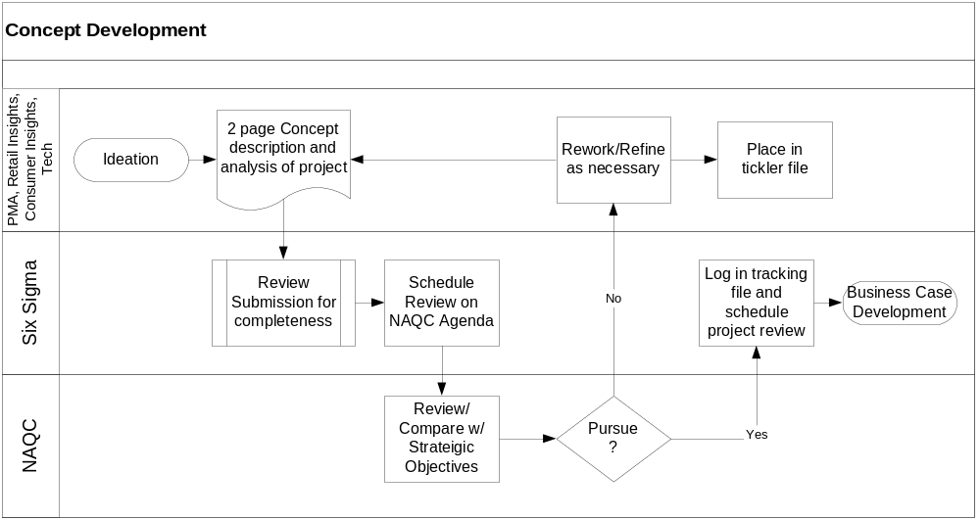
Planning:
Product Nomination
Concept Approval
Tollgate #1
Customer
Strategic
Planning/
Prioritization
Matrix
Business Benefits
Inform Management
Communicate Issues/Info (Issues Documented)
Fits/Doesn’t Fit w/strategic plan
Pursue/Do Not Pursue
Prioritize w/other ideas
NA Quality Council
Need
Dependencies for Success:
Predetermined Financial Threshold
Prioritization/Correlation Matrix
Market Analysis Developed
(2-Pages)
Description
Potential Market
Parties and their roles
Customer Impact/VOC
Competitors/Partners
Outstanding Issues
Strategic Scoring Matrix
IRI Value Proposition
High level revenue drivers
Notes:
Proposed projects (both improvement and development) can come from virtually anywhere in the business.
At Tollgate 1, proposals are screened against our strategic priorities (Big Y’s) and reviewed by the North American Quality Council for further development

Slide 5
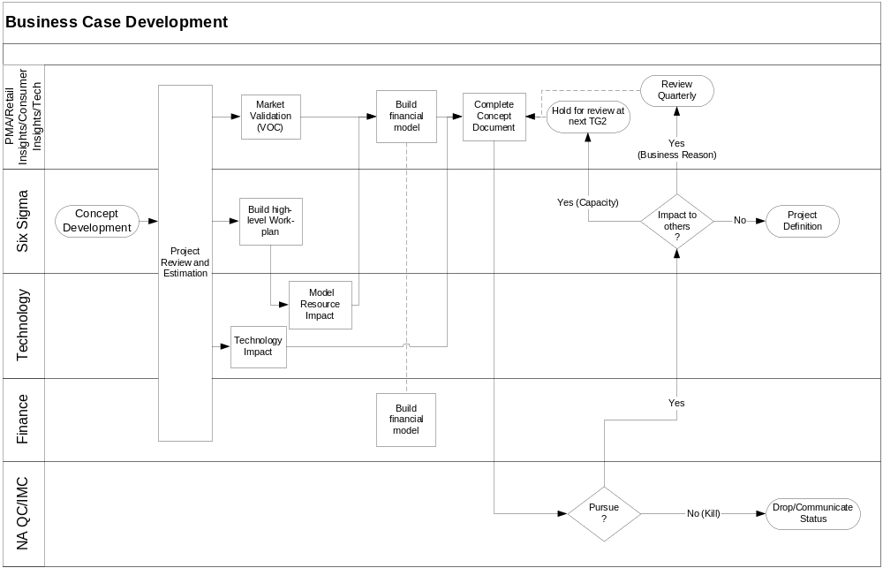
Resource Commitment
Tollgate #2
Planning:
Product Nomination
Obtain input and buy-in to product/enhancement expectation, milestones & deliverables
Identify and de-conflict resources and other priorities
Prioritize w/other projects in progress
NA Quality Council
Customer
Strategic
Planning/
Prioritization
Matrix
Business Benefits
Need
Dependencies for Success:
Streamlined Project review and Estimation Process
  Critical Touch Points
MS Project Server
Semi-Fix Program
  Planned/Budgeted Resources
  0-based budgeting
Scope Project/Business Case
Refined Financial Model
Resources/Budget Impact
Market Validation (more specific sources of revenue)
Set Stakeholder expectations
Risk Assessment
IT Assessment
Notes:
With additional detail and financial information, the Council makes a second assessment at Tollgate 2 and decides whether to add the project to our Platinum List (the top 15 business priorities).

Slide 6
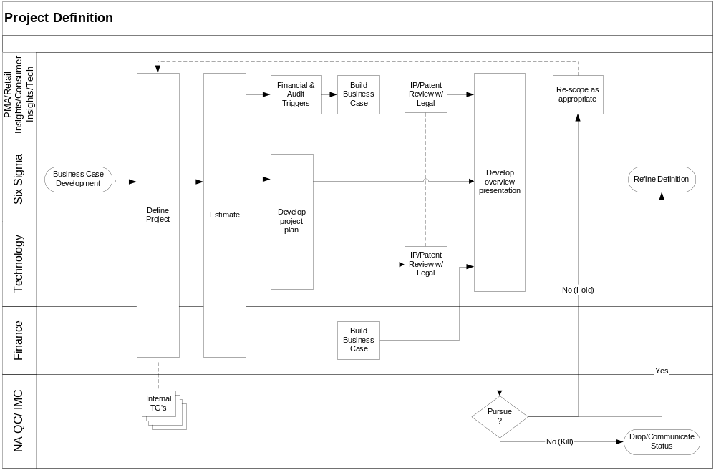
Project Approval
Tollgate #3
Execution:
Functional Design & Analysis
Development
Present Business Case
Identification of Sponsor & Pilot Team
Evaluate Costs/Benefits
Review IP/patent impact
Confirm project definition
NA Quality Council
Definition
Pilot
Final
Refinement
TG3
TG4
TG5
Dependencies for Success:
Economic/Financial Policy
  Pricing
  Compliance
Define Product/Project
DMAIC/DMADV
Gantt Chart/Work plan
Product Features/Capabilities
Resolve Issues (Tech/Legal)
Finalize Economic Plan
Risk Abatement Plan
Intellectual Property/Patent Review
Cap-Ex Review
Notes:
Once on the list, Six Sigma resources, in conjunction with the project sponsor lead cross-functional teams through a prescribed process of defining and designing solutions that best meet the needs of our clients.
Tollgate 3 is a review of the solution’s cost benefit analysis. If the returns are appropriate and in line with our pre-determined parameters, we will proceed with developing the solution.

Slide 7
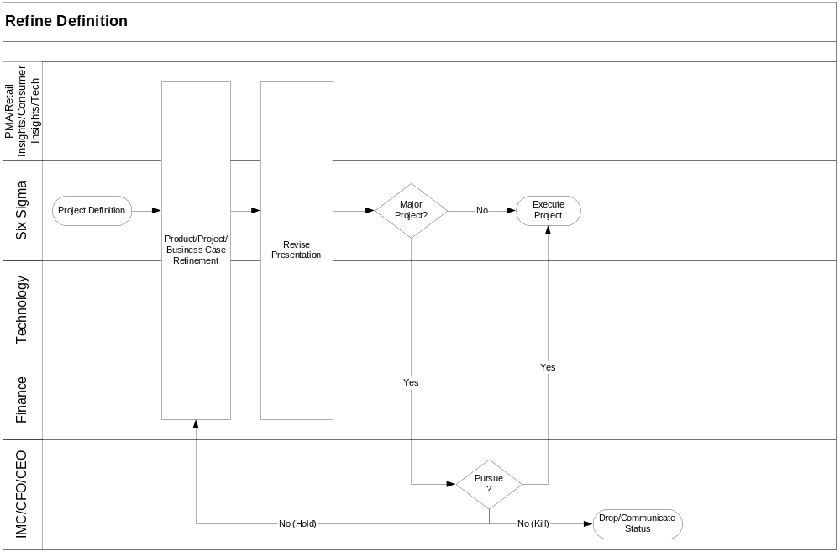
Corporate Approval
Tollgate #4
Execution:
Functional Design & Analysis
Development
Definition
Pilot
Approval as determined by CEO, COO, Legal
Formal sign-off by CFO
Present Business Case
Agreement to pilot as is vs. refinement necessary
Inform Product Manager
Investment Management Council
Final
Refinement
TG3
TG4
TG5
Dependencies for Success:
IMC
Globally Oriented Chair
Only major projects
Refine Definition
Resolve issues from Tollgate 3
Refine financial plan
Revise product definition
Notes:
Tollgate 4 is a senior executive review, required for projects with sizeable investments

Slide 8
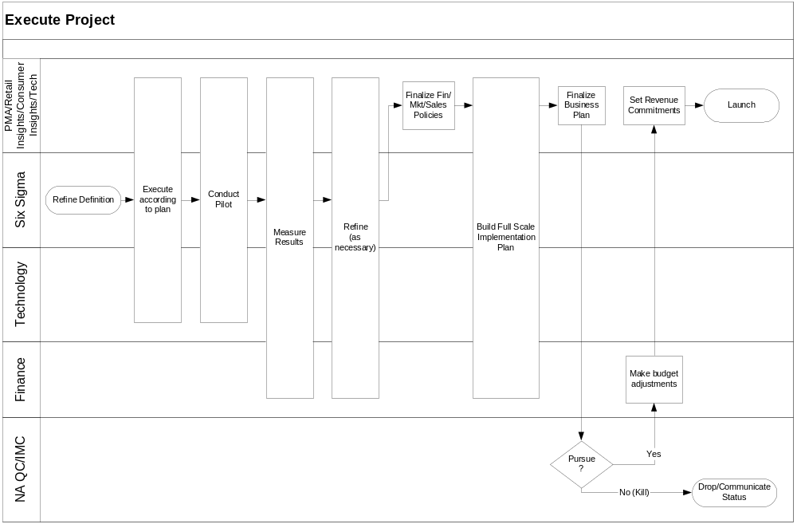
Launch Approval
Tollgate #5
Execution:
Functional Design & Analysis
Development
Review of pilot results and launch plan.
Sign-up for Revenue, Capital, Expense targets.
Communicate job requirements
If pilot doesn’t meet or exceed business case economics, pilot review with NAQC members
NA Quality Council
Definition
Pilot
Final
Refinement
TG3
TG4
TG5
Dependencies for Success:
IMC
P&L Accountability
Alignment of Incentive Structure
More robust QA process
Project Execution
Product Development/Project Completion
QA, User Acceptance Testing
Customer Presentations
Create Pilot Implementation work plan
Summary of Customer Impact
Update Business & Technical Plans
Conduct Pilot
Finalize job descriptions
SOP’s
Policies updated
Collect:
  Market feedback/VOC
  VOS/VOE
Prepare summary of results
Finalize Sales/Marketing plan
Finalize Finance Policy & triggers (from TG #3)
Notes:
Tollgate 5 is a chance to test and measure the product/solution on a small scale
This minimizes our risks and allows us to work through some of the unanticipated challenges of implementation.
Clients play a very big role in this phase of the project. In the initial phases of the project, clients are asked to define their product needs. This is the team’s chance to have the client validate the actual deliverable(s).
If the product/solution performs as expected, we can proceed with full-scale launch.

Slide 9
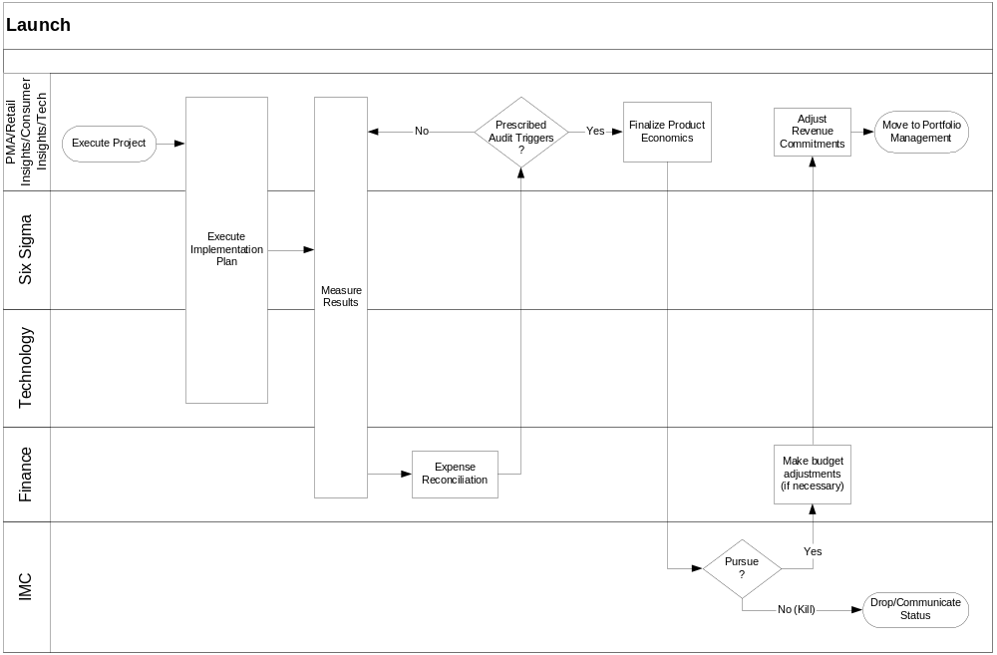
Post-Launch Audit
Tollgate #6
Growth:
Analysis of Results
Implement
Customer
Support &
Track
Product Manager presents results of:
Implementation/Full Scale Production
Expense reconciliation
Customer Adoption
Product Economics
IMC
TG6
Dependencies for Success:
Cost & Revenue allocation mechanism
Robust Reporting System
Introduction (Place/Promotion)
Transfer to Production
Training Plans (Sales Wizard, etc.)
Marketing material development & production
CSC/TMC Training
Product Economic results
Notes:
Tollgate 6 is the very last stop in the process. It is a post-mortem review of the solution at the full scale level.
The timing of tollgate 6 is generally 6 to 9 months after launch. This gives the solution sufficient time to realize some benefits.

