Slide 1
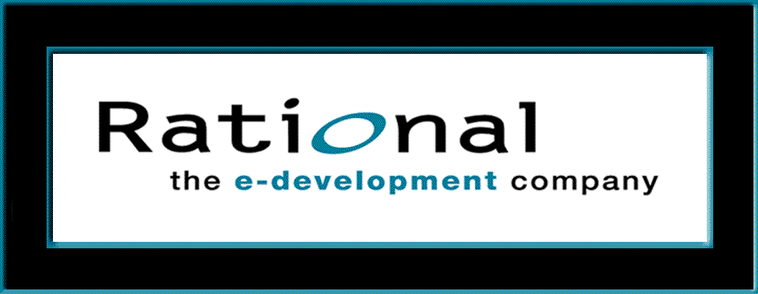
Requirements Management
with Use Cases
Module 2: Introduction to RMUC

Slide 2
RMUC: Course Outline
0 - About This Course
1 - Best Practices of Software Engineering
2 - Introduction to RMUC
3 - Analyze the Problem
4 - Understand Stakeholder Needs
5 - Define the System
6 - Manage the Scope of the System
7 - Refine the System Definition
8 - Manage Changing Requirements
9 - Requirements Across the Product Lifecycle

Slide 3
Introduction to RMUC: Overview
Problem
Problem Space
Needs
Solution Space
Features
Traceability
The Product To Be Built
Software
Requirements
Test Procedures
Design
User Docs
Notes:
In this module we are continuing with the introduction to requirements management with use cases.
The requirements management methods we will study in this course can be used to management requirements in a wide variety of situations. They have been applied successfully to entire systems, to hardware and to processes. In this course, we will concentrate on requirements management for software systems.
Point to the paper where you have posted this pyramid. Explain that in this module we are continuing with the introduction to requirements management with use cases.

Slide 4
Introduction to RMUC: Module Objectives
Define requirements management terms
Gather information about why requirements management is crucial to project success
Learn how requirements management drives the entire development process
Begin use-case modeling of requirements
Notes:
Remind the students of the goal that we discussed in Module 0.

Slide 5
Why Are We Here?
The GOAL is to deliver
quality products
on time and on budget
which meet the customer’s
real needs.
Notes:
Remember our goal as we go through this course.
Remind the students of the goal that we discussed in Module 0.

Slide 6

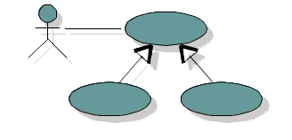
Agreement on What the System Should Do
The Goal
Customer
User Community
System
To Be Built
Requirements
Verification
Surrogate
Goal
Requirements
Adapted from Al Davis
Notes:
Since we probably will not have direct access to our customer and user community at all times, and since some customers have been known to change their minds, it is important to write down the agreed-upon requirements of the system to be built.
Requirements can be viewed as a “proxy” for the customer, because the requirements represent the customer. That is, the requirements provide the details of the customer’s desires and agreements on what the system should do.
The requirements should be captured in a form that is understandable to both the customer and the development team. The requirements provide the surrogate goal for the development team while building the system, as well as the criteria for acceptance and validation of the system by the customer upon delivery.
Emphasize that the goal of requirements management is to come to agreement with the customer on what the system should do. The Requirements Specification is a “proxy” for the customer.
This slide introduces the concept of a requirement capture model that includes both visual diagrams and textual description.
Make sure that you understand and stress throughout the course that the “Software Requirements” for our system are based on the text included in the use-case model -- especially the details in the use-case reports -- and the Supplementary Specifications.

Slide 7
Definitions: Requirements and Their Management
A requirement is a condition or capability to which the system must conform
Requirements management is a systematic approach to
  Eliciting, organizing, and documenting the requirements of the system, and
  Establishing and maintaining agreement between the customer/user and the project team on the changing requirements of the system
Notes:
Requirements specify what the system must do rather than how the system will do it.
There are many kinds of requirements. For example, “feature” requirements are requirements that directly tied to user needs, and “software requirements” give the detailed requirements for the software. We will discuss these different types of requirements later in the course.
Requirements management will only be successful if it allows for uncertainty of the requirements early in the project. However, requirements management also ensures that requirements become better defined over time.
It’s a good idea to have some examples of requirements to make this definition less abstract. Include functional requirements such as would be included in a use-case model. Also include performance, legal, availability, etc. For an ATM machine, a functional requirement might be “withdraw cash.” An example of a performance requirement might be to validate the customer ID within 5 seconds.

Slide 8
Requirements Specifications
Needs
Vision Document
Features
Supplementary Specifications
Software
Requirements
Use-Case Model
Test
Specifications
Design Specifications
User Documentation Specifications
Notes:
Here is the requirement structure we will use in the class and the specification artifacts in which they will be captured. We will focus first on the Vision Document -- which will contain the Key Needs and Features of the System -- and then on how to specify the details in the the Software Requirement Specification, or SRS (in this model made up of Use Cases and Supplementary Specifications).
Understand that these documents feed the lower level documents: Test, Design, and User Doc Specifications.
Here is the approach we will use in the class, focusing on the Vision Document - which will contain the Key Needs and Features of the System -- and the SRS (in this model made up of Use Cases and Supplementary Specifications) -- which will contain our software requirements.
Understand that these feed the lower level documents: Test, Design, and User Doc Specs.

Slide 9
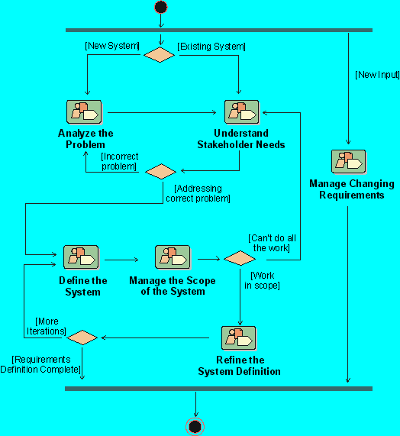
What Do We Do in Requirements Management?
Notes:
This diagram shows the Requirements Workflow in the Rational Unified Process. The major activities in the Requirements Workflow are called “workflow details”.
What are the major activities for requirements management in your own software development process?
This is the first time we look at the Workflow details within the Requirements Management Workflow in RUP. Point out that the workflow details are exactly the activities we are studying in this course. Go through the workflow details, and how it fits in the entire workflow.
If you are presenting this course on-site at a company not using RUP, discuss the activities that they use to accomplish the objective of analyzing the problem.

Slide 10
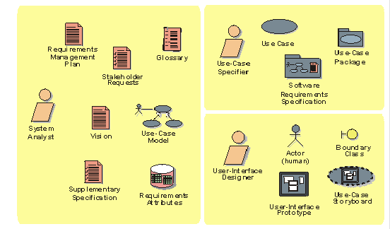
Workers and Artifacts in The Requirements Workflow
Notes:
In the Rational Unified Process (RUP), the system analyst leads and coordinates requirements elicitation and use-case modeling by outlining the system's functionality and delimiting the system. For example, the system analyst establishes what actors and use cases exist and how they interact.
The use-case specifier details the specification of a part of the system's functionality by describing the Requirements aspect of one or several use cases. The use-case specifier can also be responsible for a use-case package and maintaining the integrity of that package.
The user-interface designer leads and coordinates the prototyping and design of the user interface, by:
Capturing requirements on the user interface, including usability requirements
Building user-interface prototypes
Involving other stakeholders of the user interface, such as end-users, in usability reviews and use testing sessions
Another important worker in the Requirements workflow is the requirements reviewer, who plans and conducts the formal review of the use-case model and other requirements.
These are the workers and artifacts involved in the the entire RUP Requirements Workflow.
You can give a brief description of the role of each of these workers in the project. Make sure to emphasize that these are (probably) not job titles -- rather roles that individuals will play throughout the development of the product.
Don’t go into too much detail on the artifacts -- they will be covered later in the course.

Slide 11
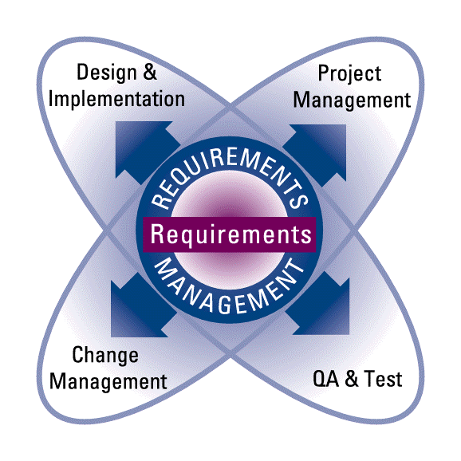
Linking Requirements
Attributes
Traceability
Notes:
How do the requirements of your project relate to the other development activities?
Point out how requirements affect all parts of the product development group.
Talk about how requirements should interface with other project groups and tools.
It is important to be able to keep track of these relationships (For example, RequisitePro interfaces with Rose (Design), SQA (QA & Test), ClearCase and MS Visual Source Safe (CM), and MS Project.
Note that Attributes and Traceability are important keys to linking requirements to other project elements. For example, we want to trace a requirement to the design classes which will perform it and to the tests which verify it. That way we can ask questions such as “What requirements have not yet been tested?”

Slide 12
What Factors Contribute to Project Success?
Project Success Factors
1) User Involvement
15.9%
13.9%
2) Executive Management Support
3) Clear Statement of
11.8%
Requirements
However...
Only 16% of projects completed on time and on budget (all companies)
  9% (large companies)
  28% (small companies)
53% of projects over-ran their original estimates
  Average overrun: 189% (+$59 billion)
31% of projects canceled before completion ($81 billion)
Why are these results so bad?
Standish Group, ‘95 (www.standishgroup.com)
Notes:
Standish Chaos report on 365 companies, 8,380 projects:
Surveyed IT Executive Managers: Project Success Factors
Many of the projects were cancelled, or overran schedule / budget
Full report is on the Standish Group Web site: www.standishgroup.com

Slide 13
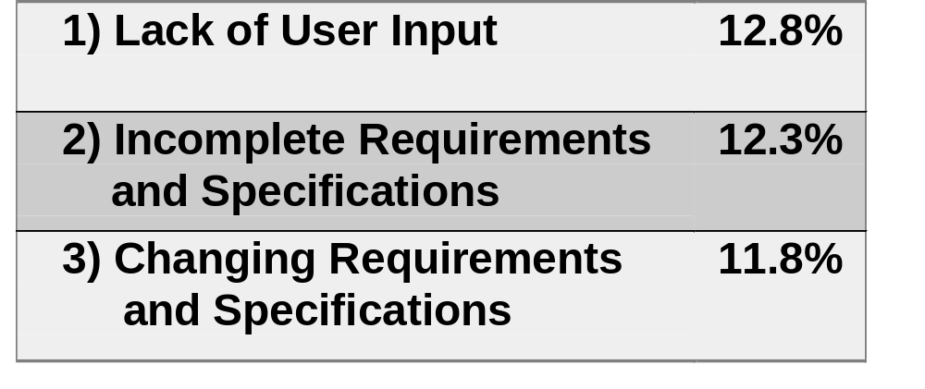
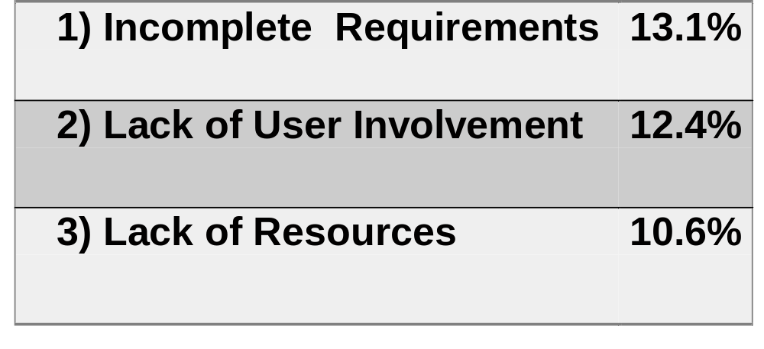
What Factors Contribute to Project Failure?
Project Challenged
(over-runs) Factors
Project Impaired
(canceled) Factors
Standish Group, ‘95 (www.standishgroup.com)
Notes:
Note that the top item on each list refers to problems involving users and managing requirements.

Slide 14
How Can Use Cases Help Projects Succeed?
Show why the system is needed
  Use cases: what users will be using the system for
  Actors: who/what wants to use the system
Provide unifying thread for system development
  Use cases are the behavior the system must provide
  Use cases drive Analysis & Design, and Test
The idea behind use cases is to decide what the system will be used for before defining what the system is supposed to do.
Notes:
As we shall see in the following examples, use cases are a way to organize requirements from a user perspective. All of the requirements for a user to accomplish a particular task are gathered together in a single use case. The use-case model is the collection of all of the individual use cases.
Since the use cases are specified from the user’s perspective, the use-case model is ideal for communicating the proposed system’s functionality and behavior to the customer or end user. How do you know that you are developing the right system? Ask the users and the customer if the use-case model is what they will want to do with the system.
The use-case model is also key to developing the right system.
What do your designers design to?
They design a system that will allow users to do the tasks specified in the use-case model.
What do your testers test?
They test to make sure that the system will be able to perform all of the use cases.
What will the user documentation look like?
It will document how to do all of the tasks in the use cases.
Could you use help in these areas with your current requirements management process?
Start emphasizing the key concepts of use-case modeling.
The important point here is that use cases permeate all parts of RUP. Use cases are a key mechanism in managing requirements throughout the development process.

Slide 15
What Is a Use-Case Model? A Sample System
An Automated Teller Machine (ATM)
Withdraw Cash
Bank Customer
Bank
Consortium
Transfer Funds
Cashier
Deposit Funds
Maintenance
Crew
Maintain ATM
Notes:
A use-case model shows what the system is supposed to do (use cases), the system's surroundings (actors), and the relationship between actors and use cases.
The use-case diagram is a graphical description of the use-case model. Can you tell at a glance what users can do with an ATM?

Slide 16
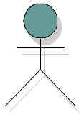

Definitions and symbols: Actors and Use Cases
Actor: someone/something outside the system that interacts with the system
Use case: sequence of actions performed by a system that yields an observable result of value to an actor
Actor
Use Case
Notes:
An actor represents anything that interacts with the system.
A use case defines a set of use-case instances, where each instance is a sequence of actions a system performs that yields an observable result of value to a particular actor.
These are the formal definitions of the two major concepts in use-case modeling of system requirements. Go through the definitions briefly.

Slide 17
Definitions and symbols: Communicates-Association
Communicates-association (Line or Arrow): an association between an actor and a use case, indicating that they interact
Arrow: indicates who initiates communication with the use case
Actor
Use Case
Actor 2
Notes:
Relationships between actors and use cases are called communicates-associations. A communicates-association between an actor and a use-case indicates that they interact: the actor participates in and communicates with the system containing the use case. A communicates-association is represented on UML diagrams as a solid line or path (a line with an arrowhead).
The UML standard recommends the use of an arrowhead if needed for clarification. Many styles of using arrow heads are in common use, including a style that uses no arrowheads at all.
Arrowheads may be used to indicate who initiates communication in the interaction. If an arrowhead points to a use case, the actor at the other end of the association initiates the interaction with the system. If the arrowhead points to an actor, the system initiates the interaction with the actor at the other end of the association.
By convention, RU courses only use arrowheads to show the actor who initiates communication with the system at the beginning of the use case (pointing from the actor toward the use case). A line with no arrowhead indicates that the actor participates in a use case but does not initiate communication. A use-case-to-actor arrowhead *may* be used if necessary, for clarification. No double-headed arrows are used, because 2-way communication is always assumed.
In practice, each project should set their own conventions for the use of an arrowhead. Whatever standard you adopt, it should be clearly specified in the Use-Case-Model Guidelines for this project. The Golden Rule for use-case-model guidelines: to effectively *communicate* the requirements to ALL stakeholders.
These are the formal definitions of the two major concepts in use-case modeling of system requirements. Go through the definitions briefly.

Slide 18

Each Communicates-Association Is A Whole Dialog
Insert Card
Approve card
Enter PIN
Approve PIN
Enter account, amount
Withdraw Cash
Bank
Customer
Bank
Consortium
Dispense cash
Ask for Receipt
Printed receipt
Return bank card
Transmit request
Send back approval
Notes:
A communicates-association is a two-way dialog. The relationship between an actor and a use case is represented on the diagram by a single line or arrow, but the single line or arrow represents a whole dialog. For example, the relationship between the Bank Customer actor and the Withdraw Cash use case might include the whole dialog shown on the left side of this slide. The relationship between the Withdraw Cash use case and the Bank Consortium actor might include the whole dialog shown on the right side of this slide.
Where are the dialogs recorded? The dialogs, also called scenarios, are instances of a detailed flow of events in a use case. Each use case is defined in a use-case report that fully details the use case.
This is the first time that students will see a scenario. Go over the dialogs between each actor and the Withdraw Cash use case. Mention the term “flow of events”.
Emphasize that the use-case diagram is intended only to show the actors, use cases and the relationships between them. But the relationships will be spelled out in great detail in the use-case reports (this is a good lead-in to the next slide).

Slide 19

A Use-Case Model Is Mostly Text!
An ATM
Use-Case-Model Survey
- survey description
- list of all actors
- list of all use cases
Bank Customer
Withdraw Cash
Bank Consortium
Transfer Funds
Withdraw Cash
- brief description
- flow of events
Deposit Funds
Cashier
Transfer Funds
- brief description
- flow of events
Maintain ATM
Maintenance
Crew
Deposit Funds
- brief description
- flow of events
Maintain ATM
- brief description
- flow of events
Notes:
The most important part of the use-case model is the text. Many people get the wrong idea of the word “modeling,” and believe that use cases are just about drawing figures and arrows.
Use cases involve writing text. Drawing the pictures only a small part of the effort. More than 75% of all effort during requirements capture is to write the textual description of the flow of events within each use case.
The important part of the use-case model is the text. Too many people get the wrong idea of the word “modeling” and believe that use cases are just about drawing figures and arrows.
Use cases involve writing text. Don’t stress the modeling work; instead, stress the text work. A use case without the text is useless.
More than 75% of all effort during requirements capture is to write the textual description of the flow of events.
You can emphasize this point on the next slide, when you have them look at the sample Use-Case Model included in the student handouts.

Slide 20
Sample System: Requested Features for An ATM
Design the software for an automated teller
machine (ATM). The ATM requests necessary
information from the bank by communicating with the bank consortium system.
The ATM accepts a cash card, interacts with the user via a display and a key pad, communicates with the bank consortium system to carry out the transaction, receives and dispenses cash, and prints out a receipt.
A user should be able to withdraw cash, transfer funds between two of her accounts, and deposit to an account.
When a transaction is finished, the card is ejected.
The system requires appropriate record keeping and security provisions.
Notes:
Here are the initial customer requests for the sample ATM model. The ATM is a sample project that we will use throughout the course to illustrate some of the concepts of requirements management.
This is a list of the initial customer requests (features?) that were received for the sample ATM use-case model.

Slide 21
Sample System: Sketch of User Interface
7
8
9
4
5
6
1
2
3
0
Ready
Undo
Help
Card Reader
Printer
Deposit Input
Cash Dispenser
Notes:
Here is a sketch of the user interface of the ATM system.

Slide 22
Exercise: A Sample Use-Case Model
1. Look at ATM Use-Case Model in the Handouts
  Use-Case-Model Survey for ATM in Handout UC 1
  Use-Case Report for Withdraw Cash in Handout UC 3.1
  Don’t try to understand all the details. We’ll revisit later.
2. Answer the following questions
  What actors are humans? What actors are not human?
  How many use cases are there?
  If a Bank Customer withdraws
  cash, is a receipt always printed?
  If a Bank Customer wants to withdraw
  cash and enters a wrong PIN,
  what is this ATM required to do?
Handout
UC1 and UC3.1
Notes:
The purpose of this exercise is to preview an existing use-case model. This exercise should help you understand what we mean when we say “use-case model.” It is much more than just a picture.
Look at the Sample Use-Case Model in the Student Handouts. It shows an example of a use-case model, for an ATM system.
The Use-Case-Model Survey in Handout UC 1 provides an overview of the whole use-case model.
The “Withdraw Cash” Use-Case Report in Handout UC 3.1 provides the details of an individual use case.
Don’t worry about understanding everything in the reports. This is only an introduction; we’ll revisit later in more detail. Just get a feel for what is in the reports:
Structure
Level of detail
Language
Recommended:
Individual study of UC1 and UC3.1, followed by whole-class discussion.
Estimated time:
3-5 minutes to study the handouts.
5-10 minutes to discuss the handout and answer the questions.
This exercise gives the students an opportunity to see a fairly well-developed use-case model and its associated documents.
The idea here is to “show them a house before you ask them to build one.”
If possible, show a little of the Use-Case Model Survey, and a little of the first Use-Case Report (for Withdraw Cash) on the screen. Point out how the flow of events organizes requirements in a logical sequence. Point to a few of the requirements that are embedded in the flow of events.
Stress that we do not expect them to understand everything they see in the reports, but they should make note of their structure, level of detail, and language used.
The purpose of the questions is to help the students focus on some basic features of the use-case model for the ATM: actors, use cases, relationships, and detailed flow of events.
Don’t take too much time on this exercise. Let them know that we will be going into much more detail about the ATM example throughout the course.

Slide 23
Benefits of Use Cases
Use cases are easy to understand
  Use terminology that customers and users understand
  Verify developer understanding
Use cases give context for requirements
  Identify users of the system
  Identify system interfaces
  Put system requirements in logical sequences
  Help verify that all requirements are captured
Use cases facilitate agreement with the customer on system requirements
Notes:
Do you have any problems in these areas with your current requirement process?
Use cases are tools for modeling the system from an external viewpoint. They describe the system as it appears from the outside. Users interact with the system by interacting with its use cases. Taken together, all use cases represent everything users can do with the system.
Advantages of use-case modeling include:
The model is comprehensible to both people inside the development organization (analysts, designers, implementers, testers) and to people outside (customers, users).
The model expresses requirements in terms of how users thinks of the system and what the system should do (an end users view).
The model is a means to communicate requirements between customers and developers, in order to make sure that the system we build is what the customer wants.
Use case modeling is the best tool (so far) to capture requirements and put them in context. A Requirement without context is useless.
Emphasize the ways the use cases help facilitate agreement (see student notes).

Slide 24
A Use-Case Model Helps with ‘Scope Creep’
I’ll need a new use case and change
some existing use cases...
The customer is aware there is a change to the use-case model
Makes the cost impact visible to the customer
Customer
Notes:
One of the biggest problems with requirements is that they tend to grow unless they are properly controlled.
Another advantage of use-case modeling is that you can manage requirements creep more effectively. Users will still get new ideas, but it’s easier to explain their impact on the project schedule.
Changes need to be controlled through a change process.
Another advantage of use-case modeling is that you can manage requirements creep more effectively. Users will still get new ideas, but it’s easier to explain their impact on the project schedule.

Slide 25
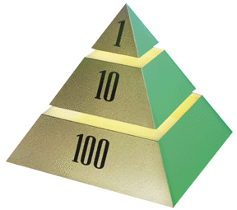
The High Cost of Requirement Errors
The 1-10-100 Rule
Stage
.1-.2
Requirements Time
0.5
Design
1
Coding
“All together, the results show as much as a 200:1 cost ratio between finding errors in the requirements and maintenance stages of the software lifecycle.”
2
Unit Test
5
Acceptance Test
20
Maintenance
Relative Cost to Repair Errors: When introduced vs. when repaired
Average cost ratio 14:1
Grady 1989
Boehm 1988
Notes:
The most expensive errors to correct are those introduced at Requirements Time and not found until after release to the customer.
Note: These same errors are also the least expensive to correct if found during Requirements Time! The longer they exist, the more expensive they become.
Use this slide to explain the 1-10-100 rule.
Start by saying that before we get to the actual costs, let’s illustrate the costs with some real examples.
Ask if there is anybody in the class who writes requirements specifications. Ask him/her what they need to to to correct an error in a requirement BEFORE the Requirements Specification is released for the first time. The answer will probably be to get approval and to change the text.
Then ask if somebody in the class is a tester. Ask him/her what they need to do to correct an error they find during acceptance test. The answer will probably be very lengthy. Point out the difference in cost between fixing a requirement initially and during testing.
Now explain the 1-10-100 rule by pointing to the pyramid. The figures are the order-of-magnitude relative costs of fixing a requirement error during requirements capture, coding, and testing. You can mention the Boehm and Grady studies that found similar relative costs. Stay away from getting caught up in the fractions and other details.
Help students understand that requirement errors are obviously the most expensive cost if they are not discovered until later in the lifecycle.

Slide 26
Involve the Whole Team in Requirements
Developers, Testers, Writers
  Help develop requirements management practices
  Monitor adherence to practices
  Verify elicitation process
  Help document requirements
  Participate in requirements reviews
  Participate in or chair a CCB (Change Control Board)
  Review traceability outcomes
  Verify quality, testability, completeness
Notes:
What are some of the ways members of different groups of the development team can be involved in your requirements activities?
What are the advantages of involving the whole product development team during requirement activities? The main advantage is that the team will gain a better understanding of the requirements and why they are important to the client. What are some other advantages?
Most recommendations regarding standards for the software development process include a strong recommendation to involve the development team in requirement activities. For instance, the recommendation is included in the Capability Maturity Model (CMM).
Use this slide to seed discussion for ideas of involving the product development team during requirement activities.

Slide 27
Review: Introduction to RMUC (Modules 0 and 2)
1. What is our goal?
2. How can we “measure” quality?
  What are the FURPS categories of requirements?
  What categories within each of these apply to your product?
3. Why is it important to establish a baseline? How is it done?
4. How can a Use-Case Model help a project succeed?
  What is a use case? What is an actor?
  What is the relationship from an actor to a use case?
  How does a Use-Case Model help avoid scope creep?
5. What does the “1-10-100 Rule” tell us about finding defects?
6. What are some ways to involve the development team early?
Notes:
1.
2.
3.
4.
5.
6.
Use these questions to monitor the students’ level of understanding and to help them review.
Tell them it is an “open book test,” so they can look back through the material to get the answers.
Give them time to answer. Don’t be afraid to stand quietly while they look up the answer.

